Slide 1
About OMICS Group
OMICS Group is an amalgamation of Open Access Publications and worldwide international science conferences and events. Established in the year 2007 with the sole aim of making the information on Sciences and technology ‘Open Access’, OMICS Group publishes 500 online open access scholarly journals in all aspects of Science, Engineering, Management and Technology journals. OMICS Group has been instrumental in taking the knowledge on Science & technology to the doorsteps of ordinary men and women. Research Scholars, Students, Libraries, Educational Institutions, Research centers and the industry are main stakeholders that benefitted greatly from this knowledge dissemination. OMICS Group also organizes 500 International conferences annually across the globe, where knowledge transfer takes place through debates, round table discussions, poster presentations, workshops, symposia and exhibitions.

Slide 2
OMICS International Conferences
OMICS International is a pioneer and leading science event organizer, which publishes around 500 open access journals and conducts over 500 Medical, Clinical, Engineering, Life Sciences, Pharma scientific conferences all over the globe annually with the support of more than 1000 scientific associations and 30,000 editorial board members and 3.5 million followers to its credit.
OMICS Group has organized 500 conferences, workshops and national symposiums across the major cities including San Francisco, Las Vegas, San Antonio, Omaha, Orlando, Raleigh, Santa Clara, Chicago, Philadelphia, Baltimore, United Kingdom, Valencia, Dubai, Beijing, Hyderabad, Bengaluru and Mumbai.

Slide 3
Intentional medication errors: Off label use?
Angela van der Salm, Director PV
17 August, 2015

Slide 4
Disclaimer
The views and opinions expressed in the following Power Point slides are those of the individual presenter.
These Power Point slides are the intellectual property of the individual presenter and are protected under the copyright laws of the Netherlands and other countries. Used by permission. All rights reserved.
17 August, 2015

Slide 5
Topics
Risk management planning
Medication errors
Off label use
Data capture challenges
Signal detection
Conclusion
17 August, 2015

Slide 6
Risk Management Planning
New EU pharmacovigilance legislation in 2012:
  Introduction of the PRAC, to provide recommendations for regulatory action on safety issues arising due to errors associated with the use of medicines authorised in the EU. This includes all aspects of risk management and monitoring the effectiveness of specific measures to prevent or minimise the risk of medication errors, as contained in the risk-management plan (RMP) for a medicine (specific EU requirement).
  Accordingly, each periodic safety update report (PSUR) assessed by the PRAC contains data on any medication errors that occurred with a medicine during the reporting period regardless of whether it is associated with adverse reaction(s).
  This information feeds into the continuous evaluation of the benefits and risks of each medicinal product medicinal product.
  http://www.ema.europa.eu/ema/index.jspcurl=pages/special_topics/general/general_content_000570.jsp
17 August, 2015

Slide 7
Risk Management Planning
New EU pharmacovigilance legislation in 2012:
  Art 23 (2) of DIR 2001/83/EC requires the MAH to report to the competent authorities “any other new information which might influence the evaluation of the benefits and risks of the medicinal product concerned ”, including “data on the use of the medicinal product where such use is outside the terms of the marketing authorisation”
  Per GVP Module V, post-marketing updates to the safety specification should include information on EU off-label use (including use in non-authorised paediatric age categories; again: specific EU requirement).
17 August, 2015

Slide 8
Medication errors
The EU regulatory description of a medication error is (not defined as such in GVP Definitions, but covered in GVP Module V on RMP) :
“Medication error refers to any unintended error in the prescribing, dispensing or administration of a medicinal product while in the control of the healthcare professional, patient or consumer.”
Medication errors are an important cause of morbidity and mortality and many could be prevented or mitigated.
Broadly 4 categories:
1. wrong medication;
2. wrong dose (including strength, form, concentration, amount);
3. wrong route of administration;
4. wrong patient
http://www.ema.europa.eu/ema/index.jspcurl=pages/regulation/document_listing/document_listing_000345.jsp
17 August, 2015

Slide 9
Medication errors
Risk management planning for medication errors should be proactive and begin early in development
MAHs should consider the various sources of medication error and the likely impact on the benefit-risk balance (pre-and post-authorisation)
The following aspects may be relevant:
Concentration / strength | Pharmaceutical form
Labeling | Instructions for use
Composition | Route of administration
Use in a different population / indication | Appearance (of device or packaging)
17 August, 2015

Slide 10
Medication errors
Current/Ongoing initiatives:
  30 May 2013 EMA/CHMP/277591/2013 - Committee for Medicinal Products for Human Use (CHMP)
  Position paper on potential medication errors in the context of benefit-risk balance and risk minimisation measures
  Draft EMA/762563/2014 - Pharmacovigilance Risk Assessment Committee (PRAC)
  Good practice guide on recording, coding, reporting and assessment of medication errors
  Draft EMA/606103/2014 - Pharmacovigilance Risk Assessment Committee (PRAC)
  Good practice guide on risk minimisation and prevention of medication errors, and
  Draft EMA/686009/2014
  Risk minimisation strategy for high strength and fixed combination insulin products, addendum to the good practice guide on risk minimisation and prevention of medication errors
  http://www.ema.europa.eu/ema/index.jspcurl=pages/special_topics/general/general_content_000570.jsp
17 August, 2015

Slide 11
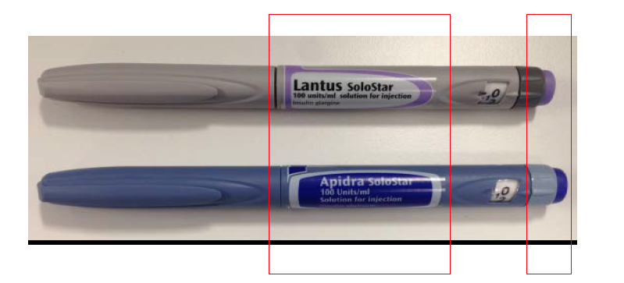
Draft good practice guide –routine risk minimisation for high strength & fixed combination insulin products
Medication errors due to mix-up between long-acting (basal) and short-acting (bolus) insulins, including by visually impaired or colour blind patients
Dr Julie Beynon (MHRA), DIA EMA RMP information day dd 30-Jun-15
17 August, 2015

Slide 12
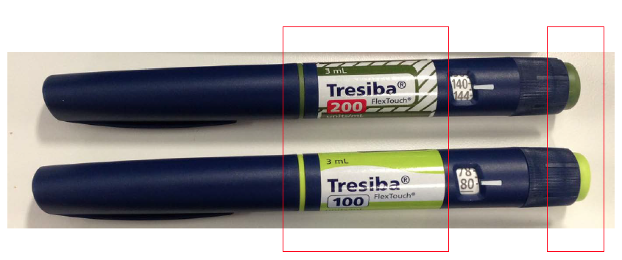
Draft good practice guide –routine risk minimisation for high strength & fixed combination insulin products
Medication error due to non-compliance with instructions for use –unnecessary dose recalculation
17 August, 2015

Slide 13
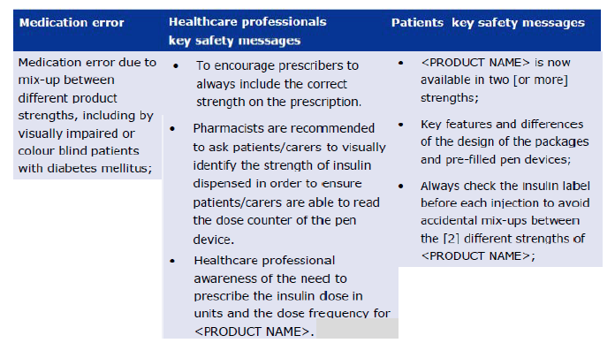
Draft good practice guide –routine risk minimisation for high strength & fixed combination insulin products
Key safety messages for high strength insulin products addressing the risk of medication errors
17 August, 2015

Slide 14
Off label use
Off label use relates to situations where the medicinal product is intentionally used for a medical purpose not in accordance with the authorised product information. This is particularly relevant where a medicinal product has an indication restricted to a subset of the population within a disease area, or there are situations where the medicinal product must not be given for safety reasons. The potential for use in other disease areas should also be considered where this is likely.
EU-wide signal detection activities should include with a higher-than-regular frequency any product considered to have an identified or potential risk that could impact significantly on the benefit-risk balance or have implications for public health. This may include risks associated with significant misuse, abuse or off label use (GVP Module IX).
17 August, 2015

Slide 15
Off label use
Post-marketing updates to the safety specification in the RMP should include information on EU off-label use (including use in non-authorised paediatric age categories)
  Information from drug utilisation studies (or other observational studies where indication is a variable) should be provided where available. This includes drug utilisation studies which were requested by NCAs for purposes other than risk management.
  When off label use is a safety concern or a concern has been raised by NCAs regarding off label use, MAHs should attempt to quantify such use along with a description of the methods used to arrive at these figures.
  http://www.ema.europa.eu/ema/index.jsp?curl=pages/regulation/document_listing/document_listing_000345.jsp
17 August, 2015

Slide 16
Off label use - Example
Basiliximab – SIMULECT (CAP)
Cardiovascular instability resulting in fatal outcome in association with off-label use in cardiac transplantation
Basiliximab: monoclonal antibody authorised in the prophylaxis of acute kidney transplant rejection in de novo renal transplantation.
Signal of cardiovascular instability triggered by 3 fatal cases following off-label use in heart transplantation, identified by the Swedish Medicines Agency.
Search in EudraVigilance: cases of cardiac failure and cardiac arrest in temporal association with basiliximab when used within its authorised indication.
PRAC agreed the signal needed further investigation.
  Georgy Genov, EMA, DIA EuroMeeting 2014
17 August, 2015

Slide 17
Off label use - Example
Basiliximab – SIMULECT (CAP)
Cardiovascular instability resulting in fatal outcome in association with off-label use in cardiac transplantation
Feb 2013 PRAC: MAH requested to perform a cumulative analysis of all cases describing thromboembolic events, rhythm disorders (e.g. arrhythmia, bradycardia), or cardiac failure/insufficiency.
May 2013 PRAC: MAH requested to submit an additional analysis with regard to cardiac events which occurred within 48 h after basiliximab administration and a refined analysis of safety and efficacy in heart transplantation from all clinical trials.
Feb 2014 PRAC: MAH requested to submit within 2 months
  proposal of active communication
  variation application to update the SPC
in order to inform cardiac surgeons of the lack of favourable efficacy and safety data in the available clinical trials conducted in off-label heart transplantation.
  Georgy Genov, EMA, DIA EuroMeeting 2014
17 August, 2015

Slide 18
Off label use - Example
Basiliximab – SIMULECT (CAP)
Cardiovascular instability resulting in fatal outcome in association with off-label use in cardiac transplantation
Result: new warning added in SmPC section 4.4
Use in heart transplantation
The efficacy and safety of Simulect for the prophylaxis of acute rejection in recipients of solid organ allografts other than renal have not been demonstrated. In several small clinical trials in heart transplant recipients, serious cardiac adverse events such as cardiac arrest (2.2%), atrial flutter (1.9%) and palpitations (1.4%) have been reported more frequently with Simulect than with other induction agents.
DHPC requested by CHMP to remind cardiac surgeons and physicians in EU heart transplant centres that Simulect is indicated only for the prophylaxis of acute organ rejection in de novo allogeneic renal transplantation.
  Georgy Genov, EMA, DIA EuroMeeting 2014
17 August, 2015

Slide 19
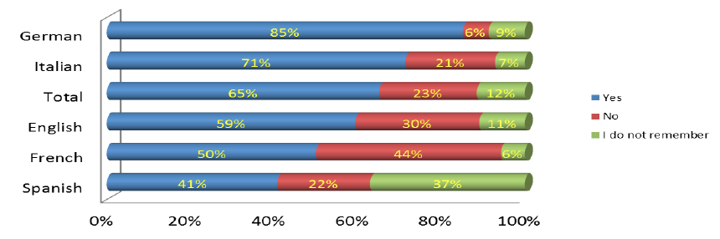
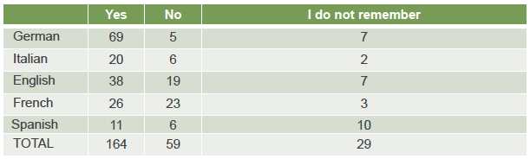
Off label use – patient’s view
Rob Camp, EuroRDis Survey results, DIA EuroMeeting 2014
17 August, 2015

Slide 20
Data capture Challenges
There is no legal requirement to record reports on medication errors or off-label use in the MAH safety database for the collection of Individual Case Safety Reports (ICSRs).
There is no legal requirement to submit ICSRs of medication errors or off-label use if not linked to a suspected adverse reaction
However, the information should be collected for the fulfillment of the pharmacovigilance tasks. In this aspect, appropriate recording mechanisms should be in place to ensure that these reports are considered in signal management activities and included in the RMPs and in the PSURs (as necessary).
  http://www.ema.europa.eu/docs/en_GB/document_library/Presentation/2015/03/WC500184248.pdf
17 August, 2015

Slide 21
Data capture Challenges
Case study 1:
Consumer reports taking drug X for inflammation. The label only states fever and pain.
Code as off label use? Or as misuse? Or as medication error?
Case study 2:
Consumer reports taking drug X for inflammation as prescribed by his physician. The label only states fever and pain.
Code as off label use? Is this misuse?
Case study 3:
Consumer reports taking drug Z already for 2 months. The label states that the drug should not be taken longer than for 10 days without consulting a physician.
Code as off label use? Or as Inappropriate duration of drug administration?
17 August, 2015

Slide 22
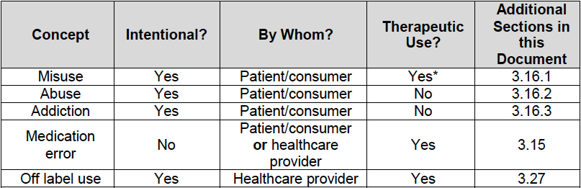
Data capture Challenges
17 August, 2015

Slide 23
Signal detection
Drug X is indicated for:
  Choriocarcinoma and similar trophoblastic diseases
  (Non-Hodgkin’s) Lymphoma
  (Acute lymphocytic) Leukaemia
  Treatment and prevention of leukemic meningitis
  Osteogenic sarcoma
  Metastatic or recurrent head and neck cancer
  Advanced cancers of urinary bladder
  Advanced mycosis fungoïdes (skin carcinoma)
  Active rheumatoid arthritis in adult patients,
  Polyarthritic forms of severe, active juvenile idiopathic arthritis, when the response to nonsteroidal anti-inflammatory drugs (NSAIDs) has been inadequate,
  Severe recalcitrant disabling psoriasis, which is not adequately responsive to other forms of therapy, and severe psoriatic arthritis in adult patients.
  Mild to moderate Crohn's disease either alone or in combination with corticosteroids in adult patients refractory or intolerant to thiopurines.
17 August, 2015

Slide 24
Signal detection
MAH A has Drug X indicated for:
  Choriocarcinoma and similar trophoblastic diseases
  (Non-Hodgkin’s) Lymphoma
  (Acute lymphocytic) Leukaemia
  Treatment and prevention of leukemic meningitis
  Osteogenic sarcoma
  Metastatic or recurrent head and neck cancer
  Advanced cancers of urinary bladder
  Advanced mycosis fungoïdes (skin carcinoma)
  Active rheumatoid arthritis in adult patients,
  Polyarthritic forms of severe, active juvenile idiopathic arthritis, when the response to nonsteroidal anti-inflammatory drugs (NSAIDs) has been inadequate,
  Severe recalcitrant disabling psoriasis, which is not adequately responsive to other forms of therapy, and severe psoriatic arthritis in adult patients.
  Mild to moderate Crohn's disease either alone or in combination with corticosteroids in adult patients refractory or intolerant to thiopurines.
17 August, 2015

Slide 25
Signal detection
MAHs would consider a certain report differently depending on their own label, therefore the same report on a certain ADRs may be reported as associated with off-label use.
Particular issue for literature publications!
How to conduct signal detection for off label use in larger databases, if for MAH A, several indications are considered off label that are “in-label” for other MAHs?
MAHs need to have a policy in place on how to code certain adverse events (make use of MedDRA Points to Consider documentation)!
17 August, 2015

Slide 26
Conclusion
At the time of obtaining the MA, the safety data collected defines the label and intended use.
Post-marketing, health care providers or consumers may not use your product according to the label: medication error or off-label use (/misuse)
From the reported information, it may not always be easy to distinguish between the unintentional medication error from the intentional off-label/misuse, so what is the specific issue? (if any…).
Code reports according to company policy (create one for consistency).
Managing product usage outside of routine pharmacovigilance activities, requires adequate knowledge and solid data => Joint effort for MAH and Regulators
17 August, 2015

Slide 27

Questions?
17 August, 2015

Slide 28
Let us meet again..
We welcome you all to our future conferences of OMICS International
5th International Conference & Exhibition on Pharmacovigilance & Clinical Trials
On
September 19 - 21, 2016 at Vienna, Austria http://pharmacovigilance.pharmaceuticalconferences.com/

