Slide 1
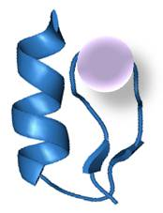
BioGlobaX Inc.
Analytical methodology
and toolkit for improvement of quality attributes
and process optimization of biopharmaceuticals
Anelia Atanassova, Sr. Scientist, BioGlobaX Inc., Toronto, Canada
August 10-12, 2015, London, UK
Notes:
Today, I will cover some basic, practical aspects and strategies of how to manage the process of purification and characterization of proteins that we want to use either for research, diagnostics or drug discovery. Commonly, purified proteins lose activity, specificity, efficacy...majority of the drugs are immunogenic. The importance of extensive characterization is evident and it requires careful selection of appropriate techniques. And most importantly, knowledge of protein structural and dynamic properties.
Proteins often lose activity, specificity, efficacy in purified form and generate toxicity when they are used as drugs.

Slide 2
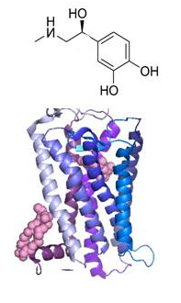
Drug Discovery
The “New” Biology:
X-omics
The Traditional:
Single Drug - Target
Adopted from J. of Internal Medicine 2010, 268 pp 432-448
BioGlobaX
2
Notes:
The old traditional model in drug discovery should be replaced with new understanding about cell and system biology.
The traditional model: interaction between drug and target. The new biology: External signals (drug or environment) activate kinases, redox switches and ion channels and in coordinated physiological responses.

Slide 3
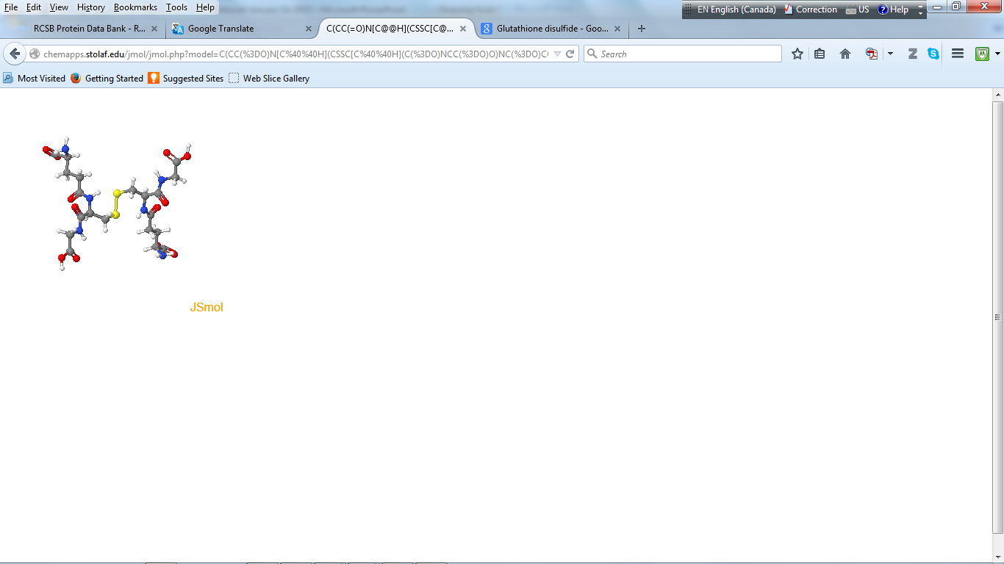
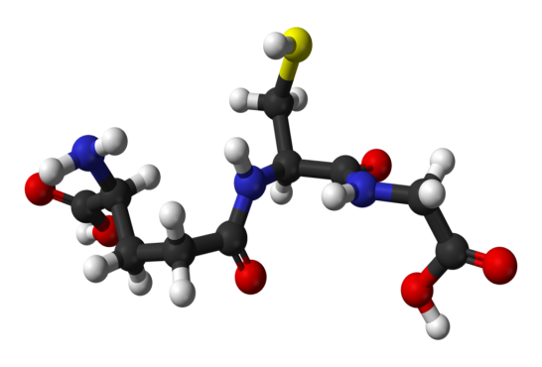
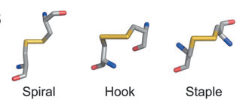
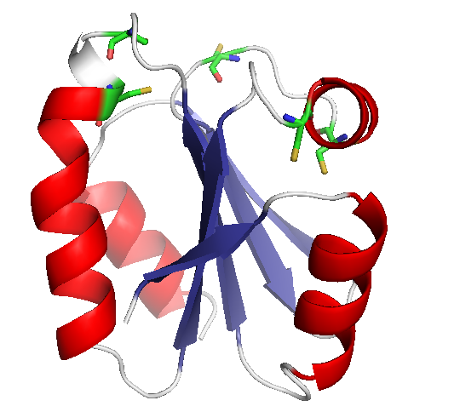
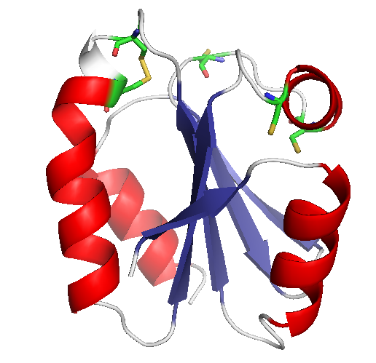
The Traditional: Thiol-based
Redox Homeostasis
The “New” Biology:
Cys Proteomics
GSH/GSSH
The Human Redox / Cys Proteome
214,000 Cys residues
5–12% - oxidized
H. proteins 3Ds C-C bonds
Total 4,104 16,538
Thioredoxin
20 possible C-C configurations
Cook K & Hogg P (2013) Antioxid Redox Signal 18: 1987–2015
BioGlobaX
3
Notes:
Until recently, we believed that the redox homeostasis in cells is kept mainly by glutathione and thioredoxin with reversible formation of disulfide bonds. What statistics from cysteine proteomics show is that in human 214,000 cysteine residues exist (on average 10 residues per protein), 5–12% - oxidized (may form disulfide bonds). From 3D structures of over 4000 human proteins, over 16000 disulfide bonds have been observed. That means, that almost every single proteins possess redox properties with existence of more that one cysteine residue. Something more, the data from crystal structures show 20 possible disulfide bond configurations with different potential to participate in chemical reactions.

Slide 4
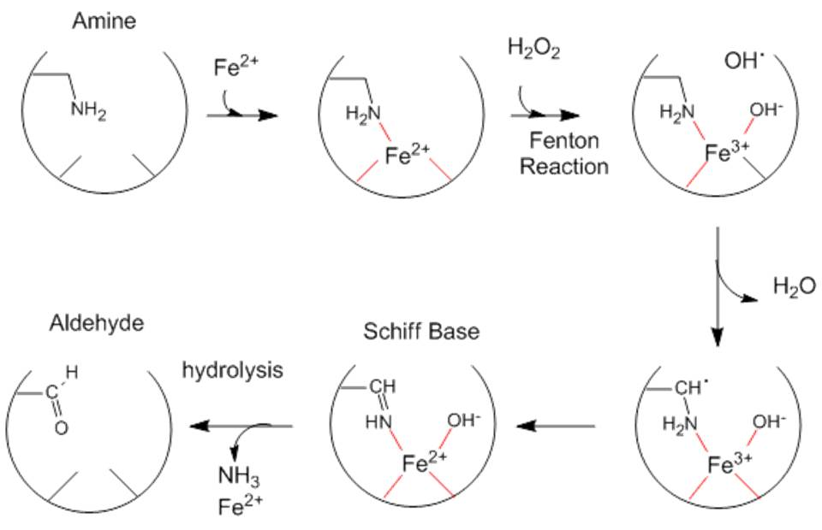
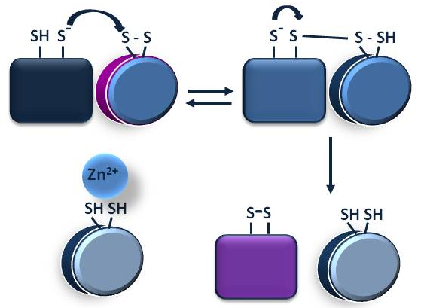
Reactive Oxygen Species
Metal Induced Oxidation and Degradation
The “New” Biology:
Cys Proteomics
The Traditional:
Fe³⁺/Fe²⁺
Cu²⁺/Cu⁺
V/S
Zn²⁺
BioGlobaX
4
Notes:
In addition, metal induced protein oxidation and degradation have been studied in cells not extensively and mainly regarding formation of reactive oxigen species via Fenton reaction. When metals are bound to cysteines, they may either protect or induce oxidation in different ways. For example, zinc protects sulfhydryls from oxidation, iron and copper induce oxidation and degradation. Recent data show that shuffling of disulfide bonds between two proteins may generate different folding and properties. Zink finger (zink bound to cysteines) protects this kinds of transitions. This is another new area of research that we need to evaluate when prepare projects. Keeping in mind that those three metals are the most abundant trace metals in cells, correspondingly in the media for expression and with consequence to stability and activity of the purified proteins.

Slide 5
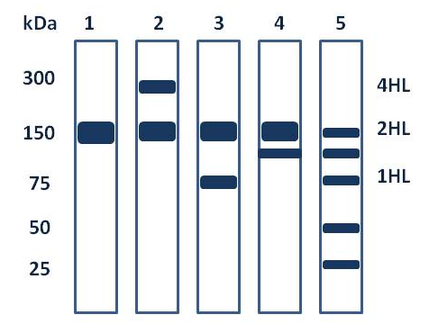
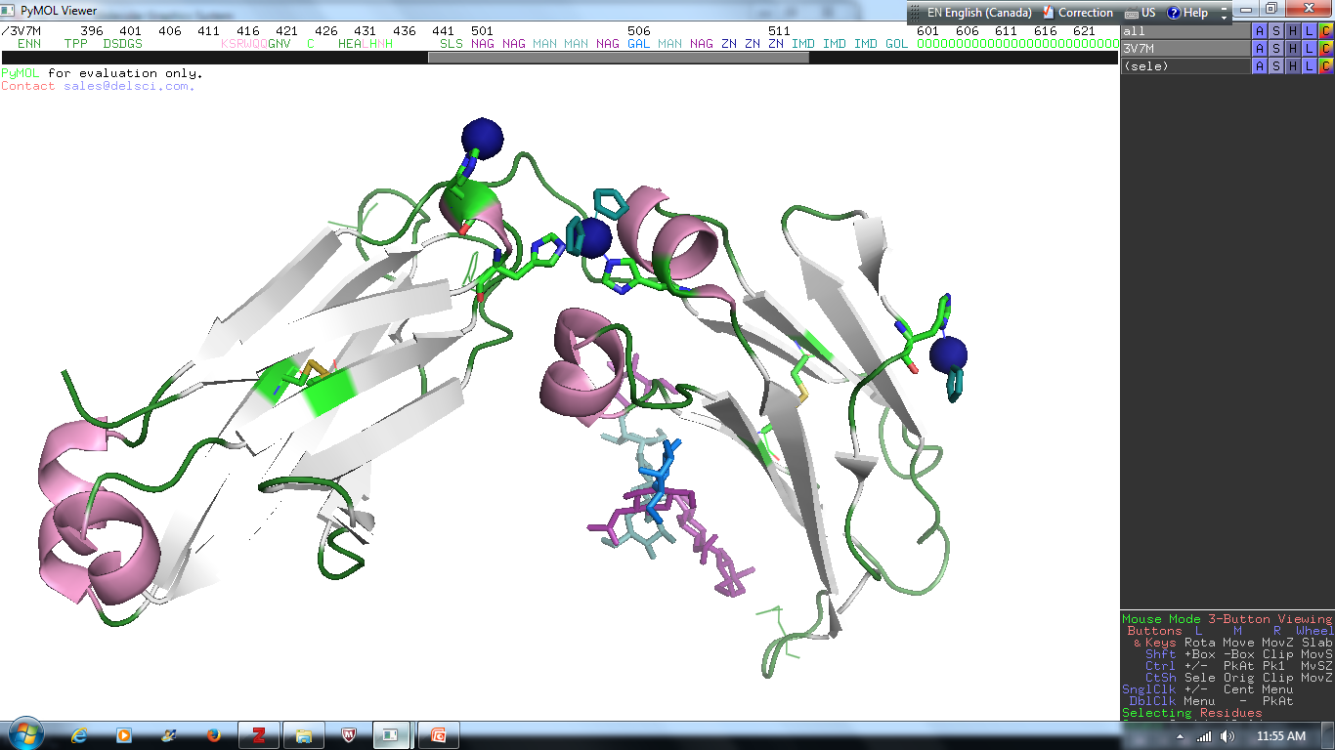
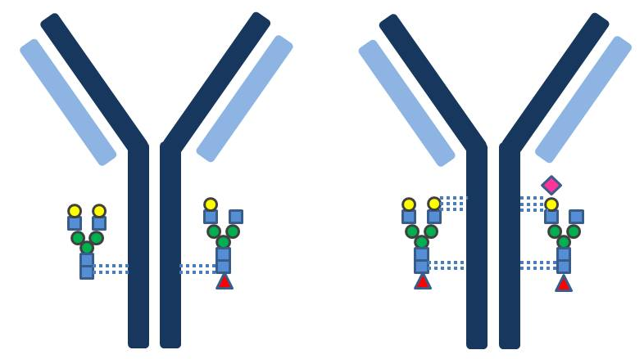
Antibodies: Real Data
IgG1 / Fcγ
PDB 3V7M
Zn²⁺
IgG1b12
IgG1 Fc
Zn²⁺
Zn²⁺
PDB 1HZH
PDB 4BYH
Sibéril S , Immunol.Lett. (2012) 143: 60-69
BioGlobaX
5
Notes:
Examples with antibodies. Main concerns: Lack of activity, specificity, multiple band on a gel. Lane 1 – single expected band. Lane 2 – mixture with dimer, 3- mixture with half of the complex, 4 – probable degradation or oxidation, 5 – mixture of both 3 and 4.
PTM – Mass-spec and cystal structures shows mixture of multiple forms of antibody’s glycosilation, how we can explain it?
Metals bound to histidines and other reactive residues during the purification process may activate or reduce protein activity. In this study, histidines at interface of the Fc portion of human IgG1 can coordinate a Zn2+ and participate in the control of the CH2-CH2 interdomain opening. Structures obtained in the absence of Zn2+ have a reduced interdomain gap that likely hamper FcγR binding. This closed conformation of the Fc is stabilized by inter-CH2 domain sugar contacts. Zinc appears to counteract the sugar mediated constriction, suggesting that zinc could be an important control factor in IgG1/FcγR interactions.

Slide 6
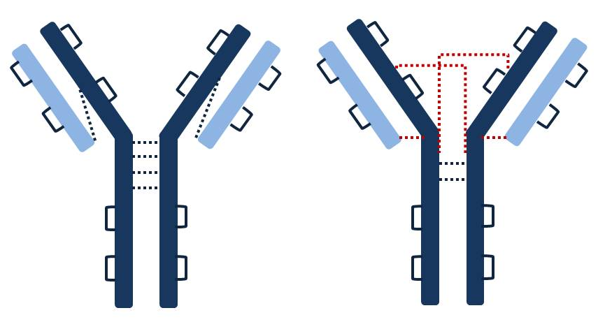
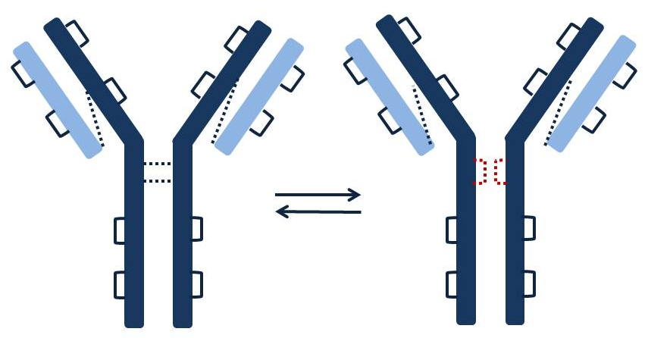
The “New” Biology:
Redox Proteomics
Antibodies
The Traditional Approach:
V_{L}
C_{L}
IgG₂
V_{H}
C_{H}1
C_{H}2
C_{H}3
IgG₄
BioGlobaX
6
Notes:
The traditional approach to study antibodies with conserved and variable regions and ignoring the contribution of the cysteines (over 20). It was assumed until recently that all are locked in disulfide bonds. New data show that some of the cysteine pairs may recombine (red dotted connecting lines). That may explain formation of different types of structures and mobility on gels, correspondingly different activity.
The methodology to purify and study antibodies should reflect the new datasets that allow to explain many abnormalities observed

Slide 7
Antibodies Abnormalities
BioGlobaX
7

Slide 8
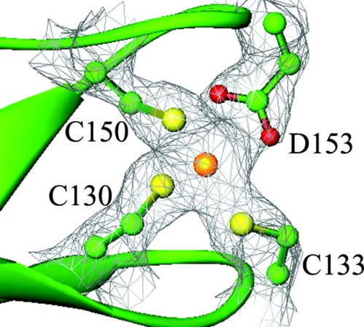
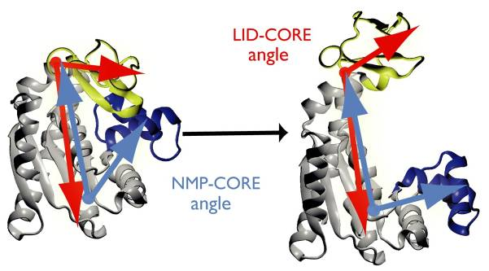
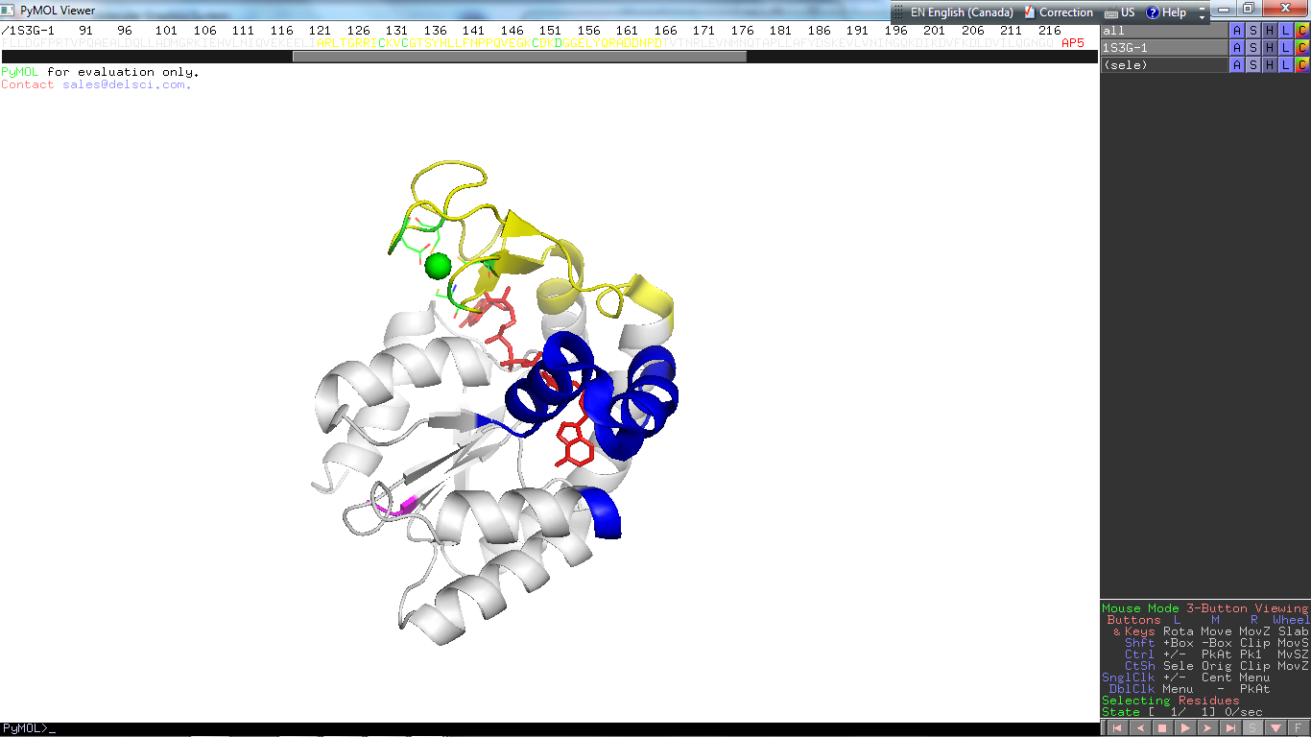
A Paradigm Shifts
Lessons from Enzymes: Adenylate Kinase
Mg²⁺ - ATP + AMP ↔ Mg²⁺ - ADP + ADP
BioGlobaX
8
Notes:
Lessons from Enzymes: Methionine Aminopeptidases has been widely studied for over 20 years as a cancer marker. Figure a shows conserved residues in all the family members involved in the substrate binding domain with two metal ions bound. The mechanism of action was proposed, based on interactions with inhibitors. Now, based on statistics from sequence and structures comparisons, another conserved domain in the substrate binding pocket for prokaryotic type (b) and eukaryotic type (c) allows to re-evaluate the mechanisms of action for both types: redox couple (disulfide bond) and monovalent ion bound at the same place, where valine and asparagine replace cysteines. These finding will completely change the analytical approaches for further work with the enzyme, as new data support that the redox properties of the eukaryotic type of the enzyme modulate its activity.

Slide 9
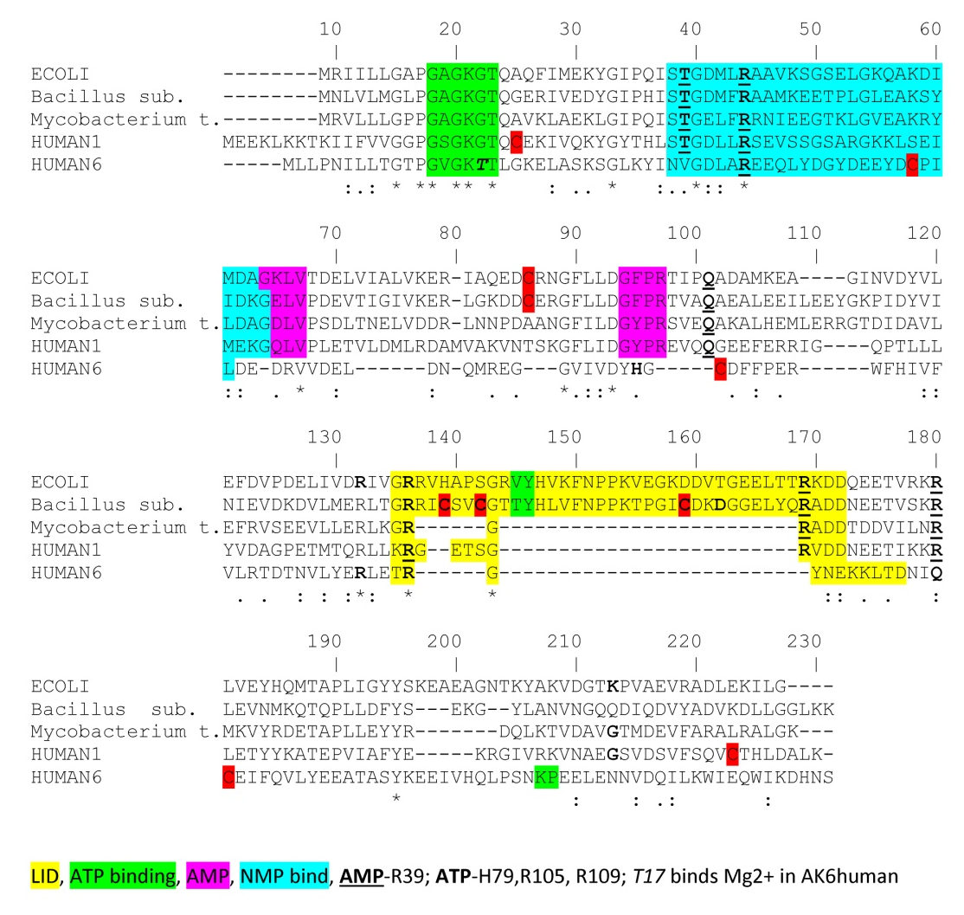
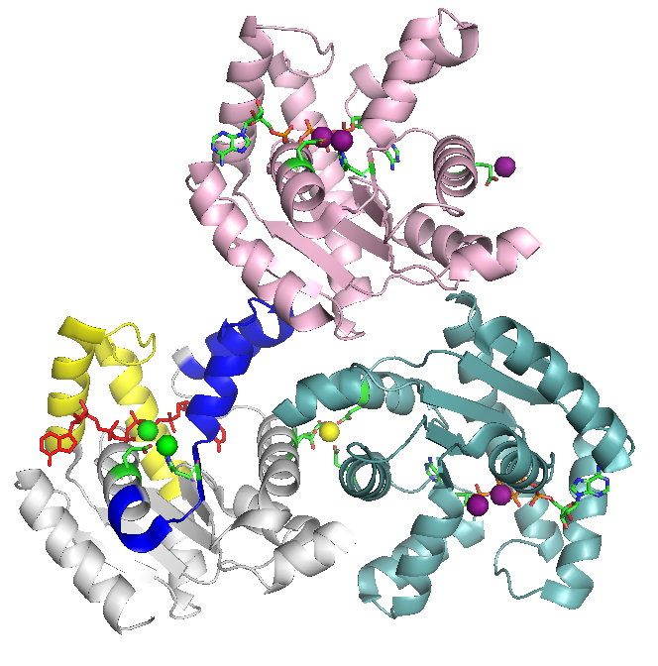
The Power of Bioinformatics
Human AK1-trimer
AP5 - Zn²⁺ PDB 1Z83
BioGlobaX
9
Notes:
The power of Bioinformatics: sequences alignment (crytical residues colored) and in the scheme is shown the conserved domain that allows to find common features and distinguish pro- from eukaryotic types and develop more successful strategies for disease treatment and to characterize family members.

Slide 10
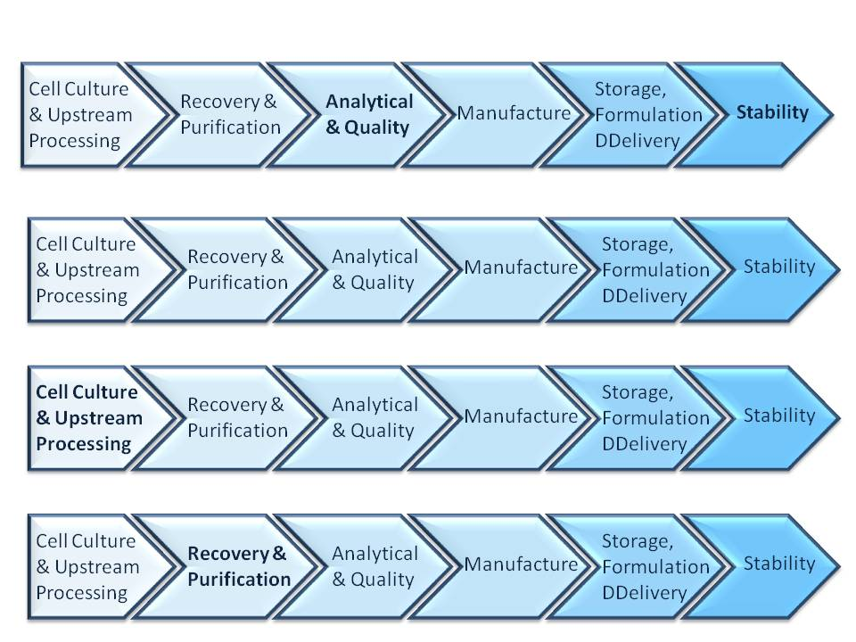
Analytical Toolkit
Methodology
Bioinformatics
Targets and systems
Factors and instrument
Single, multiple and routine assays
Sequence
Interactions
BioGlobaX
10
Notes:
The traditional pathway for biopharmaceuticals R&D is:
Methodology should be designed on a case by case basis: target and system (protein family, origin etc., in what kind of cells should be expressed)
Factors and instruments (protein properties, what type of instruments we have in house for routine assays
The common practice of expanding the analytical description of the proteins during later steps of the development leads to uncertainties, such as degradations, aggregations, instability, lack of reproducible results, repetitions and delay in the entire process.
The methodology should be designed specifically for every single target-expression system with extensive preliminary data mining and analysis from bioresources and science literature in order to assess important factors and newly proposed models for mechanisms of action.

Slide 11
Analytical Toolkit
Data Mining, Analytical & Quality
Methodology
Bioinformatics
Targets and systems
Factors and instrument
Single, multiple and routine assays
Sequence
Interactions
BioGlobaX
11
Notes:
With multiple assays from the very beginning of the process and with a solid methodology applied to both the sequence and the selection of appropriate analytical tools, and with a focus on correlations and causation, short-term and long-term process- and product-related difficulties could be overcome.

Slide 12
Factors to Consider:
Data Mining, Analytical & Quality
Factors Process Product
Cell type / strains √ √
Gene constructs √ √
pH, T⁰, metabolites √ √
O₂, agitation √ √
Media composition - √
Sequence and structure √ √
Activity
Stability
Yield
BioGlobaX
12
Notes:
Cell Culture & Upstream Processing: typically, host of expression, gene constructs, pH, T⁰, metabolites have been evaluated. Both process and product related factors. Less or no attention has been paid to O₂, agitation, media composition, sequence and structure and how they would affect activity, stability and yield. The goal is to get good yield at the end, however with low activity and stability over 50% of the initial protein amount could be lost.
To chase high yield from expression is double-edged sword (soord): larger amount of the heterologous protein in the cells leads to a large deviation of the cells from their normal homeostasis. The protein plays a role of stress factor for the cells and they respond to this stress with generation of ROS, oxygen and other metabolites that leads to PTM and heterogeneity of the over-expressed protein.
Media compositions becomes estimated factor, it wouldn't affect the process very much, but affects product quality and I will give later examples.

Slide 13
Factors to Consider:
Data Mining, Analytical & Quality
Factors Process Product
Buffers composition - √
Purification process √ √
Additives - √
pH variations √ √
O₂, H₂O₂, ROS √ √
Impurities (metals) √ √
Activity and Stability √ √
BioGlobaX
13
Notes:
During the recovery & purification: Buffers composition and Purification process are the mainly considered factors with less attention to Additives, pH variations, O₂, H₂O₂, ROS (deriving from the crushed cells), Impurities (particularly metals). A distinction of process from product related factors is important, so activity and stability should be assessed constantly, from recovery and at each of the purification steps.

Slide 14
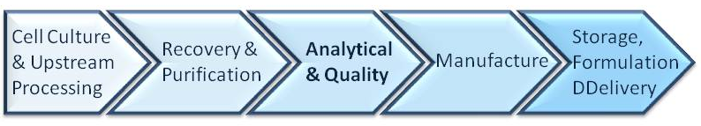
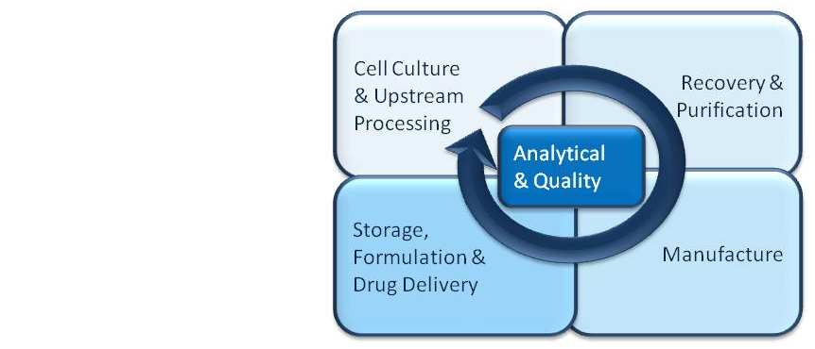
Sequential VS DoE Approach
Study ≥ two factors in parallel;
Searching for correlations between them;
  More precise information;
  Fewer experiments.
BioGlobaX
14
Notes:
Replace the traditional sequential pathway with DoE approach where Analytical & Quality apply from the very beginning: Study ≥ two factors in parallel; Searching for correlations between them; that allows to get more precise information from fewer experiments.

Slide 15
Cost Effective Assays
Absorption spectra of purified proteins
BioGlobaX
15
Notes:
Furthermore, a combination of low-cost multiple techniques from the very beginning of the pre-clinical process will make it easier to understand data on protein structure, functions, and dynamics and would enable further selection of more sophisticated and rigorous techniques to meet the regulatory requirements and to advance the analytical spectrum of in-house methods for validation purposes.
Here is an example of absorption spectra of purified proteins: blue – ideal UV-Vis curve with maximum at 280 nm; violet – shift at 280 nm, due to local re-arrangement of aromatic residues (conformational change); green – bound metals; gray – aggregation. Surprisingly, those kind of very cheap assays

Slide 16
Cost Effective Assays
Absorption spectra of purified proteins
  Kinetics
  Molecular Weight
  Oligomers / Aggregates
  Conformational Changes
  Binding affinity / Specificity
  Small Molecule Coordination
BioGlobaX
16
Notes:
Furthermore, a combination of low-cost multiple techniques from the very beginning of the pre-clinical process will make it easier to understand data on protein structure, functions, and dynamics and would enable further selection of more sophisticated and rigorous techniques to meet the regulatory requirements and to advance the analytical spectrum of in-house methods for validation purposes.
Here is an example of absorption spectra of purified proteins: blue – ideal UV-Vis curve with maximum at 280 nm; violet – shift at 280 nm, due to local re-arrangement of aromatic residues (conformational change); green – bound metals; gray – aggregation. Surprisingly, those kind of very cheap assays

Slide 17
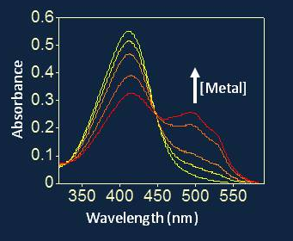
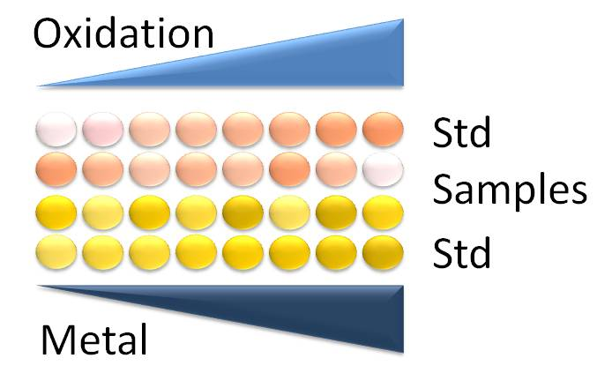
Cost Effective Assays
The Power of UV/Vis spectrometry
  Kinetics
  Molecular Weight
  Oligomers / Aggregates
  Conformational Changes
  Binding affinity / Specificity
  Small Molecule Coordination
  Metal content
  Oxidation status
BioGlobaX
17
Notes:
Furthermore, a combination of low-cost multiple techniques from the very beginning of the pre-clinical process will make it easier to understand data on protein structure, functions, and dynamics and would enable further selection of more sophisticated and rigorous techniques to meet the regulatory requirements and to advance the analytical spectrum of in-house methods for validation purposes.
Here is an example of absorption spectra of purified proteins: blue – ideal UV-Vis curve with maximum at 280 nm; violet – shift at 280 nm, due to local re-arrangement of aromatic residues (conformational change); green – bound metals; gray – aggregation. Surprisingly, those kind of very cheap assays

Slide 18
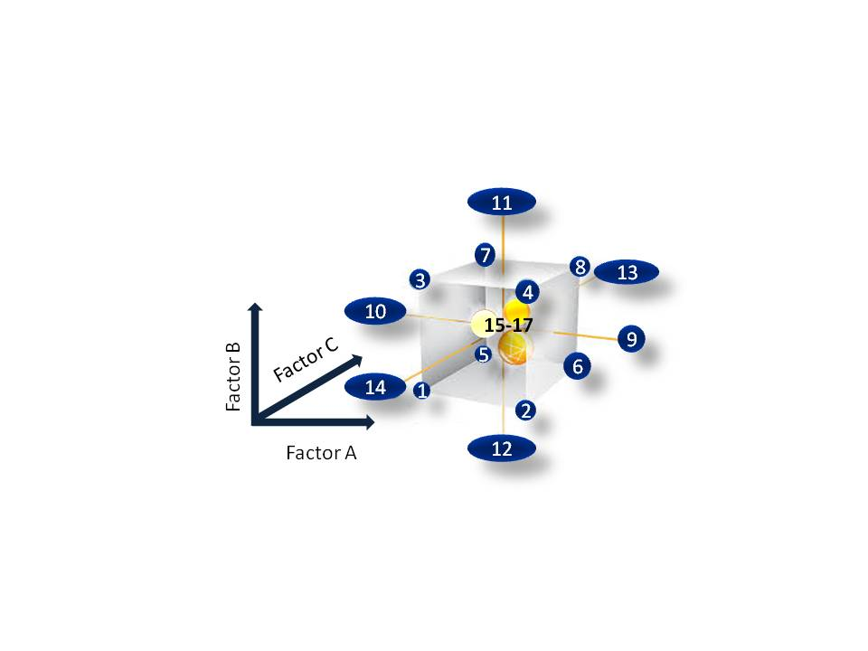
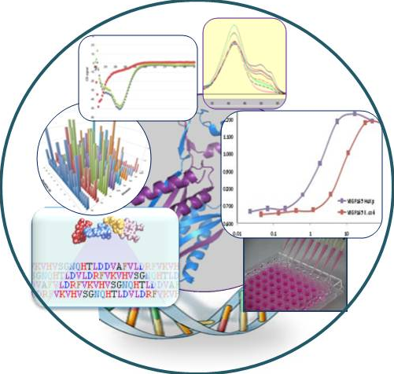
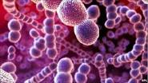
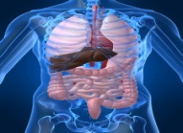
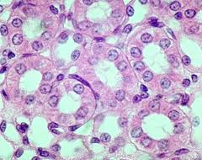
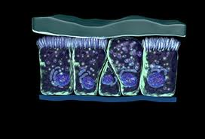
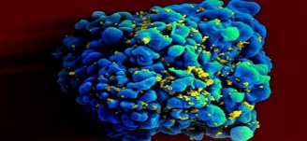
The Future
Relevant data collection / bioinformatics ↔ comparative analysis
Multidisciplinary DoE approaches
BioGlobaX
18
Notes:
The future: Starting from knowledge of cells, applying of DoE approaches where more than one factor should be consider and studied in parallel. Relevant data collection / bioinformatics ↔ comparative analysis

Slide 19




www.bioglobax.com
Acknowledgments
BioGlobaX Inc., Canada:
Slav Dimov, M.Sc.
University of Toronto, Canada:
Prof. Deborah Zamble
Prof. Cheryl Arrowsmith
Prof. Aled Edwards
Prof. Emil Pai
Dr. Robert Lam
Prof. Hee-Won Park
Stockholm University, Sweden:
Prof. Martin Högbom
Nagoya University, Japan:
Prof. Masahiro Sugiura
Prof. Mamoru Sugita
Prof. Toshimitsu Niwa
Sofia University, Bulgaria:
Prof. Atanass Atanassov
Inst. Mol. Biol., Bulgaria:
Prof. Ivan Ivanov
Dr. Roumjana Mironova
Dr. Tamara Paipanova
Dr. Genoveva Nacheva

