Slide 1
Trends in AgBiotech
4th International Conference on Agriculture and Horticulture
Beijing, July 13, 2015
Andy Renz, Vice President Business Development

Slide 2
Overview
Scope
1st Generation ag biotech – Bt & HT
The Challenge: feed the world
2nd Generation ag biotech – complex traits
  Disease resistance
  Complex quality traits
  Abiotic stress tolerance and yield improvement
Biologicals – rise from a niche product to a key market
Breakthrough technologies
  The sequencing revolution
  Molecular breeding
  Phenotyping and big data integration
  Genome editing
Future Trends
  Precision Crops
  Plant-microbiome interactions
Notes:
Technical Approach:
Target identification using systems-based approach (plant as a system)
Employ synthetic biology to engineer a plant’s primary metabolism

Slide 3


Scope – Ag Biotech in the Past and Today
2020
Consortia
biologicals
Genome editing
Modern breeding
1
Sprayable RNAi
Complex quality traits
Yield increase
Single-strain biologicals
Synthetic biology
Precision agriculture
Stress tolerance
2010
Multigene stacks
(HT/IR)
Disease resistance
Biological
plant growth regulators
Herbicide tolerance
2000
Bt
Roundup Ready
1990
Plant transformation
Notes:
130005 (BHB2-4): 7 T1 plants from a single T0 parent (B3)
130009 (BHB2-8): 14 T1 plants from two T0 parents (3 T1s from A10; 11 T1s from D2)

Slide 4
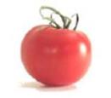
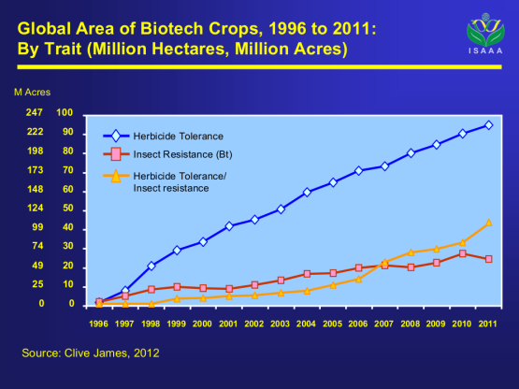
1st Generation Ag Biotech – Bt and Herbicide Tolerance (HT)
1994: Calgene’s FlavrSavr™ tomato received FDA approval
1996-2013:
from 1.7 to 175 million hectars
GM crops world wide;
all Bt and HT
Single-gene traits;
no or not much interference with crop
metabolism
Today: Multi-gene stacks of Bt and HT
Notes:
Technical Approach:
Target identification using systems-based approach (plant as a system)
Employ synthetic biology to engineer a plant’s primary metabolism

Slide 5
High Penetration Rate of GM Traits for Major Crops
Worldwide
Projected future biotech crops:
(millions of acres annually)
Wheat (544)
Rice (406)
Sugarcane (63)
Potato (48)
Eucalyptus (47)
Tomato (12)
Note: Sugarbeet and alfalfa hold >90% and >10% market penetration on U.S. acreage, respectively, but each constitute <1% of worldwide production. Small acreages of papaya, squash, and poplar are also grown.
Source: Clive James, 2012

Slide 6
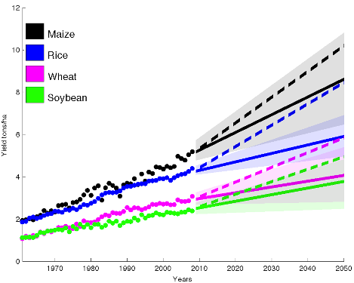
The Challenge and Innovation Driver: 100% Increase in Productivity Required by 2050
Rapidly growing
world population
Growing middle class
Higher meat consumption
Biofuels production
Limited arable land
Ray et al, 2013, PLoS ONE
Required yield increases are significantly higher than historical yield increases.

Slide 7
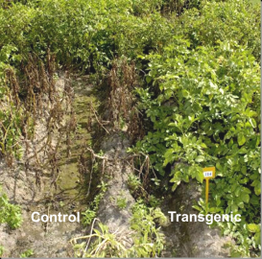
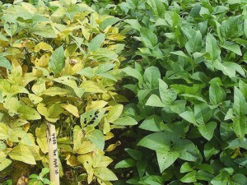
2nd Generation Ag Biotech – Disease Resistance
Syngenta & Monsanto: GM wheat programs in late 90’s
BASF’s Phytophtera resistant potato Fortuna™ approved,
but finally shelfed
  2 resistance genes from a wild potato variety
  introduced via GM-technology
  Strong resistance & good agronomic performance
So far most fungal disease resistance programs are
non-GM through breeding
In development:
  GM soybean resistant against Asian Soybean Rust
  Disease resistant corn plants
Notes:
Technical Approach:
Target identification using systems-based approach (plant as a system)
Employ synthetic biology to engineer a plant’s primary metabolism

Slide 8
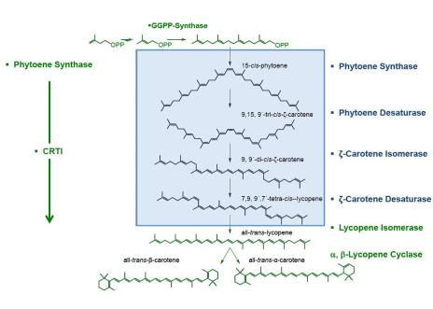
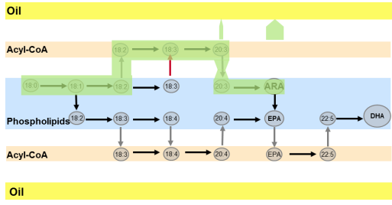
2nd Generation Ag Biotech – Complex Quality Traits
Golden rice (IRRI)
  Humanitarian project: β-carotene rice
  Long R&D timelines
Healthy fatty acids from canola (BASF)
  Production of LC-PUFAs in canola through
  metabolic engineering of an entire pathway (8 genes!)
Much more complicated than anticipated
Complex interactions with crop metabolism
Metabolic engineering & synthetic biology enabled
Note: most other GM quality traits were discontinued
Notes:
Technical Approach:
Target identification using systems-based approach (plant as a system)
Employ synthetic biology to engineer a plant’s primary metabolism

Slide 9
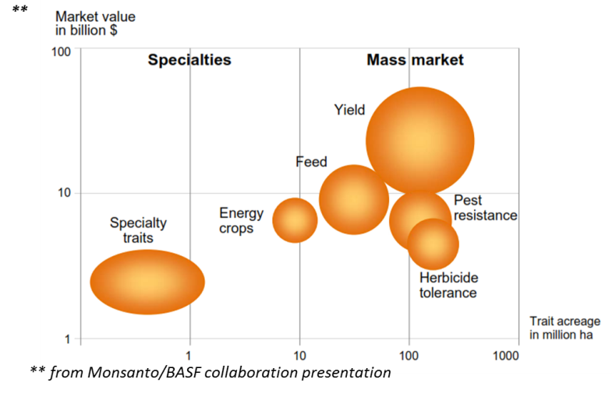
2nd Generation Ag Biotech – Abiotic Stress Tolerance & Yield Increase
2025
2nd generation traits
1st generation traits, currently $12B market
Yield traits represent the largest opportunity in ag biotech

Slide 10
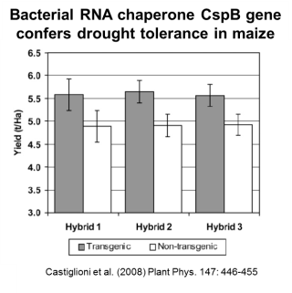
2nd Generation Ag Biotech – Abiotic Stress Tolerance & Yield Increase
Excellent results and products from molecular breeding
  AQUAmax™ corn from Pioneer
  Artesian™ corn from Syngenta
  Droght tolerant rice from IRRI
Opportunity and Challenge for GM approaches:
  Monsanto/BASF: largest partnership in the history of Ag Biotech
  R&D: $2.5 billion(!)
    HTP screens in model and crop plats
    Field testing in crops (commercial germplasm)
    First prducts: Droughtgard™ corn launched in 2013 (Cspb)
  Benson Hill Biosystems:
    Focus on yield improvement through improved photosynthesis
Notes:
Technical Approach:
Target identification using systems-based approach (plant as a system)
Employ synthetic biology to engineer a plant’s primary metabolism

Slide 11
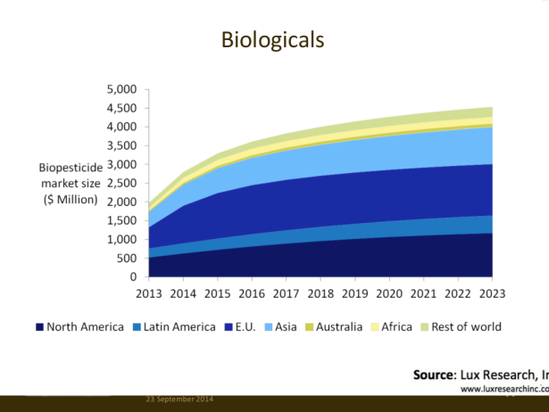



Biologicals – From a Niche Product to a Key Market
Enormous growth of market volume and capital invested
  2012: $1.6 billion
  2016: $3.2 billion
Major investments & acquisitions in past years:
  Bayer: Athenix & Agraquest
  Syngenta: Pasteuria
  BASF: Becker Underwood
  Monsanto – Novozymes (BioAg Alliance)
Independent player:
Sprayable RNAi
  Monsanto’s BioDirect™ Technology
  Source: Lux Research, INC.
Notes:
Technical Approach:
Target identification using systems-based approach (plant as a system)
Employ synthetic biology to engineer a plant’s primary metabolism

Slide 12
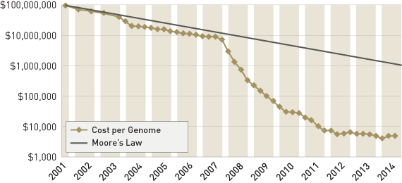
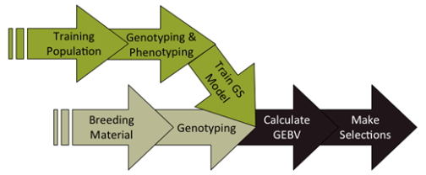
Breakthrough Technologies – Based on the Sequencing Revolution
Sequencing costs per genome are 10,000X lower compared to 15 years ago
Enabled Molecular Breeding:
  Genotyping by Sequencing (GBS)
  Transcriptomics (RNAseq)
  Genomic Selection
    Predict phenotypes in breeding and hybrid production
    Much more advanced in cattle than in crops
Notes:
Technical Approach:
Target identification using systems-based approach (plant as a system)
Employ synthetic biology to engineer a plant’s primary metabolism

Slide 13
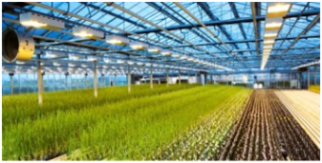
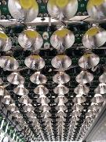
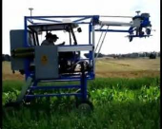
Breakthrough Technologies – Phenotyping: from Indoors to the Field
State-of-the-art: automized phenotyping
  CropDesign/BASF
  Monsanto, Syngenta, Pioneer
  Keygene/LemnaTech (Phenolab)
  Donald Danforth Plant Science Center
  Photosynthetic Phenometrics (Michigan State Univrersity)
Field-based Phenotyoping
  CSIRO’s Phenomobile
  Huazhong Agricultural University
  University of Nebraska Lincoln
Notes:
Technical Approach:
Target identification using systems-based approach (plant as a system)
Employ synthetic biology to engineer a plant’s primary metabolism

Slide 14
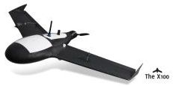

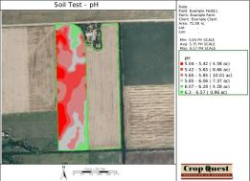
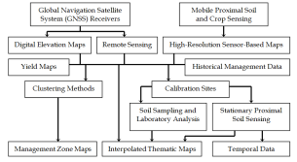
Breakthrough Technologies – Aerial Imaging and Big Data Integration
Aerial Imaging
  Drones, fixed-wing planes and multi-copters
  Multiple sensors: RGB, LiDAR, Thermal IR,
  Hyperspectral Imaging
Environmental Data
  Weather data
  Soil data
Big Data Integration
  Climate Corp/Monsanto
  Many others
Notes:
Technical Approach:
Target identification using systems-based approach (plant as a system)
Employ synthetic biology to engineer a plant’s primary metabolism

Slide 15
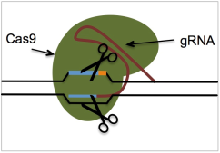
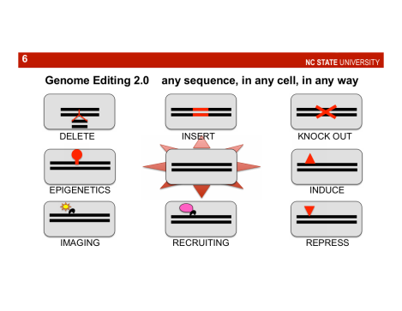
Breakthrough Technologies – Genome Editing
ZFNs: Sangamo & Dow Agrosciences
Meganucleases: Precision Biosciences, Cellectis
TALENs: 2Blades Foundation, Calyxt
CRISPR/Cas:
  Technology of the year 2014: CRISPR Craze
  DNA encoded, RNA mediated
  Versatile
  Precise
  Proof-of-concept in plants
  Complicated patent portfolio;
  Calyxt holds certain rights in plants
Notes:
Technical Approach:
Target identification using systems-based approach (plant as a system)
Employ synthetic biology to engineer a plant’s primary metabolism

Slide 16
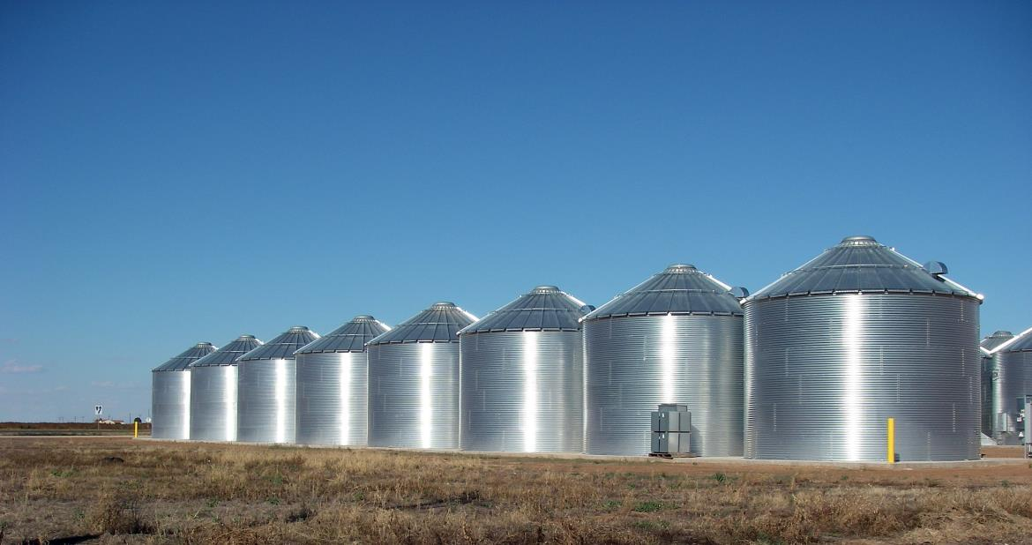
Future Trends – From Isolated Silos to Integrated Approaches
Genomic
selection
Molecular
breeding
Advanced
phenotyping
Genome
editing
Advanced
mutagenesis
Biologics
Multi-genic
GM traits (Yield)
2nd Generation
GM traits (FR, Yield)
1st Generation
single-gene GM
Traits (HT, IR)
Notes:
Silos – or better said: grain bins

Slide 17
Future Trends – From Isolated Silos to Integrated Approaches
Genomic
selection
Molecular
breeding
Advanced
phenotyping
Genome
editing
Advanced
mutagenesis
Biologics
Multi-genic
GM traits (Yield)
2nd Generation
GM traits (FR, Yield)
1st Generation
single-gene GM
Traits (HT, IR)
In the future, more integrated approaches will increase the innovation potential.
Notes:
Silos – or better said: grain bins

Slide 18
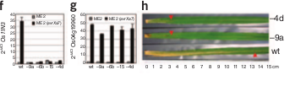

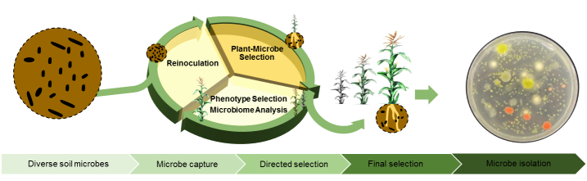
Future Trends
Integrated discovery platforms
  Combining molecular breeding, multi-gene traits & genome editing
Precision crops
  Targeted integration for up- and
  down-regulation of genes
  GM and non-GM products
  based on genome editing
Crop-microbiome Interactions
Proof-of-concept for functional traits
through genome editing
Li et al (2013) Nature Biotechnology 30: 390-392
‘s proprietary Advanced Microbial Selection system
Formulations of biologicals with
agrochemicals
Notes:
Technical Approach:
Target identification using systems-based approach (plant as a system)
Employ synthetic biology to engineer a plant’s primary metabolism

Slide 19
2030
Integrated products
for improved crop-microbiome interactions
Quality improved precision crops
Yield
increased precision crops
Combined biologicals products
2020
Consortia
biologicals
Genome editing
Modern breeding
Sprayable RNAi
Complex quality traits
Yield increase
Single-strain biologicals
Synthetic biology
Precision agriculture
Stress tolerance
2010
Multigene stacks
(HT/IR)
Disease resistance
Biological
plant growth regulators
Herbicide tolerance
2000
Bt
Roundup Ready
1990
Plant transformation
Notes:
130005 (BHB2-4): 7 T1 plants from a single T0 parent (B3)
130009 (BHB2-8): 14 T1 plants from two T0 parents (3 T1s from A10; 11 T1s from D2)

Slide 20
Thank You

