Slide 1



Hepatitis 2016
Dubai, UAE
October 10 - 12, 2016
Andrew Vaillant

Slide 2


Nucleic Acid Polymers:
Broad spectrum antiviral agents and their development as the backbone of new antiviral therapies for the treatment of chronic HBV and HBV / HDV infection.
Andrew Vaillant, Ph.D.
Chief Scientific Officer, Replicor Inc.

Slide 3
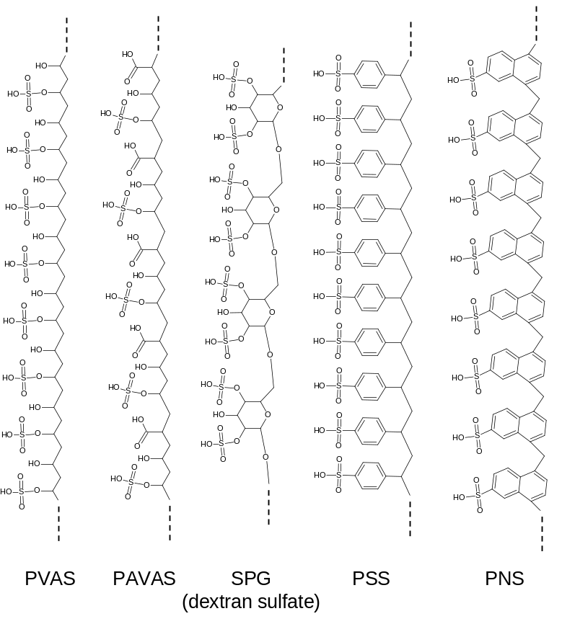
Antiviral polymers: a history
Size dependent, amphipathic interactions
Target exposed amphipathic α-helices in surface glycoproteins
Block infection of many enveloped viruses
human immunodeficiency virus
herpes viruses
respiratory syncytial virus
parainfluenza virus
influenza,
dengue virus
encephalitic flaviviruses
hepatitis C
hepatitis B (HBV)
hepatitis delta (HDV)
Poor tolerability
Side effects and mechanism have blocked clinical development
Vaillant, 2016 Antiviral Res: 133: 32-40

Slide 4
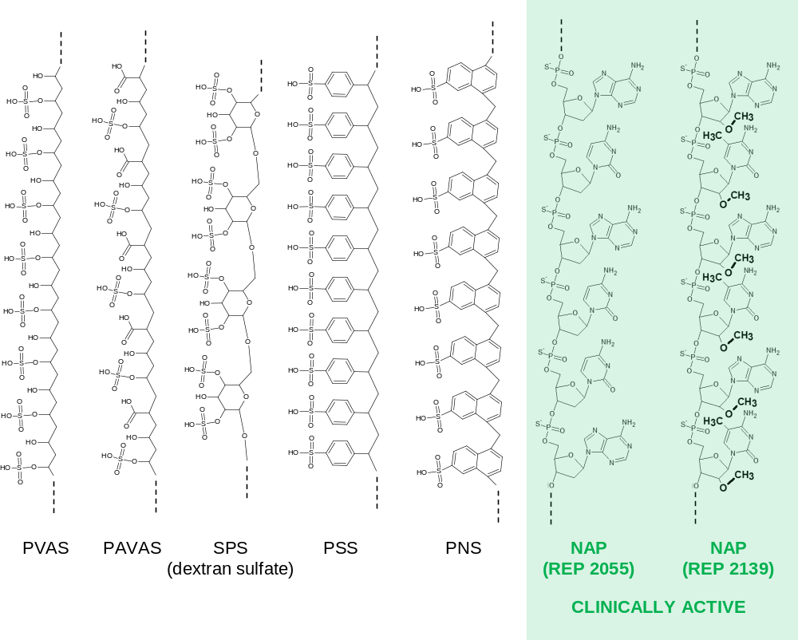
Latest generation of antiviral polymers: nucleic acid polymers (NAPs)
Oligonucleotide-based (requires phosphorothioation for amphipathicity )
Activity independent of sequence or immunostimulatory properties
Naturally occurring chemistry, proven tolerability in humans with chronic exposure
Vaillant, 2016 Antiviral Res: 133: 32-40

Slide 5
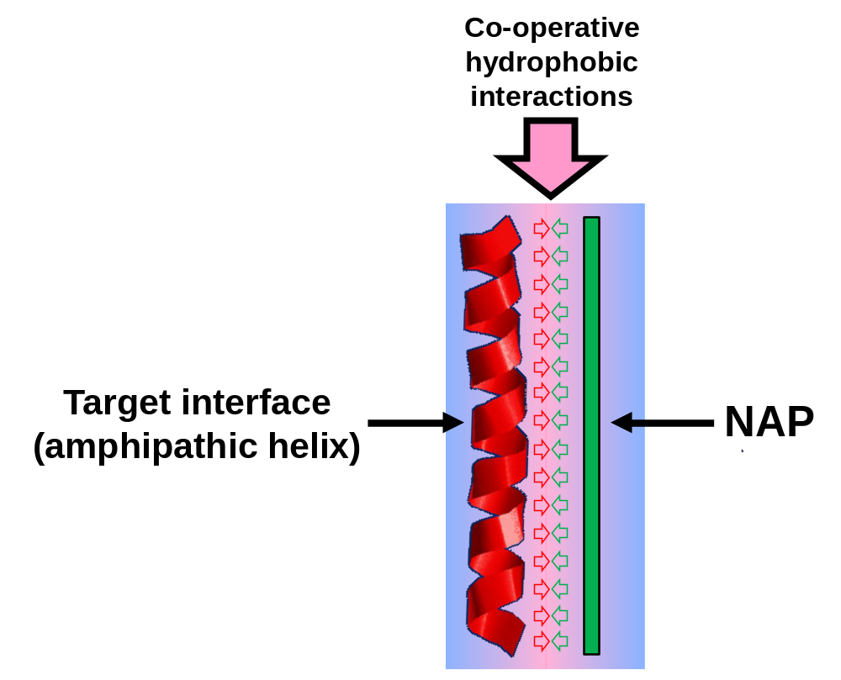
Basis of antiviral interactions for NAPs
Vaillant 2016 Antiviral Res: 133: 32-40

Slide 6
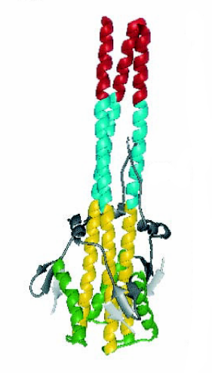
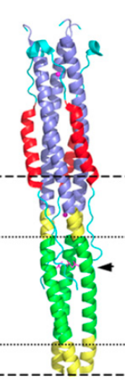
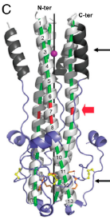

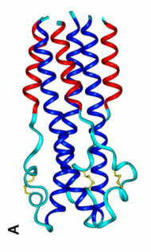
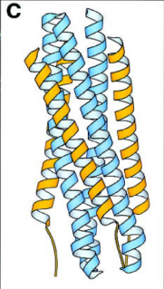
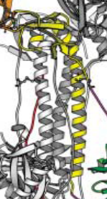
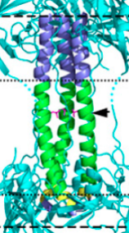
Viral fusion proteins:
A case of convergent evolution
Conserved amphipathic α-helices in type 1 viral fusion glycoproteins are targeted by NAPs
published
crystal
structures
LCMV
GP2
Influenza
HA
HIV
gp41
Sars
S2
Ebola
GP2
RSV
F
HSV
gB
EBV
gB
NAP GP binding | ü* | ü | ü* |  | ü
NAP activity in vitro | ü* | ü | ü* | ü | ü | ü | ü* | ü*
NAP activity in vivo |  | ü |  |  | ü | ü | ü*
* published data (see Vaillant, 2016 Antiviral Res: 133: 32-40)

Slide 7
NAPs are active against diverse influenza strains
HOST | Viral Strain | Subtype
Human | New Caledonia | A/H1N1
 | Taiwan | A/H1N1
 | Panama | B
 | Singapore | B
 | PR8 | A/H1N1
 | Hong Kong /68 | A/H3N2
 | WSN | A/H1N1
 | Harbin/7/94 | B
 | Texas/31 | A/H1N1
 | Sydney/5/9 | A/H3N2
 | Panama/2007/99 | A/H3N2
 | Sydney R292K | A/H3N2 (Tamiflu®/ Relenza® resistant)
 | Beijing E119G | B (Tamiflu® / Relenza® resistant)
 | Vietnam/1203/04 | A/H5N1 (highly pathogenic in humans)
Avian | Equine/Prague/56 | A/H7N7
 | Turkey/England/63 | A/H7N3
 | Chicken/Hong Kong/G9/97 | A/H9N2
 | Duck/Czech/1/6 | A/H4N6
 | Gull/Maryland/704/77 | A/H13N6
NAPs will be effective against current and emerging influenza strains

Slide 8
Clinical Experience with PS-ONs
Substantial clinical database with numerous PS-ONs
Cumulative exposure data > 8000 patients with chronic dosing
FDA approvals:
Vitravene®(CMV antisense) to treat CMV retinitis
Macugen®(VEGF aptamer) to treat advanced wet macular degeneration
Kynamro® (Apo B100 antisense) to treat familial hypercholesterolemia
Class-conserved pharmacokinetics:
Short residence time in the blood ( ½ life <1h)
Accumulation in kidney, liver, spleen and lungs
ideal for treating diseases involving targets in these organs
Well tolerated
Geary et al., 2015 Adv. Drug Deliv. Rev. 87: 46-51
Yu et al., 2015 Mol. Ther. – Nuc. Acids 4: e218
Aartsma-Rus 2016 Mol. Ther. 24: 193-194.

Slide 9
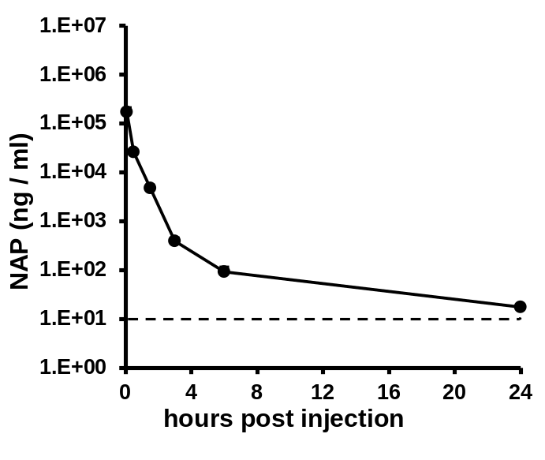
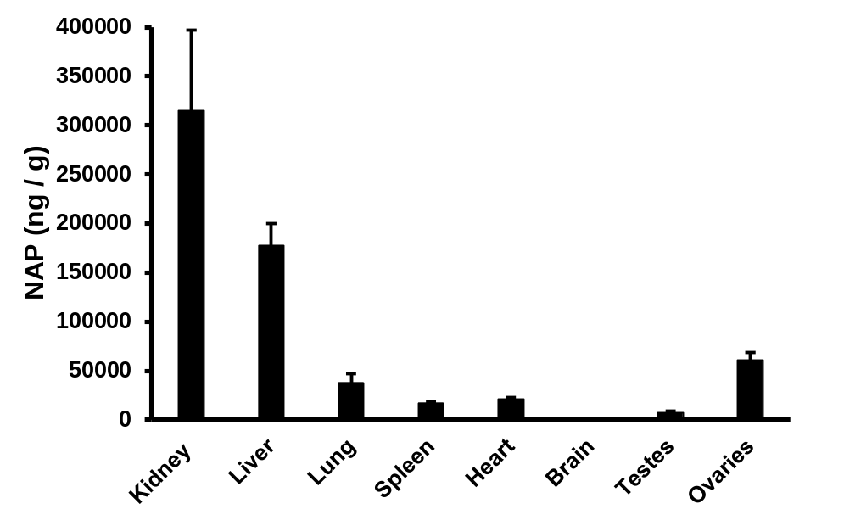
NAP PK / PD mirrors that of other PS-ONs
REP 2139 via tail vein injection
Mouse plasma
Mouse tissue accumulation
6 hours post-injection

Slide 10
NAP interactors in human blood
Protein | NAP interaction | PS-ON interaction
albumin | YES | YES
thrombin | YES | YES
fibrinogen | YES | YES
α2-macroglobulin | YES | YES
apolipoprotein B | YES* | not reported
apolipoprotein E | YES* | not reported
apolipoprotein H | YES | not reported
apolipoprotein A | NO | not reported
apolipoprotein H | NO | not reported
Previously unreported PS-ON interactions likely involved in accumulation in liver, spleen and lung

Slide 11
In vivo response to NAPs
Tissue distribution of NAPs dictates antiviral utility in vivo
Virus | Animal Model | Tropism | Effective treatment modalities
HIV-1 | monkey (SIV) | blood | not effective
Hepatitis C | Scid/Hu chimeric mouse | liver | prophylaxis
Influenza | mouse | lung | prophylaxis therapeutic
RSV | cotton rat | lung | prophylaxis
HSV-2 | mouse | genital | prophylaxis
CMV | mouse | liver, spleen, lung | prophylaxis
Ebola | mouse | ? | prophylaxis therapeutic
Potential application to treat viral infection in humans
Vaillant, 2016 Antiviral Res: 133: 32-40

Slide 12
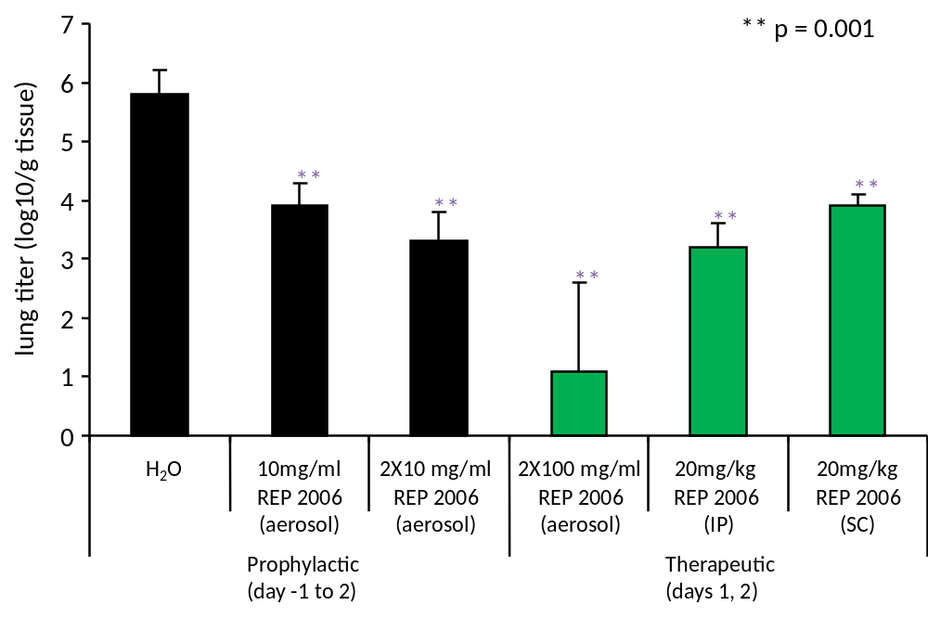
NAPs versus influenza infection in vivo
A/HONGKONG/8/68 (H3N2)

Slide 13
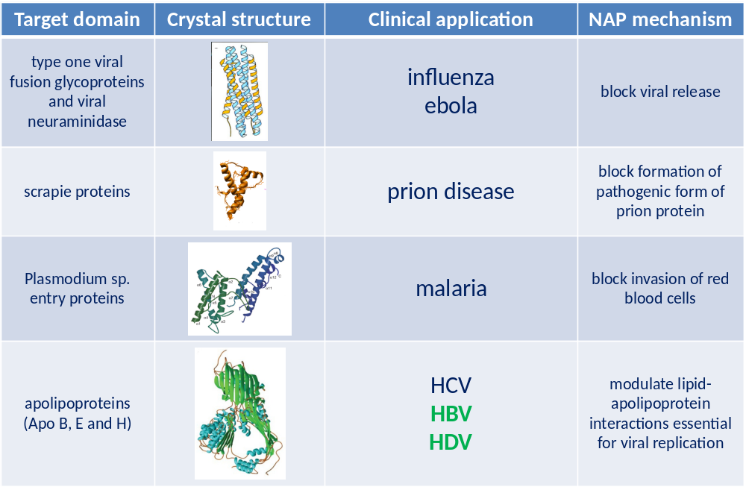
Common protein domains defines the therapeutic potential of NAPs
Vaillant, 2016 Antiviral Res: 133: 32-40

Slide 14
Rationale for focusing on HBV
Up to 350 million patients have HBV worldwide
Current vaccines are highly effective in protecting against the infection but are ineffective in patients with established infection
Current therapies achieve very low rates of the HBV surface antigen (HBsAg) clearance and rarely restore control of infection
Clear need for new therapies which can clear serum HBsAg and restore control of infection

Slide 15
Particle production in HBV infection
Subviral particles
(bulk of serum HBsAg)
HBsAg is the key:
Sequesters anti-HBs
Suppresses innate immunity
Suppresses T-cell proliferation
Suppresses cytokine signaling
Suppresses immunotherapy
Infected
hepatocyte
Nucleus
cccDNA
HBsAg removal
will be essential
to achieve high rates
of functional cure
HBeAg
Capsids
Virions
Replenishment
of cccDNA
Cheng et al., 2005. Journal of Hepatology, 43:4 65-471
Op den Brouw et al., 2009. Immunology, 126: 280-289
Shi et al. 2012 PLoS ONE 7: e44900
Vanlandschoot et al., 2002. J. Gen. Virol., 83: 1281-1289
Woltman et al. 2011 PLoS ONE 6: e15324
Wu et al., 2009. Hepatology, 49: 1132-11
Xu et al., 2009. Molecular immunology, 46: 2640-2646
Al-Mahtab et al., 2016 PLOS One 11: e0156667
Infection

Slide 16
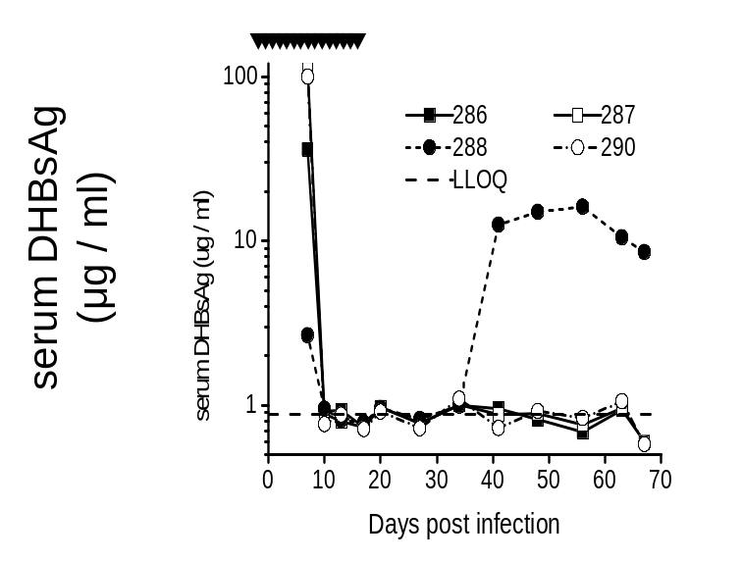
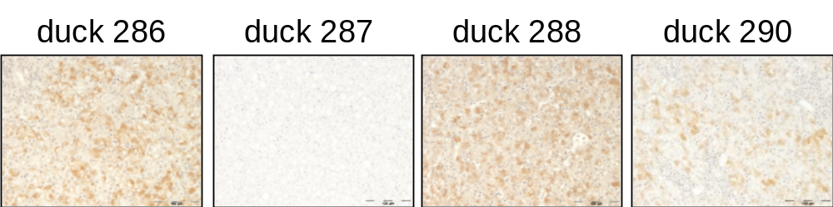
Therapeutic evaluation of NAPs in vivo
(with follow up off-treatment)
Infection of Pekin ducks with duck HBV virus
NAP
treatment
End of treatment:
Surface antigen not detectable in the blood
Still detectable in the liver
Serum DHBsAg
(ug / ml)
Liver DHBsAg at end of treatment
NAPs block the release of surface antigen from infected cells
Noordeen et al., 2015 PLOS One 10: e0140909

Slide 17
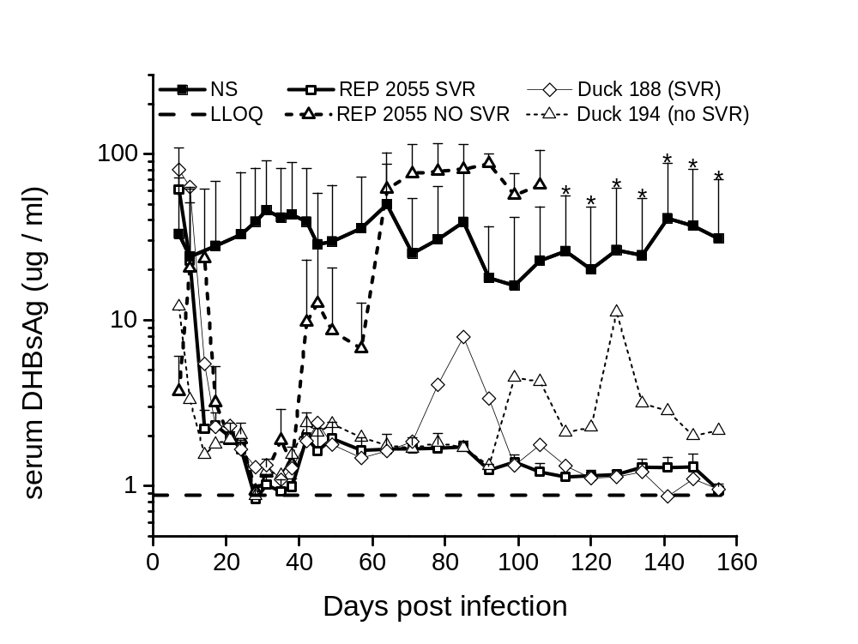
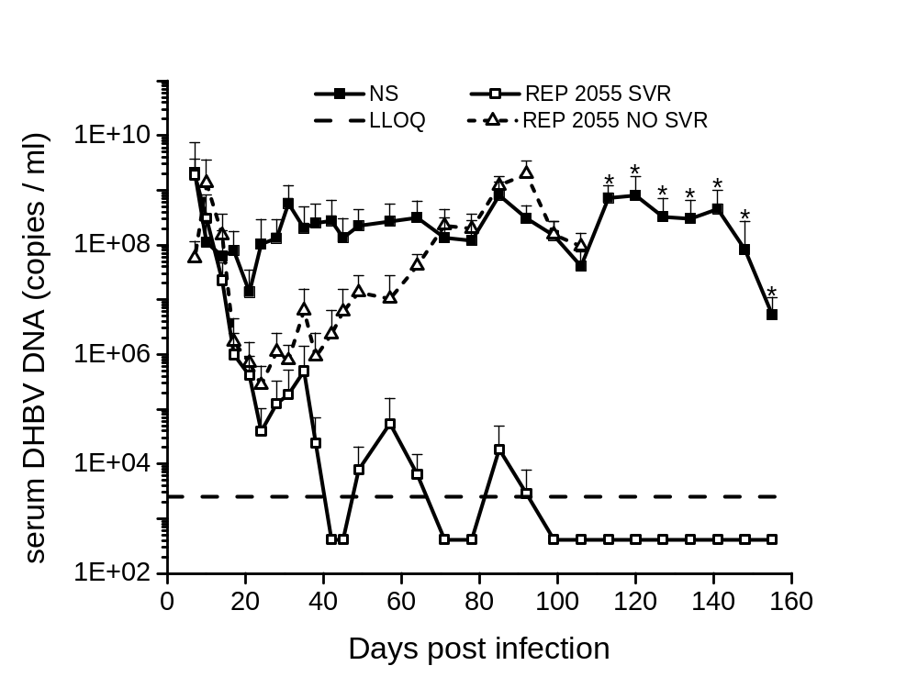
Therapeutic evaluation of NAPs in vivo
(with follow up off-treatment)
Surface antigen universally cleared
Virus persists in many ducks
Block of release of surface antigen release is selective for subviral particles
Noordeen et al., 2015 PLOS One 10: e0140909

Slide 18
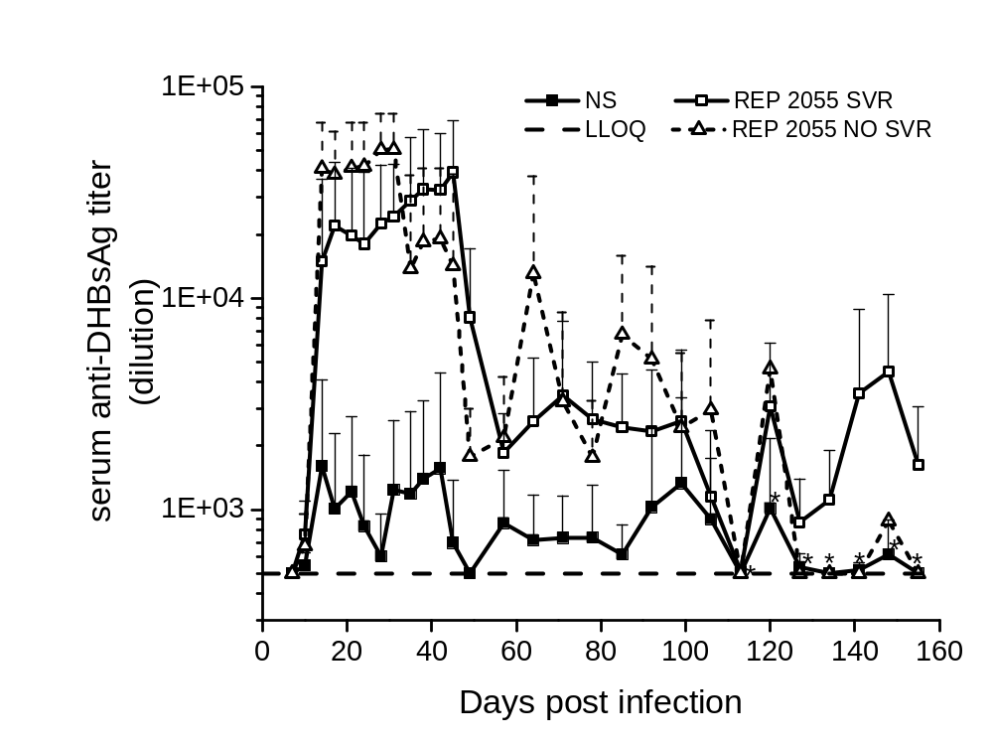
Therapeutic evaluation of NAPs in vivo
(with follow up off-treatment)
Unmaksing of anti-surface antigen antibodies with surface antigen clearance
Antibody production is not correlated with control of infection off treatment
Role in restoring immune control of infection unclear
Noordeen et al., 2015 PLOS One 10: e0140909

Slide 19
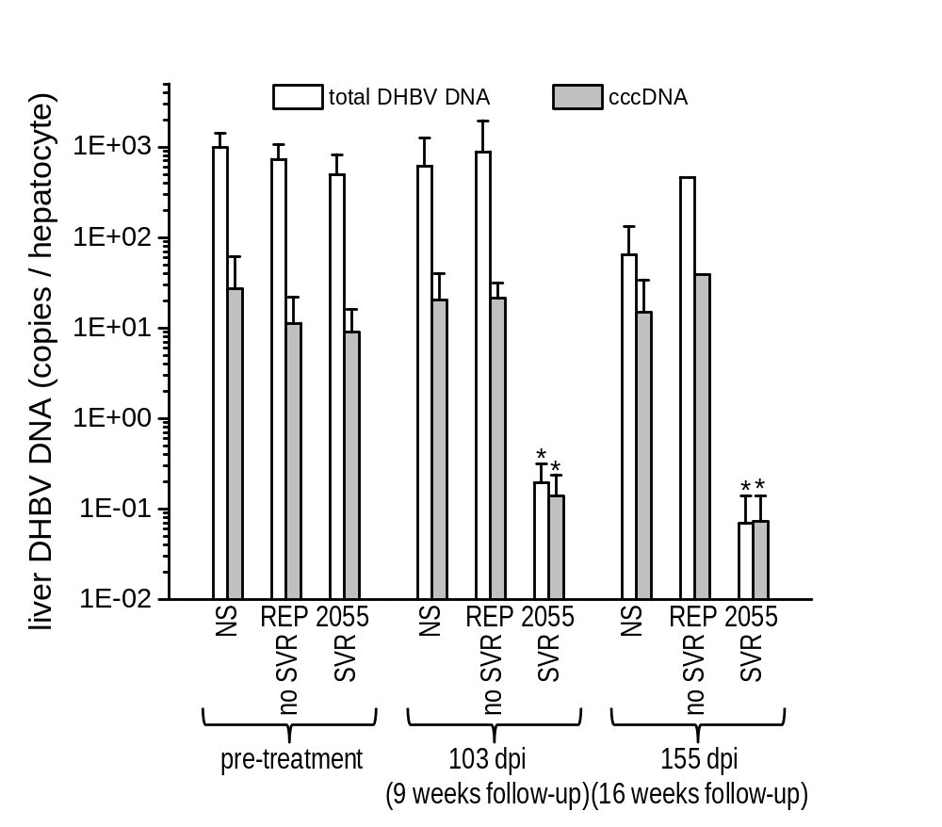
Clearance of HBsAg is correlated with elimination of cccDNA
Transcriptional inactivation and clearance of cccDNA suggests T-cell and or innate response is restored
Noordeen et al., 2015 PLOS One 10: e0140909

Slide 20
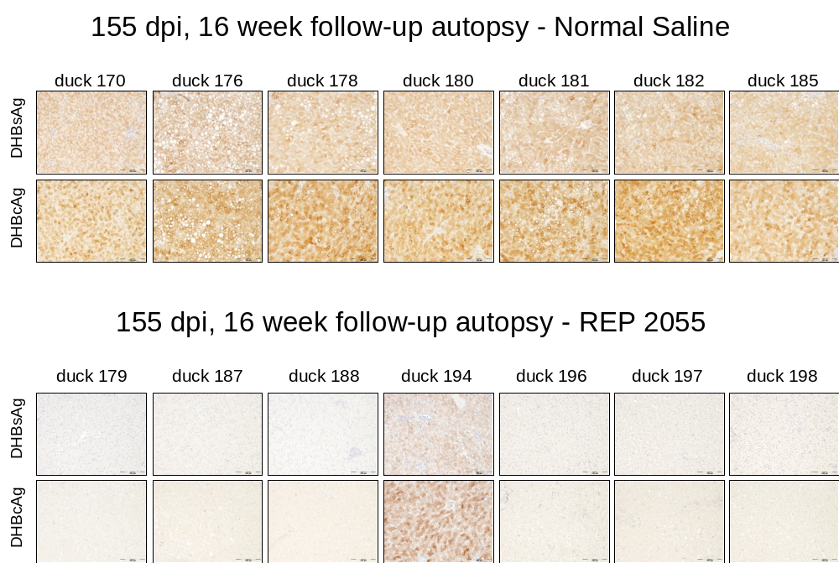
Clearance of HBsAg is correlated with elimination of viral antigens in the liver
Surface and core antigens are cleared from the liver
Noordeen et al., 2015 PLOS One 10: e0140909

Slide 21
NAPs block the release of subviral particles
HBsAg mediated immunosuppression removed
Permissive immunological environment restored
Improved effect of immunotherapy
(and potentially other antiviral agents)
Infected
hepatocyte
NAPs
Nucleus
cccDNA
HBeAg
Capsids
Virions
Replenishment
of cccDNA
  Virions are not directly targeted by NAPs
Infection

Slide 22
REP 101 Trial Overview
Bangladeshi patients treated in Dhaka, Bangladesh
Clinicaltrials.org #
Proof of concept, open label
REP 2055 400mg qV via IV infusion
8 patients enrolled with HBeAg+ chronic HBV infection:
treatment naïve
HCV, HIV negative
HBV DNA > 10⁵ copies / ml
mild to moderate fibrosis, non cirrhotic
Viremia assessed locally and in India and validated at external sites:
Royal Adelaide Hospital, Adelaide, Australia
University of Duisburg-Essen, Essen, Germany
  Roche cobas™PCR (HBV DNA)
  Roche Impact™ (quant-HBsAg, quant-anti-HBs, HBeAg, anti-HBe)
  Abbott Architect™ (quant-HBsAg, quant-anti-HBs, HBeAg, anti-HBe)
Al-Mahtab et al., 2016 PLOS One 11: e0156667

Slide 23
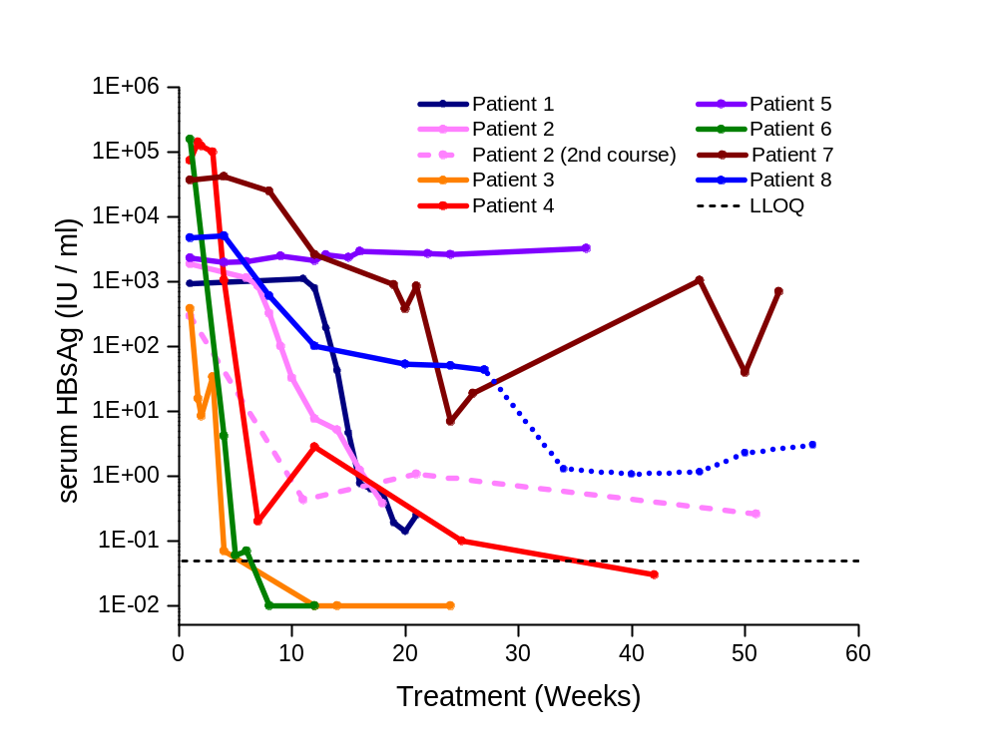
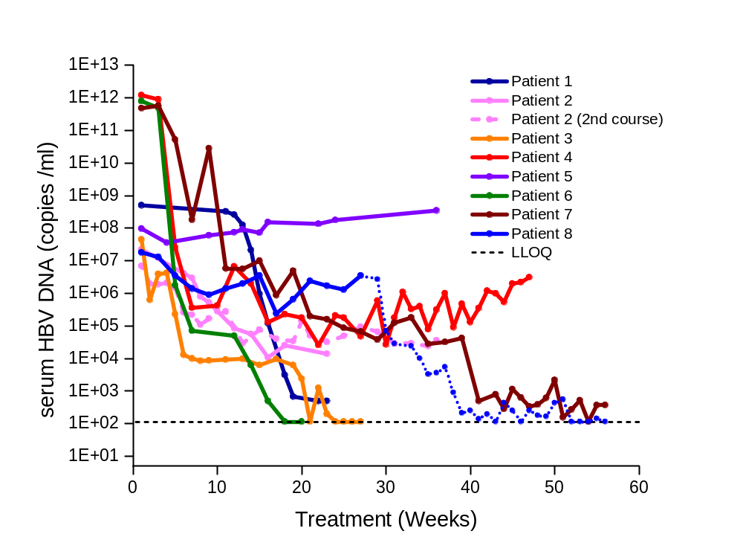
REP 101 Efficacy
Serum HBsAg (SVP)
Serum HBV DNA (virus)
In some patients, virus persists despite HBsAg loss similar to ducks
In vivo effects of NAPs in the duck model accurately model effects in humans
Al-Mahtab et al., 2016 PLOS One 11: e0156667

Slide 24
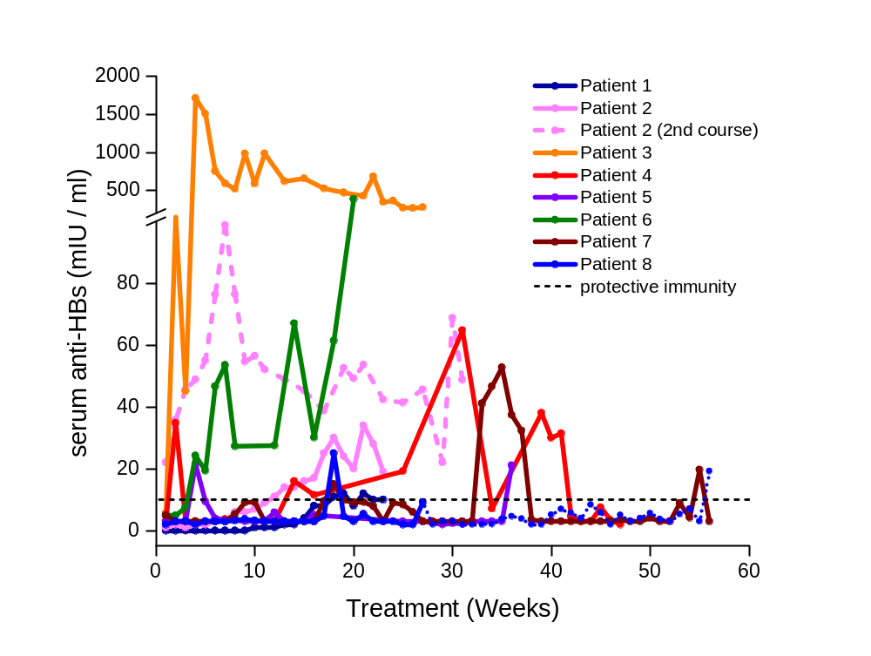
REP 101 Efficacy
Clearance of HBsAg unmasks anti-HBsAg antibodies
Al-Mahtab et al., 2016 PLOS One 11: e0156667

Slide 25
REP 101 follow-up
Serum HBV DNA (virus)
Functional control > 5 years
Functional control 1 years
Virema controlled in all other patients after REP 2055 therapy with entecavir
Addition of immunotherapy will be required to achieve functional control in most patients
Functional control = HBsAg < 1 IU / ml, HBV DNA < 1000 copies / ml
Al-Mahtab et al., 2016 PLOS One 11: e0156667

Slide 26
Combination therapy will be essential to achieve high SVR rates
STEP 1:
Elimination of
serum HBsAg
(achieved by suppression of
SVP release by NAPs)
Infected
hepatocyte
NAPs
Nucleus
which allows…
STEP 2:
Restoration of immune
response with ANY
immunotherapy
Inactivation
and clearance
of cccDNA
HBeAg
Capsids
Virions
Rabe et al. 2003 PNAS 100: 9849-9854
Werle-Lapostolle et al. 2004 Gastroenterol. 126: 1750-1758
Wong et al. 2006 Antivir. Ther. 11: 909-916
Wong et al. 2013 Clin. Gasterenterol. Hepatol. 11: 1004-1010
Lai et al. 2016 J. Hepatol. (Epub Sept 14).

Slide 27
REP 102 Trial Overview
Bangladeshi patients treated in Dhaka, Bangladesh
Clinicaltrials.org #
Proof of concept, open label:
REP 2139-Ca 500mg qW via 2h IV infusion
Transition to immunotherapy (peg-IFN or thymosin a1) in patients with 2 log reduction in both HBsAg and HBV DNA
12 patients enrolled with HBeAg+ chronic HBV infection:
treatment naïve
HCV, HIV negative
HBV DNA > 10⁵ copies / ml
mild to moderate fibrosis, non cirrhotic.
Viremia assessed locally and in India and validated at external site:
University of Duisburg-Essen, Essen, Germany
  Roche cobas™ PCR (HBV DNA)
  Abbott Architect™ (quant-HBsAg, quant-anti-HBs, HBeAg, anti-HBe)

Slide 28
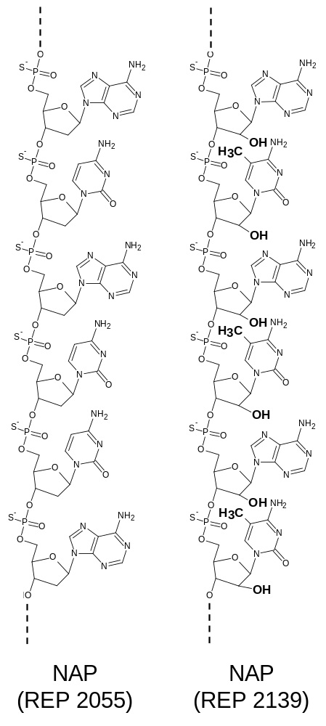
REP 2139 – an improved version of REP 2055
Modifications:
2’O methylation in ribose
5-methylation of cytosine
naturally occurring
Effect:
block recognition by innate immune response
improve compound solubility
REP 2055
(DNA)
REP 2139
(RNA)
Erlich et al. 1982 NAR 10: 2709-2721
Kiss 2001 EMBO J. 20: 3617-3622
Kariko et al., 2005 Immunity 23: 165-175
Judge et al., 2006 Mol. Ther. 13: 494-504
Robbins et al., 2007 Mol. Ther. 15: 1663-1669

Slide 29
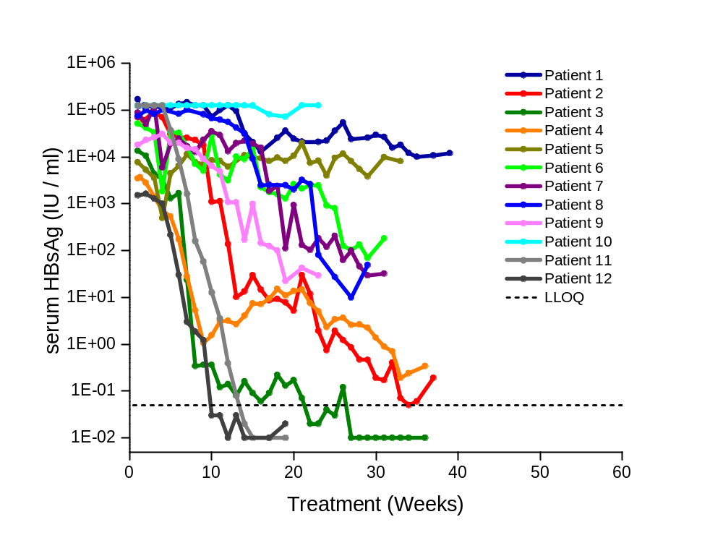
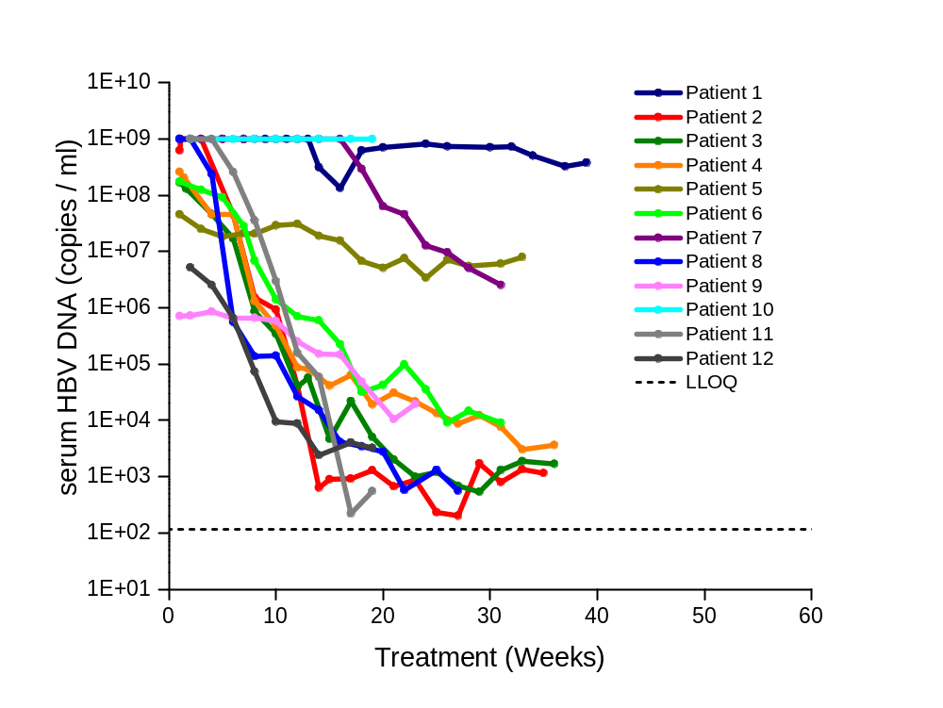
REP 102 Efficacy
(REP 2139 monotherapy)
Serum HBsAg (SVP)
Serum HBV DNA (virus)
Antiviral effects similar to REP 2055
IV infusion well tolerated
Al-Mahtab et al., 2016 PLOS One 11: e0156667

Slide 30
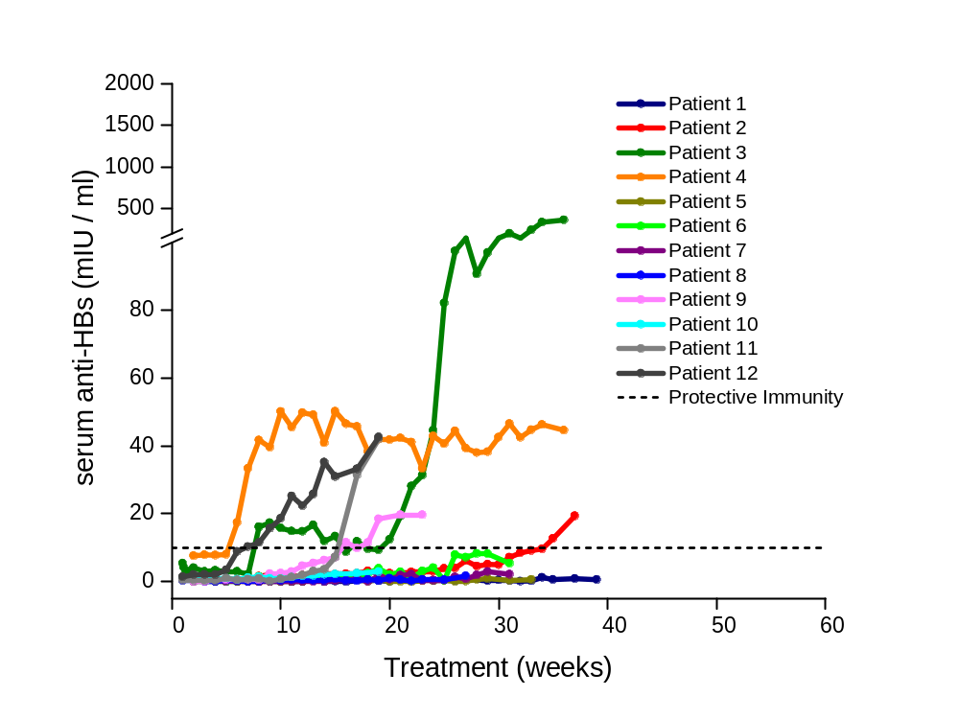
REP 102 Efficacy
(REP 2139 monotherapy)
Clearance of HBsAg unmasks anti-HBs
Al-Mahtab et al., 2016 PLOS One 11: e0156667

Slide 31
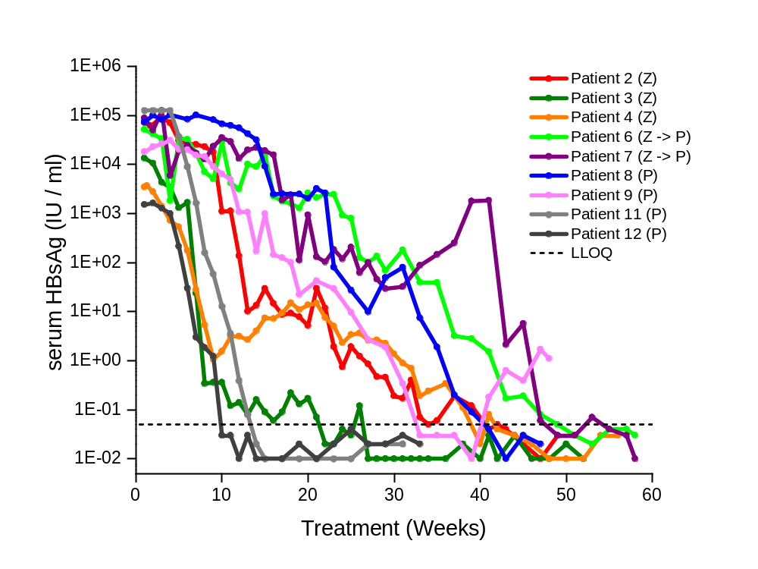
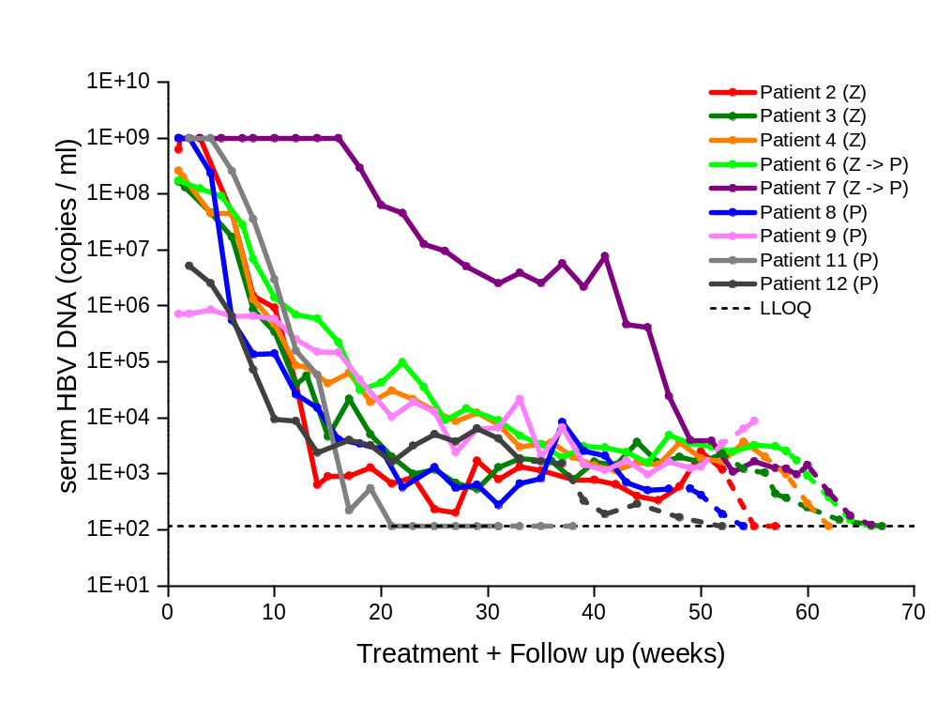
REP 102 Efficacy
(addition of immunotherapy)
9 patients eligible to receive REP 2139 with immunotherapy
Serum HBsAg (SVP)
Serum HBV DNA (virus)
Dashed lines:
initial follow-up after removal of all therapy
Surface antigen loss (< 0.05 IU / ml)
in all patients
During initial follow-up, 8/9 patients had HBV DNA < LLOQ (116 copies / ml)
Functional control > 2 years achieved in 4 patients
Al-Mahtab et al., 2016 PLOS One 11: e0156667

Slide 32
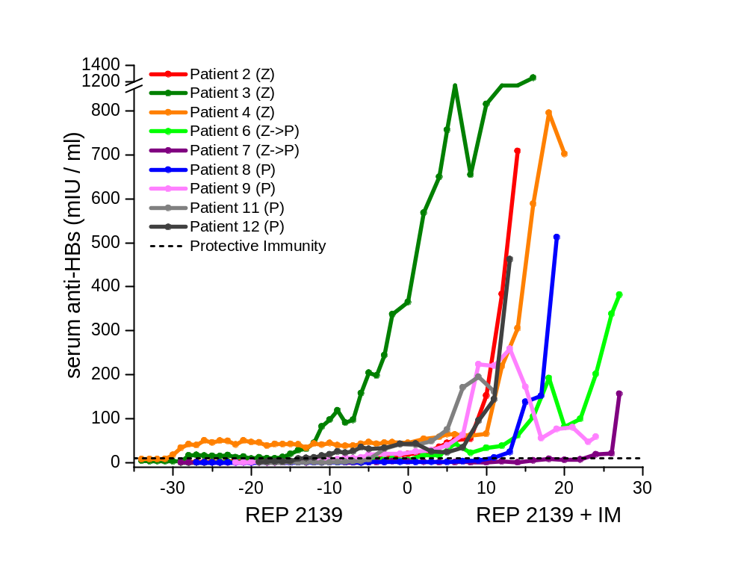
REP 102 Efficacy
(additional of immunotherapy)
Anti-HBs before and after immunotherapy
Dramatic increases in anti-HBs production indicate a rapid and profound response to immunotherapy in all patients
Al-Mahtab et al., 2016 PLOS One 11: e0156667

Slide 33
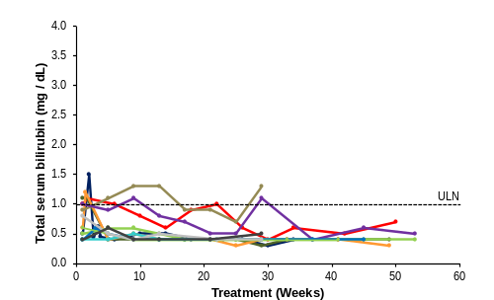
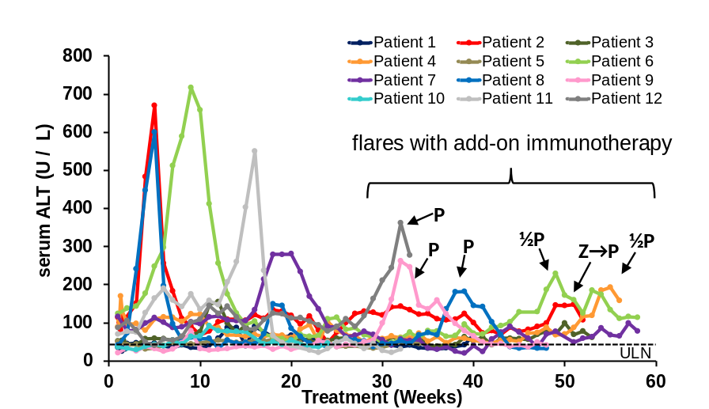
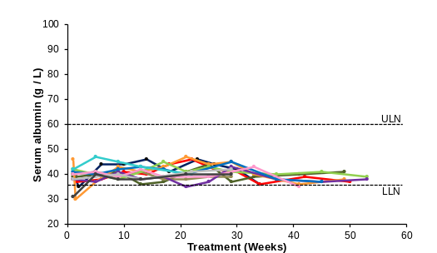
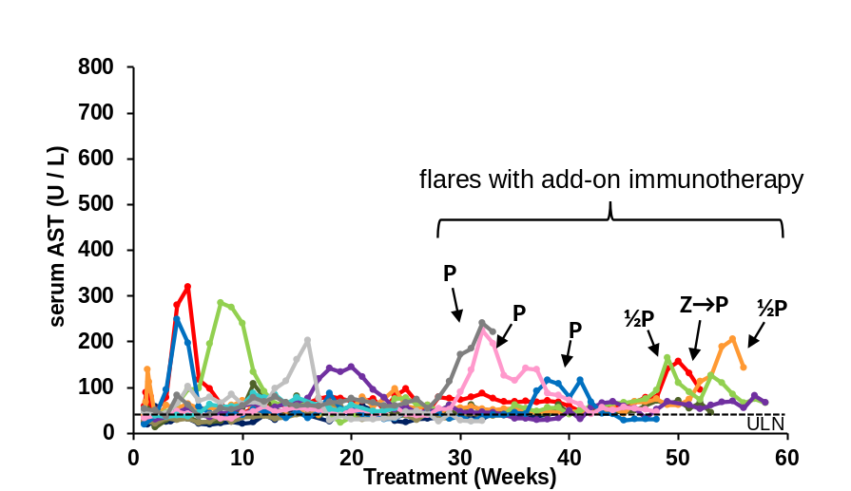
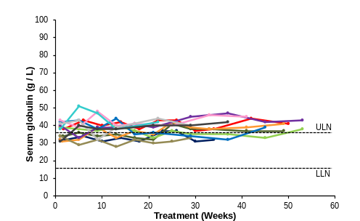
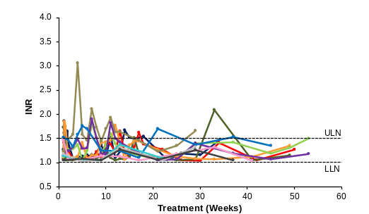
Liver flares signal restoration of immune response in the liver
Bilirubin
Clearance of serum viremia
Albumin
Liver function
is normal
P = peg-IFN
Z = thymosin α1
Globulin
INR
Al-Mahtab et al., 2016 PLOS One 11: e0156667

Slide 34
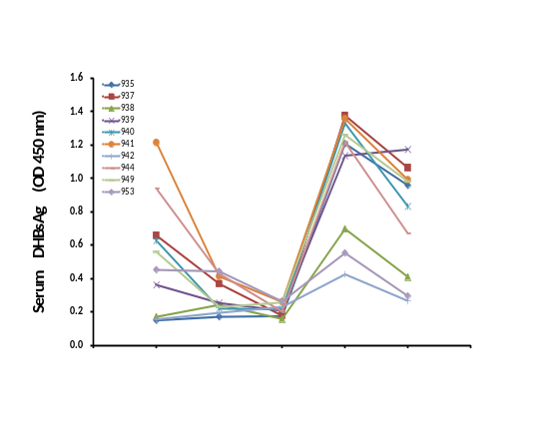
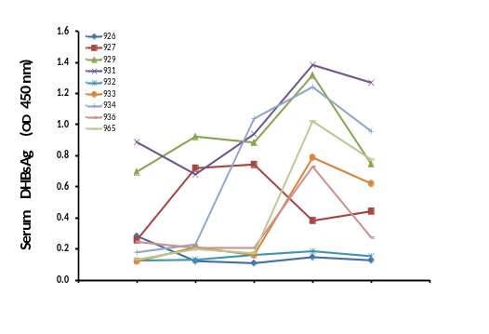
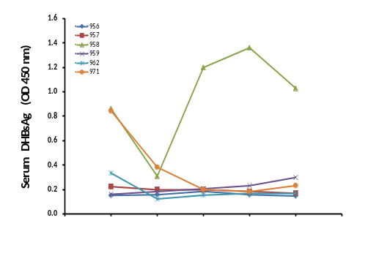
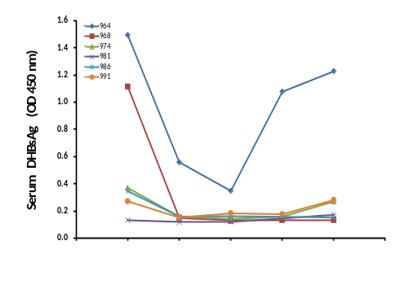
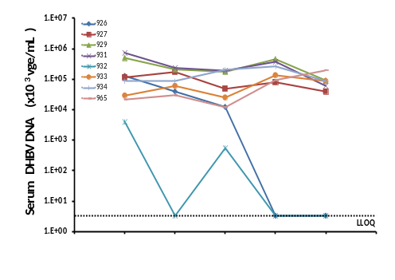
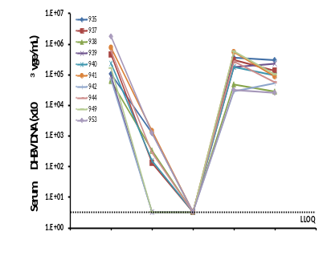
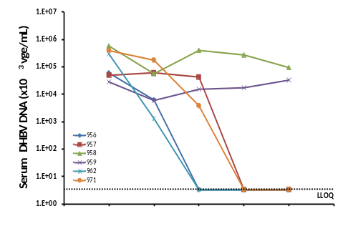
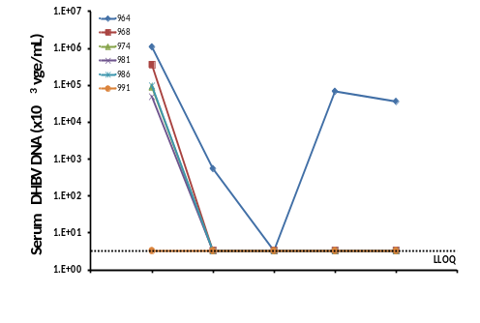
Synergy of NUCs and NAPs in vivo
DHBV infected Pekin Ducks
Normal saline
(control)
TDF
REP 2139
REP 2139 + TDF
DHBsAg
(SVP)
DHBV DNA
(virus)
Treatment
(4 weeks)
Follow-up
(8 weeks)
No functional control
Selective effect on SVPs
Functional control
Accelerated clearance of SVP and virus
Functional control
Treatment: REP 2139 = 10mg/kg REP 2139-Ca daily
TDF = tenofovir disoproxil fumarate 15mg daily
Follow-up = all treatment removed
Birkh et al., 2015 J. Hepatol. 62: S518

Slide 35
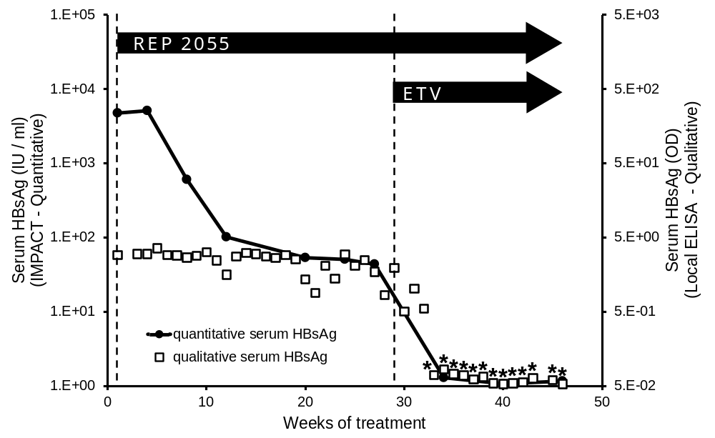
Clinical evidence of synergy with NAPs + NUCs
Single patient in the REP 101 protocol (REP 2055)
*HBsAg negative
Al-Mahtab et al., 2016 PLOS One 11: e0156667

Slide 36
Combination therapy will be essential to achieve high SVR rates
STEP 1:
Elimination of
serum HBsAg
(achieved by suppression of
SVP release by NAPs)
Infected
hepatocyte
NAPs
Nucleus
which allows…
STEP 2:
Restoration of immune
response with ANY
immunotherapy
Inactivation
and clearance
of cccDNA
HBeAg
Capsids
X
Virions
X
X
X
X
X
X
X
STEP 3:
Block replenishment
of cccDNA with DAAs
(ADV, ETV or TDF)
X
Rabe et al. 2003 PNAS 100: 9849-9854
Werle-Lapostolle et al. 2004 Gastroenterol. 126: 1750-1758
Wong et al. 2006 Antivir. Ther. 11: 909-916
Wong et al. 2013 Clin. Gasterenterol. Hepatol. 11: 1004-1010
Lai et al. 2016 J. Hepatol. (Epub Sept 14).

Slide 37
REP 401 Trial Overview
Caucasian patients treated in Chisinau, Moldova
CRO monitored trial compliant with EU GCP, 3 trial sites
Clinicaltrials.org # NCT02565719
Randomized, open label, active comparator controlled
40 patients enrolled with HBeAg- chronic HBV infection:
treatment naïve
HDV, HCV, HIV negative
serum HBsAg > 1000 IU / ml
HBV DNA > 7500 copies / ml
mild to moderate fibrosis, non cirrhotic.
Viremia monitored at University of Duisburg-Essen, Germany:
  Abbott PCR (HBV DNA)
  Abbott Architect Quantitative (q-HBsAg, q-anti-HBs, HBeAg, anti-HBe)
  Diasorin (anti-HDAg)

Slide 38
REP 401 Trial Design
Week 1
Week 25
Week 49
Week 73
Week 97
EXPERIMENTAL
(20 patients)
REP 2139-Mg / REP 2165-Mg (1:1)
Follow-up
Recruitment complete
19 patients are 12 weeks post-randomization (week 25)
TDF + peg-IFN
TDF + peg-IFN + NAP
Preliminary efficacy and safety data will be presented at AASLD 2016 (Boston)
Pegasys
TDF
40
Pegasys
Follow-up
TDF
TDF
ADAPTIVE
COMPARATOR
CONTROL
(20 patients)
Patients with
< 3 log HBsAg
response at
49 weeks
REP 2139-Mg / REP 2165-Mg (1:1)
Pegasys
Follow-up
TDF
Follow up 4, 12, 24 and 48 weeks after all treatment stopped
Dosing:
TDF 300mg PO qD
Pegasys 180ug SC qW
NAPs 250mg IV qW (given before Pegasys)
Primary efficacy endpoints:
Serum HBsAg reduction
Appearance of anti-HBs
Functional control maintained 48 weeks after treatment withdrawal
(HBsAg < 1 IU/ml, HBV DNA < 1000 copies / ml)

Slide 39
REP 2139 vs REP 2165
REP 2139
REP 2165
REP 2139 and REP 2165 have identical functional properties
Three 2’OMe riboadenosines modified to 2’OH (regular RNA)
Accelerated formation of 10 mer degradation products
Reduced tissue accumulation with chronic treatment
  (verified in ducks, mice and monkeys)
Improved tolerability with chronic exposure

Slide 40
Summary
NAPs have broad spectrum antiviral activity in most viruses infecting humans
Clinical application in several viruses
Alter viral glycoprotein function (influenza and ebola virus)
Alter host apolipoprotein function in viral replication (HCV, HBV and HDV)
Novel, potent additional mechanism remains to be elucidated in HDV (talk this afternoon)
Well tolerated with chronic exposure in patients
First antiviral agent able to clear serum HBsAg in HBV and HDV infection
Clearance of HBsAg allows immunotherapy to function effectively to restore host immune control of infection that persists after therapy is halted
NAP-based combination therapy will be effective in all patient populations with HBV or HBV / HDV infection and will change therapeutic modalities in treating these infections

Slide 41

Meet the eminent gathering once again at
Hepatitis 2017
London, UK
August 10 - 12, 2017
Hepatitis 2017 Website:
http://hepatitis.conferenceseries.com/

