Slide 1


Nucleic Acid Polymers:
Application in the treatment of HBV / HDV co-infection and potentiating the effects of immunotherapy
Andrew Vaillant, Ph.D.
Chief Scientific Officer, Replicor Inc.

Slide 2
Particle production in HBV infection
Subviral particles
(bulk of serum HBsAg)
HBsAg is the key:
Sequesters anti-HBs
Suppresses innate immunity
Suppresses T-cell proliferation
Suppresses cytokine signaling
Suppresses immunotherapy
Infected
hepatocyte
Nucleus
cccDNA
HBsAg removal
will be essential
to achieve high rates
of functional cure
HBeAg
Capsids
Virions
Replenishment
of cccDNA
Cheng et al., 2005. Journal of Hepatology, 43:4 65-471
Op den Brouw et al., 2009. Immunology, 126: 280-289
Shi et al. 2012 PLoS ONE 7: e44900
Vanlandschoot et al., 2002. J. Gen. Virol., 83: 1281-1289
Woltman et al. 2011 PLoS ONE 6: e15324
Wu et al., 2009. Hepatology, 49: 1132-11
Xu et al., 2009. Molecular immunology, 46: 2640-2646
Al-Mahtab et al., 2016 PLOS One 11: e0156667
Infection

Slide 3
NAPs block the release of subviral particles
HBsAg mediated immunosuppression removed
Permissive immunological environment restored
Improved effect of immunotherapy
(and potentially other antiviral agents)
Infected
hepatocyte
NAPs
Nucleus
cccDNA
HBeAg
Capsids
Virions
Replenishment
of cccDNA
  Virions are not directly targeted by NAPs
Infection
Vaillant, 2016 Antiviral Res: 133: 32-40

Slide 4
Combination therapy will be essential to achieve high SVR rates
STEP 1:
Elimination of
serum HBsAg
(achieved by suppression of
SVP release by NAPs)
Infected
hepatocyte
NAPs
Nucleus
which allows…
STEP 2:
Restoration of immune
response with ANY
immunotherapy
Inactivation
and clearance
of cccDNA
HBeAg
Capsids
Virions
Rabe et al. 2003 PNAS 100: 9849-9854
Werle-Lapostolle et al. 2004 Gastroenterol. 126: 1750-1758
Wong et al. 2006 Antivir. Ther. 11: 909-916
Wong et al. 2013 Clin. Gasterenterol. Hepatol. 11: 1004-1010
Lai et al. 2016 J. Hepatol. (Epub Sept 14).

Slide 5
HBV vs HBV / HDV co-infection
Subviral particles
(bulk of serum HBsAg)
HDV virus (SVP-like)
Infected
hepatocyte
Nucleus
cccDNA
HDV
RNA
15-20 million patients are affected
Most aggressive form of viral hepatitis
No approved therapy
HDV
RNP
Bonino et al., 1986 J. Virol. 58: 945-950

Slide 6
REP 301 Trial Overview
12 Caucasian patients with confirmed chronic HBV / HDV co-infection
Clinicaltrials.org # NCT02233075
1 trial site (Moldova), GCP-compliant, CRO monitored
previously presented at EASL 2016
REP 2139-Ca
500mg qW IV 15 weeks
REP 2139-Ca
250mg qW IV 15 weeks
Follow up
(4, 12 and 24 weeks)
Pegylated interferon α-2a
180 μg qW SC 48 weeks
Primary efficacy endpoints (viremia monitored offsite in Essen, Germany):
Serum HBsAg reduction
Anti-HBs production
HDV RNA reduction
Functional control maintained 24 weeks after treatment withdrawal
to be presented at AASLD 2016 (Boston)

Slide 7
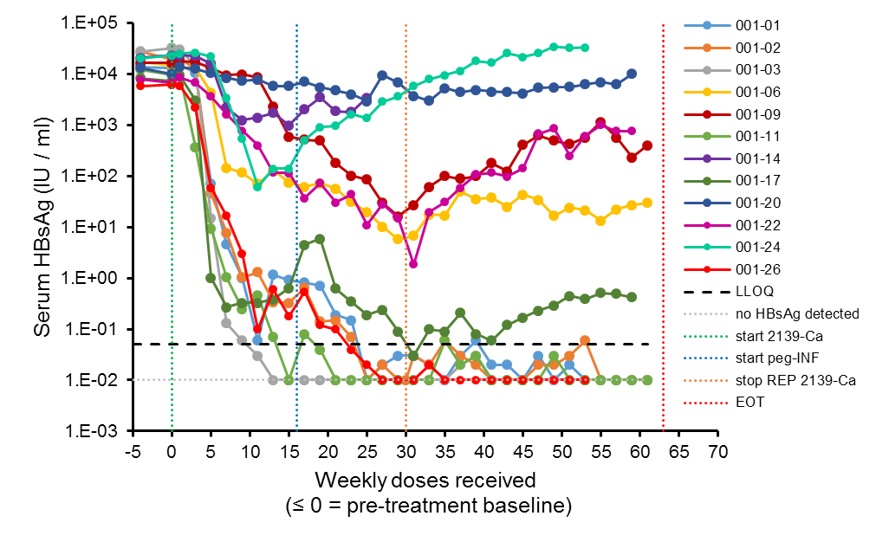
Interim REP 301 Efficacy Data
(serum HBsAg)
Reported
HBsAg level
(IU / ml)
REP 2139-Ca
Peg-IFN
0.01 (EOT)
0.01 (EOT)
TND (EOT)
0.01 (EOT)
0.42 (TW60)
Partial response
TND (TW54)
Full response
75% of patients achieved a multilog reduction in serum HBsAg
LLOQ = lower limit of quantification EOT = end of treatment

Slide 8
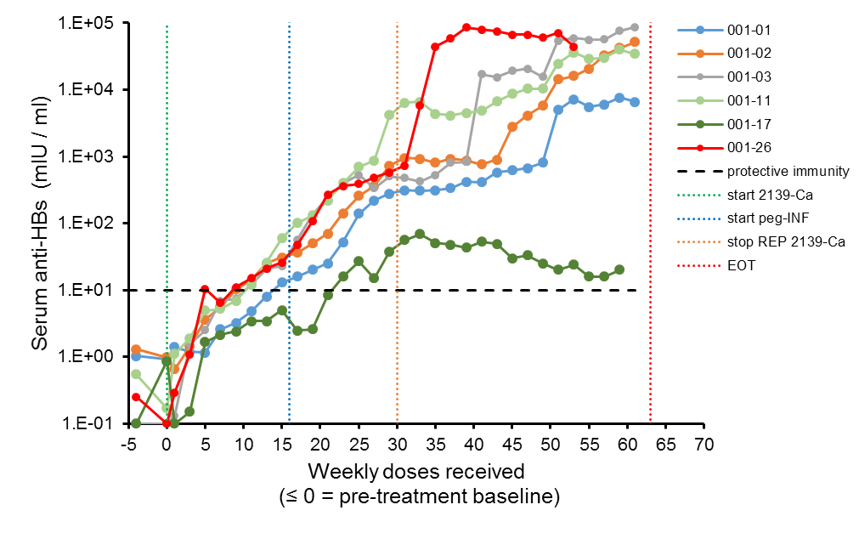
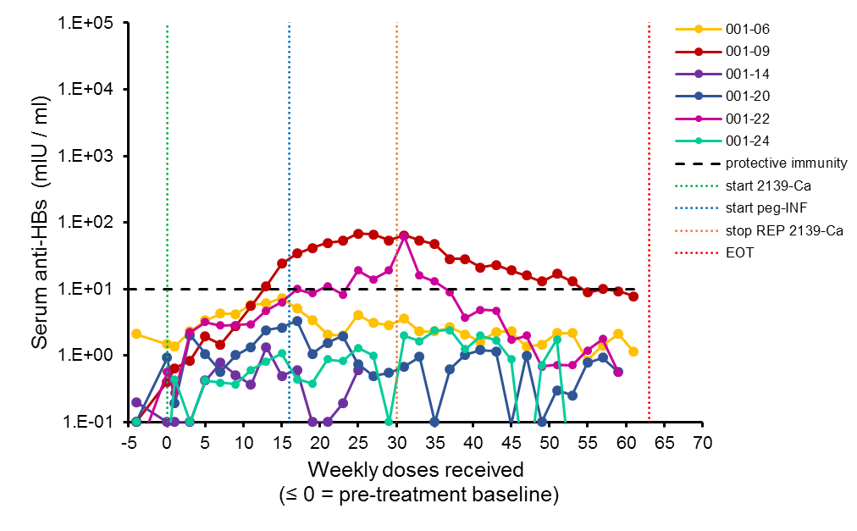
Anti-HBs response versus HBsAg response
HBsAg full response
(HBsAg < 1 IU / ml)
HBsAg partial response
(HBsAg > 1 IU / ml)
2139-Ca
Peg-IFN
2139-Ca
Peg-IFN
Increased anti-HBs titers are correlated with serum HBsAg < 1 IU / ml
at the start of peg-INF therapy
Indirect evidence of improved immune function
EOT = end of treatment

Slide 9
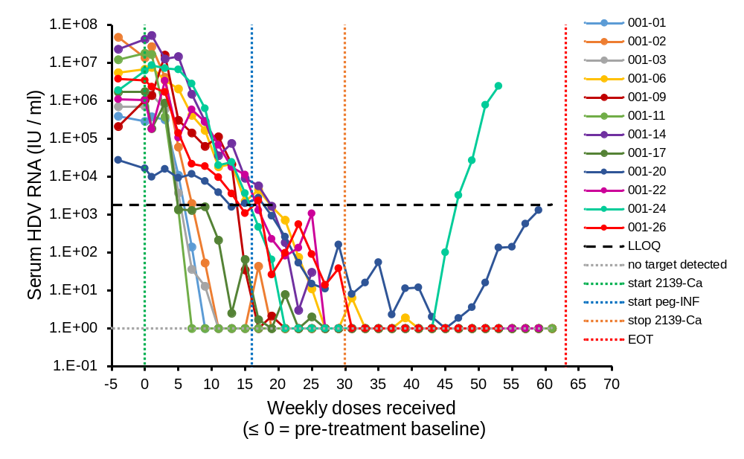
Interim REP 301 Efficacy Data
(serum HDV RNA)
REP 2139-Ca
HDV RNA currently
undetectable
Peg-IFN
EOT
poor or no
HBsAg response
EOT
EOT
EOT
EOT
EOT
TW60
TW60
TW54
HDV RNA response in all patients (undetectable in 9/12)
A distinct antiviral activity of NAPs against HDV is present
LLOQ = lower limit of quantification EOT = end of treatment

Slide 10
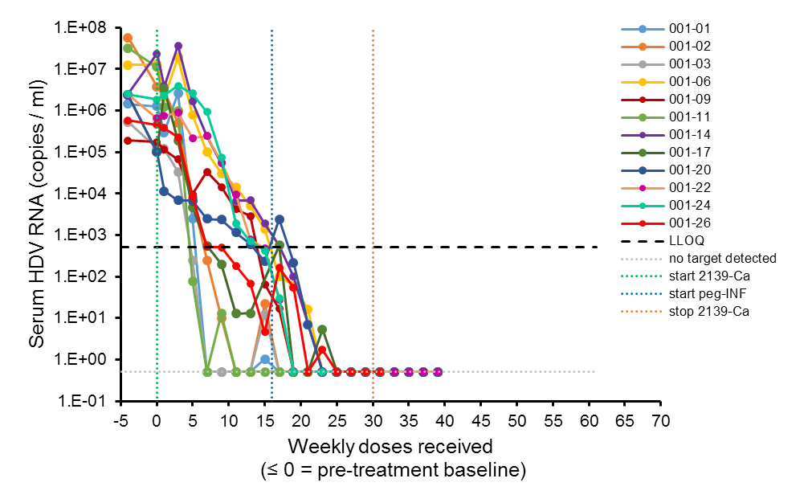
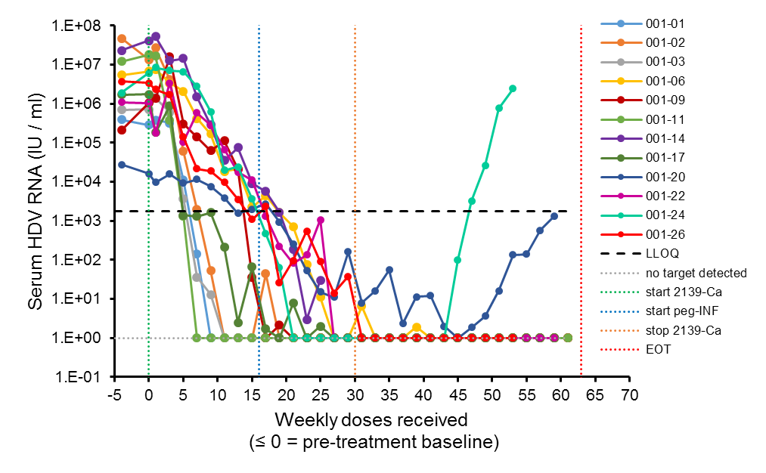
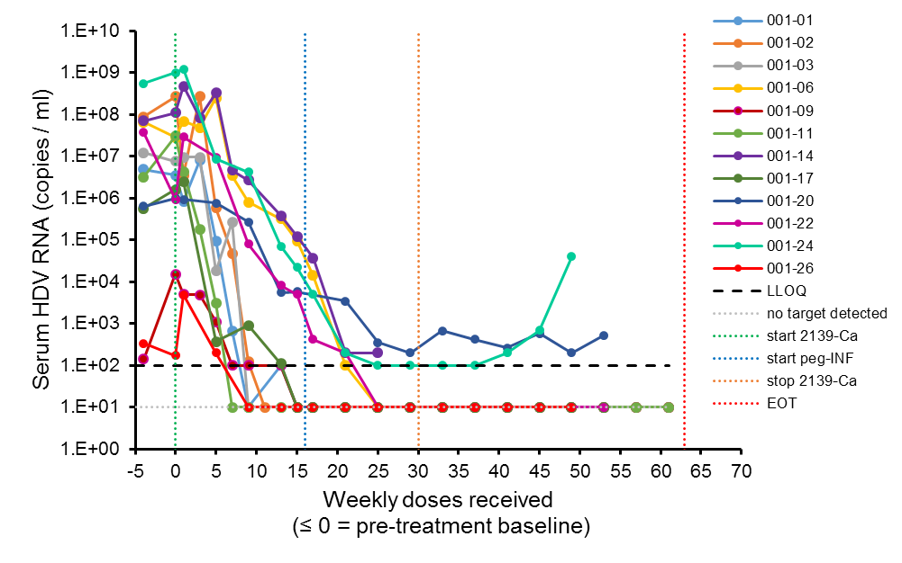
Validation of HDV RNA response
Technical University of Munich
updated
data
pending
University of Duisburg - Essen
National Genetics Institute
HDV RNA clearance validated
in three independent labs

Slide 11
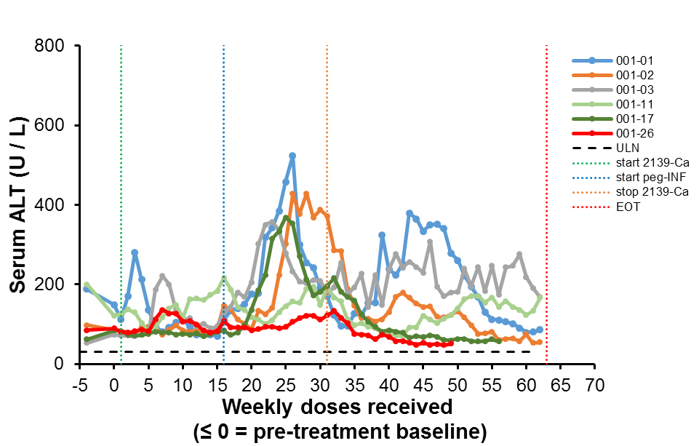
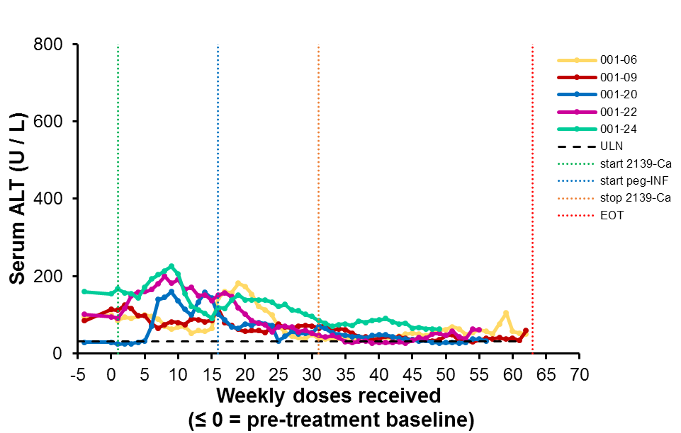
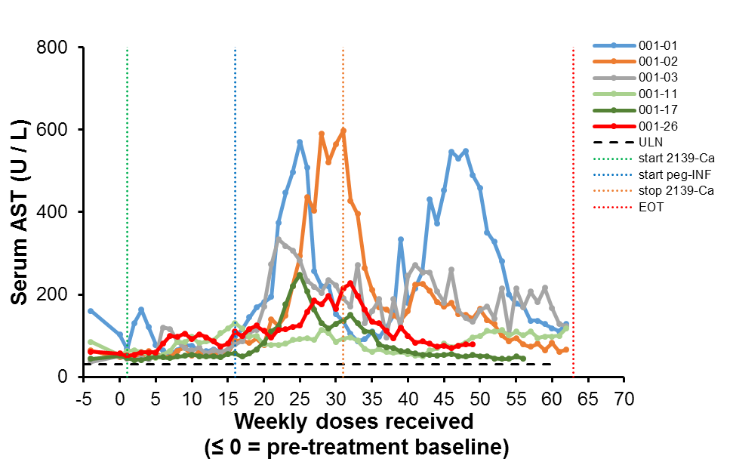
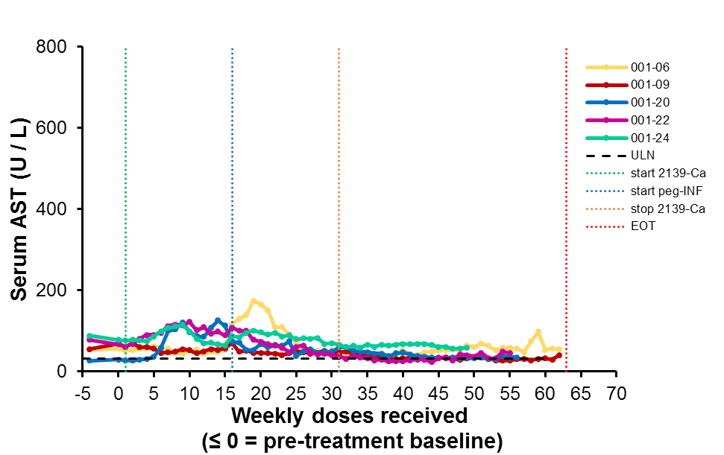
Serum ALT / AST response versus
HBsAg response
HBsAg full response (HBsAg < 1 IU / ml)
HBsAg partial response (HBsAg > 1 IU / ml)
REP 2139-Ca
Peg-IFN
REP 2139-Ca
Peg-IFN
Liver flares restricted to patients with serum HBsAg < 1 IU / ml
(self resolving with continued therapy)
EOT = end of treatment

Slide 12
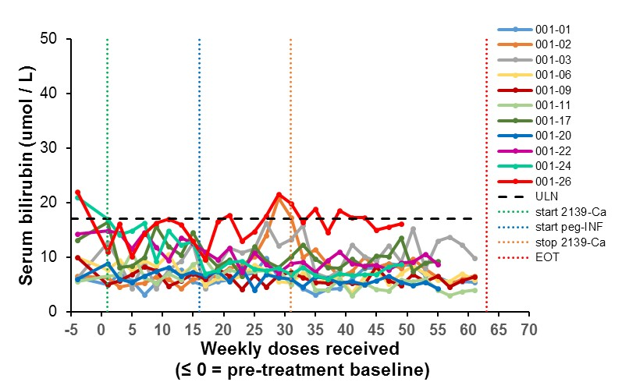
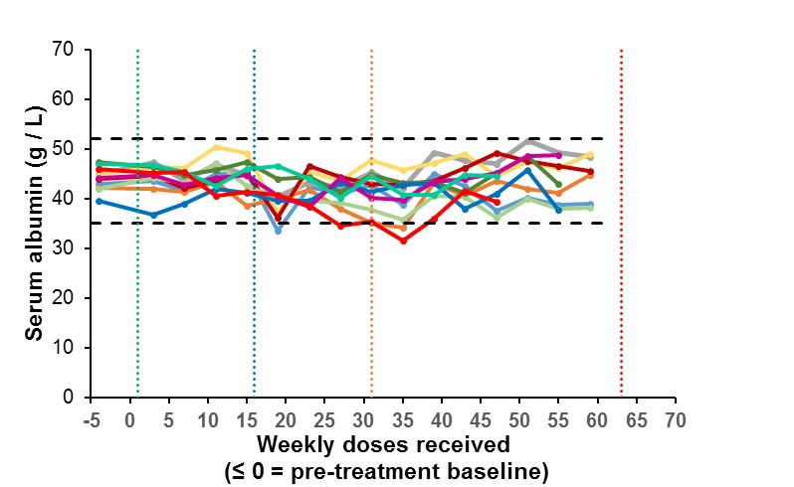
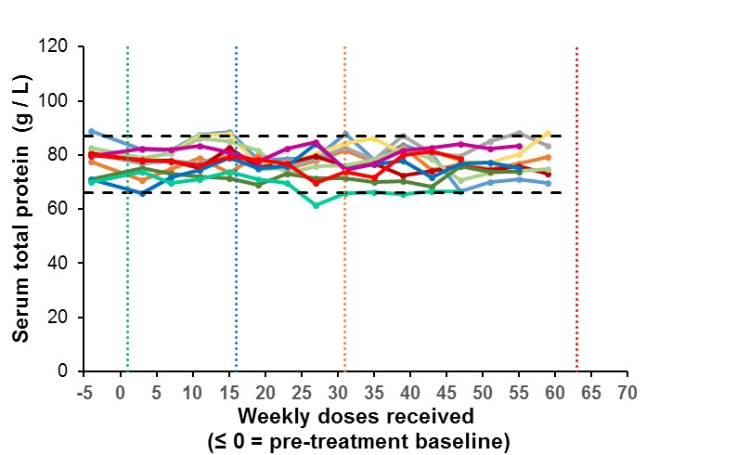
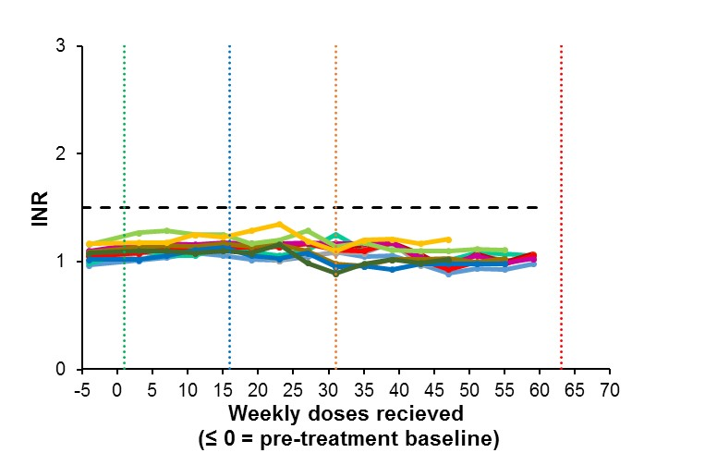
REP 301 liver function
Liver function is normal

Slide 13
Updated REP 2139-Ca safety profile in the REP 301 protocol
REP 2139 mono-therapy exposure:
  Infusion AEs (grade 1-2 fever, redness itchiness, asthenia or headache):
    Attributed to the presence of phthalate plasticisers in IV tubing
    Self-resolve after infusion
    Acclimation with continued therapy
  Mild, asymptomatic reductions in hemoglobin (2/12 patients), platelets and white blood cell counts develop during the last half of monotherapy exposure.
    With the addition of peg-INF to REP 2139 therapy:
      Reductions in hemoglobin, platelet and white blood cell counts are stable but maintenance has required reduced peg-INF α2a dosing / supportive therapy in 5 patients.
      ALT / AST flares: limited to start of peg-IFN α2a exposure and appear self resolving
      No other signs of liver dysfunction (except bilirubin elevation in one patient after peg-IFN a2a exposure).

Slide 14
Summary
REP 2139-Ca is able to simultaneously reduce HBsAg and HDV RNA in patients with chronic HBV / HDV co-infection.
Increased anti-HBs production and liver flares correlated with the start of peg-INF exposure appears to be related to the extent of clearance of serum HBsAg.
HBsAg clearance threshold for activation of immunotherapy appears to be > 1 IU / ml.
Longer combination treatment with immunotherapy will likely result in a higher proportion of patients with a full HBsAg response (< 1 IU / ml).
NAP-based antiviral therapy will become an important new treatment option for patients with HBV / HDV co-infection.

