Slide 1
Particulate Embolisation Agents: Impact of Biomaterial Physicochemical Properties on Clinical Performance
Professor Andrew Lewis
Professor of Biomaterials & Drug Delivery
Director of Research & Development, Innovation
Biocompatibles UK Ltd, a BTG International group company

Slide 2
Forward-looking statements
This presentation and information communicated verbally to you may contain certain projections and other forward-looking statements with respect to the financial condition, results of operations, businesses and prospects of BTG plc (“BTG”). These statements are based on current expectations and involve risk and uncertainty because they relate to events and depend upon circumstances that may or may not occur in the future. There are a number of factors which could cause actual results or developments to differ materially from those expressed or implied by these forward-looking statements. Any of the assumptions underlying these forward-looking statements could prove inaccurate or incorrect and therefore any results contemplated in the forward-looking statements may not actually be achieved. Nothing contained in this presentation or communicated verbally should be construed as a profit forecast or profit estimate. Investors or other recipients are cautioned not to place undue reliance on any forward-looking statements contained herein. BTG undertakes no obligation to update or revise (publicly or otherwise) any forward-looking statement, whether as a result of new information, future events or other circumstances. Neither this presentation nor any verbal communication shall constitute an invitation or inducement to any person to subscribe for or otherwise acquire securities in BTG.

Slide 3

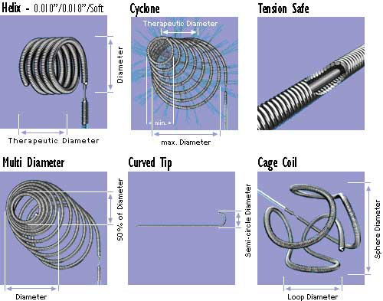

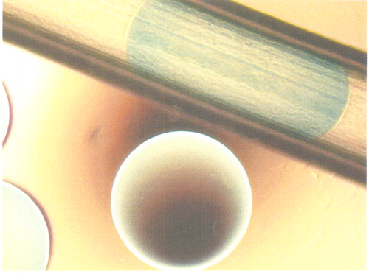
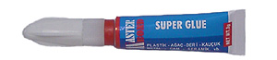
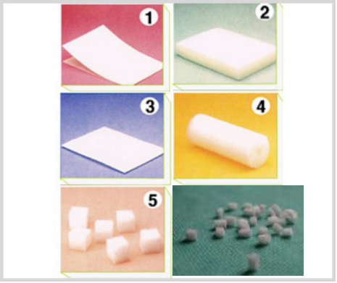
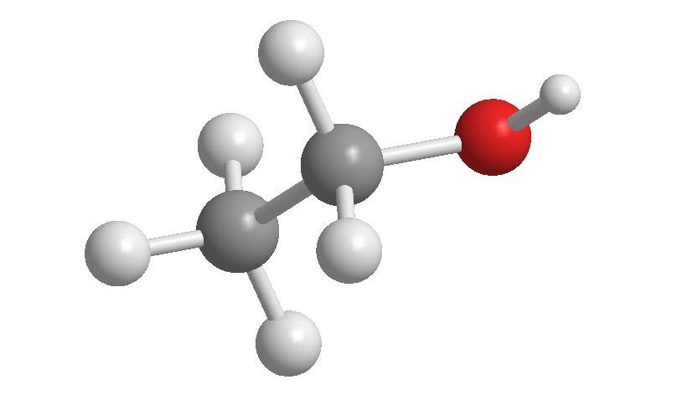
Embolic Devices:
Engineered to Block Blood Vessels
TransArterial Embolisation
3

Slide 4
Impact of Size and Shape

Slide 5
Factors Influencing the Location of Embolisation
Primarily determined by physicians choice of:
  Particle calibration size (microspheres and particles)
  Particle morphology (smooth microspheres versus irregular particulates)
But also influenced by additional factors:
  Particle size distributions
  Particle material and structure (stiffness and elasticity)
  Particle aggregation tendency
  Catheter selectivity, rate of delivery, dilution of particle suspension
Particle shape
Particle size
Notes:
The factors effecting the site occlusion for embolic agents are described, with primary reference to size and shape, but then introducing additional factors that may not be initially considered.

Slide 6

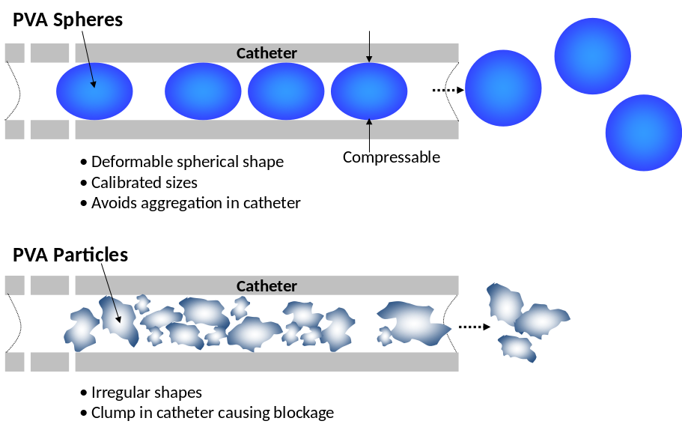
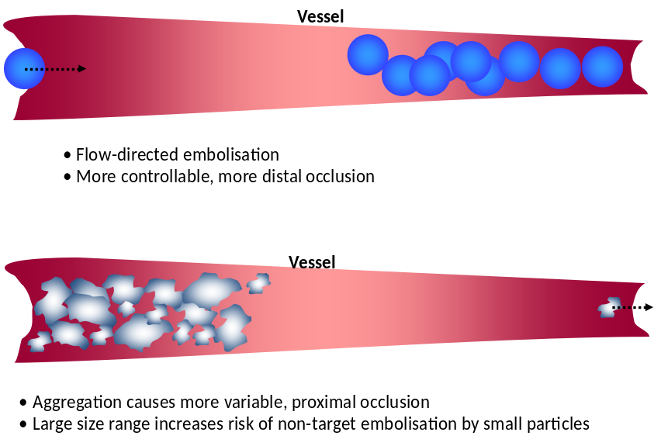
Particle Morphology
Irregular Particles
Compressible Microspheres
Particle Morphology
Notes:
Morphology is important as irregular particles tend to aggregate and form proximal occlusions, whereas compressible microspheres have been designed to avoid aggregation and be flow-directed in the blood stream to more distal locations.

Slide 7
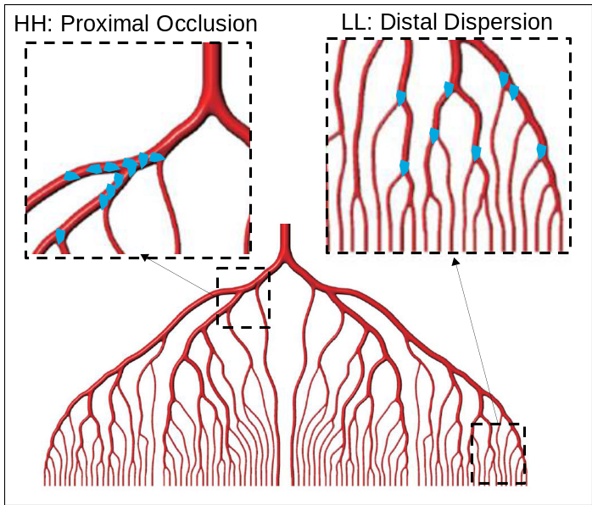
Controlling Particle Targeting
The level of embolization is influenced by delivery technique
Choe² investigated delivery technique in a rabbit kidney study (PVA particles) with high (H) and low (L) particle dilution and injection rate
Increased peripheral infarct and more distal PVA particles were found when injection rate and concentration were low
Group (Rate:Dilution) | Peripheral Infarct | PVA Particles in Small Arteries
HH (n=4) | 0 | 1
HL (n=3) | 1 | 2
LH (n=3) | 1 | 2
LL (n=4) | 3 | 4
Notes:
Although particles tend to form proximal occlusions, the technique adopted by the interventionalist is also important, including the degree of dilution of the product and the rate at which it is delivered. Of course, this has to be placed in the context of clinical practically, as high levels of dilution would require unacceptable volumes of contrast agent and slow rates of delivery make procedures too long.

Slide 8
Bead Characteristics Affecting Targeted Embolization
Precise targeted embolization also depends on:
Particle size distribution
Particle mechanical properties
Narrow
Broad
Particle aggregation
Extreme
Notes:
Other factors influencing the location of occlusion also include the distribution of particle size, their mechanical properties (material structure and composition) and the tendency to aggregate together.

Slide 9
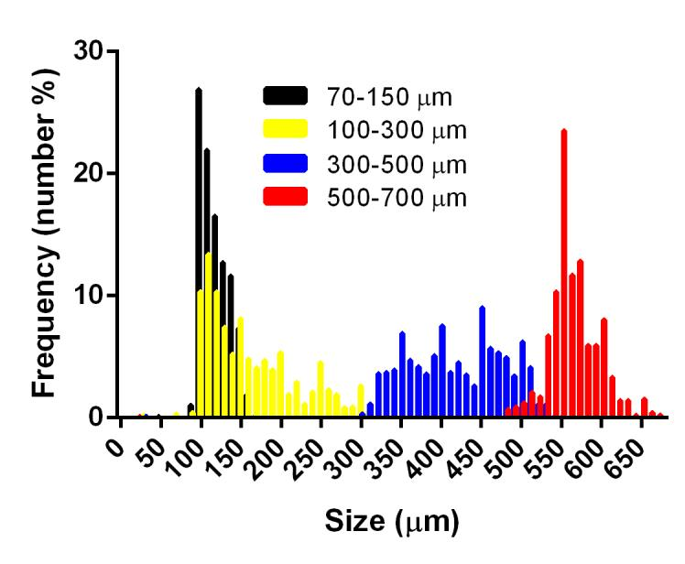
DC Bead™ Size Calibration
Bead size distribution falls within the labeled size range
Wide range of available sizes to match diversity in target vessel size³
Designed to deform as beads pass through catheter
Temporary compression of 20%–30%⁴
Designed to quickly recover shape after leaving catheter⁵
1000 measurements over 5 lots
[3] Biocompatibles data on file.
[4] Lewis AL, et al. JVIR 2006;17:1335-1343
[5] Hidaka et al., J Mech Behav Biomed Mater 2011;4(8):2161-7
Bead Size & Distribution
Notes:
LC Bead is available in 4 different size ranges to allow the embolic to be approximately matched to the size vessel to be occluded. The particle size distribution may be skewed as the entire size range is manufactured in one go (normally distributed) and then this is sieved into sub-fractions to create the different size ranges.

Slide 10
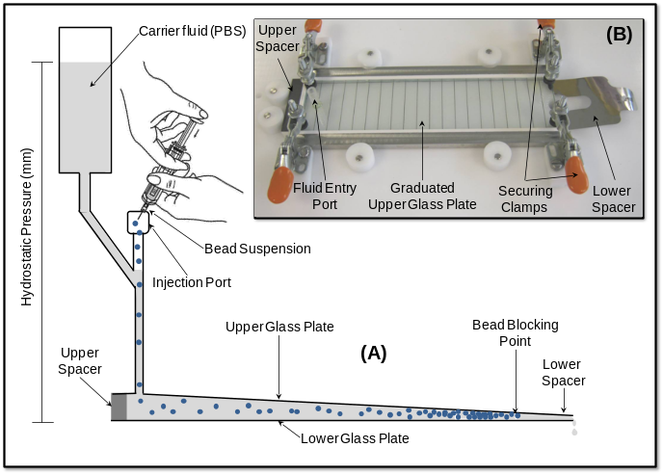
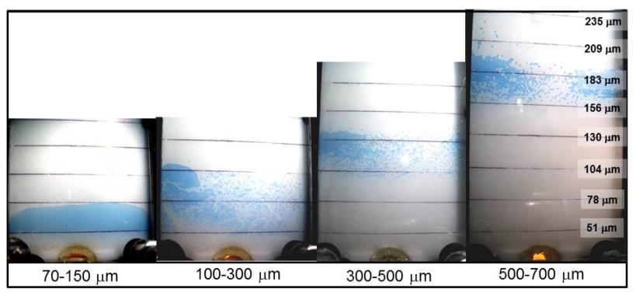
  Controlled and Targeted Occlusion in vitro using APVA: The Plate Model
[6] Lewis AL et al, JMSM, 2015,;27(1); 1-12.
The zones where beads gather will be a function of their size and compressibility
COMPRESSION
Uniaxial:
Plate
Model
Radial:
Vessel
Bead Mechanical Properties
Notes:
We have developed the Plate Model to enable visualisation of the occlusion process in a two-dimensional space. This shows that LC Bead occludes according to its size range, creating a occlusion band indicative of the size distribution across the various ranges. Note that M1 and 100-300 um reach the same distal penetration potential but that the occlusion band is much tighter and densely-packed for the narrower distribution of the M1 product, with more beads present at the distal location.

Slide 11
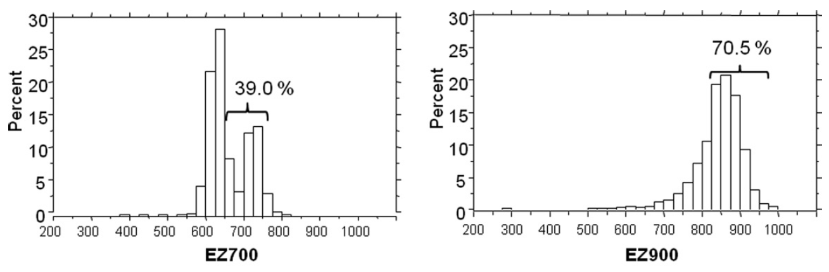
Other Product Size Calibration Features
Some products claim “the tightest size distribution of any particle embolic product on the market” ⁷
Independent publications have shown a large fraction of these microspheres fall outside of the manufacturer’s specifications⁸
  Only 39.0% of EmbozeneTM 700 and 70.5% of EmbozeneTM 900 meet the manufacturer’s specifications
39.0%
within
label
70.5%
within
label
[7] http;//celonova.com
[8] Verret et al., J Vasc Interv Radiol. 2011; 22(2): 220-8
Bead Size & Distribution
Notes:
An independent study showed the size ranges measured for some products are not in line with their label specification and now as narrowly distributed as claimed.

Slide 12
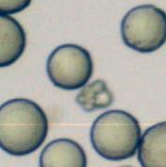
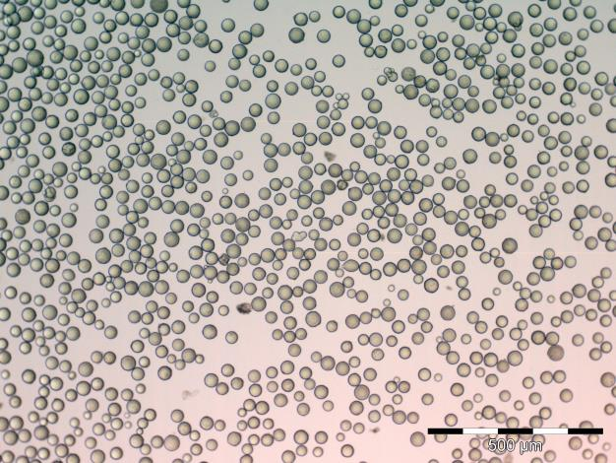
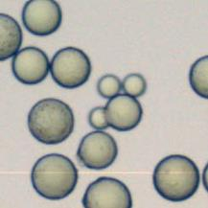
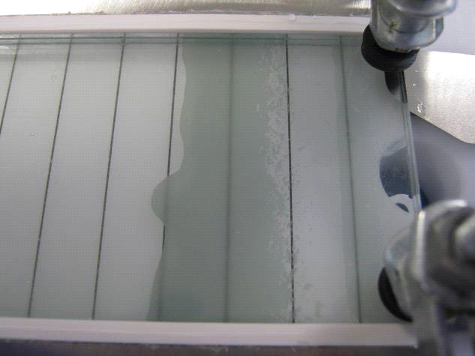
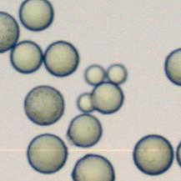
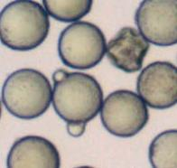
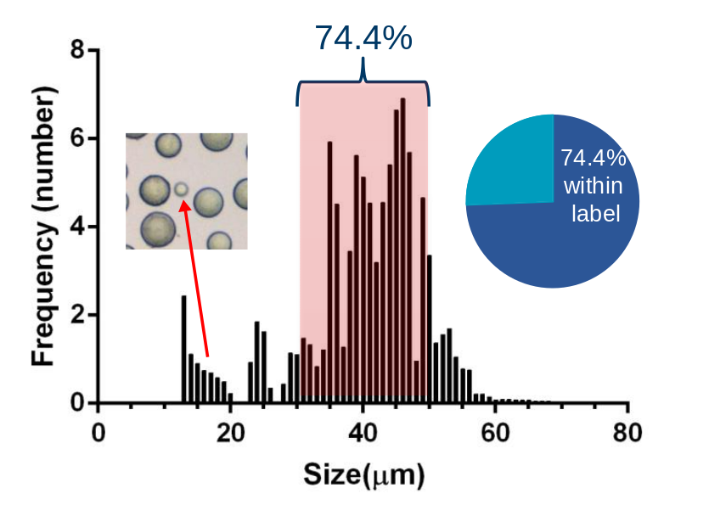
The Plate Model: A Useful Tool for Observing Bead Sub-populations
This 40µm product has many beads that do not meet the label specification including very small and irregularly shaped beads and signs of aggregation
4
0
μ
μ
m claimed range
≤10
m sub
-
Biocompatibles data on file.
population
Bead Size Distribution
Notes:
The plate model is also a very visual tool for observing sub-populations of beads within a size range.

Slide 13
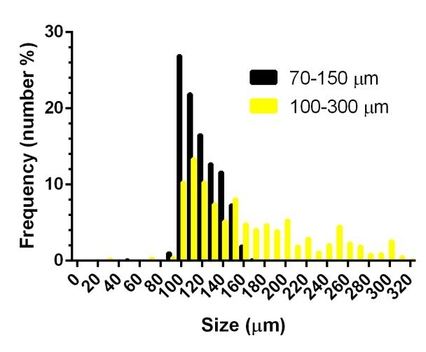
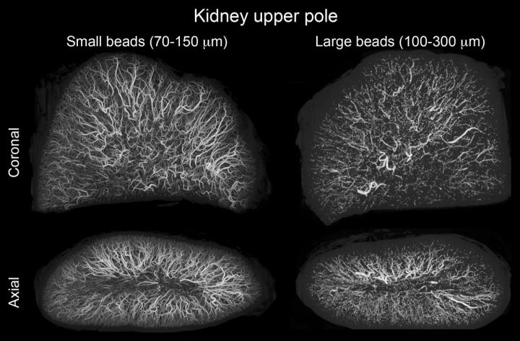
Effects of Distribution Width: Small Beads
[9] Lewis AL et al, JMSM, 2015,;27(1): 1-12.
[10] Dreher et al, J Vasc Interven Radiol, 2012; 23(2):257-64.
[11] Brown KT, J Vasc Interven Radiol, 2004; 15(8): 887-8.
DC BeadM1TM (70-150µm) is within the size range of DC BeadTM (100-300µm) minus the larger bead population⁹
At this lower end of the size range, the narrow distribution of DC BeadM1TM provides a more distal embolization¹⁰ whilst ensuring the distribution remains within a safe lower size limit¹¹
1000 measurements over 5 lots
Bead Size & Distribution
Notes:
Size distribution width becomes more important at the small end of the size range. LC Bead M1 has been created as a sub-fraction of the existing 100-300um product range and therefore remains within the safe lower size limits. It provides for a more distal embolisation as demonstrated in a recent publication in which radiopaque M1 bead were compared to 100-300um size radiopaque beads in kidney and liver and clearly showed M1 penetration out towards the capsule of the organs.

Slide 14
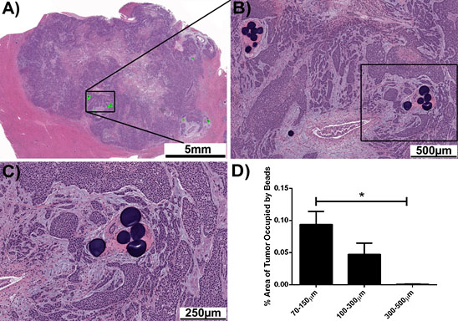
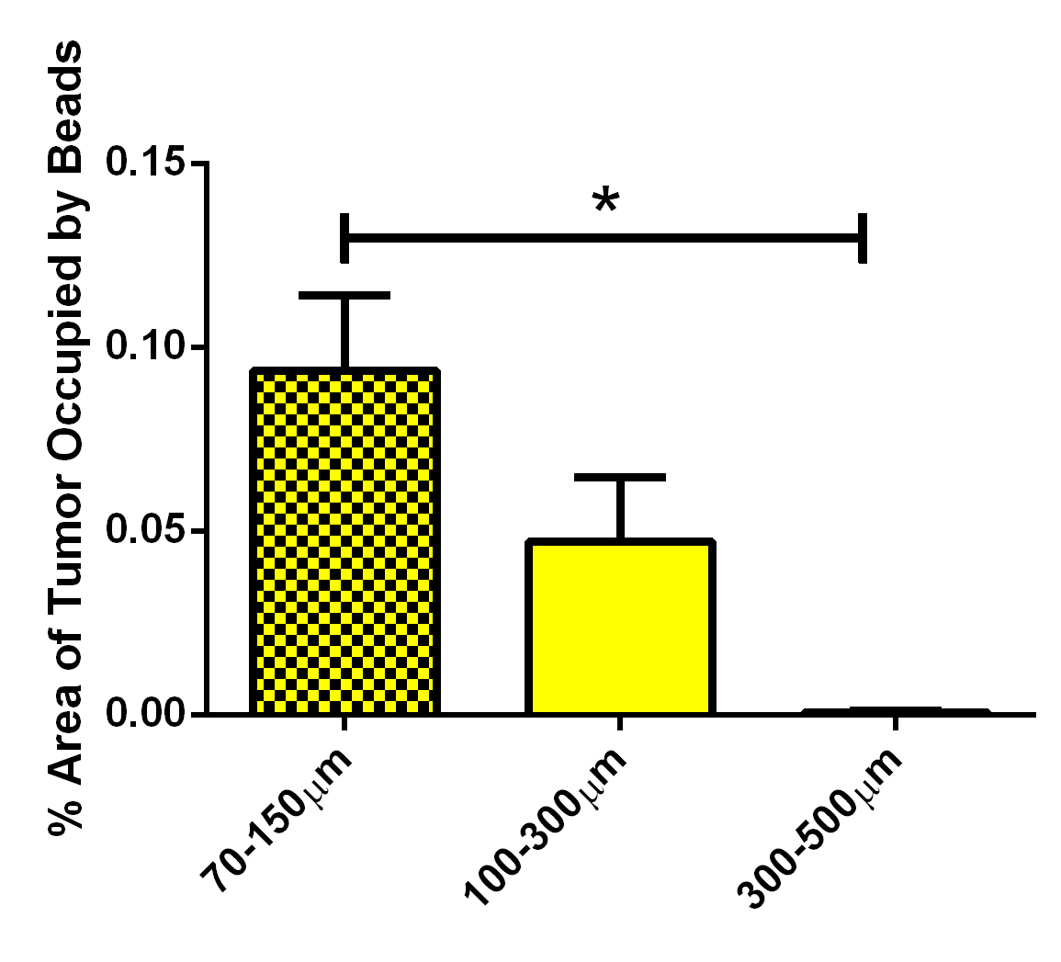
Enhanced Tumour Targeting with
DC BeadM1™
[12] Levy et al J Vasc Interven Radiol, 2015; 26(10), 1567-73.
VX2 Tumour model study
Administration of:
  DC Bead™ 300-500μm
  DC Bead™ 100-300μm
  DC Bead™ 70-150μm
Histopathology shows increased area of the tumour occupied by DC BeadM1™ in this rabbit model
70-150
μm
100-300
μm
300-500
μm
(A, B + C) Histology of tumour showing DC BeadM1™ in vessels
(D) % Area occupied by different size products
Bead Size & Distribution
Notes:
Comparison of different sizes of LC Bead in a rabbit VX2 tumour model shows that the area occupied by the beads within the tumour increases with decrease in product size range, demonstrating the ability of M1 to penetrate more deeply within the small vessels of this animal tumour model.

Slide 15
Impact of Physicomechanical Properties

Slide 16
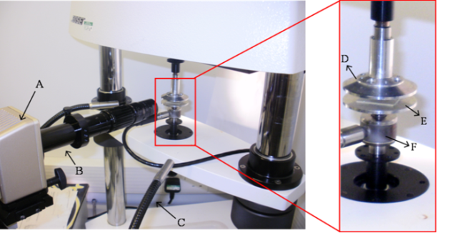
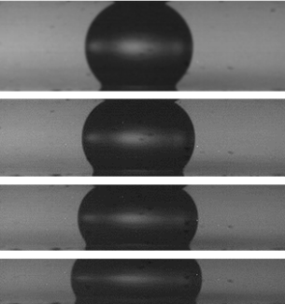
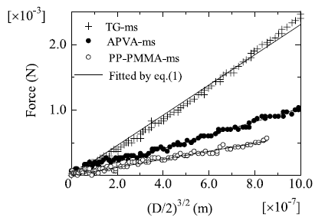
Stiffness and Elasticity
The stiffness, or compressibility is a measure of the ability of the beads to deform under an applied force
Elasticity describes the ability of a bead to regain its original shape
These physicomechanical properties are related to the composition and structure of the beads¹³
Stiffness and elasticity determine the level of occlusion and the reproducibility of targeted embolization → reliability and predictability
[13] Hidaka et al., J Mech Behav Biomed Mater. 2011;4(8):2161-7.
Bead Mechanical Properties
Notes:
The ability of the embolic particle to be deformed is useful for microcatheter delivery but also can determine the level of occlusion that the will be achieved.

Slide 17
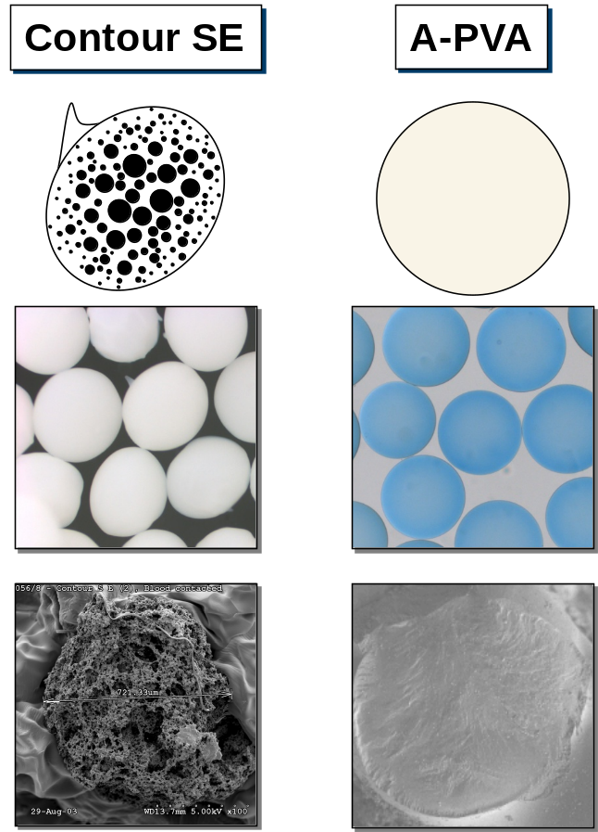
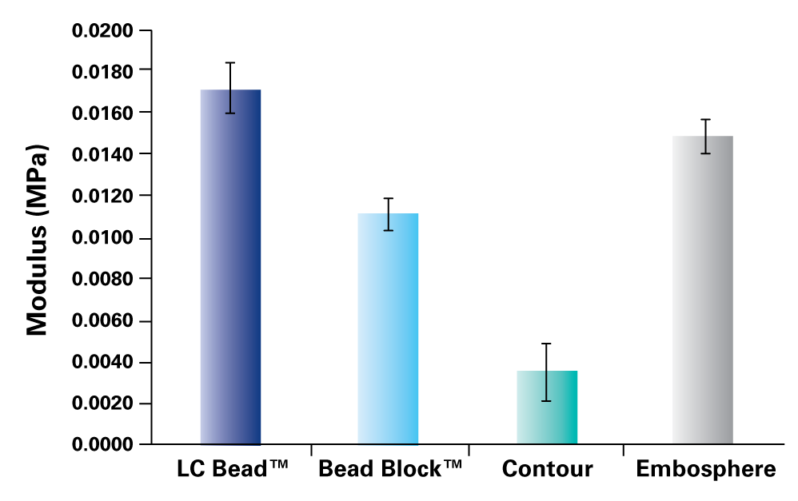
Bead Stiffness and Structure
[14] Forster et al., J Mater Sci Mater Med. 2010;21(7):2243-51.
[15] Lewis, J Mater Sci Mater Med. 2006;17(12):1193-204.
DC Bead™ / Bead Block™ (APVA) – microporous hydrogel resists compression
Contour SE – macroporous structure, easily compressed^{14,15}
Sponge-like structure
easily deformed
DC Bead™
TM
(APVA)
SE
™
Bead Mechanical Properties
Notes:
The mechanical properties of the bead are related to its composition and structure. Microporous hydrogels such as LC Bead, Bead Block and Embosphere have a continuous phase water-swollen internal structure that can resist compression. Contour SE on the other hand, has a macroporous sponge-like internal structure that provides little resistance to compression and does not recover its shape once deformed.

Slide 18
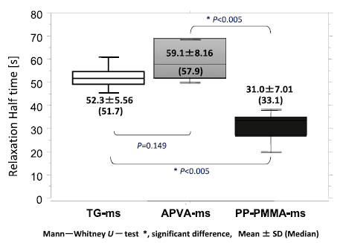
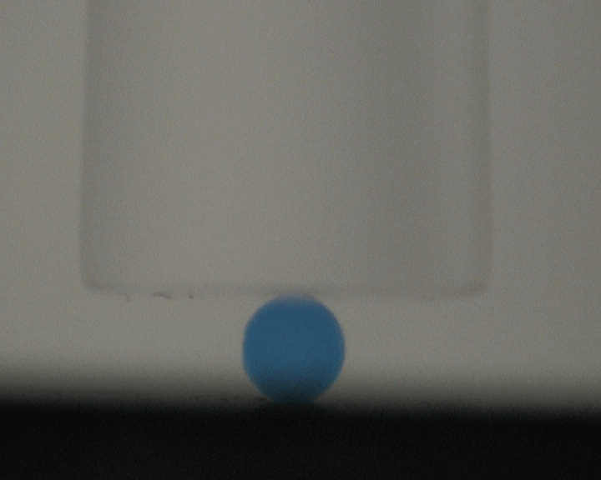
Elasticity is a Measure of Recovery after Deformation
Although some microspheres claim to be designed to regain their original shape and volume they are less elastic than APVA
APVA is the most elastic- instantaneous recovery from deformation
[13] Hidaka et al., J Mech Behav Biomed Mater. 2011;4(8):2161-7
Bead Mechanical Properties
Notes:
The chemistry and structure of LC Bead makes it more elastic than other materials enabling an instantaneous elastic recovery from deformation of the bead.

Slide 19
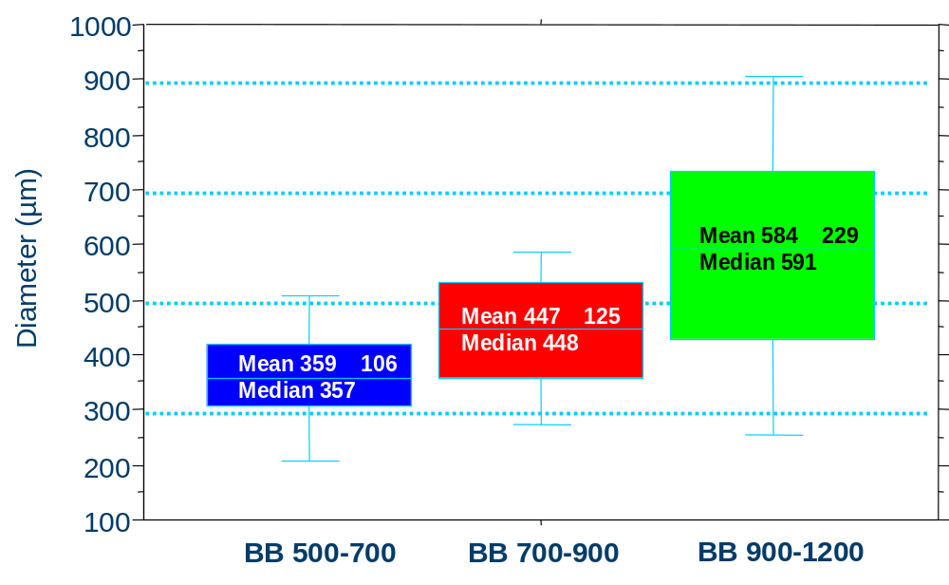
  Controlled and Targeted Embolization in vivo using APVA
Bead diameter controls the size of the embolised blood vessel
Bead properties result in targeted and predictable embolization
Flow
P < 0.0001
Flow
Flow
APVA
APVA
APVA
Biocompatibles data on file.
Bead Mechanical Properties
Notes:
The properties of the material from which LC Bead is composed ensure that the bead size directly translates into embolised vessel size, allowing for a targeted and predictable occlusion.

Slide 20
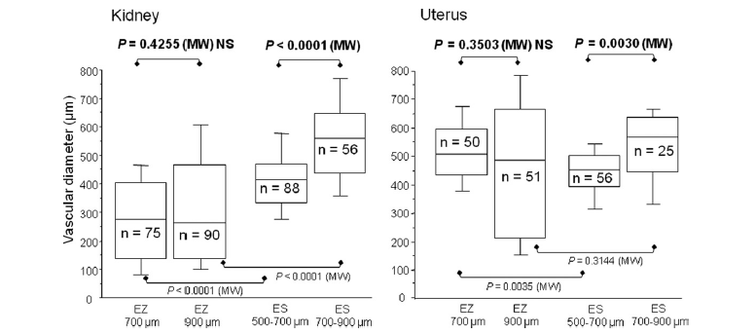
Differing Mechanical Properties Lead to Unpredictable Targeting
[7] Verret et al., J Vasc Interv Radiol. 2011;22(2):220-8
Study published in JVIR⁷ shows EmbozeneTM size does not influence embolized vessel size whereas EmbosphereTM does (soft versus stiffer)
Also demonstrates again that a narrow size distribution offers no targeting advantage as it is dominated by mechanical property effects
“The deformation of Embozene™ appears to determine the size of the vessels occluded as opposed to the granulometric particle size, which makes level of occlusion unpredictable”⁷
700
900
Bead Mechanical Properties
Notes:
A recent study compared embolic microspheres of differing material compositions and found differences in how the products behaved with regards to predictable size of occlusion, and once again, no tissue targeting advantages from a narrower size range versus a broader distribution.

Slide 21
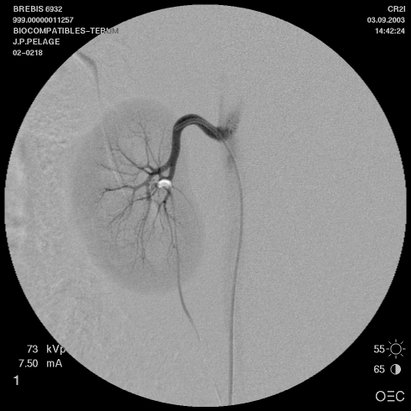
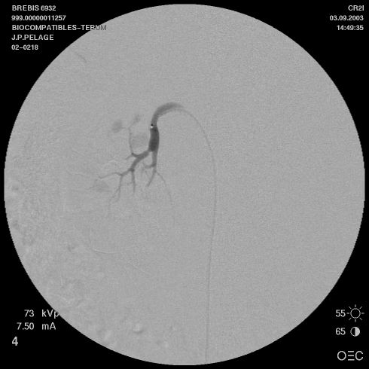
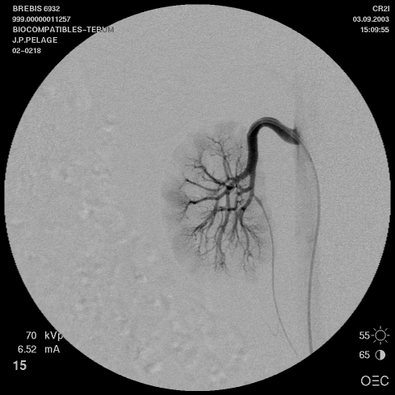
Redistribution Phenomena
Deformation of soft embolic particles can lead to redistribution of the product in the vessels over time – distal migration
Important to wait and check embolization end-point when using more deformable products to account for migration effects
Immediate
Post-embolization
20 mins
Post-embolization
Pre-embolization
(Images from sheep kidney embolisation model)
Bead Mechanical Properties
Notes:
It is important to note that deformable beads may also have an effect on embolisation end-point. Redistribution may occur after initial administration as the blood pressure forces the beads to migrate distally over time as they deform under within the vessel, altering the end-point and re-opening vessels that were originally occluded.

Slide 22
Impact of Drug Loading for Drug Eluting Beads

Slide 23
Effect of Drug Loading on DC Bead™ Size
Effect of [Dox]
Effect of [Iri]
>[Drug] < Avg Bead Size
Absolute size change is greater for larger bead sizes
Size decrease is between 20-30% depending on drug and dose
[16] Gonzalez et al, JMSM, 2007,;18, 1691-9.
[17] Taylor et al, Eur J Pharm, 2007; 30, 7-14.

Slide 24
Compressibility of DC Bead™ Post Drug Loading
Effect of [Dox] on EWC and modulus
Effect of [Iri] on modulus
900-1200 μm 700-900 μm
>[Drug] > Modulus > Force to compress (stiffness)
[16] Gonzalez et al, JMSM, 2007,;18, 1691-9.
[17] Taylor et al, Eur J Pharm, 2007; 30, 7-14.

Slide 25
Effect of Drug Loading on Penetration Potential
Penetration potential remains largely the same
The decrease in average diameter is off-set by the increase in stiffness
[9] Lewis AL et al, JMSM, 2015,;27(1), 1-12.

Slide 26
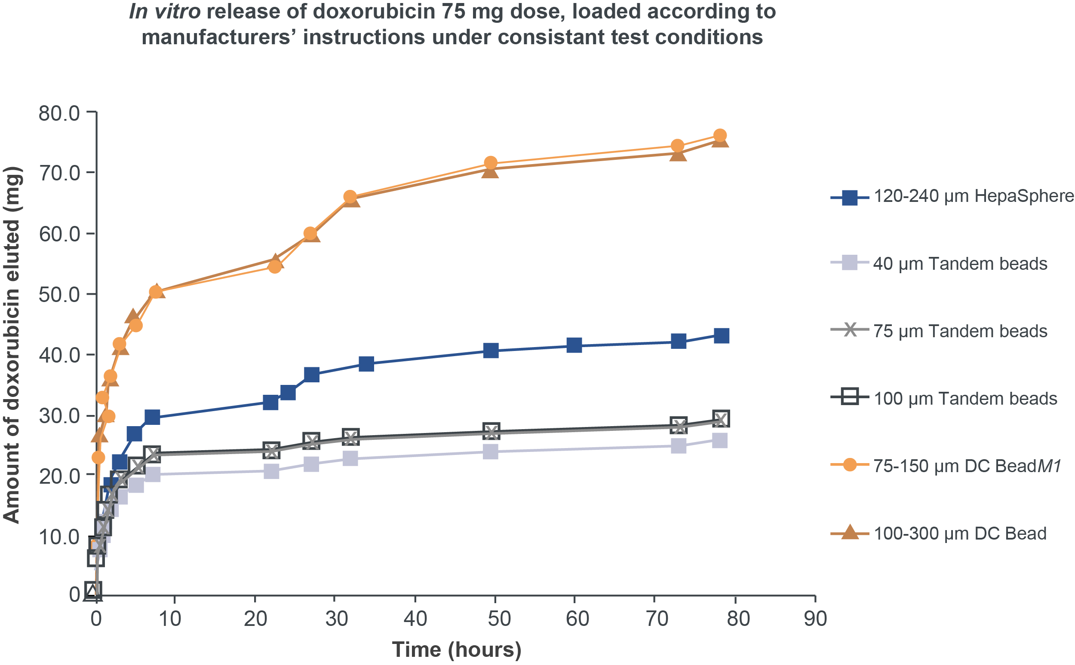
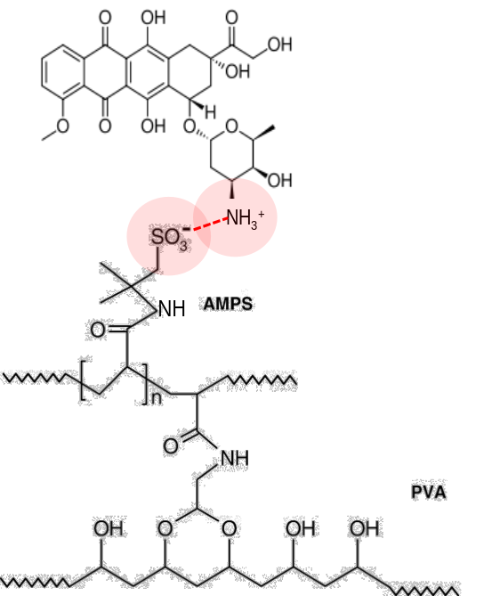
Effect of Composition: Drug-polymer Interaction Should Be Reversible
DC Bead™ delivers drug in controlled manner
  DC Bead™ loads drug through a unique sulfonate binding in contrast to the carboxylate binding with HepaSphere™ and Tandem™ beads, leading to significantly different elution profiles
Doxorubicin
DC Bead™

Slide 27
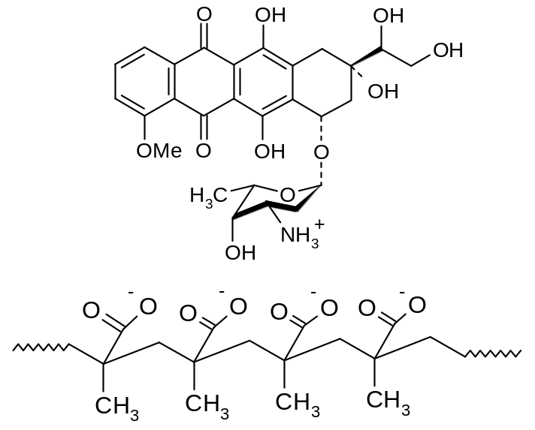
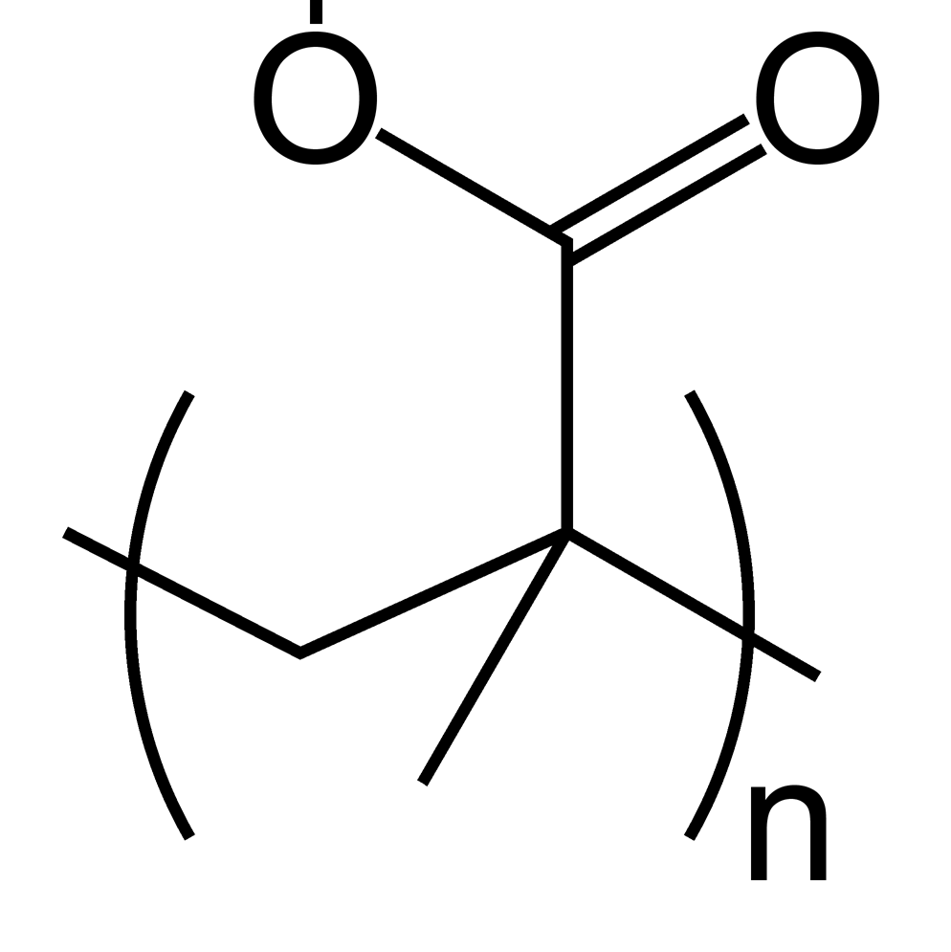
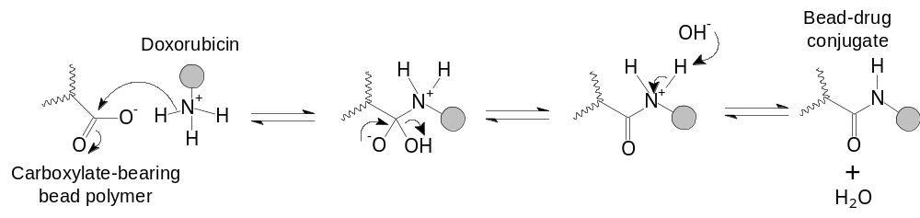

Effect of Composition: Incomplete Doxorubicin Elution with Carboxylate-based Binding Systems
Multiple carboxylic acid charged groups interact with doxorubicin by ionic interaction
Increased cross-link density is used to prevent microsphere shrinkage after drug loading
Very high drug/charge density means drug binds tightly
A high portion of drug seems to be irreversibly bound and is not released, even after forced extraction conditions
Cross-linked
PMAA Bead
(Hydrophilic)
K⁺ ⁻
PTFEP Coated
PMAA Bead
Drug Loaded
PMAA Bead
Poly(phosphazene)
Coating (PTFEP)
Notes:
Tandem® as with DC Bead® loads doxorubicin and irinotecan via an ionic mechanism. However, the link (circled) between the drug and microsphere is more complex and stronger, this is partially due to the increased cross-link density that is used to prevent the product shrinking once loaded. The product is also densely packed with charged groups. This allows a higher level of drug to be loaded, however as will be shown it may also account for the lower amount of drug that can be eluted off Tandem®. Therefore, by increasing the cross link density the product may reduce in performance by having a lower level of drug elution.

Slide 28
Incorporation of New Features:
Radiopacity

Slide 29
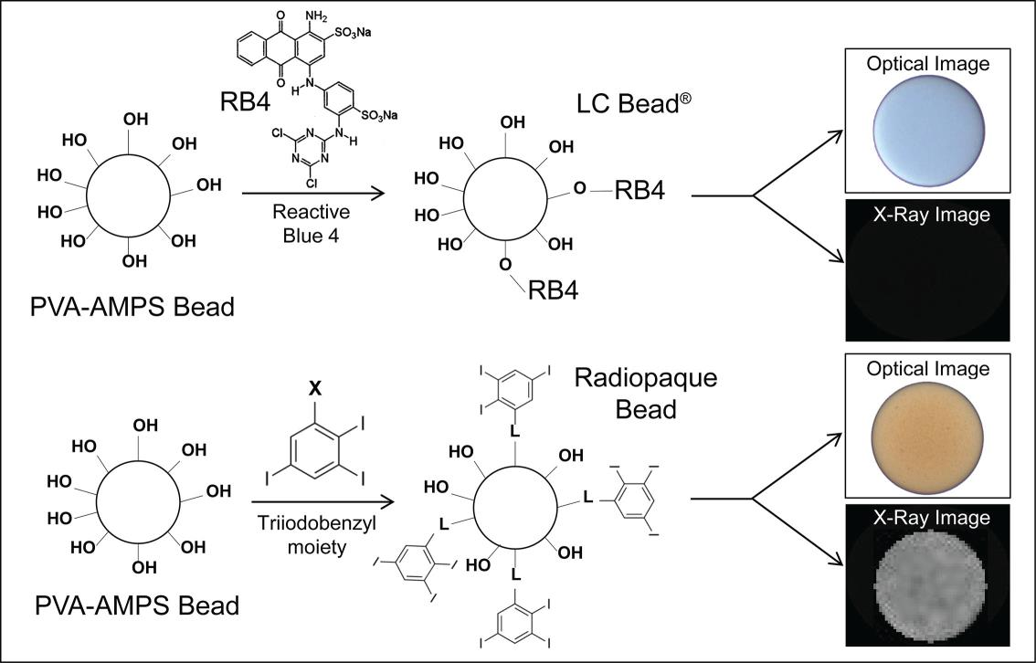
Effect of Composition
Same core chemistry and drug binding process as DC BeadTM with iodine added in place of blue dye during manufacturing process
DC BeadTM
    [18] Duran R, et al., Theranostics. 2016 6(1):118-130.
Notes:
DC Bead currently use in clinical practice are tinted blue using a reactive dye called Reactive Blue 4 to enable vizualisation of the bead suspension and help during manipulation.
We developed a novel process in which the blue tinting step was replaced by an alternative reaction to attach a radiopaque moiety (triiodonated benzyl) to the preformed hydrogel which imparts a slight yellow color and importantly renders the beads visible on X-ray

Slide 30
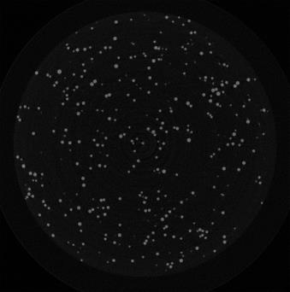
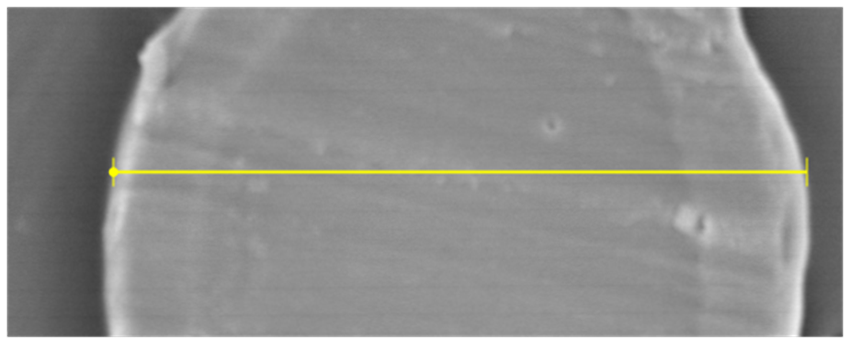
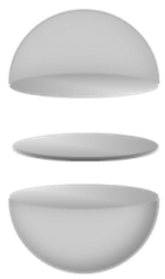
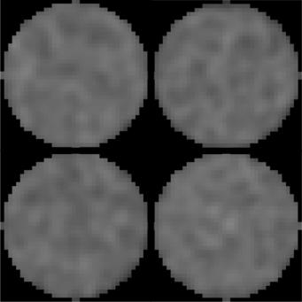
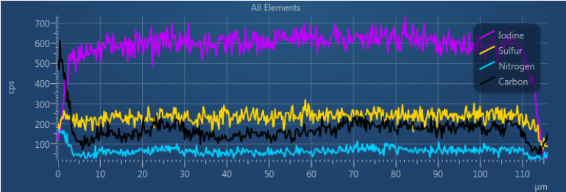
Composition: Iodine distribution
MicroCT Image
Line profile shows even iodine distribution throughout the bead, to ensure adequate radiodensity for great visibility of RO Bead
(a)
(b)
10 μm
bead
section
50 μm
(c)
Individual RO Bead
average attenuation = 5639 ± 228.8 HU
Bead sectioned by cryomicrotome,
(b) section subjected to SEM / (c) EDX analysis.
BTG Confidential
    [18] Duran R, et al., Theranostics. 2016 6(1):118-130.
Notes:
In a slice through a 3D micro-CT reconstructed data [here in the bottom left] a similar attenuation of each bead is seen suggesting that the iodination was uniform throughout the bead population. Moreover, examination of individual bead cross-sections revealed a uniform distribution of iodine throughout the bead interior

Slide 31
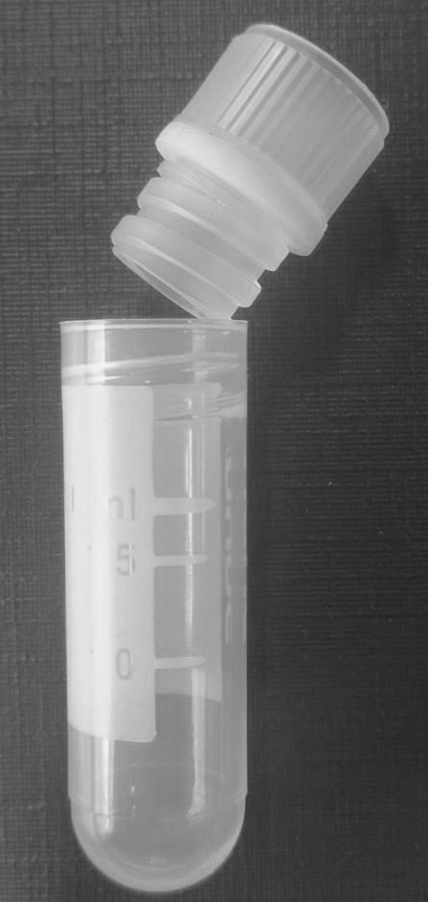
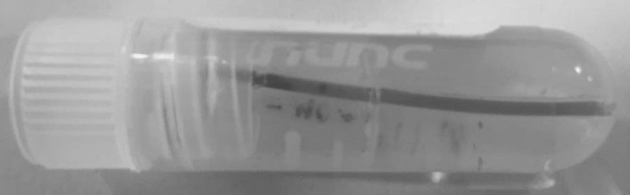
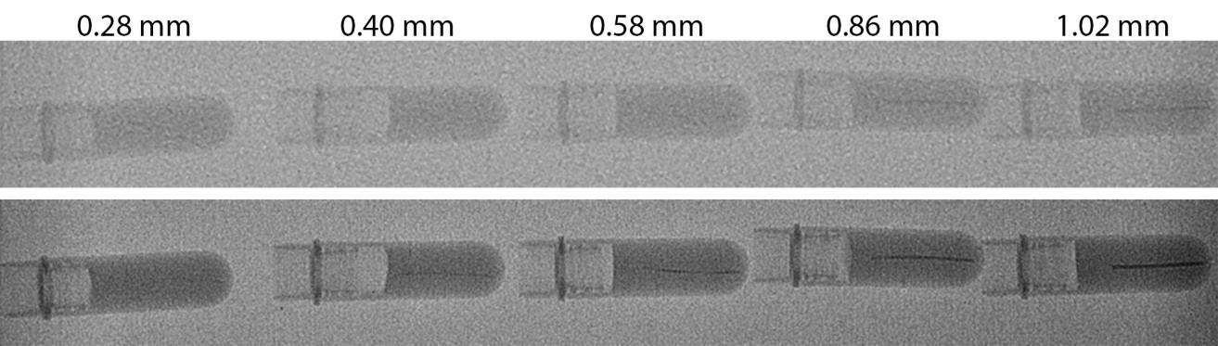
Composition: X-ray Visibility
Bead line phantom packed with RO Bead
Line phantoms were used in development to determine the minimum ‘vessel’ diameters under different imaging modalities of RO Bead in an in vitro setting
Agar gel matrix
Single shot Fluoroscopy
RO Bead line phantoms; internal diameter indicated on top
    [18] Duran R, et al., Theranostics. 2016 6(1):118-130.

Slide 32
Composition: Impact on Handling
Product | Iodine Concentration (mg/ml) | Mean Density (g/cc) | Water Content (%) | Elastic Modulus (MPa)
DC Bead™ | 0 | 1.03 | 95 | 0.2
RO Bead | 150 | 1.29 | 66 | 33.3
  Concentration of iodine inside RO Bead is similar to Iodine concentration in commonly used contrast agents (250mg/mL, 150mg/mL sedimented beads)
Attaching a hydrophobic iodine containing moiety to the bead affects the bead structure and material properties:
  Increased density
    Requires mixing with pure contrast agent to achieve a stable suspension
  Lower water content and higher stiffness
    Suspension must be maintained to ensure successful delivery through microcatheters
    [18] Duran R, et al., Theranostics. 2016 ; 6(1):118-130.

Slide 33
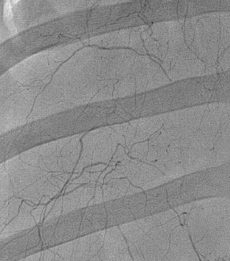



Swine Healthy Liver
Human Tumour
Translation:
Non-clinical vs
Human Imaging
Single Shot Fluoro
First in human studies show that images are of similar quality or better than predicted from non-clinical studies
CBCT- MIP

Slide 34

CBCT MIP of ACC
First Images of Radiopaque Embolic Beads in Human Tumours
CBCT MIP of HCC

Slide 35
Conclusions
Particles occlude vessels more proximally than microspheres
Microsphere size and distribution, compressibility, elastic recovery and potential to aggregate dictate the level of occlusion in the vasculature
Microsphere composition and internal structure impacts their mechanical properties, hence their robustness, stiffness and elasticity
The ability of these products to load drugs to form a drug-eluting bead may affect one or more of these properties, impacting on their behaviour
Novel microspherical embolisation beads now exist that are visible under X-ray imaging modalities
The radiodense components of microsphere composition increase the density and hence their suspension, handling and administration– this must be balanced with their optimum visibility

Slide 36
Thank You
Questions?
EM-DCB-2016-0166 EMEA Date of Preparation: 03/2016

