Slide 1

Towards Affordable Vaccines
Andrew Lees, Ph.D.
Scientific Director
Fina Biosolutions
Rockville, Maryland USA

Slide 2
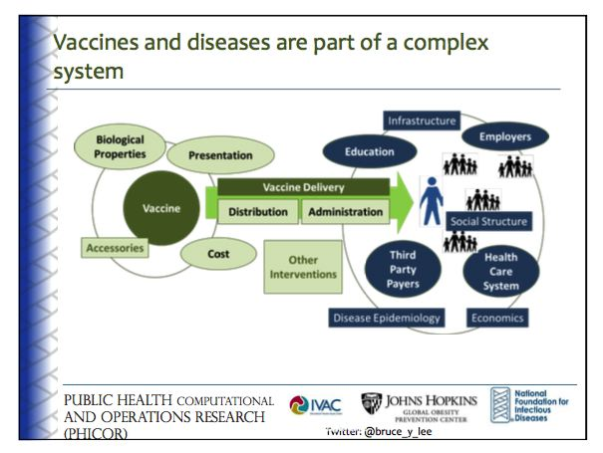
Borrowed from Bruce Y. Lee, Johns Hopkins School of Public Health

Slide 3
Vaccines are different
Essential, especially once made part of national plan
Oligopoly
  Pfizer, GSK, MSD, Sanofi-Pasteur
Near monopoly of products
  Even vaccines for same disease not equivalent
    Different serotypes
    Formulations
    Different combinations
Significant intellectual property issues
Very long development times
Poor transparency on pricing

Slide 4
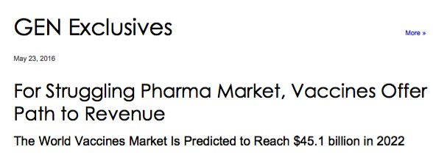

Vaccines are BIG business
World Vaccines Market is Predicted to Reach $45.1 billion in 2022
^{Pfizer earns more than} ^{$17 million in sales per day}
from the pneumonia vaccine alone.

Slide 5
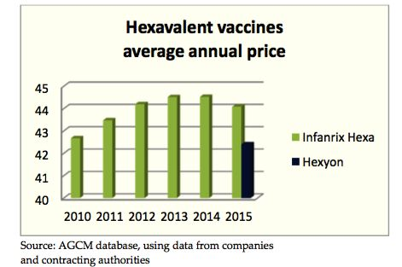
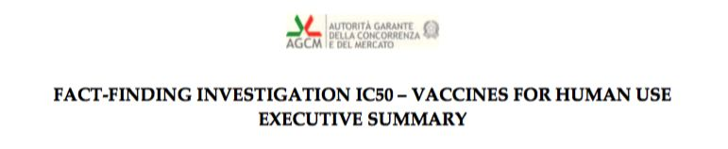
Competition can help reduce vaccine price

Slide 6
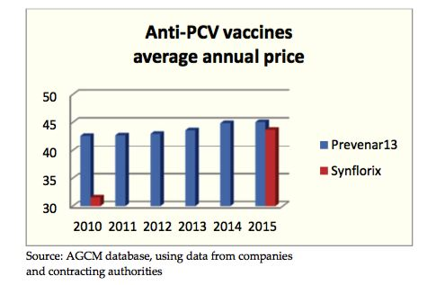
Pneumoccocal Conjugate Vaccine
“The average price rose from about 31.5 to 43.6 euro per dose, which seems to suggest a purely parasitical strategy of following the market leader’s price.”

Slide 7
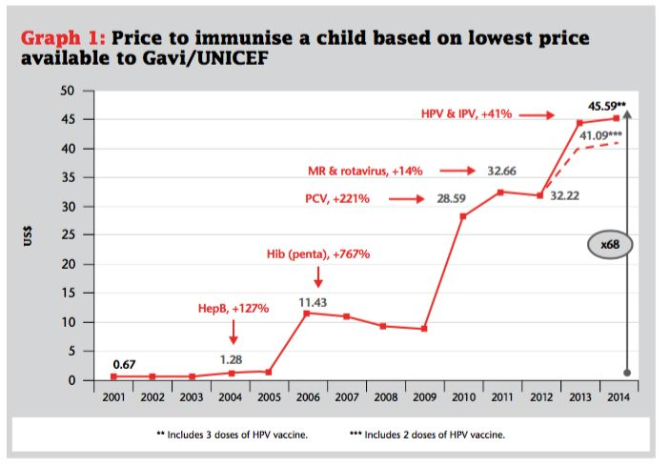
it is now 68 times more expensive to vaccinate a child than in 2001
http://cdn.doctorswithoutborders.org/sites/usa/files/attachments/the_right_shot_2nd_edition.pdf

Slide 8
Towards Affordable Conjugate Vaccines
Efficient Chemistry and Low Cost CRM₁₉₇ Carrier Protein
Andrew Lees
EuroVaccines
Rome, Italy
June, 2016

