Slide 1
Translational Approaches to Curing HIV infection
Andrew D Badley MD
Director HIV immunology Lab
Chair Research Core Oversight
Professor on Medicine
Mayo Clinic and Foundation

Slide 2
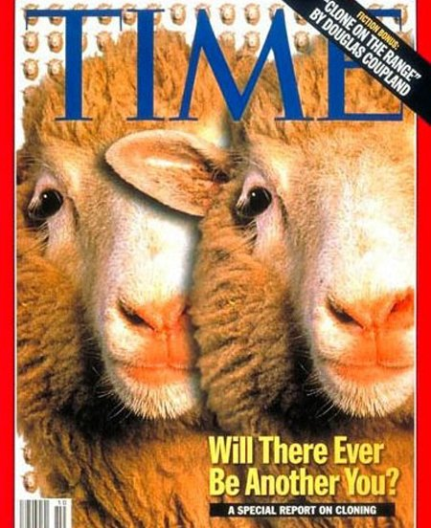
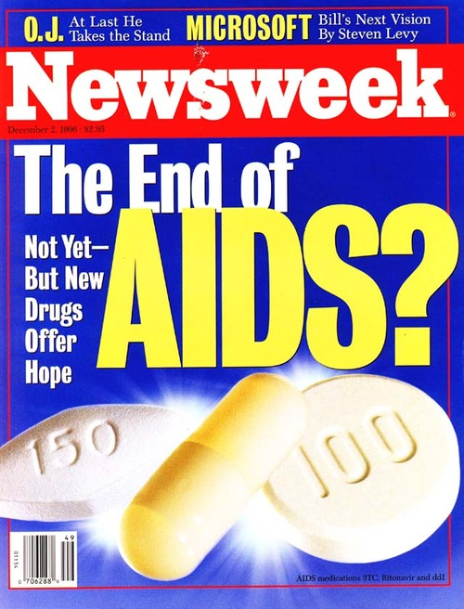
1996

Slide 3
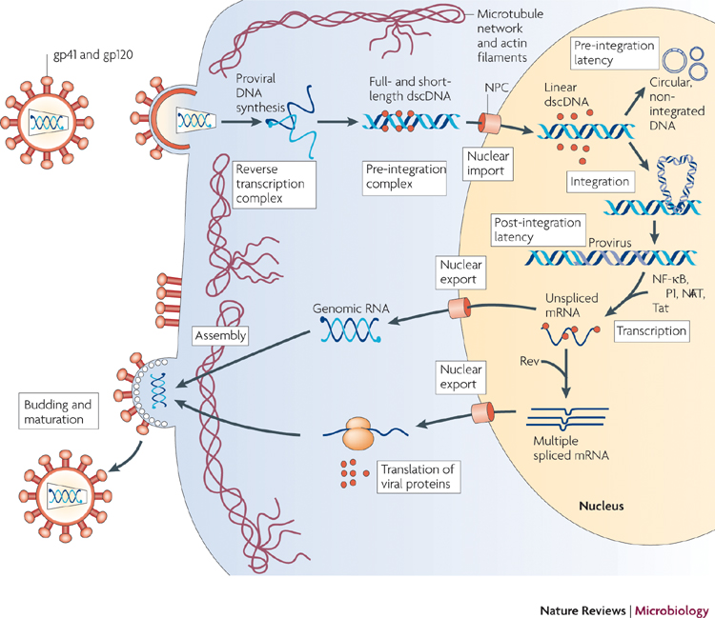
Why don’t drugs cure HIV : The HIV Life cycle

Slide 4
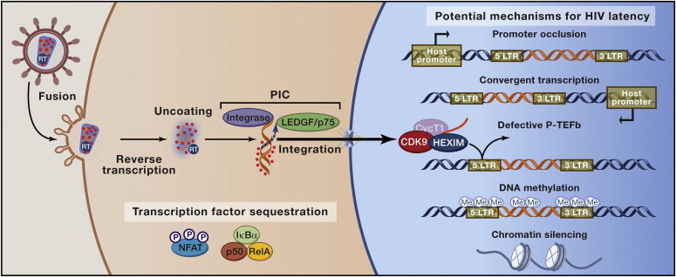
Mechanisms of Latency

Slide 5
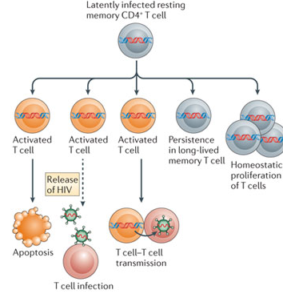
Sequelae of latency

Slide 6
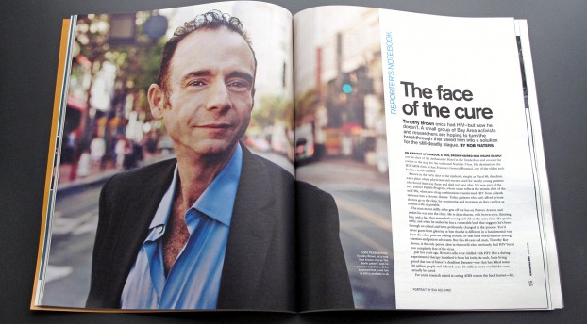
Cure IS possible
Timothy Ray Brown, the Berlin patient
  Allo Tx times 2, ART through chemo ( 3 years).
  Now off ART, >6 years post Tx, no intact HIV sequences

Slide 7
How does BMT cure HIV infection??
Cytotoxic chemo Rx – kills lymphoid and myeloid cells containing HIV; ART blocks new infection
Anti HIV effect of ChemoRx
GVHD = Graft VS HIV Effect ?
CCR5 delta 32
What is minimum??

Slide 8
Cure strategies
Gene therapy
Vaccination /
immune based Rx
Reactivation
Low accessibility
Oncogenic ?
Toxicity concerns
Curative vs preventative
Low cost, high accessibility

Slide 9
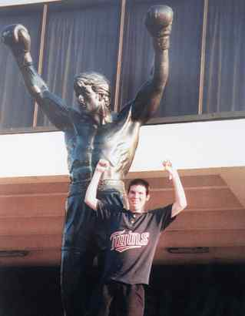
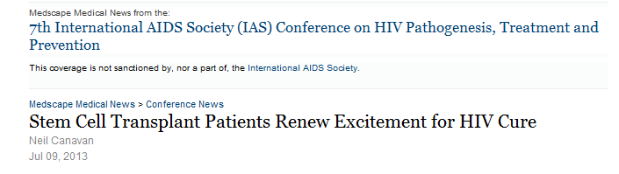

Gene therapy Approaches
Knockdown
  Eg CXCR4 / CCR5
Overexpression
  chimeric TRIM5α
Engineered receptors
  Eg CAR

Slide 10
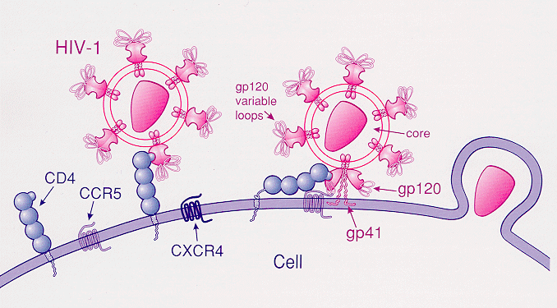
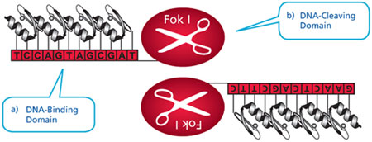
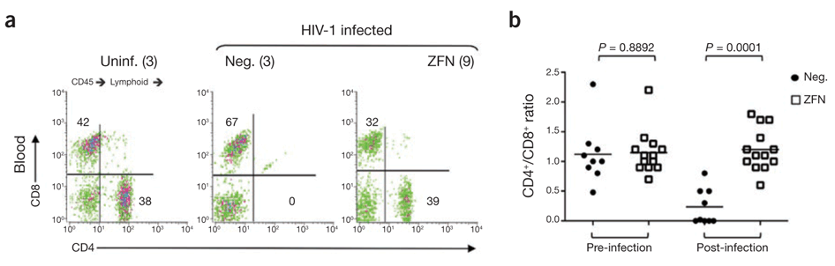
CCR5 knockdown in BLT mice.
Holt N et al.. Nature Biotech. 28, 839–847 (2010).

Slide 11
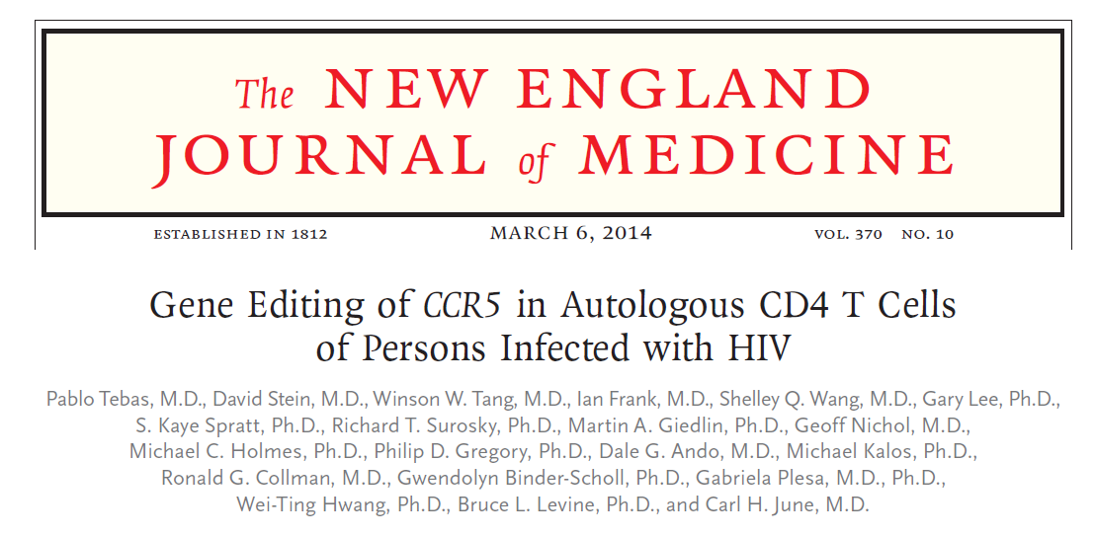
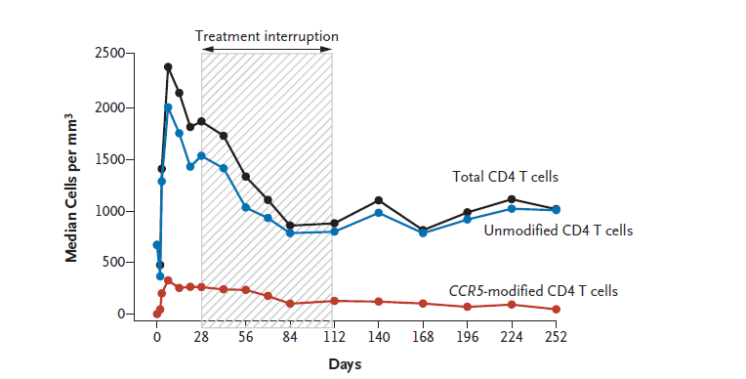

Slide 12
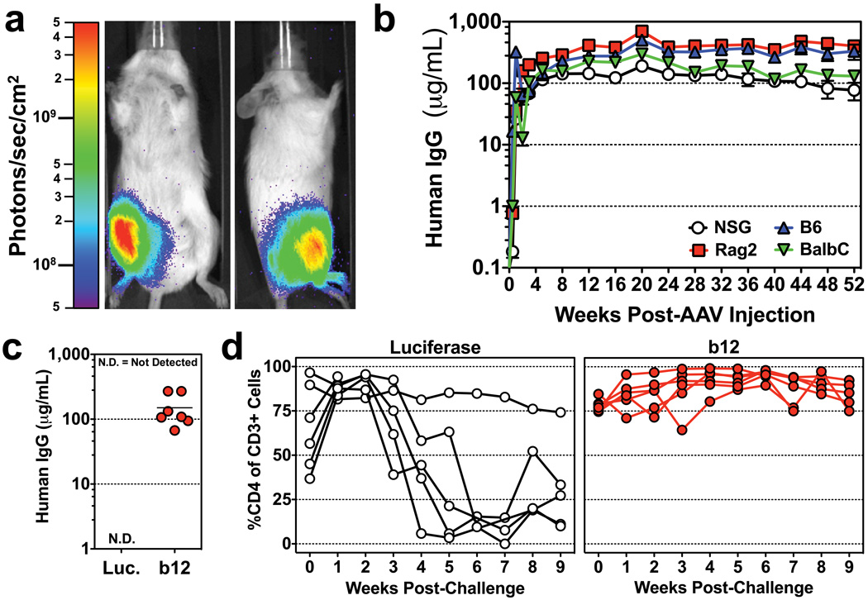
Over expression of b12 anti HIV antibodies, in BLT mice
Nature. 2011 November 30; 481(7379): 81–84.
iAntibody-based Protection Against HIV Infection by Vectored ImmunoProphylaxis

Slide 13

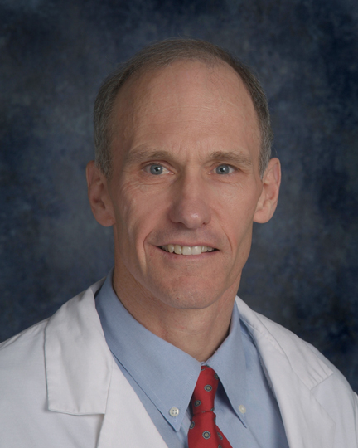
My Bet for a Nobel Prize
CAR
ALL
CLL
Melanoma
Glioma
Numerous others…..
Novartis and Penn.

Slide 14
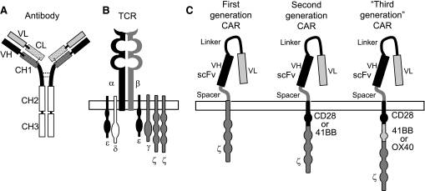
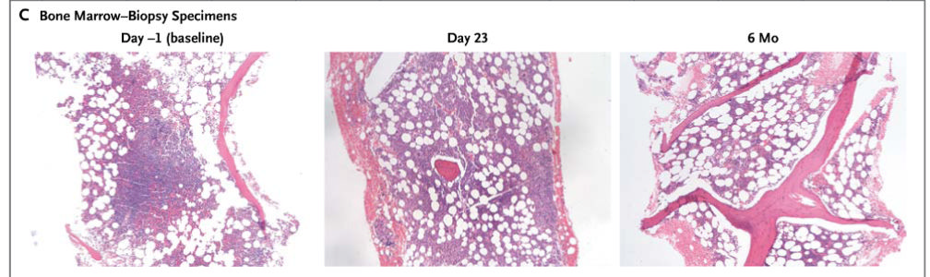
CAR generations
CAR in CLL; NEJM 2011

Slide 15
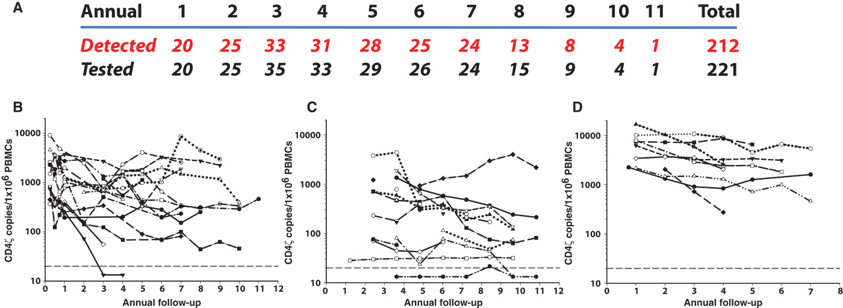

Persistence of CD4ζ-modified CAR T cells over 11 years
after infusion.
Scholler J et al. Sci Transl Med 2012;4:132ra53-132ra53

Slide 16
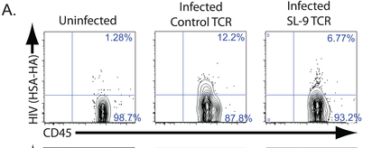
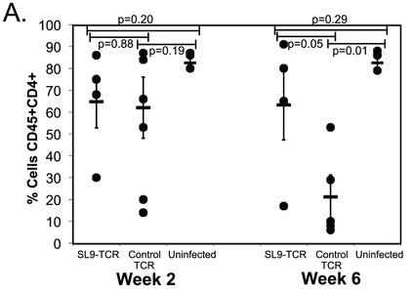
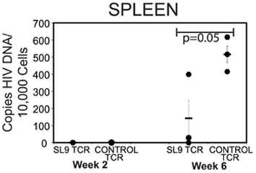
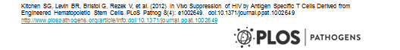
Human CD34+ repopulated NSG mice;
3rd generation CAR

Slide 17
Vaccination / Immune based therapy
Interleukin therapy - disappointing
Other biologics
Therapeutic vaccination - disappointing
Preventative vaccination

Slide 18
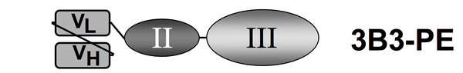
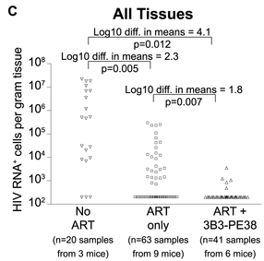
αgp120 immunotoxin; BLT mice

Slide 19
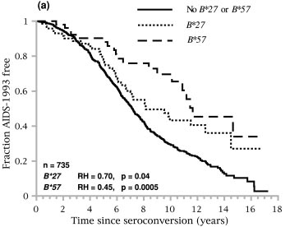
Host Factors in HIV Control
Known factors
  Chemokine family: CCR5 delta 32 homozygosity prevents HIV, heterozygosity delays progression
  MHC locus: HLA-B5701, HLA-B27 slower HIV disease
  Not yet established - Host restriction factors: Apobec3G, Trim5a, tetherin, others-role in LTNP/EC not yet defined
Notes:
the chemokine system is a major
weapon of the early host defense system against infectious diseases
At a time when HIV-1 entry inhibitors such as CCR5 and
CXCR4 antagonists are being developed, the identification of
a molecular mechanism of AIDS pathogenesis involving a new
chemokine receptor is of particular interest and opens new
insights for therapeutic drug targets and prediction of HIV-1
progression.
and comprises >100 members

Slide 20
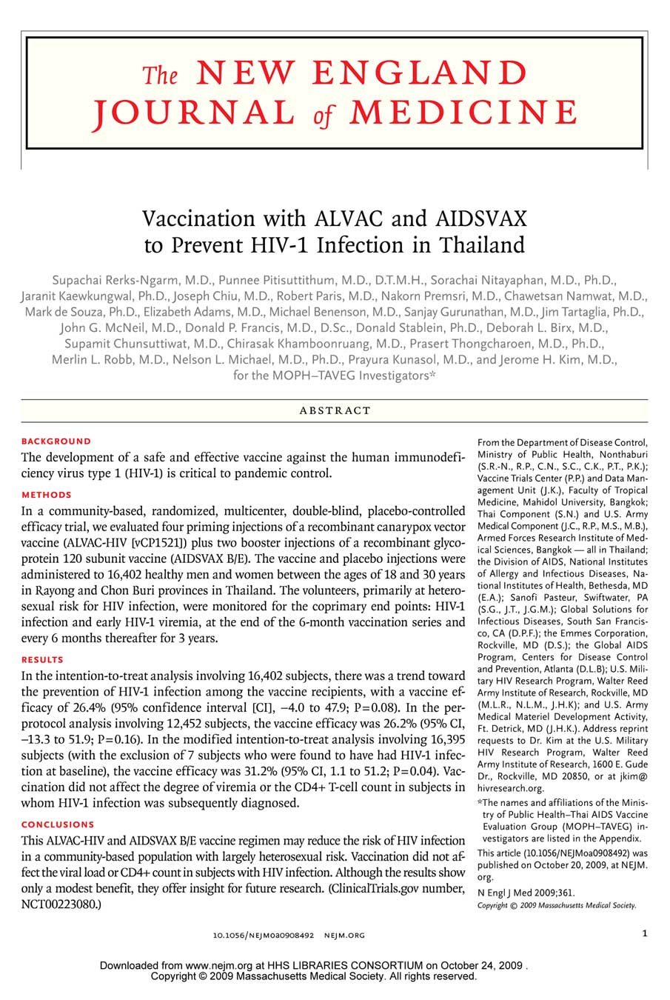
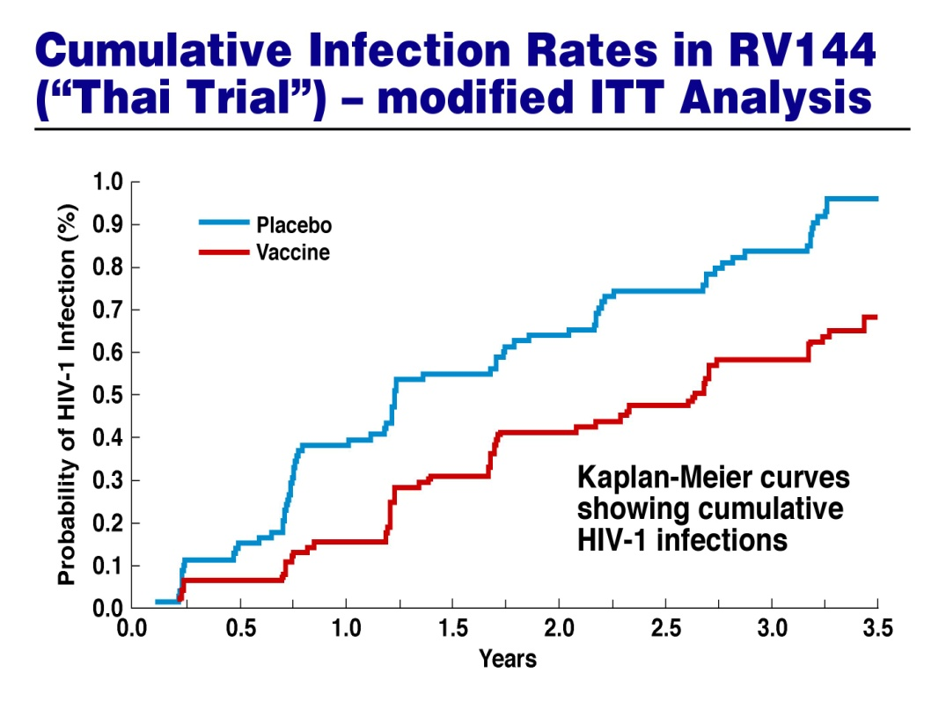
RV-144: Evidence that an AIDS Vaccine Can Prevent
HIV-1 Infection in Humans
Prime boost : Recombinant gp120
- Modest 31% reduction in infection
limited duration
Proof of concept for a
protective vaccine

Slide 21
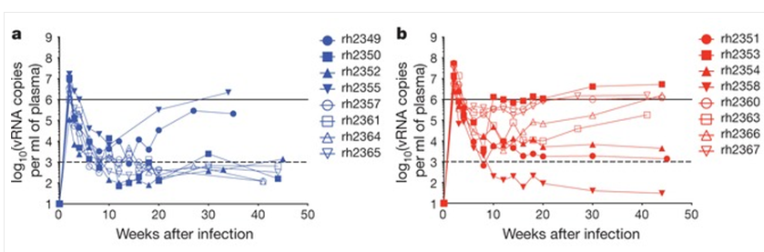
Most promising approach to HIV Vaccination: Genotype specific
HLA-B57 = Mamu B
Vaccinogen Gag epitope in Mamu B vs non-MamuB
Non-MamuB – rapid progression after SIV challenge
MamuB - protected.
Nature. 2012 November 1; 491(7422):

Slide 22
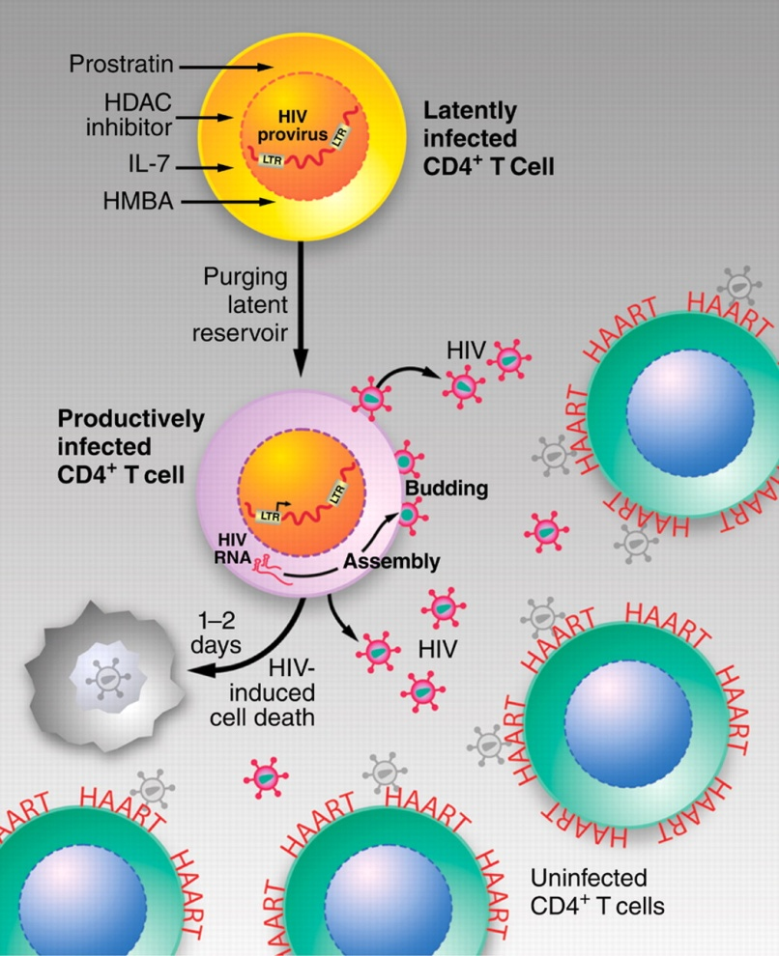
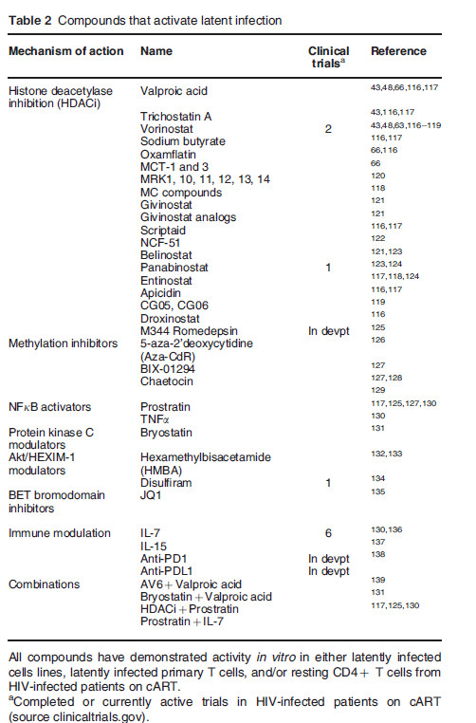
Shock and Kill hypothesis
D. D. Richman et al., Science 323, 1304 -1307 (2009)
Badley Cell Death and Disease 2013
Notes:
Tim
22

Slide 23
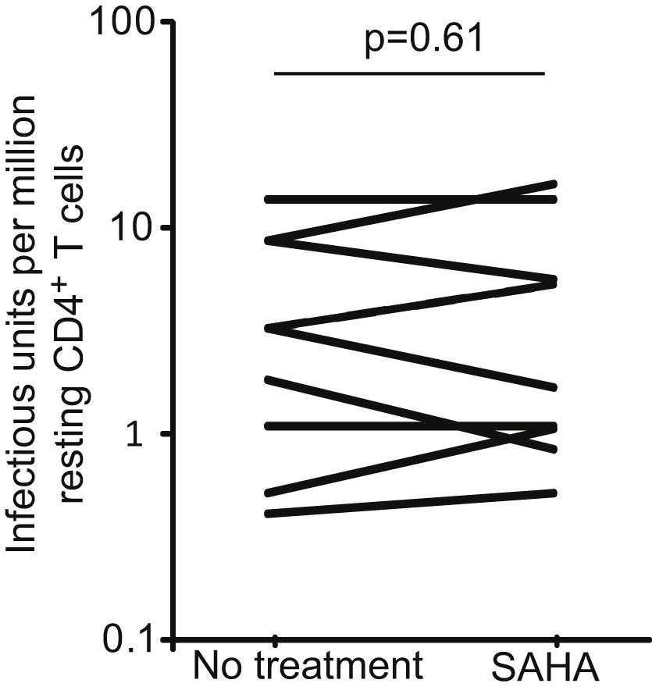
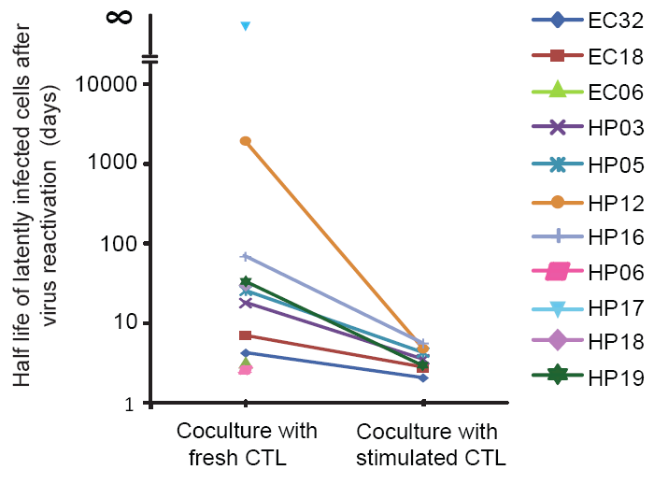
Does HIV reactivation with decrease viral burden ?
Immunity. 2012 Mar 23;36(3):491-501. Epub 2012 Mar 8.
Stimulation of HIV-1-specific cytolytic T lymphocytes facilitates elimination of latent viral reservoir after virus reactivation.

Slide 24
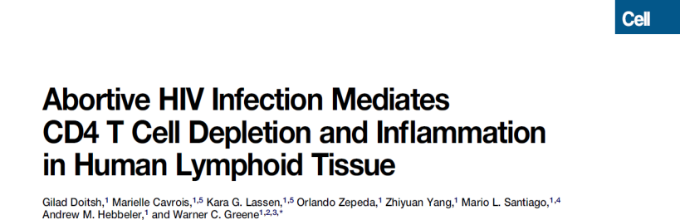
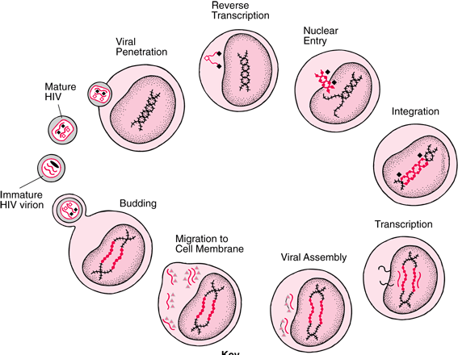
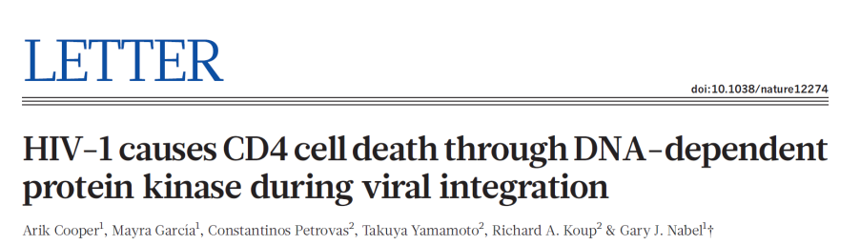
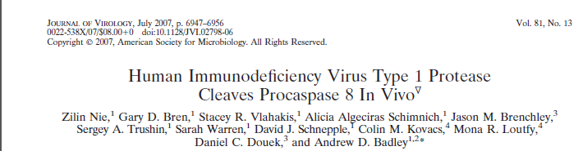
How do HIV infected CD4 T cells die?
Before integration
Latency
Coincident with Viral replication

Slide 25
HIV Protease
Discovered in early 80’s
Expression in cells is cytotoxic
Target for therapy / cytotoxicity exploited as screening tool.
Degenerate substrate specificity
Cleaves Actin, Desmin, eIF4G, Bcl2

Slide 26
Casp8p41
Pr cleaves Procaspase 8 between 355:356
F355:F356
DED
DED
P18
P10
HIV Pr
DED
DED
P18
P18
P10

Slide 27
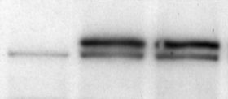
Mutating the Pr cleavage site in procaspase 8 abrogates HIV induced death
120
100
Casp 8 RN
80
60
Percent Viable
WT Casp8
I9.2 WT Casp 8
40
I9.2 Casp 8 RN
I9.2
20
0
0 12 24 36 48 60
Hours post Infection

Slide 28
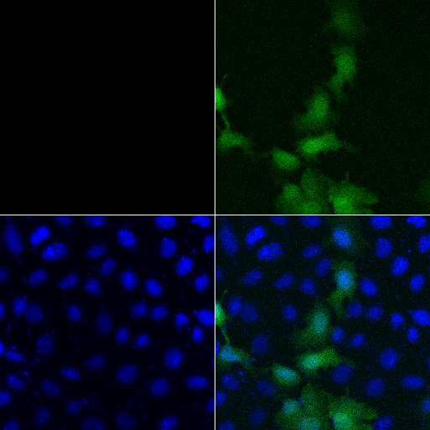
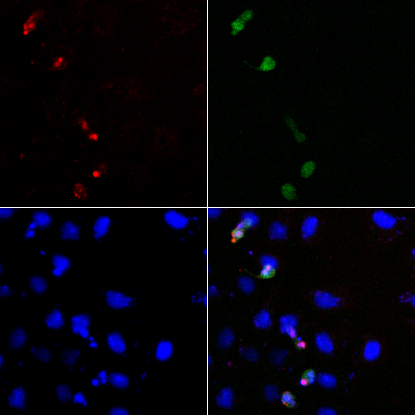
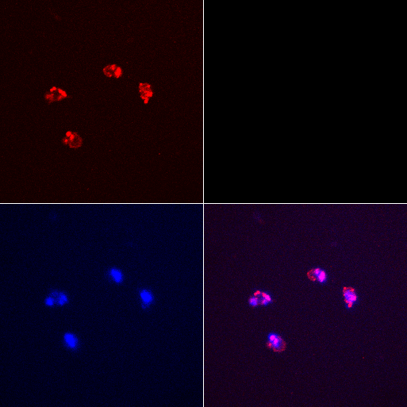
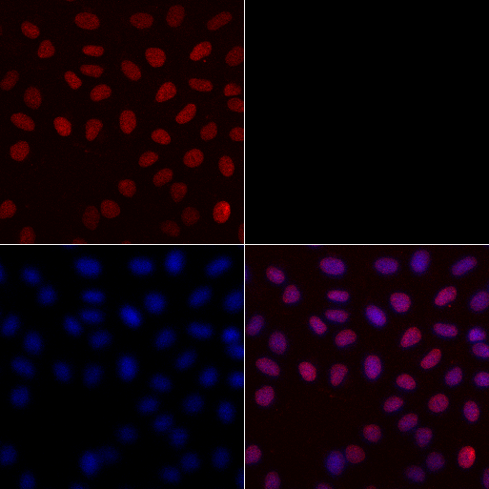
Casp8p41 Induces Apoptosis
GFP
TUNEL
DAPI
Overlay
GFP
GFP casp8p41
CPT
DNaseI
HeLa Cells

Slide 29
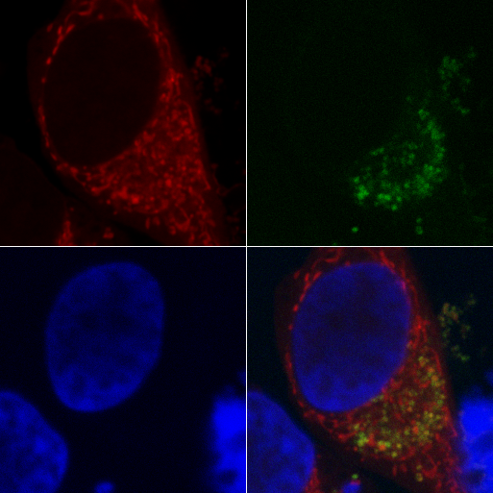
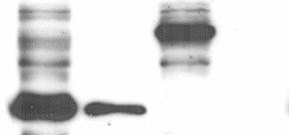


Caspase8p41 colocalizes
with mitochondria
HA-Casp8p41
HA-Caspase 8 FL
Mitotracker
GFP casp8p41
HM Fraction
HM Fraction
Cytosol
Cytosol
HA-Caspase 8 FL
HA-Casp8p41
VDAC
AKT
DAPI
Merge

Slide 30
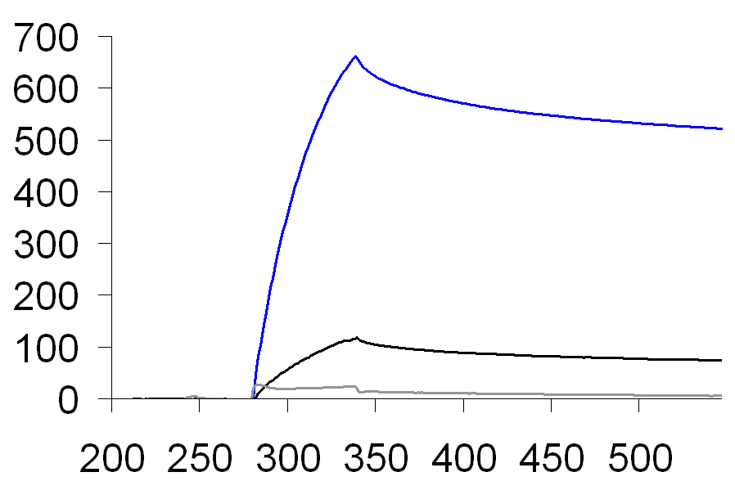




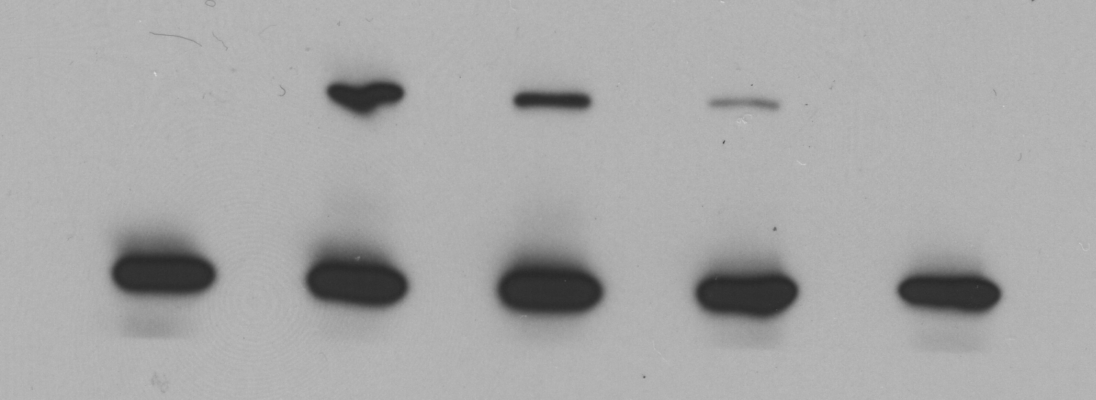
Casp8p41, Not Caspase 8 Binds Bak
Immobilized HIS-Bak
Response Units (RU)
GST-Casp8p41
HA-Empty Vector
HA-Casp8p41
Time (seconds)
GST-Caspase 8
GST
IP: Bak
IB: HA
IP: Bak
IB: Bak
Total Protein
IB: HA
Bak + Casp8p41 V150E L157K
Bak + Casp8p41 WT
Bak + GST
IP: Agarose
IB: HA
Bak
Bak + Bim BH3
50
37
IB: Bak
25

Slide 31
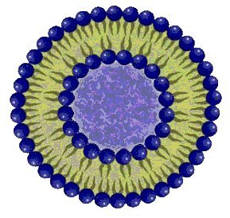
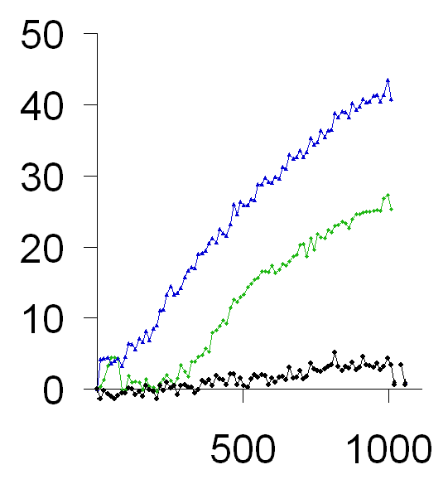
Casp8p41 stimulates Bak pore like function
Bak alone
No Bak oligomerization
% FITC-Dextran Release
Bak + GST-Casp8p41
Bak & Bim
Bak
Dextran FITC release
GST-Casp8p41
Bak & Casp8p41
Time (seconds)
????

Slide 32
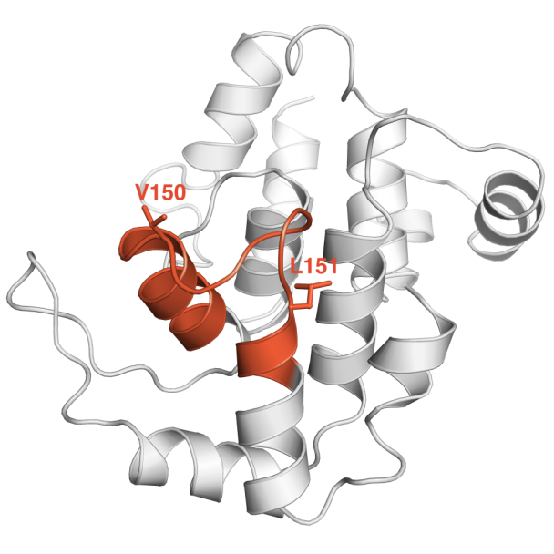
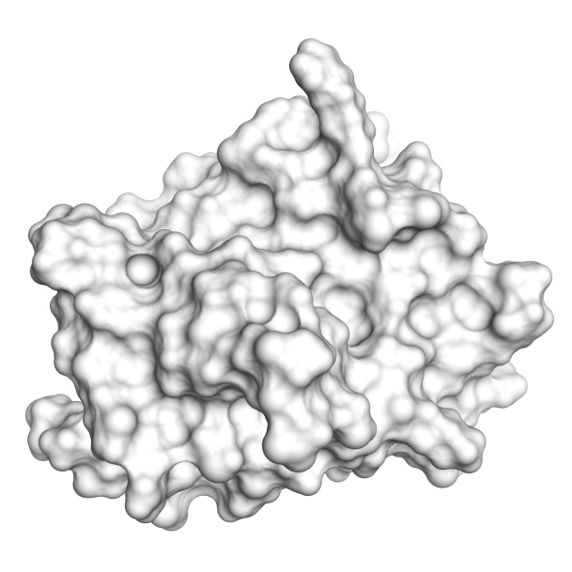
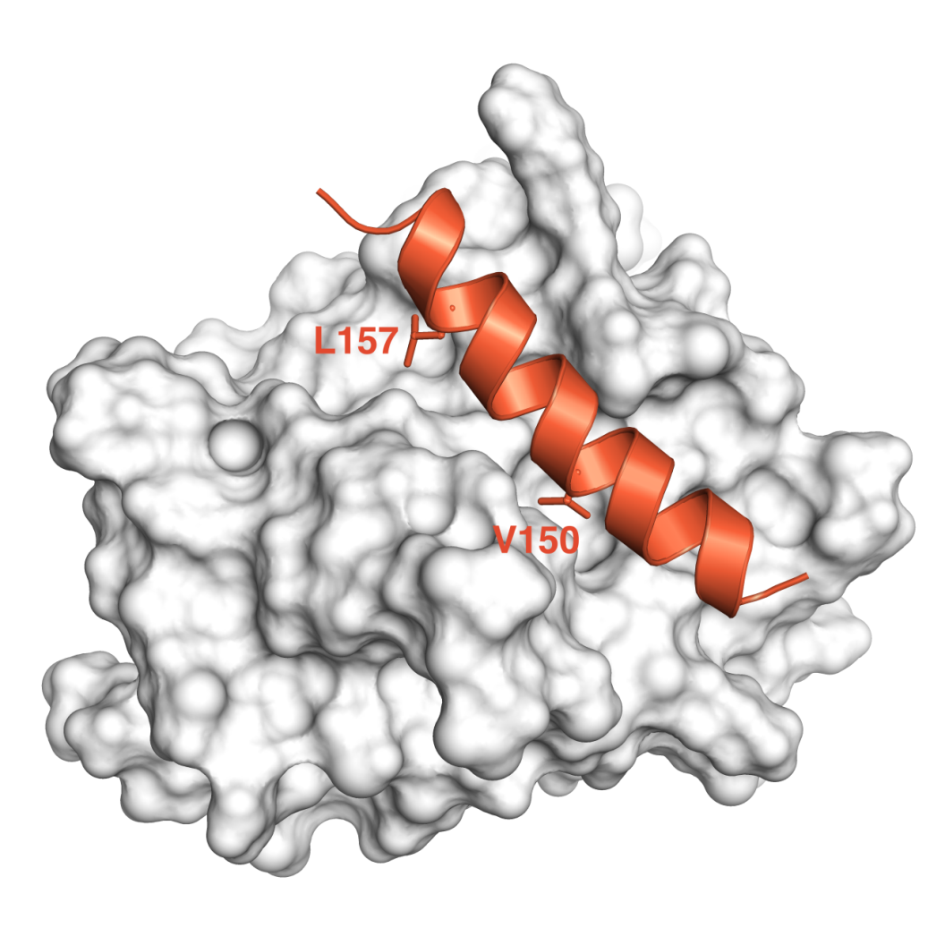
Molecular Dynamic Simulation
Casp8p41
Bak
©2012 MFMER | slide-32

Slide 33

Casp8p41
1
3
2

Slide 34
Casp8p41
Casp8p41 is a novel cleavage fragment of procaspase 8
Molecular signature of cells in which Protease has cleaved procaspase 8 (αCasp8p41)
Predictive of ongoing CD4 losses
Mechanistically linked to discordance
Novel paradigm in Caspase biology
May provide insight into how to kill cells reactivating HIV

Slide 35




Why don’t latently HIV infected memory
CD4 T cells die following HIV reactivation
Activated
CD4
Memory
CD4
Memory CD4
CD3/CD28 - + - +
CD3 / CD28
-
+
+
+
HIV-1 PR 1:2000
Procaspase 8
Casp8p41
Bcl2
Actin
Also Upregulated Bcl2, Decreased Fas / FasL

Slide 36


Memory cells upregulate antiapoptotic and
down regulate proapoptotic proteins.

Slide 37


Slide 38

Approaches to cure
Status
Gene editing – eg CCR5
Overexpression of restriction factors
CAR’s
Vaccination
Immune based therapy
Shock and Kill
Prime shock and kill

Slide 39
Acknowledgements
Badley Lab Members
(past and present)
Gary Bren
Stacey Rizza
Alicia Algeciras-Schimnich
Zilin Nie
Sergey Trushin
Nathan Cummins
Sekar Natesampillai
Amy Sainski
Dave Schnepple
Brett Shepard
Sergei Trushin
Mayo Collaborators
Scott Kaufmann
Greg Gores
Tom Griffith
Joseph Yao
Paul Leibson*
Yuan-Ping Pang
Zami Temesgen
David Katzmann
Marina Ramirez-Alvarado
Haiming Dai
Peter Wettstein
Other Collaborators
Guido Kroemer
Danny Douek
Jason Brenchley
Steve Deeks
Nawal Boukli
Guido Silvestri
Tom Griffith
David Lynch
Catherine Brenner
Alan Landay
Mike Lederman
Notes:
I would be completely remiss if I didn’t acknowledge the help, support, advice, and labor of all those involved on this project →
So I’d like to thank all the members of the Badley Lab…etc. etc.

