Slide 1
Conference Series LLC Conferences
Conference Series LLC is a pioneer and leading science event organizer, which publishes around 500 open access journals and conducts over 500 Medical, Clinical, Engineering, Life Sciences, Pharma scientific conferences all over the globe annually with the support of more than 1000 scientific associations and 30,000 editorial board members and 3.5 million followers to its credit.
Conference Series LLC has organized 500 conferences, workshops and national symposiums across the major cities including San Francisco, Las Vegas, San Antonio, Omaha, Orlando, Raleigh, Santa Clara, Chicago, Philadelphia, Baltimore, United Kingdom, Valencia, Dubai, Beijing, Hyderabad, Bengaluru and Mumbai.

Slide 2


“Biosimilars development for small to mid-size Pharma companies”
Andreu Soldevila CeO and Founder @leanbiopro

Slide 3
Leanbio History
Founded in June 2014
First Client June 2014
First Biosimilar Project October 2014
First Lab March 2015
First Enzyme project January 2015
First NBE Project November 2015
FTO Expression system Launch March 2016
Isothermal qPCR based HC DNA June 2016
Expansion to second lab at Barcelona Science Park July 2016
Member of inkemia group www.leanbiopro.com asoldevila@leanbiopro.com

Slide 4
Products and Services
Strategic, technical and Regulatory consultancy in NBE and Biosimilars CMC
Development of NBE and Biosimilars
Perform QTPP, development, process characterization and manage the GMP manufacture
Co-development of products and technologies sharing risk and rights of products

Slide 5
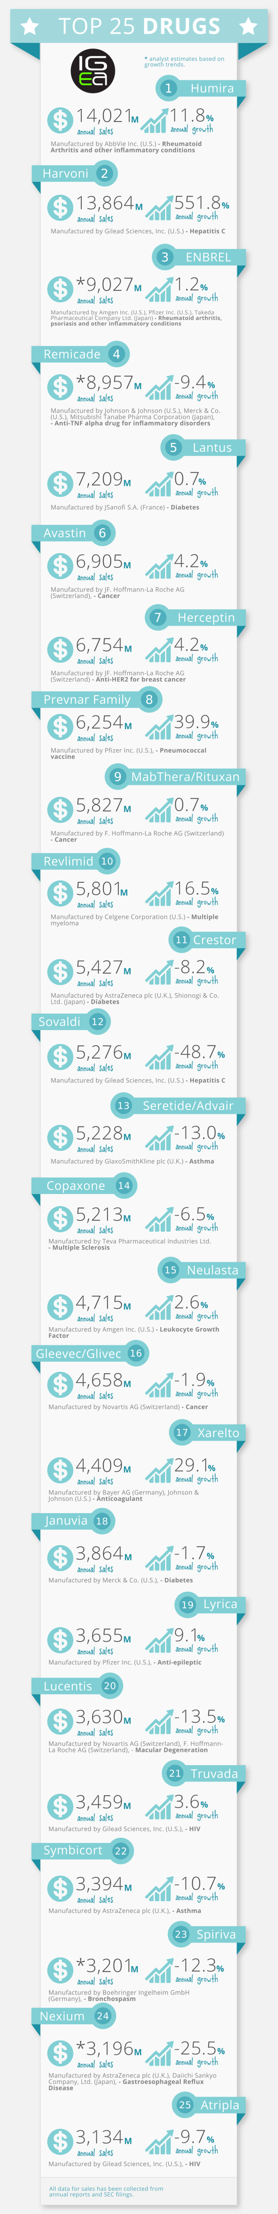
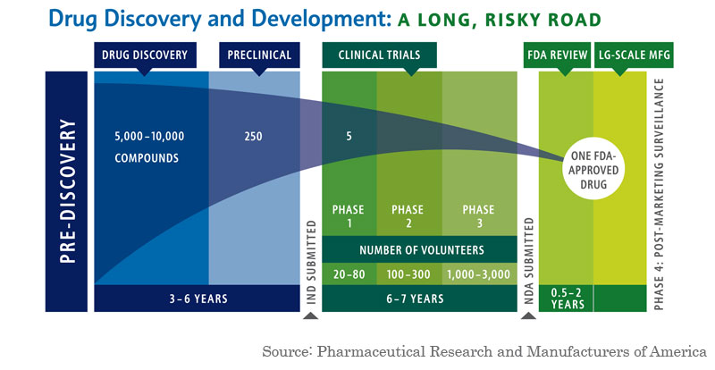
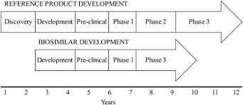
Why Biosimilars?
Amount of Biologic products and sales continuously increase
Each new biologic opens new possibilities for future Biosimilars
High Difficulties , cost and risk to reach market for NCE
Difficulties in Spanish/European Generic Brands
Easier technical pathway compared to NBE...but still difficult as barrier for other countries willing to get to western market
Reduced cost? And Substantial margin
Regulatory agencies evolution is positive towards biosimilars
Notes:
-will agencies cancel phase III clinical trials soon?

Slide 6
New stakeholders in Biologics:
Problems
COST
Different mindset, skills, facilities to SM
Extremely regulated pathways for Biosimilars
Big costs in Clinical development
Overcost in most CRO/CMO/Consultancy

Slide 7
Cost?
Traditional NBE program 150-300Mo€
Traditional Biosimilar program 100-200Mo€
“Low cost”Biosimilar Programs 70-90Mo€
Possible to reduce to 25-50Mo€?
Traditional Cost of a Generic 1-2Mo€
Notes:
If we talk about NBE,to add drug discovery process and more expense in clinical trials
Traditional Biosimilar program 100-200Mo€
Consultancy
CMC 20-40Mo€
(non)clinical

Slide 8
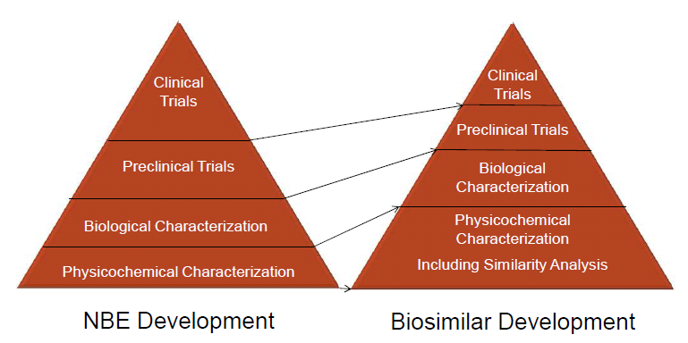
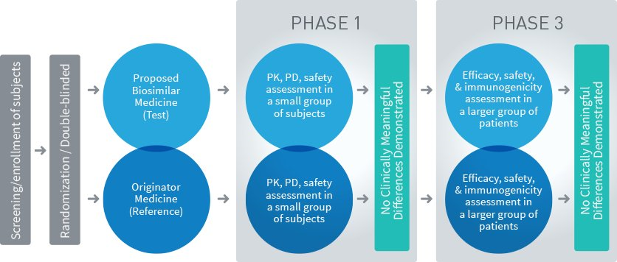
How to develop a Biosimilar?

Slide 9
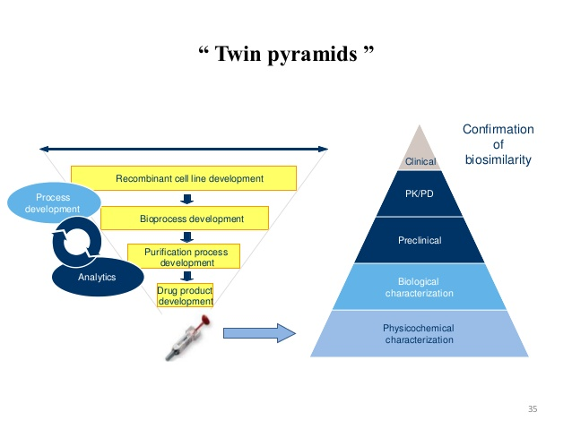
How to develop a Biosimilar?
QTPP
and

Slide 10
Leanbio Aim:
Overcome technical challenges in limited budget scenarios
To democratize access of Biosimilars to small-mid size companies
To minimize time to market and To reduce development cost
To Execute Analytical and Process development
To lead and manage outsource through closely related partners
To implement FTO technologies

Slide 11
How do we work
Small, flexible highly skilled scientist group with Extremely low structural costs
Strong partner relationships in a co-development approach. Risk share
Introduce new technologies
  Expression system FTO
  HC DNA Isothermal q-PCR methodology
Reduce cost of CMC
  Microbial 12,5 Mo€
  Mammalian 20Mo€
Reduced time to market
“ Will Regulatory evolution drive to minimized clinical development program in a 5-7 years timeframe?”

Slide 12
Leanbio Operational approach
Molecular biology Platform
DoE
Statistical Analysis
IPC/IPT DS/DP
Specifications
USP Platform
AD Platform
USP Platform
DSP Platform
TECH TRANSFER In &Out
LEAD & MANAGE&MONITOR CRO/CMO PARTNERS

Slide 13
Strategy for Biosimilars
Strong Analytical development programs for QTPP
Integrated Analytical and Process development teams
QbD and High Throughput approach in line with Guidelines
Specific partners Network for full package Dev &manufacture
Clients become partners through Co-development programs

Slide 14
Quality Target Product Profile
Innovator procurement
Analytical development & qualification & validation
Innovator characterization as guidance for process development and reference for comparability studies
Cell line and Platform development
Strain development
RCB manufacture
Platform PD and AD
Qualified methods for DS/DP
GMP Cell Banks
TT of RCB for MCB and WCB
Specific development
Qualified methods for IPC/DS/DP
Lab scale batches for Reproducibility
Preliminary Biosimilarity assessment
Preliminary Reference standard
Preliminary Stability studies
Phase I GMP Batch
TT of Process for GMP manufacture and control
TT of Control strategy for IPC, method validation and QC
Process Characterization
Process Design space
Reproducibility/Repeatability/Robustness
Stability and Hold times
Global characterisation
Re-development of specific analytical methods
Phase III GMP Batch
TT forProcess Validation and GMP manufacture
TT of adjusted methods , re-validation and QC
Notes:
Development and manufacture approach at Leanbio:
Focused on continuous development program across all disciplines(CB/USP/DSP/Formulation and AD) and with an eye to industrial scale
Life cycle of : raw materials, analytical methods, processes, reference standards, specifications, stability studies
cell banks, Following QbD principles of RA, RR, development through DoE, evaluation of Design space, reproducibility, repeatability and robustness with guidance of innovator DS/DP specifications
Determination of Critical, key and non-key raw materials,process parameters, tests and Attributes and understand their interelations

Slide 15
Life Cycle
Analytical methods life cycle
  Platform vs Specific development vs Qualification vs Validation
Process life cycle
  Platform vs Specific development vs Characterized vs Validated
Reference standards life cycle
  Innovator vs R&D vs Pre-clinical vs PhI vs PhIII
Specifications life cycle
  CoA innovator vs dev. methods vs qualified/validated methods
Member of inkemia group www.leanbiopro.com asoldevila@leanbiopro.com

Slide 16
Analytical dev. and Characterisation
ICHQ6B
Parameter | Attribute |  | Methods
Structural Characterization
Primary structure | Amino acid sequence |  | Deduced to fullest extent possible and then compared to gene sequence
 | Amino acid composition |  | Amino Acid Analysis
 | Terminal sequence |  | LC-ESI-MS/MS, Edman
 | Peptide Map |  | HPLC, LC-ESI-MS/MS
 | -SH and –S-S- |  | LC-ESI-MS/MS, Elmans Reagent
 | Carbohydrate structure | Monosaccharide | HPLC-FLD, HPAEC-PAD, MALDI-MS, LC-ESI-MS/MS, GC-MS, Enzyme analysis
 |  | Sialic acids
 |  | Gylcan profile
 |  | Glycosylation site
Higher-order structure | 2º, 3º (and 4º) structure |  | Crystal structure, CD, intrinsic fluorescence, DSC, SDS-PAGE
 | 4º, Oligomers and aggregates |  | SDS-PAGE, SEC-HPLC, AUC, DLS, MALS, FFF
 | Particulates |  | DLS, AUC, Microflow Imaging

Slide 17
Analytical dev. and Characterisation
ICHQ6B
Parameter / Attribute |  | Methods
Physiochemical Properties
Molecular weight and Size |  | SDS-PAGE, SEC-HPLC, MS (top-down, MALDI),
Charge isoform profile |  | gel-IEF, icIEF, CE, IEX-HPLC
Extinction Coefficient |  | Amino acid analysis and UVA280
Electrophoretic pattern |  | 1D and 2D PAGE, SDS-PAGE, Western Blot, IEF
Chromatographic pattern |  | RP-HPLC, IEX-HPLC, SEC-HPLC
Spectroscopic profiles |  | UV, FTIR, NMR, MS
Impurities
Process Related Impurities | Host cell protein | HCP ELISA, MS
 | Host cell DNA | qPCR, Threshold, Hybridisation
 | Protein A | ELISA
 | IPTG, Antibiotics, Media, metalic ions, solvents + other leachable/extractables , | Bespoke, as necessary.

Slide 18
Analytical dev. and Characterisation
ICHQ6B
Parameter / Attribute |  | Methods
Impurities
Product Related Impurities | Truncated forms / fragments | SDS-PAGE, SEC-HPLC, MS
 | Oxidation | RP-HPLC, Pepmap
 | Deamidation & isomerisation | IEX-HPLC, pepmap, (Δ)IEF
 | Miss-matched -S-S- | Pepmap – LC-MS
 | Glycosylation heterogeneity | Various LC and MS methods
 | Other PTMs | As necessary
 | Oligomers & Aggregates | SDS-PAGE, SEC-HPLC, AUC, DLS, MALS, FFF
Biological Activity and Potency
Binding assays |  | ELISA, BLI (Octet), SPR (Biacore), ITC, Flow Cytometry
Cell based bioassays |  | Cell proliferation or reporter assays (various and bespoke)
Animal based |  | If necessary

Slide 19
Analytical dev. and Characterisation
ICHQ6B
Parameter / Attribute | Methods
Others (including release tests)
Content / quantity | UVA280, Total protein (Bradford/BCA), ELISA.
General tests | pH, osmolality, conductivity, + other Ph.Eur
Appearance | Colour, clarity, visible particles
Safety tests | Bioburden, Sterility, Endotoxin

Slide 20
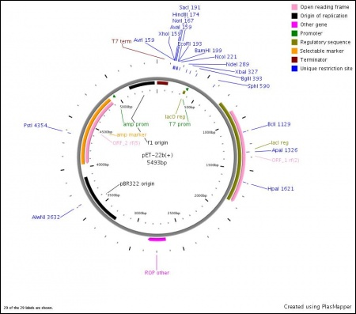
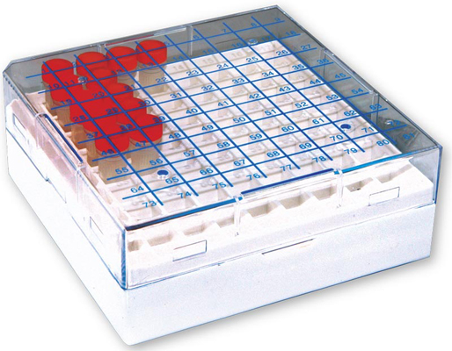
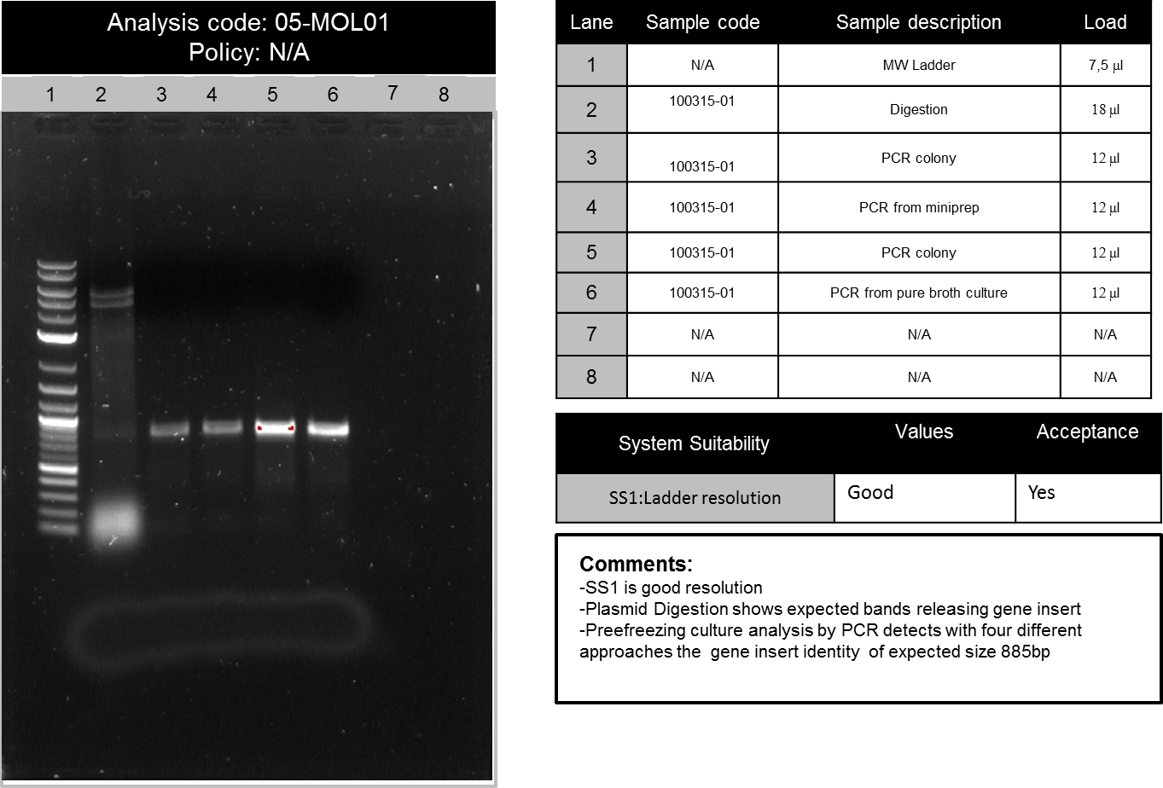
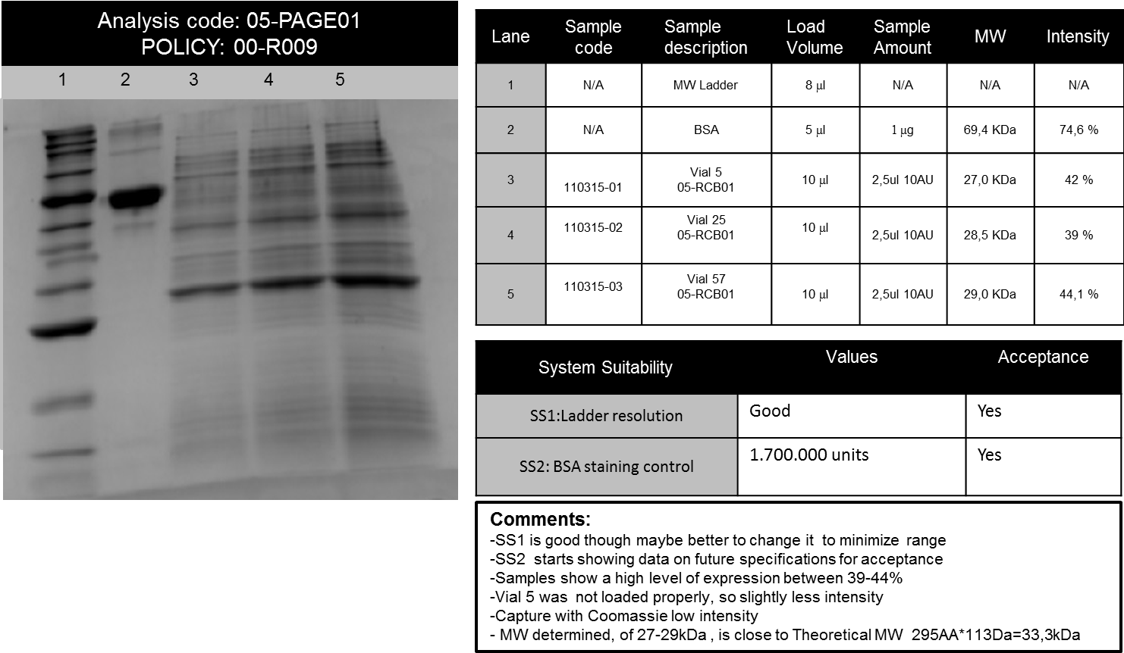
Strain development
Gene Design and Cloning
Clone selection and characterization
Pre-RCB manufacture
Evaluation of level of expression
Evaluation of Quality attributes
RCB Manufacture and Characterization
Notes:
Nombrar els tests del RCB
Microbial identity and purity
Genetic markers
Plasmid
Gene insert
Expression and functionality
Titer of cells, viability, homogeneity

Slide 21
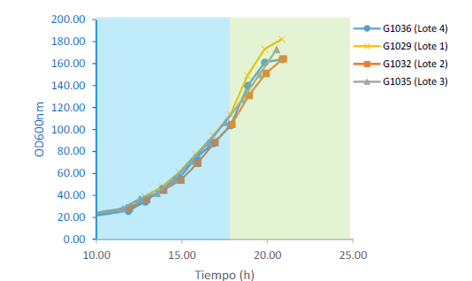
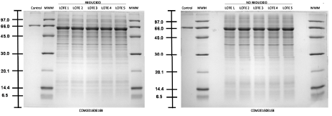
USP Development
FTO expression system
Chemically defined media
High cell density
Titers up to10g/L
High quality target protein
DoE -Design space
Reproducible and Robust methods

Slide 22
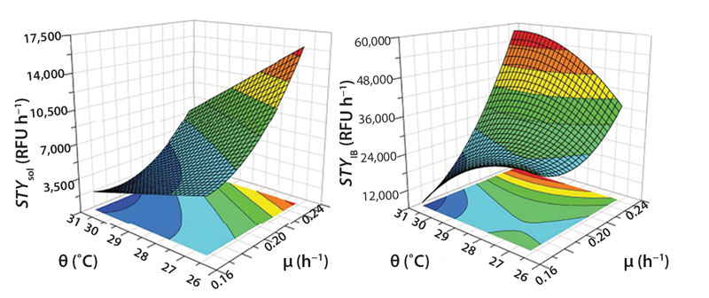
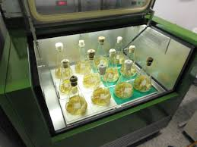
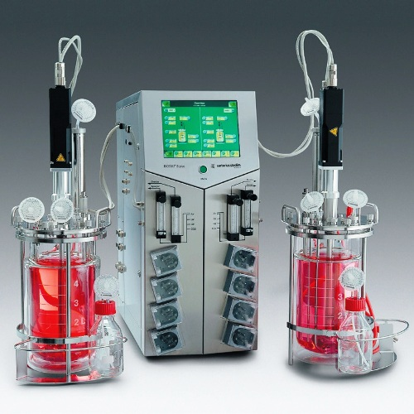
USP Development

Slide 23
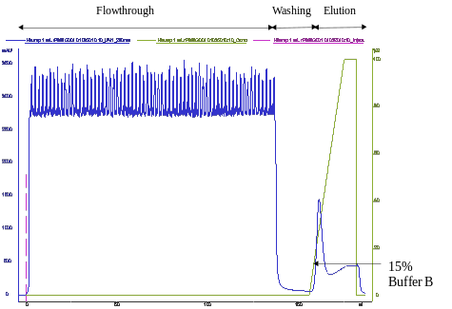
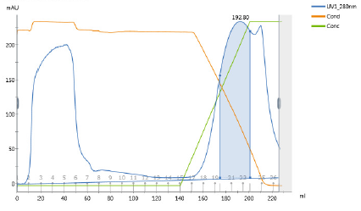
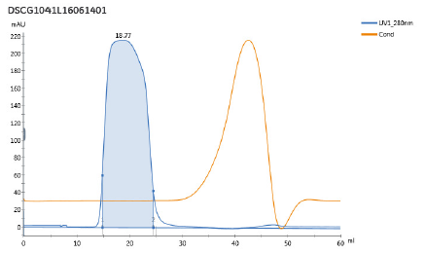
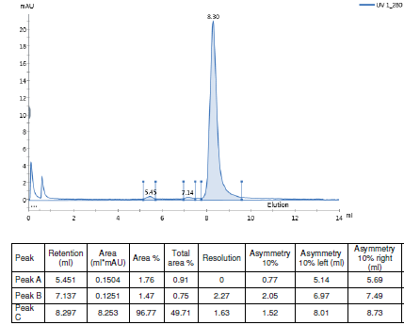
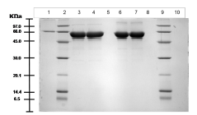
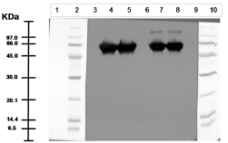
DSP Development
High trhougput DSP development and IPC testing
High Yield
High quality and stable target protein
DoE -Design space
Reproducible and Robust methods

Slide 24
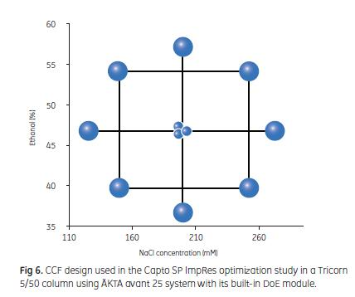
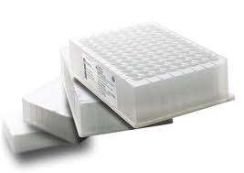
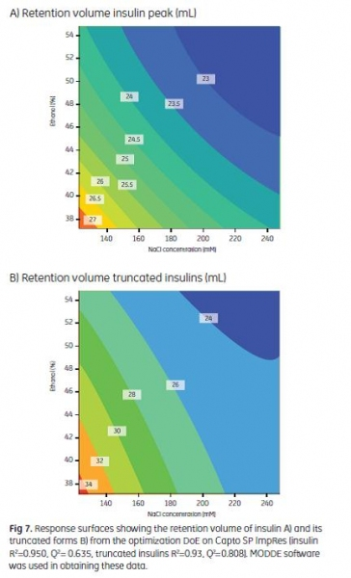
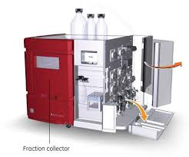
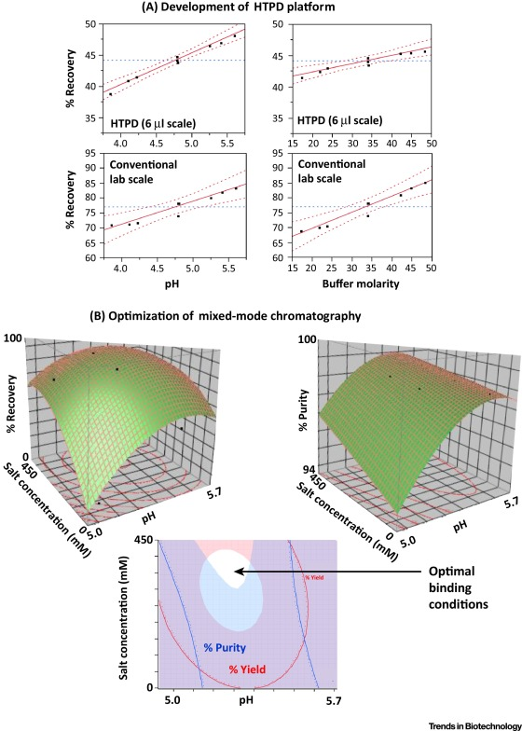
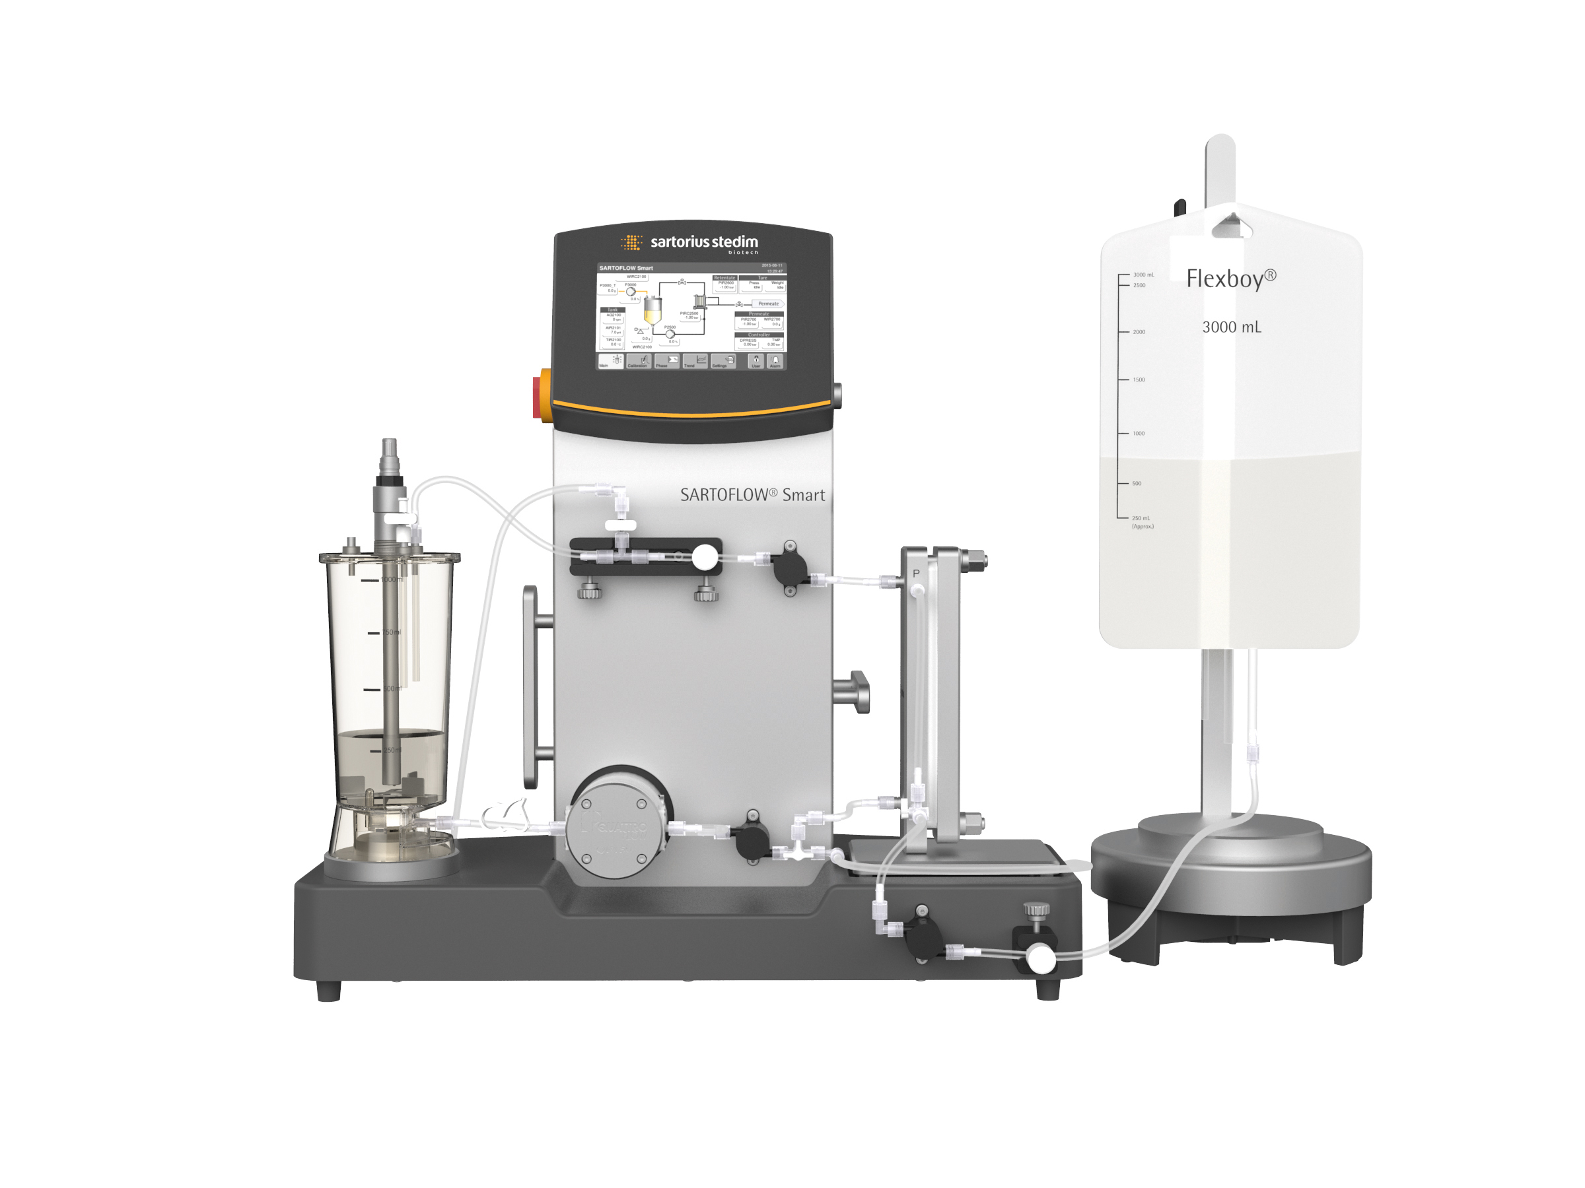
DSP Development
Notes:
Development guided to reach the sweet spots of the process, providing high yield and quality

Slide 25
Microbial process
Fermentation Harvest Lysis Clarification I Clarification II
Capture CEX Intermediate HIC Polish Filter Q Formulation TFF Filtration
Notes:
microbial

Slide 26
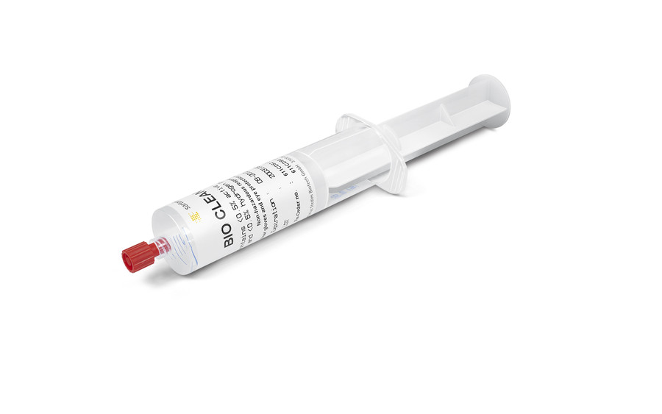
Mammalian process
Cell Expansion Feed Batch Filtration Filtration Capture Prot A Viral Inactivation
Intermediate CEX Polish Filter AEX Nanofiltration Formulation TFF Filtration Fill&Finish

Slide 27
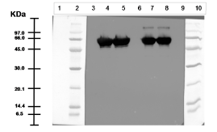
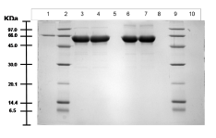
Characterization and Comparability
Identity, purity and impurity testin g by SDS PAGE and WB
Innovator and Biosimilar head to head comparability
Reducing and non reducing conditions

Slide 28
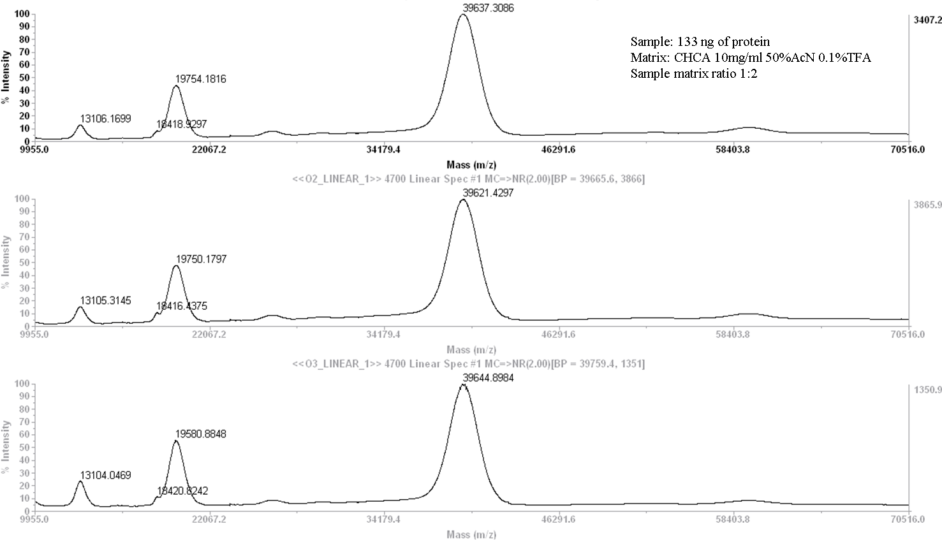
Intact mass MALDI TOF
Characterization and Comparability

Slide 29
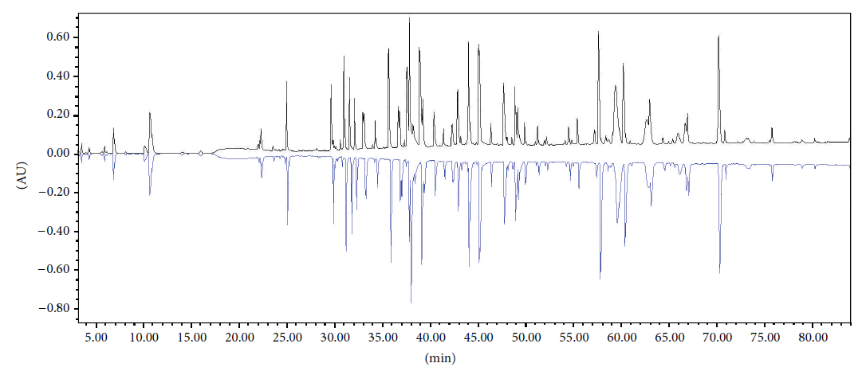
Characterisation of a Monoclonal Antibody - A Case Study
Characterization and Comparability
1º structure - Peptide map LC (only)
Mirror plot RP-UPLC-UV for Biosimilar (Trastuzumab-Probiomed ) (upper) and the RMP (lower).
Physicochemical and Biological Characterization ofa Biosimilar Trastuzumab. López-Morales et al, BioMed Research International, 2015

Slide 30
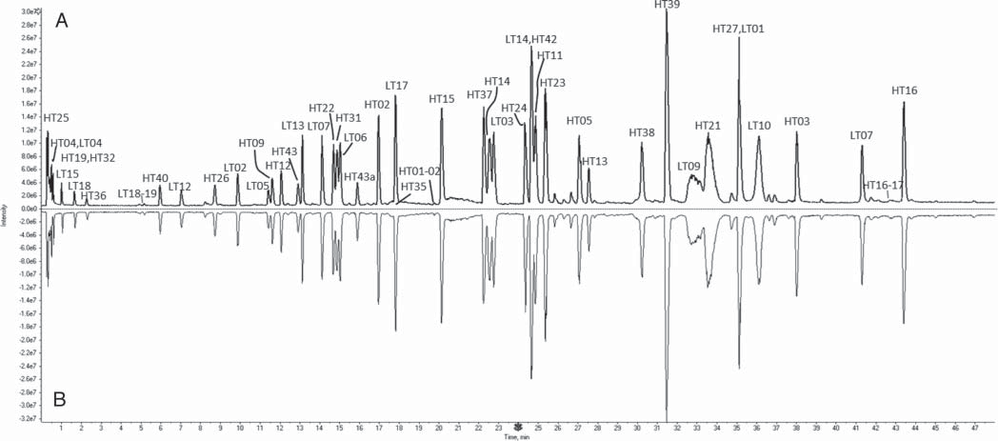
Characterisation of a Monoclonal Antibody - A Case Study
Characterization and Comparability
1º structure - Peptide Map LC-ESI-MS
Comparison of Total Ion Chromatogram of LC-ESI-MS peptide mapping between (A) Biosimilar (CT-P13) and (B) RMP
Physicochemical characterization of Remsima®. Soon Kwan Jung et al. (Celltrion), (2014), mAbs, 6:5, 1163-1177

Slide 31
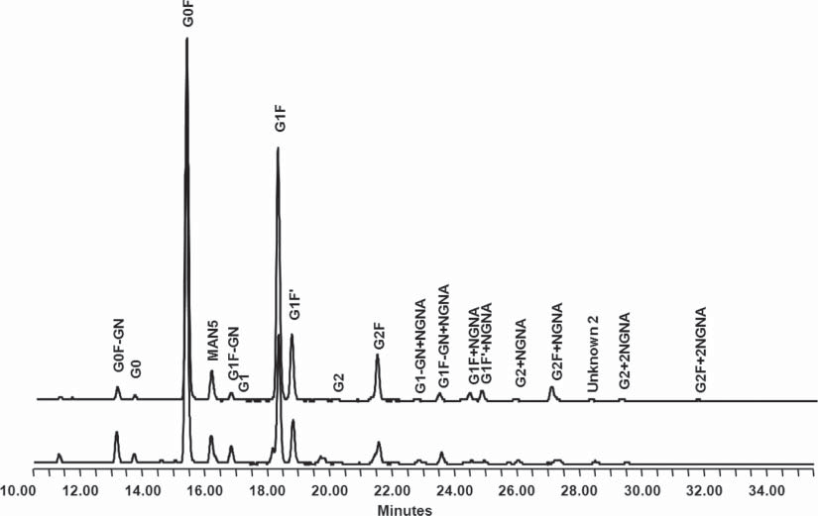
Characterisation of a Monoclonal Antibody - A Case Study
Characterization and Comparability
1º structure - Glycan profile by NP HPLC-FLD
Comparison of oligosaccharide profiles between RMP (up) and CT-P13 (down) analyzed by normal phase chromatography.
Physicochemical characterization of Remsima®. Soon Kwan Jung et al. (Celltrion), (2014), mAbs, 6:5, 1163-1177

Slide 32
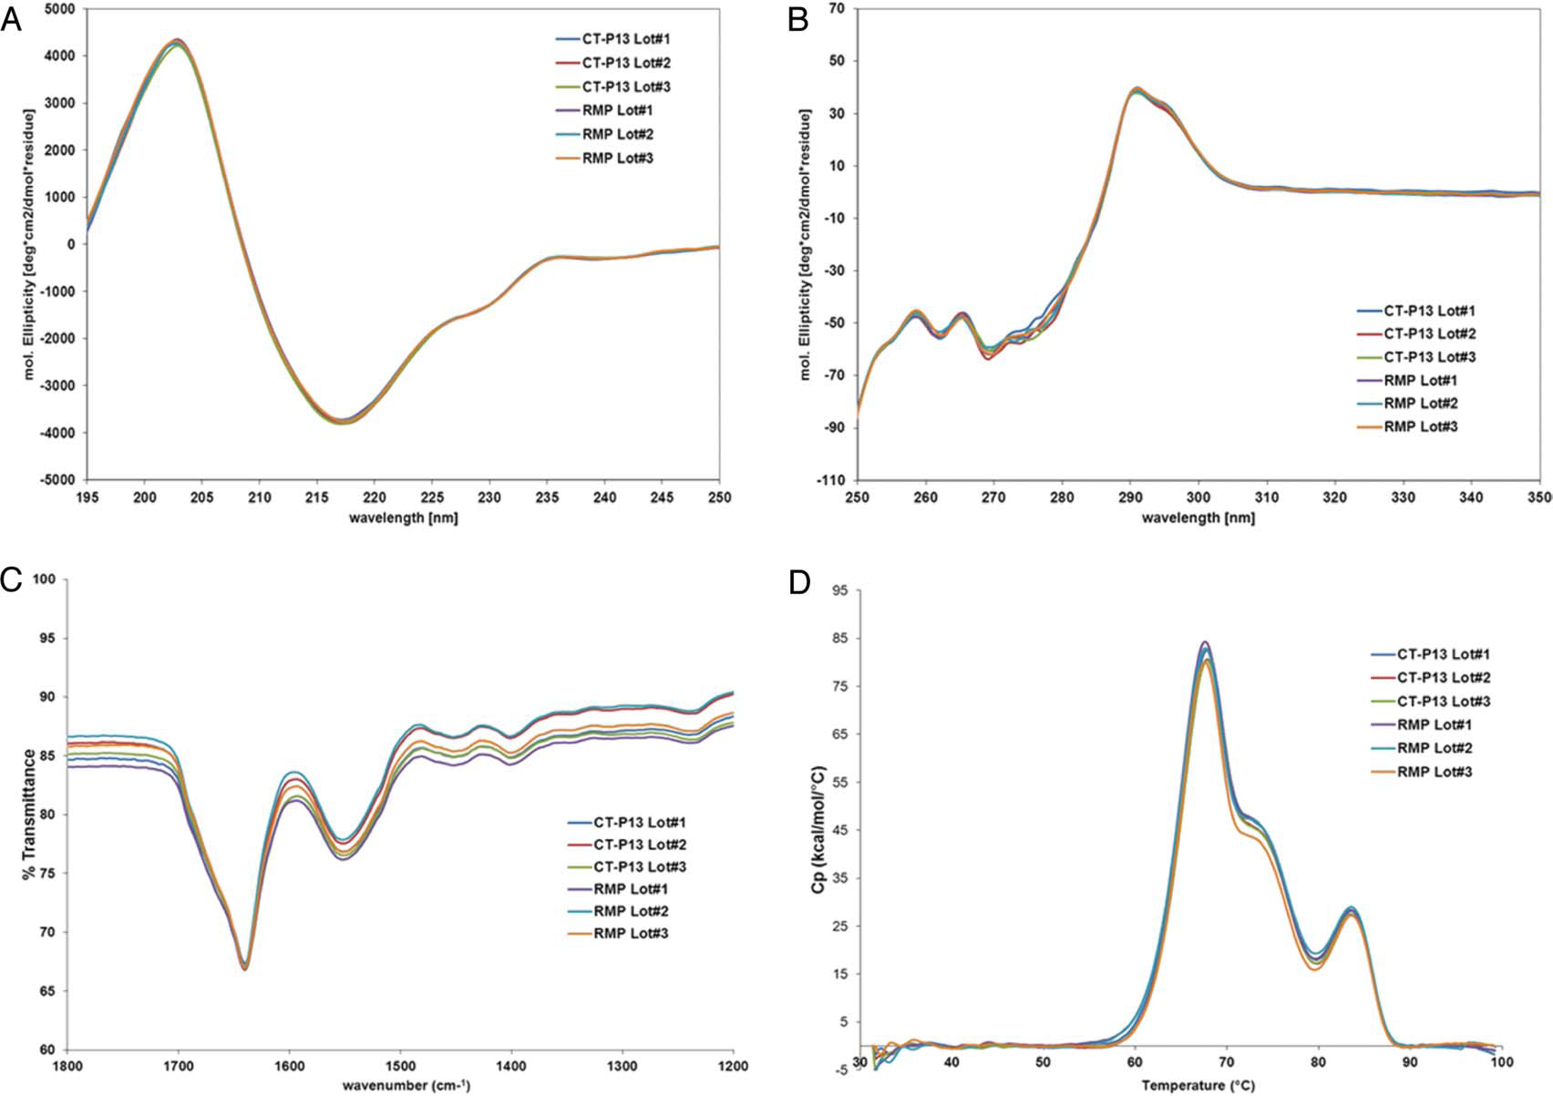
Characterisation of a Monoclonal Antibody - A Case Study
Characterization and Comparability
Higher order structure analysis
(A) Far-UV CD; (B) Near-UV CD; (C) FT-IR; (D) DSC.
Physicochemical characterization of Remsima®. Soon Kwan Jung et al. (Celltrion), (2014), mAbs, 6:5, 1163-1177

Slide 33
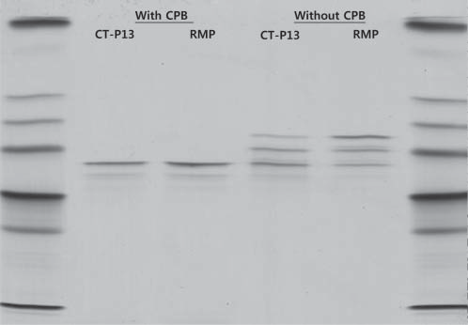
Characterisation of a Monoclonal Antibody - A Case Study
Characterization and Comparability
Charge Isoform profile by gel IEF
IEF results for CT-P13 (biosimilar) and RMP treated with and without Carboxypeptidase B.
Physicochemical characterization of Remsima®. Soon Kwan Jung et al. (Celltrion), (2014), mAbs, 6:5, 1163-1177

Slide 34
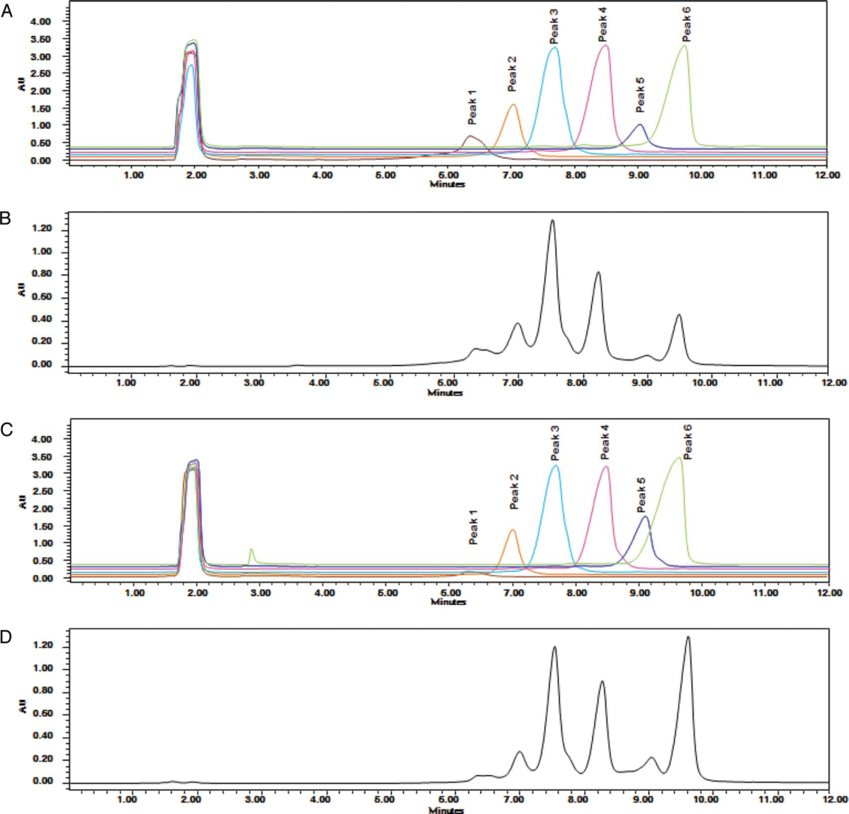
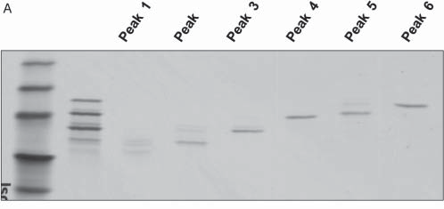
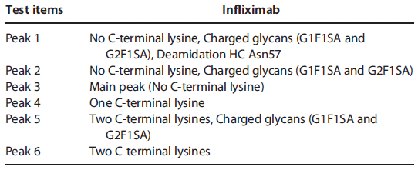
Characterisation of a Monoclonal Antibody - A Case Study
Characterization and Comparability
Identification of Charge Isoforms
Collect peak fractions and re-inject seperately. Overlay shown
WCX IEX-HPLC
IEF of each fraction
Pepmap ID and glycan analsyis of each fraction
Physicochemical characterization of Remsima®. Soon Kwan Jung et al. (Celltrion), (2014), mAbs, 6:5, 1163-1177

Slide 35
Characterisation of a Monoclonal Antibody - A Case Study
Comparability?
Biosimilar
WCX IEX-HPLC
RMP
Pepmap ID and glycan analsyis of each fraction
Clinical or safety effect?
Physicochemical characterization of Remsima®. Soon Kwan Jung et al. (Celltrion), (2014), mAbs, 6:5, 1163-1177

Slide 36
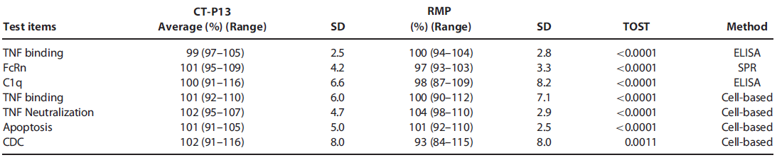
Characterisation of a Monoclonal Antibody - A Case Study
Biological activity
Physicochemical characterization of Remsima®. Soon Kwan Jung et al. (Celltrion), (2014), mAbs, 6:5, 1163-1177

Slide 37
Let us meet again..
We welcome you to our future conferences of Conference Series LLC
through
6th International Conference and Exhibition on Biologics and Biosimilars
October 19-21, 2016 Houston, TX, USA
http://biosimilars-biologics.pharmaceuticalconferences.com/europe

