Slide 1
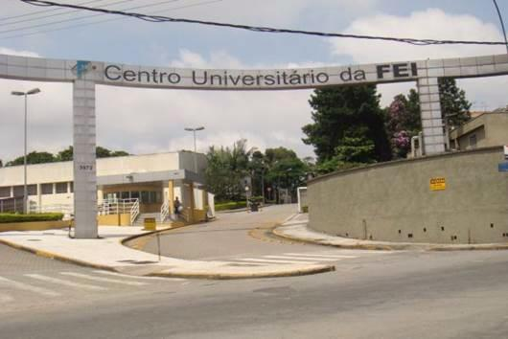

Optimization of conditions for obtaining hydrogels of PVA/SMTP and evaluation of the presence of crosslinks between chains
Profa. Dra. Andreia de Araújo Morandim-Giannetti
June, 2014

Slide 2
Definition of biomaterials
The biomaterial can be defined as natural or synthetic biological compound used in contact with the intention to treat, augment or replace tissue, organs or body functions being formed mainly from metals, ceramic materials and polymer materials systems
Application:
Dermatology (prosthetic filling, release transdermal drug delivery system).
Ophthalmology (vitreous replacements, contact lenses, intraocular drug release) among others.
Okaya T., Suzuki A., Kikuchi K. Colloids and Surfaces A: Physiochemical and Engineering Aspects. V.153, p.123-125, 1999.
Swindle-Reilly K. E., Shah M., Hamilton P. D., Eskin T.A., Kaushal S., Ravi N. Investigative Ophthalmology & Visual Science, v.50, n.10, p.4840-4846, 2009.

Slide 3
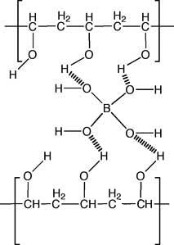
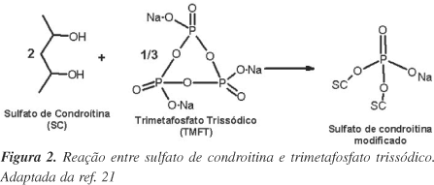
Definition of hydrogels
Crosslinked polymeric material which retains a significant fraction of water in its structure but without dissolving.
The crosslinking between chains can be obtained from:
covalent interactions
Physical interactions (eg, intermolecular interaction)

Slide 4
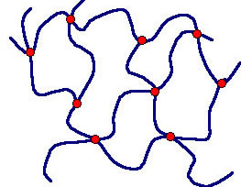
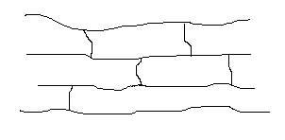
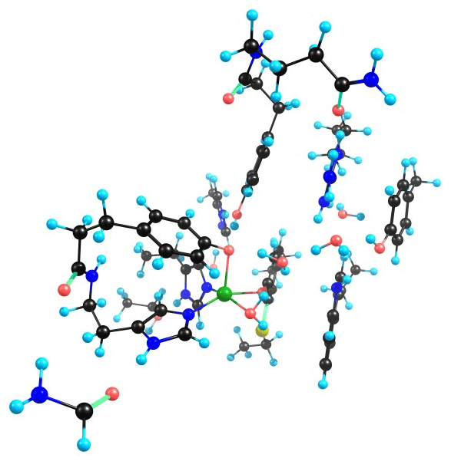
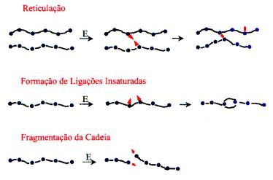
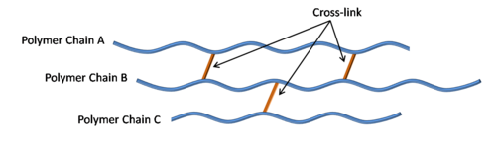
Crosslinked hydrogels

Slide 5
Choose the matrix
While obtaining possible hydrogels, it is possible to use various polymers alone or as blends as matrices. E.g.
polyvinyl alcohol
polyacrylamide
Chitosana
methylcellulose
starch
Methyl Methacrylate
polyvinylpyrrolidone
polysaccharides
hydroxyapatite
Chirila T.V., Hongb Y., Dalton P.D., Constable I.J., Refojo M.F. Progress in Polymer Science. V.23, p.475-508, 1998.
Okaya T., Suzuki A., Kikuchi K. Colloids and Surfaces A: Physiochemical and Engineering Aspects. V.153, p.123-125, 1999.
Swindle-Reilly K. E., Shah M., Hamilton P. D., Eskin T.A., Kaushal S., Ravi N. Investigative Ophthalmology & Visual Science, v.50, n.10, p.4840-4846, 2009.

Slide 6
Selection of crosslinker agents
Regarding primers crosslinking, we can include:
ionizing radiation
1,5-hexadiene-3 ,4-diol
Ammonium persulfate
Ethylene diacrylate
glutaraldehyde
genipin
Trisodium trimetaphosphate

Slide 7
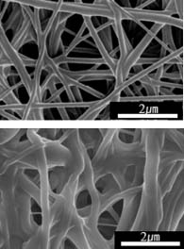
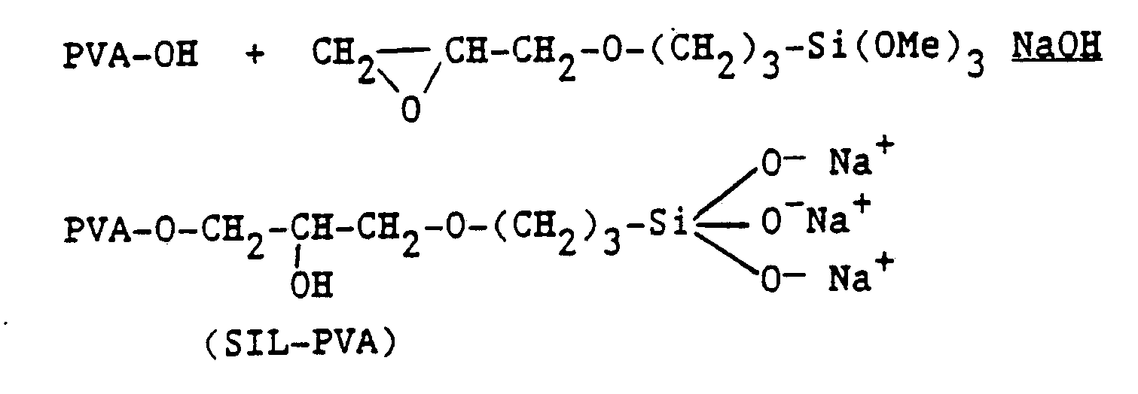
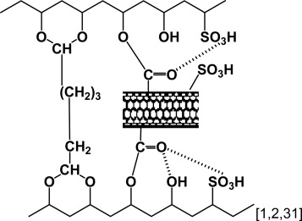
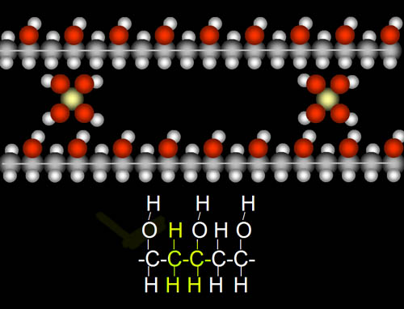
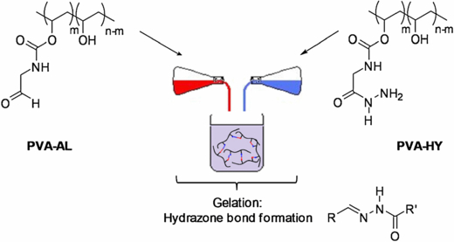
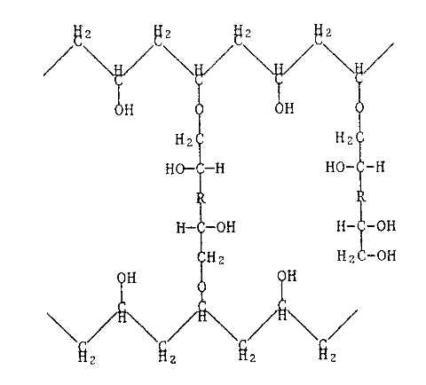
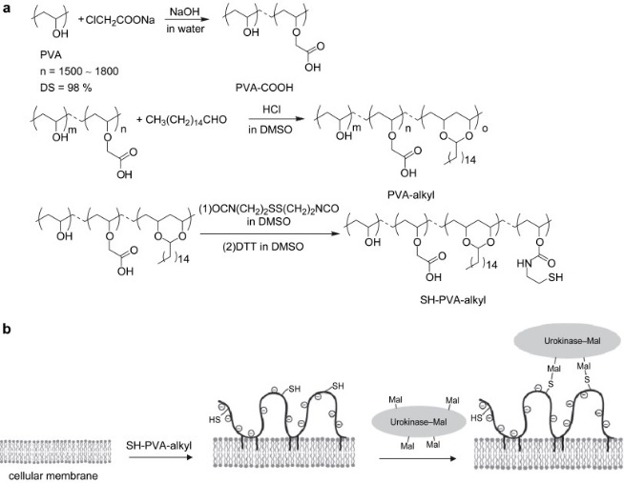

Slide 8
Physical and chemical characterizations
Characterizations, include:
mechanical properties
rheological Testing
viscosity
density
infra red
Scanning electron microscopy
X-Ray Diffraction
thermal analysis
Refractive Index
Swell Grade
Fraction sol / gel

Slide 9
Biological characterizations
Biological characterizations:
cytotoxicity
microbiological
“In vitro" tests
“In vivo“ tests

Slide 10
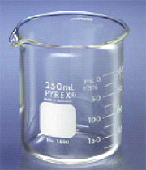
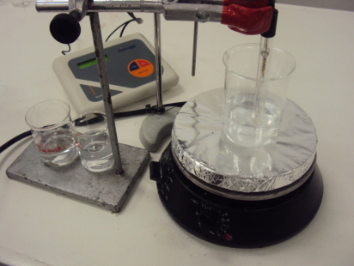
PVA hydrogel with SMTP
100
mL
water
hydrogel
5 g de PVA
0.625
g SMTP
Refractive Index
agitation
Density
T = 80ºC
Viscosity
T = 2 h
Property | Unit
Weight | 4 g
Density | 1.0053-1.0089 g/cm
Water content | 98-99%
pH | 7.0-7.4
Viscosity | 4.0-4.2 mPa
Refractive Index | 1.3345-1.3348

Slide 11
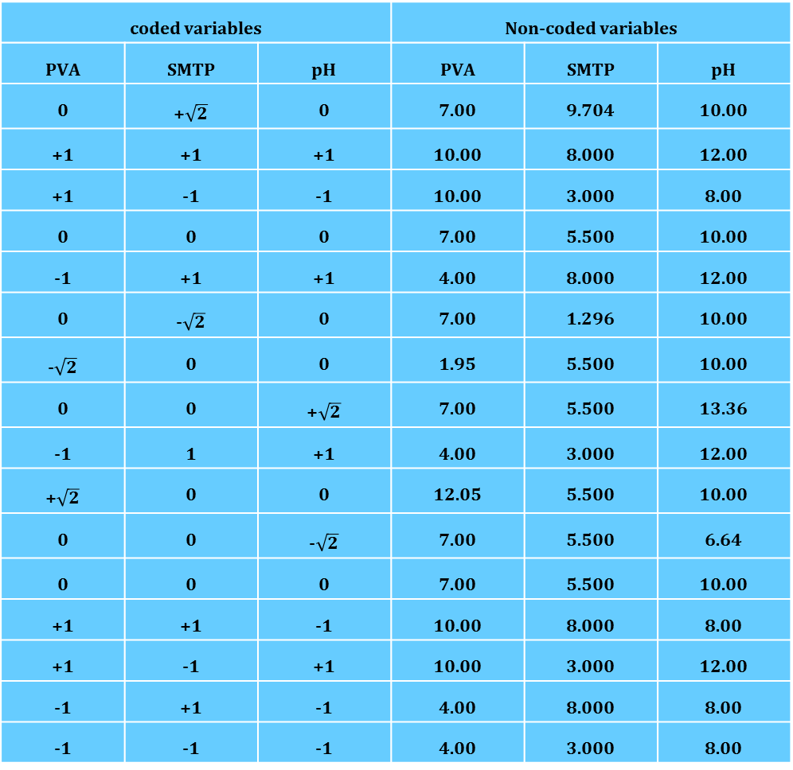
Experimental Design
coded variables |  |  | Non-coded variables
PVA | SMTP | pH | PVA | SMTP | pH
0 | +$\sqrt{2}$ | 0 | 7.00 | 9.704 | 10.00
+1 | +1 | +1 | 10.00 | 8.000 | 12.00
+1 | -1 | -1 | 10.00 | 3.000 | 8.00
0 | 0 | 0 | 7.00 | 5.500 | 10.00
-1 | +1 | +1 | 4.00 | 8.000 | 12.00
0 | -$\sqrt{2}$ | 0 | 7.00 | 1.296 | 10.00
-$\sqrt{2}$ | 0 | 0 | 1.95 | 5.500 | 10.00
0 | 0 | +$\sqrt{2}$ | 7.00 | 5.500 | 13.36
-1 | 1 | +1 | 4.00 | 3.000 | 12.00
+$\sqrt{2}$ | 0 | 0 | 12.05 | 5.500 | 10.00
0 | 0 | -$\sqrt{2}$ | 7.00 | 5.500 | 6.64
0 | 0 | 0 | 7.00 | 5.500 | 10.00
+1 | +1 | -1 | 10.00 | 8.000 | 8.00
+1 | -1 | +1 | 10.00 | 3.000 | 12.00
-1 | +1 | -1 | 4.00 | 8.000 | 8.00
-1 | -1 | -1 | 4.00 | 3.000 | 8.00

Slide 12
Results and Discussion

Slide 13
Results and Discussion
Parameters used during the analysis:
Final pH: Between 7.0 and 7.4 (optimum = 4.2)
Index of Refraction: <1.337
Dynamic viscosity (25 ° C): Between 4.0 and 4.2 (optimum = 4.1)
Density (25 º C): Between 1.0053 and 1.0089 (ideal = 1.0071)

Slide 14
Results and Discussion

Slide 15
Analysis of results
Optimized input variables:
Initial pH: 9.328
Mass of polyvinyl alcohol per 100 ml water: 4.1383 g
Relationship SMTP / PVA: 1/7.4619
Optimized output variables
Final pH: 7.20
Refractive Index: 1.3407
Dynamic viscosity (25 ° C): 4.617 mPa
Density (25 º C): 1.0071 g / mL

Slide 16
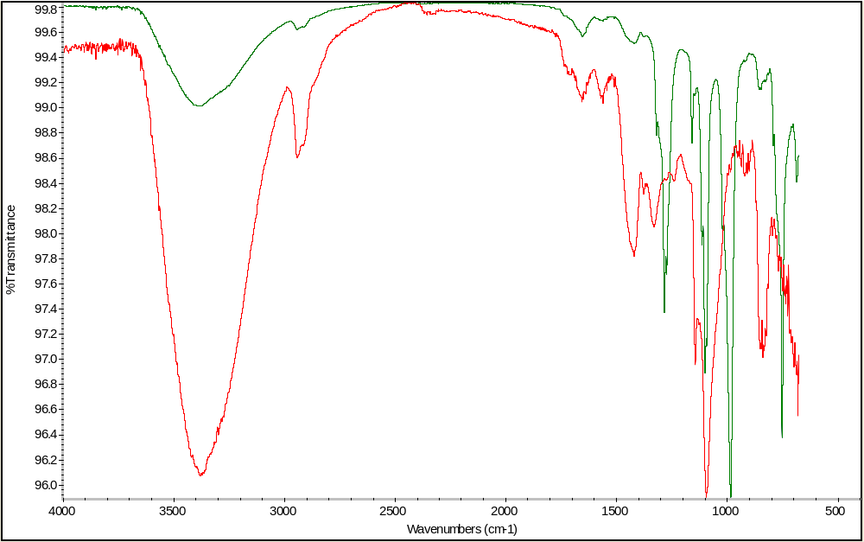
Infrared spectra
Hydrogel with SMTP
Hydrogel without SMTP

Slide 17
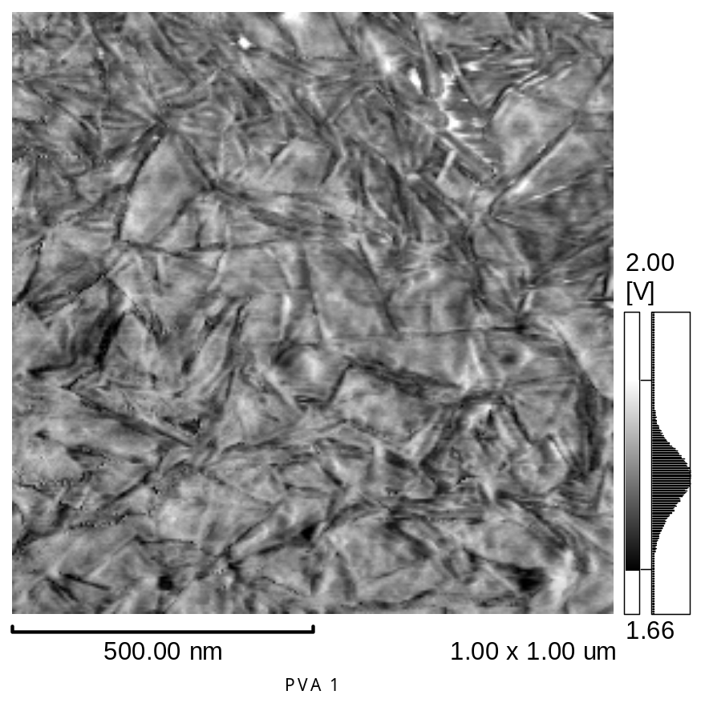
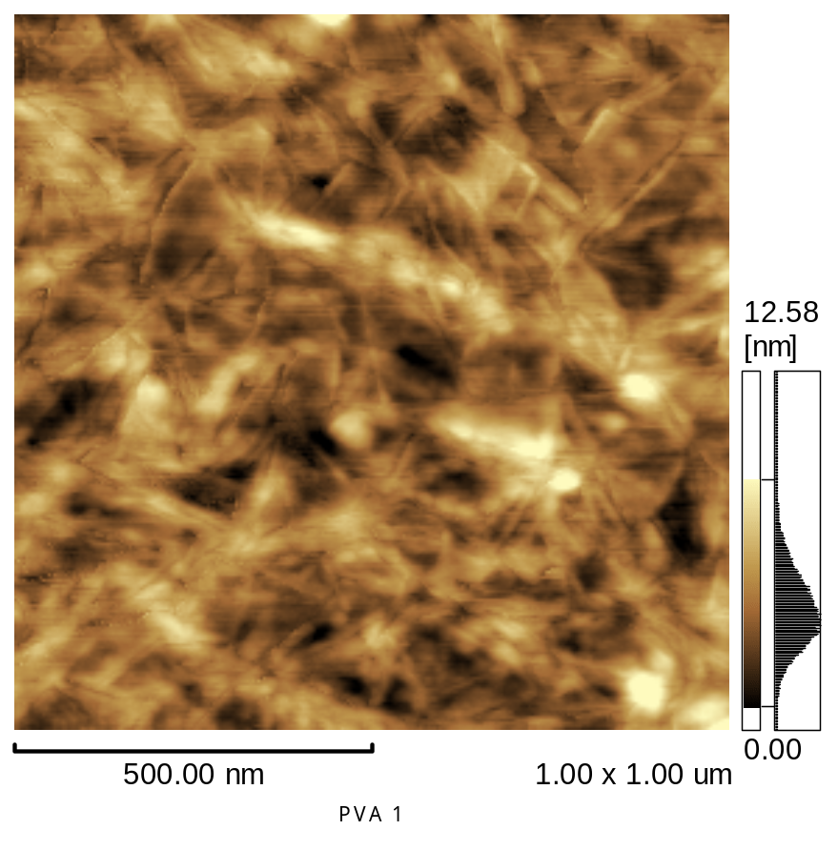
Analysis by atomic force microscopy

Slide 18
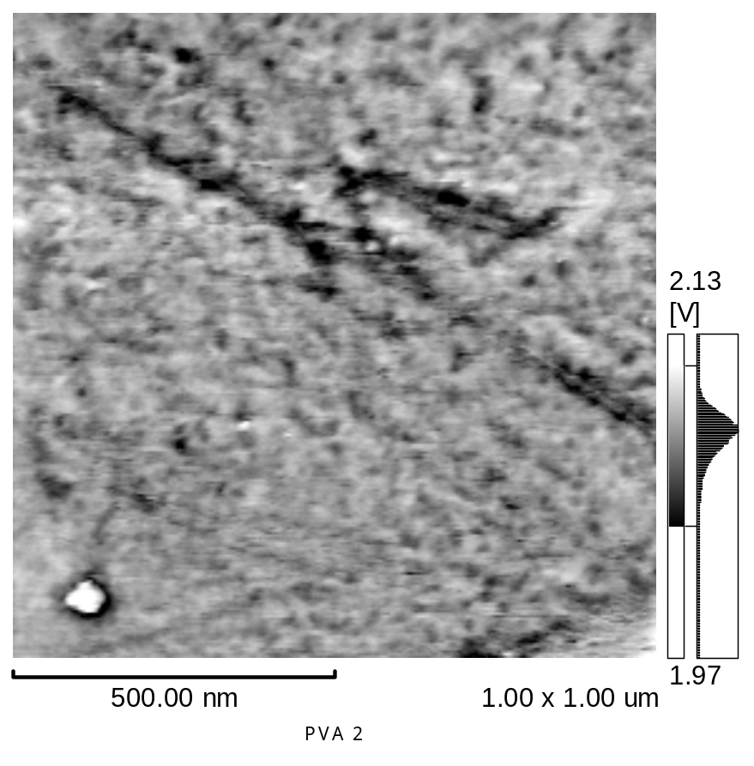
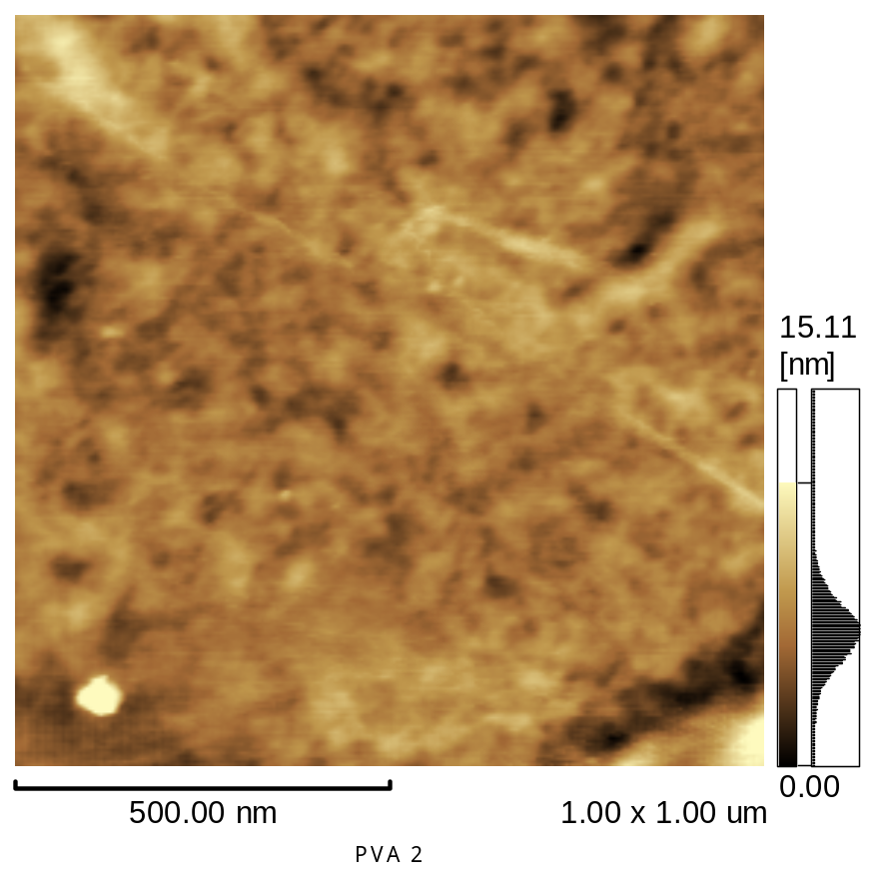
Analysis by atomic force microscopy

Slide 19
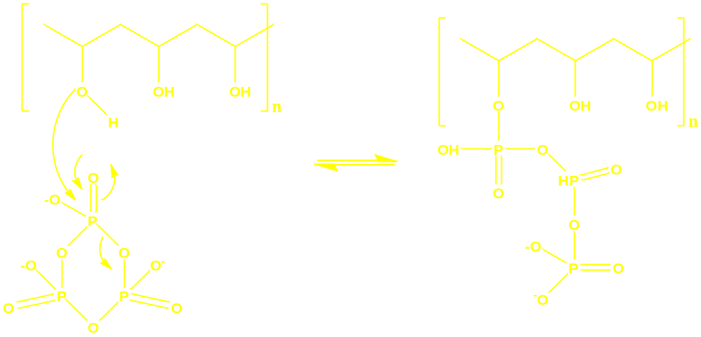
Analysis by atomic force microscopy
We observe a more compact material because of the presence of crosslinking between the PVA and the SMTP

Slide 20
Biomaterial Properties
Changes in ownership of swelling due to lower availability of hydrogen bonds and larger space between the chains
24
Degree of swelling of hydrogels with or without SMTP

Slide 21
Conclusion
The biomaterial obtained had the necessary characteristics
Crosslinking between PVA and SMTP was checked due to the observed changes in the material
The SMTP was important to obtain the required specification

Slide 22
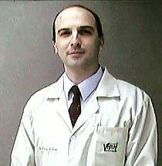

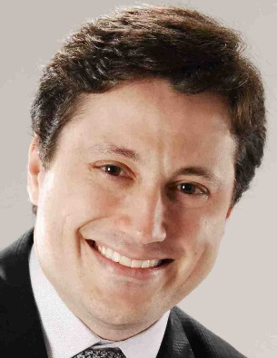


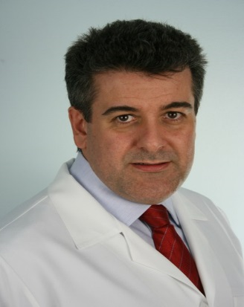
Team
Andreia de Araújo Morandim Giannetti
Octaviano Magalhães Junior
Patrícia Alessandra Bersanetti
Paulo Schor
Regina Freitas Nogueira
Wallace Chamon Alves de Siqueira

Slide 23



Acknowledgements

Slide 24
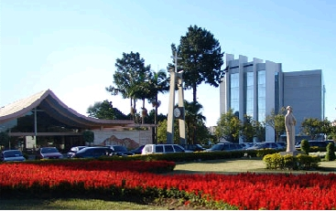

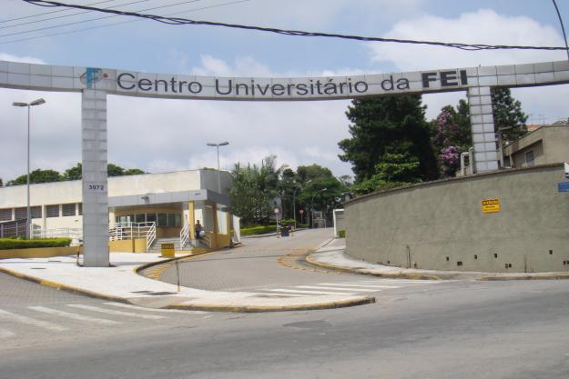
Acknowledgements

