Slide 1

Utilizing cancer sequencing in the clinic: Best practices in variant analysis, filtering and annotation
Dr. Andreas Scherer
Dr. Andreas Scherer
President and CEO
Golden Helix, Inc.
scherer@goldenhelix.com
Twitter: andreasscherer

Slide 2




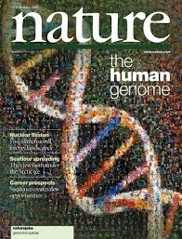

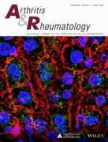
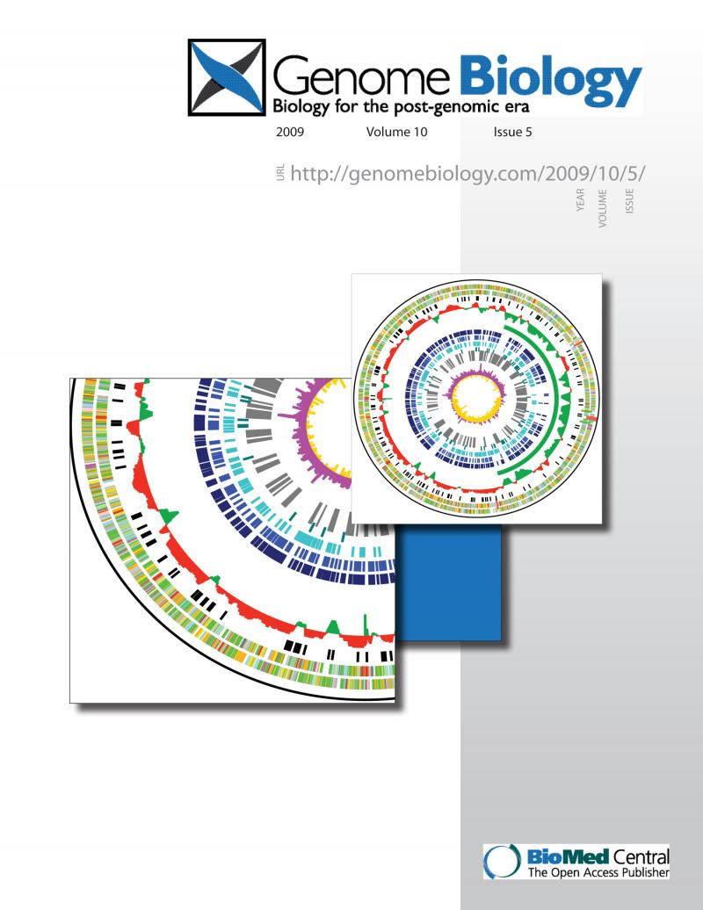
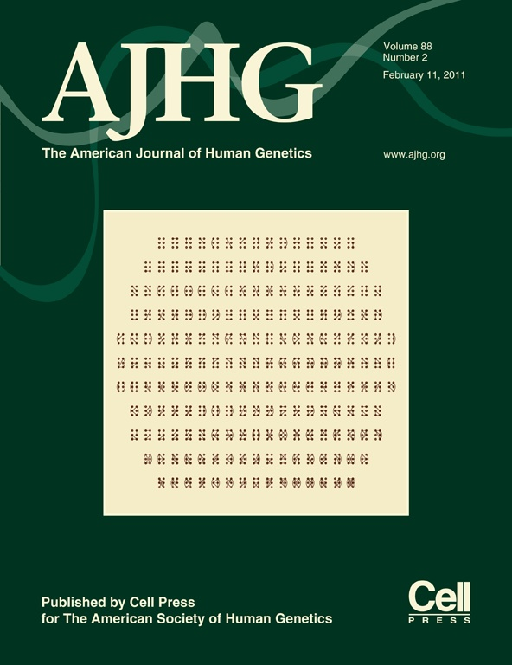



Golden Helix – Who We Are
Golden Helix is a global bioinformatics company founded in 1998.
We are cited in over 900 peer-reviewed publications
Notes:
Founded in 1998
Founder spun off from early work at GlaxoSmith Kline, who was a key investor
Started with HelixTree, which is now SNP & Variation Suite, or SVS, and have added 2 new products, GenomeBrowse and VarSeq.
Company has 17 years of expertise in the field of bioinformatics, have been in the market since before GWAS was born
Cited in over 900 peer-reviewed publications

Slide 3
























Our Customers
Over 200 organizations world wide, and thousands of users, trust our software.
Notes:
Global
Customers on all continents except Antarctica
Over 200 organizations, including top-tier research universities around the world, major government institutions, and pharmaceutical companies
More than 7,000 installs of our products

Slide 4
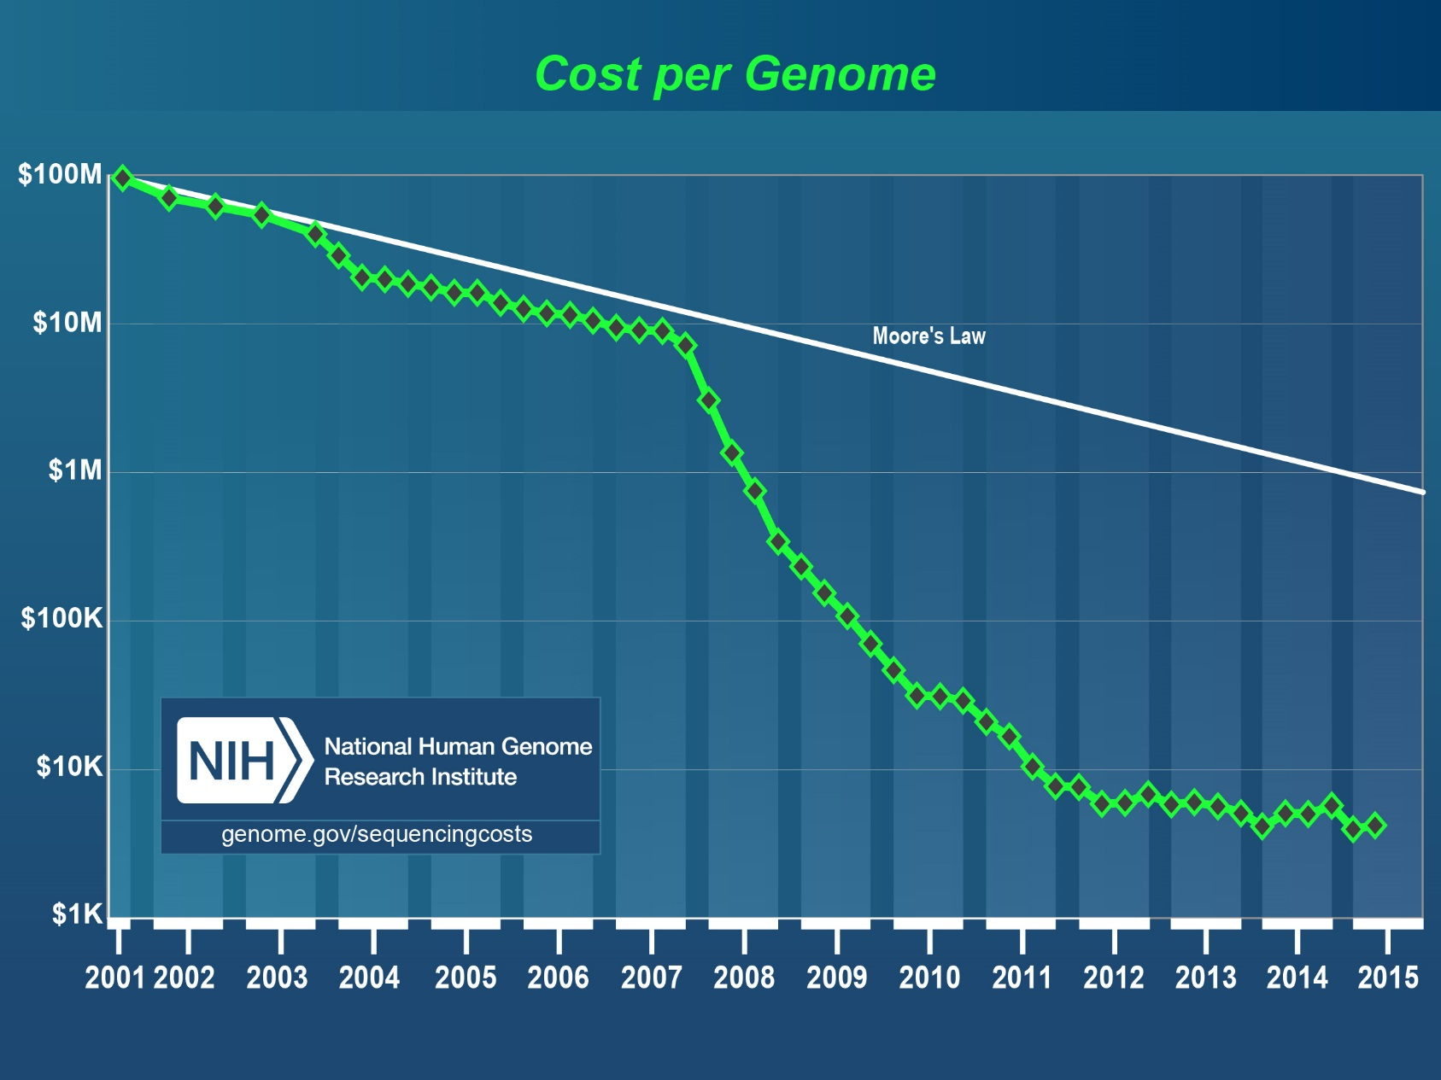
“Moore’s Law” NGS Cost Graph

Slide 5

Adoption
Early Stage | Moderate Adoption | High Adoption
Market focus is on science and research, lack of infrastructure, clinical evidence and physician education. | Clinical genetic standard for selected targets and therapeutic areas. Bioinformatics increasingly crucial for diagnosis and treatment selection. | Greater availability of data around testing with genetic services becoming standard of care for a majority of patients.
Regulatory Landscape | Reimbursement | Bioinformatics
Testing Technology | Education | Consumer Demand

Slide 6

New E-book on Precision Medicine
www.goldenhelix.com

Slide 7
Global numbers
In 2012 about 14.1 million cases in cancer occurred globally (excluding skin cancer). Common types are
Cancer risk increases with age. It occurs more commonly in the developed world due to increased life expectancy and lifestyle choices.
The financial costs of cancer is estimated to be $1.16 trillion in 2010 according to the World Cancer Report.
Males | Females
Lung cancer | Breast cancer
Prostate cancer | Lung cancer
Colorectal cancer | Colorectal cancer
Stomach cancer | Cervical cancer

Slide 8
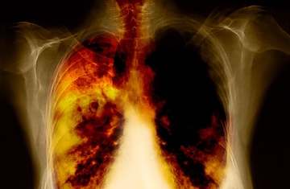
Lung Cancer
Small cell lung cancer (SCLC): Highly aggressive with a high likelihood of metastases at diagnosis. Mostly, patients are treated with chemotherapy.
Non-small cell lung cancer (NSCLC): About one third of the patients are diagnosed with this subtype. If caught early enough, then the likelihood of the cancer being local to the lungs is high. Therefore surgery is a valid treatment option, although the chances for NSCLS patients to develop recurrences after surgery is still to be quantified at 30%-60%.

Slide 9
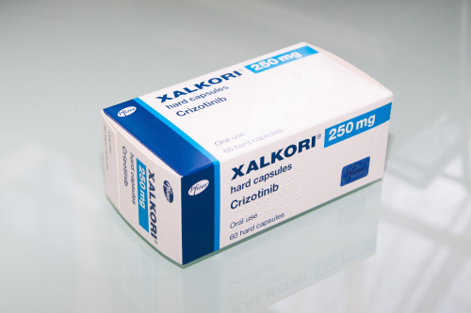
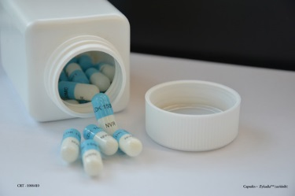
Lung Cancer
Crizotinib
Ceritinib
Now, in recent years more effective therapies have been developed to target very specific molecules or pathways that influence the cancer tumor. One example is the anaplastic lymphoma kinase (ALK). Clinical trials have shown that patients with tumors driven by these aberrant genes can be treated with very specific drugs resulting in response rates of over 60%.
Craddock et. al. (2013) provides an extensive list of genes that have mutated forms linked to lung cancers. The variations are typically simple mutations that can be tested effectively via a gene panels

Slide 10
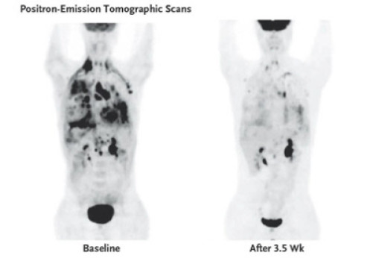
Impact of Ceritinib

Slide 11
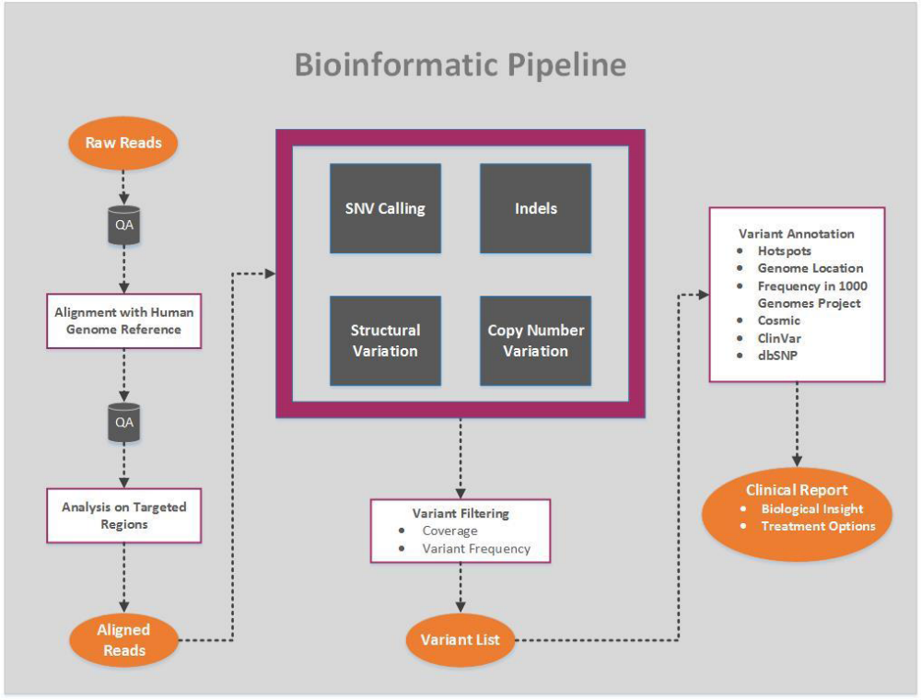
Bioinformatics Pipeline

Slide 12
Alignment and Variant Calling
FASTQ File
BAM File
TCAGACTGGAA
AGACTGGAAGC
AGTCAAATTGG
CAGACTGGAAG
CAGTCAAATTG
GTCAAATTGGA
AGACTGGAAGC
TCAAATTGGAA
TCAGACTGGAA
AGACTGGAAGC
AGTCAGATTGG
CAGACTGGAAG
CAGTCAAATTG
GTCAGATTGGA
AGACTGGAAGC
TCAAATTGGAA
Alignment
REF: CAGTCAGATTGGAAGC
VCF File
Position 7, Genotype: G/A, AF=0.25
Position 9, Genotype: T/C, AF=0.5
Notes:
Fasta files simple unaligned reads between 50 to 250 bp long
With a sweet spot around 100.
Each base has a quality score assicated.
Quality of a read goes down over the length of the read.
Now we have to align to read to a standard reference sequence producing a bam file
More organized version that inludes the mapping information
FastQ files millions reads
Matching those in Gene Panels is a bit easier (more defined target space)
Today’s cancer gene panels from Illumina or Ion torrent have about 100 -200 genes associated with the disease
We also see custom panels.

Slide 13
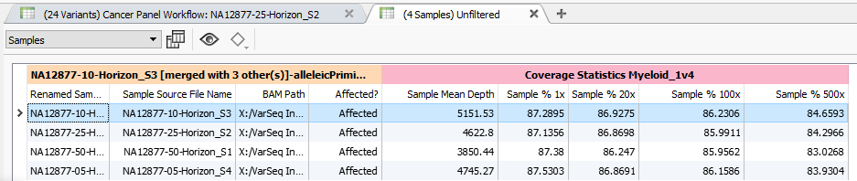
Cancer Gene Panels
Focus on cancer genes with available treatment options, e.g.
  ALK – crizotinib - Lung Cancer
  BRAF (BRAF V600E) – dabrafenib and trametinib - FDA approved combination therapy for melanoma patients -
Quality assurance needed to know expected regions properly “covered”.
Notes:
Sources are updated by Golden Helix when an update is available
Example:
ClinVar database is released by NCBI on a monthly basis in two files (VCF and TXT)
Our data curation team supplements the variants in the VCF file with those in the TXT file for a single ClinVar source
The curated data is then subjected to a rigorous quality control procedure to ensure the data is correctly represented and complete
Curated data sources are often smaller than the original file due to our storage format
Example:
dbNSFP 2.9 was originally 8.2 GB compressed, 60.5 GB uncompressed in 24 files, in TSF format it is 6.5 GB uncompressed

Slide 14
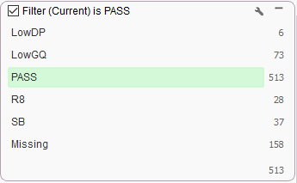
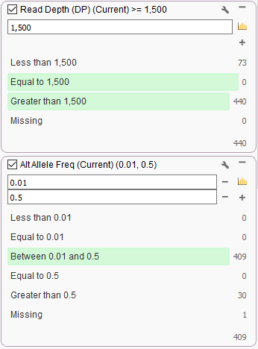
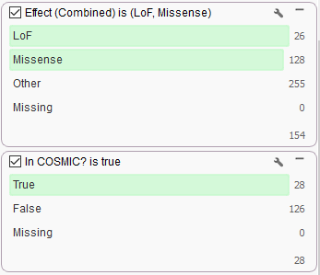
Cancer Gene Panels Filtering
Quality Score
Secondary Analysis
Verifying Read Depth &
Allele Frequency
Damaging Variants
Discussed in Cosmic

Slide 15
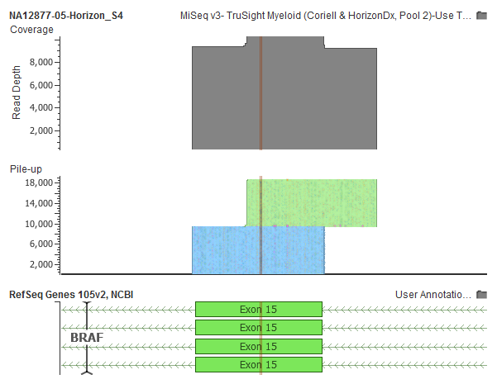
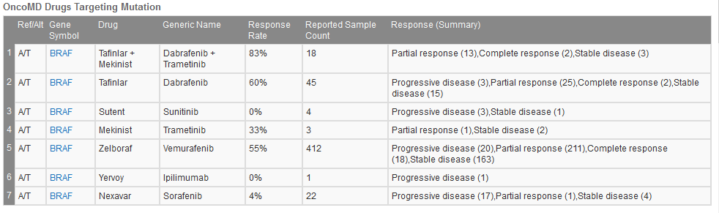
Example BRAF V600E
BRAF V600E in Context.
10K coverage with amplicon capture over full exon 15 of BRAF
Targeted Molecular therapies for patients with BRAF V600E through OncoMD

Slide 16
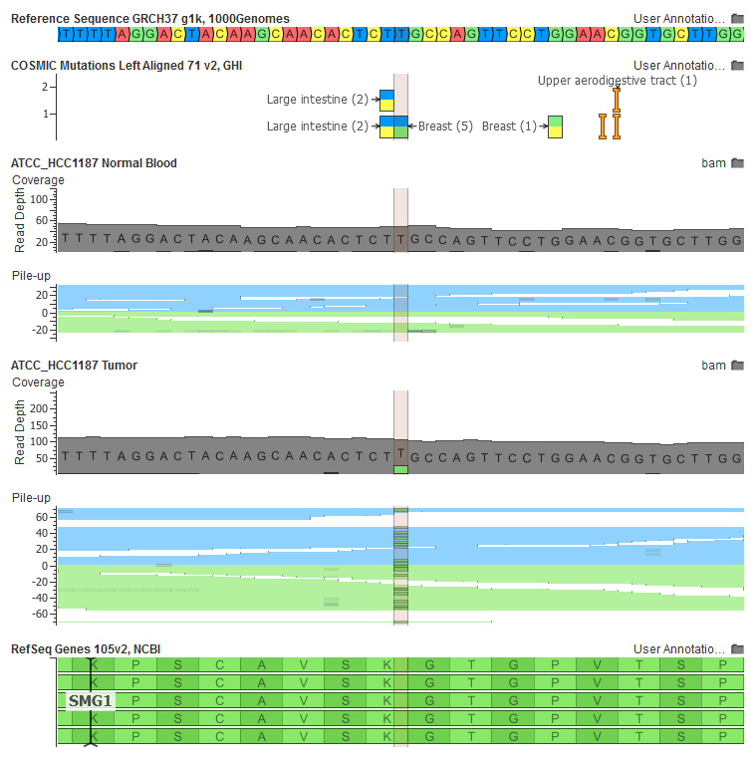
Tumor / Normal Analysis
Often done on exomes, to find novel somatic mutations regardless of their proportion of mutated cells to normal cells in tumor sample.
Subtract out germline mutations present in “normal” blood
Use sources like COSMIC to provide context of prevalence of mutation in different cancer types
Use visualization to validate.
Notes:
Sources are updated by Golden Helix when an update is available
Example:
ClinVar database is released by NCBI on a monthly basis in two files (VCF and TXT)
Our data curation team supplements the variants in the VCF file with those in the TXT file for a single ClinVar source
The curated data is then subjected to a rigorous quality control procedure to ensure the data is correctly represented and complete
Curated data sources are often smaller than the original file due to our storage format
Example:
dbNSFP 2.9 was originally 8.2 GB compressed, 60.5 GB uncompressed in 24 files, in TSF format it is 6.5 GB uncompressed

Slide 17
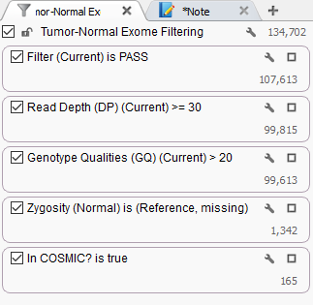
Tumor Normal Filtering
QC of the secondary pipeline in Filter 1, 2 and 3
Look at variants called in the tumor not present in the normal
Is the variant in Cosmic documented
Start research on resulting variant set

Slide 18
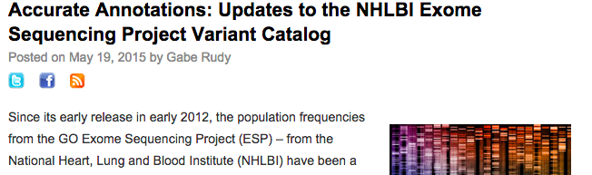
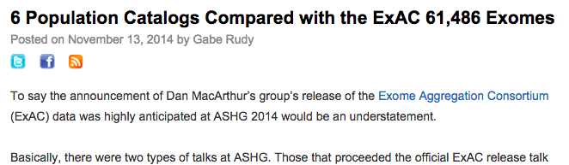
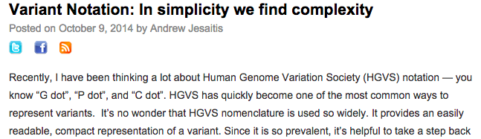
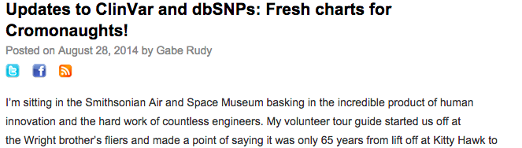
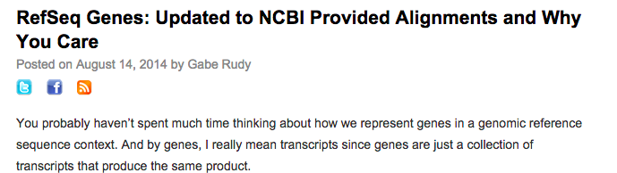
Annotations are Hard!
HGVS is a standard that is not standard
  Tries to serve different goals
  Many representations of same variant
  Should not be used as IDs, but not many good alternatives
Transcripts
  Transcript set choice extremely important, hard to curate with meaningful attributes as well.
Public Data Curation
  ClinVar: multi-record lines
  NHLBI: MAF vs AAF, splitting “glob” fields
  1kG: No genotype counts
  ExAC: Multi-allelic splitting, left-align
  COSMIC: No Ref/Alt, only HGVS
  dbNSFP: Abbreviations and aggregate scores
Versioning and Issues
  ClinVar missing variants in VCF
  dbSNP patches without version changes
Notes:
Upload VCF, get back VCF or interactive report

Slide 19
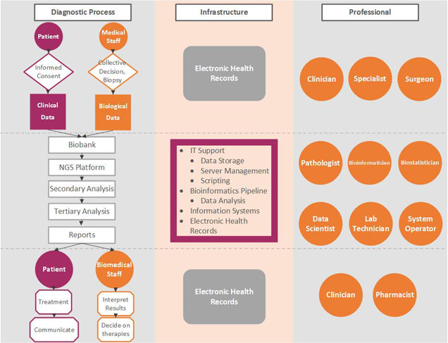
Extended Infrastructure

Slide 20
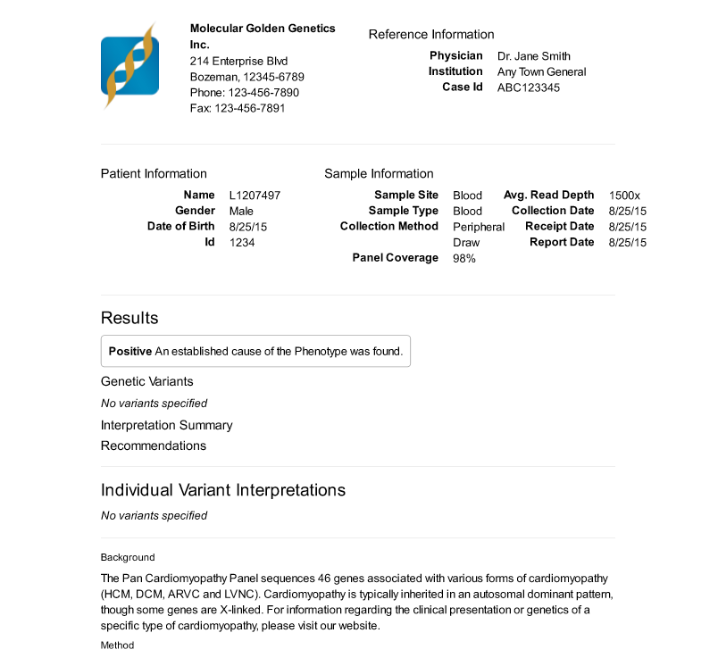
Clinical Reporting
Primary findings
  Per variant: evidence, drug targets, potential clinical trials
  Interpretation of results & Diagnosis
Secondary Findings
  Findings of novel or rare variants
  Evidence of potential pathogenicity
  Incidental findings
Important Capabilities
  Integration into legacy systems
  Warehousing
  Automation to minimize human error and increase lab throughput

Slide 21
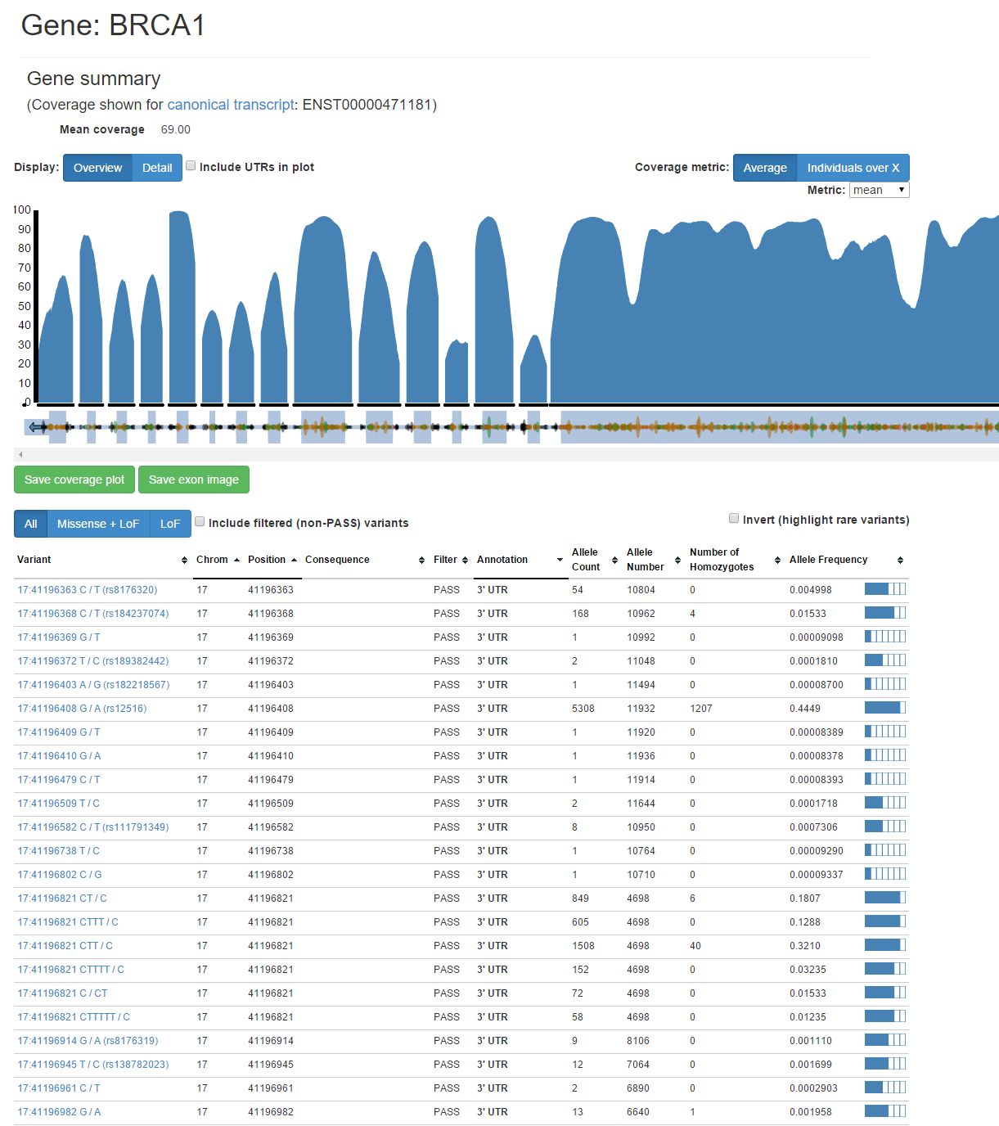
Warehousing of Sequenced Variants
Lab-level Warehouse
  Store every sample ever processed
  Store all variants and associated annotations
  Store all associated reports
Queries
  Have I observed this variant before?
  At what frequency?
  Was it a primary/secondary finding in a report?
  Did the classification of a variant change (e.g. from rare to common, from unknown pathogenicity to pathogenic)
Integration Point
  Integration with LIMS/EMR

Slide 22

Summary
www.goldenhelix.com/resources/ebooks

