Slide 1

Precision Medicine
Dr. Andreas Scherer
President and CEO
Golden Helix, Inc.
scherer@goldenhelix.com
Twitter: andreasscherer
Dr. Andreas Scherer

Slide 2

Precision Medicine
“Doctors have always recognized that every patient is unique, and doctors have always tried to tailor their treatments as best they can to individuals. You can match a blood transfusion to a blood type — that was an important discovery. What if matching a cancer cure to our genetic code was just as easy, just as standard? What if figuring out the right dose of medicine was as simple as taking our temperature?”
President Obama, January 30, 2015

Slide 3



Golden Helix – Who We Are
Golden Helix is a global bioinformatics company founded in 1998.
Filtering and Annotation
Clinical Reports
Pipeline
Data Warehousing
GWAS
Genomic Prediction
Large-N-Population Studies
RNA-Seq
CNV-Analysis
Notes:
Founded in 1998
Founder spun off from early work at GlaxoSmith Kline, who was a key investor
Started with HelixTree, which is now SNP & Variation Suite, or SVS, and have added 2 new products, GenomeBrowse and VarSeq.
Company has 17 years of expertise in the field of bioinformatics, have been in the market since before GWAS was born
Cited in over 900 peer-reviewed publications

Slide 4
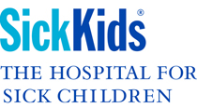











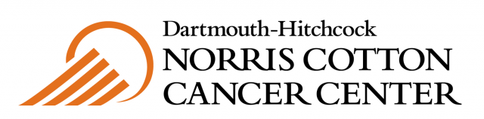







Over 350 customers globally

Slide 5

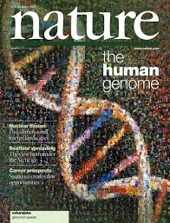



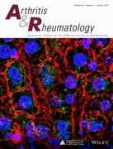
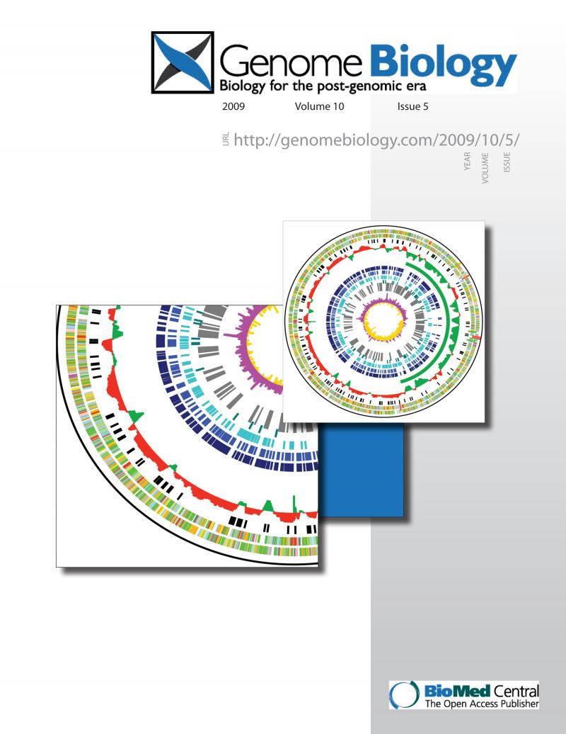
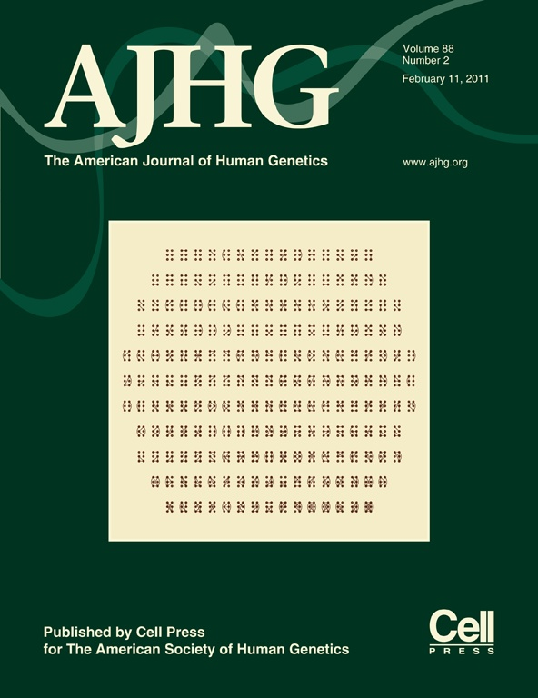



Cited in over 1000 peer-reviewed publications

Slide 6
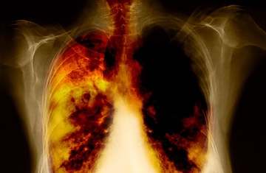
Precision Medicine: Lung Cancer
Small cell lung cancer (SCLC): Highly aggressive with a high likelihood of metastases at diagnosis. Mostly, patients are treated with chemotherapy.
Non-small cell lung cancer (NSCLC): About one third of the patients are diagnosed with this subtype. If caught early enough, then the likelihood of the cancer being local to the lungs is high. Therefore surgery is a valid treatment option, although the chances for NSCLS patients to develop recurrences after surgery is still to be quantified at 30%-60%.

Slide 7
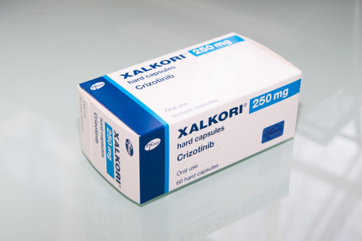

Precision Medicine: Lung Cancer
Crizotinib
Ceritinib
Now, in recent years more effective therapies have been developed to target very specific molecules or pathways that influence the cancer tumor. One example is the anaplastic lymphoma kinase (ALK). Clinical trials have shown that patients with tumors driven by these aberrant genes can be treated with very specific drugs resulting in response rates of over 60%.
Craddock et. al. (2013) provides an extensive list of genes that have mutated forms linked to lung cancers. The variations are typically simple mutations that can be tested effectively via a gene panels

Slide 8
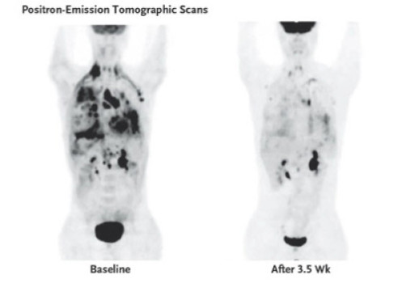
Precision Medicine: Impact of Ceritinib

Slide 9
Precision Medicine: Mendelian Diseases
BRCA1/2: A woman’s lifetime risk of developing breast and/or ovarian cancer is greatly increased if she inherits a harmful mutation in BRCA1 or BRCA2.
Breast cancer: About 12 percent of women in the general population will develop breast cancer sometime during their lives. By contrast, according to the most recent estimates, 55 to 65 percent of women who inherit a harmful BRCA1 mutation and around 45 percent of women who inherit a harmful BRCA2 mutation will develop breast cancer by age 70 years.
Ovarian cancer: About 1.3 percent of women in the general population will develop ovarian cancer sometime during their lives. By contrast, according to the most recent estimates, 39 percent of women who inherit a harmful BRCA1 mutation and 11 to 17 percent of women who inherit a harmful BRCA2mutation will develop ovarian cancer by age 70 years.

Slide 10
Precision Medicine: Cystic Fibrosis
Cystic Fibrosis (CF) is a progressive, genetic disease that causes persistent lung infections and limits the ability to breathe over time. According to the Cystic Fibrosis Foundation, in the United States alone about 12 million people are carriers, and every year 2,500 babies are born with the disease which occurs when the child inherits two defective genes. CF causes a thick, buildup of mucus in the lungs, clogging the airways and trapping bacteria. This leads to infections, extensive lung damage and eventually, respiratory failure. In the pancreas, the mucus prevents the release of digestive enzymes that allow the body to break down food and absorb vital nutrients.
More than 2,000 different genetic mutations have been reported. However, only 200 of them have been categorized.
It is vital to determine and identify these mutations. Nine different mutations, or about 4 percent of the population with CF, can be treated with a drug called Kalydeco. While another drug, Orkambi, effectively treats about 70 percent of CF patients.

Slide 11
Precision Medicine: Mendelian diseases
Approximately 7300 Mendelian diseases have been described as of July 2014.
For 3963 a mutated gene likely to be responsible for the disease is known.
This number is expected to go up as the genomic analysis becomes better integrated in clinical practice.
It is probable that many more Mendelian diseases have yet to be described.

Slide 12
Precision Medicine: Drug metabolism
Warfarin: anticlotting agent that is administered to patients with heightened risk of forming clots. The metabolism of warfarin is affected by two genes, VKORC1 and CYP2C9. For CYP2C9 there are variant forms that lead to a slower metabolism of the drug. Patients with this variant need to receive a lower dosage to prevent excessive blood thinning.
Tamoxifen: used for the treatment of endocrine responsive breast cancer. Tamoxifen is given to patients postsurgery and dramatically reduced the rate of cancer recurrence. This drug is metabolized by cytochrome P450 2D6, the product of the CYP2D6 gene. FDA approved genetic tests exists for finding variants of the CYP2D6 gene that help to guide the dosage for this drug.

Slide 13
NGS Testing in every Hospital
As the cost per genome declines, the use of NGS-based testing will become the standard across hospitals globally. According to Grand View Research, the global bioinformatics market was valued at US $3.51 billion in 2013. It is estimated to grow to about 13.47 billion by 2020.

Slide 14
NGS Testing Adoption Curve
Early Adoption | Moderate Adoption | High Adoption
Market focus is on science and research, lack of infrastructure, clinical evidence and physician education. | Clinical genetic standard for selected targets and therapeutic areas. Bioinformatics increasingly crucial for diagnosis and treatment selection. | Greater availability of data around testing with genetic services becoming standard of care for a majority of patients.
Regulatory Landscape | Reimbursement | Bioinformatics
Testing Technology | Physician Adoption | Consumer Demand

Slide 15
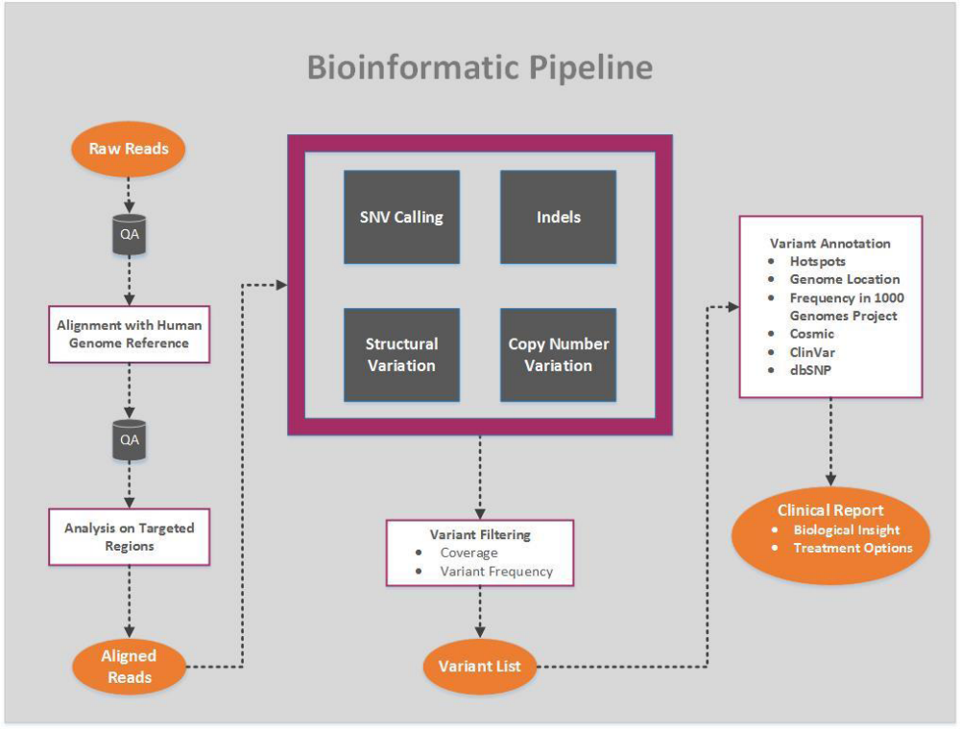
Bioinformatics/Testing Technology

Slide 16
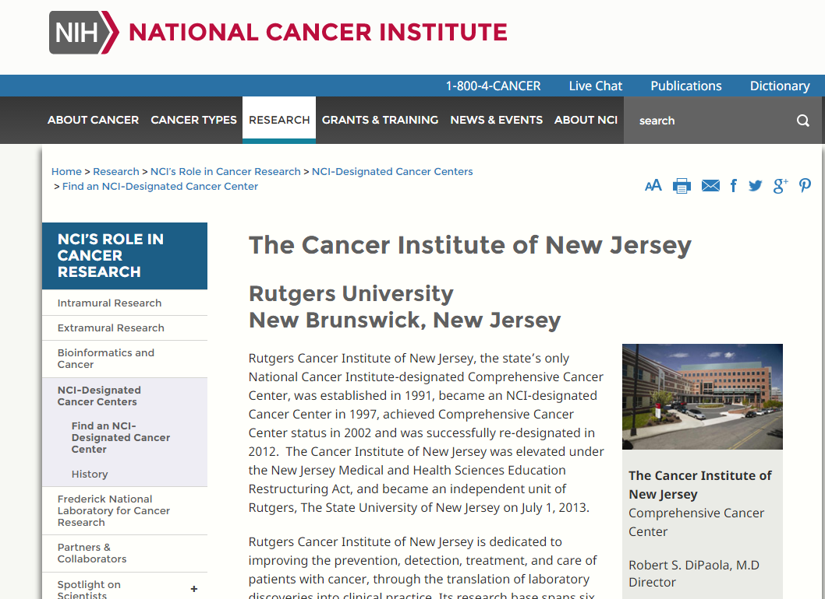
Cancer Institute of New Jersey

Slide 17
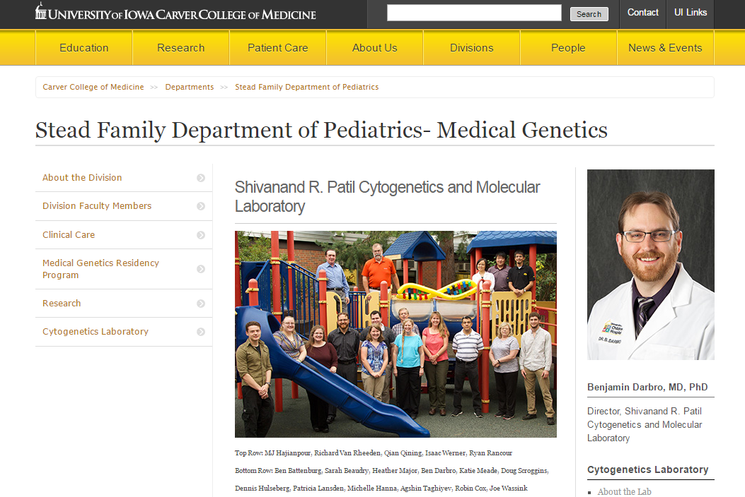
University of Iowa
Today, the lab is mainly focused on oncology, pre and post-natal
genetics testing and serves the University of Iowa Hospitals
and Clinics as well as the University of Iowa Stead Family Children’s
Hospital. In last year alone they have performed over 5,500 clinical tests.

Slide 18
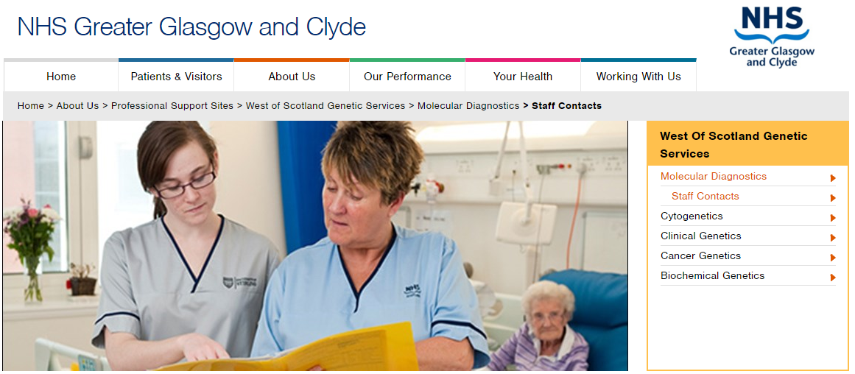
NHS in the UK

Slide 19

Bonei Olam
Bonei Olam is at the forefront of reproductive medicine, research and
technology. The service offering covers every step up the process
including financial assistance, work up, medication, high-risk pregnancy,
pre-implantation, genetic diagnosis, pre-and-post cancer fertility,
education, awareness, and adoption assistance.

Slide 20
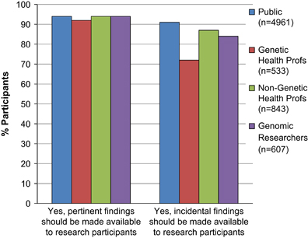
Physician Adoption/Consumer Demand

Slide 21
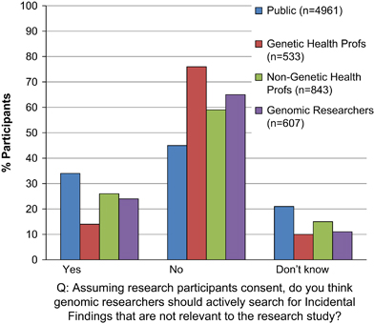
Physician Adoption/Consumer Demand

Slide 22
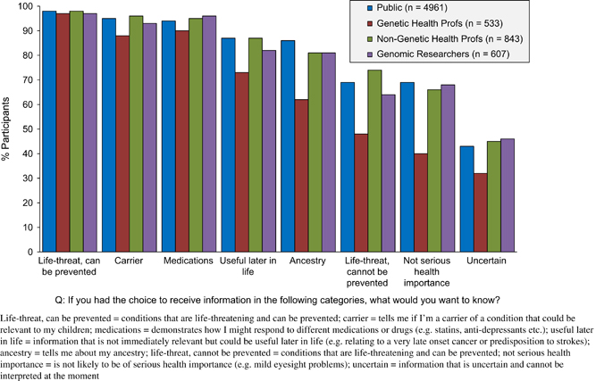
Physician Adoption/Consumer Demand

Slide 23
Precision Medicine: Getting the test approved
Aetna guidelines developed by Blue Cross and Blue Shield Association’s Technology Evaluation Center
The test or treatment must have final approval from appropriate governmental regulatory bodies, where required.
Scientific evidence must permit conclusions about its effect on medical outcomes;
Technology must improve net health outcomes;
The technology must provide as much health benefit as established alternatives; and
The improvement in health must be attainable outside investigational settings.

Slide 24
Precision Medicine: Reimbursement
A recent phase III study compared crizotinib with standard chemotherapy in patients with locally advanced or metastatic ALK-positive lung cancer. Everything favored crizotinib:
1) median progression-free survival (PFS) was higher 7.7 versus 3.0 months,
2) response rate of the tumor was 65% versus 20% and
3) symptoms and quality of life were also substantially better during treatment. Overall survival was not improved. A cure has not yet been discovered. However, 64% of the group receiving chemotherapy crossed over to crizotinib, which is a powerful vote of confidence.
BUT: In our example, the treatment of a patient with crizotinib can increase the incremental cost-effectiveness ratio (ICER) to $148,000 per additional life year

Slide 25

Be Fast or Be Gone

Slide 26
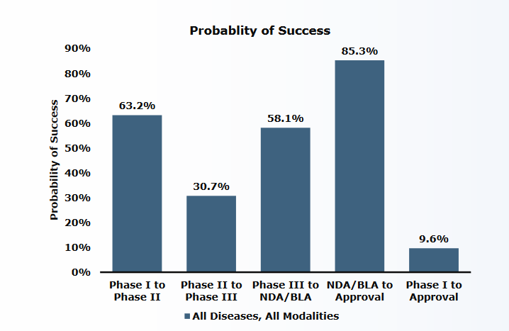
Pharma R&D Process: Inherently Inefficient

Slide 27
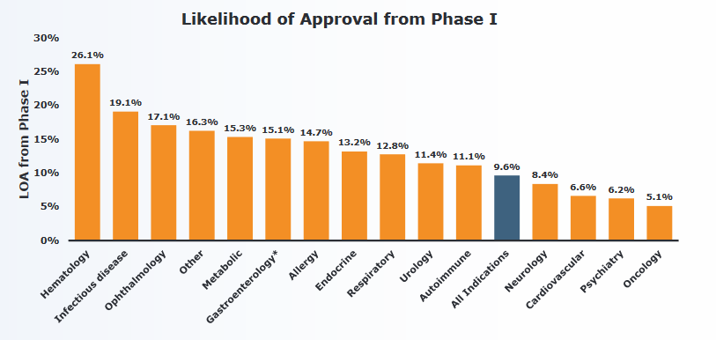
Probability of Success by Disease Category

Slide 28
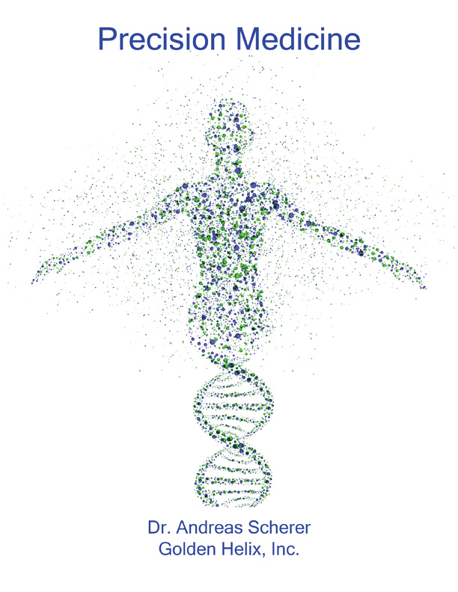

Summary
www.goldenhelix.com/resources/ebooks

