Slide 1
Design and evaluation of a novel OspA-based vaccine for the prevention of Lyme borreliosis
September 25, 2014
4th International Conference on Vaccines & Vaccination

Slide 2
Disclaimer
Forward Looking Statements
These materials contain certain forward-looking statements relating to the business of Valneva SE (the “Company”), including with respect to the progress, timing and completion of the Company’s research, development and clinical trials for product candidates, the Company’s ability to manufacture, market, commercialize and achieve market acceptance for product candidates, its ability to protect its intellectual property and operate its business without infringing on the intellectual property rights of others, the Company’s estimates for future performance and its estimates regarding anticipated operating losses, future revenues, capital requirements and its needs for additional financing. In addition, even if the Company’s actual results or development are consistent with the forward-looking statements contained in this presentation, those results or developments may not be indicative of the Company’s results or developments in the future. In some cases, you can identify forward-looking statements by words such as “could,” “should,” “may,” “expects,” “anticipates,” “believes,” “intends,” “estimates,” or similar words. These forward-looking statements are based largely on the Company’s current expectations as of the date of this presentation and are subject to a number of known and unknown risks and uncertainties and other factors that may cause actual results, performance or achievements to be materially different from any future results, performance or achievement expressed or implied by these forward-looking statements. In particular, the Company’s expectations could be affected by, among other things, uncertainties involved in the development and manufacture of vaccines, unexpected clinical trial results, unexpected regulatory actions or delays, competition in general, the impact of the global credit crisis, and the Company’s ability to obtain or maintain patent or other proprietary intellectual property protection. In light of these risks and uncertainties, there can be no assurance that the forward-looking statements made during this presentation will in fact be realized and no representation or warranty is given as to the completeness or accuracy of the forward-looking statements contained in these materials.
The Company is providing the information in these materials as of this date, and we disclaim any intention or obligation to publicly update or revise any forward-looking statements, whether as a result of new information, future events or otherwise.

Slide 3
Lyme Borreliosis (LB)

Slide 4
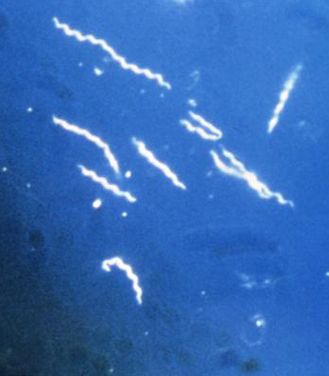
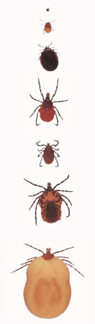
Introduction to vaccine
Biology of Borrelia
At least 14 species, where 3 cause the
majority of clinical cases
Helical shape, 5-20 μm long
Very motile (periplasmic flagella)
Generation time; 12 – 24 h
“Gram negative-like”; No LPS, but
multiple lipoproteins on surface
Segmented genome (B31, Bb: 1.5 Mbp)
  1 linear chromosome
  21 plasmids; 12 linear and 9 circular
  plasmids
Many genes are uncharacterized and
have no homolog in other species
Several OspA serotypes
Rather low homology between species and within B. garinii
Only transmitted by Ixodes ticks
B. burgdorferi grown in culture medium (CDC) and EM of B. garinii isolated from a neuroborreliosis patient (Sweden)
developmental stages of Ixodes ricinus ticks

Slide 5
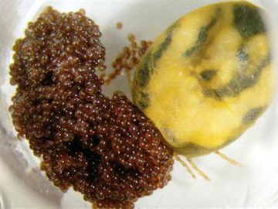
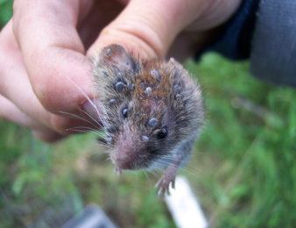
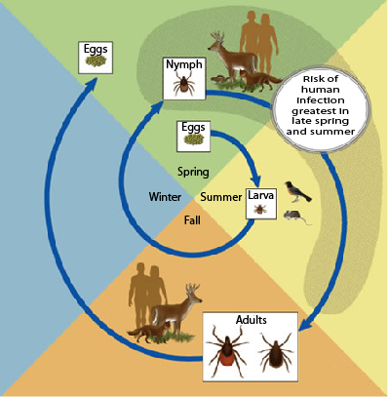
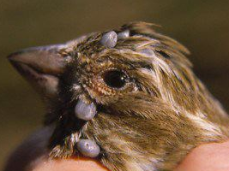

Introduction to vaccine
Infection cycle of Borrelia
One female tick can lay $>$1000 eggs
Rodents and birds are natural Borrelia reservoirs
Infected nymphs attack humans mainly during spring and summer

Slide 6
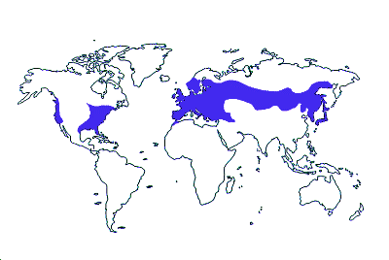
Introduction to vaccine
Epidemiology of Borrelia
Country | Average annual incidence per 100,000 | Average number of cases per year
Germany | 25 | 20,700
Austria | 130 | 14,000
France | 16.5 | 10,022
Lithuania | 25 | 8,500
Sweden (S.) | 80 | 7,223
Netherlands | 43 | 4,890
Latvia | 16 | 3,680
Bulgaria | 55 | 3,500
Slovenia | 155 | 3,096
Czech Rep. | 29 | 2,962
Switzerland | 30.4 | 2,264
Poland | 4.8 | 1,832
Slovakia | 18.4 | 1,000
Finland | 12.7 | 700
Estonia | 35 | 500
U.K. | 0.7 | 423
Norway | 2.8 | 128
Ireland | 0.6 | 30
Total | - | 85,450
Estimated average annual LB incidence (over 10 years) in selected European countries (Lindgren and Jaenson, 2006). Note: Some countries do not use standardized diagnostic tests or accepted case definitions, therefore data may be subject to considerable error.
B. burgdorferi (ST1)
B. afzelii (ST2)
B. bavariensis (ST4)
B. garinii
(ST3, ST5, ST6 & ST7)

Slide 7
Introduction to vaccine
Distribution of OspA serotypes in clinical isolates
Spirochetes cultivated from clinical samples collected from LB patients
  V. Fingerle (Munich, Germany) collection 236 strains and Baxter data from 359 isolates
Strains were typed by sequencing of the ospA gene
Invasive cases defined when strains were isolated from CSF and synovia
B. afzelii most common isolate in both strain collections
Variation between strain collections in OspA serotypes involved in invasive disease
Borrelia sp. | OspA serotype | Human isolates
 |  | Total | Invasive
B. afzelii | 2 | 53% (126) | 24% (19)
B. bavariensis | 4 | 15% (36) | 22% (17)
B. burgdorferi | 1 | 13% (31) | 27% (21)
B. garinii | 6 | 8% (19) | 15% (12)
B. garinii | 5 | 4% (10) | 5% (4)
B. garinii | 3 | 3% (8) | 5% (4)
B. spielmanii | snd | 2% (4) | 0% (0)
B. garinii | 7 | <1% (2) | 1% (1)
Analysis of strain collection from V. Fingerle. 236 human isolates from Germany of which 78 were isolated from people with invasive disease. Number of isolates in brackets.
Borrelia sp. | OspA serotype | Human isolates
 |  | Total | Invasive
B. afzelii | 2 | 57% (204) | 12% (7)
B. garinii | 6 | 16% (57) | 38% (23)
B. burgdorferi | 1 | 12% (42) | 12% (7)
B. garinii | 5 | 7% (26) | 15% (9)
B. bavariensis | 4 | 4% (16) | 12% (7)
B. garinii | 3 | 2% (7) | 9% (5)
B. spielmanii | snd | 1% (4) | 0% (0)
B. garinii | 7 | <1% (3) | 3% (2)
BAXTER analysis of 359 human isolates from 16 European countries of which 60 were isolated from people with invasive disease. Number of isolates in brackets.
Snd – OspA serotype not defined

Slide 8
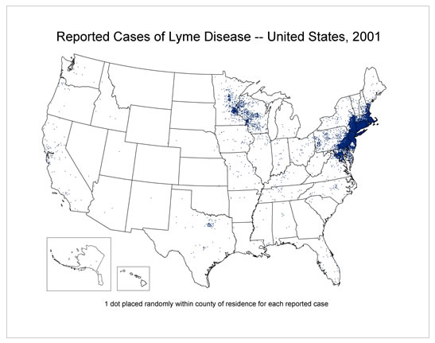
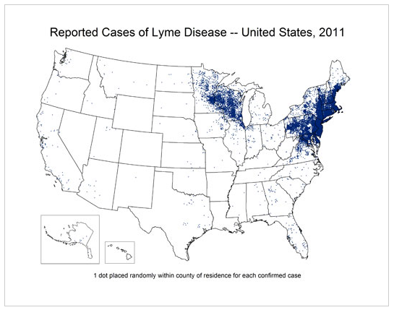
Lyme borreliosis in the United States
Distribution of reported LB cases over an eleven years period
Only OspA serotype 1 present in US: Borrelia burgdorferi
  Between 2001 and 2011 the number of reported cases went from 17,029 to 24,364, making LB the sixth most common reportable disease in the US
  In endemic areas 2nd (New England) and 3rd (Mid Atlantic states) most common
  These numbers are an underestimate, as preliminary results from CDC indicate that over 300,000 Americans are diagnosed with LB each year (makes LB third most common reportable disease in the US after Chlamydia and Gonorrhea)

Slide 9
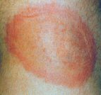
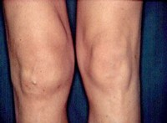
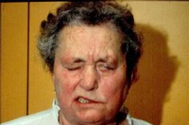
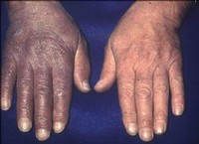
Introduction to vaccine
Clinical manifestations of LB
Localized infection
  Skin: Erythema migrans (~80% of infections)
Disseminated infection
  Joints: Lyme arthritis (B. burgdorferi)
  CNS: Neuroborreliosis (B. garinii and B. bavariensis)
  Skin: Acrodermatitis chronica atrophicans (B. afzelii)
Erythema migrans
Lyme arthritis
Facial nerve palsy
Acrodermatitis chronica
atrophicans

Slide 10
Lyme Borreliosis vaccine

Slide 11
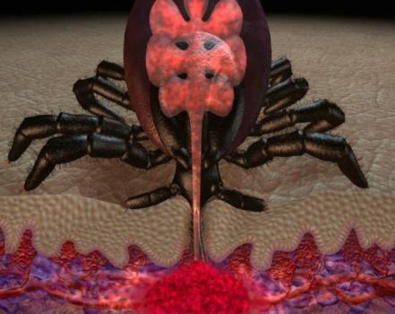
Introduction to vaccine
Mechanism of action of an OspA based vaccine
Expression of OspA
      OspA is expressed when spirochetes are located in the mid-gut of an unfed tick
      During feeding, the incoming blood elicits the down regulation of OspA expression
      Down regulation of OspA allows the spirochetes to migrate to the salivary glands and into the blood of the vertebrate host
Function of anti-OspA antibodies
      The anti-OspA antibodies in the blood of the host bind to the spirochetes before OspA expression is down regulated
      Migration to the salivary glands is blocked and borreliae
      are killed in a complement independent manner* in the tick
      Thus, only antibodies that bind OspA are needed for
      elimination of spirochetes in the tick
* Valenzuela et al., JMB 2000 ,Rathinavelu et al., Inf. Imm. 2003, Gipson et al., Inf. Imm. 2005

Slide 12
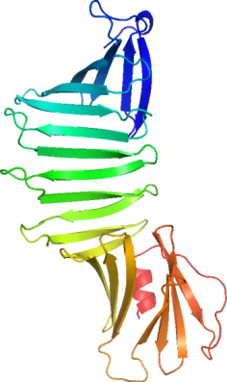
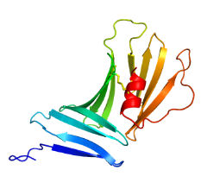
The OspA strategy
Learnings from other studies
B. afzelii (OspA-ST2) is the most common cause of LB in
Europe
Pronounced cross-protection is not expected due
to sequence variation among the OspA serotypes
Crystal structure of OspA B. burgdorferi (OspA-ST1) has
been determined*
Anti-OspA antibodies block the transmission of spirochetes
from ticks to the vertebrate host
Studies have claimed that epitope LA-2 (OspA-ST1)
correlates with protective immunity after vaccination**
The C-terminal part of OspA (aa131-273) from
B. burgdorferi (ST1) is protective in mice, but not structurally
stable. Point mutations facilitating formation of hydrophobic
interactions restore stability and vaccine efficacy***
Focus on C-terminal region of OspA
N
N
C
C
1 2 3
1 2 3
“LA-2” (mAb)
“LA-2” (mAb)
Left: Crystal structure of full-length OspA from
B. burgdorferi serotype 1 when bound to mAb LA-2 (not shown). Right: C-terminal part of OspA.
* Li et al. PNAS 1997; Ding et al. JMB 2000, Makabe et al. Prot. Sci. 2006; ** Golde et al. Inf. Imm. 1997; Steere et al. N Engl J Med 1998; *** Koide et al. JMB 2005

Slide 13
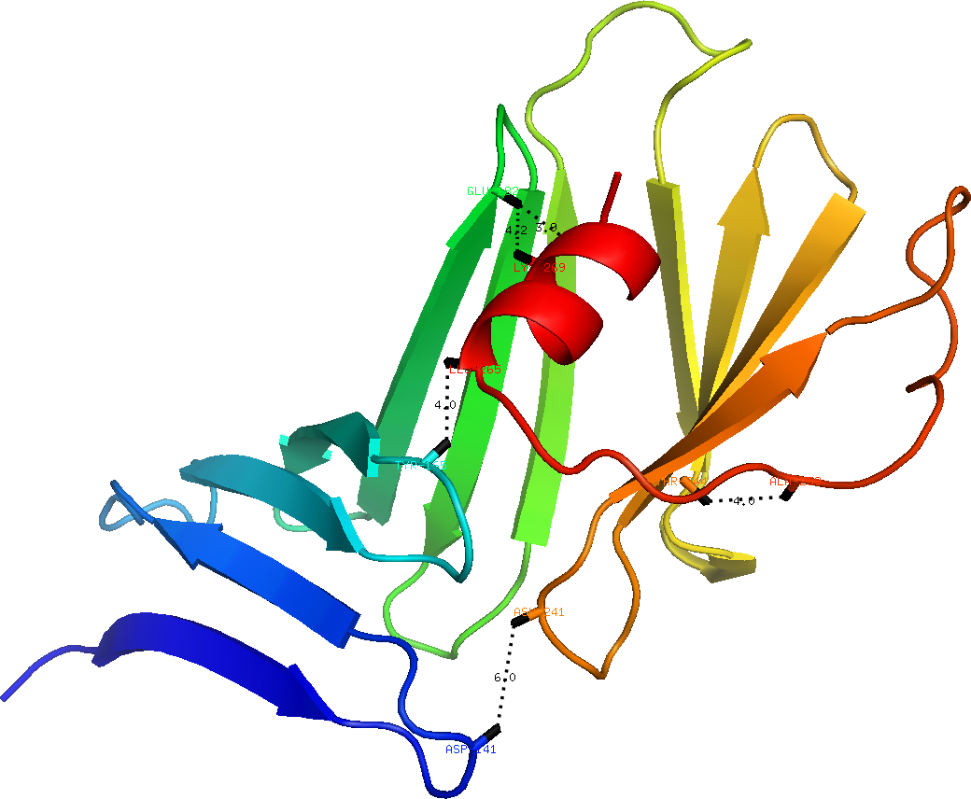
The OspA strategy
Stabilizing mutations for C-terminal OspA
Disulfide bonds introduced by point mutations
  Distance (Å) based on crystal structures (OspA-ST1) with
  monoclonal antibodies 184.1 and LA-2
  Five prioritized stabilized variants of truncated OspA
  The final disulfide bond is about 2.1 Å in length
# | Position (aa) | Distance (184.1 or LA-2)
A | 141,241* | 6.0 Å or 6.2 Å
D | 165,265** | 4.0 Å or 4.2 Å
B | 182,269** | 4.2 Å or 4.1 Å
E | 182,272** | 3.0 Å or 3.9 Å
C | 244,259** | 4.0 Å or 4.1 Å
E
C-term.
B
D
C
N-term.
A
* Proposed by ICLL Bioinformatician, ** Proposed by MODIP (distance and direction/orientation taken into account)

Slide 14

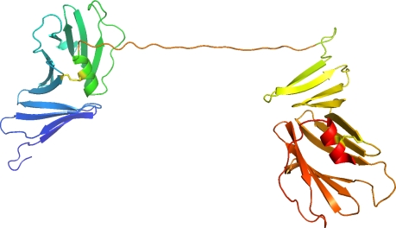

The OspA strategy
Stabilized truncated monomers linked to heterodimers
VLA15-combo: Lip-D1B2B, Lip-D4Bva3B and Lip-D5B6B
  Truncated stabilized OspA from 6 different serotypes linked to form 3 heterodimers
  Lipidation sequence ensures high immunogenicity (E. coli, Lpp (major OMP))
  Monomers linked with a 21 amino acid linker derived from two N-terminal loops of
  B. burgdorferi OspA-ST1 (aa 65-74, aa 42-53)
  Sequence of heterodimers: Lpp: aa 1 – 23, OspA: aa 126 – 273(274), Linker: 21 aa, OspA: aa 126 – 273(274)
Full-length OspA
Truncated stabilized OspA monomer
Stabilized OspA monomers representing 6 serotypes joined with a linker to 3 heterodimers
ST1
N
Linker
ST1-ST2
ST4-ST3
ST5-ST6
N
Lipidation
ST2
C
C
C

Slide 15
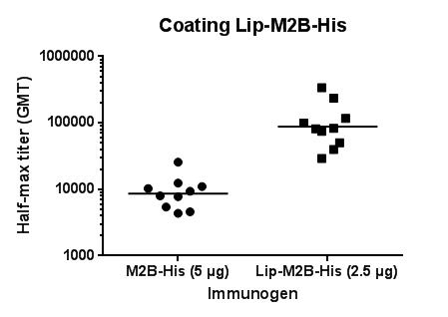
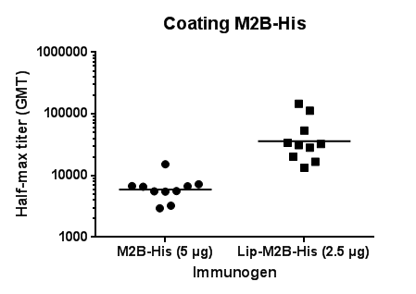
Influence of lipidation on immunogenicity
Assessment of monomers by ELISA
Lipidated and non-lipidated OspA monomer ST2 formulated with adjuvant
Mice were immunized three times with two weeks interval
Dose: 5.0 µg non-lipidated and 2.5 µg lipidated OspA monomer
Final bleed was performed one week after the third immunization
Sera were analyzed by ELISA with the homologous protein as coating antigen
    Lipid moiety increases immunogenicity at least 10-fold
GMT – geometric mean titer

Slide 16
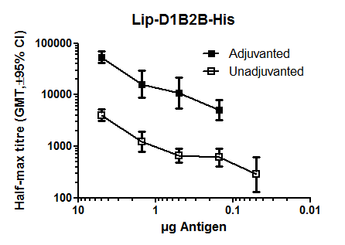
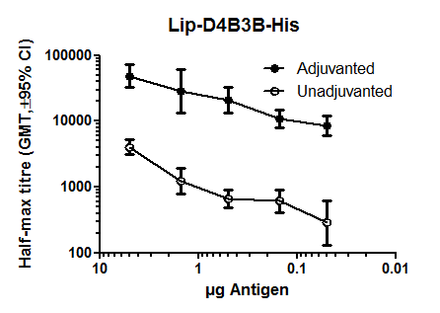
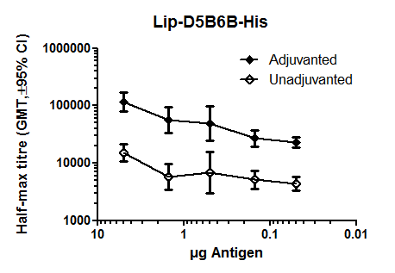
Effect of adjuvant on immunogenicity
Assessment of heterodimers by ELISA
Lipidated OspA heterodimers were formulated with or without 0.15% aluminum hydroxide
Mice were immunized three times with two weeks interval with five different doses of heterodimer (5.0, 1.5, 0.5, 0.15 and 0.05 µg)
Final bleed was performed one week after the third immunization
Sera were analyzed by ELISA with the homologous antigen as coating antigen
    Adjuvanted heterodimer gives approximately 100-fold higher immune response
GMT – geometric mean titer, CI – confidence interval

Slide 17
Comparison of Borrelia vaccine antigens
Rationale for increased immune response
wt OspA
N
Serotype 1
C
28 kDa
16
126
273 aa
OspB
Baxter OspA
N
Serotype 1
Serotype 2
C
27.5 kDa
16
25
126
215
273 aa
Linker OspA (21 aa)
C
VLA15 OspA
N
Serotype 1
Serotype 2
34.4 kDa
126
273
126
273 aa
VLA15-combo
  Similar dose of VLA15 contains almost 2x the amount of C-terminal region of OspA (aa 126 - 273) than Baxter OspA
Comparison does not calculate for cross-reactivities between serotypes

Slide 18
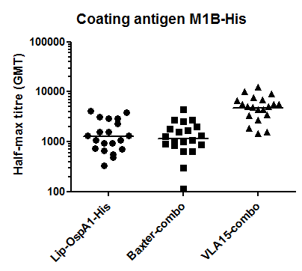
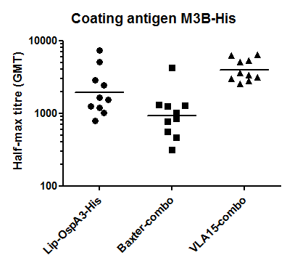
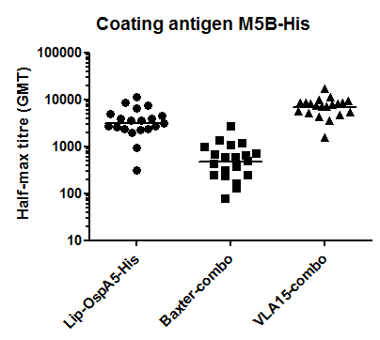
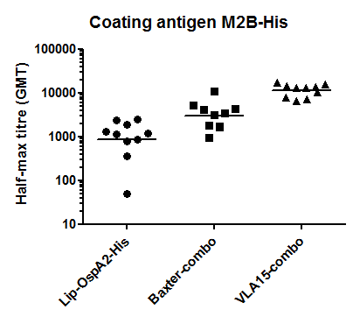
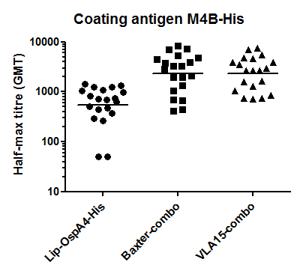
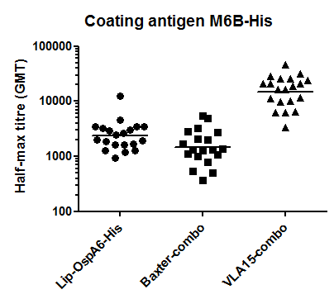
Immunogenicity of VLA15 in mice
ELISA for C-terminal OspA
The immune responses of VLA15-combo as measured by ELISA for all serotypes are non-inferior or superior to Baxter-like vaccine
GMT – geometric mean titer, CI – confidence interval, LL – lower limit, UL – upper limit

Slide 19



Mouse challenge models
Layout and readout of the two challenge models
MOUSE TICK CHALLENGE MODEL
MOUSE NEEDLE CHALLENGE MODEL
s.c. immunize
C3H/HeN mice
collect immune sera
collect final sera and organs
s.c. immunize
C3H/HeN mice
collect immune sera
collect final sera and organs
Application of
infected ticks
in vitro grown
spirochetes
1
2
3
4
2
5
2
6
7
2
8
2
9
10
11
12
2
1
2
3
4
2
5
2
6
7
2
8
2
9
10
Weeks
Serology
Weeks
Serology
Removal
of ticks
VlsE
ELISA
VlsE
ELISA
ELISA
ELISA
qPCR
qPCR
Ear
Ear
Mice are challenged with ticks feeding for 3-5 days
Mice are sacrificed 6 weeks after tick application
Readout based on VlsE ELISA and qPCR
Mice are challenged with in vitro grown bacteria
Mice are sacrificed 4 weeks after challenge
Readout based on VlsE ELISA and qPCR
VlsE: Variable major protein [VMP]-like sequence E

Slide 20
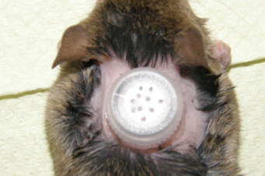
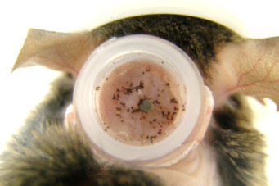
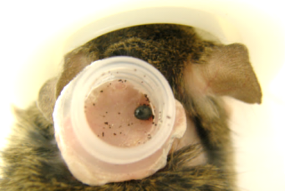
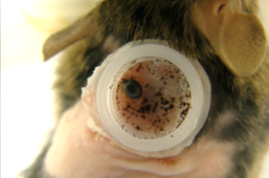
Mouse tick challenge model
Application of ticks
    The hair of the back is removed with epilation cream
    Ventilated containers are glued to the naked skin with super glue
    1-2 ticks infected with B. afzelii (OspA-ST2) are put in each container
    The feeding is monitored for 5 days and non-feeding ticks are replaced
    Only mice with at least 1 fully fed tick are included in the final readout
container mounted
(day 0)
tick feeding
(day 2)
tick feeding
(day 3-4)
fully fed tick
(day 4-5)
Pictures above illustrate the feeding progress on different mice

Slide 21
Protection by VLA15-combo
Active immunization and tick challenge: B. afzelii (ST2)
Three immunizations with two weeks interval, adjuvant 0.15% Al(OH)₃
  Controls: Lip-OspA2-His, Baxter combo
Tick challenge: Nymphs infected with B. afzelii (ST2) strain IS1 two weeks after third immunization
Final bleed and organ collection four weeks after challenge
  Infection read-out: VlsE ELISA and qPCR
All vaccines resulted in significant protection in three separate experiments
Immunogen | Dose | Infected/Total
 |  | Experiment 1 | Experiment 2 | Experiment 3
Lip-OspA2-His | 1 µg | 0/8** | 0/9*** | 0/7**
Baxter-combo | 3 µg | 0/7** | 0/9*** | 0/7**
VLA15-combo | 3 µg | 0/9*** | 0/7*** | 0/4*
Placebo | - | 5/5 | 8/8 | 7/8
Only mice with at least one fully fed tick were included in the readout
P-values were calculated with Fisher’s exact test (two tailed); * <0.05, ** <0.01, *** <0.001 and ^{ns} not significant
Notes:
Exp4175, Exp4176 and Exp4210

Slide 22
Protection by VLA15-combo
Active immunization and tick challenge: B. burgdorferi (ST1)
Three immunizations with two weeks interval, adjuvant 0.15% Al(OH)₃
  Controls: Lip-OspA1-His, Baxter-combo
Tick challenge: Nymphs infected with either B. burgdorferi (ST1) strain Pra1 or Pra4 two weeks after third immunization
Final bleed and organ collection four to six weeks after challenge
  Infection read-out: VlsE ELISA and qPCR
VLA15-combo and Baxter-combo provide significant protection using ticks infected with different strains for challenge
Immunogen | Dose | Infected/Total
 |  | Experiment 1 (Pra4) | Experiment 2 (Pra1) | Experiment 3 (Pra1)
Lip-OspA1-His | 1 µg | 0/4* | 1/8^{ns} | 1/9*
Baxter-combo | 3 µg | 0/8** | 0/9* | 0/7**
VLA15-combo | 3 µg | 0/5* | 0/10* | 0/7**
Placebo | - | 5/6 | 4/7 | 5/6
Only mice with at least two fully or almost fully (≥48 hours) fed ticks were included in the readout,
P-values were calculated with Fisher’s exact test (two tailed); * <0.05, ** <0.01, *** <0.001 and ^{ns} not significant
Notes:
Exp4185 (Pra4), Exp4236 (Pra1) and Exp4239 (Pra1)

Slide 23
Status of Borrelia animal model
OspA serotype specific mouse challenge models
Challenge experiments have been performed two or three times, further experiments with additional doses
Significant protection seen in all five tick or needle challenge models
Serotype | Challenge model (strain) | Statistical significant protection*
 |  | Full-length OspA (1 µg) | VLA15-combo (3 x 1 µg) | Baxter-combo (3 x 1 µg)
1 | Needle (ZS7) | 0.001, <0.001, <0.001 | <0.001, <0.001, <0.001 | <0.001, <0.001, <0.001
 | Tick (Pra1) | 0.048, 0.187, 0.022 | 0.026, 0.029, 0.009 | 0.006, 0.039, 0.009
2 | Tick (IS1) | 0.002, <0.001, 0.003 | 0.001, <0.001, 0.020 | 0.003, <0.001, 0.003
5 | Needle (Phei) | <0.001, <0.001, <0.001 | <0.001, <0.001, <0.001 | <0.001, <0.001, <0.001
6 | Needle (Ma) | 0.011, 0.488, 0.033 | <0.001, <0.001, 0.003 | <0.001, <0.001, <0.001
* Three independent experiments, Protection compared to the placebo group, Fisher exact test, two-tailed

Slide 24
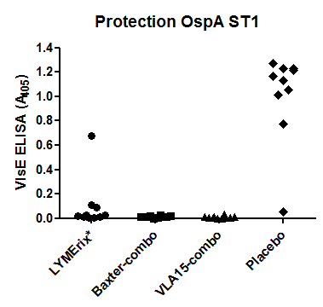
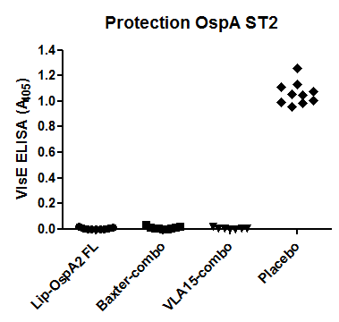
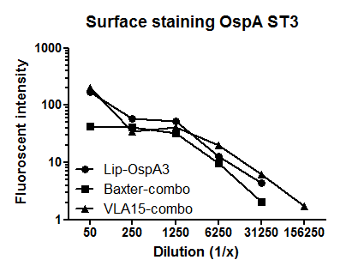
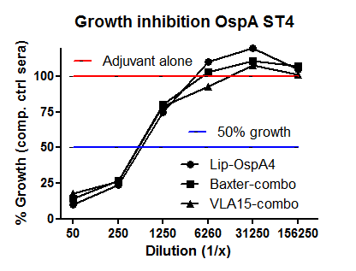
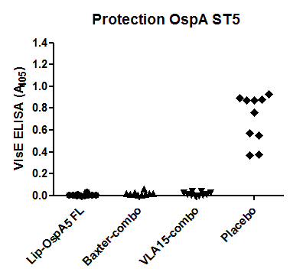
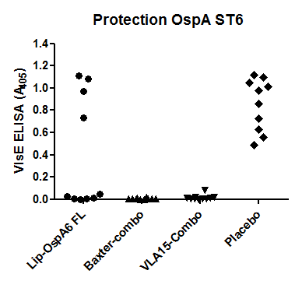
Pre-clinical data for all six OspA serotypes
In vivo protection & in vitro assays
Mice were immunized three times (s.c.) with two weeks interval (1 µg/protein)
  Sera analyzed one week after third immunization for growth inhibition & surface binding
  Mice challenged two weeks after third immunization and analyzed for infection 4 (needle challenge) or 6 weeks (tick challenge) later by VlsE ELISA and qPCR

Slide 25
Clinical development of LB vaccine
Draft clinical development strategy
2 tick seasons
LICENSURE
PHASE I/II
Healthy adults
PHASE III
Healthy adults
  OBJECTIVES
  Safety
  Immunogenicity
  Dose, Formulation, Schedule
  Antibody persistence & Booster
  Pivotal Safety and Efficacy Study
  Placebo-controlled
PHASE II
Pediatric
PHASE III
Pediatric
  Safety, immunogenicity
  Dose, schedule
  Safety
  Immunogenicity & efficacy
Concomitant
Vaccination studies
  Safety, immunogenicity (non-interference)

Slide 26
VLA15 – Summary
Protein-based vaccine protective against the 6 major OspA serotype Borrelia species causing disease in EU & US
Pre-clinical protection shown in 5 different animal models (4 OspA serotypes)
VLA15 drug substance of excellent quality produced in E. coli in scalable fermentation process (fed-batch) in defined synthetic medium, yielding app. 1.2 g/L of mature lipoprotein
Semi-generic, scalable production process for all 3 proteins, resulting in high purity and low amount of residual impurities
Project ready to move into clinical testing within 12- 15 months

Slide 27

VLA15 – Acknowledgements
Pre-clinical Research at Valneva: Urban Lundberg, Pär Comstedt, Wolfgang Schüler, Robert Schlegl, Markus Hanner, Sandra Jost, Ana Kremers, Christina Satke and many others
Collaborators: Sven Bergström, Hans Dautel, Volker Fingerle

Slide 28
Merci
Danke
Thank you

