Slide 1
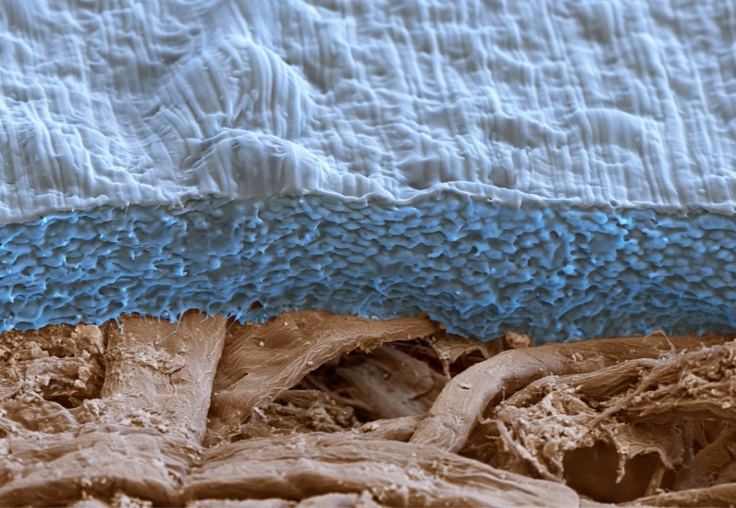
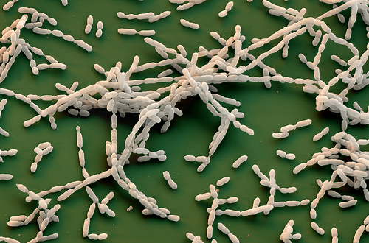
Symbiosis of Chemistry and Biology:
BASF`s Biodegradable and
Renewable Polymers
Andreas Künkel, Vice President
Biopolymers Research BASF SE
Biopolymers and Bioplastics
San Francisco, USA, August 2015

Slide 2
Agenda
Introduction
Biobased monomers and polymers
BASF biodegradable and biobased polymers & applications
Biodegradability: value and developments
Sustainability
Conclusion

Slide 3
Definition of renewable and biodegradable
Renewable raw materials
PLA
Bio-PE
ecovio®
^{(partly biobased)}
PHA
Non-biodegradable
Biodegradable
PE
ecoflex®
Renewable refers to the origin of the carbon atoms in the polymers
Biodegradation by microorganisms is a matter of polymer structure, not of carbon origin

Slide 4
Agenda
Introduction
Biobased monomers and polymers
BASF biodegradable and biobased polymers & applications
Biodegradability: value and developments
Sustainability
Conclusion

Slide 5
Biobased building blocks (monomers) and polymers from renewable resources (selected)
Feedstock
Biobased Monomers
Polymers
Ethanol → Ethylene
Polyethylene (PE)
Cellulose
Lactic acid → Lactide
Polylactic acid
Glucose
Succinic acid, Butanediol
Polybutylene succinat (PBS)
Starch
1,3-Propanediol
Polytrimethylene terephthalate (PTT)
Furandicarboxylic acid
Polyethylene furanoate (PEF)
Fatty acids from plant oils
Polyhydroxyalkanoates (PHA)
Dicarboxylic acids (e.g. azelaic acid)
Polyester
Yellow = Biobased monomer
Red = Biobased (non-biodegradable)
Blue = Biodegradable and biobased polymers

Slide 6














2006: renewable building blocks are in lab scale and only few companies are active
Lab scale
Pilot scale
Production scale
1,3-Propanediol
New dicarboxylic acids,
OH-Acids, Oils
1,5-Pentamethylenediamin
n-Butanol / Isobutanol
Succinic acid
1,4-Butanediol
3-HP as precursor
for bio-acrylic acid
Adipic acid

Slide 7




















2014: renewable building blocks enter world scale production with new alliances
Estimated
capacity in 2015
Lab scale
Pilot scale
1,3-Propanediol
60 kt
New dicarboxylic acids,
OH-Acids, Oils
≈ 60-80 kt
1,5-Pentamethylenediamin
< 2 kt
n-Butanol / Isobutanol
only Isobutanol at < 20 kt
Succinic acid
50 kt
1,4-Butanediol
20 kt
3-HP as precursor
for bio-acrylic acid
Adipic acid

Slide 8



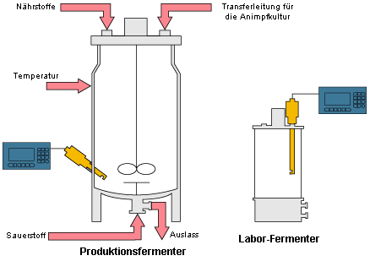
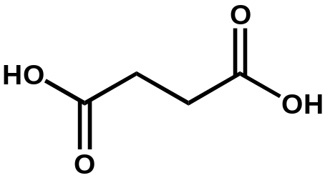
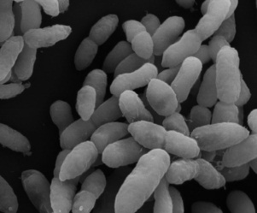

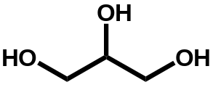
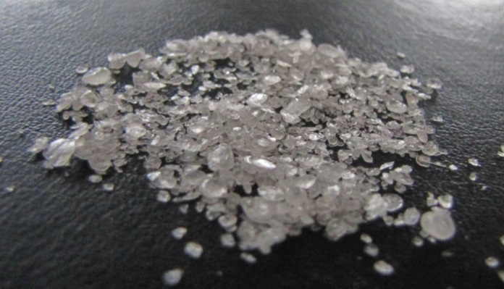
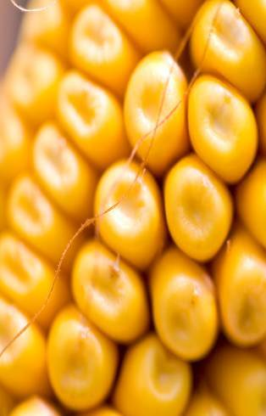
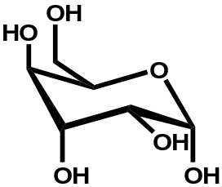
Succinic acid fermentation technology
CO₂
+
CO₂ & C-Source
Succinate
Basfia
succiniciproducens
Status: pilot phase
Notes:
Growing & aging world population
The United Nation estimates an increase of the world population over 9 billion in 2050, 40% more than today. The majority of this growth is expected in developing and emerging countries. Moreover, the portion of people over 60 should double to about 22%; the majority in the developed countries. In 2005 the number was only 10%.
How can we produce and distribute enough food for this growing population?
How can we assure good living conditions for the aging world

Slide 9
Agenda
Introduction
Biobased monomers and polymers
BASF biodegradable and biobased polymers & applications
Biodegradability: value and developments
Sustainability
Conclusion

Slide 10
ecoflex® as modular system
PBAT
(ecoflex®)
+
+
PBST
Y
Y
X
X
X
X
X
X
Succinic acid
Terephthalic acid
1,4-Butanediol
Adipic acid
Melt polycondensation
ecoflex® is a random aliphatic-aromatic copolyester
Access to biobased ecoflex® variants possible
(e.g. by replacing adipic acid with biobased succinic acid)
Each monomer change influences melting point, tensile strength, crystallization speed & biodegradation behavior
Change of monomer and monomers composition results in new properties

Slide 11
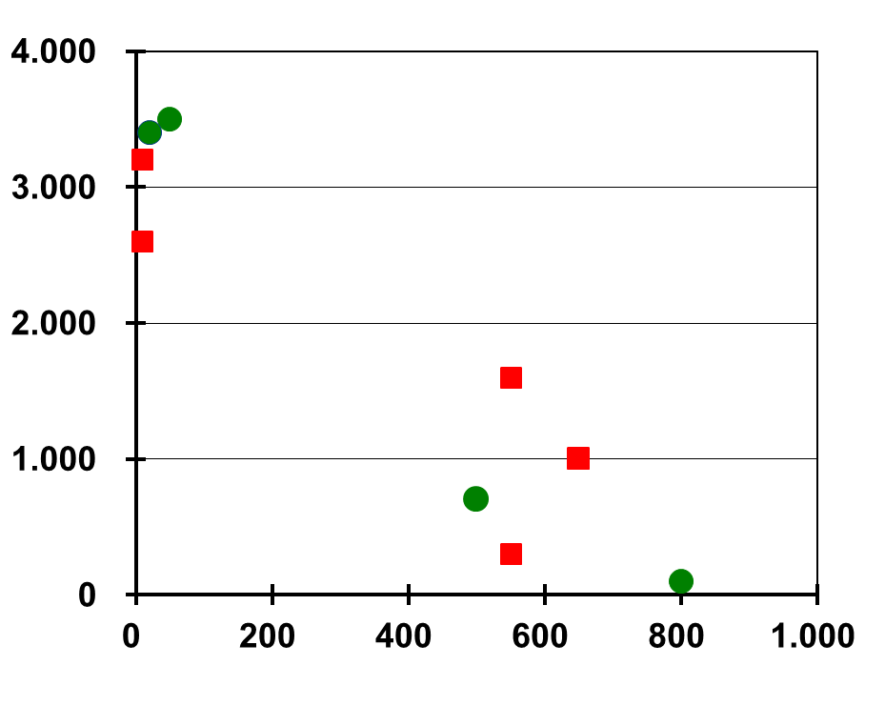
Limits of classical melt polycondensation for biodegradable polyesters
E-Modulus （MPa）
biodegradable Polyester
Poly lactic acid (PLA)
non-biodegradable Polymers
Polyhydroxybutyrate (PHB)
PS
ecovio®
PBT
PP
Polybutylen-
succinate
(PBS)
HDPE
Accessible property region for
biodegradable polyesters made
by classical melt polycondensation
ecoflex®
LDPE
Elongation @ break (%)
Compounds needed for broader property range
ecovio® is the trade name for BASF’s ecoflex® – PLA compounds

Slide 12
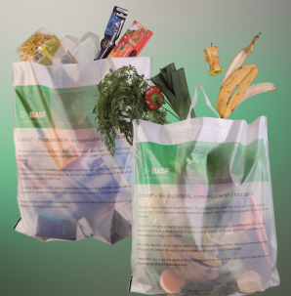
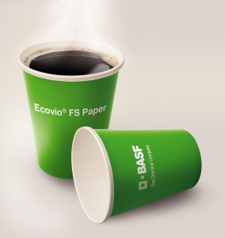

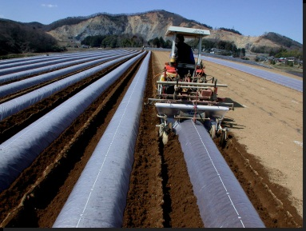
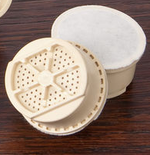


BASF as solution provider for biodegradable packaging
ecovio® F Film
ecovio® FS Paper
ecovio® FS Shrink Film
ecovio® F Mulch
ecovio® IS
ecovio® F Film
Source: B + K
Packaging Solutions
Film Applications

Slide 13


Coffee: past and present
1908
2006

Slide 14




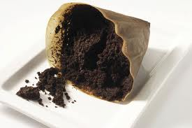
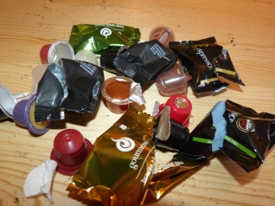
ecovio®, biodegradable coffee capsules
Coffee consumption in Germany: citizen/day
High variety of hot drinks easily prepareable via capsules
Missing
property
Used coffee capsule contain 70 wt-% of water
Compostable
Plastic waste
To use coffee grounds as composting material, degradable capsules
are required

Slide 15

ecovio® as complete packaging solution

Slide 16
Agenda
Introduction
Biobased monomers and polymers
BASF biodegradable and biobased polymers & applications
Biodegradability: value and developments
Sustainability
Conclusion

Slide 17

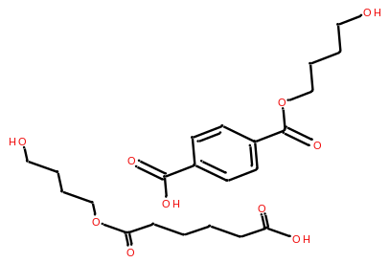
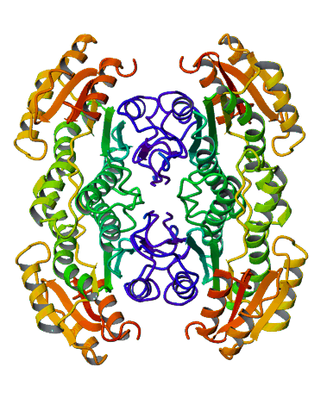
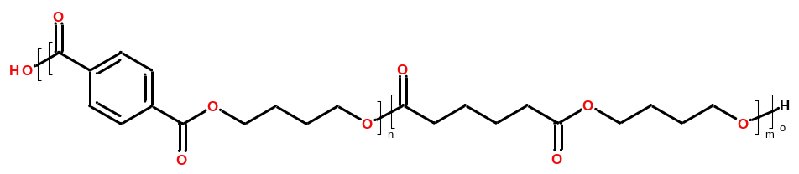


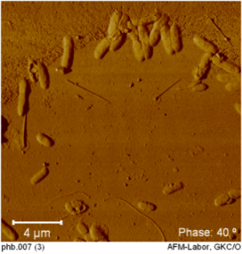
General mechanism of polymer biodegradation
Microorganisms excrete
extracellular enzymes (e.g. Hydrolases)
Intermediates are metabolized by microorganisms to CO₂, CH₄, water and biomass
CO₂
CH₄
H₂O
Enzymes attach to surface and cleave polymer chains
Microorganisms
Short chain intermediates and monomers
are dissolved into the medium
extracellular
enzyme
water soluble
polymer fragments
Surface erosion
biodegradable plastic
(e.g. ecoflex®)
UV/vis irradiation
moisture
oxygen
adapted from R.J. Müller
other abiotic factors

Slide 18
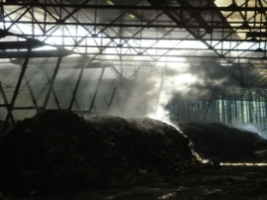
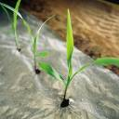


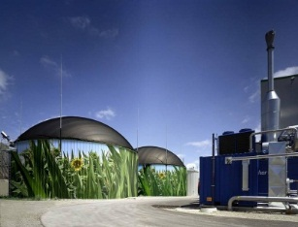
Biodegradation in different environments
Controlled | Not controlled
aerobic
Composting
Biodegradation in soil
mix
Waste water treatment
Marine water
anaerobic
Anaerobic digestion

Slide 19
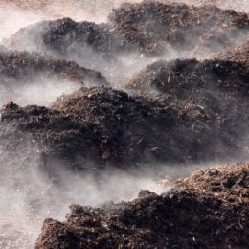
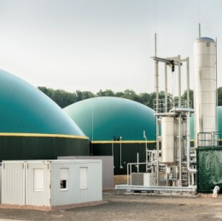
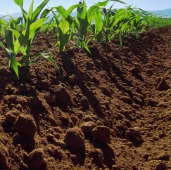
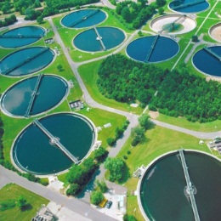

Holistic approach to understand and leverage biodegradability of polymers
Investigation of polymer biodegradation in environments relevant for applications
Dedicated research activities for water, soil, composting and anaerobic conditions
Field evaluation: assessing product performance under realistic conditions
Bringing together product performance and polymer biodegradability know-how
Knowledge of structure-properties relationship facilitates
development of new tailor-made products
Performance
Biodegradability

Slide 20
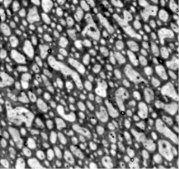
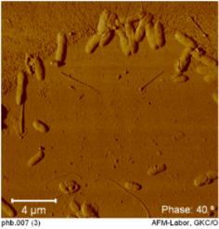
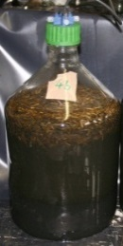
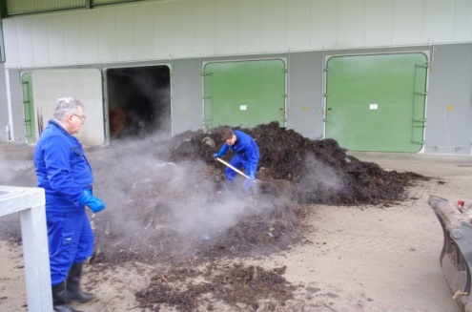
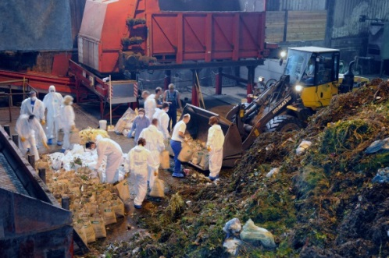
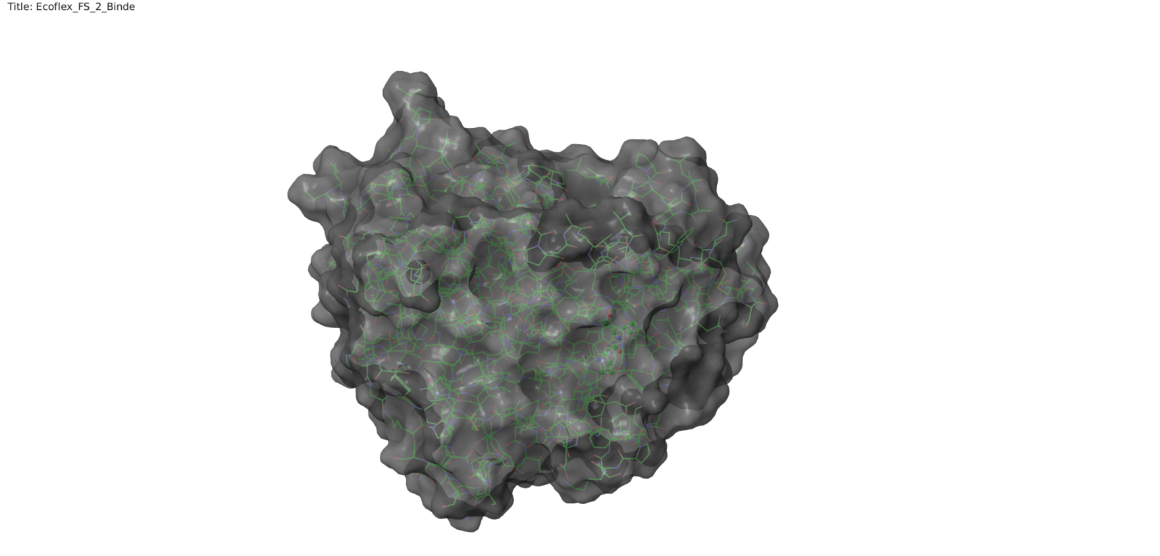
From basic understanding to industrial scale
Basic understanding
Field evaluation
Elucidating “interaction” between polymer
and microflora
Assessing product performance
in field trials
Anaerobic digestion field trial
+
?
polymer blend
microorganisms
biodegradation?
Polymer characteristics
Microorganisms and enzymes
Abiotic factors
Industrial composting field trial
Understanding structure-property-relationship facilitates product development
Field trials needed for communication and to gain stakeholder acceptance

Slide 21
Agenda
Introduction
Biobased monomers and polymers
BASF biodegradable and biobased polymers & applications
Biodegradability: value and developments
Sustainability
Conclusion

Slide 22

Development and use of biobased and biodegradable polymers considers the complete lifecycle
Renewable raw materials & polymers
Processing
Biodegradability
Applications

Slide 23
Sustainability contribution of biodegradable and highly biobased coffee capsules
ecovio® for coffee capsules can be industrially composted along with food waste. Recycling food wastes is more resource efficient than having it landfilled or incinerated.
Increased production of compost helps bring back phosphates and humus into agricultural soil. As result scarce resources are saved and soil erosion can be mitigated.
High content of Renewable raw materials enable reduced material carbon footprint allowing savings of greenhouse gas emissions.

Slide 24
Agenda
Introduction
Biobased monomers and polymers
BASF biodegradable and biobased polymers & applications
Biodegradability: value and developments
Sustainability
Conclusion

Slide 25
BASF concept for biodegradable and renewable polymers
GOAL: Performance of biodegradable plastics comparable to standard plastics
BASED on scientific evidence and basic understanding of biodegradability
WITH proven sustainability
FOR applications where biodegradability adds value to the solution
BY application of renewable resources only based on functionality (performance, LCA)
Performance made sustainable

Slide 26



