Slide 1
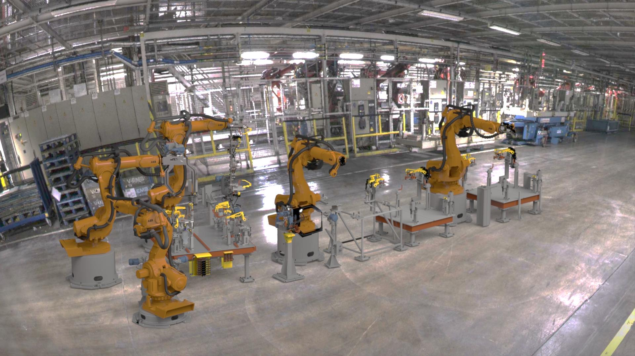
Ready4reality
Virtual commissioning at vcc
Andreas Jonsson MSc.
Method Lead BIW
Manufacturing Engineering
Volvo Car Group

Slide 2

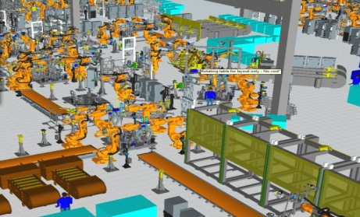

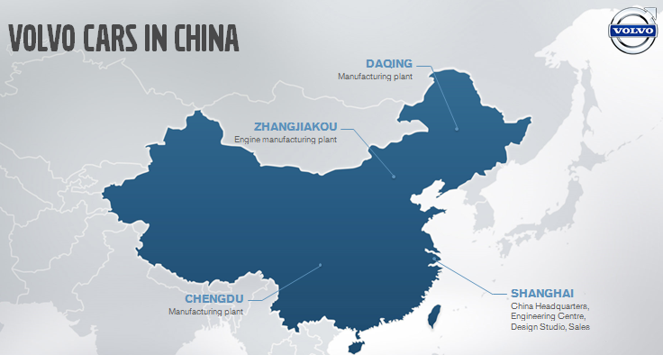
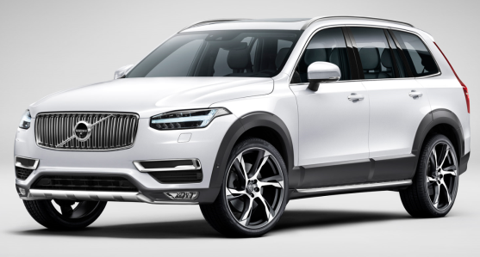
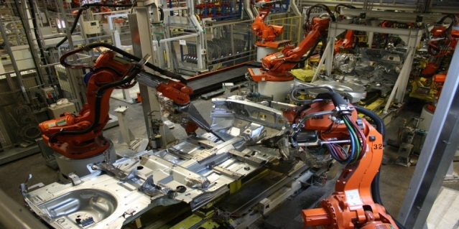
Volvo Car Group
$9B
  SWEDEN
  Gothenburg
  Head office
  Product development,
  Car production
  Skövde, Floby and Olofström
  Component manufacturing
DENMARK
Copenhagen
RD Centre
USA
Camarillo
Design centre
SPAIN
Barcelona
  Design centre
BELGIUM
  Gent
  Car production
USA
Charleston
Manufacturing Plant
  CHINA
  Car & Engine Production
  Product Development
MALAYSIA
Kuala Lumpur
  Assembly factory

Slide 3

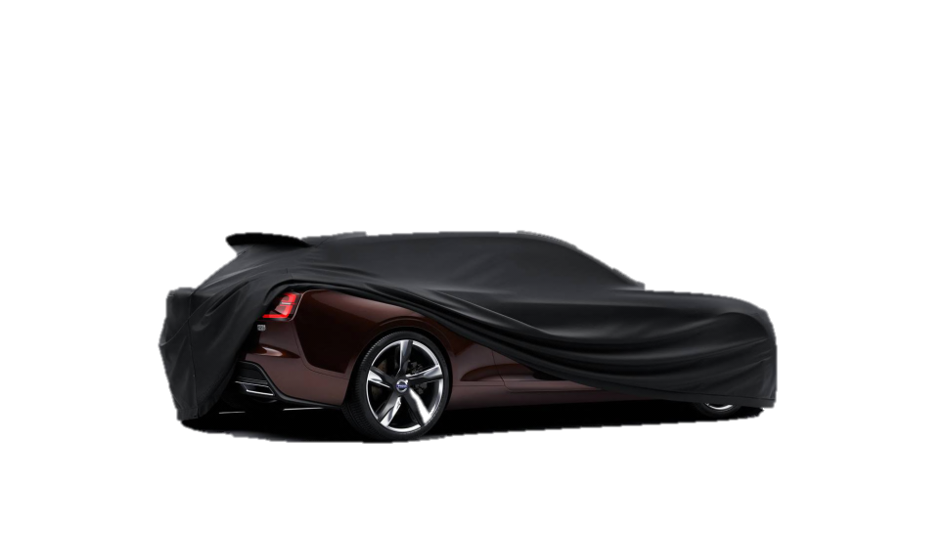
Our journey forward

Slide 4

More models!
Rapid
follower!
Designed around you
Truly global

Slide 5
More models!
But how?
When your are small…
Rapid
follower!
Designed around you
Truly global

Slide 6



>80M
0,5M

Slide 7
Shorten
Leadtime
(40 to 30 Mts)
Fast and nimble
Flexible
Plants
Reduce physical prototypes
Decisions solely on Virtual Data

Slide 8
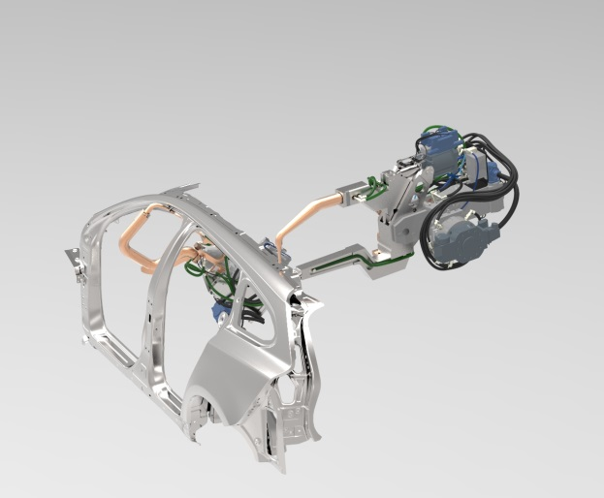
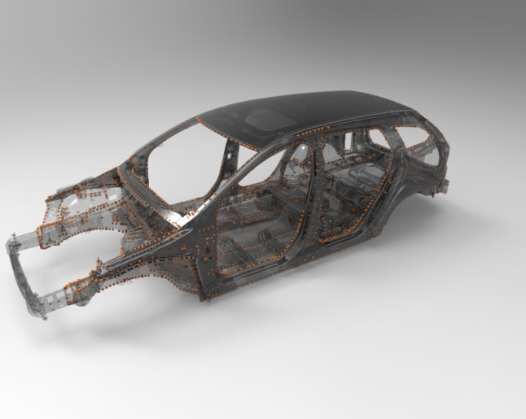
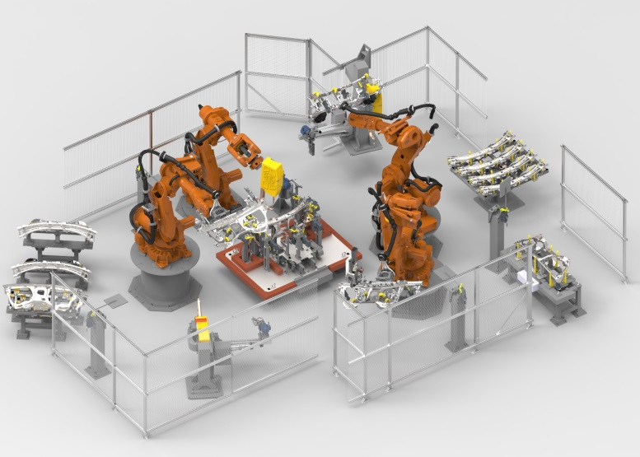
Virtual trust enable more, earlier descisions with high quality
High detailed models
High Quality PLM data
Complete simulation models
(Incl. Signals & behaviour models for all equipment etc.)

Slide 9



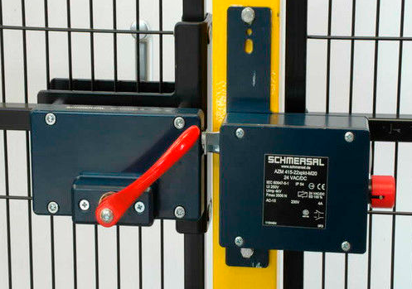
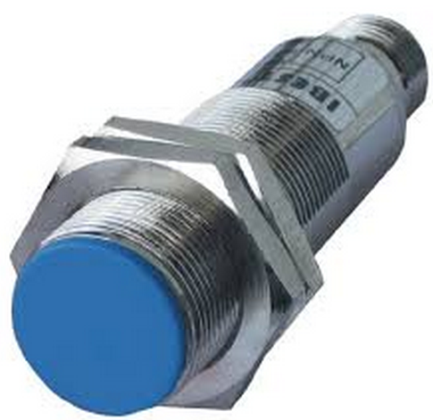


Current capabilities
30+ engineers within process simulation
Extensive standards & specifications (Sim, Robot, Plc)
VOLP – Volvo OffLine Programming tool
Not utilizing the full potential…

Slide 10
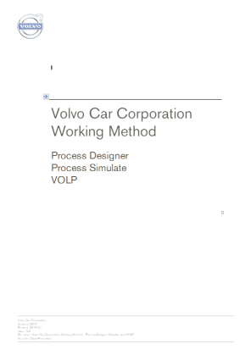
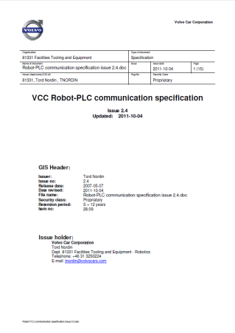
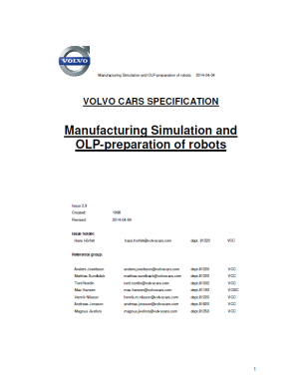
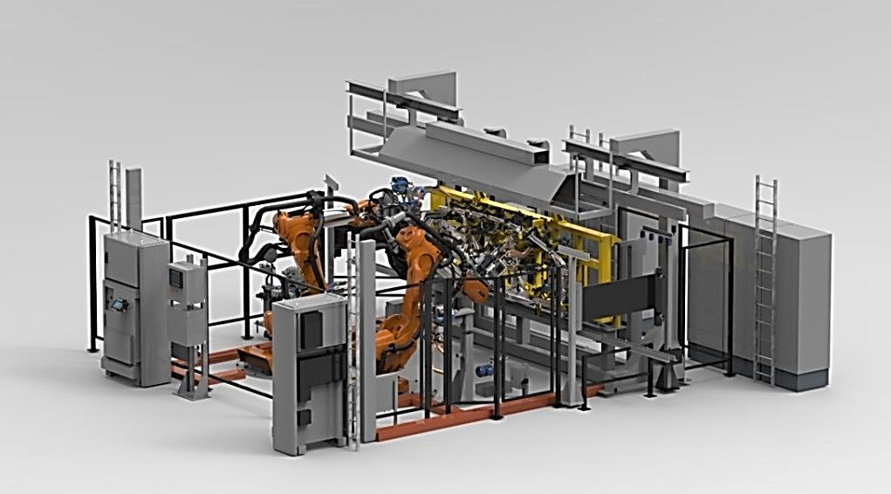
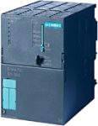
Ready 4 reality achieve higher maturity level much earlier
Virtual Commissioning captures the whole station logic!
fully verified process without physical installation
Use what we already have
Add the real control system and Code

Slide 11
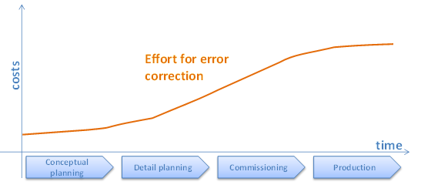
development logic much higher virtual focus
Invest more time here…
… to gain time here
PS
PC
FDJ
TT
J1
Core phase
Develop Process/product
Develop Process/product and PLC
PLC, installation and commissioning
Installation and commissioning
Virtual commissioning
Complete virtual installation
Develop More robust processes
Verification without physical prototypes
Debug process logic off-line

Slide 12


Implementation step by step
Decision to investigate VC
Decision to include VC in car projects
Initial WS at Siemens
Second WS at Siemens
Scope for Pilot decided
Pilot report out
Internal VCC Pilot
Working methods
2013
2014
2015

Slide 13
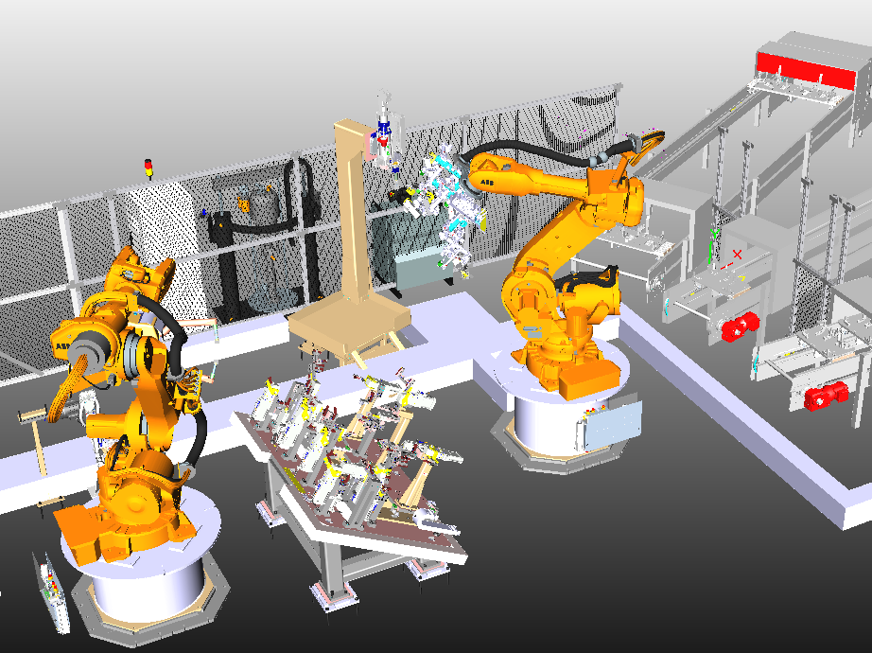
Vitual Commissioning pilot scope & findings
scope:
Small ”simple” station
Evaluate Siemens technical solution
Start develop methods and workflows
Suggest next steps
tech:
ABB IRC5 Spot-servo and Handling/Glue
Siemens CPU 319F
Process Simulate & TiaPortal
Simatic Net OPC Server
Findings:
No adaptions needed for PLC or Robotics
Very powerful debugging
Easy, fast setup
Must C the need for:
Commonality -> support auto generation
Co-locate -> create understanding
Co-operation -> responsibility split (VCC/Linebuilder)

Slide 14
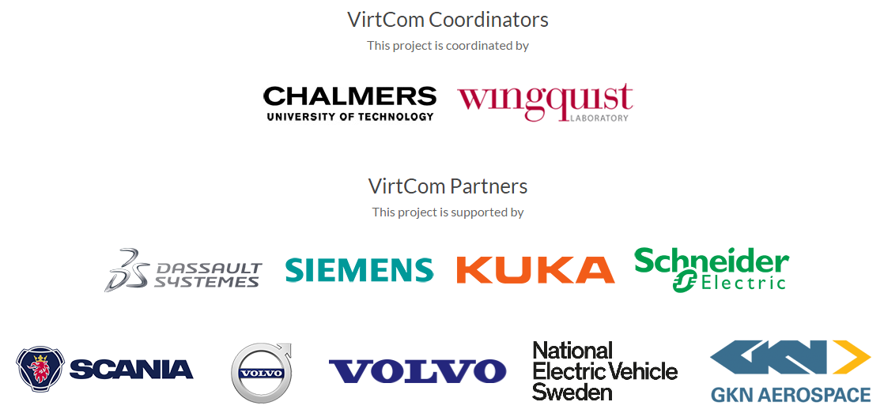
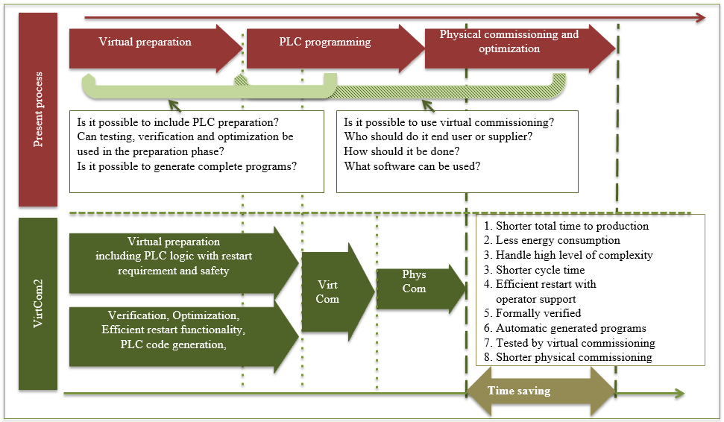
Virtcom research project

Slide 15
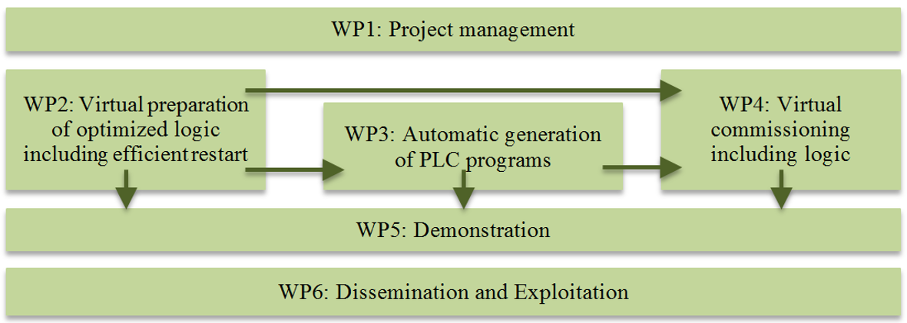
virtcom work packages

Slide 16
Current activities new car project
scope:
2 stations for 2 model introductions
Process Simulate connected via OPC or Simba
Reviews during project to track progress
VC presented before installation activities start
Safety NOT a demand
Measure success rate:
Process related errors during commissioning
Over all commissioning time of station
Did we miss something?
Preparation in early phases (more/less)
Modified hand-over to supplier:
Event based simulation instead of Gantt Charts
Equipment with behavior models instead of simple kinematics
Think about and prepare for VC, reusable logics
Take more responsibility!

Slide 17
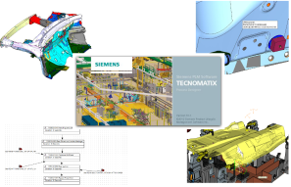

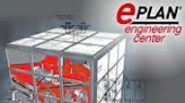

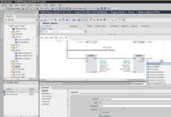
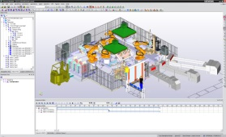
other activities input generation
scope:
Focus on the input to Virtual Commissioning
How much can we auto-generate?
POC study:
Project together with EPLAN
Use information from process planning software to generate:
Electrical schematics
I/O lists
Start with respot stations in Q3 2015

Slide 18

?
?
?
?
?
?
?
?
?
?
?
?
?

Slide 19

Thank you!

