Slide 1


Slide 2
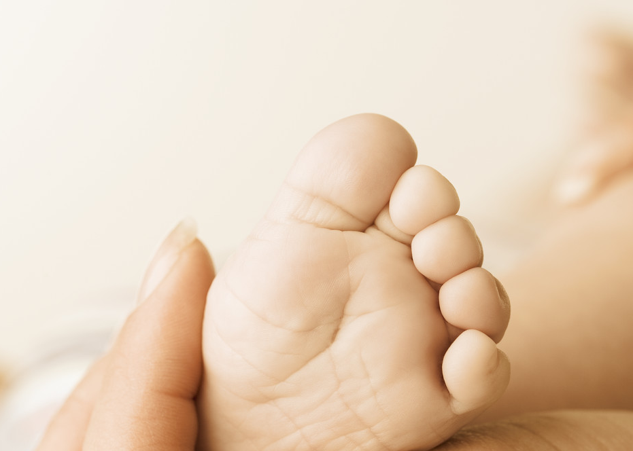

Dr Andrea Coda
PhD Paediatric Rheumatology – Podiatry
Dr P. Fowlie - NinewellsHospital and Medical School, Dundee, UK
Dr J. Davidson - Royal Hospital for Sick Children, Edinburgh, UK.
Dr J. Walsh - Royal Hospital for Sick Children, Yorkhill, Glasgow, UK.
Dr T. Carline - Second Supervisor, Queen Margaret University, UK.
Dr D. Santos - Director of Study, Queen Margaret University, UK.
Copyright © 2014

Slide 3
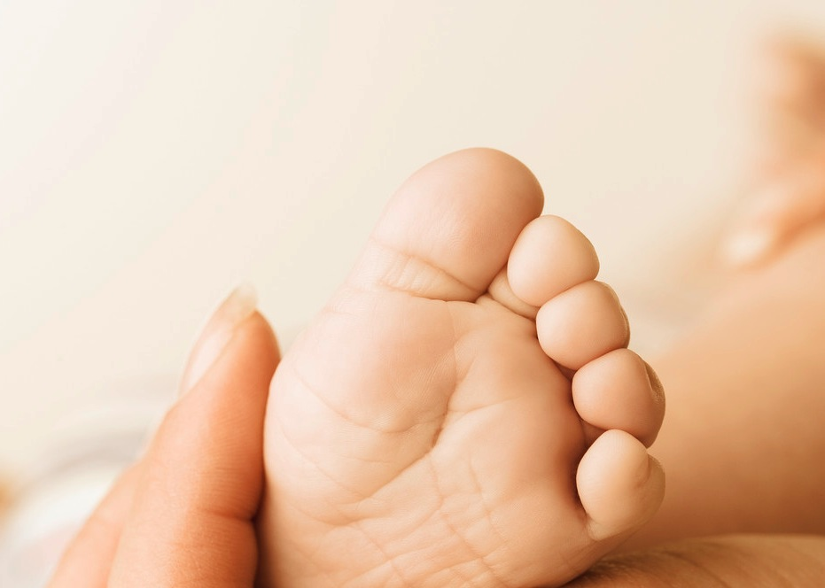

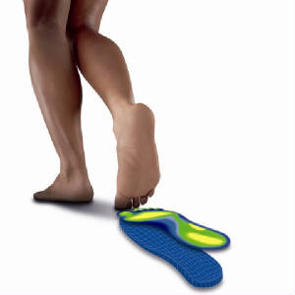
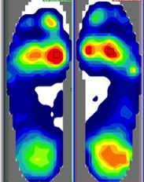
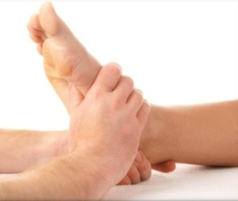

Foot Orthoses in
Juvenile Idiopathic Arthritis (JIA)
Copyright © 2014

Slide 4


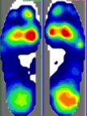
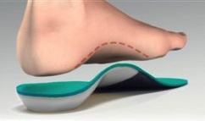
Study Title:
“A multicentre single blinded RCT to investigate the clinical effectiveness of pre-formed semi-rigid foot orthoses, on pain, quality of life and the dynamics of gait of patients diagnosed with Juvenile Idiopathic Arthritis (JIA)”
Copyright © 2014

Slide 5
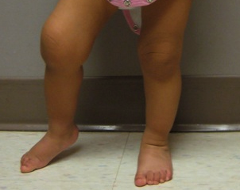
JIA
Most common chronic rheumatic disease in
children
Short and long-term disability
Painful joint & swelling
Reduced bone growth
Disturbance of gait
Physically less active compared to healthy children
(Brostrom et al. 2007; Hendry et al. 2008; Takken et al. 2008)
Copyright © 2014

Slide 6

Prevalence 0.16-1.13 per 1000
UK the prevalence is approximately 0.65 per 1000
(Manners and Bower 2002)
Prevalence of this disease is under-estimated
(Ravelli and Martini 2007).
Worldwide Incidence: 0.07- 4.01 per 1000
(Hendry et al. 2008; Karmazyn et al. 2007).
Incidence in the UK of 0.1 per 1000 children –
equivalent to 1000 new cases per year (NICE 2002).
Female to Male Ratio of 3 to 2 (Yang 2008).
Early Intervention (Cakmak, Bolukbas; 2005).
Copyright © 2014

Slide 7


1) Systemic Arthritis
2) Oligo-Articular Onset
3) Rheumatoid Factor Positive Polyarthritis
4) Rheumatoid Factor Negative Polyarthritis
5) Enthesitis-Related Arthritis
6) Psoriatic Arthritis
7) Undifferentiated Arthritis
Brescia 2008; Ravelli and Martini 2007
Copyright © 2014
Notes:
1) SYSTEMIC ARTHRITIS:
F=M; (4-17%) - Often Symmetrical – Pale. Affects the wholebody. Quotidian fever for at least 2 weeks followed by a sudden drop. Rush sudden disappear &quickly appear again. 5-8% life-threatening. Spleen & lymph nodes may become enlarged.
2) OLIGOARTICULAR ONSET: F>M & (27-56%) & Early Onset. 4 or fewer joints involved during the first 6 month. Asymmetrical. Knees & ankle mostly affected. Iritis or Uveitis (with or without active joint symptoms)
3) RHEUMATOID FACTOR POSITIVE POLYARTRITIS: 2-7%; F>M. Affects 5 or more joint during the first 6 months. IgM RF on at 2 occasions more than 3 months apart (largest antibody; found in blood and lymph fluid & first to response to an infection; destroy foreign substances; 5% to 10% of all the antibodies in the body. Small joints (hands); Symmetric. Late childhood or adolescence. RA Nodules (forearm & elobows)
4) RHEUMATOID FACTOR NEGATIVE POLYARTRITIS: F > M; 11-28%. Affects 5 or more joints during the first 6 months. During this time: Absence of IgM RF. Biphasic distribution; early peak at 2 to 4 years old & later peak at 6 to 12
5) ENTHESITIS-RELATED ARTHRITIS: M>F ; After 6 years old. Usually HLA - B27 +. Most common site are Insertion of AT; Plantar Fascia. Remitting; 50% have 4 or Fewer Joint affected.
6) PSORIATIC ARTHRITIS: F>M; 2-11%. Biphasic Distribution (2-4 & 9-11 years). Simultaneous presence of Arthritis & typical psoriatic rash. If Rash is Absent, 2 of following: Family history of Psoriasis; Dactylitis & Nail pitting. Controversy: not clear entity subgroup (very similar to Asymmetric Oligoarthritis & RF Negative poly-arthritis)
7) UNDIFFERENTIATED ARTHRITIS
It does not represent a separate subset but includes patients who not satisfy inclusion criteria for any of the previous categories or who meet more than one.

Slide 8
Treatment protocol for:
Drug therapies
Review intervals for GP
NICE guidelines for biological drugs (ie:etanercept)
Ophthalmologists
Intra-articular steroid injection
... what about PODIATRY?
Copyright © 2014
Notes:
Powell (2005) investigated the efficacy of custom foot orthotics in improving pain and functional status in JIA. Quasi-experimental prospective randomised trial. 40 subjects, subdivided into 3 groups. Investigated the use of custom made. Orthoses which are expensive & requires specialised laboratory. Equipment & materials to dispense.

Slide 9


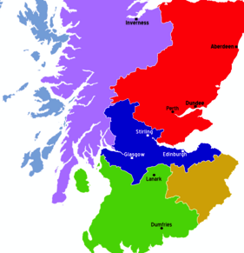
podopaediatric survey
Copyright © 2014

Slide 10
Repeatability & Reproducibility
30 healthy children
(2 visits each - 100% completed)
Coda, A; T. Carline; D. Santos (2014): Repeatability and Reproducibility of the Tekscan HR Walkway system in healthy children.
The Foot, DOI 10.1016/j.foot.2014.02.004.
Copyright © 2014

Slide 11

Research Aim
to investigate the effectiveness of commonly prescribed pre-formed semi-rigid FOs in children diagnosed with JIA over 6 months period of time
Copyright © 2014

Slide 12


Primary Outcome:
effects of FOs on pain level and quality
of life in JIA children
VAS
CHAQ
PedsQL
Copyright © 2014

Slide 13


Secondary Outcome:
- to relate gait parameters when barefoot, with shoes, and with shoes with orthoses to primary aim outcomes.
Copyright © 2014

Slide 14
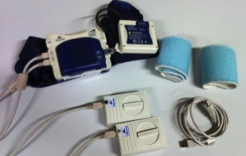
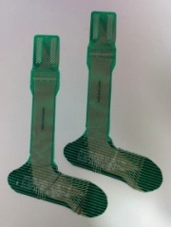
F-Scan®
Copyright © 2014

Slide 15
F-Scan®
Enable collection of data in the foot’s normal/shod functioning environment
Prevents targeting of areas
Can provide multiple footstep data from both feet during a single walk
Copyright © 2014

Slide 16
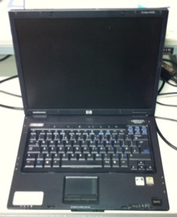
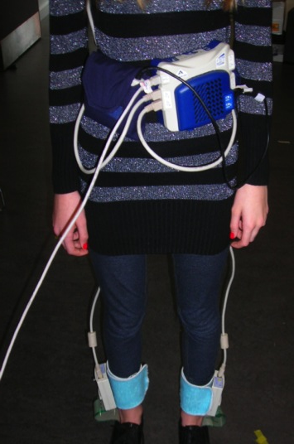
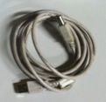
Copyright © 2014

Slide 17

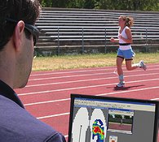
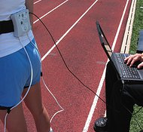
wireless version
Copyright © 2014

Slide 18
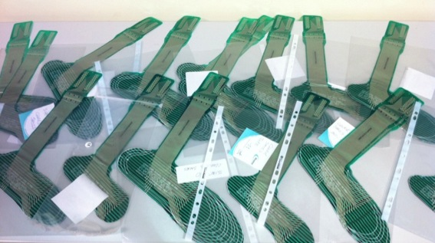
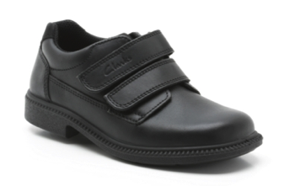
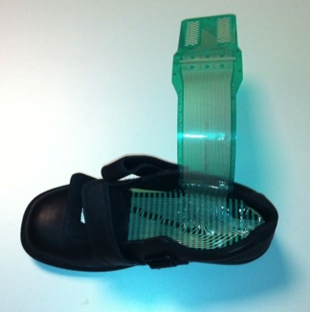
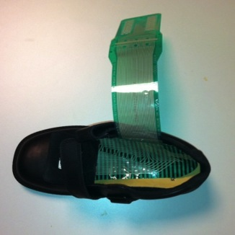


Copyright © 2014

Slide 19
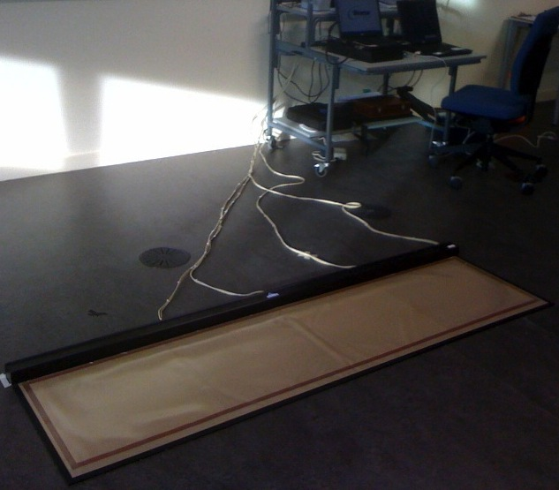
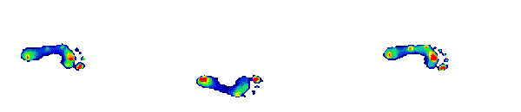
HR WalkwayTM
Copyright © 2014

Slide 20
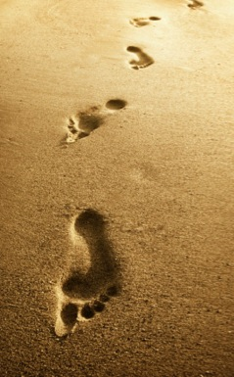
HR Walkway
Enable collection of data in a barefoot position without the influence of footwear
Subject has no wires/data boxes attached to them
Multiple steps recorded
Copyright © 2014

Slide 21
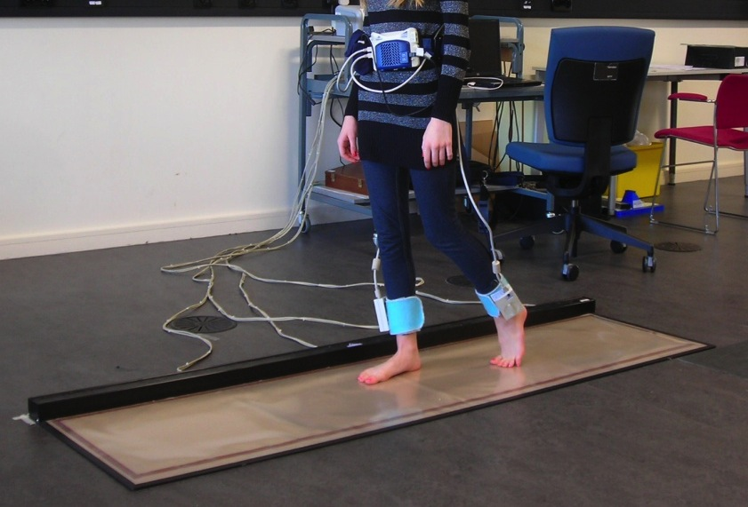
Copyright © 2014

Slide 22
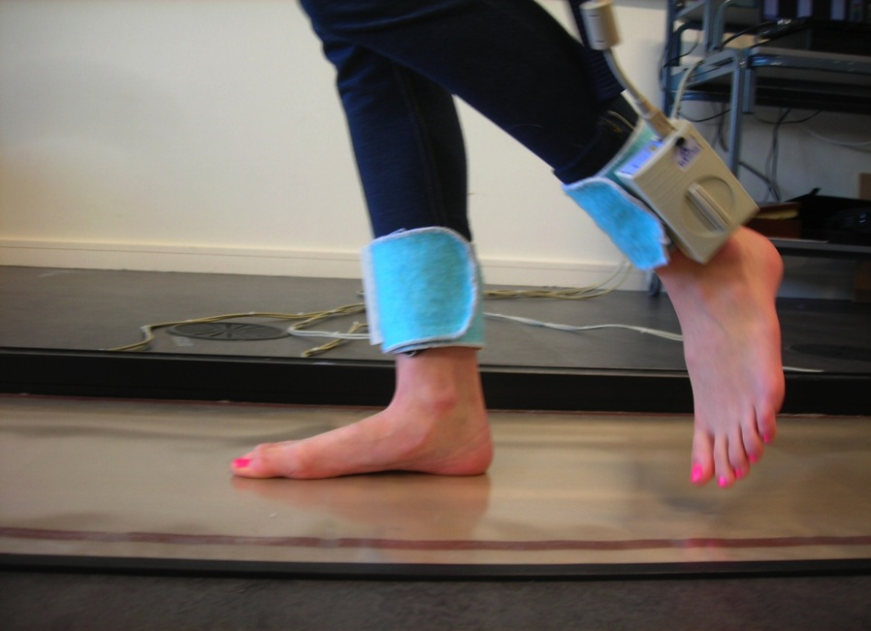
Copyright © 2014

Slide 23


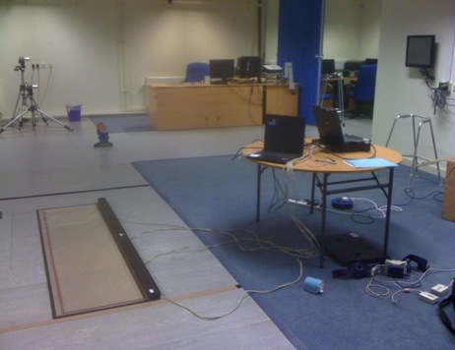
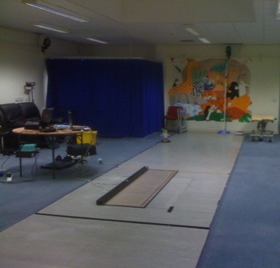
Copyright © 2014

Slide 24

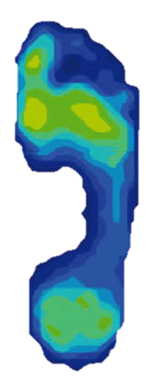

Total
Heel
Midfoot
Forefoot
1st met head
2nd met head
3rd - 4th met head
5th met head
Lesser Toes
Hallux
Plantar Pressure Mapping
Copyright © 2014

Slide 25
Methodology
Randomised Control Trial
Single-blinded patient intervention
Quality of Life Questionnaires
(randomly)
Gait Analysis
(randomly)
Copyright © 2014

Slide 26

JIA – Inclusion Criteria:
ILAR criteria
lower extremity joint involvement (5 to 18 years old)
previous failure of orthotic management, where the
patient has not worn any insoles for at least 3 months
ability to walk a minimum of 15 metres
6 months after start of DMARD and/or
biologic therapy
Copyright © 2014

Slide 27

JIA - Exclusion Criteria:
inability to walk barefoot or shod
musculoskeletal disease, central or
peripheral nerve disease & endocrine disorders,
especially Diabetes Mellitus
previous foot surgery
currently using FOs
where supply of orthotics are contraindicated
Copyright © 2014

Slide 28
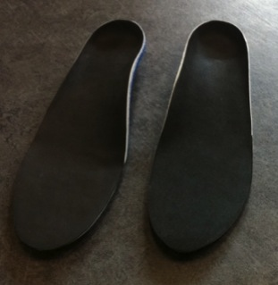
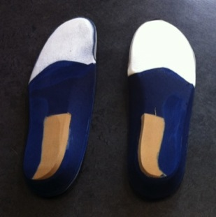
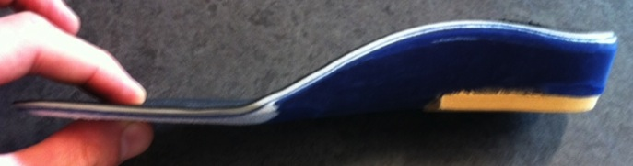
Example of Trial Insole
Copyright © 2014

Slide 29
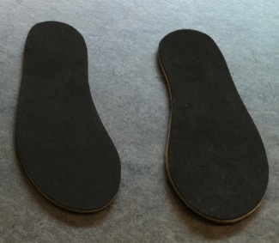
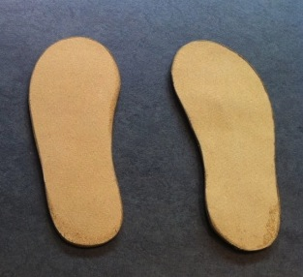
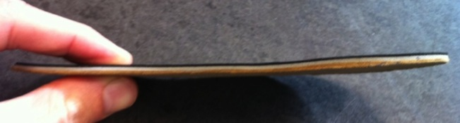
Control Insole
Copyright © 2014

Slide 30
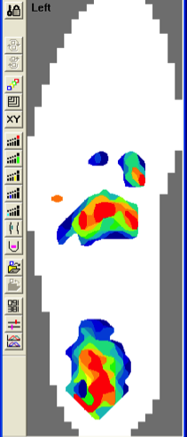
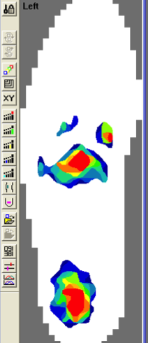
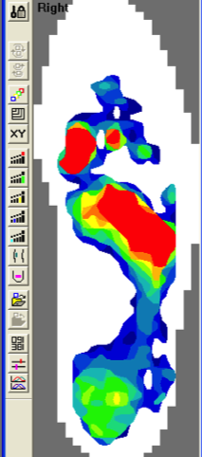
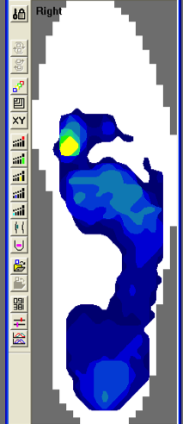
Control
Trial
without insole
with insole
without insole
with insole
Copyright © 2014

Slide 31
Working in progress...
JIA - RESULTS
60 JIA children
(99.4% completed; n= 179/180)
attrition rate = 1 out of 240 visits
Copyright © 2014

Slide 32

Working in progress...
RESULTS
Control: 48.3% (n=29) – Trial 51.7% (n=31)
Male: Control 20.7% (n=6) – Trial 29% (n=9)
Age: Control 11.17(SD3.51) - Trial 10.64 (SD3.84)
Stable: Control 65.5% (n=19) – Trial 74.2% (n=23)
Copyright © 2014

Slide 33

Working in progress...
DATA ANALYSIS
Statistical differences (control & trial) were compared at baseline, 3 and 6 months).
All data showed a non-parametric distribution
Mann-Whitney U test for the pairwise comparisons.
Copyright © 2014

Slide 34
Working in progress...
RESULTS
 | CONTROL | TRIAL
Height (cm) at baseline- mean (SD) | 142.07(17.94) | 140.39(22.17)
Weight (kg) at baseline - mean (SD) | 38.97(18.04) | 42.07(23.41)
CHAQ at baseline (p=0.247) – median (IQR) | 0.125 (1.31) | 0.375 (0.625)
DMARDs at baseline (p=0.935) | n=19 (66%) | n=20 (65%)
Steroids Injection at baseline (p=0.648) | n=23 (79%) | n=26 (84%)
Copyright © 2014

Slide 35
Working in progress...
RESULTS
JIA subtype | CONTROL | TRIAL
Systemic Onset | n=2 | n=2
Oligoarthritis | n=13 | n=20
Rheumatoid Factor “+” Polyarthritis | n=9 | n=6
Rheumatoid Factor “-” Polyarthritis | n=2 | n=1
Enthesitis Related Arthritis | n=1 | n=2
Psoriatic Arthritis | n=0 | n=0
Undifferentiated | n=2 | n=0
Copyright © 2014

Slide 36


Working in progress...
Primary Outcomes
VAS (p=0.029)
PedsQL paediatric-generic (p<0.001)
Peds QL paediatric rheumatology (p<0.001)
PedsQL parent generic (p=0.047)
PedsQL parent rheumatology (p=0.02)
clinical significance was also obtained
Copyright © 2014

Slide 37

Secondary Outcomes
Gait Time (p=0.006)
Gait Velocity (p=0.004)
Stance Time (p=0.005)
Total Plantar Surface (p<0.001)
Heel (p<0.001)
Midfoot (p=0.044)
5th Met. Head (p=0.030)
Hallux (p=0.021)
Copyright © 2014

Slide 38
CONCLUSION
Pain
Quality of life
Gait-Parameters
Coda, A; P. Fowlie; J. Davidson; J. Walsh; T. Carline; D. Santos (2014).“Foot Orthoses in Juvenile Idiopathic Arthritis (JIA) – Randomised Controlled Trial. BMJ – Arch Dis Child doi:10.1136/archdischild-2013-305166
Copyright © 2014

Slide 39


GRAZIE
Andrea.Coda@newcastle.edu.au
Copyright © 2014

Slide 40

Copyright © 2014

