Slide 1
Dr. Andre Senecal
Science Advisor Food Protection
US Army Natick RD&E Center
Combat Feeding Directorate
Food Protection and Innovative Packaging Team
Bacteriophage: A Novel Technology for Improving the Safety of Produce

Slide 2
Presentation Outline
Impact of Enteric Illness on the Military
Significance of Fresh Produce on Enteric Illness and Military Concerns
Chlorine Wash
New Strategies
  Bacteriophage
  Non-Chlorine Washes
  2-step antimicrobial treatment study

Slide 3
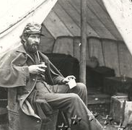
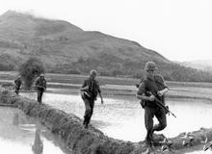
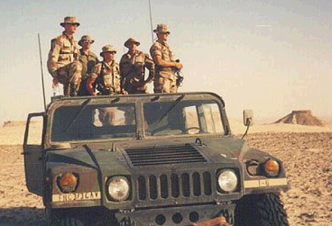
Military Significance of Enteric Illness
Military history is full of well-documented episodes in which outbreaks of diarrheal disease have weakened forces during wartime.
The Civil War:
  Chronic diarrhea claimed 27,558 lives during the war, the single most common cause of death.
  Virtually every soldier suffered from chronic diarrhea, resulting in the term that it takes good 'guts' to be a soldier.
  Civil war doctors attributed diarrhea to poor nutrition.
The Vietnam War:
  Diarrhea disease accounted for approximately 60,000 man-days lost from duty per year.
Operation Desert Shield:
  Gastroenteritis caused by enterotoxigenic E. coli and shigella was a major problem that frequently interfered with the duties of U.S. troops.

Slide 4
Military Significance of Enteric Illness
Incidence of Diarrhea
  In USA – on average between 17-19K cases/year with soldiers restricted to quarters for 24 hr., 460-530 cases/year hospitalized
  29% of US forces training in Thailand affected (Campylobacter)
  Kosovo: Mid-deployment study indicated 14% of soldiers having diarrhea often or very often
  Desert Storm: Post-deployment 62% of soldiers reported episodic diarrhea
  Gastroenteritis caused by enterotoxigenic E. coli and Shigella (49.5%) frequently interfered with the duties of U.S. troops during Operation Desert Shield (Hyams, et al, 1991)

Slide 5
Background/Historical Information
A 2013 report from the Center for Disease Control indicated that almost half, 46% of all foodborne illnesses that led to hospitalization or death in the United states between 1998-2008 were attributable to fresh produce
Produce contributed to 27% of illnesses associated to bacteria
  Greater proportion of illnesses with produce were attributed to enterotoxigenic Escherichia coli; Shiga toxin–producing Escherichia coli (STEC) O157; non-O157 STEC; Salmonella enterica serotypes Javiana, Newport, Enteritidis, Heidelberg, Typhimurium, and Typhi); Shigella spp.
Incidence of E. coli O157:H7, Shigella spp. and Salmonella spp. in produce has been well documented in the literature

Slide 6
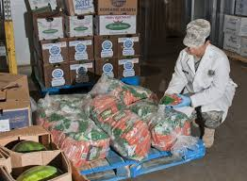
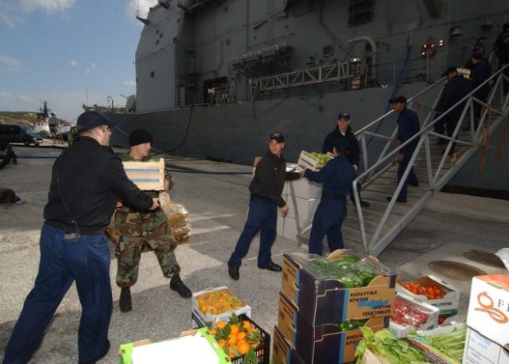
Background/Historical Information
Perishable foods, such as fresh fruits and vegetables (FF&V) have short shelf-life making it necessary for the US Military to procure FF&V from host or neighboring nations in operational regions abroad
FF&V are a concern to the Military
  Uncooked = No “kill’ step
  Commercial food sanitation standards and enforcement may be inferior in certain foreign countries
  Enteric pathogens from food and water are the number one cause of non-battle injuries
  Incidence of diarrhea among warfighter’s results in lost workdays and decreased abilities to perform their duties and could have a significant impact on overall troop performance and readiness.

Slide 7
Chlorine Wash
  Presently according to the Army medical publication TB MED 530 a 100 to 200 ppm total chlorine rinse is to be used for washing FF&V.
  Issues:
    Organic mater on FF&V has been associated for neutralizing the overall antimicrobial effect of chlorine
    Virto et al 2005 - demonstrated that chlorine has limitations in environments where soil and organic matter are shed during the wash step.
    Parish et al 2003 – in a comprehensive review of methods to eliminate pathogens in fresh cut produced revealed 200 ppm chlorine to be ineffective for eliminating pathogens on FF&V, especially leafy greens.
    New strategies that are not impacted by organic matter are needed for preventing enteric illnesses to military personnel.

Slide 8
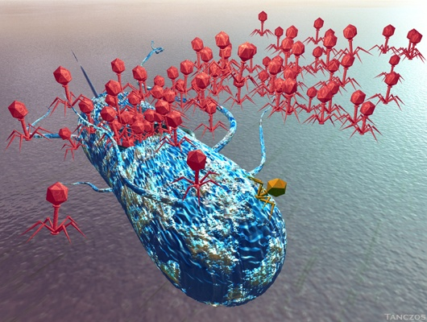

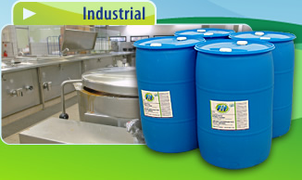
New Sanitation Strategies for Produce
A two stage antimicrobial treatment for FF&V’s using FIT® and bacteriophage
http://www.micro`biologynews.info/blog/category/viruses
Date: 01 Oct 09
JSN 03-30

Slide 9
Bacteriophage
http://www.micro`biologynews.info/blog/category/viruses
Bacteriophage – an old antimicrobial strategy that has been recommended as both a therapeutic and biocontrol agent
Bacteriophage cocktails have been shown effective against E. coli O157:H7 on cantaloupe, lettuce, tomato, spinach, broccoli and ground beef. (Abuladze et al 2008 & Sharma et al 2009)
Phage cocktails while effective do have limitations for total pathogen elimination.

Slide 10

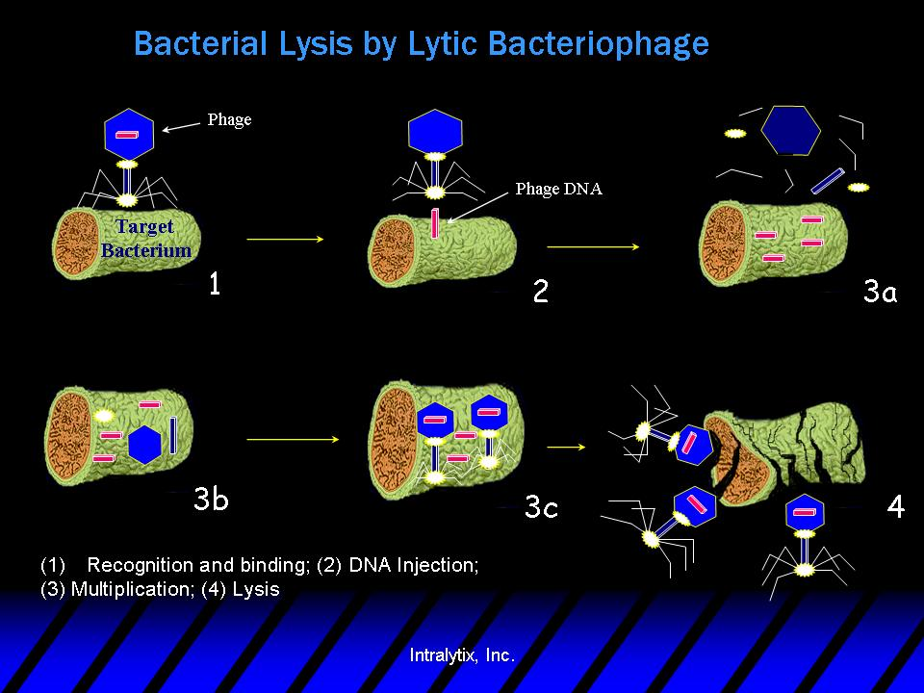
Date: 01 Oct 09
01 Oct 2012
JSN 03-30
JSN 03-30

Slide 11
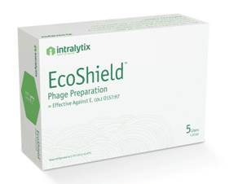
Two-Step Biocontrol Process
  Objective:
Investigate the ability of a two-step biocontrol process (produce wash and bacteriophage) for reduction of E. coli O157:H7, Shigella spp. and Salmonella spp. for fresh fruits and vegetables.
The produce wash Fit-L (Health Pro Brands Inc. Cincinnati, OH)
  Fit-L is comprised of levulinic acid, grapefruit oil terpenes and other proprietary ingredients.
  Bacteriophage used in the study were produced under an Army contract with Intralytix Inc, Baltimore MD
    EcoShield – a 3 phage cocktail
    SalmoFresh – a 6 phage cocktail
    ShigActive – a 5 phage cocktail

Slide 12
FF&V and Bacterial Test Strains
Broccoli, cantaloupe and strawberries were purchased from a local grocery store and cut into 10 ± 0.1 g samples
  Broccoli pieces included floret and stem
  Strawberry pieces included flesh and stem
  Cantaloupe pieces consisted of rind and flesh
Nalidixic acid resistant cultures were used for all experiments.
  Salmonella spp. included S. enterica subsp. enterica ATCC 9712 (serovar Saintpaul), 51962 (serovar Paratyphi B), 13311 (serovar Typhimurium), 6958 (serovar Choleraesuis) and 14028 (serovar Typhimurium)
  Shigella spp. included S. flexneri ATCC 9204, 9380, 9199, 9473, and S. sonnei sh543 (Intralytix Inc.)
  E. coli O157:H7 included 229, 230, and 231, (Intralytix Inc.) and ATCC 43894, 35150

Slide 13
Experimental Treatments
  Wash Solutions were prepared in challenge water.
  Challenge water – consisted of total organic carbon and total organic solids of 2.5g/L
  Treatments:
  1) Control
  2) 100-200 uL Bacteriophage cocktail
  EcoShield
  SalmoFresh
  ShigActive
  3) Fit-L produce wash
  4) 200 ppm free available chlorine bleach
  5) Bacteriophage cocktails plus Fit-L
  Wash Times - 1 minute

Slide 14
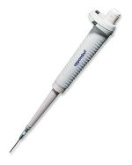

Process Flow Diagram
20 uL of bacteria –
10 random spots
Add 90 mL wash solutions
Soak for 30 s
Dry ~ 30 min.
10 grams of food
Stomacher bag
Add 100-200 uL phage cocktail
After 10 min at room temp store 24 h at 10ºC
1mL
Stomach for 30 s
Tryptic Soy Agar
50ug/mL Nalidixic acid
Serial dilutions
Butterfield’s buffer
9 mL Dey-Engel
neutralizing broth

Slide 15
E. Coli O157:H7
Food | Treatment | Challenge Water log CFU
Strawberry | Control | 5.61
 | Bacteriophage Cocktail | 5.09 ± 0.52 ª
 | Produce Wash | 3.11 ± 0.06
 | Produce Wash + Bacteriophage Cocktail | 2.75 ± 0.23
 | Bleach | 5.34 ª
Cantaloupe | Control | 6.15
 | Bacteriophage Cocktail | 4.10 ± 0.37
 | Produce Wash | 1.80 ± 0.10
 | Produce Wash + Bacteriophage Cocktail | 1.80 ± 0.10
 | Bleach | 4.63
Broccoli | Control | 6.54
 | Bacteriophage Cocktail | 4.60 ±0.10
 | Produce Wash | 3.27 ±0.78
 | Produce Wash + Bacteriophage Cocktail | 3.49 ± 0.90
 | Bleach | 6.10 ª
Wash treatments were 1 minute
a. Not significantly different from control (P≥0.05)
JSN 03-30

Slide 16
Salmonella
Food | Treatment | Challenge Water log CFU
Strawberry | Control | 6.18
 | Bacteriophage Cocktail | 5.29 ± 0.31 ª
 | Produce Wash | 3.28 ± 0.27
 | Produce Wash + Bacteriophage Cocktail | 2.08 ± 0.38
 | Bleach | 5.64 ª
Cantaloupe | Control | 6.19
 | Bacteriophage Cocktail | 4.63 ± 0.30
 | Produce Wash | 2.03 ± 0.20
 | Produce Wash + Bacteriophage Cocktail | 1.80 ± 0.10
 | Bleach | 6.03 ª
Broccoli | Control | 5.90
 | Bacteriophage Cocktail | 4.77 ±0.16
 | Produce Wash | 3.42 ±0.26
 | Produce Wash + Bacteriophage Cocktail | 2.08 ± 0.38
 | Bleach | 5.74 ª
Wash treatments were 1 minute
a. Not significantly different from control (P≥0.05)

Slide 17
Shigella
Food | Treatment | Challenge Water log CFU
Strawberry | Control | 6.16
 | Bacteriophage Cocktail | 5.17 ± 0.17 ª
 | Produce Wash | 3.72 ± 0.86
 | Produce Wash + Bacteriophage Cocktail | 2.75 ± 0.23
 | Bleach | 5.52 ª
Cantaloupe | Control | 5.73
 | Bacteriophage Cocktail | 4.96 ± 0.17 ª
 | Produce Wash | 3.02 ± 0.47
 | Produce Wash + Bacteriophage Cocktail | <1.70
 | Bleach | 5.43 ª
Broccoli | Control | 6.51
 | Bacteriophage Cocktail | 5.58 ±0.25 ª
 | Produce Wash | 5.23 ±0.10
 | Produce Wash + Bacteriophage Cocktail | 4.03 ± 0.60
 | Bleach | 5.97 ª
Wash treatments were 1 minute
a. Not significantly different from control (P≥0.05)

Slide 18
Reduction of Bacteriophage in Fit-L
JSN 03-30

Slide 19
Summary
  Spraying phage into a stomacher bag holding the inoculated sample may have resulted in an inadequate dose of phage coming in contact to the inoculated spots on the food.
    Due to the passive movement of phage in food high concentrations are needed to ensure contact with the bacteria
  200 ppm free available chlorine was found to be ineffective in challenge water for reducing pathogens from FF&V
  Pretreating samples with phage prior to the wash process resulted in an additive effect and had the best overall reduction of pathogens present on the FF&V samples
  This study demonstrated an effective 2-step process for sanitizing FF&V

Slide 20
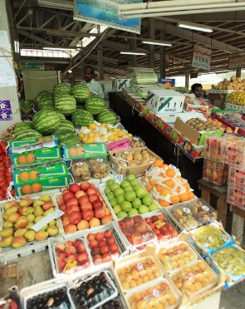
Questions?

