Slide 1

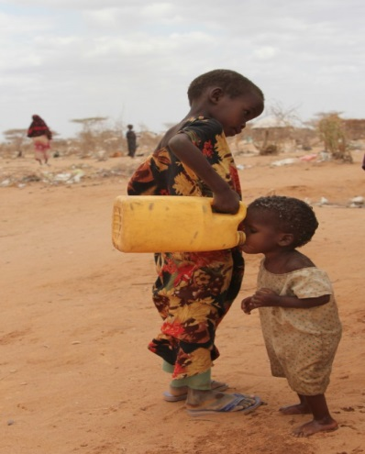
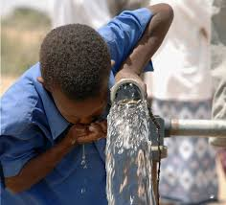
Zero Emissions from Industrial Waste water using Green solvent: Quantum Chemical Calculations.
Aim to “Produce & supply clean water for every where in the world”
Dr. Anantharaj Ramalingam
Department of Chemical Engineering
Faculty of Engineering, University of Malaya
50603-Kuala Lumpur, Malaysia.

Slide 2
Over view of Presentation
Zero Emissions from Industrial Waste water
Green Solvent
Quantum Chemical Techniques.
Solvent extractions
Quantum Chemical Approach for Zero Emissions
Important Observations

Slide 3
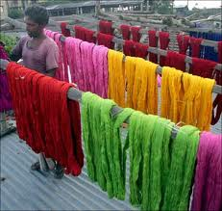
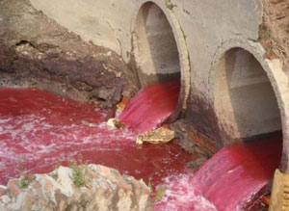
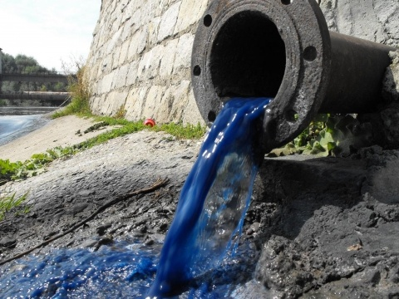
Zero Emissions from Industrial Waste water
Industrial waste water contains chemical auxiliaries like salts, heavy metals, dyes, pigments, dispersing agents, smoothing agents, polyaromatic hydrocarbons (PAH), chlorobenzene (CB) and its derivatives, phenol and its derivatives, endocrine disrupting chemical (EDC)and surfactants.
Dyes are major water pollutant which are generally present in the industrial waste water.
Various types of dyes are used in the process industries like carpet manufacturing, dyeing, textile, pulp and paper industries, leather, food processing, paper and dye manufacturing, cosmetics, etc.
In fact , 10-25% of dyes are lost during the dyeing process, and 2-20% are directly discharged with the effluent.

Slide 4
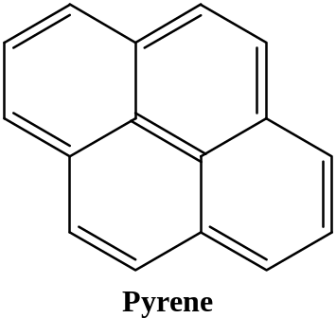
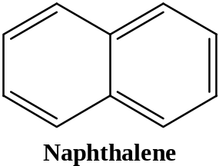
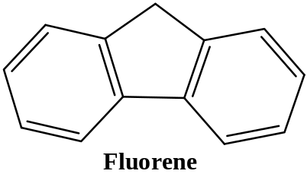
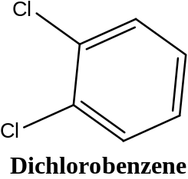
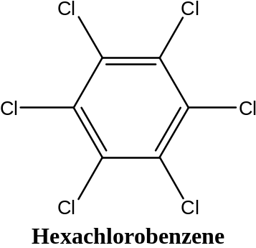
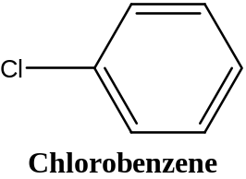
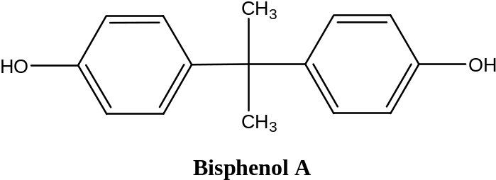
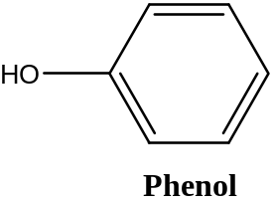
Chemical Structure of Major Water Pollutants
PAHs
CBs
EDCs & PHs

Slide 5
Typical Chemical Structure of Dyes
Acid Dye: Acid Blue-25
Base Dye : Base Blue -9 (methylene blue)
Reactive Dye : Reactive Blue-5G

Slide 6
Typical Dyes used in Dyeing Operations
Dye Class | Solubility in water | Example
Acid | Soluble | Acid blue 25, acid orange 7, acid red 14
Base | Soluble | Base blue 9, base orange, base red9
Direct | Soluble | Direct blue 1, direct orange 1, direct red 81
Disperse | Insoluble | Disperse blue 1, Disperse orange 1, disperse red1
Reactive | Soluble | Reactive blue 5G, reactive orange 16, reactive red 3.
Sulfur | Soluble | Sulphurous blue R
Vat | Insoluble | Vat blue 1, vat orange 1,vat red 10

Slide 7
Simulated Dye Effluent
{ ABR(Acid-Base-Reactive) series Dyes}
Color/types | Blue | Orange | Red
Acid (A) | AB-25 | AO-7 | AR-14
Base(B) | BB-9 | BO | BR-9
Reactive(R) | RB-5G | RO-16 | RR-3
Acid Dyes:
AB-25: Acid Blue-25
AO-7: Acid Orange-7
AR-14:Acid Red-14
Base Dyes:
BB-25: Base Blue-25
BO: Base Orange
BR-9:Base Red-9
Reactive Dyes:
RB-5G: Reactive Blue-5G
RO-16: Reactive Orange-16
RR-3:Reactive Red-3

Slide 8
Conventional Methods
Methods | Demerits
Chemical : Adsorption ; Oxidation; Coagulation. | Adsorbent regeneration; Oxidizing agent need to be activated; Need disposal in land fill; Short half life (20min); Formation of large particles; Not economically acceptable in the long-time.
Physical : Precipitation; Filtration | Very expensive; Not effective for all dyes; High sludge production
Biological: Using enzyme; Using microorganisms | Not effective; Low rate of degradation; High rate of biomass residue produced;
Physical-Chemical/Biological: combined process | Duration of the treatment (24h to 6 days)
Photochemical: | Formation of by products.
Electrochemical: | Relatively high flow rates cause a direct decrease in dye removal.

Slide 9
Coventional Methods : Major Issues
Not effective for all kind of dyes and other water pollutants
Time consuming
High initial and capital cost
Generate secondary pollutants (aromatic amine and other)
Recovery and reuse of dye is not possible
Produce a number of aromatic amines which are carcinogenic and mutagenic in nature.
Are inadequate to treat high concentration of large volume of industrial effluents.
Do not provide an ecologically acceptable long term solution

Slide 10
Why Dye Effluents
Textile industry consumes large amount of potable and industrial water as processing water (90-94%) and a relatively low percentage as cooling water (6-10%).
In chemical industry, only 20% of industrial water is used as process water and rest for cooing.
The recycling of treated wastewater has been recommended due to the high level of contamination in dyeing and finishing process (i.e. Dyes and their breakdown products, pigments, dye intermediates, auxiliary chemicals and heavy metals,etc).
Without adequate treatment these dyes can remain in the aqueous environment for a long period of time. For instance, the half-life of hydrolyzed reactive blue19 is about 46 years at Ph 7 and 298.15K.

Slide 11
What should have Alternative Method
Environmentally friendly
High process efficiency
Cost effective
Permits recovery and reuse of dyes
Absence or Low solubility of water

Slide 12
Solvent Extractions
Solvent extraction has often been a favored choice of process engineers for the development of separation process.
The separation of mixtures by solvent extraction is often applied by many industrial procedures due to simplistic operation option, mild processes conditions, and economical advantages of this method.
High efficiency of the technique depends largely on a precisely selected the most suitable solvent for specific separation process.
However, conventional solvents commonly used for extraction are highly volatile, flammable, and often toxic.
The environmental regulations all over the world are stringent so applications of green solvents in classical methods.

Slide 13
A Suitable Solvent has to Meet the Following Criteria:
High electron affinity and structural orientation
High solvent selectivity
High solvent capacity
High performance index
Safe and economically viable treatment
Recovery and regeneration possible
Tolerance for a wide range of wastewater parameters usable for all kind of dyes

Slide 14
Ionic Liquids
Ionic liquids (IL’s) are known as “ green solvent” due to their great capacity as solvents and their “ environmentally friendly” properties in comparison with common organic/inorganic solvents.
IL’s are salts that consist of bulky organic cations and organic or inorganic anions.
IL’s are typically nonvolatile, nonflammable, and thermally stable.
IL’s have been studied for application related to green chemical processes, such as extractions, gas separations, electrochemistry, and catalysis.
IL’s have higher density than organic liquids and water. Therefore, many IL’s exists as a separate phase when in contact with organic and aqueous phases.
These feature make it possible to recovery, regenerate and recycle the IL’s for multiple extractions without additional environmental concern.

Slide 15






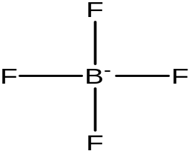
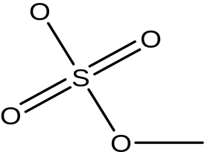

Typical Cation & Anion Structure
Cation: + ve
1-ethyl-3-methylimidazolium
1,2,4-trimethylpyrazolium
1-ethyl-1-methylpyrrolidinium
1-ethylpyridinium
1-ethyl-1-methylpiperidinium
Anion: -ve
Chloroaluminate
Tetrafluoroborate
Methylsulphate

Slide 16
COSMO-RS Model
COSMO-RS: COnductor Like Screening MOdel for Real Solvents
COSMO : COnductor Like Screening MOdel
(Quantum Chemical Calculation)
RS : Real Solvents
  (Statistical Thermodynamics)
COSMO-RS depends on a small number of global parameters and its requires molecular structure as the only initial input.

Slide 17
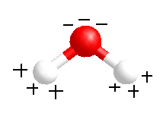
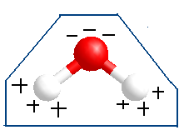
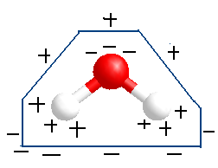
COSMO : COnductor Like Screening MOdel
Element Specific
Molecular Cavities
Created
Solvent
Accessible Area
(SAS)
Solute Molecule
Molecule Placed
In a conductor
Surface Charge Distribution : SIGMA PROFILE
Molecule Pulls Charges
From the conductor
To the interface
SAS divided into small segments each having a screening charge density σ

Slide 18
Universal Parameter used in COSMO-RS Model
Universal Parameter | Value (Banerjee et.al.,2007)
a_{eff} (effective contact surface area) | 6.32 Å²
σ_{hb} (cut-off surface charge density for hydrogen bonding) | 0.0084 e/Å² *
α' (misfit constant) | 8419 (kcal Å⁴ )/(mole² )
c_{hb} (hydrogen bonding coefficient) | 75006 (kcal Å⁴ )/(mole² )
α' = (0.64 ×0.3 × )/ε₀, with ε₀ = 2.395 × 10⁻⁴ (e² mole)/(kcal Å).

Slide 19
Results and Discussion
COSMO.file Generation:
Step:1: Geometry Optimization in Gas Phase
Level of Theory: PBV86 (Density Functional Theory)
Basis Set: TZVP (Triple Zeta Valence Polarized ) with
DGA1 (Density Gradient Approximation)
Step 2: COSMO File Generation
Level of Theory: PBV86 (Density Functional Theory)
Basis Set: TZVP (Triple Zeta Valence Polarized ) / DGA1
SCRF Calculation is done with SCRF=COSMORS keyword in GAUSSIAN03

Slide 22
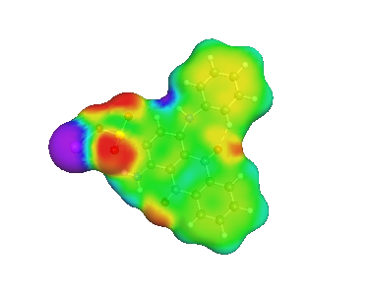
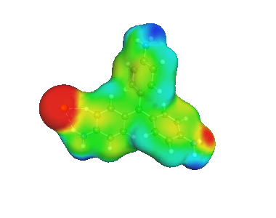
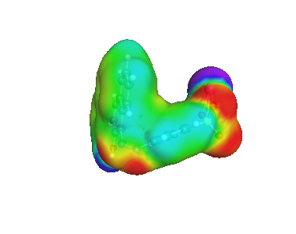
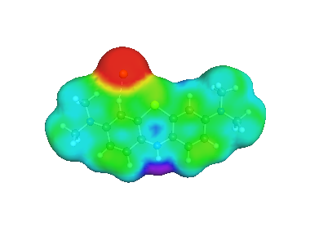
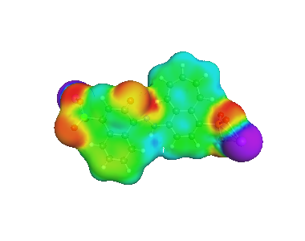
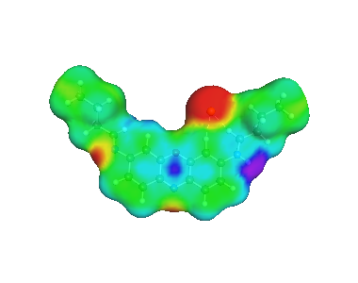
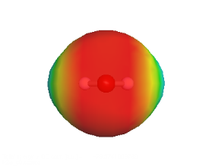
Sigma Profile for Dye Effluent with Imidazolium
Acid blue 25
Basic blue 9
Acid orange 7
Basic orange
Acid red 14
Basic red 9
Reactive blue 5G
water

Slide 23
Screening of Ionic Liquids using COSMO-RS model
Selectivity (S):
Where is the activity coefficient of aromatic sulfur-nitrogen species at infinite dilution and is the activity coefficient of model liquid fuel at infinite dilution.
Capacity (C):
Where the subscript ’1’ and ‘2’ indicates S/N species and model liquid fuel respectively
Performance Index (P.I):

Slide 27
Screening Ionic liquid for Decolorization Process
Parameters | Cation (10) | Anions (28) | Maximum | Minimum
_{Selectivity} | _{[OMIM]} _{[NIMIM]} _{[DMIM]} | Acetate Decanate Salicylate | 55.92 56.154 37.157 | 55.44 53.26 34.104
_{Capacity} | _{[OMIM]} _{[NIMIM]} _{[DMIM]} | Acetate Decanate Salicylate | 66.8 65.54 43.59 | 4.18 4.13 3.69
_{Performance Index} | _{[OMIM]} _{[NIMIM]} _{[DMIM]} | Acetate Decanate Salicylate | ~3750 ~3680 ~1620 | ~232 ~220 ~125

Slide 28
Validation & Prediction
RMSD :1.12%
Phase Behaviour of Ionic Liquid + Pyridine + n-Hexadecane system

Slide 29
Prediction of Phase Behavior
Ionic Liquid + Reactive Orange 107 + Water System

Slide 30
Important Point observation
COSMO-RS is the power full tool a prior model prediction for thermodynamic properties such as activity coefficient and LLE/SLE/VLE data and others.
COSMO-RS model not only minimize our experimental cost and time consumption but also design effective solvent for the process at ambient conditions.
Decolonization process efficiency is depends on alkyl substitution at cation and anion and size and shape of anions with alkyl substitution.
Above C₈ substitution at imidazolium cation with acetate, decanate and salicylate anions shows higher selectivity, capacity and performance index at 298.15K and pressure 1 bar.
Phase diagram shows positive slope at lower concentration of dye in water which indicates the amount of solvent required more. However, recovery and reuse of solvent may be considerable in industrial applications.

Slide 31
Acknowledgement
Head of the Department, university of Malaya, Malaysia.

Slide 32
Thank You for Your Kind Attention

