Slide 1
About OMICS Group
OMICS Group is an amalgamation of Open Access Publications and worldwide international science conferences and events. Established in the year 2007 with the sole aim of making the information on Sciences and technology ‘Open Access’, OMICS Group publishes 500 online open access scholarly journals in all aspects of Science, Engineering, Management and Technology journals. OMICS Group has been instrumental in taking the knowledge on Science & technology to the doorsteps of ordinary men and women. Research Scholars, Students, Libraries, Educational Institutions, Research centers and the industry are main stakeholders that benefitted greatly from this knowledge dissemination. OMICS Group also organizes 500 International conferences annually across the globe, where knowledge transfer takes place through debates, round table discussions, poster presentations, workshops, symposia and exhibitions.

Slide 2
OMICS International Conferences
OMICS International is a pioneer and leading science event organizer, which publishes around 500 open access journals and conducts over 500 Medical, Clinical, Engineering, Life Sciences, Pharma scientific conferences all over the globe annually with the support of more than 1000 scientific associations and 30,000 editorial board members and 3.5 million followers to its credit.
OMICS Group has organized 500 conferences, workshops and national symposiums across the major cities including San Francisco, Las Vegas, San Antonio, Omaha, Orlando, Raleigh, Santa Clara, Chicago, Philadelphia, Baltimore, United Kingdom, Valencia, Dubai, Beijing, Hyderabad, Bengaluru and Mumbai.

Slide 3


Glutathione supplement for Skin Lightening & Anti ageing
Anandmayi Priyadarshini
Origo Cosmeceuticals Pvt. Ltd., India

Slide 4

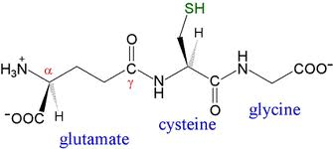

Glutathione
Master Anti-oxidant in the body.
Is a small protein composed of 3 amino acids called Cysteine, Glutamic acid, and Glycine,
Produced normally by the body in response to today’s environment
The greater the exposure to toxins, the faster the body uses up its supply of Glutathione.
acts as an A I D,
  A - Antioxidants,
  I - Immune system boosters and
  D - Detoxification

Slide 5
Glutathione
The body produces and stores the largest amounts of GSH in the liver, where it is used to detoxify harmful compounds so that they can be removed from the body through the bile.
The liver also supplies GSH directly to RBC & WBC in the bloodstream
Helps to keep red blood and white blood cells healthy to maximize the disease-fighting power of the immune system.
Have an anti-aging affect on the body.
GSH levels decline with age, and a lack of glutathione has been shown to leave the body more vulnerable to damage by free radicals, thus speeding up oxidation (wearing down) of the body.

Slide 6

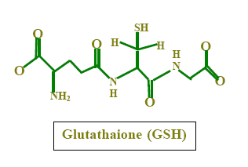
Glutathione
It is the most powerful anti-oxidant occurring naturally in all of 70-100 trillion cells that make up the human body. That is why it is called the master antioxidant (MA).
Glutathione levels have been shown to decrease with aging.
Glutathione inhibits the synthesis and accumulation of melanin by interrupting the function of L-DOPA

Slide 7
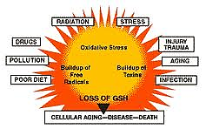
GLUTATHIONE DEPLETION

Slide 8
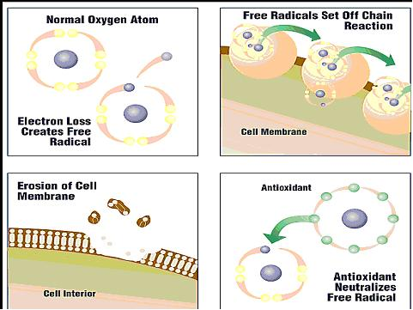
MECHANISM
Antioxidants are substances that may protect cells from the damage caused by unstable molecules known as free radicals. Free radicals are molecules with incomplete electron shells which make them more chemically reactive than those with complete electron shells
Antioxidants interact with and stabilize free radicals and may prevent some of the damage free radicals.

Slide 9

Glutathione supplement with Vitamin C for Skin Lightening & Age Defying
Lightens the skin,
Helps make the skin smoother with a
more even tone,
Gives a rosy white glow
Delays aging
Easy to use
Revolutionary formula for skin whitening

Slide 10
Glutathione not only supply your body with additional glutathione it needs but also increase the body's efficiency to absorb and produce glutathione.
A Glutathione efficacy in skin Lightening works only if it is taken with Vitamin C at least equal or twice its dosage. So if you’re taking 500mg of glutathione, Vitamin C should be at least 1000mg.

Slide 11
How does Glutathione works
Interference with cellular transport of tyrosinase
Direct inactivation of the enzyme tyrosinase by binding with the copper-containing active site of the enzyme
Mediating the switch mechanism from eumelanin to phaeomelanin production as GSH is the major physiologic reservoir of cysteine and increase in cysteine levels results in switching of eumelanogenesis to pheomelanogenesis
Quenching of free radicals and peroxides that contribute to tyrosinase activation and melanin formation
Modulation of depigmenting abilities of melanocytotoxic agents.

Slide 12
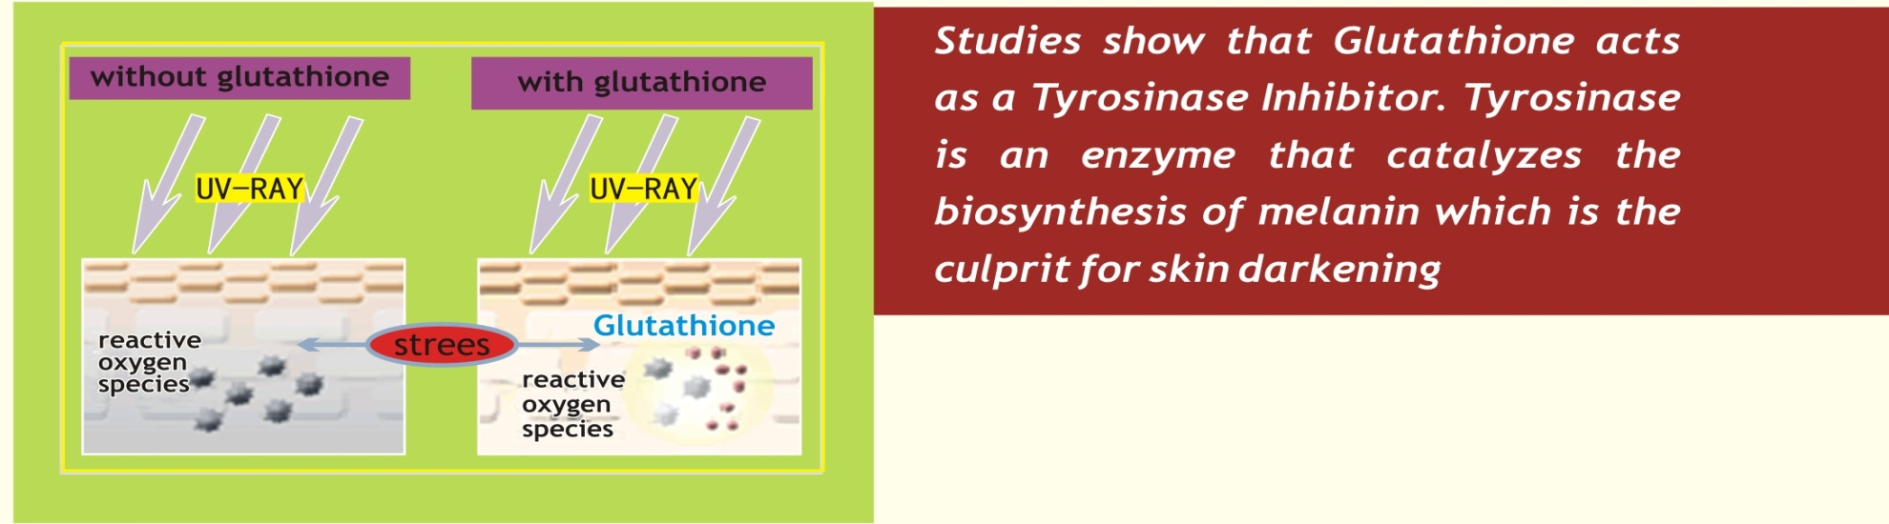

How does it works
Glutathione is proven to reverse the melanin's metabolism turning dark pigmentations (Eumelanin) into light pigmentations (Pheomelanin).
Inhibits and blocks Tyrosinase, the enzyme responsible for the production of dark melanin pigments, The end product becomes PHEOMELANIN (Reddish – white pigmentation) instead of EUMELANIN (dark brown).
Continuous and consistent supplementation will result into gradual skin lightening

Slide 13
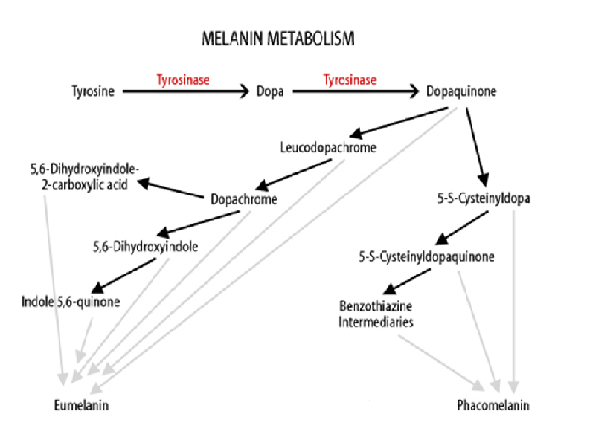

Glutathione
Glutathione
Cysteine
Glutathione

Slide 14


Slide 15
How does it works
Contains the most powerful antioxidants which work synergistically to create what Scientists call as the Antioxidant Cycling.
A process in which antioxidants work together to extend each others’ lives and make each other more powerful .
That’s the reason why Glutathione supplement is very potent and effective in bringing results.

Slide 16
Natural source of Glutathione
Glutathione is found in almost all fruits and vegetables.
Acorn squash, asparagus, avocado, cantaloupe, grapefruit, okra, orange, peach, potato, spinach, strawberries, tomato, watermelon, and zucchini are all good sources of GSH.
Some vegetables, such as broccoli, cabbage, Brussels sprouts, cauliflower, kale, and parsley

Slide 17
Natural source of Glutathione
Glutathione dietary supplements are known as L-glutathione, reduced glutathione or GSH.
They come in
  pills,
  capsules,
  tablets,
  in powdered and liquid form, as sublingual drops or slow-melt tablets.

Slide 18
Usage and Indication
Consume one tablet of I-fair Glutathione and 1 tablet of I-Fair Vit C along with water once or twice in a day/as directed by the physician.
Best if taken with meals or at night 2 to 3 hours after your last meal for better absorption.
Standard dosage is 20-40mg per kilogram of body weight (50kg x 20mg = 1000mg ) for 3 to 6 month. It is also advisable to put on sunblock cream and lotion for the face and body

Slide 19
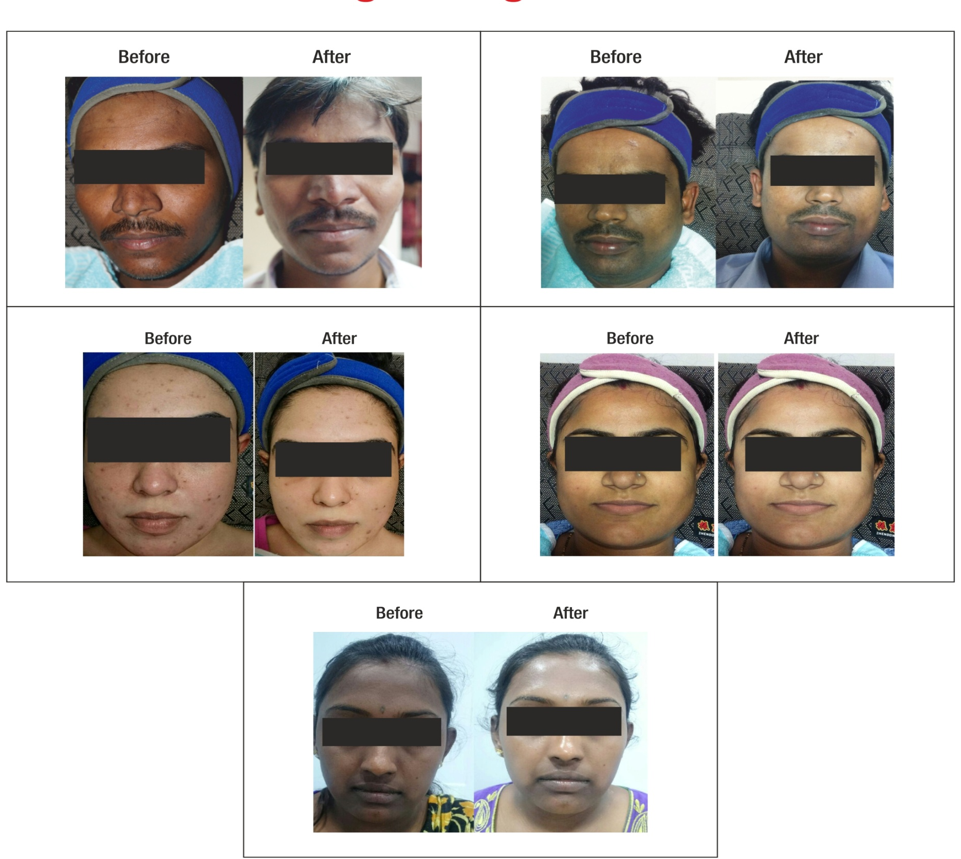
Results

Slide 20


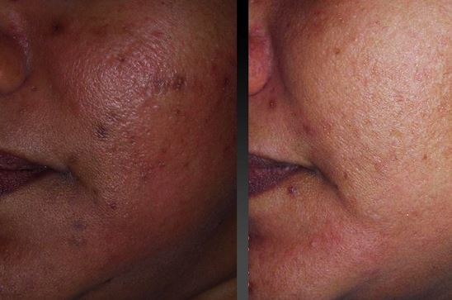
Results

Slide 21
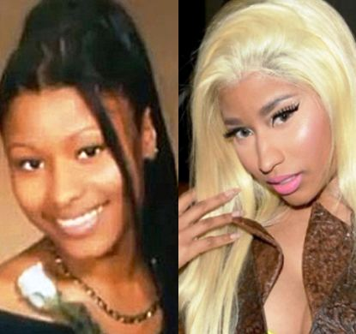


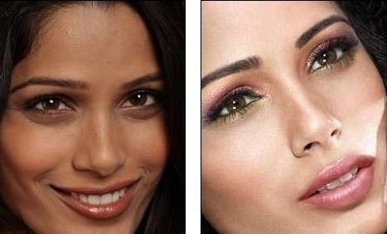
Results

Slide 22


Reasonable expectations
One taking it should try to avoid smoking, liquor or any alcoholic drink .
On average, the first 3 months use of glutathione builds its foundation in your body and you will experience lightening gradually.
speed normally depends on your metabolism and body chemical functioning. For some the results take longer.
As you lighten you will notice that your skin is shinier and healthier than before.

Slide 23

Benefits of Glutathione
Lightens the skin and gives skin a radiant glow.
Makes pores finer and Removes skin hyper-pigmentations.
Skin becomes smoother and clearer thereby nourishes skin.
Controls acne and prevents acne marks.
Defies the aging process also protects the skin from sun and environmental damages.
Lightens skin color, pigmentation, tan & freckles thereby Prevent/remove pimples & pimple marks.
Anti-aging & anti wrinkles- makes your skin smooth, fresh & radiant and Hasten healing of wounds.

Slide 24
"How long will anyone see an improvement?“
Light-medium brown skin: 1-3 months
Dark brown skin: 3-6 months
Very dark skin: 6-12 months
Black skin: 2 years and above
On average will take between 1-4 months before beginning to recognize the benefits. However, it really depends on biological individuality and how efficiently and effectively body absorbs and assimilates these nutritional substances and, of course, the physical and emotional awareness. Generally, the duration and severity of the signs, symptoms, or illness determines the length of time it takes to notice sustained improvements.

Slide 25
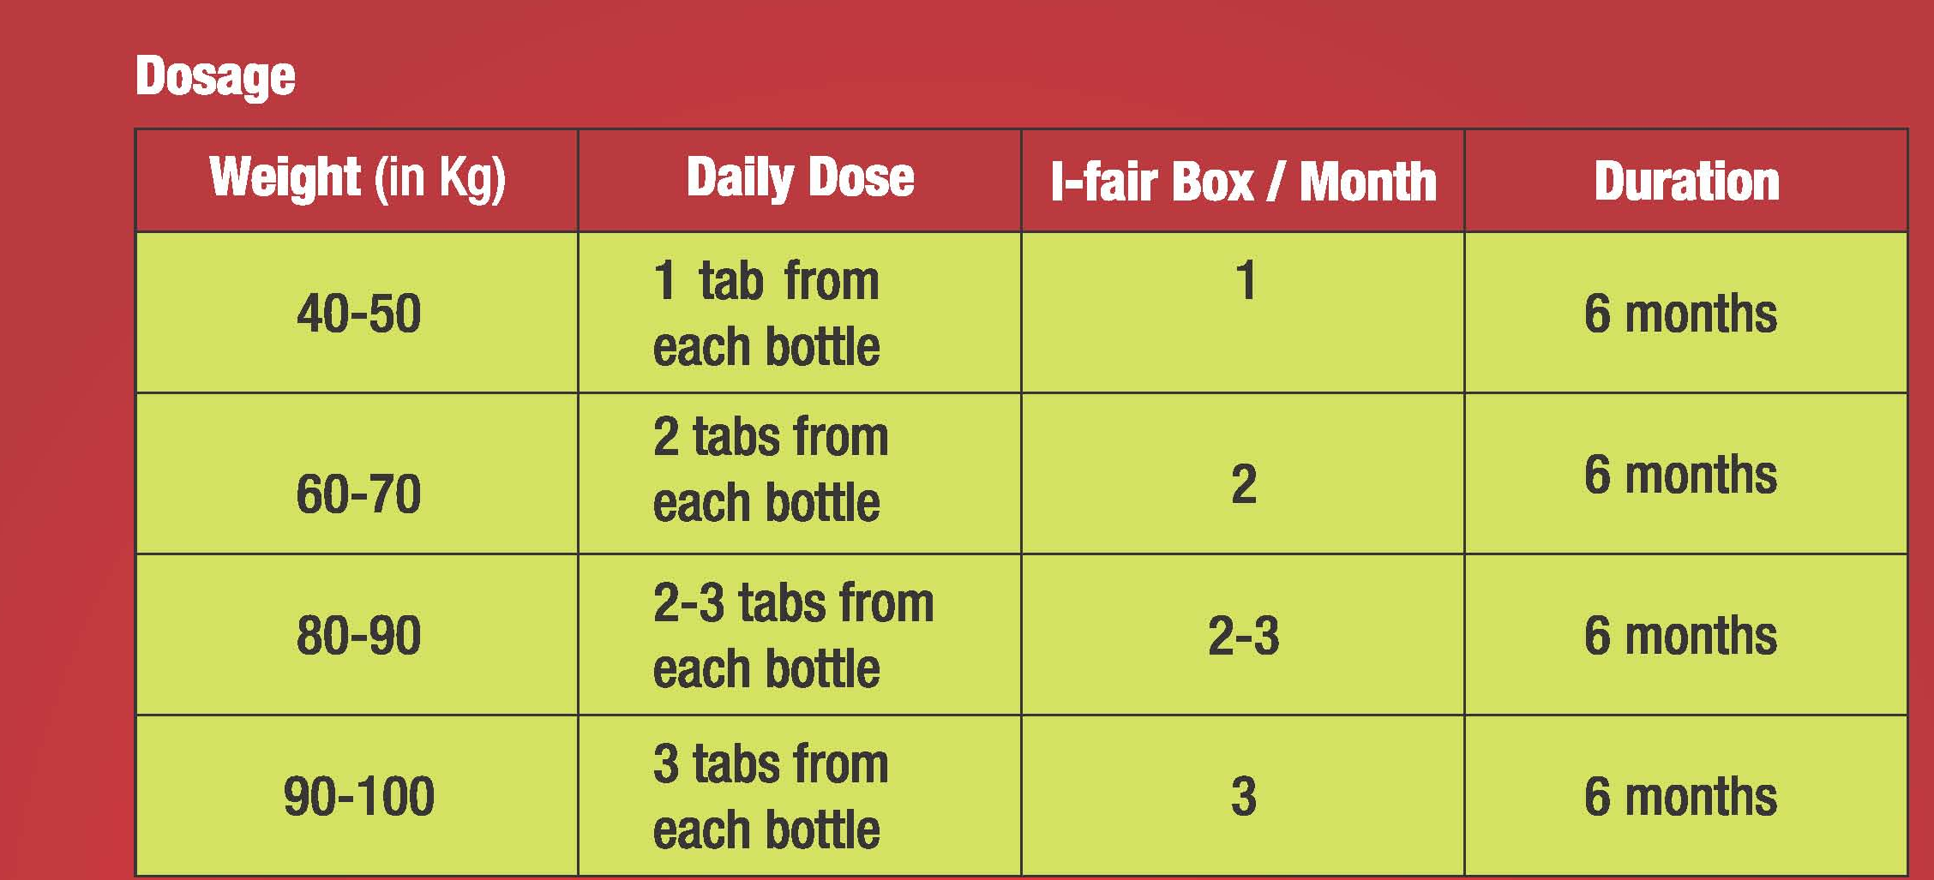
Usage and Indication
For Asians such as Chinese, Japanese, Taiwanese, Korean, Filipino, Indian, Thai or of such descent, pills are said to work well to lighten the skin.
for African Americans, the same pills also work, but you should not expect them to ‘lighten ’ your skin to achieve the Caucasian white skin appearance

Slide 26

Brands available
I-fair Tablet
Fair Beauty Skin Lightening Tablets
Ivory Caps Glutathione Pills
Dr. James GSH whitening pills
Tatiomax
MET TATHIONE – Skin Whitening Glutathione Capsules
Kyusoku Bihaku (KB) Skin Whitening Pills
BeauOxi White Plus 5-in-1
Mosbeau Placenta White Advanced Supplement
Fairtone Skin Lightening Pills
LUXXE WHITE ENHANCED GLUTATHIONE

Slide 27
Brands available as Injection
Tatiomax by Sujie Pharmaceutical, Tokyo Japan
saluta glutathione is manufactured by QAF Pharmaceuticals Labs
Germed glutathione is made by Germed Pharma Italy
Glutanova 900

Slide 28
References
Villarama CD, Maibach HI. Glutathione as a depigmenting agent: An overview. Int J Cosmet Sci 2005;27:147-53.
Hospers GA, Eisenhauer EA, de Vries EG. The sulfhydryl containing compounds WR-2721 and glutathione as radio- and chemoprotective agents. A review, indications for use and prospects. Br J Cancer 1999;80:629-38.
Arjinpathana N, Asawanonda P. Glutathione as an oral whitening agent: A randomized, double-blind, placebo-controlled study. J Dermatolog Treat 2012;23:97-102.
Witschi A, Reddy S, Stofer B, Lauterburg BH. The systemic availability of oral glutathione. Eur J Clin Pharmacol 1992;43:667-9.
Hong SY, Gil HW, Yang JO, Lee EY, Kim HK, Kim SH, et al. Pharmacokinetics of glutathione and its metabolites in normal subjects. J Korean Med Sci 2005;20:721-6.
Injectable glutha not FDA-approved. Available from: http://www.journal.com.ph/index.php/news/national/44605-injectable-glutha-not-fda-approved. [Last accessed on 2013 Apr 2].
Skin whitening pills. Available from: http://www.magicproducts.in. [Last accessed on 2013 Apr 2].
Perfect white skin whitening and anti-aging tablets. Available from: http://www.perfectwhiteaim.blogspot.in. [Last accessed on 2013 Apr 2].
Smit NP, Van der Meulen H, Koerten HK, Kolb RM, Mommaas AM, Lentjes EG, et al. Melanogenesis in cultured melanocytes can be substantially influenced by L-tyrosine and L-cysteine. J Invest Dermatol 1997;109:796-800.
del Marmol V, Ito S, Bouchard B, Libert A, Wakamatsu K, Ghanem G, et al. Cysteine deprivation promotes eumelanogenesis in human melanoma cells. J Invest Dermatol 1996;107:698-702.
Agrup G, Hansson C, Rorsman H, Rosengren E. The effect of cysteine on oxidation of tyrosine, DOPA, and cysteinyldopas. Arch Dermatol Res 1982;272:103-15.
Ando H, Matsui MS, Ichihashi M. Quasi-drugs developed in Japan for the prevention or treatment of hyperpigmentary disorders. Int J Mol Sci 2010;11:2566-75.
Cho YH, Kim JH, Park SM, Lee BC, Pyo HB, Park HD. New cosmetic agents for skin whitening from Angelica dahurica. J Cosmet Sci 2006;57:11-21.
Konda S, Geria AN, Halder RM. New horizons in treating disorders of hyperpigmentation in skin of color. Semin Cutan Med Surg 2012;31:133-9.
Skin whitening pills in India. Available from: http://www.drjamespills.blogspot.in/2013/01/glutanova-900-skin-whitening-injections.html. [Last accessed on 2013 Apr 28].
I-Fair-Glutathione supplement with vitamin C for skin whitening. Available from: http://www.cosmonova.in/i_fair.html. [Last accessed on 2013 Apr 28].
Kvam E, Dahle J. Pigmented melanocytes are protected against ultraviolet-A-induced membrane damage. J Invest Dermatol 2003;121:564-9.
Wenczl E, Van der Schans GP, Roza L, Kolb RM, Timmerman AJ, Smit NP, et al. (Pheo) melanin photosensitizes UVA-induced DNA damage in cultured human melanocytes. J Invest Dermatol 1998;111:678-82.
Verma SB. Obsession with light skin - Shedding some light on use of skin lightening products in India. Int J Dermatol 2010;49:464-5.
Mire A. The scientification of skin whitening and the entrepreneurial university-linked corporate scientific officer. Can J Sci Math Technol Educ 2012;12:272-9.

Slide 29
References
Cho YH, Kim JH, Park SM, Lee BC, Pyo HB, Park HD. New cosmetic agents for skin whitening from Angelica dahurica. J Cosmet Sci 2006;57:11-21.
Konda S, Geria AN, Halder RM. New horizons in treating disorders of hyperpigmentation in skin of color. Semin Cutan Med Surg 2012;31:133-9.
Skin whitening pills in India. Available from: http://www.drjamespills.blogspot.in/2013/01/glutanova-900-skin-whitening-injections.html. [Last accessed on 2013 Apr 28].
I-Fair-Glutathione supplement with vitamin C for skin whitening. Available from: http://www.cosmonova.in/i_fair.html. [Last accessed on 2013 Apr 28].
Kvam E, Dahle J. Pigmented melanocytes are protected against ultraviolet-A-induced membrane damage. J Invest Dermatol 2003;121:564-9.
Wenczl E, Van der Schans GP, Roza L, Kolb RM, Timmerman AJ, Smit NP, et al. (Pheo) melanin photosensitizes UVA-induced DNA damage in cultured human melanocytes. J Invest Dermatol 1998;111:678-82.
Verma SB. Obsession with light skin - Shedding some light on use of skin lightening products in India. Int J Dermatol 2010;49:464-5.
Mire A. The scientification of skin whitening and the entrepreneurial university-linked corporate scientific officer. Can J Sci Math Technol Educ 2012;12:272-9.

Slide 30
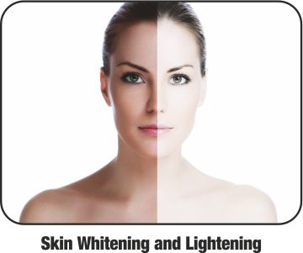
For More Details Please contact –
Anandmayi@origopharma.com
Mob : +91-8880499977
Thank You

Slide 31
Let us meet again..
We welcome you all to our future conferences of OMICS International
5th International Conference and Expo
on
Cosmetology, Trichology & Aesthetic Practices
On
April 25-27, 2016 at Dubai, UAE
http://cosmetology-trichology.conferenceseries.com/

