Slide 1

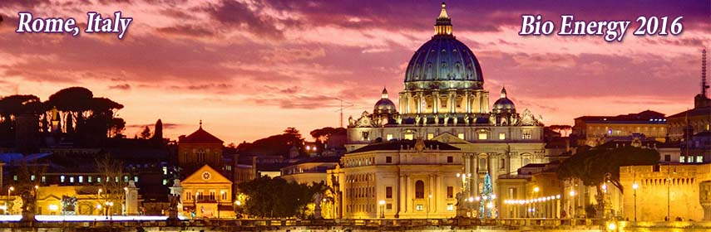
Ionic liquid based artificial cellulase type catalysts for cellulosic ethanol process
Ananda S. Amarasekara*, Onome S. Owereh, Preethi Shanbhag, Bernard Wiredu
Prairie View A&M University,
Texas, USA

Slide 2
1st and 2nd generation ethanol
_______________________________________________________________
1st generation – ethanol from starch/sugars
US – 13.9 BGY⁻¹, 64% of world production (corn ethanol) Brazil – 5.6 BGY⁻¹, 25% of world production (Sugar cane ethanol) (2015)
2nd generation – cellulosic ethanol from non-food
biomass
About 20 ~ 20 MGY⁻¹ plants in US + EU, few in
operation, mostly under construction (2015-16)
BioEnergy 2016
June 13-14, 2016 Rome

Slide 3
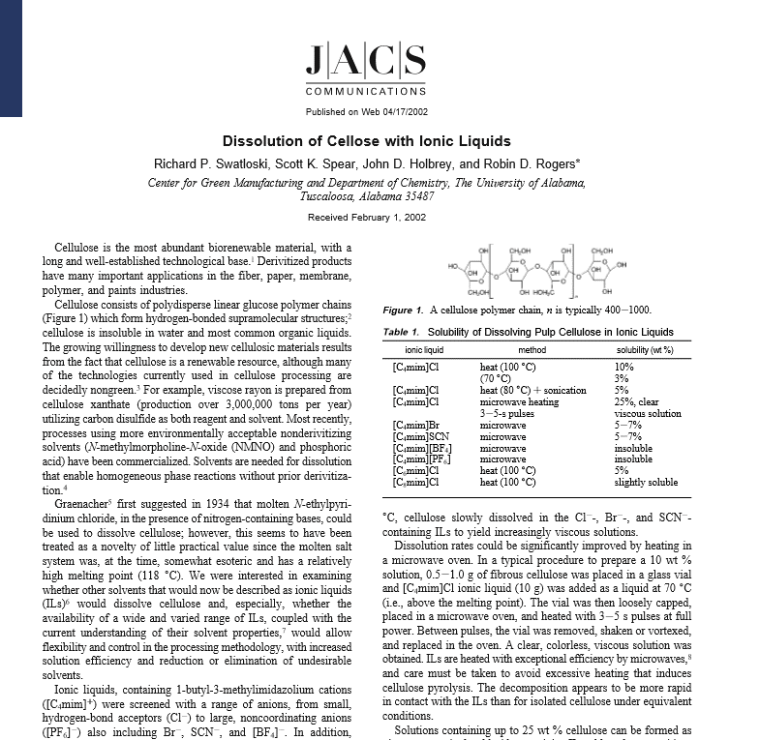
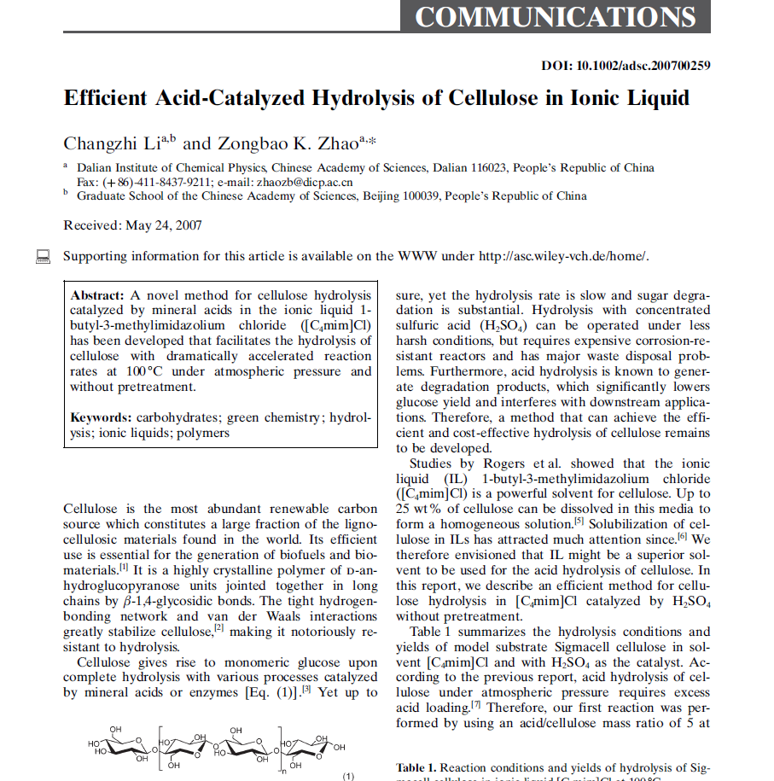

Ionic liquids & biomass processing
___________________________________________________________________
R.D. Rogers et al.
J. Am. Chem. Soc. 2002, 124, 4974
Z.K. Zhao et al.
Adv. Synth. Catal. 2007, 349, 1847
BioEnergy 2016
June 13-14, 2016 Rome

Slide 4
Brönsted acidic ionic liquids
________________________________________________________________
BioEnergy 2016
June 13-14, 2016 Rome

Slide 5
Cellulose dissolution in acidic ionic liquids
__________________________________________________________________
Neutral Ionic Liquid
80 °C, 3 h.
10% Cellulose ( DP ~ 450)
Acidic Ionic Liquid
23 °C, 2 min.
20% Cellulose ( DP ~ 450)
BioEnergy 2016
June 13-14, 2016 Rome

Slide 6
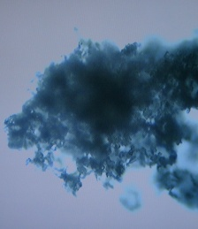
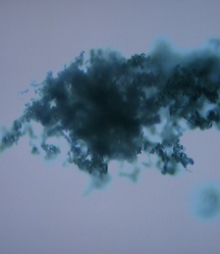

Cellulose dissolution and hydrolysis in acidic ionic liquids
Dissolution of cellulose
Hydrolysis of cellulose
t = 0 s t = 60 s t = 150 s
Neat, 70 ^{O}C, 90 min. 62% TRS.
14% Glucose
A.S. Amarasekara et al. Ind. Eng. Chem. Res. 2009, 48, 10153
Microscope images of rapid dissolution of cellulose in acidic
Ionic liquid, at room temperature and atmospheric pressure
BioEnergy 2016
June 13-14, 2016 Rome

Slide 7
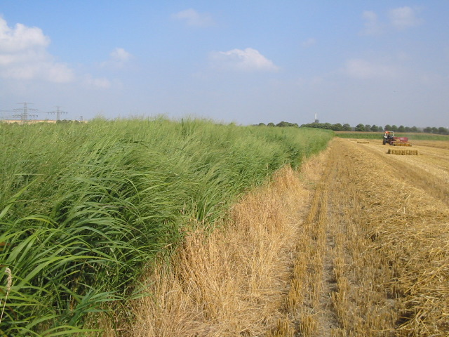
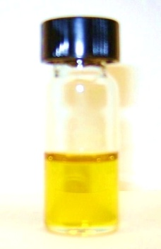
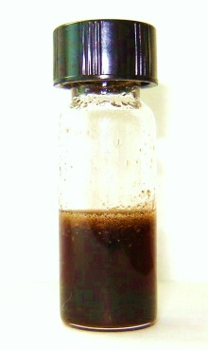
Switch grass saccharification in acidic ionic liquids
_____________________________________________________
Temp. ( °C) /time (min.)
before after Yield (%)
Entry IL/switchgrass adding H₂O adding H₂O TRS glucose
_____________________________________________________
1 1a/PV1 70/60 70/60 56 10
2 1a/PV2 70/60 70/60 48 13
3 1a/PV3 70/60 70/60 47 11
4 1b/PV1 70/60 70/60 50 10
5 1b/PV2 70/60 70/60 45 14
6 1b/PV3 70/60 70/60 58 15
7 1b/PV3 70/60 70/30 46 6
1b/PV3 70/60 70/120 36 5
1b/PV3 70/60 70/240 32 5
_____________________________________________________
PV-1 = pre-boot stage,
PV-2 = anthesis or flowering,
PV-3 = post-frost after senescence
Neat, 70 ^{O}C, 120 min. 58% TRS
15% Glucose
A.S. Amarasekara et al. BioEnerg. Res.
2013, 6, 719
BioEnergy 2016
June 13-14, 2016 Rome

Slide 8
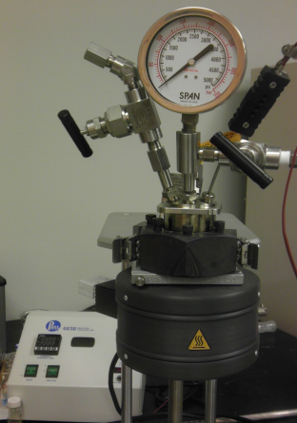
Acidic ionic liquids as homogeneous catalysts in water
Hydrolysis of cellulose
High pressure reactor
140-190 ⁰C
0.36 -1.25 MPa
BAIL, 170 ^{O}C, 3 h. 33 % TRS
H₂SO₄, 170 ^{O}C, 3 h. 21 % TRS
[H⁺] = 0.032 M
A.S. Amarasekara et al. Ind. Eng. Chem. Res. 2011, 50, 12276
BioEnergy 2016
June 13-14, 2016 Rome

Slide 9
Structure activity relationships (SAR)
TRS % yield vs Temperature ______________________________________________________
cellulose (DP ~ 450) in 0.032 M [H⁺]
A.S. Amarasekara et al. Sustain. Energ. 2014, 2(3), 102
BioEnergy 2016
June 13-14, 2016 Rome

Slide 10
Structure activity relationships (SAR)
^{Glucose % yield vs Temperature}
__________________________________________________________________
cellulose (DP ~ 450) in 0.032 M [H⁺]
A.S. Amarasekara et al. Sustain. Energ. 2014, 2(3), 102
BioEnergy 2016
June 13-14, 2016 Rome

Slide 11
Silica immobilized Brönsted acidic ionic liquid catalyst and hydrolysis of cellulose in water
Solid acid catalysts
190 ^{O}C, 3 h. 50% TRS
23% Glucose
A.S. Amarasekara et al. Cat. Commun. 2014, 48, 41
BioEnergy 2016
June 13-14, 2016 Rome

Slide 12
Acidic ionic liquid catalyzed hydrolysis of cellulose in water with metal ions as co-catalysts
O
O
o
160-170 ^{O}C, 3 h.
Mn²⁺ 92% TRS
(without metal ions 28% TRS)
Cellulose DP ~ 450
H₂O, BAIL [H⁺] = 0.032 M
M^{n+} = 20 mol% of glucose equv.
A.S. Amarasekara et al. Cat. Commun. 2015, 70, 82
BioEnergy 2016
June 13-14, 2016 Rome

Slide 13
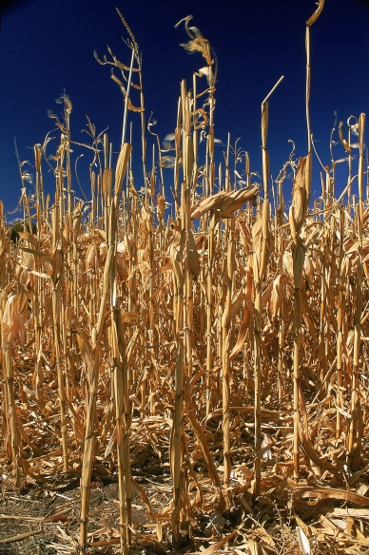
Acidic ionic liquid catalyzed hydrolysis of corn stover in water with metal ions as co-catalysts
o
o
o
o
160 ^{O}C, 3 h.
Mn²⁺ 90% TRS
(without metal ions 54% TRS)
H₂O, BAIL [H⁺] = 0.032 M
M^{n+} = 20 mol% of glu + Xyl equv.
A.S. Amarasekara et al. Bioresource Technol. 2015, 189, 405
BioEnergy 2016
June 13-14, 2016 Rome

Slide 14
Acidic ionic liquid catalyzed hydrolysis of cellulose at 37 ºC, 1 atm.
37 ^{O}C, 1 atm., 4 d.
78% TRS
19 % Glucose
Cellulose DP ~ 450
30% (w/w) BAIL in ZnCl₂·1.74H₂O
10% (w/w) cellulose in solvent-catalyst medium
BioEnergy 2016
June 13-14, 2016 Rome

Slide 15
Summary – cellulose hydrolysis
__________________________________________________________________________________________________________________
neat BAIL, 70 ⁰C, 90 min. 62% TRS
0.032M aq. BAIL, 170 ⁰C, 3h. 33% TRS
Silica-BAIL, 190 ⁰C, 3h. 50% TRS
0.032M aq. BAIL + MnCl₂, 160 ⁰C, 3h. 92% TRS
30% (w/w) BAIL in ZnCl₂.1.74H₂O, 37 ⁰C, 4d. 78% TRS
BioEnergy 2016
June 13-14, 2016 Rome
15

Slide 16



Acknowledgements
Dr. Bernard Wiredu Preethi Shanbharg Dominique Wells
Dr. Hua-Jun Fan Julie Dominguez Moriam Animashaun
Dre'Langala Edwards Muhammad Hasan Onome Owereh
Timila Singh Eve Larkin Uyen Ha
Brian Ezeh Ashfaqur Razzaq Alexandria Martin
Paul Bonham
BioEnergy 2016
June 13-14, 2016 Rome

