Slide 1
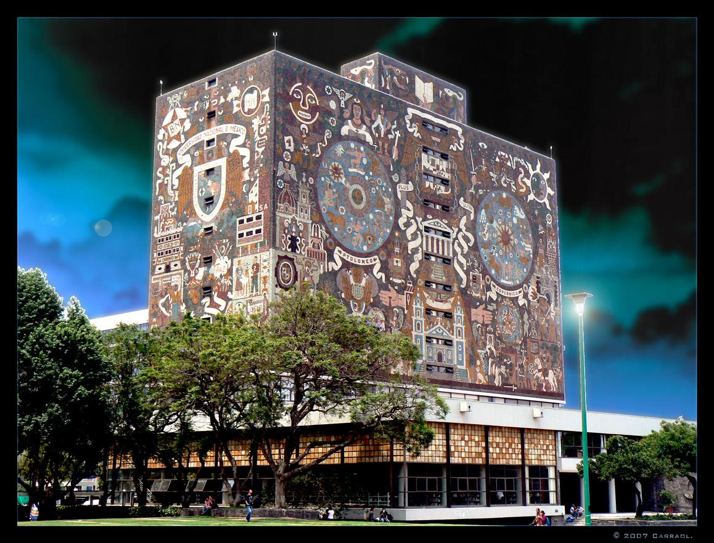
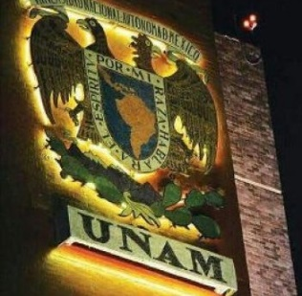
Genetic transformation
of cells
using physical methods
Ana Leonor Rivera
Universidad Nacional Autónoma de México

Slide 2
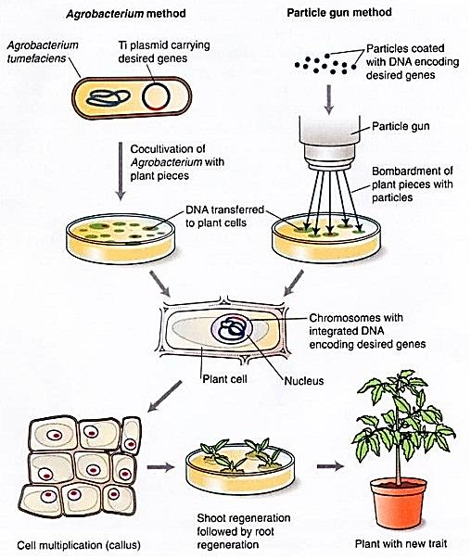
Abstract
We present a general panorama of the physical methods used for genetic transformation of cells, making a comparison of their advantages and drawbacks.

Slide 3
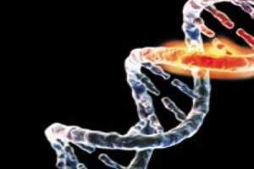
Outline
Introduction: Why to perform physical methods to genetically transform cells?
Physical transformations
Traditional popular methods:
  Electroporation
  Biolistics

Slide 4
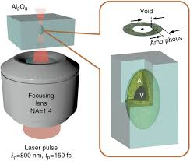
Outline
Less common methodologies:
  Agitation with glass beads
  Vacuum infiltration
  Silicon carbide whisker
  Laser manipulation
New techniques:
  Shock waves
Conclusion

Slide 5
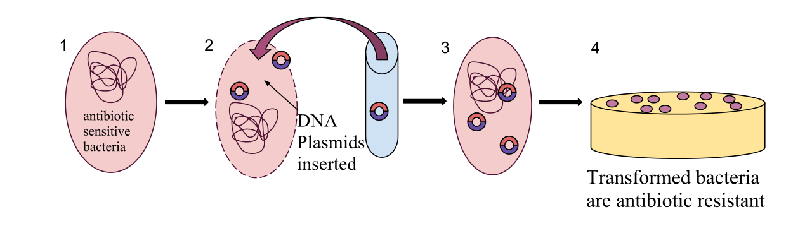
Introduction:
Why to perform physical methods to genetically transform cells?

Slide 6
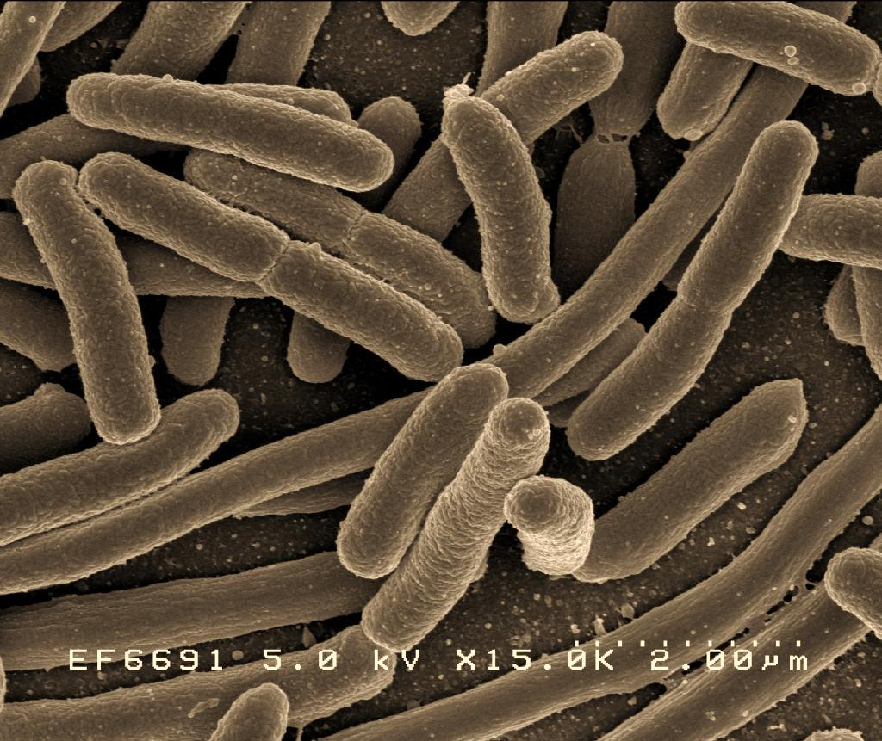
Why to perform physical methods to genetically transform cells?
To insert genes from plants, fungi, viruses, bacteria and even animals into cells,
to insert enzymes, metabolites, lipids and pharmaceutical compounds,
to identify sequences that confer resistance to antibiotics (selective markers),
to elaborate DNA vaccines,
PJ Canatella et al. (2001) Gene Ther 8:1464.
L Frelin et al (2010) Drug News Perpect 23:647.

Slide 7
Why to perform physical methods to genetically transform cells?
to produce enzymes that generate a specific property not observed in the wild type strain (reporter genes),
to characterize genes involved in a metabolic route,
for cancer treatment,
JM Lee et al. (2013) J Mammary Gland Biol Neoplasia 18:233.
D. Miklavi et al. (2012) Med Biol Eng Comp 50:1213.

Slide 8
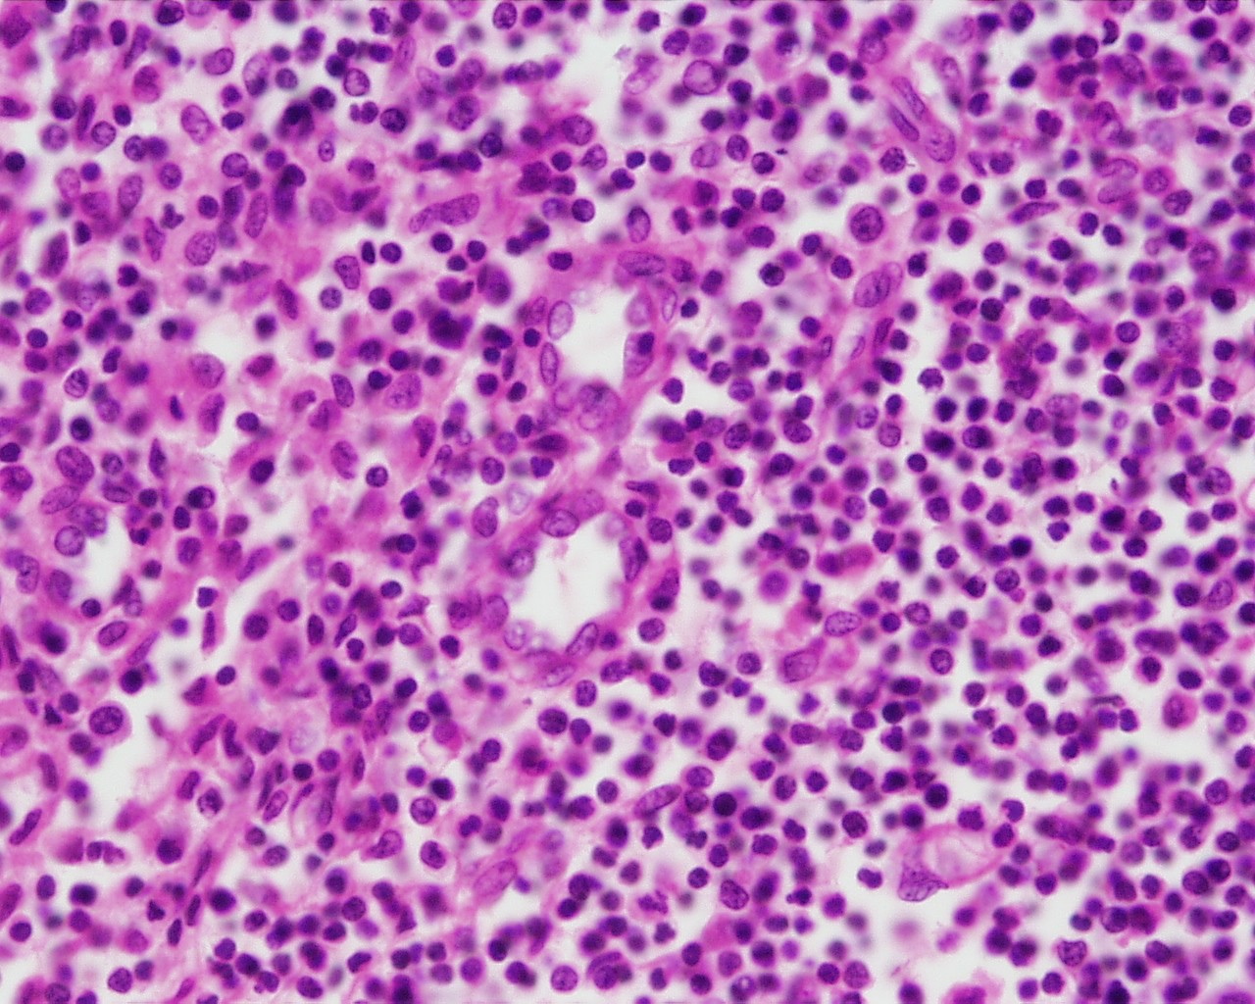
Why to perform physical methods to genetically transform cells?
To transform from one cell type to another (reprograming cells).
Example: transformation of human scar-tissue into heart muscle cells. Fibroblasts could be reprogrammed into beating heart cells by injecting 3 genes GMT mix plus genes ESRRG & MESP1 (for complete transform MYOCD & ZFPM2).
L Qian et al. (2012) Nature 485:593.
JD Fu et al. (2013) Stem Cell Rep 22.

Slide 9
Requirements for genetically transformation of cells
Production of recombinant DNA fragments
transferring of the DNA into the cell by membrane permeabilization,
integration of the DNA into a chromosome and its maintenance and replication.

Slide 10
For genetically transformation of cells it is necessary:
in vitro culture for multiplication of clones,
to select suitable promoters for a specific gene,
over-expressing activator genes,
removing epigenetic silencing,
introducing heterologous genes,
improving bioinformatics programs of random mutagenesis.

Slide 11
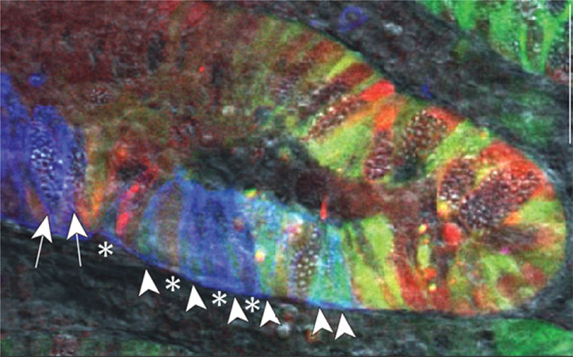
Physical transformation

Slide 12
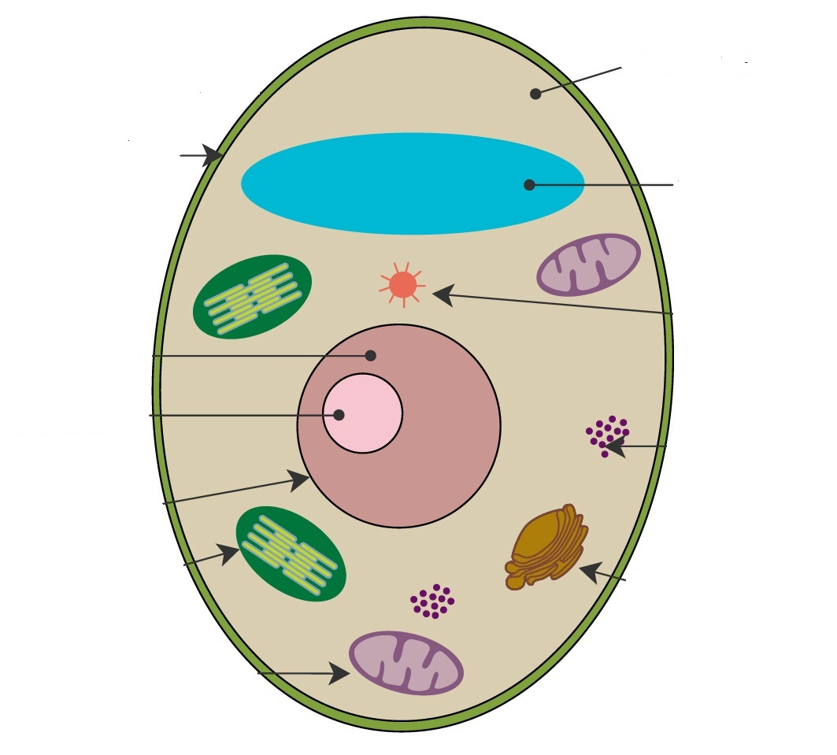
Genetic transformation
It requires penetration of the transgene through the cell membrane (hydropho-bic layer 10nm).
M Meselson & R Yuan (1968) Nature 217:1110.
AL Rivera et al. (2012) Phys Life Rev 9:308.
AL Rivera et al. (2014) Phys Life Rev 11:184.

Slide 13
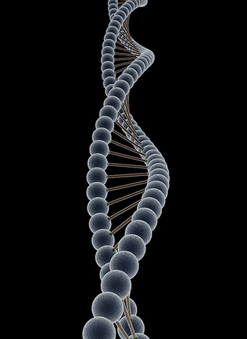
Genetic transformation obstacles
DNA is a highly charged macromolecule, difficult to manipulate, that cannot diffuse through the cell membrane.
Electron microscope false colored DNA image from
https://www.flickr.com/photos/13338351@N07/2244645930.

Slide 14
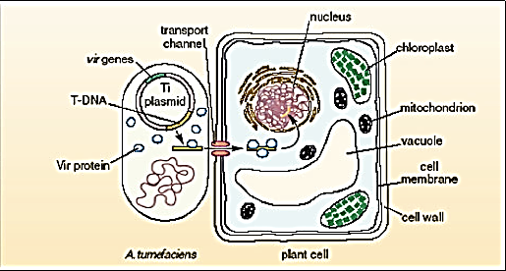
Genetic transformation techniques
Biological
  Agrobacterium tumefaciens-mediated transformation
  protoplast transformation using cell wall degrading enzymes
SB Gelvin (2009) Plant Physiol 150:1665.

Slide 15
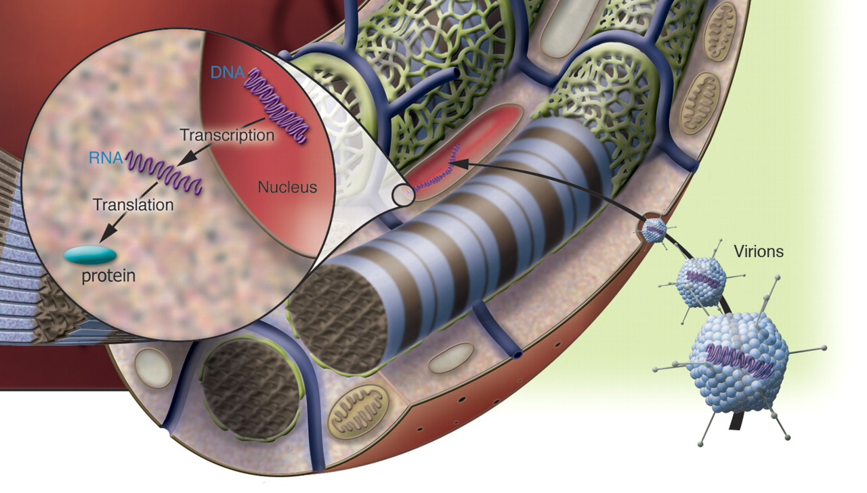
Genetic transformation techniques
Chemical
  calcium phosphate coprecipitation
  lipofection
EH Chowdhury et al. (2004) Gene 341:77.
Y Kawata et al. (2003) Biosci Biotechnol Biochem 67:1179.

Slide 16
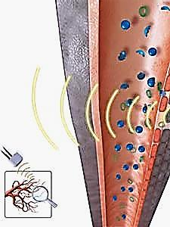
Genetic transformation techniques
Physical
  Electroporation
  Biolistics
  Agitation with glass beads
  Vacuum infiltration
  Silicon carbide whisker
  Laser manipulation
  Ultrasound
  Shock waves
AL Rivera et al. (2014) J Gen Syndr Gene Ther 5:237.

Slide 17
Traditional popular methods:
Electroporation
Biolistics

Slide 18
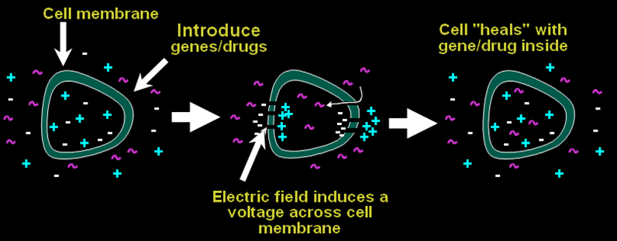
Electroporation
DNA is inserted through pores due to permeabilization of the cell membrane induced by a strong electrical pulses.
H Potter (1984) Proc Natl Acad Sci USA 81:7161.
Notes:
Electric field distribution (E) inside an electroporator, showing the charge difference and the dipolar moments (μ) for a cell exposed to a low frequency (lf) and a high frequency (hf) electric field.
If the cell is exposed to a high frequency field, its cellular membrane suffers a short circuit and its dipolar moment grows and rotates towards the direction of the field, producing a cellular stretching along this direction, leading to a temporal permeabilization of the membrane.

Slide 19
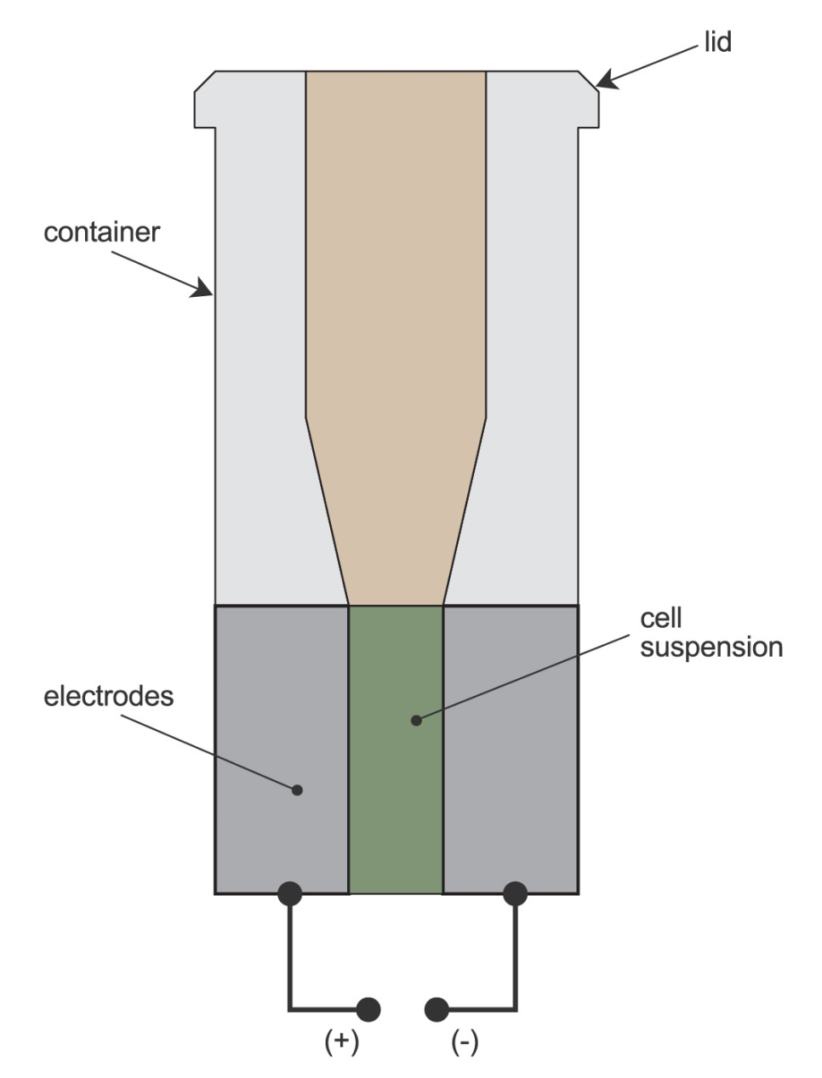
Electroporation parameters
Pulse length, energy and duration of the electrical field,
extent and duration of membrane permeation,
mode and duration of molecular flow,
DNA concentration,
tolerance of cells to membrane permeation.
JM Escoffre et al. (2009) Mol Biotechnol 41: 286.

Slide 20
Electroporation
Advantages
Drawbacks
Simple,
fast,
low cost.
Low efficiency,
requires laborious protocols,
transforms mainly protoplasts.
AL Rivera et al. (2014) J Gen Syndr Gene Ther 5:237.

Slide 21
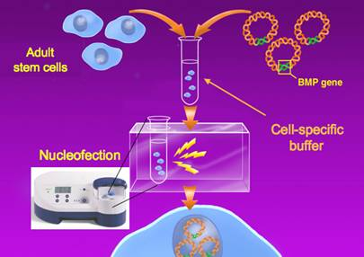
Nucleofection
Successful in cancer studies and tissue engineering.
Voltage, frequency, pulse duration are not disclosed to user.
Allows primary cells, cell lines and stem cells transfection.
HI Trompeter et al. (2003) J. Immunol Meth 274:245.
M Freeley & A Long (2013) Biochem J 455:133.

Slide 22
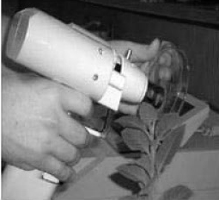
Biolistics
(particle bombardment or gene gun)
High density carrier particles covered with genes are accelerated through the cells leaving the DNA inside by an adsorption mechanism.
JC Sanford (1987) Sci Technol 5:27.

Slide 23
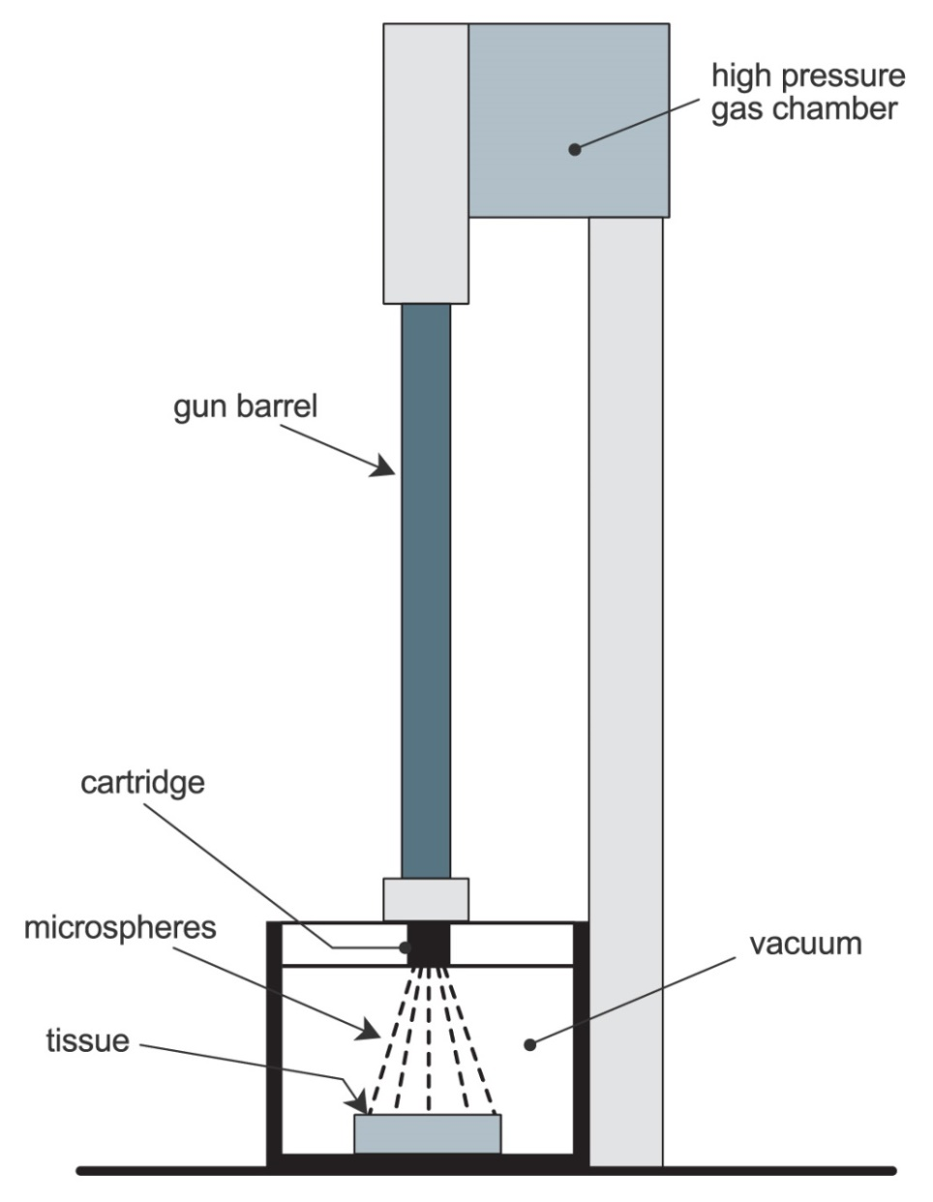
Biolistics parameters
Kinetic energy of the bombarding particles,
temperature,
amount of cells,
cell‘s ability to regenerate,
susceptibility of the tissue,
number of DNA-coated particles,
amount of DNA that covers each particle.
JC Sanford (2000) In Vitro Cell Dev 36:303.

Slide 24
Biolistics
Advantages
Drawbacks
Simple,
no need to treat the cell wall,
allows transformation of different cells,
independent of the physiological properties of the cell,
allows the use of multiple transgenes.
Expensive,
Low efficiency,
Transformation parameters must be optimized to each biological target.
Risk of multiple copies of the introduced genes that cause gene silencing or altered gene expression,
DNA and cells can be damage
AL Rivera et al. (2014) J Gen Syndr Gene Ther 5:237.

Slide 25
Less common methodologies:
  Agitation with glass beads
  Vacuum infiltration
  Silicon carbide whisker
  Laser manipulation

Slide 26
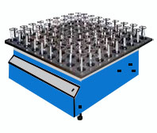
Agitation with glass beads
Rapid agitation with glass beads allows the penetration of the plasmid DNA.
MC Costanzo & TD Fox (1988) Genetics 120:667.

Slide 27
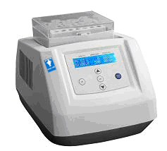
Agitation with glass beads parameters
DNA concentration,
sensitivity of the cells to membrane penetration,
amount of cells and
cellule's ability to regenerate.
P Rattanachaikunsopon et al. (2009) Braz J Microbiol 40:923.

Slide 28
Agitation with glass beads
Advantages
Drawbacks
Simple,
cheap,
unnecessary chemical treatments, enzymatic cocktails or sophisticated devices,
fast.
Low efficiency,
DNA can be damage.
AL Rivera et al. (2014) J Gen Syndr Gene Ther 5:237.

Slide 29
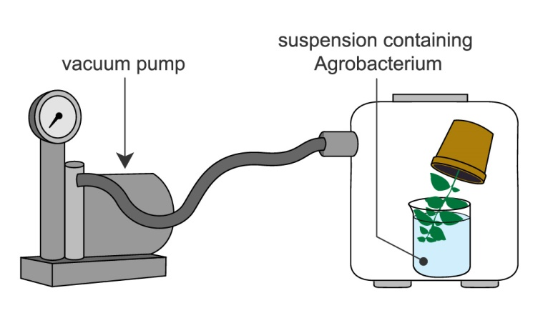
Agrobacterium infiltration mediated by vacuum
Vacuum generates a negative atmospheric pressure that increases the air spaces between cell’s membrane allowing Agrobaterium penetration.
P Bundock et al. (1995) EMBO J 14:3206.

Slide 30
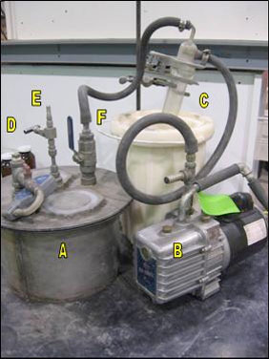
Vacuum infiltration parameters
Duration and type of the air pressure,
temperature,
pH,
time or induction of genes.
CB Michielse et al. (2005) Curr Genet 48:1.

Slide 31
Vacuum infiltration
Advantages
Drawbacks
Simple,
Fast,
Low somaclonal variation,
Many independent cells can be transformed.
Some strains of Agrobacterium are unable to infect certain cell types,
risk of multiple copies of the introduced genes that cause gene silencing or altered gene expression.
AL Rivera et al. (2014) J Gen Syndr Gene Ther 5:237.

Slide 32
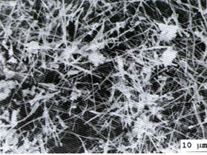
Silicon carbide whisker
Silicon carbide fibres are capable of puncturing cells without killing them, so they are mixed in a vortex with a suspension of tissue and DNA allowing its introduction by abrasion.
HF Kaeppler et al. (1990) Plant Cell Rep 9:415.

Slide 33
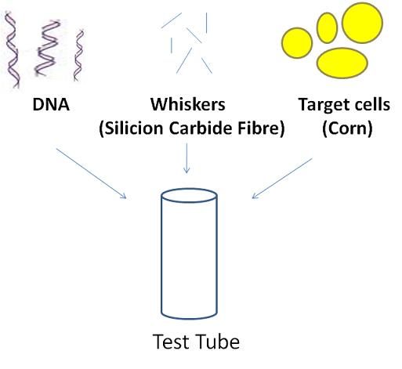
Silicon carbide whisker parameters
Fibre size,
vortex parameters (type, duration and speed of agitation),
vessel shape,
thickness of the cell wall,
cell’s ability to regenerate.
M Rakoczy-Trojanowska (2002) Cell Mol Biol Lett 7:849.

Slide 34
Silicon carbide whisker
Advantages
Drawbacks
Simple,
cheap,
can be used in different cell types,
fast.
Very low efficiency,
cells can be damage affecting regeneration capacities.
It could be hazardous to technicians due to fibers' inhalation.
AL Rivera et al. (2014) J Gen Syndr Gene Ther 5:237.

Slide 35
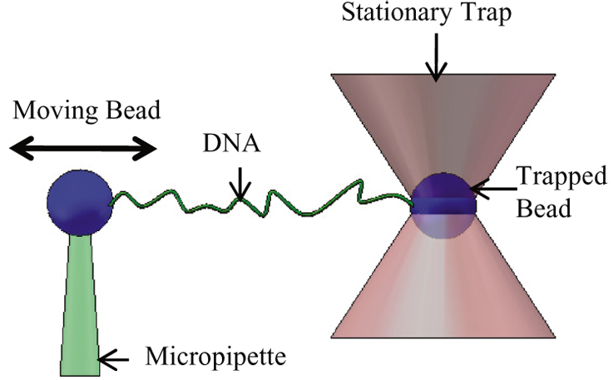
Laser manipulation: microinjection
A laser microbeam punctures self-healing holes into the cell wall allowing DNA penetration.
MW Berns et al. (1981) Science 213:505.

Slide 36
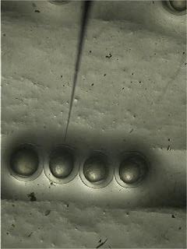
Microinjection parameters
Laser characteristics of the optical tweezer coupled to the appropriate microscope.
KO Greulich (2000) J Microsc 198:182.

Slide 37
Microinjection
Advantages
Drawbacks
Allows precise and gentle treatment of cells, subcellular structures, and even individual DNA molecules.
High cost (expensive equipment required),
Laborious protocols.
AL Rivera et al. (2014) J Gen Syndr Gene Ther 5:237.

Slide 38
New techniques:
  Shock waves

Slide 39
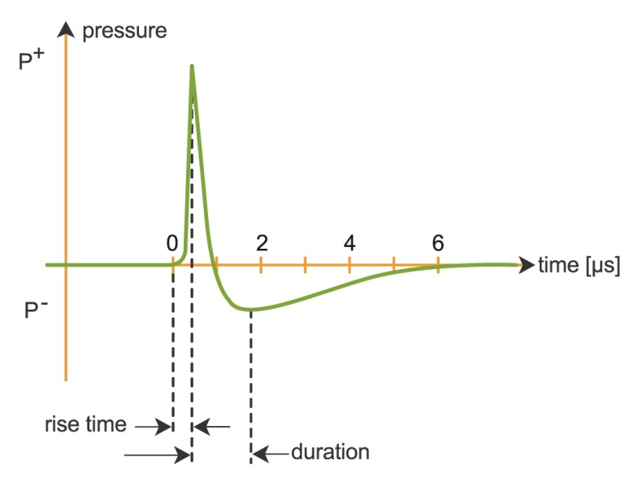
Shock wave mediated transform
Cell permeabilization occurs due to shock waves induce cavitation.
Shock waves are pressure pulses with a peak of 30 to 150 MPa, lasting 0.5 and 3 µs, followed by a tensile pulse of up to -20 MPa with duration of 2 to 20 µs.
AM Loske et al. (2011) Ultrasound Med Biol 37:502.

Slide 40
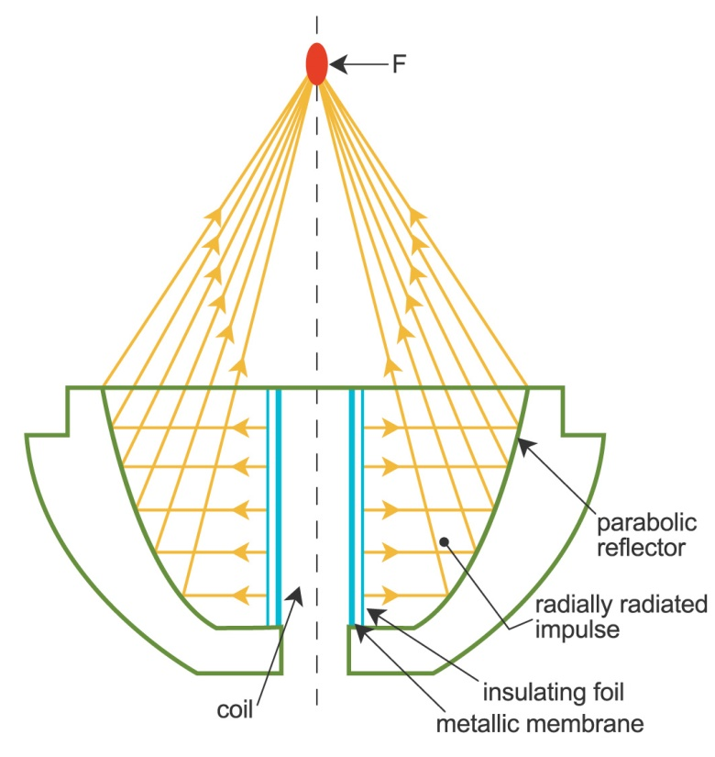
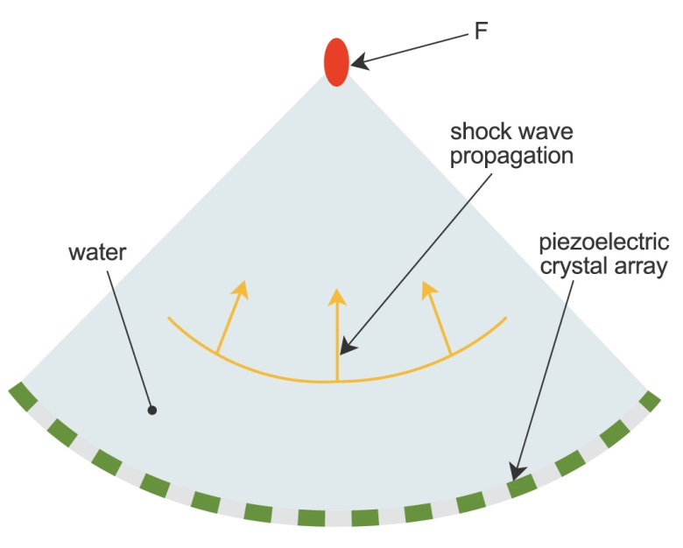
Shock wave mediated transform

Slide 41
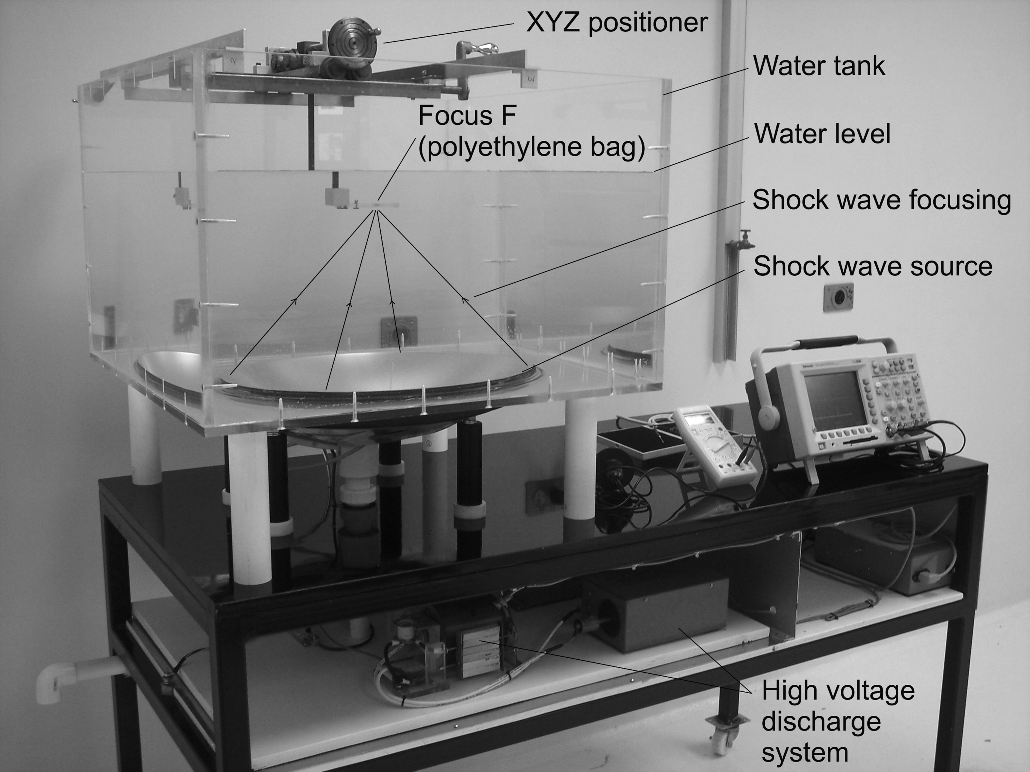
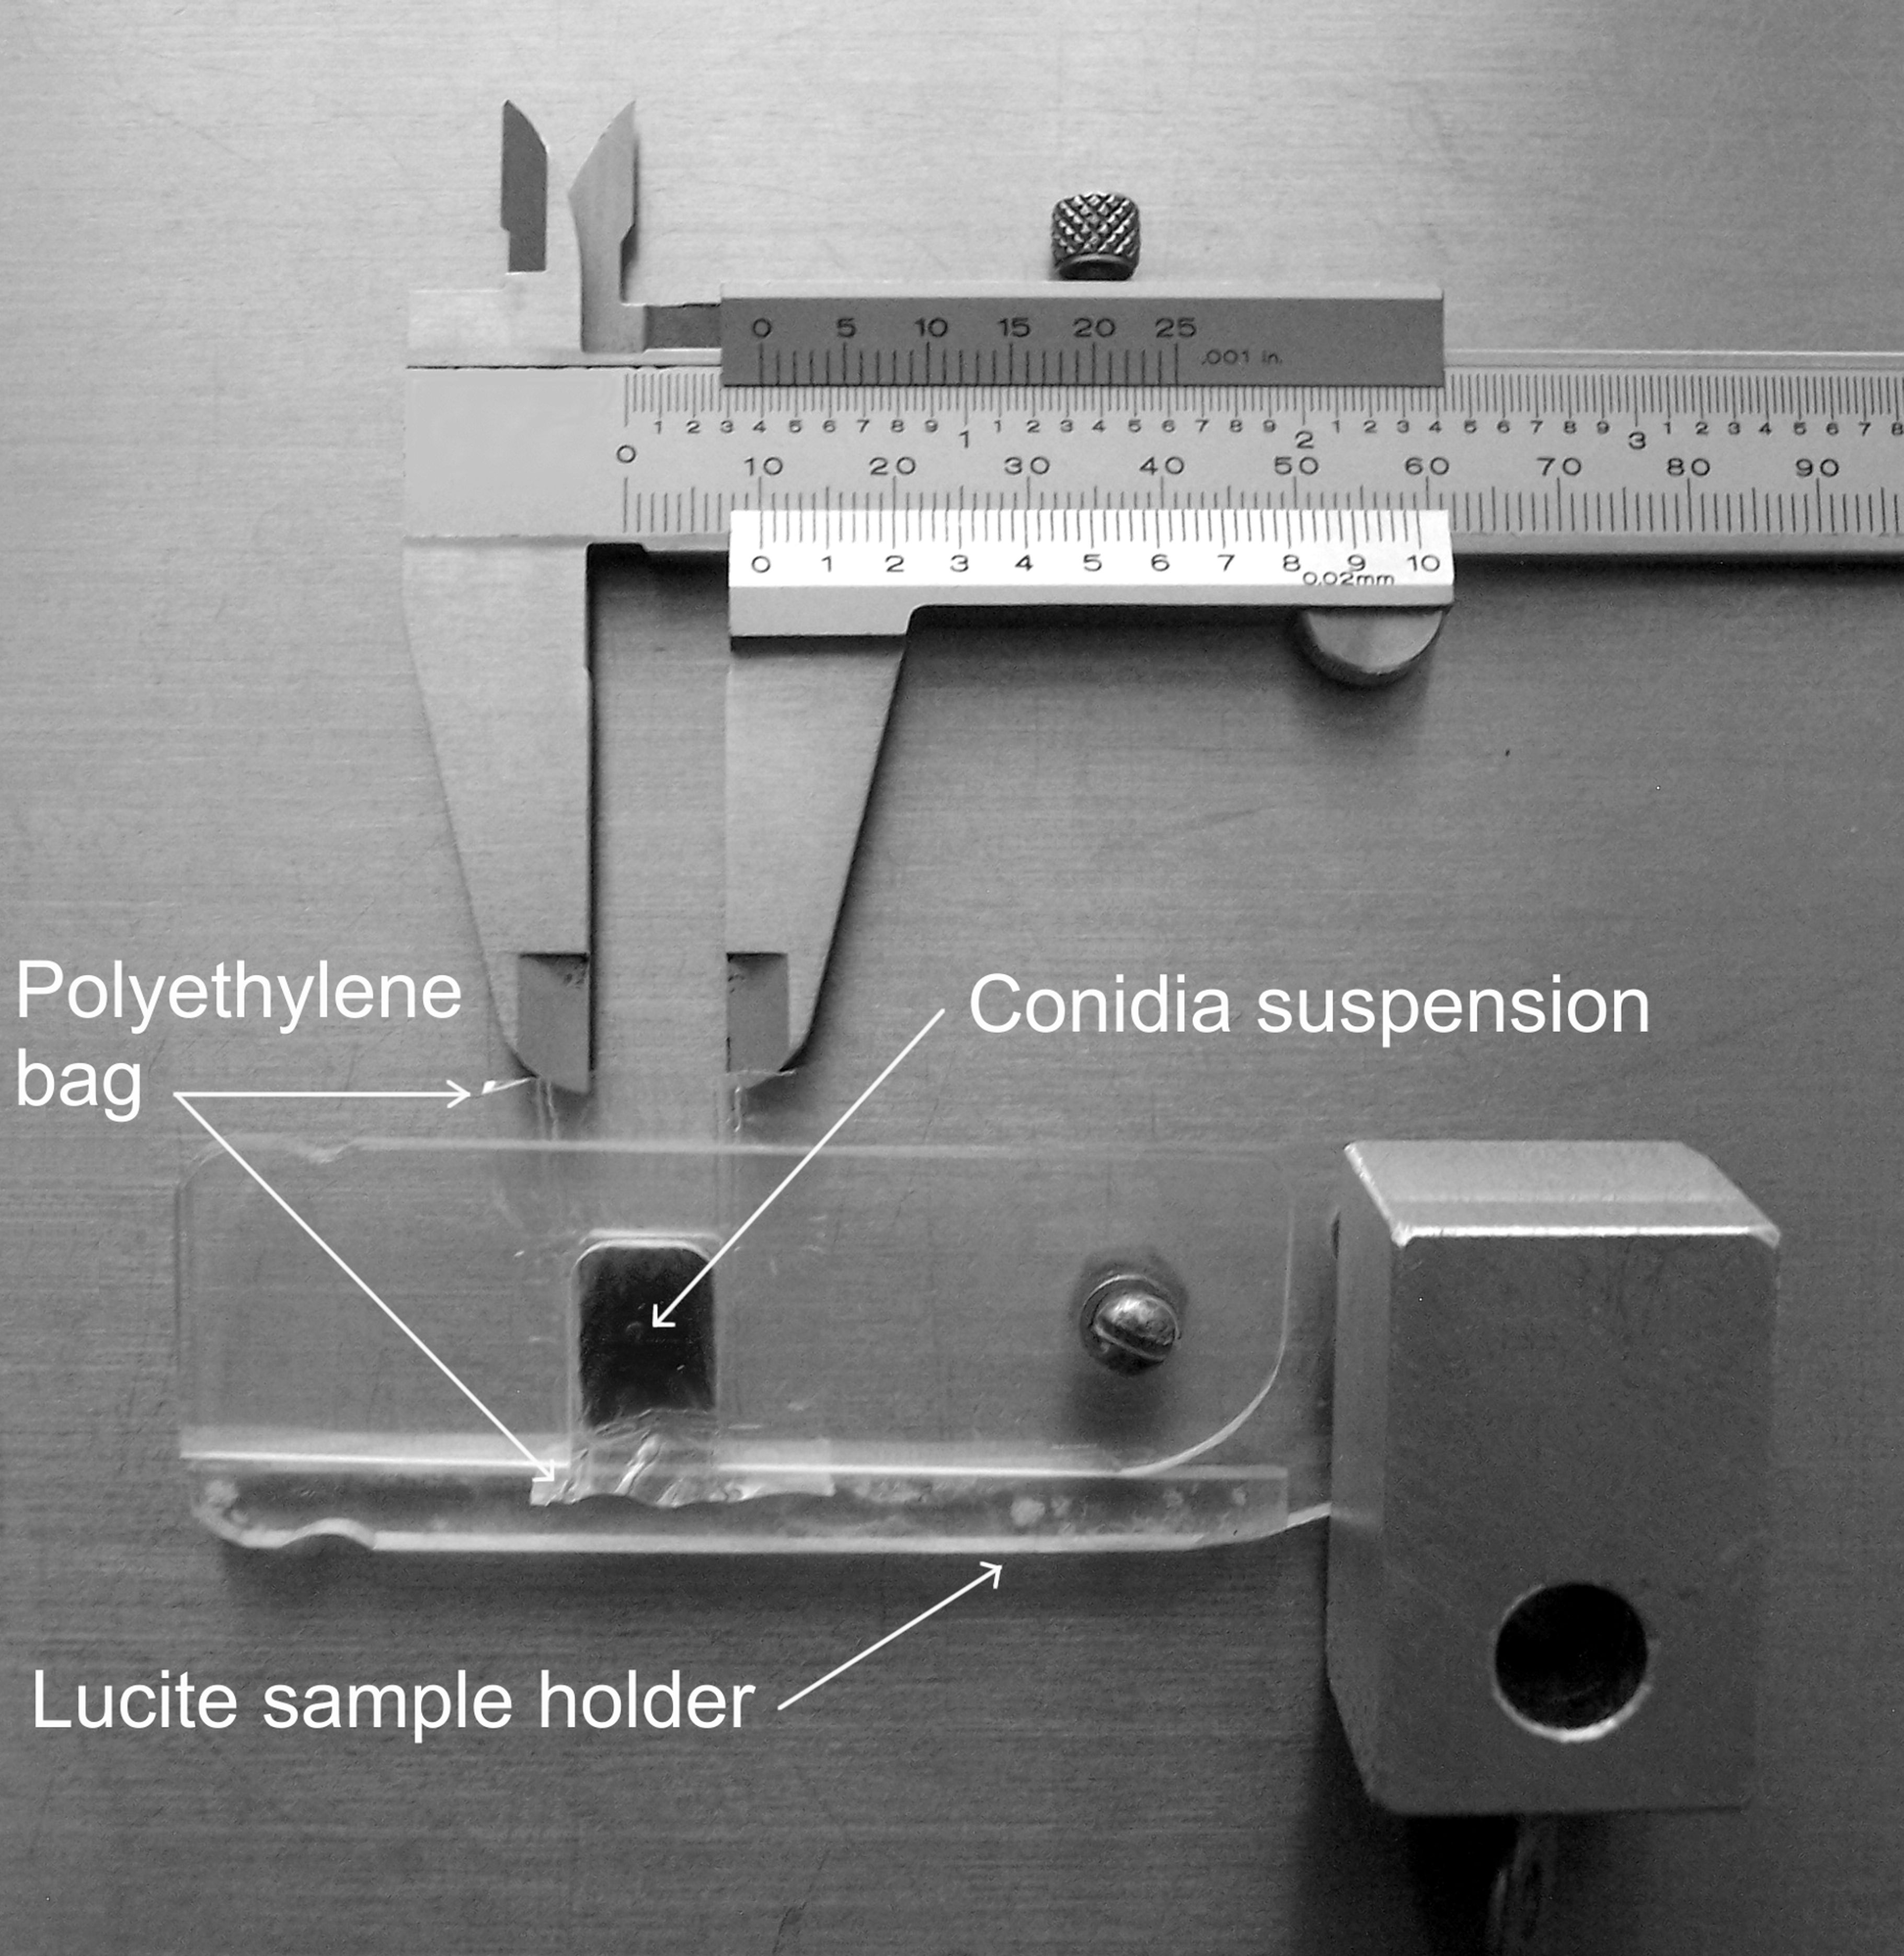
Shock wave mediated transform
AL Rivera et al. (2012) Phys Life Rev 9:308.
AL Rivera et al. (2014) Phys Life Rev 11:184.

Slide 42
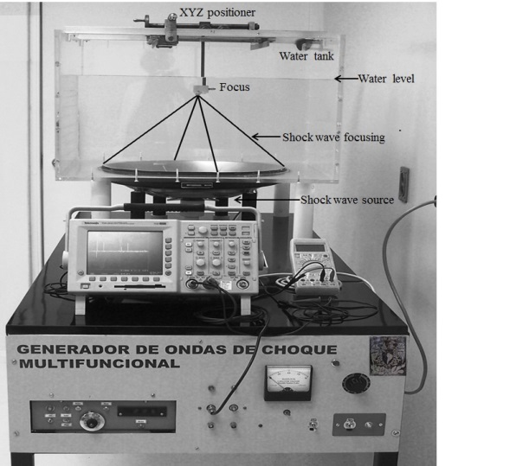
Shock wave mediated transform parameters
Frequency
Energy
Voltage
Shock wave profile
Number of shock waves
AL Rivera et al. (2014) Phys Life Rev 11:184.

Slide 43
Shock wave mediated transform
Advantages
Drawbacks
Fast,
easy to perform,
reproducible with high efficiency,
no need of enzymatic cocktails,
can be used to transform several cell types.
Shock wave generators for this purpose are not on the market yet and experimental devices are relatively expensive.
AL Rivera et al. (2014) J Gen Syndr Gene Ther 5:237.

Slide 44
Conclusion
Efficient transformation techniques to control gene expression are needed to increase production levels and to ensure product quality.
Shock-wave mediated transform is a promising technique not yet employed for human cells.

Slide 45
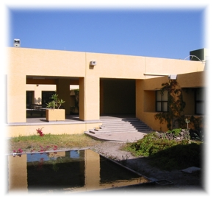
Group team
Denis Magaña
Francisco Fernández
Miguel Gómez-Lim
Achim M. Loske

Slide 46
T H A N K Y O U
anarivera2000@yahoo.com
Rivera et al, “Genetic transformation of cells using physical methods”
Journal of Genetic Syndromes & Gene Therapy 5:237 (2014)
Rivera et al, “Physical methods for genetic transformation of fungi”
Physics of Life Reviews 11 # 2:184 (2014).
Rivera et al, “Physical methods for genetic plant transformation”
Physics of Life Reviews 9 # 3:308 (2012).

