Slide 1



Gypsum to Gypsum (GtoG): The European Life+ project that aims to transform the gypsum waste market
De Guzmán Báez, A.; Jiménez Rivero, A.; García Navarro, J.;
Rodríguez Quijano, M.
RESEARCH GROUP SUSTAINABILITY IN CONSTRUCTION AND INDUSTRY
World Congress and Expo on Recycling
July 20-22, 2015
TRYP Barcelona Apolo Hotel

Slide 2
Table of contents
PROJECT INFORMATION
MAIN OBJECTIVES
WORK PLAN
IMPACT

Slide 3

PROJECT INFORMATION
LIFE11 ENV/BE/001039
LIFE+ Environment Policy & Governance in 2011:
  EU's financial instrument supporting environmental, nature conservation and climate action projects throughout the EU
  Duration: 36 months (01.01.2013 – 31.12.2015)
Budget: 3,566,250.00 €
EU Contribution (50%): 1,783,123.00 €

Slide 4













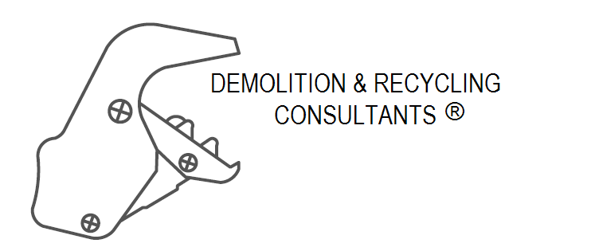


PROJECT INFORMATION: consortium
Coordination:
  Promoted by the Gypsum European Industry, in order to enhance general awareness at an European level about the benefits to the environment as well as the improvement of social aspect related with construction .
17 partners involved in the value chain:
Demolition companies, Gypsum Industry, Gypsum Recyclers, Consultant and Research centers.

Slide 5
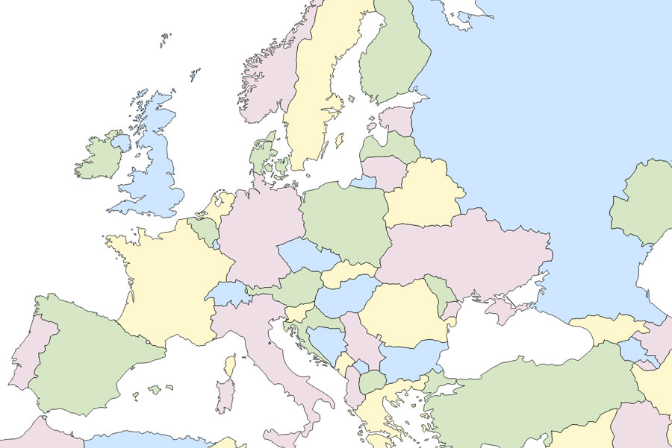









PROJECT INFORMATION: consortium
Deconstruction consultants
Recycling companies
Deconstruction companies
Plasterboard manufacturers
Project coordination
Research centers
Notes:
ESTÁ BIEN TRADUCIDO CONSULTORÍA DECONSTUCCIÓN

Slide 6
Overall aim of the GtoG project
To transform the gypsum demolition waste market
To reach higher recycling rates of gypsum waste, thereby helping to achieve a resource efficient economy.
Closed-loop recycling for gypsum products will only happen if:
Deconstruction techniques are applied for all demolition or refurbishment projects;
Sorting of waste is done at source - avoiding C&D mixed waste;
Processing is carried out according to clear standards;
Reincorporation of the recycled materials in the production process is carried out with innovative techniques.

Slide 7
GtoG project specific objectives
To demonstrate the feasibility and advantages of deconstruction versus demolition.
To qualify gypsum waste.
To reincorporate up to 30% of recycled gypsum (both pre and post-consumer).
To develop European criteria for recycled gypsum to establish the EoW status.
To reassess the percentage of recycled gypsum in the GPP for wall panels (currently, 5%).
To assess the carbon footprint and methods to mitigate it.

Slide 8
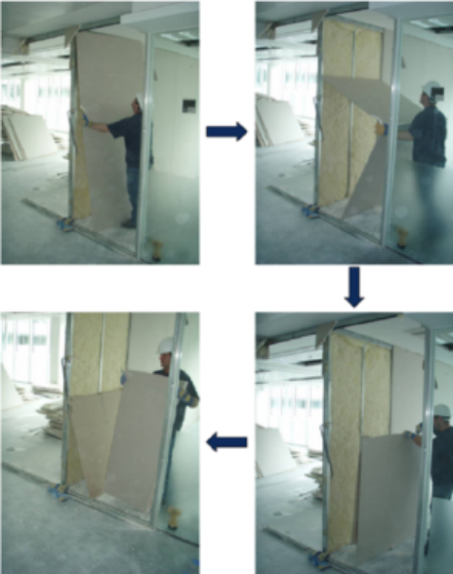
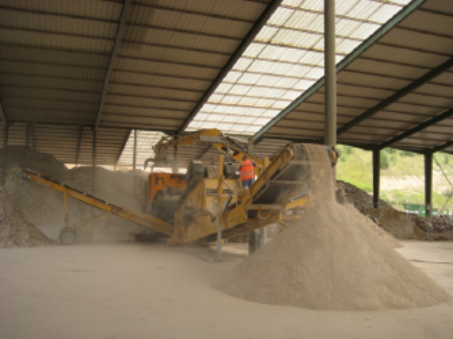
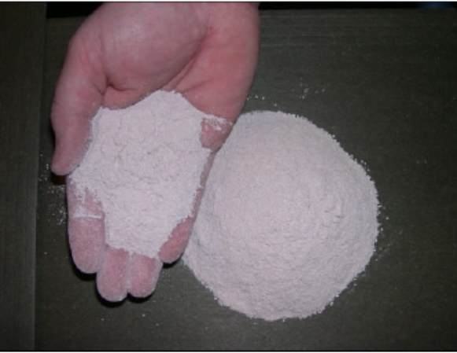
Deconstruction
Gypsum waste characterisation
Manufacturing of plasterboard with recycled content
Gypsum waste processing
Deconstruction of gypsum-based systems
Gypsum waste processing (recycling)
Recycled Gypsum

Slide 9
Work plan
A. Preparatory Actions:
B. Implementation Actions:
B.1. Eco-efficiency of deconstruction/segregation: Technical/Economic/market feasibility
C. Monitoring Actions:
C.1. Monitoring of the impact in the value chain (cradle to cradle approach)
D. Communication and Dissemination Actions:
B.2. Valorisation of deconstruction waste.
B.3. Towards sustainable lightweight systems
D.1 Communication and dissemination.
E. Project Management and Monitoring of the project progress:
E.1 Coordination and monitoring
A.1. Value Chain analysis in terms of deconstruction methodologies, economics of logistic and recycling
E.2. After Life Communication Plan

Slide 10

Action A – PREPARATORY ACTIONS
Analysis of current practices:
Deconstruction practices
Recycling
Plasterboard manufacturing practices
Technical-Economic-Legislative-Environmental criteria
DELIVERABLES
DA1. Report: Inventory of current practices (September 2013)
DA2. Report: Inventory of best practices (December 2015)

Slide 11
ACTION B – IMPLEMENTATION
European pilot projects (deconstruction – recycling – reincorporation of the recycled gypsum) in BE, FR, UK and DE.
Pre-deconstruction audit and deconstruction of gypsum-based construction systems.
Waste Acceptance criteria - Gypsum waste processing according to – Recycled gypsum quality criteria
Demonstrate, at industrial level, the optimized value chain (up to 30% recycled gypsum content in new plasterboard)
DELIVERABLES
DB1: EU Handbook: best practices in deconstruction (March 2015)
DB2: EU manual for best practices in audit (March 2015)
DB3: Guidance on gypsum waste acceptance criteria (June 2015)
DB4: Report: Production process parameters (July 2015)

Slide 12
ACTION C - MONITORING OF THE IMPACT
OF THE PROJECT ACTIONS
Definition of Best Practice Indicators
Monitoring of deconstruction-recycling-reincorporation practices (validating the effectiveness of the indicators applied in the pilot projects)
Road map and proposal of procedures for the implementation of a sustainable value chain.
DELIVERABLES
DC1. Report: Best practice indicators for deconstruction, recycling and reincorporation (July 2015)
DC2. Report: Specifications for recycled gypsum end-of-waste
DC3. Technical handbook and outline roadmap

Slide 13
Socio-economic EXPECTED IMPACTS
Makeover of the demolition industry;
Influence the local authorities behaviour to encourage deconstruction of buildings;
Increase sustainability credentials of gypsum products in the local economy;
Push towards collection of plasterboard waste in the local areas;
Improve the conditions for the uptake of a gypsum recycling market.

Slide 14


THANK YOU VERY MUCH
http://gypsumtogypsum.org/
Ana de Guzmán Báez
ana.deguzman@upm.es
http://blogs.upm.es/gisci/en/home/

