Slide 1



MiR-155-5p positively regulates colon cancer cell migration by targeting RhoA
2016 Molecular Biomarkers, Berlin | AMR AL-HAIDARI | Department of Clinical Sciences, Surgery research unit
Department of Clinical Sciences, Section of Surgery
16th Sep Amr Al-Haidari

Slide 2
Facts and figures
1
Up to date 2500 miRNAs Identified and only 600 characterized
3
Role in cancer
Proliferation, cell cycle regulation, migration, survival
2
Function
Regulate gene expression
4
Colon cancer
Third leading cause of death
90% metastasis
Department of Clinical Sciences, Section of Surgery
16th Sep Amr Al-Haidari

Slide 3
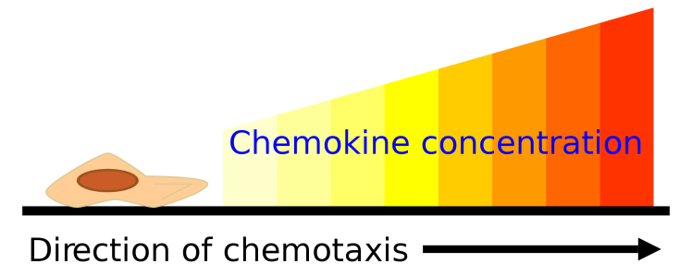
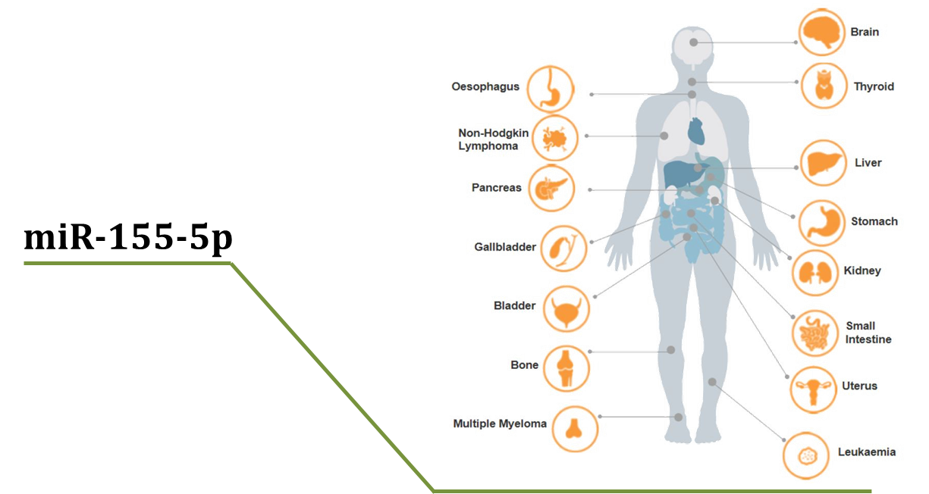
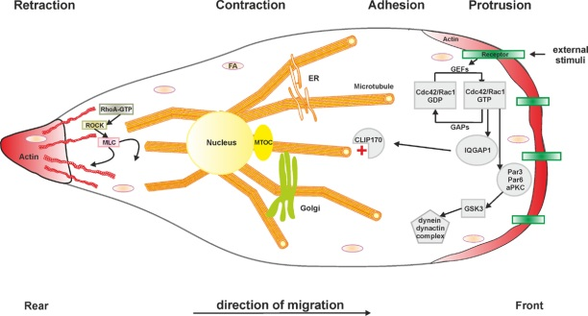
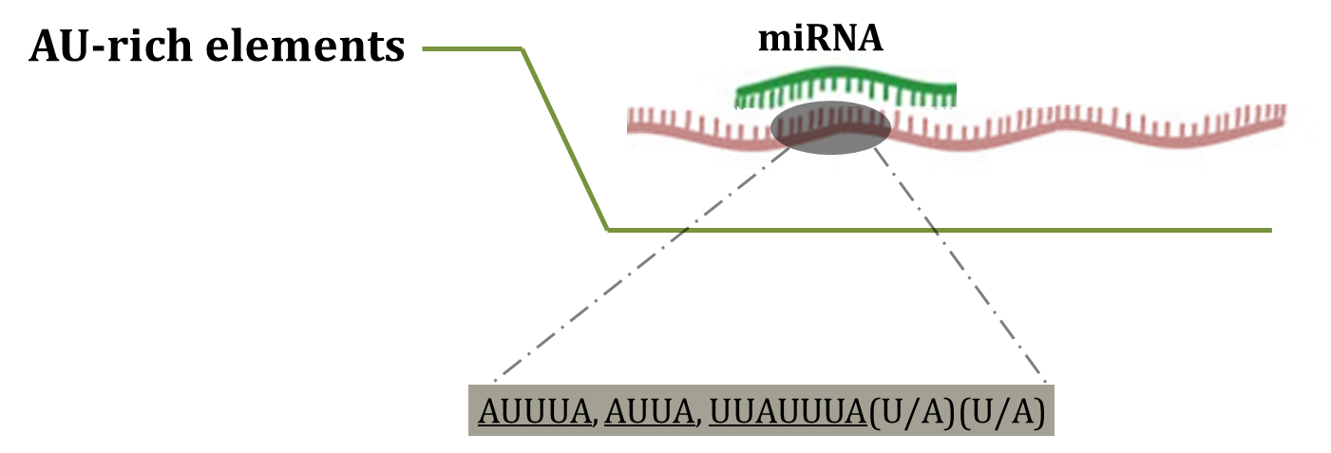
Key players of the paper
Chemokine CCL17
RhoA
Notes:
AU-rich elements
3′-UTRs of many but not all mRNAs

Slide 4
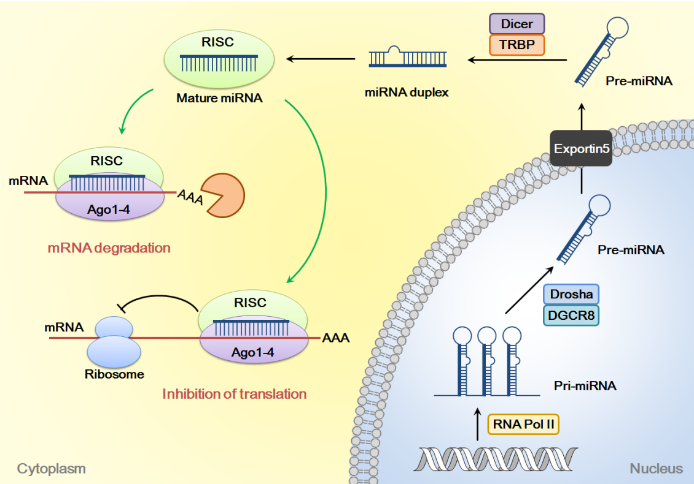
Mechanisms of miRNA positive regulation
Seahyoung Lee, Eunhyun Choi, et al. (2015), Implications of MicroRNAs in the Vascular Homeostasis and Remodeling, Muscle Cell and Tissue
Department of Clinical Sciences, Section of Surgery
16th Sep Amr Al-Haidari

Slide 5
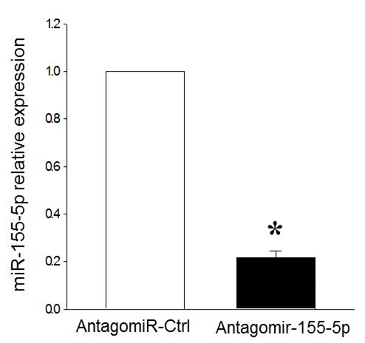
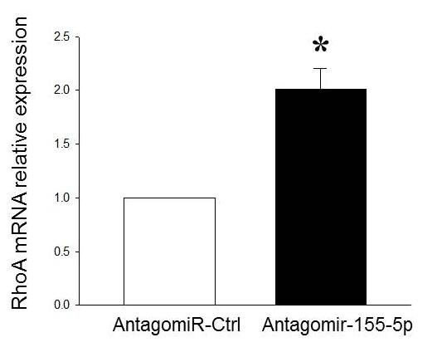
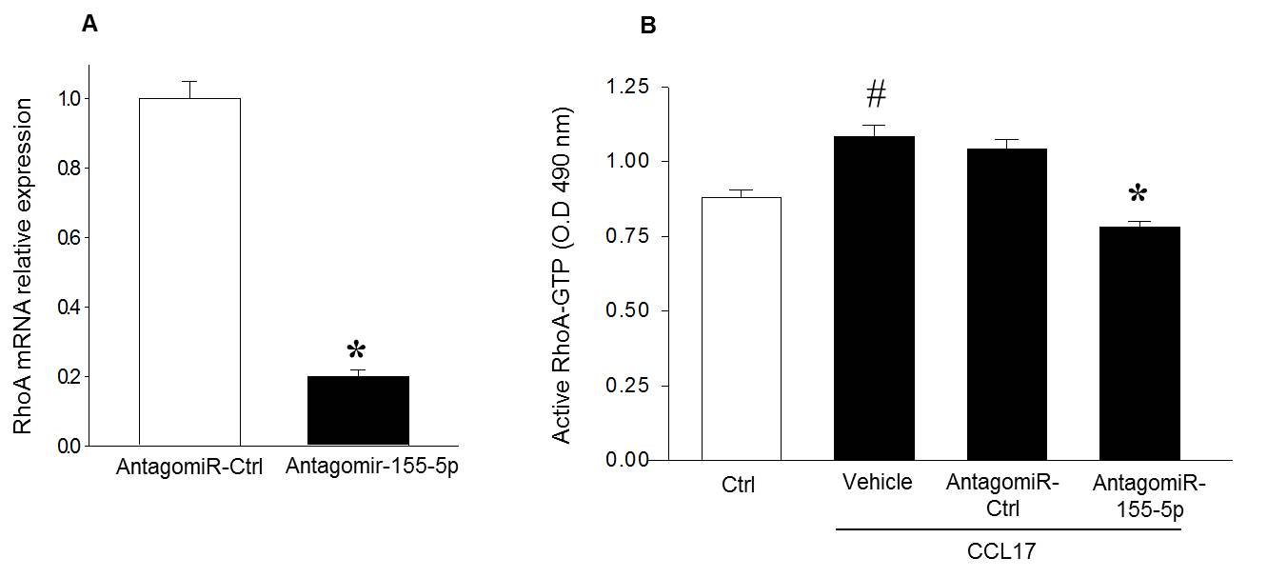
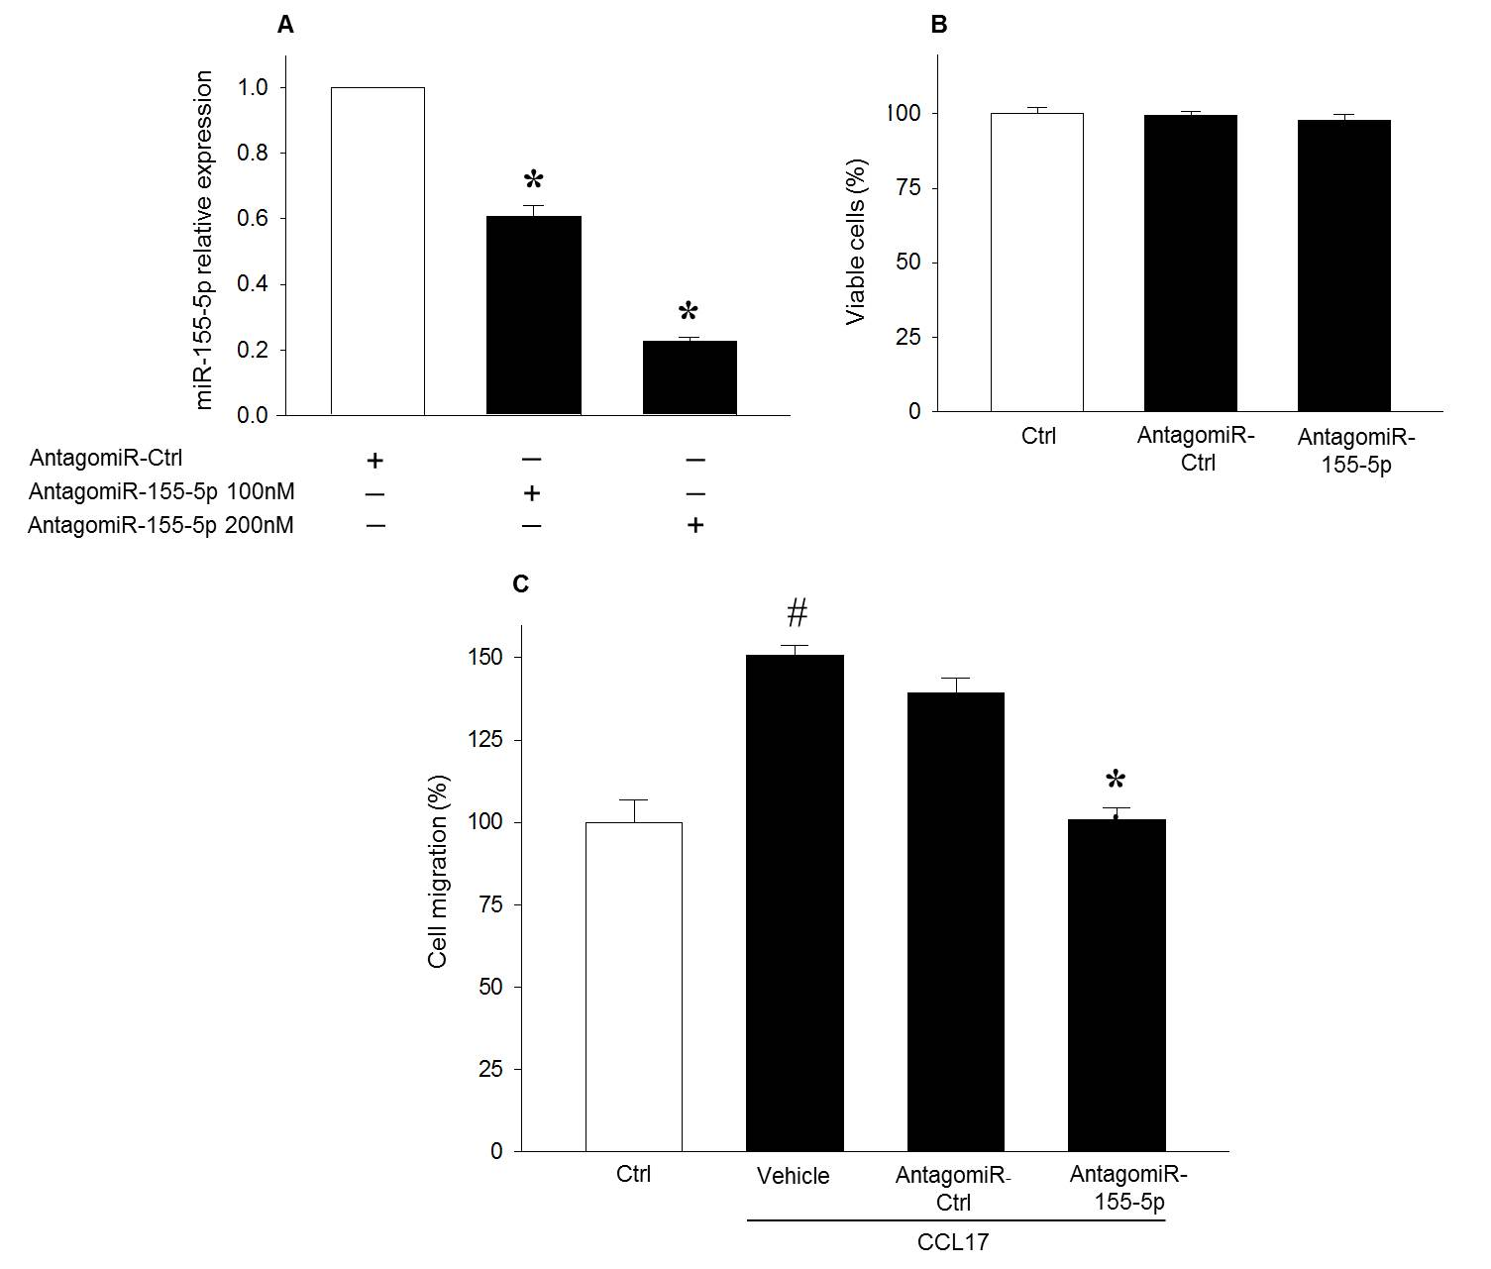
RhoA regulation
depends on
cellular conditions
78%
2-folds
Serum condition
Serum free condition
77%
80%

Slide 6
miR-155-5p regulates colon cancer cell migration
Non toxic transfection
Department of Clinical Sciences, Section of Surgery
16th Sep Amr Al-Haidari

Slide 7
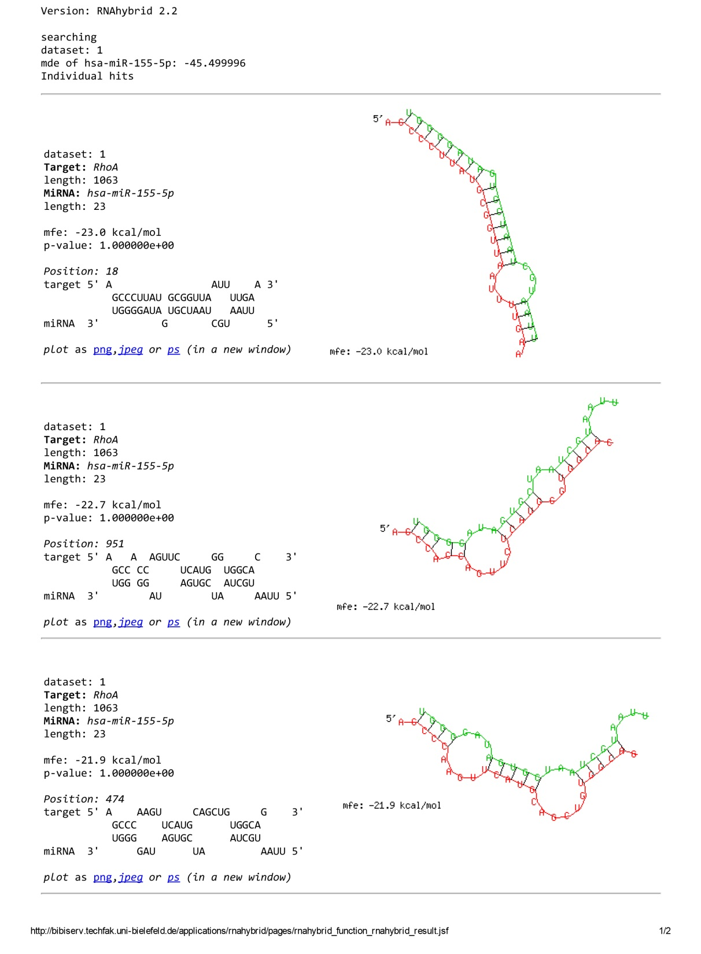
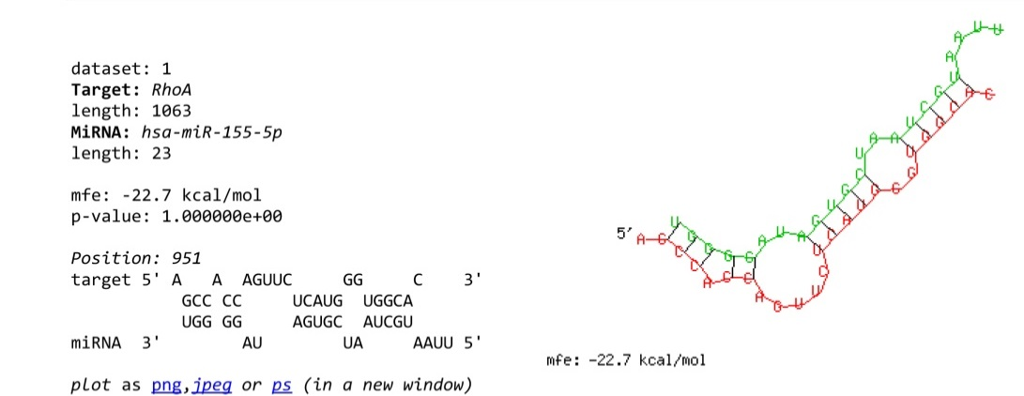
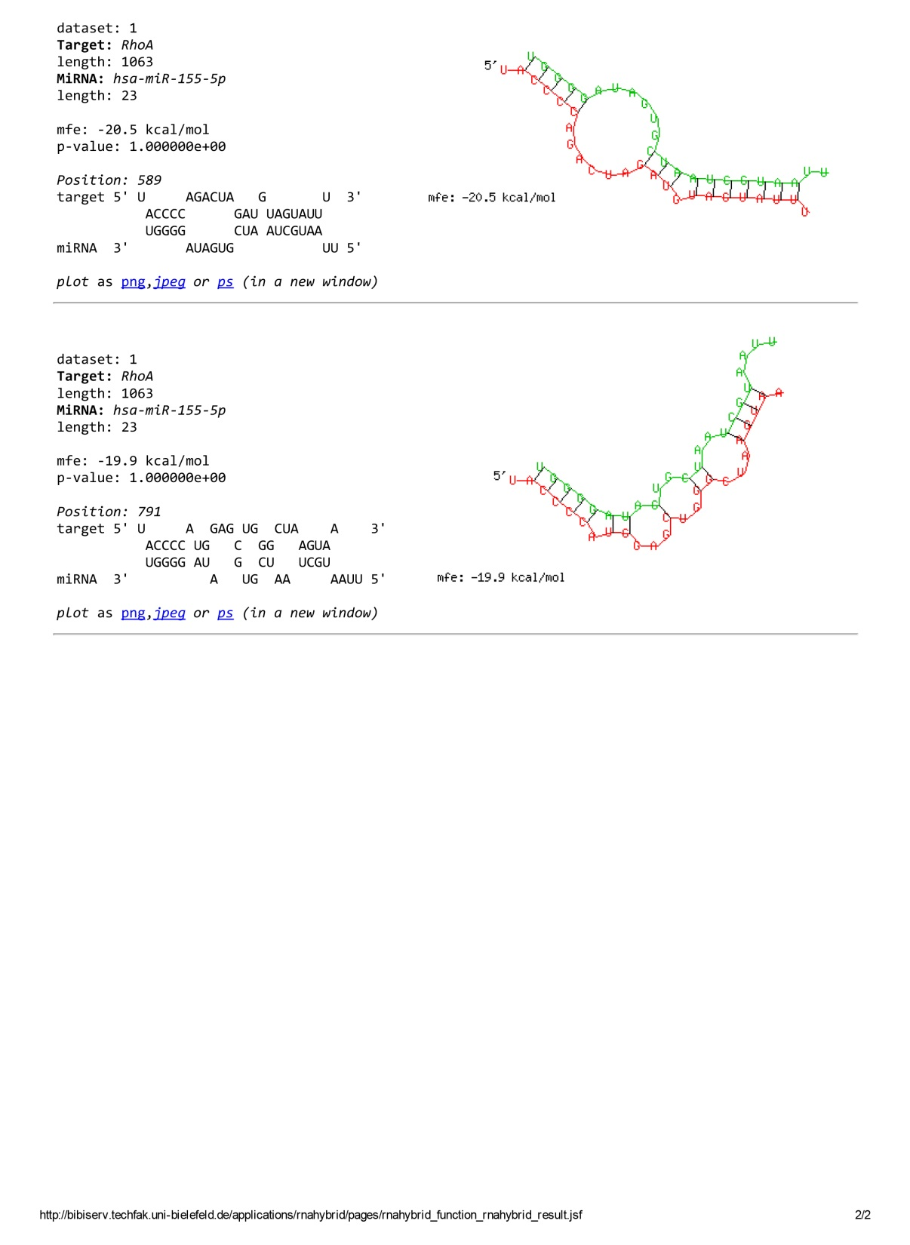
RhoA is a direct target of miR-155-5p
Department of Clinical Sciences, Section of Surgery
16th Sep Amr Al-Haidari

Slide 8
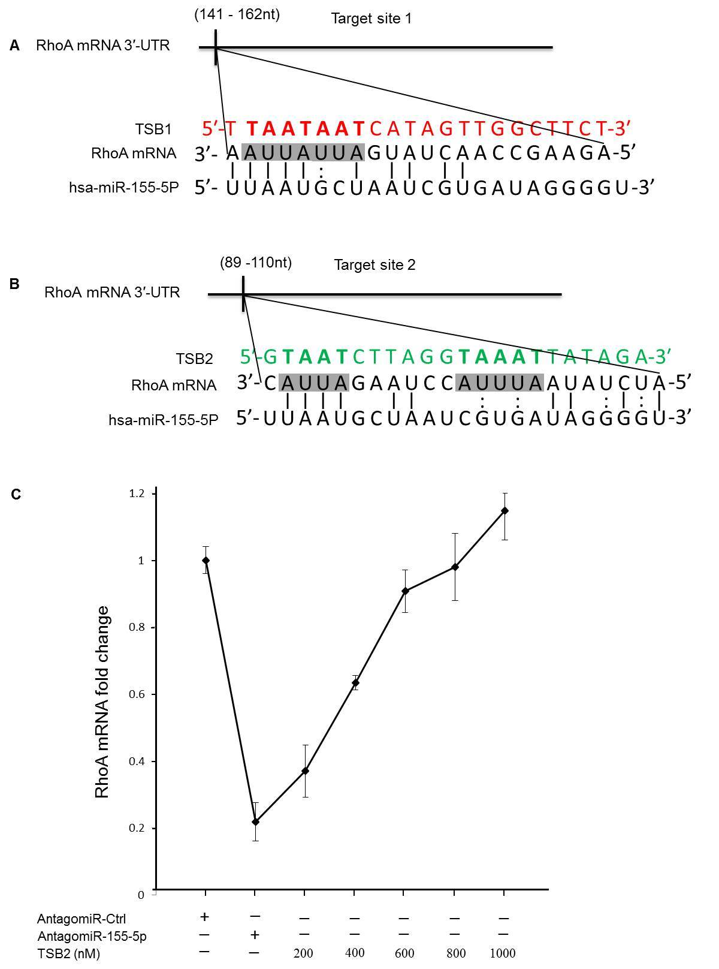
AREs are involved in RhoA mRNA regulation
Department of Clinical Sciences, Section of Surgery
16th Sep Amr Al-Haidari

Slide 9
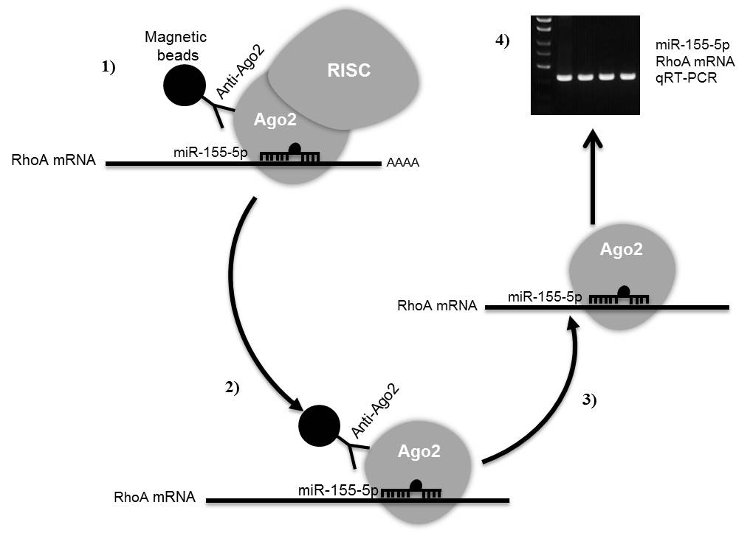
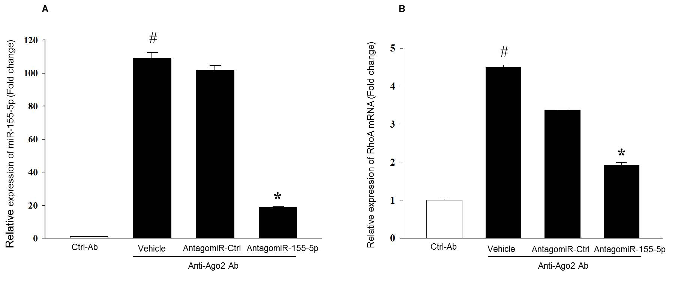
RhoA mRNA and miR-155-5p
are associated with Ago2
4.5-folds
2.5-folds
80%
Department of Clinical Sciences, Section of Surgery
16th Sep Amr Al-Haidari

Slide 10
Mechanisms of miRNA positive regulation
GW182
Hur
TNRC6A
Dicer
TRBP
Serum condition
Serum condition
Ago2
S
miR-155-5p
AAAA
RhoA mRNA
TTP
GW182
TNRC6A
Dicer
TRBP
Serum free condition
Ago2
miR-155-5p
S
Hur
AAAA
RhoA mRNA
FXR1
TTP
Department of Clinical Sciences, Section of Surgery
16th Sep Amr Al-Haidari

Slide 11
Conclusion
miR-155-5p positively regulates CCL17-induced RhoA activity and migration of serum starved colon cancer cells
Effect of miR-155-5p was found to be mediated by specific ARE elements present in the 3´-UTR region of RhoA mRNA.
Targeting miR-155-5p could open new strategies in antagonizing colon cancer metastasis
Department of Clinical Sciences, Section of Surgery
16th Sep Amr Al-Haidari

Slide 12
Thanks
Department of Clinical Sciences, Section of Surgery
16th Sep Amr Al-Haidari

