Slide 1

TRUSTED INNOVATIONS IN PATIENT ADHERENCE
Amos Adler M.Sc.
President & Co-Founder
amos@memotext.com
Twitter: @memotext
1877.MEMO.TXT

Slide 2

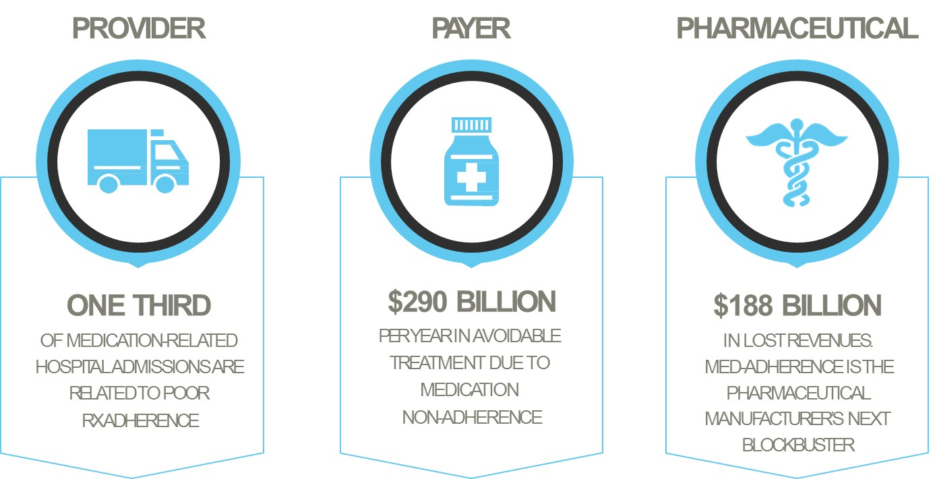
The cost of non-adherence:
  With every 10% increase in Medication Possession Ratio (MPR) there is a net 9-30% decrease in annual total healthcare costs.
  CVS State of the States: Adherence Report. 2012, CVS Caremark
  Value Health. 2009; 12(6): 915-922
  2012 Patient Adherence and Compliance: Improving Outcomes through Patient Engagement Programs- Cutting Edge Info (PH166) 2012

Slide 3
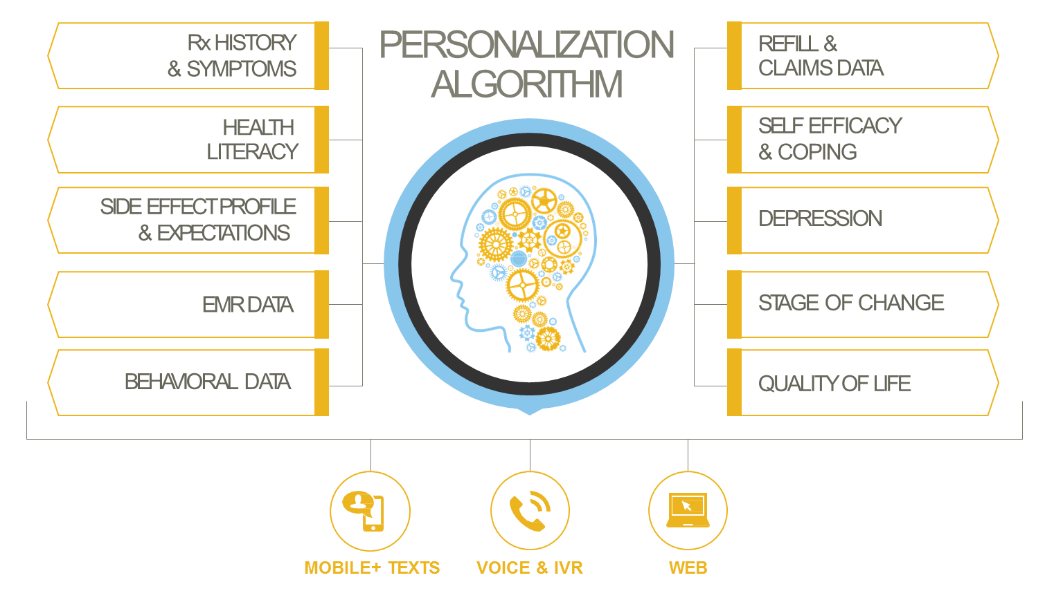
MEMOTEXT®
Evidence-based, ROI-driven digital adherence and behavior change solutions.
We improve the bottom line for healthcare stakeholders by increasing adherence to treatment.

Slide 4

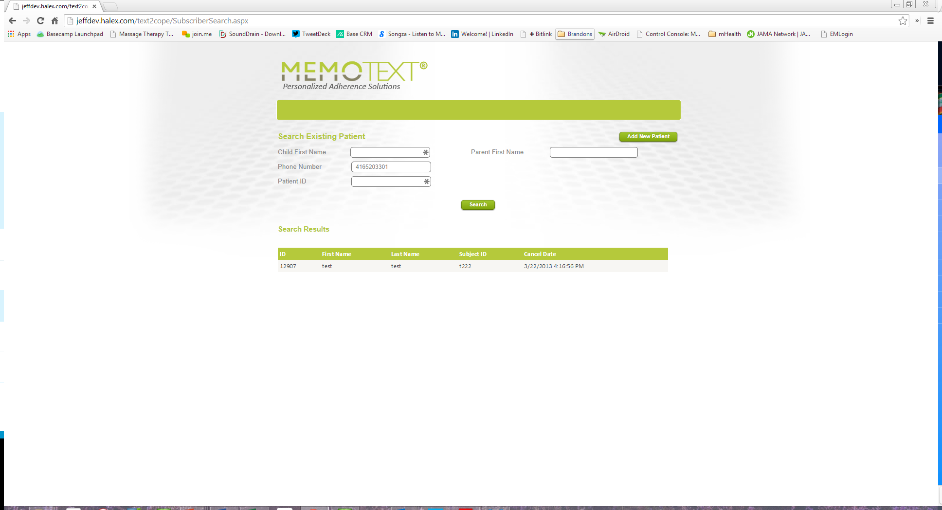
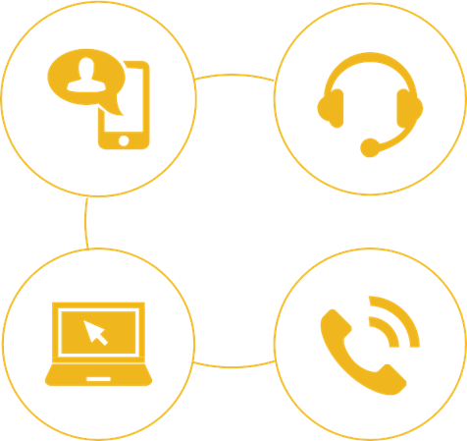
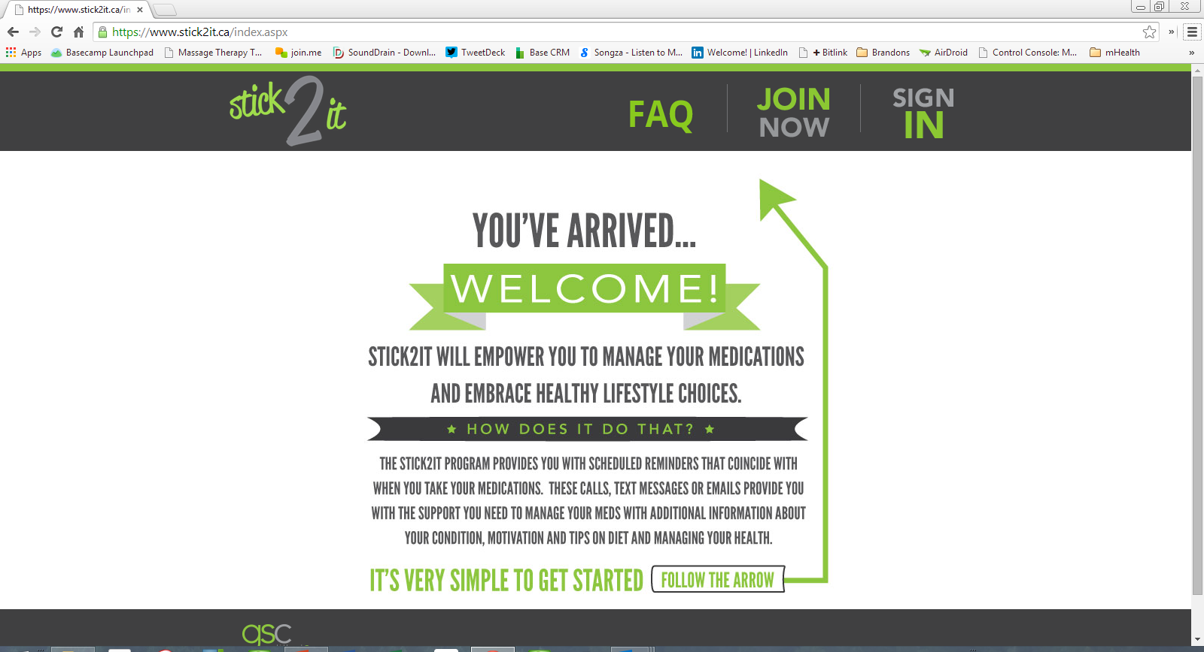
The MEMOTEXT® Intervention
Best practices in program recruitment are used to develop enrollment app or sites.
Multi-channel
  Patient Self-Enroll
  Call Center
  Web, Mobile, Telephone, Point of Sale
  Provider

Slide 5

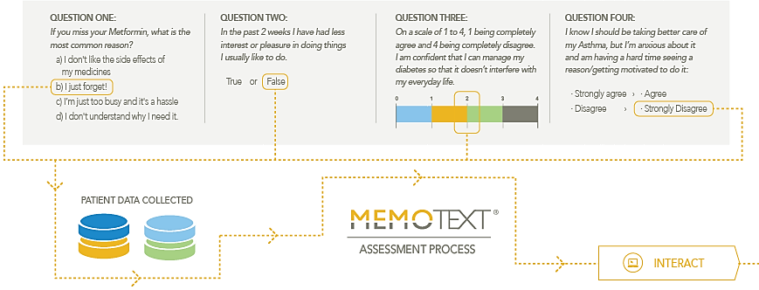
Self-referencing from patient responses.
Validated, short, frequent assessment
Condition specific literacy, behavioral
Securely administered for privacy
Personologic™ ASSESSMENT

Slide 6

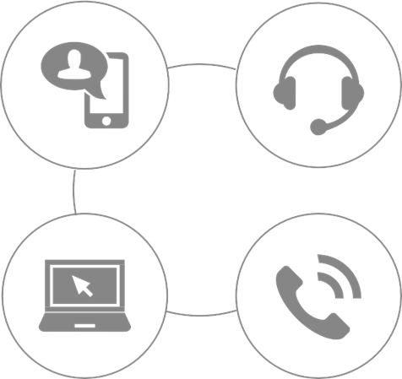



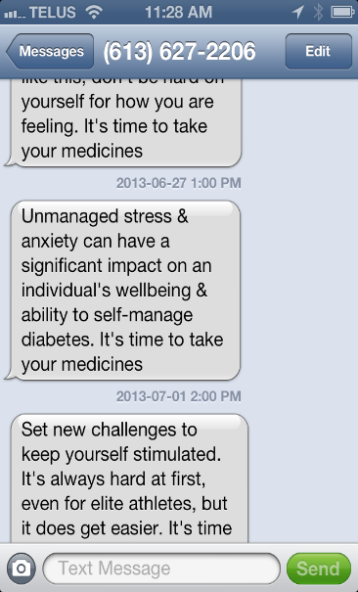

Personalized
Content by Text and Mobile
Click for sample audio
Patient Responses
Refill Data
Claims + EMR
Actionable
Dataflow
Automated, Personalized, Interactive, Self-Referencing Information, Motivation + Live Support

Slide 7



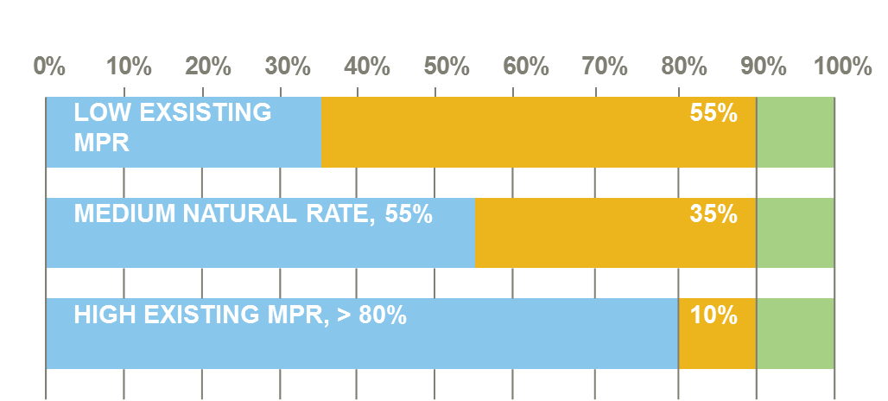
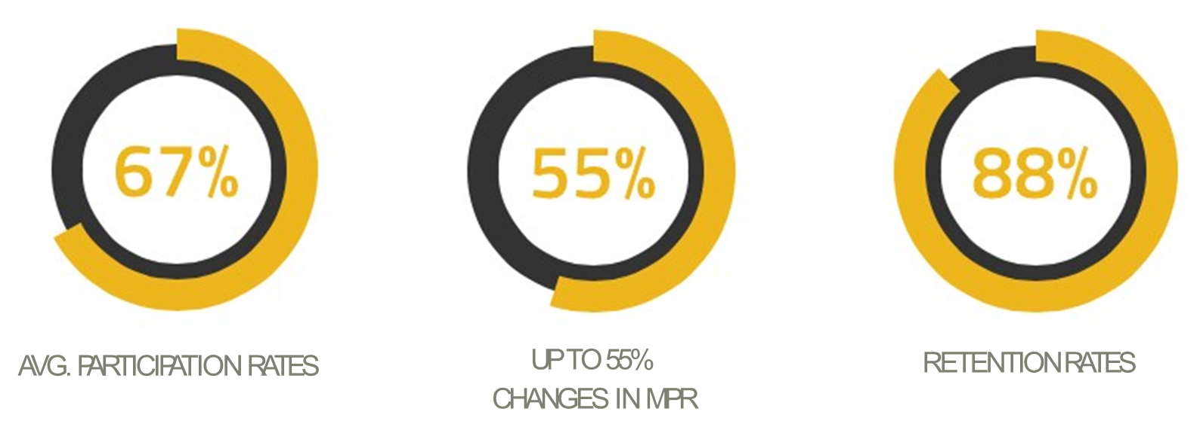
Real-World Data
Pharmacy | Recruitment | Intervention | Results/references
 | In-store DTC Call Center (Web + POS) | Self-efficacy & depression adherence METFORMIN. Adaptive SMS and IVR outreach and interactive education program. | Very significant increases in MPR – 18+ months
79% of patients rate programs very highly
17% + change in patients rating confidence in self management
76% of patient self-report feeling better, healthier and happier since starting a T2 Diabetes program
@memotext

Slide 8
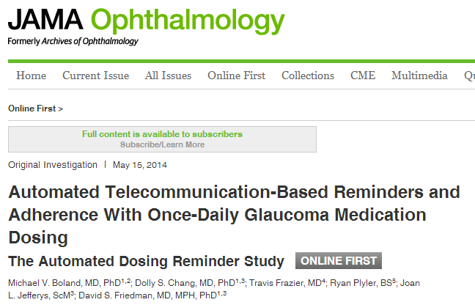
The MEMOTEXT effect
Johns Hopkins Wilmer Eye Clinic
Recruitment: JHU Research / MS Healthvault
Condition: Glaucoma (Travatan/Xalatan)
Michael V. Boland MD PhD. – Wilmer Eye Clinic Johns Hopkins Univ.
Results: Significant improvements in medication adherence with daily medications: Intervention group increase adherence from 51% to 67% adherence p. 0.003 (Electronic Monitoring of Dosing)
3 months
Randomize
6 months
Monitor Adherence for 3 months <75%
Poor Adherence
Good Adherence
MEMOTEXT group
Control group
http://archopht.jamanetwork.com/article.aspx?articleid=1871612
Presented at Stanford Persuasive Behavior Lab, mHealth 2012 and Kaiser Permanente Gallery of Innovation, Amer. Academy of Ophthalmology
INITIAL (%)
49 %
51%
FINAL (%)
50%
67%
Control Intervention

Slide 9
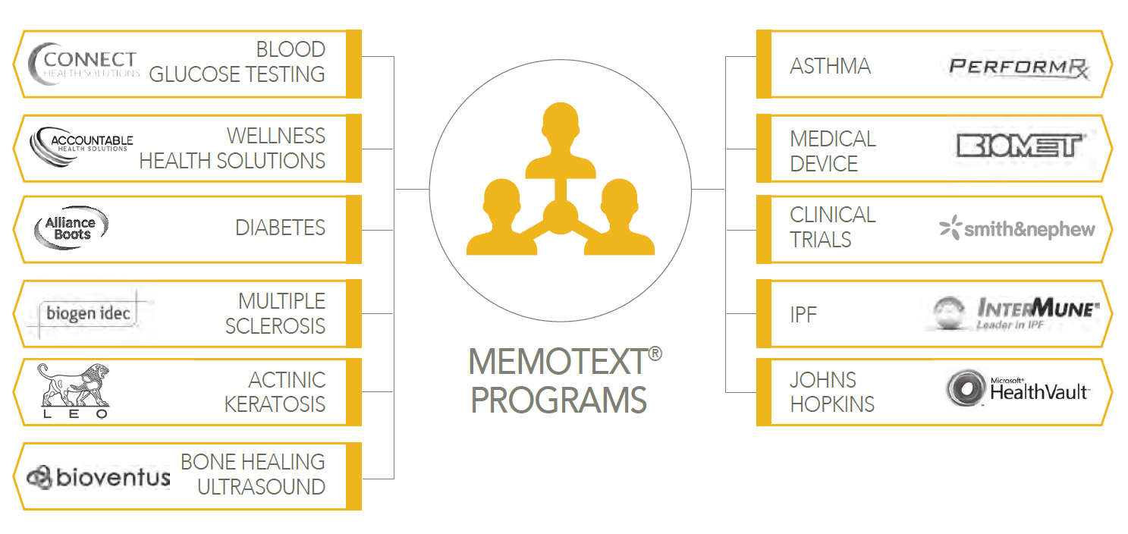
Select MEMOTEXT Pharma and other Use Cases
Recruitment, Intervention, Measurement
Privacy, Pharmacovigilance, Info Security

Slide 10
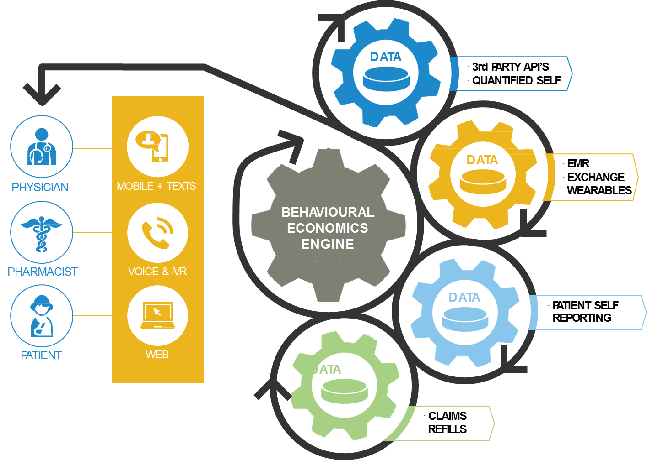
MEMOTEXTLabs
Collaborative development to automate and assess digital evidence-based behavior change.
Leverage and grow behavioral economics & artificial intelligence engine.
Development of an agile science methodology.
US Veterans Affairs, Univ. of Pittsburgh: CHF Follow-Up.
Arizona State Univ. TEXT2Cope: SMS: CBT + self talk
Nova S.E Univ.: Resolving Med Issues in Diabetes (SMS)
St. Michael’s Hospital: Prenatal Vaccination Adherence

Slide 11
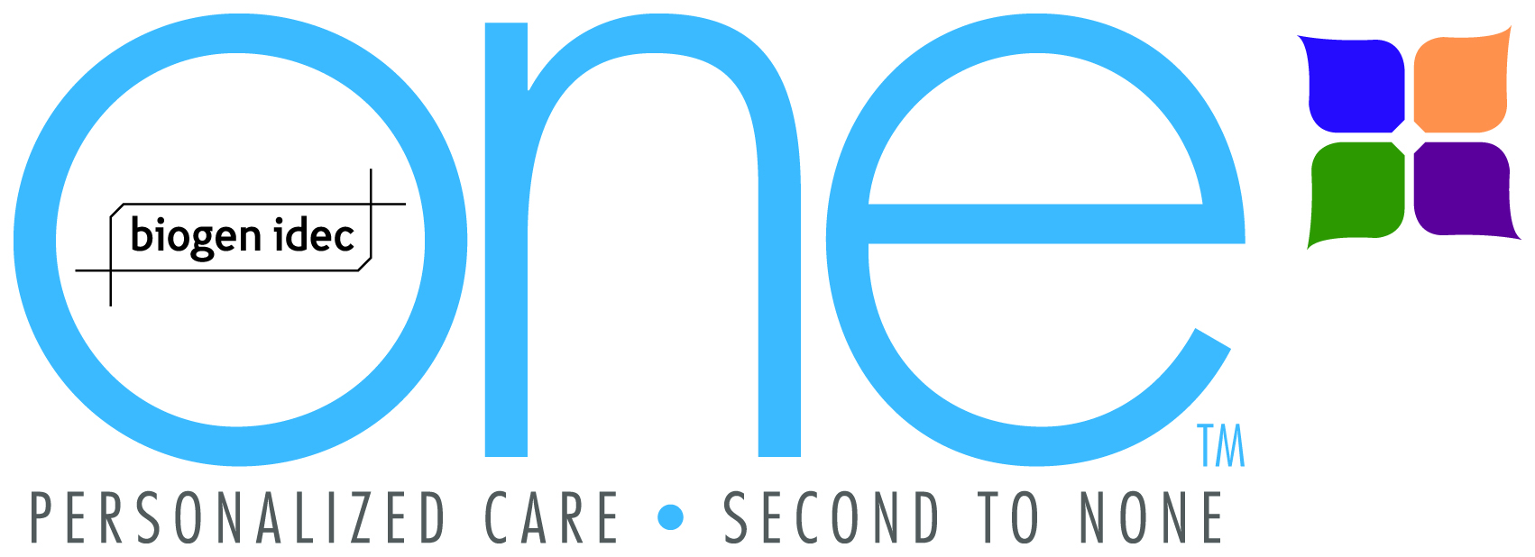




Select MEMOTEXT Use Cases
Pharmaceutical Manufacturer | Recruitment | Intervention | Results/references
Genzyme RENAGEL® | Hospital Pharmacy and Salesforce led HCP recruited. | ESRD adherence RENAGEL pilot program – Patient support, education and caregiver/support worker notification | >30% acquisition rate. Results confidential.
BIOGEN IDEC | Nurse and Case Worker – Homecare (Bayshore Healthcare) recruitment. | AVOTALK – Avonex adherence program – recruited via nurse/caseworker (Bayshore HealthCare) – Direct connection to call ctr via adherence program. | 4year program to-date Significant adherence sustainability. References available.
LEO Pharma | Co-Pay card integrated recruitment with STI. | PICATO support program, Real-time IVR Patient Reported Outcomes Data gathering program. | Analytics and data led to targeted support program. References available upon request.
Other Pharmaceutical Clients: Merck Canada, Bayer Canada
Pharmacy | Recruitment | Intervention | Results/references
 | In-store web-based and POS | Oral Diabetes adherence program for METFORMIN. Adaptive SMS and IVR outreach and interactive education program | +55% increases in MPR – 18+ months
Notes:
I assume that you will be presenting in person, so no need to have a title on this slide, you can just talk through the customers and clinical pathways.

Slide 12



Pharmacy Benefit Management | Recruitment | Intervention | Results/references
 | Recruited through participating HealthPlan | Adaptive Asthma program. Behavioral and educational content segmentation + Daily Air Quality Index Forecast | Ongoing
Wellness | Recruitment | Intervention | Results/references
 | Healthplan, Employer, Insurance | 3- way collaboration with wireless blood glucometer, personal health coach and blood glucose testing adherence (behavioral/educational) intervention. Real-time BGM data (trending and adherence) input into algorithm and escalations/caregiver alerts. | Ongoing
Insurance Carrier/Health Plan | Recruitment | Intervention | Results/references
Green Shield Canada | Through healthplan, Direct Mail/Segmented lists. | Educational and Behavior based Heart Health Program: www.stick2it.ca Cholesterol and blood pressure medication adherence. | Significant improvements in MPR, Delay to refill.
Provider/Hospital | Recruitment | Intervention | Results/references
 | HealthCare Practitioner Recruited | See referenced study | 31% increase in daily adherence to TRAVATAN, XALATAN
Notes:
I assume that you will be presenting in person, so no need to have a title on this slide, you can just talk through the customers and clinical pathways.

Slide 13
We get it.
Adherence programs require forward thinking and very robust control mechanisms:
Privacy & Data Security
Patient Health Information and HIPAA/PIPEDA
Regulatory Frameworks
Pharmacovigilance
InfoSec
Technology Reliability Redundancy &DRP

Slide 14
THANK YOU!
  Questions for me?
@memotext
amos@memotext.com
My mobile: 416-520-3301
Toll Free: 1877- MEMO-TXT

