Slide 1

Room-Temperature Terahertz Microbolometer Arrays for Biomedical Imaging Applications
Amit Banerjee
¹Advanced Device Research Division, Research Institute of Electronics,
²Innovative Photonics Evolution Research Center,
Shizuoka University, Japan

Slide 2



Research Institute of Electronics

Slide 3

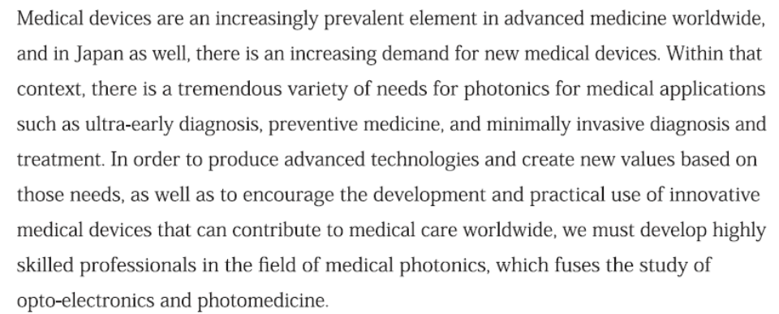

iPERC
Shizuoka University
Hamamatsu University School of Medicine,
Graduate School for the Creation of New Photonics Industries
Hamamatsu Photonics K.K.

Slide 4
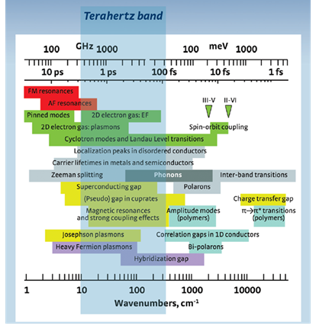
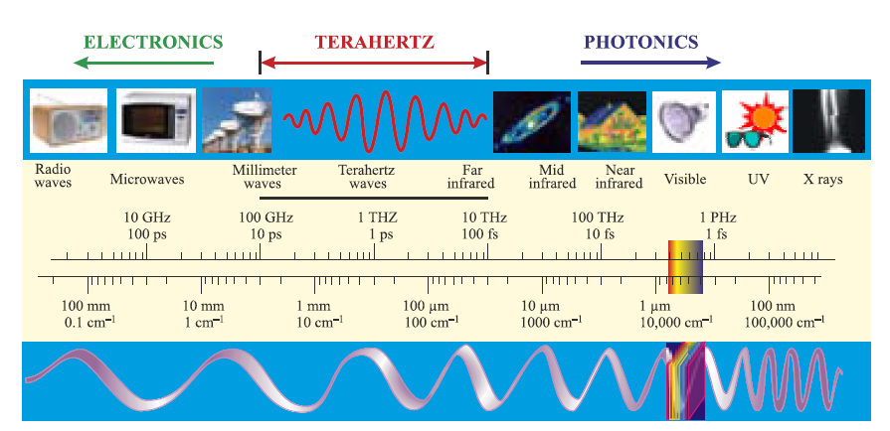
Electromagnetic Spectrum
Introduction to THz Photonics
THz radiations (0.3–10 THz ; 1 THz = 10¹² Hz)
[THz Band: 0.3 to 3 terahertz i.e 1 mm to 0.1 mm (100 μm)]
Radiation penetrates many common barrier materials enabling concealed objects to be seen.
Wavelengths are short enough to give adequate spatial resolution for imaging or localization of objects.
Radiation at these Frequencies is non-ionising and, at modest intensities, safe to use on Humans.
Fundamental Importance:
Light-Matter Interaction
[Rev. Mod. Phys. 83, 471, 2011]

Slide 5
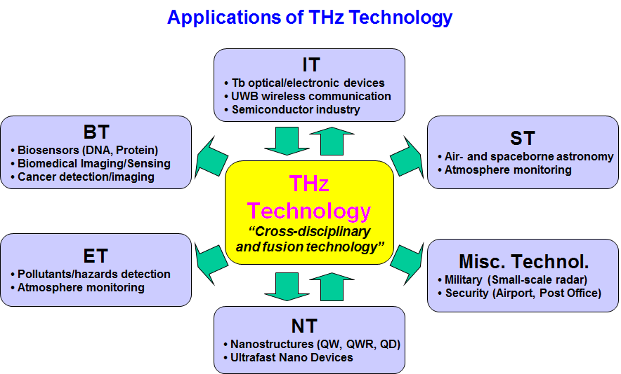
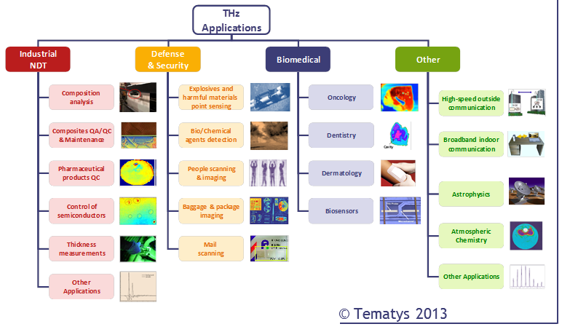
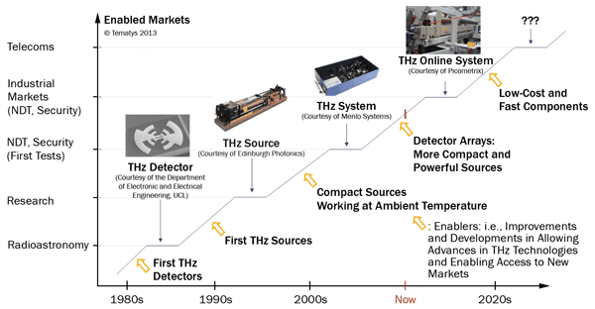
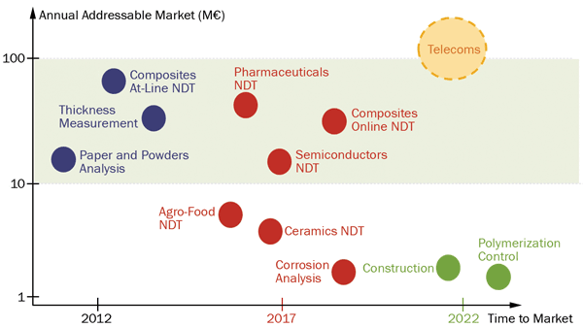
Introduction to THz Photonics
Evolution of THz Technology
THz industrial applications Road map
[photonics.com: Industrial Photonics April 2014]
The Terahertz market will reach around €350M in 2022 ! [http://tematys.fr]

Slide 6
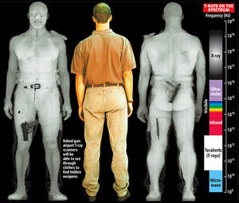

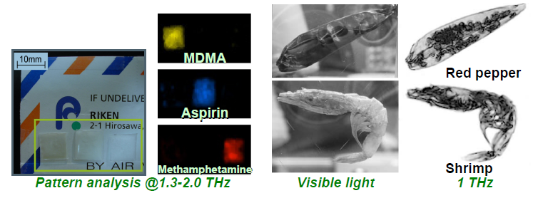
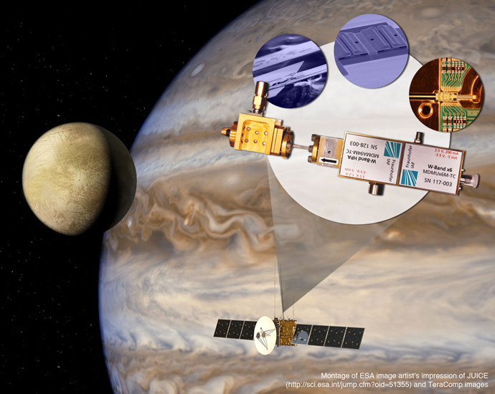
THz Imaging
Hidden weapons or drugs are clearly distinguishable and corresponding spatial patterns obtained.
ThruVision's T5000 terahertz camera can see through clothes without x-rays, but also obscures the body of the observees
[dailytech.com]
[dailymail.co.uk]
Non-destructive terahertz imaging of illegal drugs using spectral fingerprints
[Opt. Photon. News 15 (2004) 34]
[phys.org]
Terahertz sensor aiming for Jupiter's moons

Slide 7
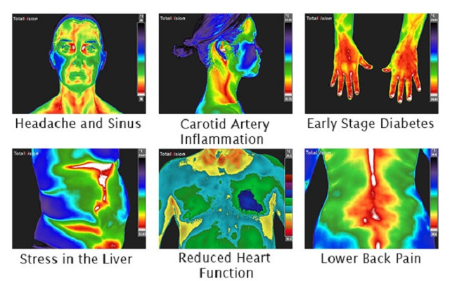
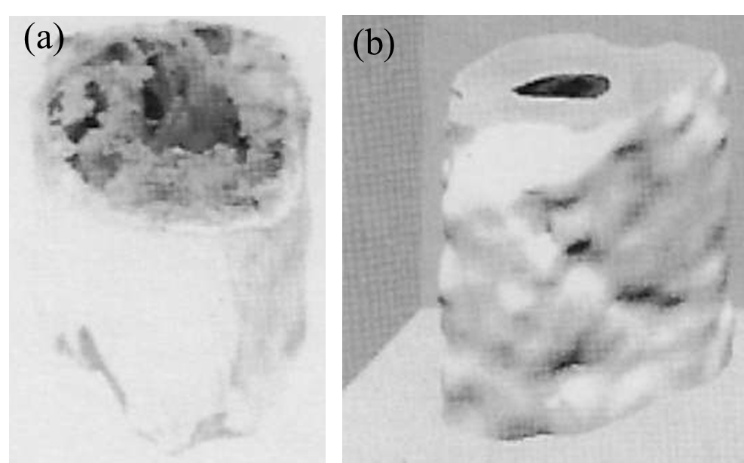
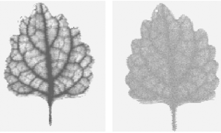
Biomedical Imaging Applications
Photo（visible)
THz image
3D Image of the Turkey’s Leg Bone by Pulsed THz CT
[International association of medical thermographers]
[J. Phys. D 37 (2004) R1]
[Rep. Prog. Phys.
70 (2007)1325]
[Opt. Exp. 11 (20) (2003) 2549]
The plant was first starved of water for several days (left image). Several tens of minutes after watering (right image).

Slide 8
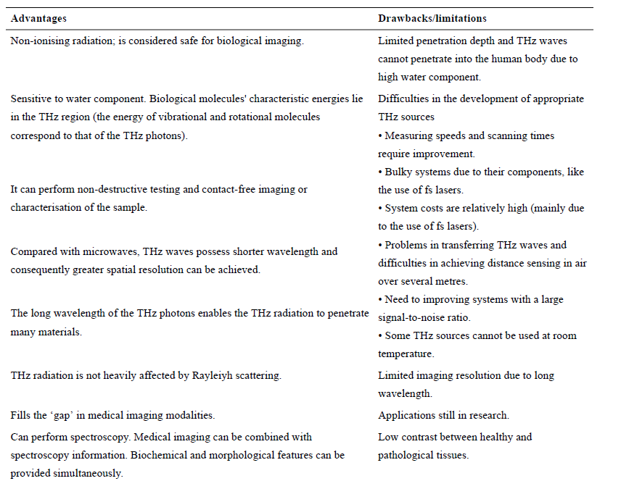
Advantages and limitations/drawbacks of THz imaging
[Rep. Prog. Phys. 70 (2007)1325]

Slide 9
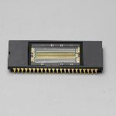
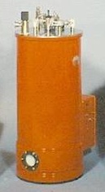
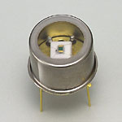
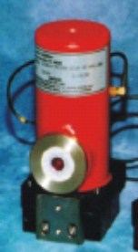
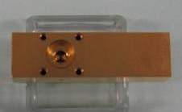
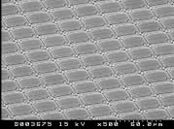
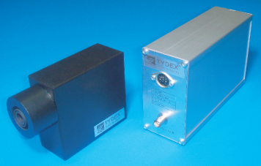
Infrared-THz Detectors and THz Gap
Wavelength (μm)
0.3
3
30
300
3000
10¹⁵
InGaAs
1024×1
array (HPK）
Detectivity (D)×B (Hz /W)
GaP-PD
Stressed Ge:Ga PC (LHe)
^{1/2}
10¹⁴
Si-PD
InGaAs
-PD
Si Bolometer
(LHe)
^{1/2}
10¹³
InSb-PD
(HPK）
InSb-PD
(LN₂)
Si Bolometer (LHe)
LHe cryostat
(QMC)
10¹²
THz Gap
10¹¹
MCT-PD
(LN₂)
MCT-PD
(LN₂)
Stressed Ge:Ga PC
(Hiromoto et al.)
LN₂ cryostat
Micro-bolometer
10¹⁰
DLaTGS
Golay Cell
DLaTGS
1000
100
10
1
0.1
Uncooled microbolometer 320×240 arary (NEC)
Frequency (THz)
Golay cell
(Tydex)
Bruker Optics: http://www.brukeroptics.com/fileadmin/be_user/Products/FT_IR/Product_Notes/DigiTect_Detectors.pdf

Slide 10
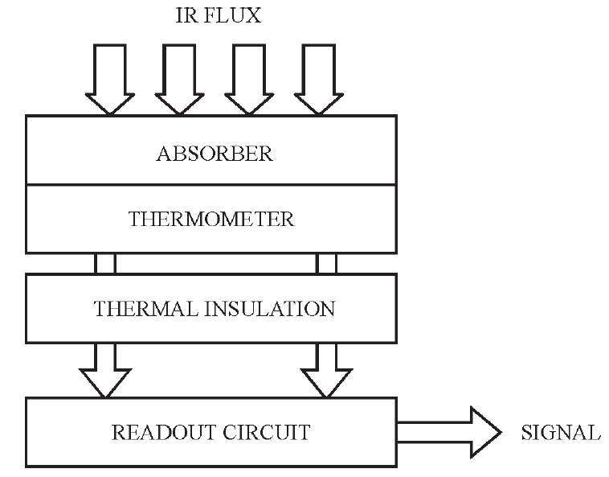
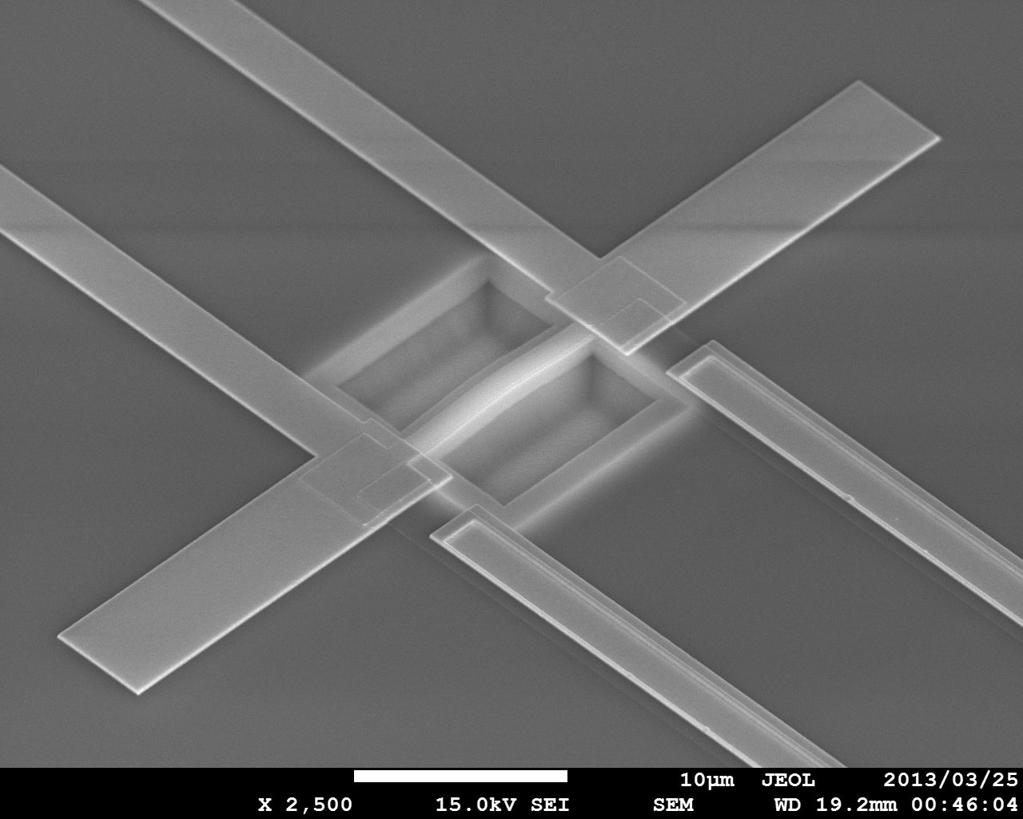
Introduction to THz Photonics
Detectors (Far Infrared to Terahertz)
Photon Detectors
Thermal Detectors
Fast, more sensitive and commercialized for military and space science
Cryogenic cooling is required
Room temperature, low cost, more reliable
Surveillance, night vision, military
Low detectivity (thermal noise) and low response time
THz region
Absorber become too large to be mechanically supported and thermally isolated
Antenna-Coupled Microbolometers are more viable
Radiation is absorbed by antenna and converted to heat by load resistor
Thermistor/Heater
IR FLUX
Antenna
ABSORBER
THERMISTOR
Cavity
INSULATION
SUBSTRATE
Thermal
Detectors
10 μm
Antenna-Coupled
Microbolometer

Slide 11
Room-Temperature Antenna-Coupled
Terahertz Microbolometer
Microbolometer : Detector for infrared (IR) & terahertz (THz) waves.
Important Parameter: Temperature coefficient of resistance (TCR) of the thermistor; responsivity is proportional to the TCR.
As long as the resistance values and the bias current are kept the same and the noise is limited by shot noise produced by the bias current, it is expected that the noise equivalent power (NEP) is inversely proportional to the TCR.
We have reported the fabrication of room-temperature antenna-coupled microbolometer for 1-THz region with a responsivity: 90 V/W, NEP: 4.5E-10 W/Hz^{0.5}, fc: 7 kHz [Sens. Actu. A Phys. 222 (2014) 1].
Device Miniaturization: the TCR and resistivity (ρ) suffers heavily for lower width of the thermistor.
Currently, the narrow width effects on the TCR and ρ for platinum (Pt) and titanium (Ti) are studied.

Slide 12
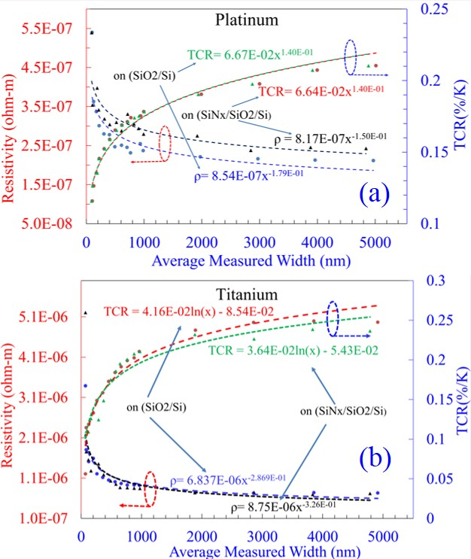
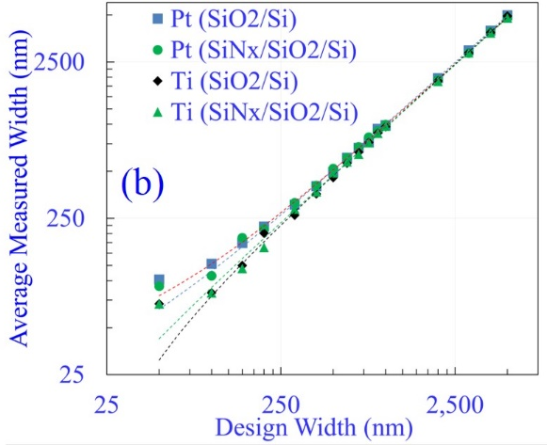
Width Dependence of Thermistor
(e)
Fig. 1. (a,b) OM and SEM image of straight and (c,d) meander devices fabricated for measurement of the width effect on the thermistor. (e) Variation of DW and AMW for two different substrates.
Fig. 2. Temperature coefficient of resistance (TCR) and resistivity (ρ) with the variation of average measured with for (a) Pt and (b) Ti thermistor for two different substrates for devices with wire structure.

Slide 13
Width Dependence of Thermistor
(e)
Fig. 1. (a,b) OM and SEM image of straight and (c,d) meander devices fabricated for measurement of the width effect on the thermistor. (e) Variation of DW and AMW for two different substrates.
Fig. 2. Temperature coefficient of resistance (TCR) and resistivity (ρ) with the variation of average measured with for (a) Pt and (b) Ti thermistor for two different substrates for devices with wire structure.

Slide 14
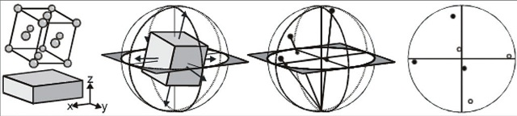
Narrow Width in Ti: Grain Distribution
Fig. 3. Electron backscatter diffraction (EBSD) with phase map, phase ratio, local diffraction patterns, grain distribution map and grain statistics for Ti nanowire with design width (DW) (a) 100 nm (b) 300 nm (c) 1000 nm and (d) large-area Ti film (150 x 150 µm)
Fig. 4. Electron backscatter diffraction (EBSD) results with 2D & (d) 3D pole figures with different viewing angles for Ti nanowire with design width (DW) (a) 100 nm (b) 300 nm (c) 1000 nm and (d) large-area Ti film (150 x 150 µm)
The production of a stereographic projection for a single crystal (in this case a unit cell)

Slide 15
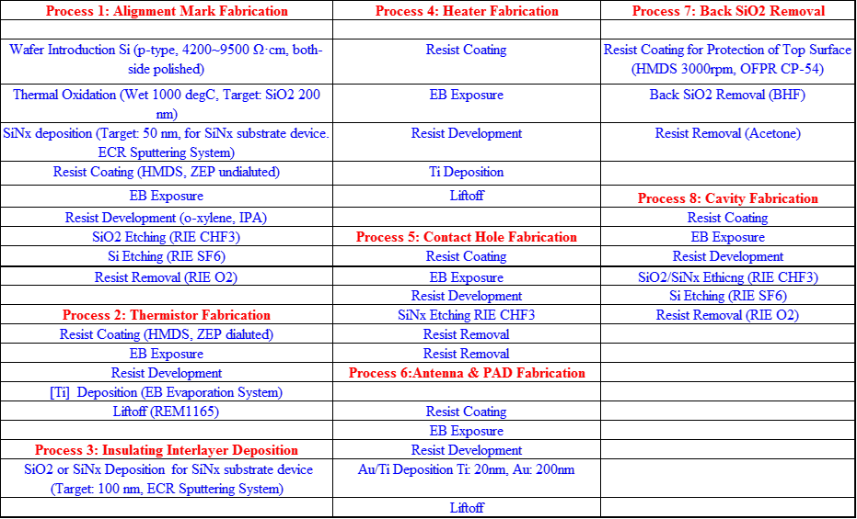
Device Fabrication Steps: EBL
DEVICE | Substrate/Interlayer | Thermistor | Heater
1 | SiO₂ (230 nm/100 nm) | Ti (50 nm) | Ti (100 nm)
2 | SiO₂ (230 nm/100 nm) | Ti/Pt (5 nm/50 nm) | Ti (100 nm)
3 | SiO₂/SiNx (230/50 nm)/SiNx (100 nm) | Ti (50 nm) | Ti (100 nm)
4 | SiO₂/SiNx (230/50 nm)/SiNx (100 nm) | Ti/Pt (5 nm/50 nm) | Ti (100 nm)
Antenna & Pad: Ti/Au (20/200 nm)
Cavity Fabrication : [SiO₂(100 nm) or SiNx (150 nm) + SiO₂ (230 nm) + Si (3100 nm)] * 1.2
EBL Steps: 6

Slide 16
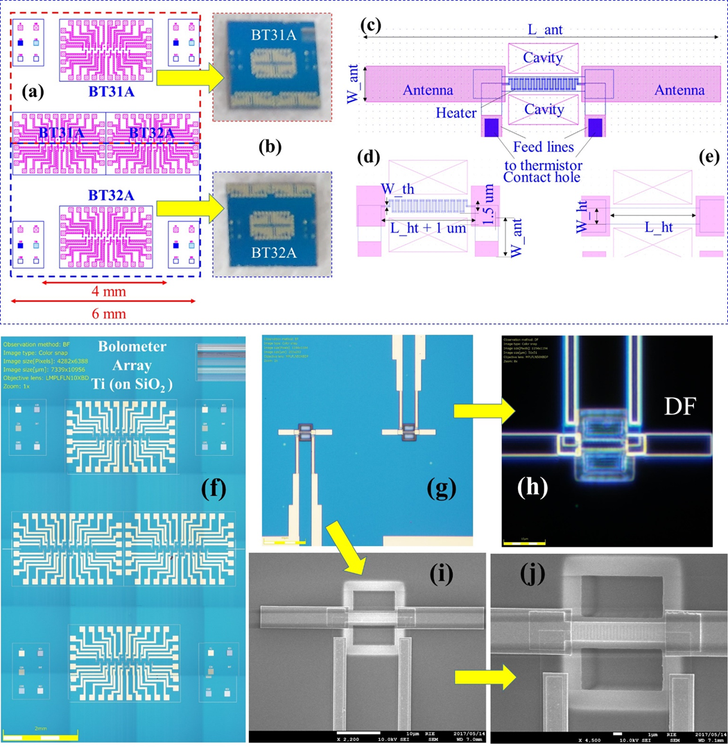
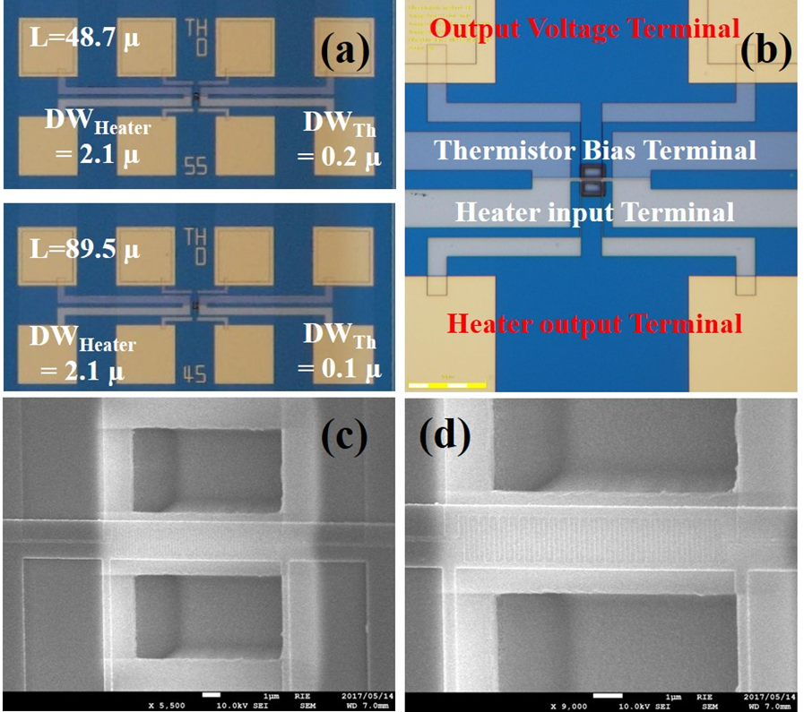
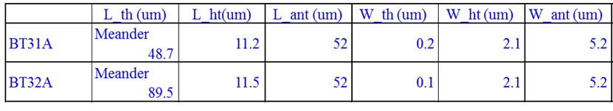
Uncooled Antenna-coupled Terahertz Microbolometer Arrays
Fig. 5. (a-e) IC Design of uncooled antenna-coupled terahertz microbolometer arrays. (f,g) OM images of antenna-coupled Ti-microbolometer arrays fabricated with thermistor with DW= 0.1, 0.2 µm. (h) dark-field OM and (i,j) FESEM enlarged view of one microbolometer device showing the heater and meander structured thermistor suspended on top of the cavity.
Fig. 6. (a-d) Devices with identical dimensions to that of devices BT31A, BT32A for the measurement of the electrical responsivity and frequency response

Slide 17
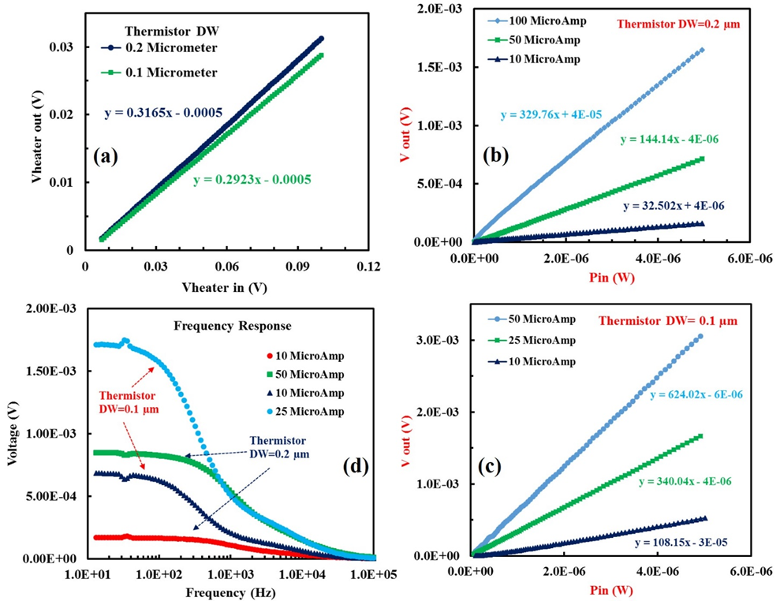
Device Performance with Meander Thermistor: Ti
Fig. 7. (a) Voltage input-output response for heater for both the microbolometer devices with thermistor width DW= (a) 0.2 µm (b) 0.1 µm. Electrical Responsivity of microbolometer devices on different bias currents to thermistor at a frequency= 10Hz, with DW= (b) 0.2 µm (c) 0.1 µm. (d) frequency response for microbolometer devices with thermistor width DW= (a) 0.2 µm (b) 0.1 µm.

Slide 18
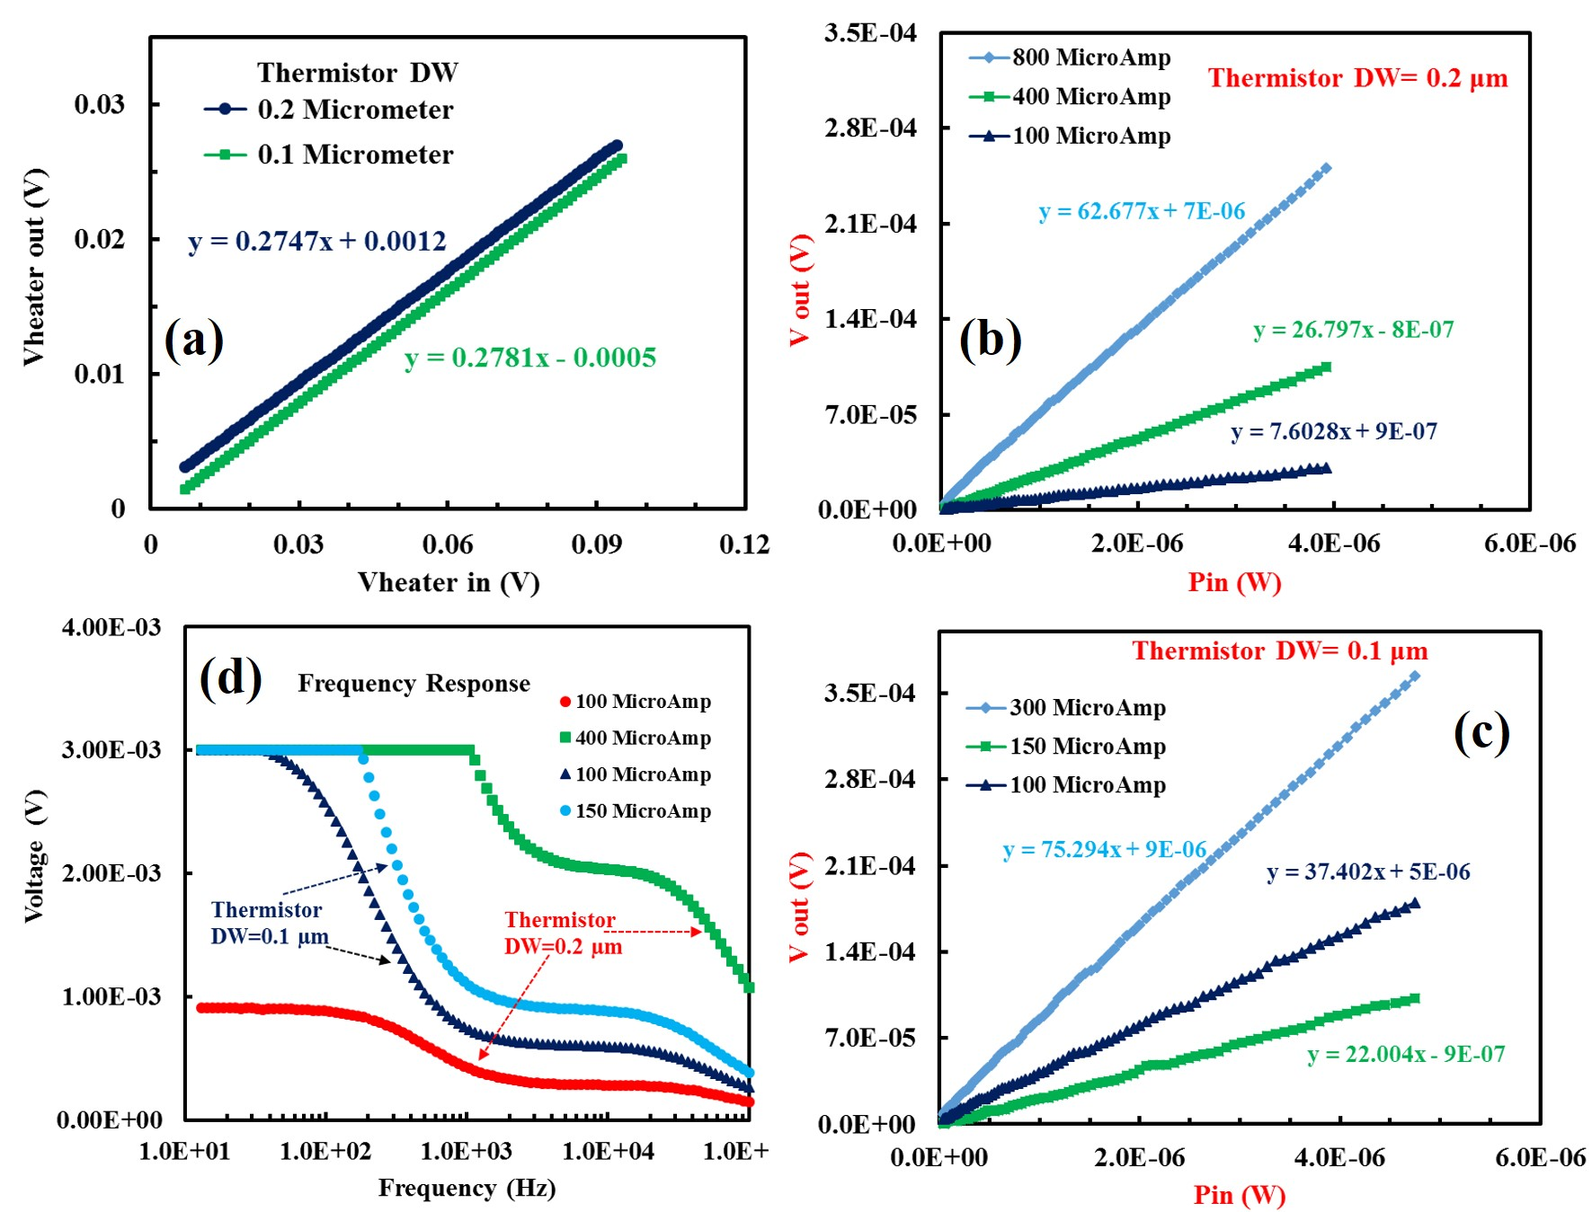
Device Performance with Meander Thermistor: Pt
Fig. 8. (a) Voltage input-output response for heater for both the microbolometer devices with thermistor width DW= (a) 0.2 µm (b) 0.1 µm. Electrical Responsivity of microbolometer devices on different bias currents to thermistor at a frequency= 10Hz, with DW= (b) 0.2 µm (c) 0.1 µm. (d) frequency response for microbolometer devices with thermistor width DW= (a) 0.2 µm (b) 0.1 µm.

Slide 19
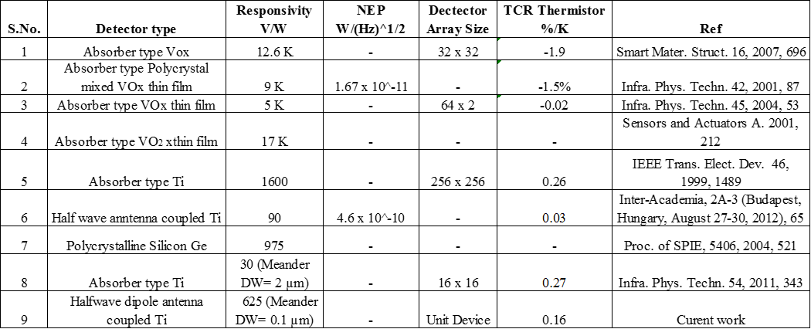
Comparative Performance Study of Related Devices

Slide 20
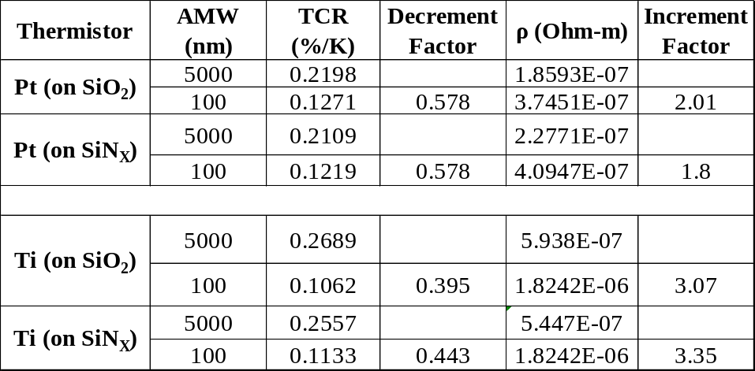
Summery
Correlation between increased ρ and reduced TCR, with the line width decreased, is commonly observed in Ti and Pt for different substrates and structures. Reduced TCR correlated with reduced grain size but not dependent on crystal orientation (in current work).
Pt shows smaller width dependence, expected NEP can be improved by 12% by replacing thermistor material from Ti to Pt, keeping its resistance constant by increasing its length by factor of 4.7 (by meander structure) for the target freq. of 1 THz. Understanding the mechanism of the resistivity-TCR correlation may lead to the improved performance of the metal-resistor-based bolometers.
Ti device with DW= 0.1 µm of thermistor has about 2.5 time higher electrical responsively (624 V/W) than that with DW= 0.2 µm (329 V/W) and it is also 7 time higher than our previous results (90 V/W), at maximum allowable current. Importantly with DW= 0.1 requires half the current for twice the value of responsivity.
The results in current report lead to the detailed understanding of the narrow width effect of TCR for Ti, Pt at a level of nanodevices, to our knowledge, is not available at present. Cause of higher responsively could be TCR or higher resistivity or a trade-off in both.
The optical response with THz source is in investigation currently however it is expected to have proportional improvements.

Slide 21
My Heartiest Thanks to….
Members of the Nanosystem Integration Lab
R.I.E., Shizuoka University

Slide 22
THANKS FOR YOUR TIME
*[ThruVision T5000]

