Slide 1
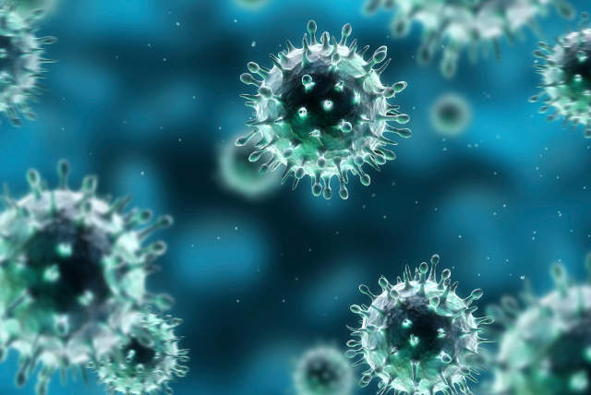
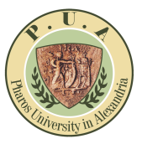

Polymeric Nanoparticles for CNS Targeting:
It Is Time to Think About The Nanotoxicological Aspects
By
Amira S. Hanafy, Ph.D.
Lecturer of Pharmaceutics
Faculty of Pharmacy and Drug Manufacturing,
Pharos University in Alexandria, Egypt
Pharma Middle East, Nov 02-04, 2015, Dubai, UAE
Notes:
My name is Amira Hanafy, I’m a pharmaceutics lecturer at Faculty of Pharmacy and Drug Manufacturing, Pharos University, in Egypt.
I defended my PhD thesis last month, which was on using polymeric nanoparticles for CNS drug delivery via nasal route.
I thought to present a talk about an aspect that has not gained the attention it deserves, which is the nanotoxicology of polymeric nanoparticles.

Slide 2
Objectives
Redirect the current interest of pharmaceutical researchers to nanotoxicological aspects.
Encourage the pharmaceutical researchers
+ Pharmacologists
+ Toxicologists
↓
Polymeric nanoparticles for CNS drug delivery
Notes:
This presentation aims to redirect the current interest of pharmaceutical researchers to nanotoxicological aspects,
And to encourage them to comb their efforts with pharmacologists and toxicologists
To push forward the development of polymeric nanoparticles for CNS drug delivery.

Slide 3
Polymeric Nanoparticles
PLGA
PLA
Poly-ε-caprolactone
Chitosan
Gelatin
Poly-alkyl-cyanoacrylates
Notes:
The employment of biodegradable polymeric nanoparticles has been pioneered in 1999.
Several polymers have been utilized such as PLGA, polylactic acid, caprolactones, chitosan, gelatin, and polyalkyl cyanoacrylates.

Slide 4

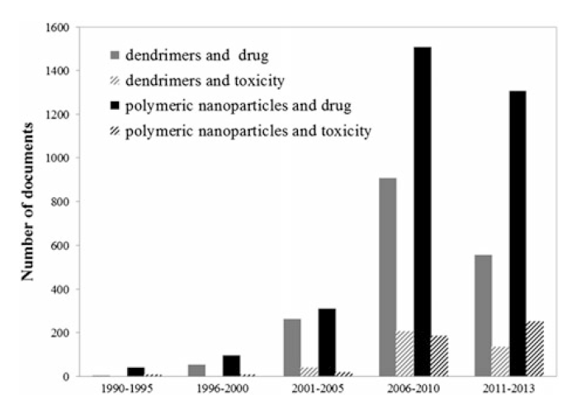
What does attract the pharmaceutical researchers working on polymeric nanoparticles?
Optimizing the formulation & its stability
Nanoparticles’ efficiency
Processability and cost/benefit ratio
Administration safety!
Garcia, Solange C., et al. "Polymeric Nanoparticles: In Vivo Toxicological Evaluation, Cardiotoxicity, and Hepatotoxicity." Nanotoxicology. Springer New York, 2014. 299-324.
Notes:
What does really attract the pharmaceutical researchers working on polymeric nanoparticles?
They usually focus on optimizing the formulation & its stability
Nanoparticles’ efficiency,
And Processability and cost/benefit ratio.
However, the safety parameter of such nanoparticles is usually overlooked!
According to the ISI database, between 2011 and 2013, the number of articles relating to the use of polymeric nanoparticles in pharmaceuticals has been growing exponentially.
In parallel, there is also a recent interest in the toxicological evaluation of these structures in the brain, liver, and kidney. However, the % of these articles is still considered low.

Slide 5
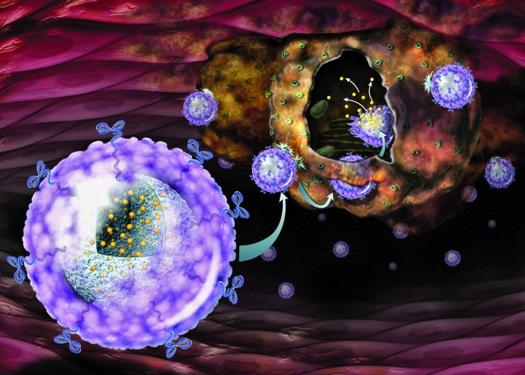
Clinical Trials on Polymeric Nanoparticles
There is NONE!
The In Vivo Fate & Safety!!
Notes:
Consequently, if we considered the Clinical Trials on Polymeric Nanoparticles,
Up to our knowledge, they have not been enrolled in any clinical trials up to this year!
And one factor that could have delayed enrolling the nanoparticles into clinical trials is the lack of understanding of their in vivo fate and safety.

Slide 6
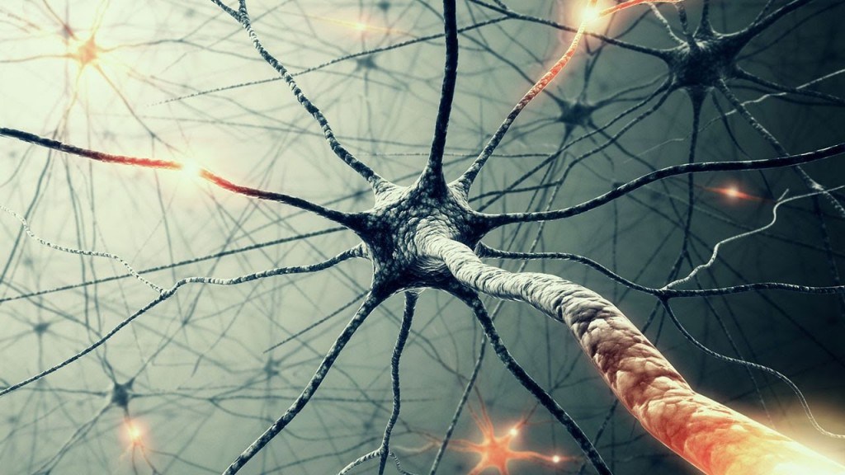
Factors Affecting The Safety of Polymeric Nanoparticles
Polymer’s Biodegradability
Only the bulk material of the polymer matters!
Unique small size + Surface properties
Surface coatings
Tendency to aggregation
Addition of stabilizers
1
Fragments… Clearance
2
NPs
3
4
5
Notes:
Several factors should be considered to understand the NPs safety.
Polymer’s biodegradability is important as it provides fragments that are suitable for clearance.
However, considering solely the toxicity of the polymeric bulk material used to prepare the NPs might not reflect the corresponding nanoparticles toxicity. … WHY?
Because of the unique small size and surface properties of the NPs, which could be responsible for their toxicity.
The other factors include the surface coatings,
tendency to aggregation,
and addition of stabilizers.

Slide 7
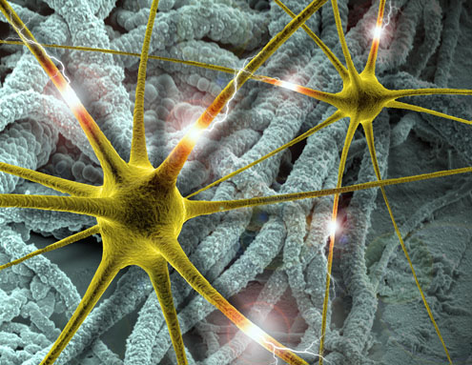
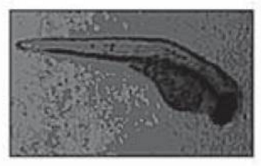
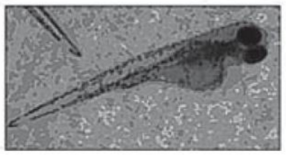
Can polymeric nanoparticles really be more toxic than their bulk materials?
The toxicity of 200 & 340 nm chitosan nanoparticles incubated with Zebrafish embryos.
The hatching rate, mortality, & embryos malformations… were observed!
Bent spines
Edematic yolk sac
Hu et al. "Toxicity evaluation of biodegradable chitosan nanoparticles using a zebrafish embryo model." International journal of nanomedicine, 6(2011)
Notes:
Can polymeric nanoparticles really be more toxic than their bulk materials?
In a study by Hu et al in 2011, the toxicity of 200 and 340 nm CS NPs upon their incubation with Zebrafish embryos was assessed.
The hatching rate, mortality, and malformations of zebrafish embryos were observed.
It was found that 200 nm NPs led to forming embryos with bent spines,
and edematic yolk sacs. The NPs possibly caused cellular apoptosis.

Slide 8
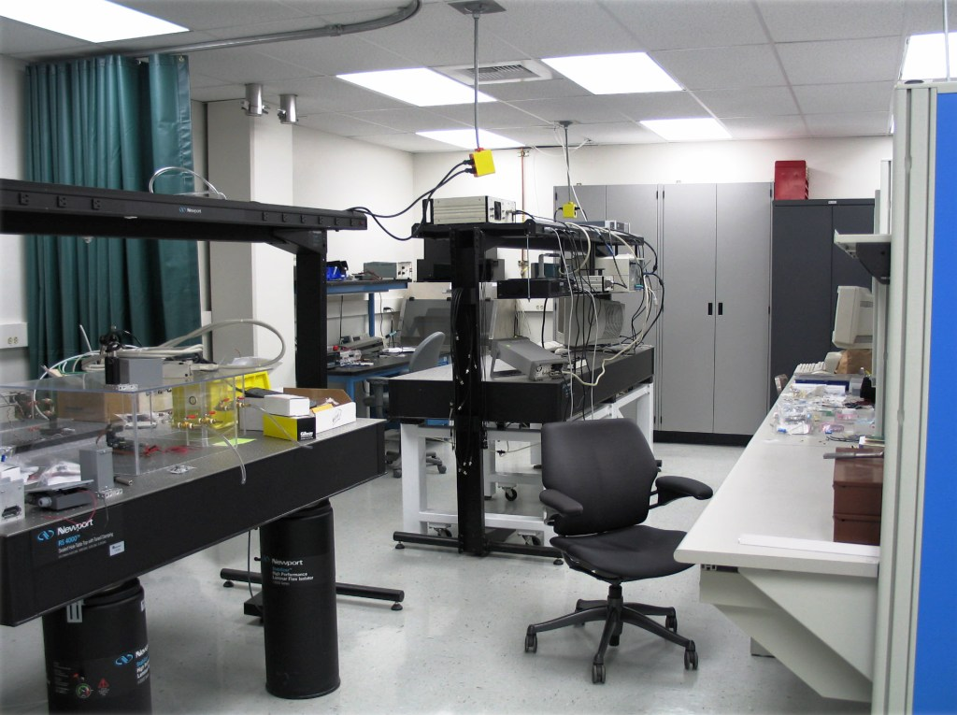
Toxicological Assessment of Polymeric Nanoparticles
In vitro Models
In vivo Models
Notes:
In vitro and in vivo models can be used for the toxicological assessment of polymeric nanoparticles.

Slide 9
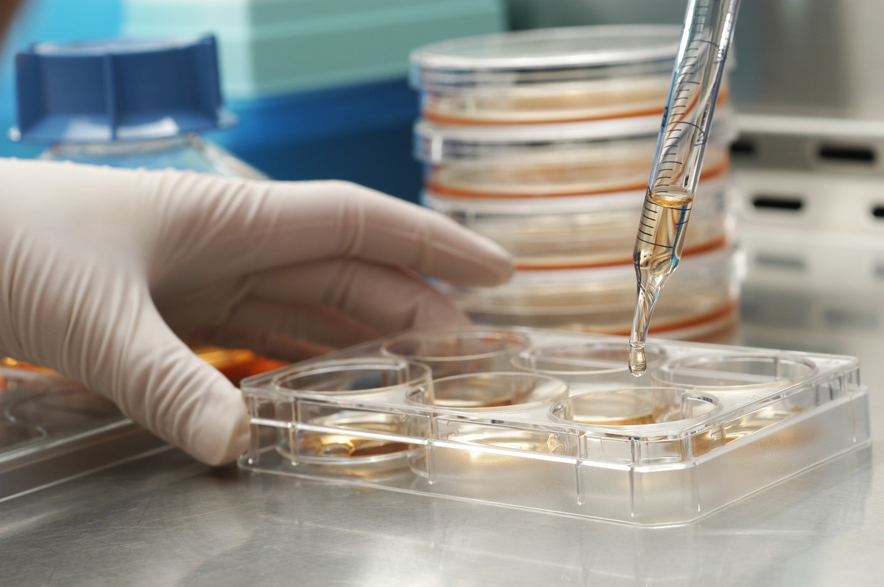
A. In Vitro Cytotoxicity Assays
Cell Cultures
Cell Viability Parameters
Morphology
Apoptosis
Lactate Dehydrogenase (LDH) Test
MTT Assay
Inflammatory Biomarkers
Notes:
Speaking of the in vitro Cytotoxicity Assays, Cell culture models are systems for screening of NPs’ toxicity.
As NPs could provoke effects such as mitochondrial damage and oxidative stress, different cell viability parameters can be screened using flow cytometric techniques
such as cell morphology & Apoptosis
Additionally, Lactate Dehydrogenase and MTT assays could be performed to assess the metabolic activity,
And the inflammatory biomarkers could be determined as well.

Slide 10
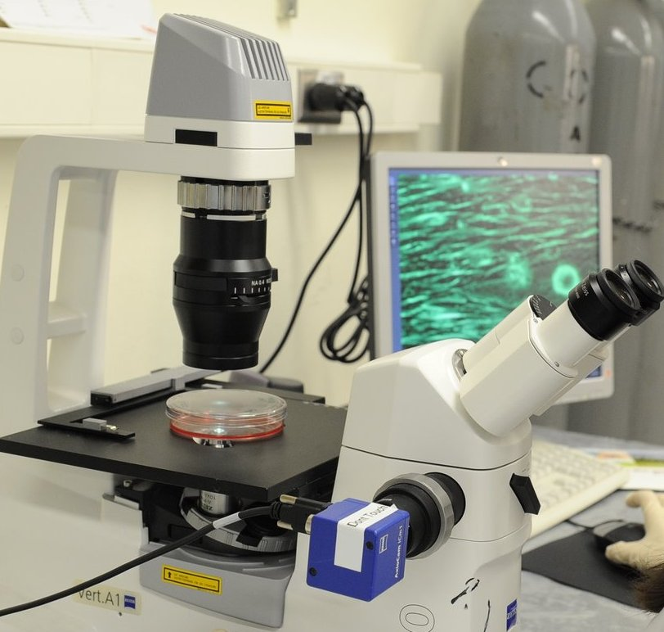
Cell Cultures
Advantages
Limitations
Fast
Devoid of any ethical issues
Easily automated
low cost compared to in vivo tests
Interfering factors! (Cell type & exposure protocols)
Stability of cell lines
Need in vivo validation (in vivo/in vitro correlation)
NO Toxicokinetics!
NO Chronic effects!
Notes:
Cell culture models offer some advantages
- as they are fast to conduct,
- Devoid of ethical issues,
- Easily automated,
- And less expensive than in vivo tests
However, some limitations are there such as
- The possible interference from the cell type & exposure protocols,
- Cell lines’ stability,
- The need for in vivo validation,
- The inability to study the toxicokinetics,
- Or the chronic effects of the NPs.

Slide 11
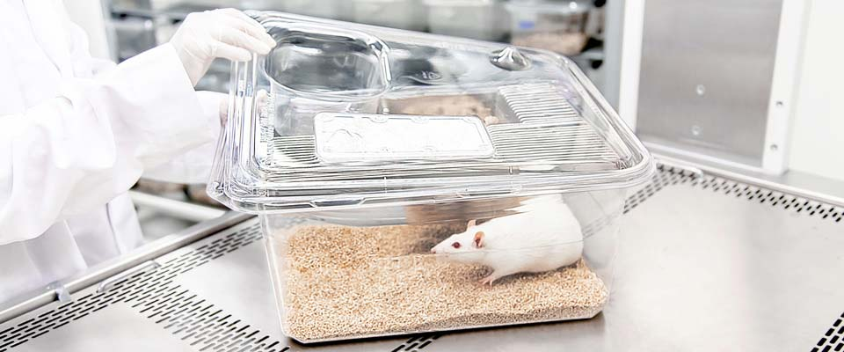
B. In Vivo Toxicological Methods
Animal Models: Mice & Rats
Monitoring the animals’ body weight
Food intake & morbidity signs
Mortality
Blood biomarkers
Brain toxicity:
Histopathological examination
LDH, MTT, & cytokines’ assays
Notes:
alternatively, some in vivo studies could be performed to assess the toxicity in the brain.
The animal models that are usually used are mice and rats.
Those assessments include: Monitoring the animals’ body weight,
food consumption, and morbidity signs,
Mortality
Monitoring biochemical blood profiles,
In addition to examining the localized brain toxicity via histological examination and performing assays such as LDH, MTT, & cytokines.

Slide 12
B. In Vivo Toxicological Methods
Advantages
Limitations
Localized organ toxicity
Toxicokinetics is possible!
Studying chronic effects is possible!
Time-consuming & Laborious
Expensive
Ethical issues!
Notes:
The in vivo models offer many advantages over the in vitro models Including:
The possibility of studying the localized toxicity in specific organs,
Conducting a toxicokinetic study,
And studying the chronic effects of the NPs too.
However, compared to the in vitro cell culture models, the in vivo models are
Time-consuming & Laborious,
Expensive,
And many Ethical issues are involved!

Slide 13
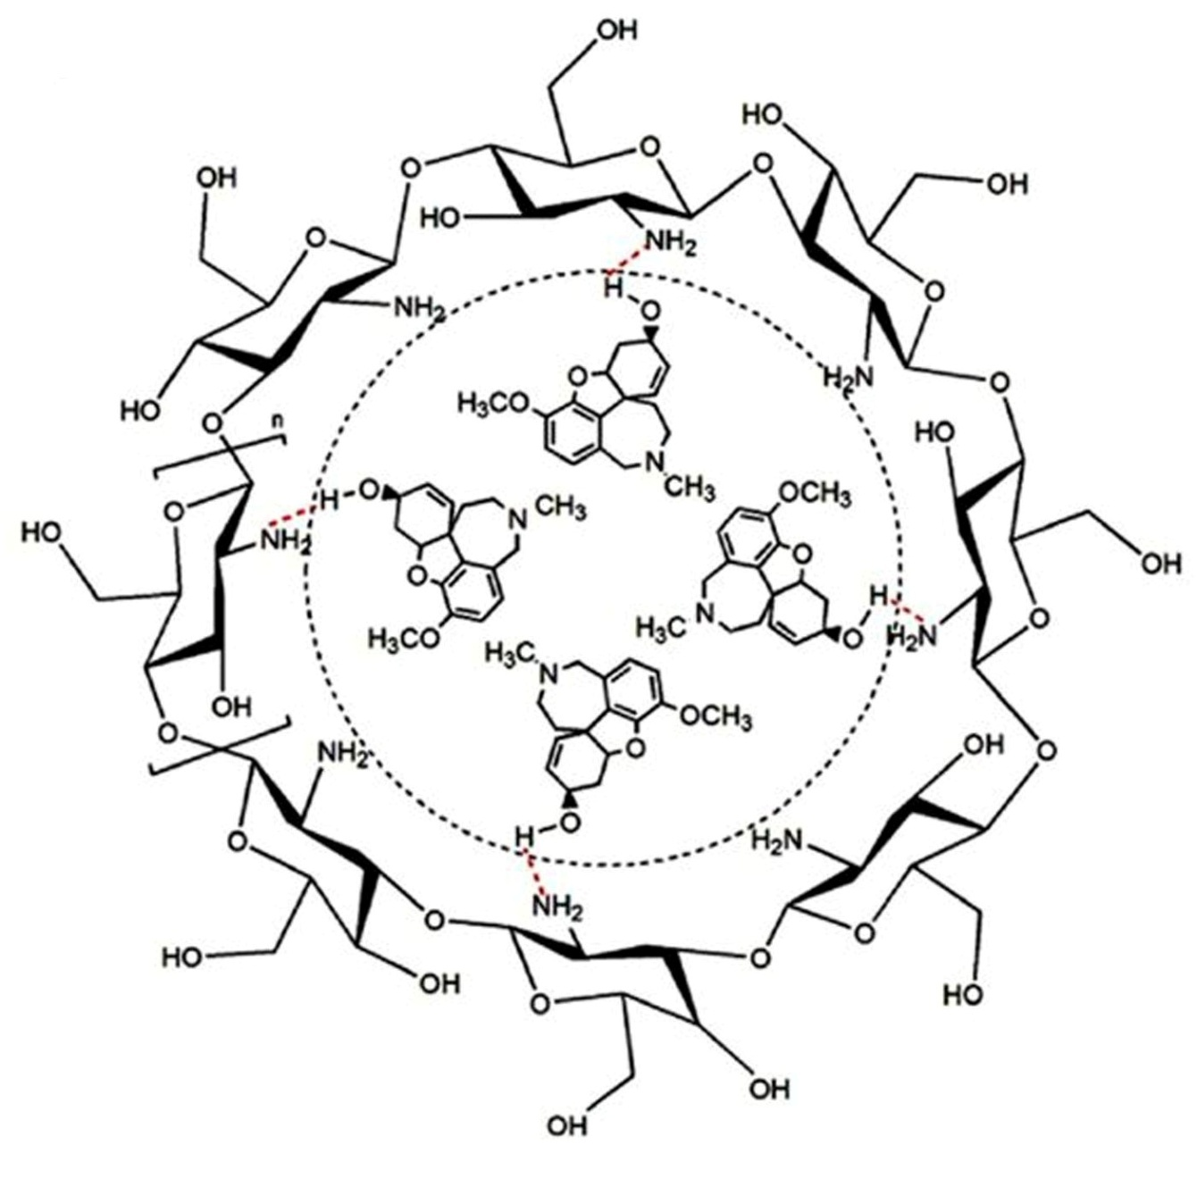

Gal/Chitosan Complex Nanoparticles
Chitosan
Gal
Chitosan Polymer
In vivo toxicity of chitosan polymers
In vivo toxicity of chitosan NPs for brain drug delivery
Notes:
Following that research perspective, during my PhD thesis, I prepared nasal Gal/chitosan complex nanoparticles for AD management
Although chitosan itself is a biocompatible polymer whose toxicity was assessed previously,
the literature lacks studies investigating the in vivo toxicity of chitosan NPs for brain drug delivery.
as I prepared a novel complex of Gal and chitosan, it was necessary to know if this complexation has altered the toxicological profile of the parent Gal.

Slide 14
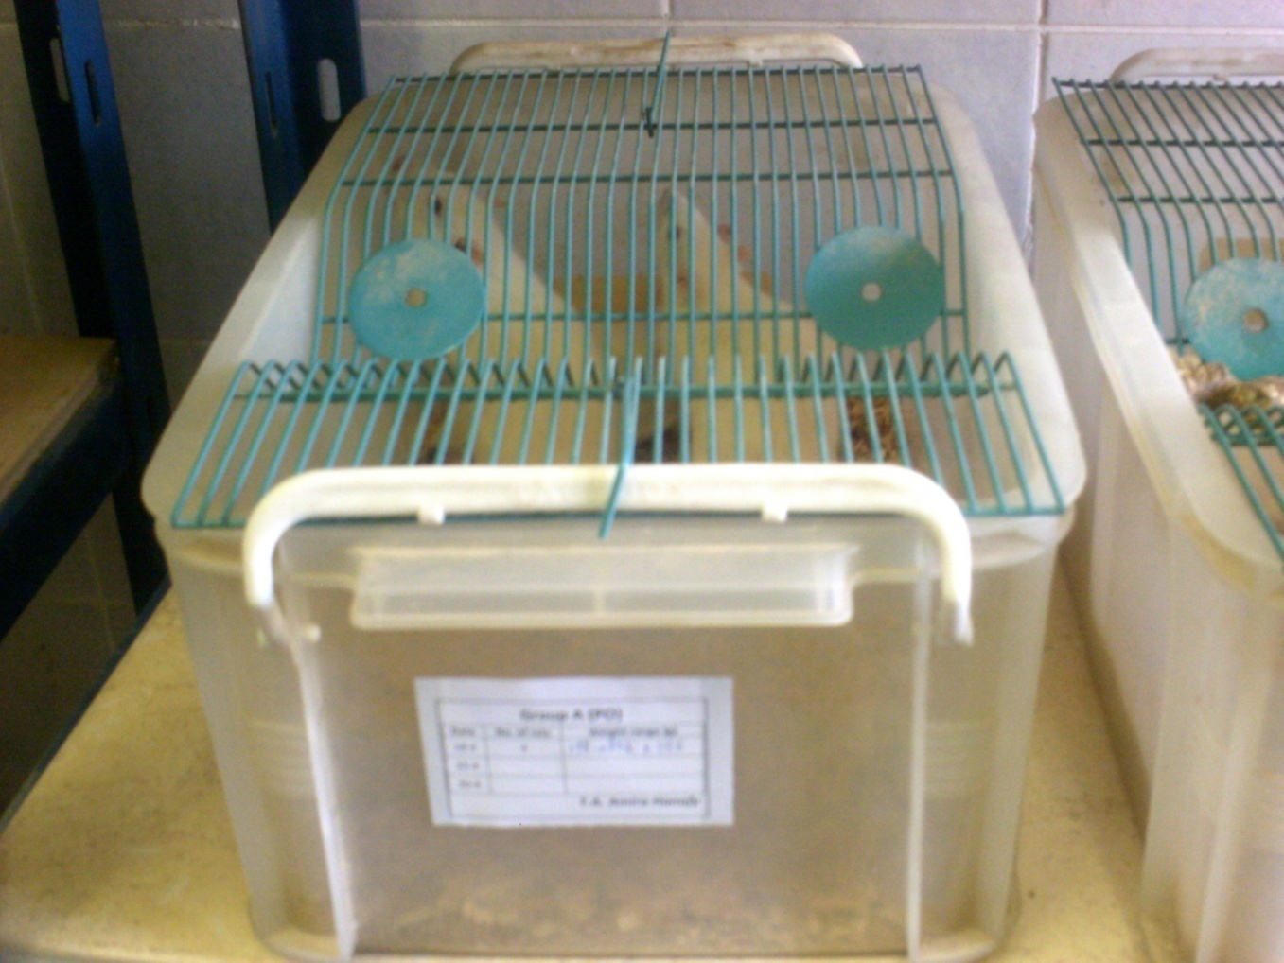
Study Design
Negative Control
Group
Oral Gal solution-treated group
Nasal Gal solution-treated group
Nasal Gal/chitosan complex NPs-treated group
Clinical signs
Blood biomarkers
Histopathological examinations
Toxicological aspects
Healthy male Wistar rats (4-5 months old, 180-220 g)
For 12 consecutive days
Notes:
Therefore, I conducted a toxicological assessment study on male Wistar rats for 12 consecutive days.
They were divided into 4 groups;
The negative control group,
The oral Gal solution group
The nasal Gal solution group
And the nasal NPs-treated group
I focused on monitoring the clinical signs and blood biomarkers, and conducted a brain histopathological examination as well.

Slide 15
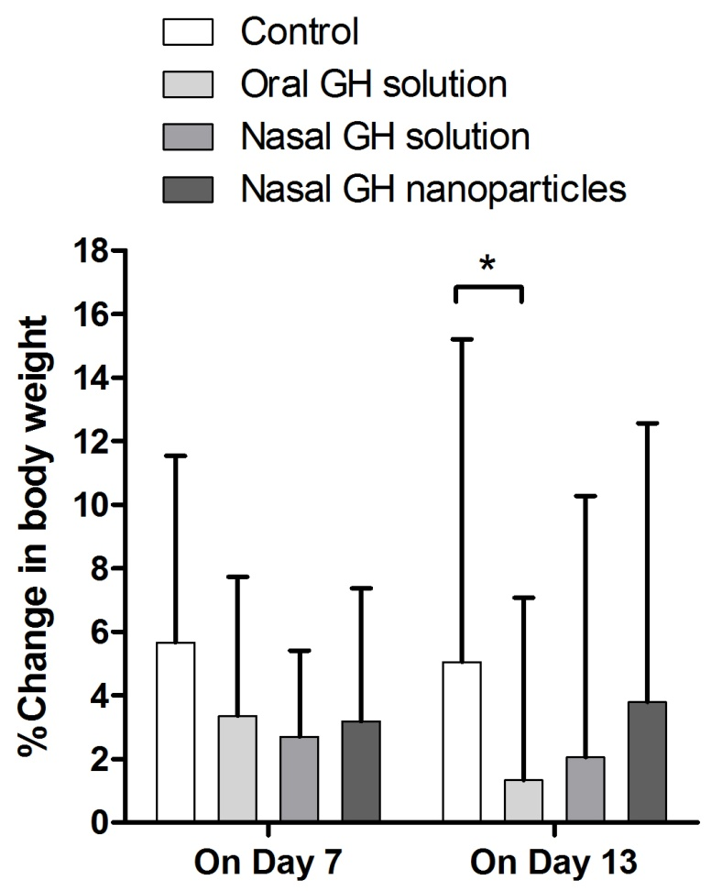
Toxicological Assessment of Nasal Gal/Chitosan Complex NPs
A. Body weight & food consumption
Control
Gal NPs
Oral Gal
Food Intake (Oral Gal-treated group)
On 1st day: 15±1.21 g/100 g body weight
On 13th day: 12±0.89 g/100 g body weight
Notes:
Monitoring the rats’ body weight revealed weight loss incidences in the oral Gal-treated group compared to the control group,
AND no significant changes were noticed in the NPs-treated group.
In addition, the Oral Gal-treated group exhibited a significantly decreased food intake, and incidences of diarrhea.

Slide 16
Toxicological Assessment of Nasal Gal/Chitosan Complex NPs
B. Monitoring Blood Biomarkers
Urea & Creatinine
Kidney functions
AST & ALT
Liver functions
Differential WBCs
Immunocompatibility
Notes:
In addition, various blood biomarkers were monitored such as,
Serum urea and creatinine as markers of kidney functions,
Aspartate and alanine transaminases as markers of liver functions,
And differential WBCs count to assess the immunocompatibility of the NPs.

Slide 17
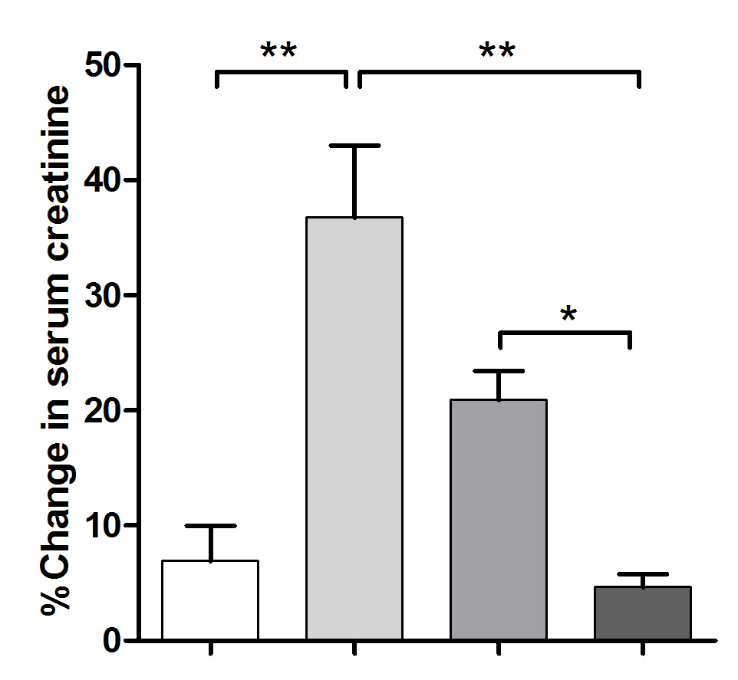
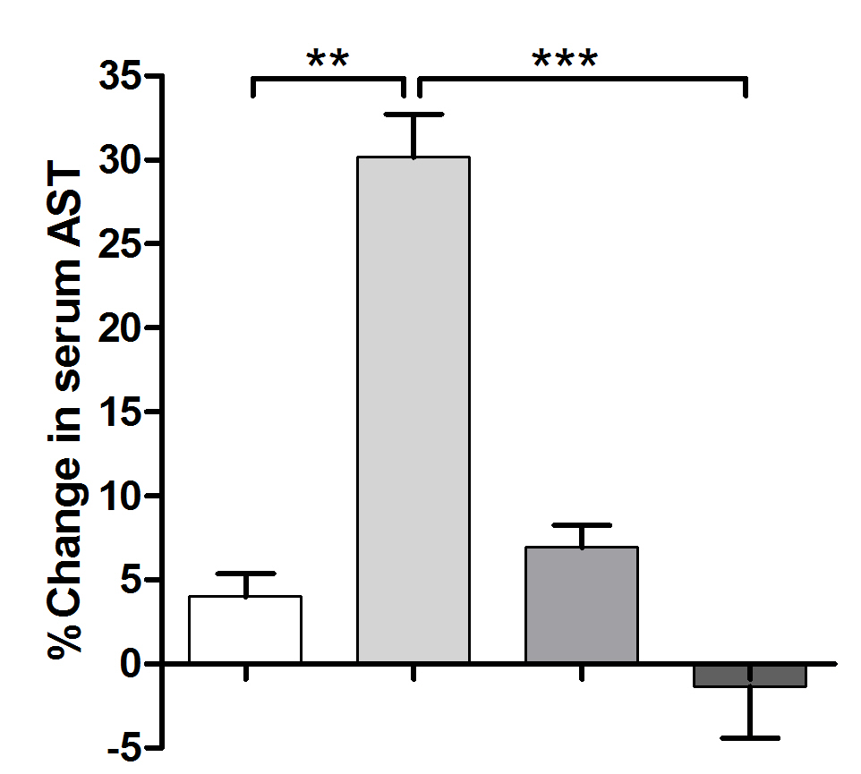
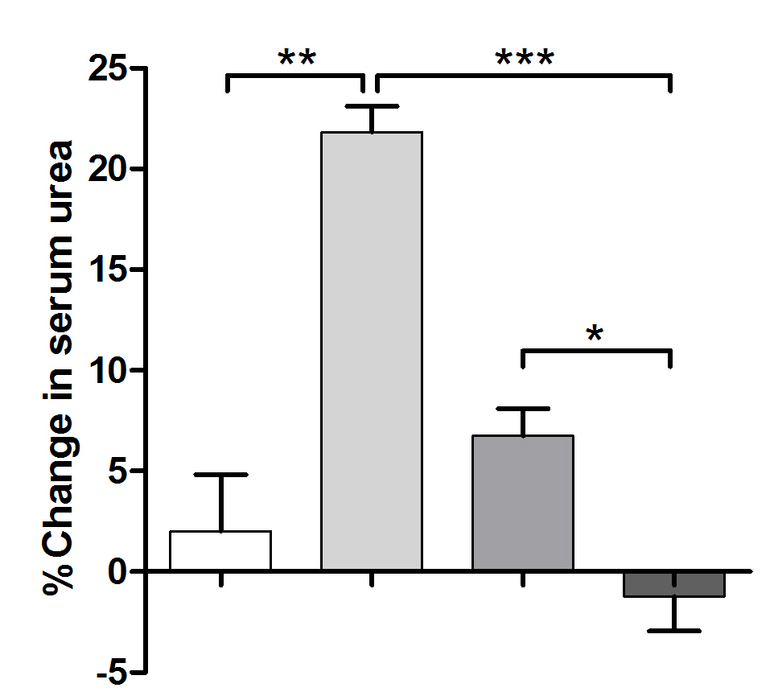
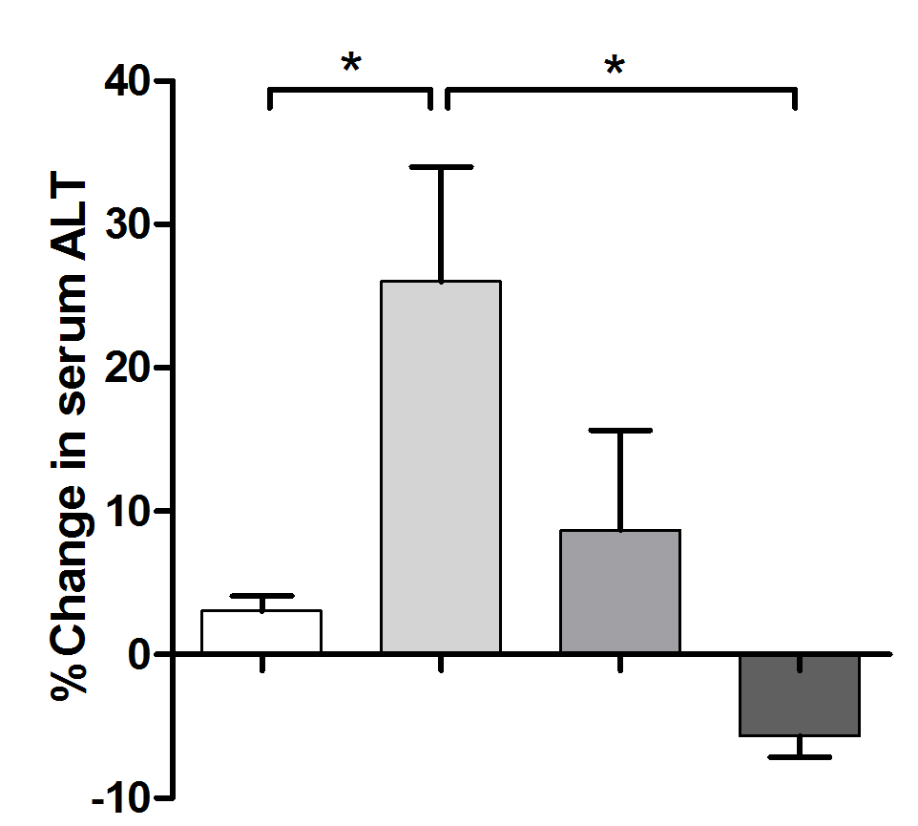
Toxicological Assessment of Nasal Gal/Chitosan Complex NPs
B. Monitoring Blood Biomarkers
Group | Total WBCs (×10³/µl) | Differential WBCs count (%of WBCs)
 |  | Neutrophils | Lymphocytes | Monocytes | Eosinophils | Basophils
Negative control | 23.7±0.7 | 14.8±0.1 | 75.6±0.3 | 6.9±0.02 | 1.5±0.01 | 0.05±0.001
Nasal Gal nanoparticles | 24.2±0.6 | 14.1±0.2 | 76.7±0.2 | 7±0.04 | 1.3±0.1 | 0.05±0.002
Control
Control
Control
NPs
Control
NPs
NPs
NPs
Notes:
In comparison with the control group,
Gal nanoparticles-treated group showed insignificant changes
in both urea and creatinine levels.
And regarding the liver enzymes, compared to the control group, Gal NPs showed insignificant changes from the baseline.
Also The WBCs results revealed that Gal NPs did not trigger immunological responses.

Slide 18
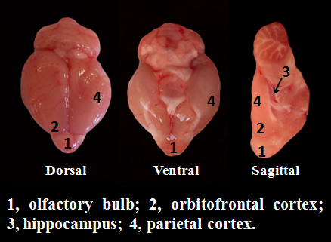
Toxicological Assessment of Nasal Gal/Chitosan Complex NPs
C. Histological Examinations
4. Parietal Cortex
1. Olfactory Bulb
2. Orbitofrontal Cortex
3. Hippocampus
Notes:
And To reveal any histopathological manifestations caused by administering Gal NPs nasally,
Sections from the olfactory bulb,
orbitofrontal cortex,
hippocampus,
and parietal cortex were examined and compared to the corresponding regions of the control brains.

Slide 19
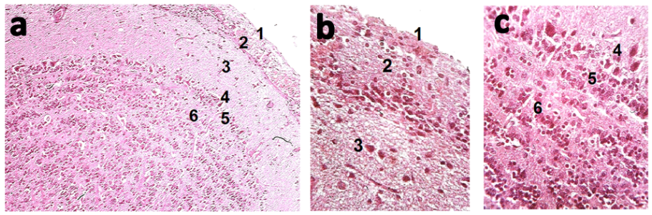
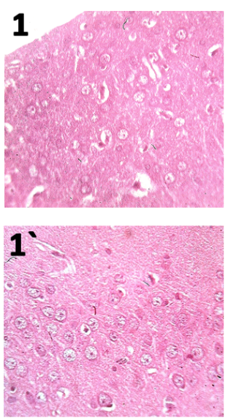
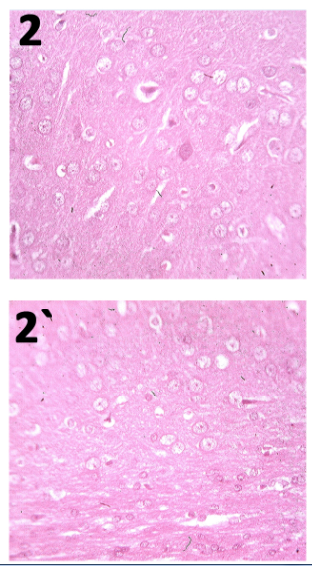
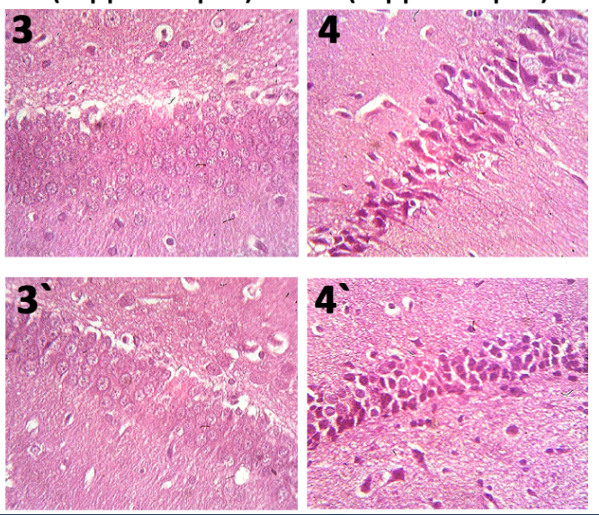
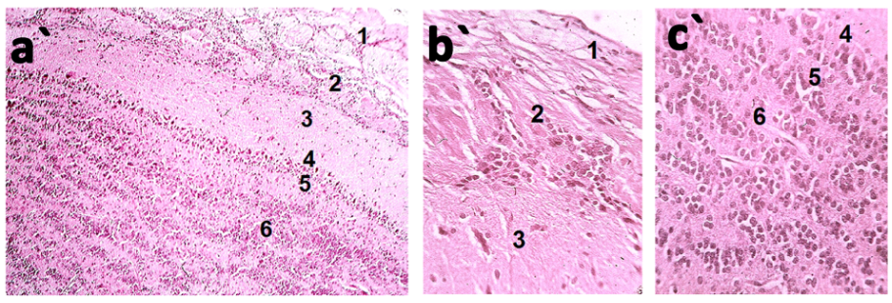
C. Histological Examinations
Olfactory bulb
OF cortex
Hippocampus
Parietal cortex
Negative control group
Nasal Gal NPs group
Pyramidal cells
Granular cells
Notes:
Upon comparing the H&E-stained brain sections,
there wasn’t any histopathological manifestations in the olfactory bulb,
Orbitofrontal cortex,
Parietal cortex,
And hippocampus sections.

Slide 20
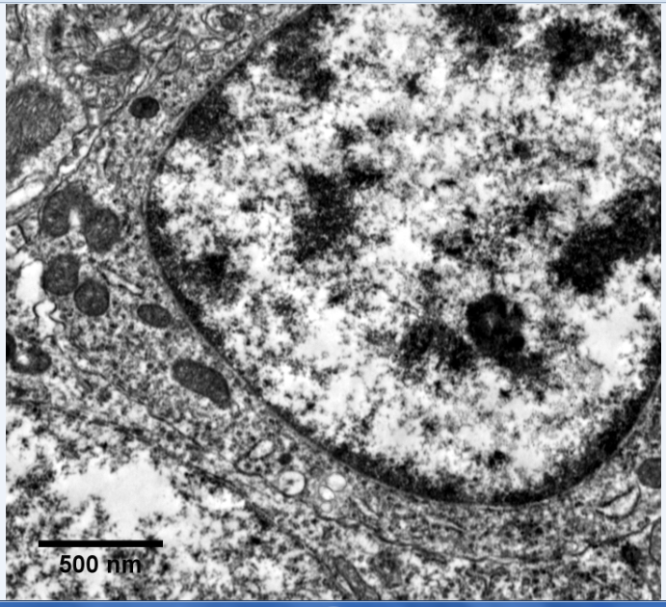
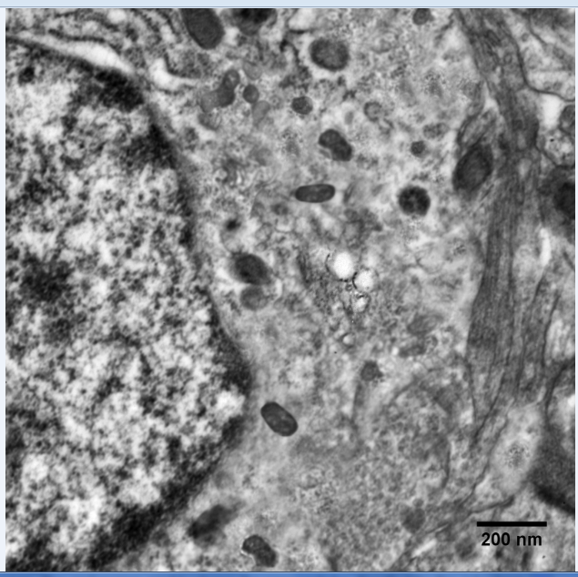
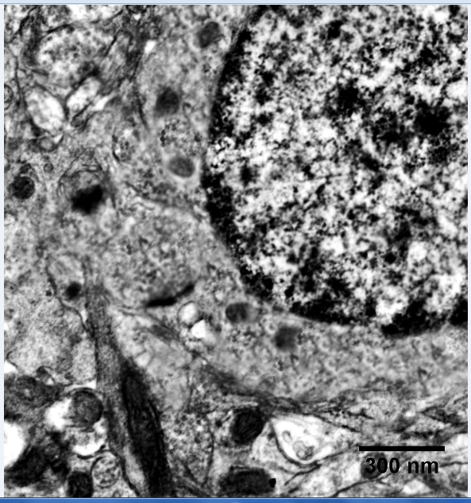
Orbitofrontal Cortex Neuronal Cells
(Nasal Gal NPs Group)
Notes:
Even upon examining the orbitofrontal cortex sections of the Gal NPs-treated group using transmission electron microscopy, no ultrastructural abnormalities were noticed.
And the NPs appeared as spherical structures within intracellular vesicles, possibly lysosomes, or free in the cytosol. It was obvious that chitosan NPs managed to be endocytosed without affecting the cell viability.

Slide 21
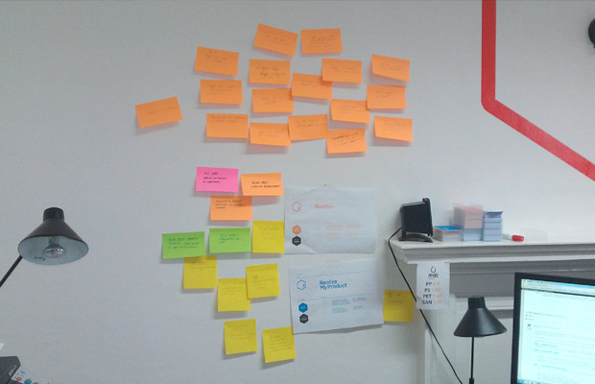
Take-Home Message
Optimizing the formulation
The pharmacological efficacy
Nanotoxicological aspects!
Notes:
So, what’s the take-home message?
Pharmaceutical researchers should not be focusing just on optimizing the formulation and its pharmacological efficacy,
And forget about the nanotoxicological aspects, that could be the real reason for failing the clinical trials.

Slide 22

Amira S. Hanafy, Ph.D.
amira.sayed@pua.edu.eg
+201 223 283 619
Faculty of Pharmacy & Drug Manufacturing, Pharos University
Alexandria, Egypt
Notes:
At last, please do not hesitate if you’d like to discuss any aspect with me.
If I haven’t answered any question that could have been raised, here’s my email address and phone number, and I’d like to go further and discuss it later with you.

