Slide 1
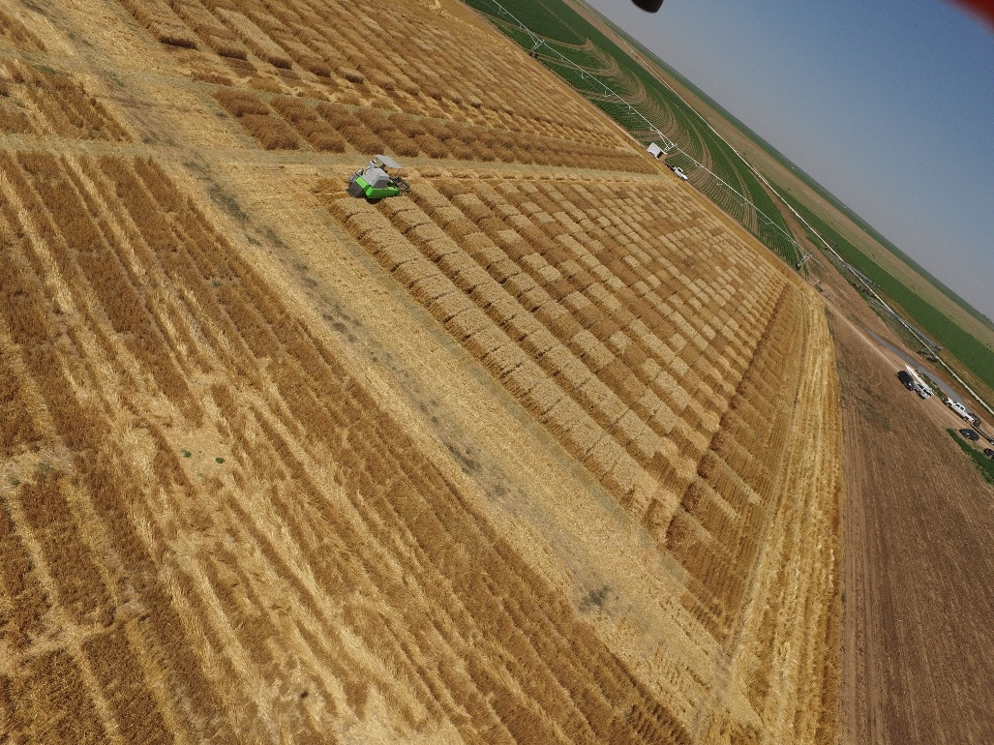
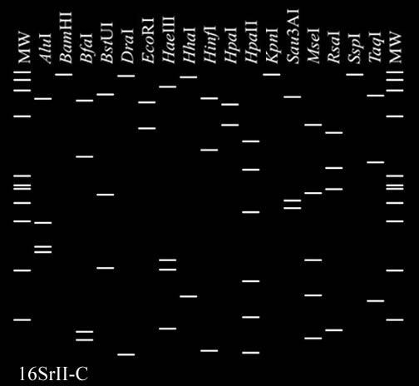
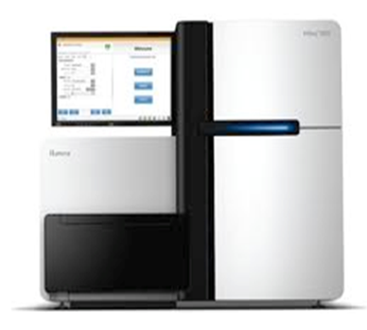
Current Trends in Genomics and Phenomics in Wheat Breeding
Amir Ibrahim, Jackie Rudd, Shuyu Liu, Qingwu Xue, Dirk Hays, Jinha Jung, Murilo Maeda, Juan Landivar, Clark Neely, Xuejun Dong, Charlie Johnson, Mike Thomson, Nithya Rajan, Alex Thomson, Brent Auvermann, and Joseph Awika
Improving lives through science and technology

Slide 2

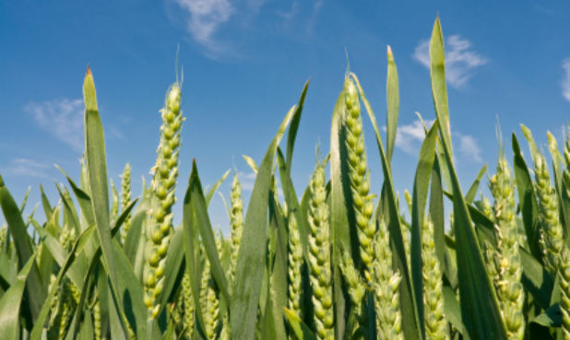
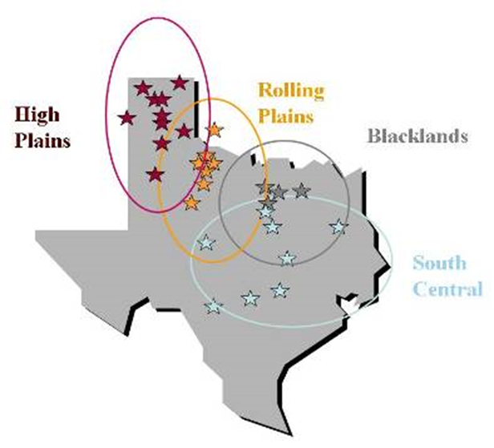

Essential components for wheat breeding
Multi-environment testing
  Diverse environments (20+)
  Multiple stresses
Germplasm
  Diverse germplasm: Synthetics/Parent building/Hybrid wheat
  Doubled-haploid production
  Genome selection
  Novel traits/Gene editing
High throughput genotyping/Phenotyping
  Genes/QTL mapping
  Marker assisted breeding/BC
  High throughput phenotyping (UAS & ground-based)
End-use quality evaluation

Slide 3
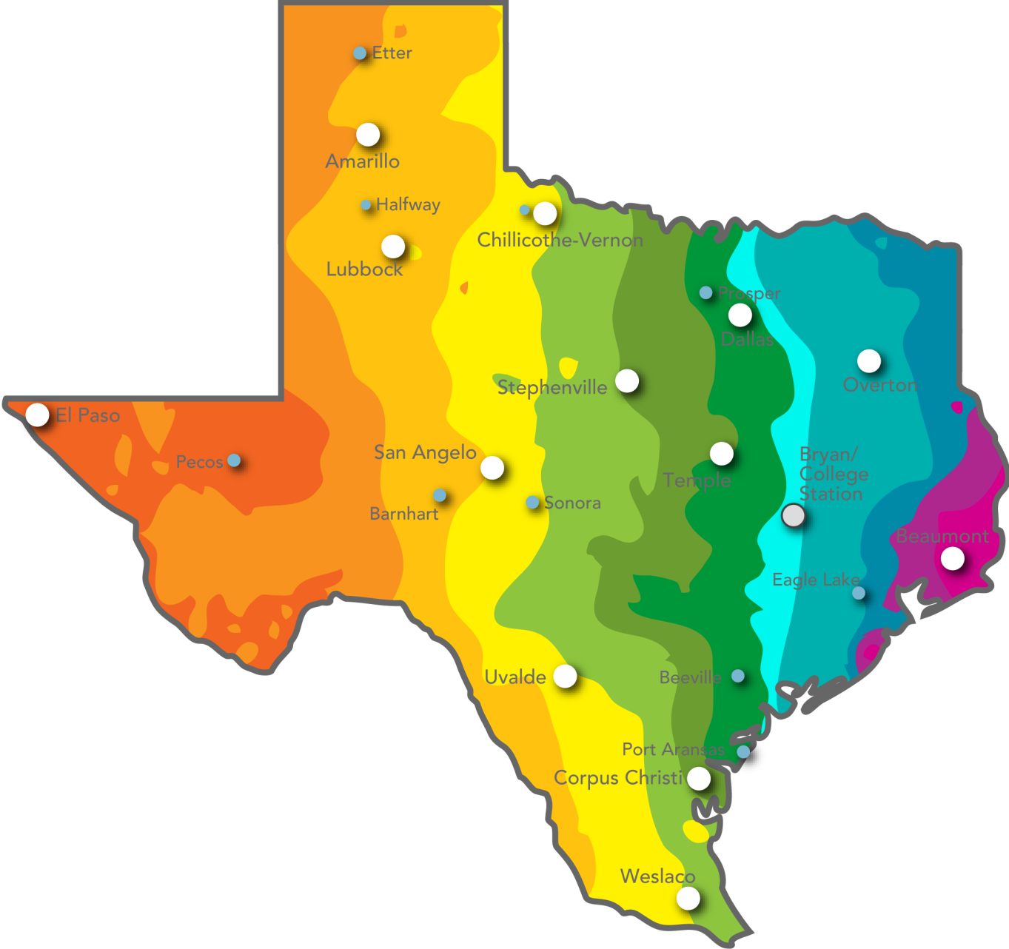
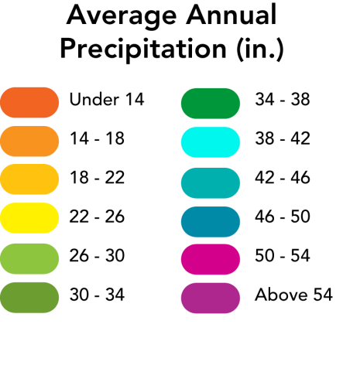

Precipitation Diversity
We can replicate production conditions for most parts of the world

Slide 4
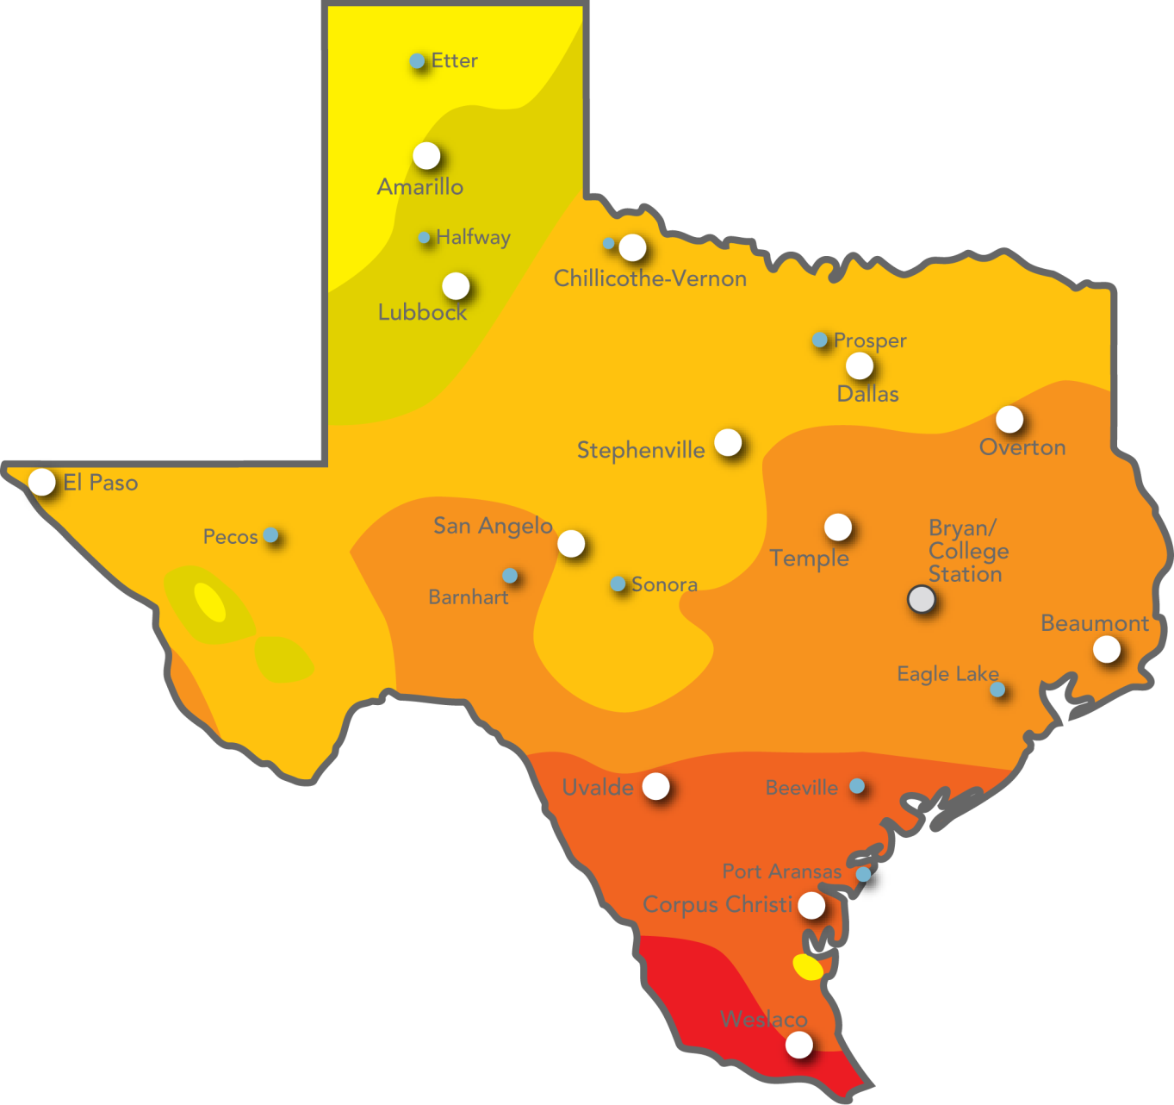
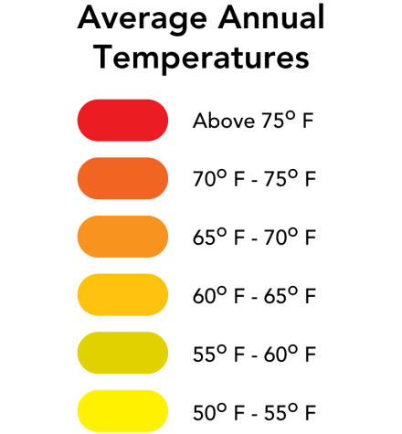
Temperature Diversity
We can replicate production conditions for most parts of the world

Slide 5
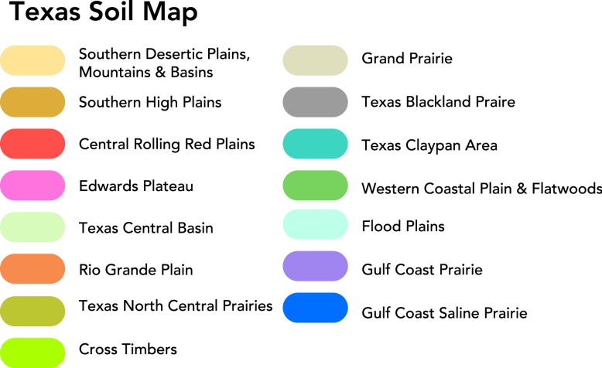
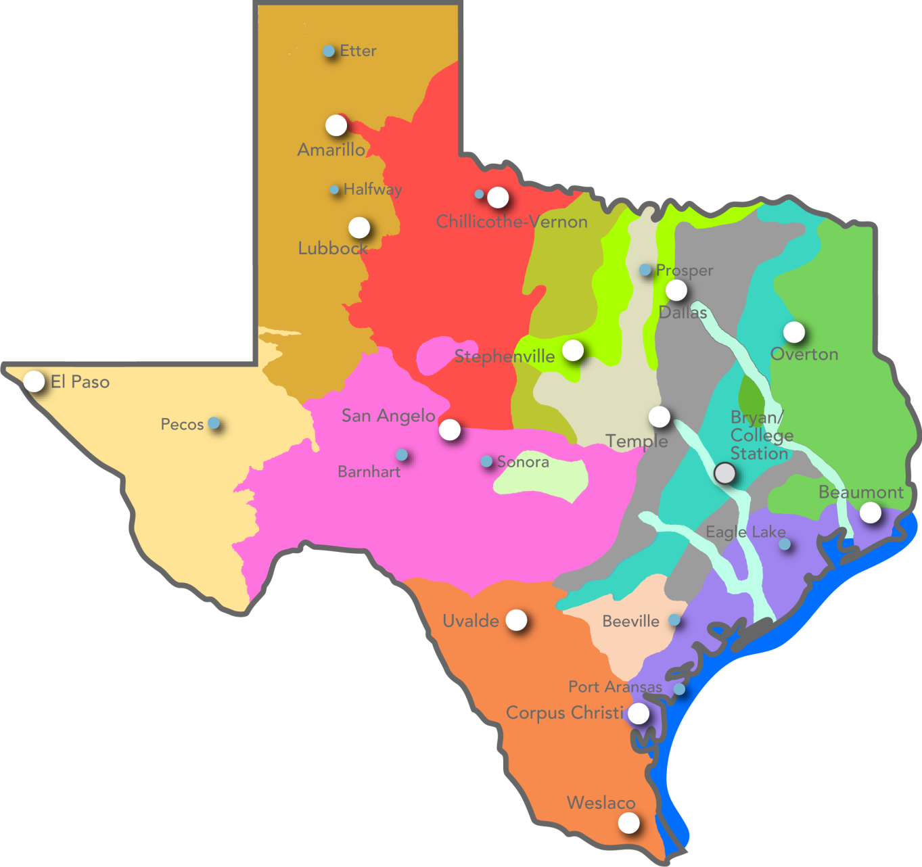
Soil Diversity
We can replicate production conditions for most parts of the world

Slide 6

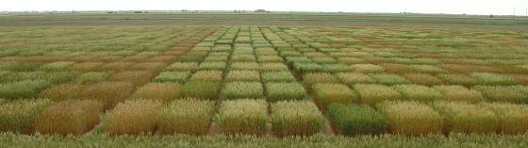
High Plains
  Drought tolerance
  Water-use efficiency
  WSMV resistance
  Russian wheat aphid
Rolling Plains
  Drought / high temp
  Hessian fly
Blackland
  Septoria diseases
  Powdery mildew
  Hessian fly
STATE WIDE
  Grain yield
  End-use quality
  Forage production
  Rust resistance
  Greenbug resistance
Central / South Texas
  High temp tolerance
  Low/intermediate vernalization
  Hessian fly
Notes:
In addition to different quality targets, we have diverse environments in Texas. Ovals indicate different environmental regions. Stars indicate the location of field testing trials. Each region has a unique set of breeding targets. There is a breeding team in Amarillo and Vernon to breed for the High Plains and Rolling Plains. There is another breeding team based in College Station that breeds for the Blackland and Central/South Texas.

Slide 7
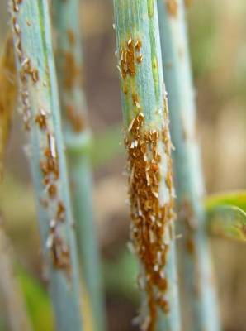
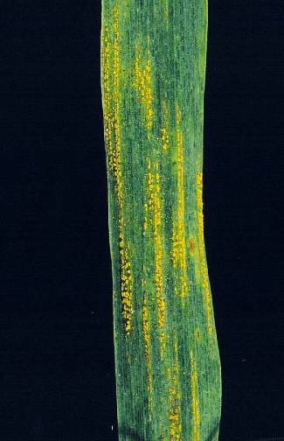
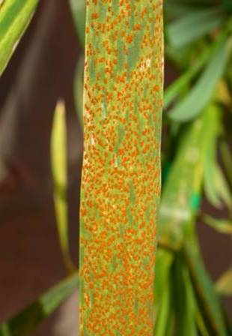
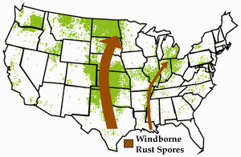
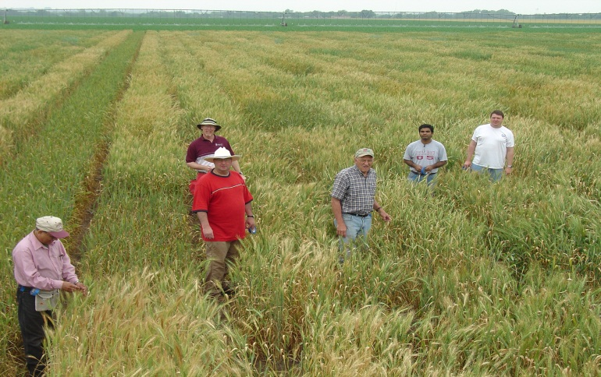
Diseases
Leaf, stripe, and stem rusts
Septoria
Tan spot
PMD
BYDV
WSMV
Karnal bunt
Leaf rust
stem rust
stripe rust
Castroville Rust Observation Nursery

Slide 8
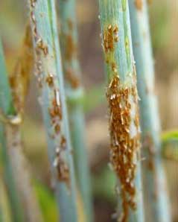
Ug99
Major gene resistance easily defeated (Sr24, Sr31, and Sr36)
US programs will release newer novel genes introgressed into adapted backgrounds
Combine Sr2, Sr22, Sr24, Sr25, Sr32, Sr35, Sr39, Sr40, 1RS.1AL, etc, with minor gene resistance (‘King Bird’)
Ug99 is wrecking havoc
In E. Africa. Are we ready
in the US?

Slide 9
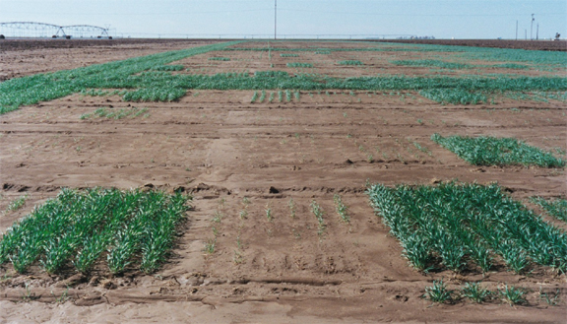
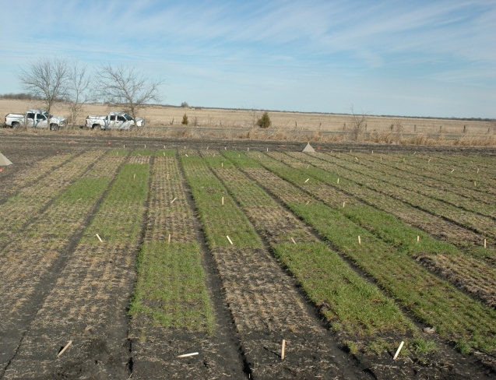
Arthropod pests
Greenbug
Wheat curl mite
Hessian fly
TAM 112(Gb3)
TAMsoft 700 H13
TAM 110 (Gb3)
Greenbug damage in Texas High Plains
Hessian fly damage in northeast Texas

Slide 10
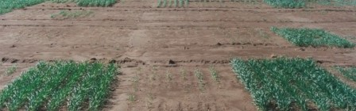
Greenbug resistance
A severe outbreak of greenbug in 2002 devastated this breeding nursery in the Texas Panhandle and only resistant wheat survived.
Chromosome 7DL
Gb3, the greenbug resistance gene in TAM 112 has been mapped and diagnostic markers have been designed.
WG380
0.6 cM
AFLP-STS11
1.0 cM
Gb3
1.0 cM
6.7 cM
EST#39
BAC-#3
Ksud2
8.3 cM
BF202806
0.5 cM
WMC824

Slide 11
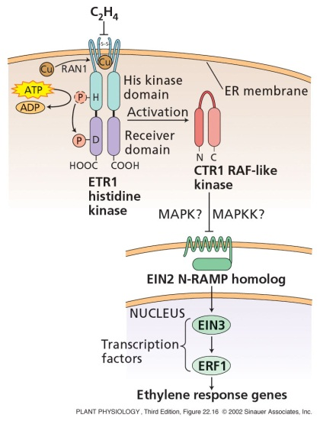
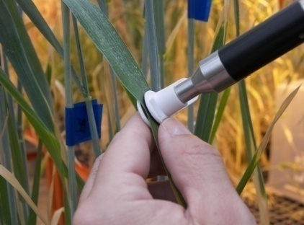
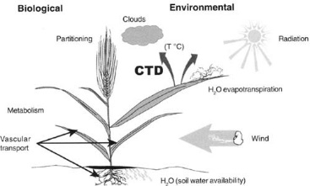
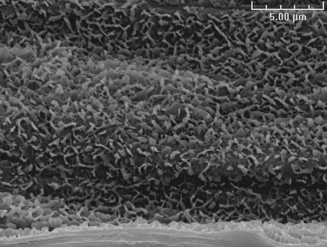
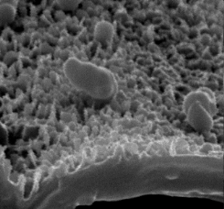
Heat and Drought Stresses
Reynolds et al., 2001
Halberd

Slide 12
Flow diagram of TAM Wheat Breeding
Year | Where / trial name | Generation | Entries | Reps | Locations
Year 1 | Greenhouse Crossing Block |  | 2000
Year 2 | Greenhouse rows | F₁ | 2000
Year 3 | Field plots | F₂ | 2000
Year 4 | Field plots | F₃ | 1600 | 1 | 2
Year 5 | Field plots | F₄ | 1200 | 1 | 2
Year 6 | Head-rows | F_{4:5} | 90,000 | 1 | 2
Year 7 | Preliminary yield trials | F_{4:6} | 3000 | 1 | 2
Year 8 | Year 1: Advanced yield trials | Advanced | 700 | 2 | 5
Year 9 | Year 2: Advanced yield trials | Advanced | 200 | 2 | 7
Year 10 | TXE |  | 15 | 3 | 18
Year 11 | SRPN, TXE, and increase |  | 6 | 3 | 42
Year 12 | SRPN, TXE, UVT, increase, and WQC |  | 2 | 3 | 65
Year 13 | Release |  | 1

Slide 13
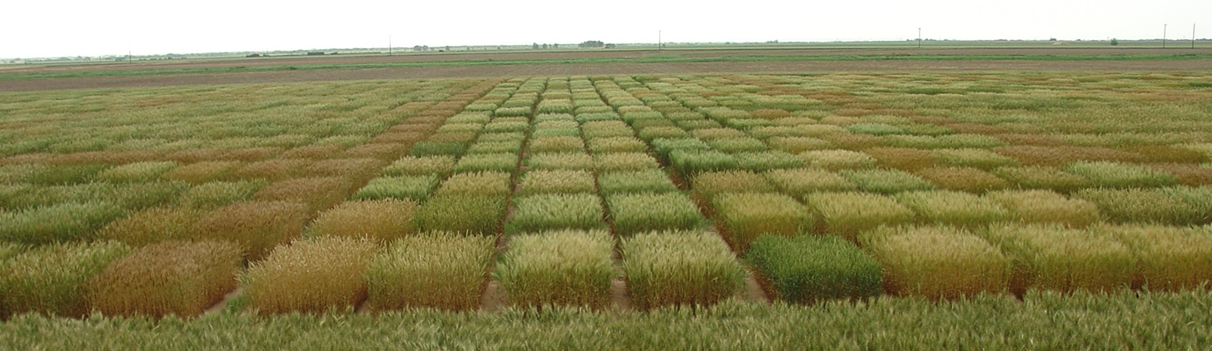
Wheat Variety Survey 2014
Texas | Kansas | Colorado | Nebraska*
TAM 111 – 16.7% | Everest – 14.3% | Hatcher – 25.2% | Settler CL – 9.5%
TAM 112 – 5.3% | TAM 111 – 11.6% | Byrd – 14.8% | TAM 111 – 6.0%
Duster – 4.0% | T158 – 5.0% | TAM 111 – 5.4% | SY Wolf – 5.6%
Fannin – 3.2% | TAM 112 – 4.6% | Snowmass – 5.1% | Brawl CL Plus – 5.3%
WM 135 – 3.0% | Armour – 4.2% | Ripper – 4.4% | Overland – 4.2%
* Nebraska variety survey is based on 2015 planting

Slide 14
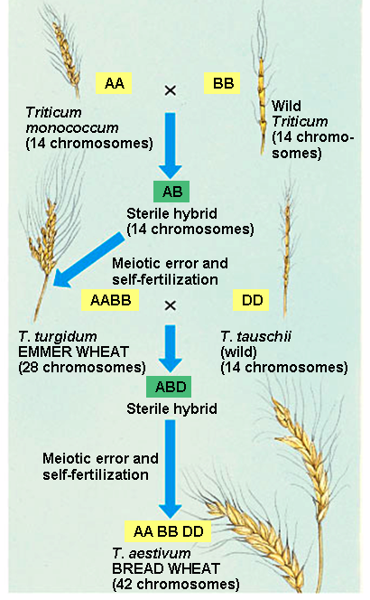
Synthetic wheat
Synthetics contribute to higher yields through increasing seed size and weight
Yield of improved synthetics mostly influenced by head number and seed per head
Improving yield could result from selections of seed per head or head number in improved synthetic lines

Slide 15
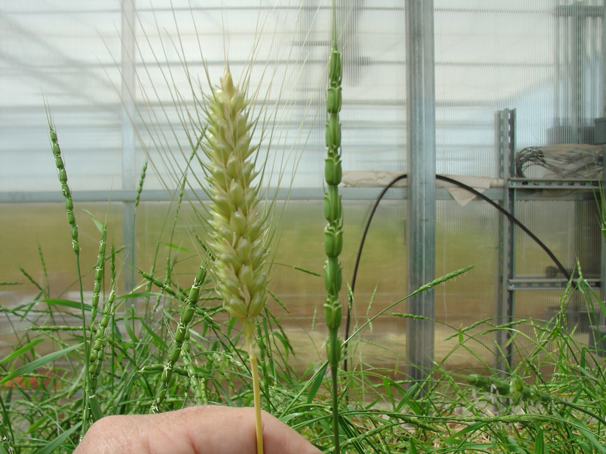
Contributions of synthetics to wheat improvement
Increased the genetic diversity of wheat
Increased yield under drought and optimum conditions
Contributed to insects, nematodes and fungal disease resistance
  Leaf, stem and yellow rusts
  Nematodes
  Septoria leaf blotch
  Greenbug
Salinity tolerance

Slide 16
Synthetic wheat
All synthetics combined well for SEED WEIGHT
Synthetic that combined well for HEAD NUMBER
(S3,S5,S8,S9)
RP that combined well for SEED PER HEAD
(TAM111)
Highest Yielding progeny
X

Slide 17
Synthetic wheat
Seed yield is positively correlated (P < 0.01) with head number, seeds per head, and single kernel weight
Preliminary studies show that there is wide range of diversity in the association mapping panel for abiotic and biotic stress tolerance
Work in progress:
  Identify SNP markers associated with drought tolerance
  Determine genetic gain achievable for yield via indirect selection for tiller number and seeds per head
  Identify new genotypes with higher yield and better tolerance to abiotic and biotic stresses

Slide 18
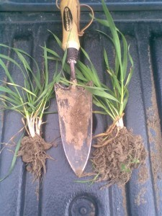
Hybrid wheat:
Reasons for renewed interest
Availability of new next generation sequencing technology
Performance potential
  Higher biomass and yield
  Drought tolerance
  Consistent performance
  Good and consistent quality
  Good disease resistance and agronomic adaptation
  Vigorous root system
  Increase production in marginal lands and low fertility levels
Higher prices of wheat
Source: http://www.cropco.co.uk/cropco-services/hybrid-wheat/
Notes:
Though hybrid wheat breeding has at one time been an area of interest in the industry and public sector, the prices of wheat were never at a feasible price for production of lines that would have returns to cover the cost of creating the hybrids in the first place. However, with new sequencing and genotyping technology, the molecular step has become more efficient, and in turn, cheaper. This, coupled with the rising prices of wheat, has renewed the spark of interest within both private and public entities.

Slide 19
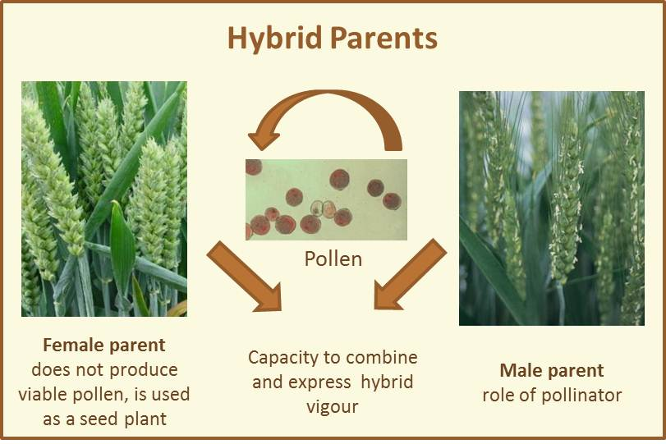
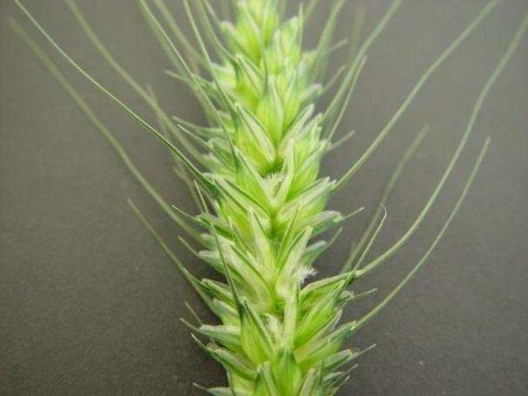
Hybrid wheat - Challenges
Poor pollen dispersal and viability
Floral morphology
Large cost of seed increase
Long time to incorporate CMS genes
Source: http://www.hybridwheat.net/Presentation-616.aspx
Gapping CMS female wheat plant with the lemma and palea separated and stigma exposed to receive pollen
Notes:
Despite all of this, hybrid wheat does contain a rather daunting problem; wheat is a morphological self-pollinating crop that rarely cross-pollinates in natural populations. Wheat therefore has a very weak cross-pollinating mechanism. The pollen dispersal is usually poor and pollen is only viable for hours to a few days. Wheat is pollinated by wind flow alone; it’s not insect pollinated. Even if there is dispersal and pollen movement by wind, a combination of this and a receptive female with gaping glumes that increase pollen receptivity (pictured here on the bottom left) is desirable because it increases the chance of fertilization when attempting a hybrid cross.
For efficient seed increase in such crosses, cytoplasmic male sterile genes are the current best way in order to achieve this. However, there is still a time commitment when transferring CMS genes into the desired lines chosen for hybrid production.

Slide 20
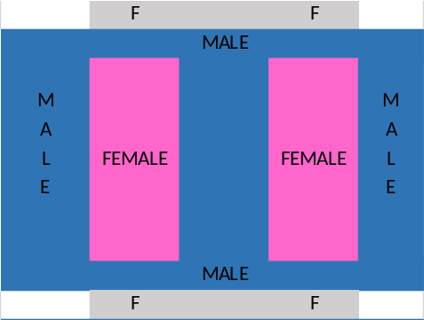
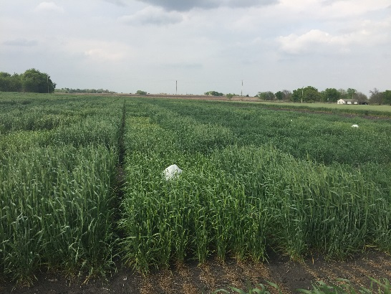
Crossing Block
Elite lines screened for floral traits and yield
Three crossing blocks; one each in Lincoln, Bushland and Prosper
Number of female plots surrounded by single male parent
Female plots sprayed with CHA (CROISOR®) from Saaten-Union
Few female plants covered with bags to check sterility
Female plots harvested upon maturity

Slide 21
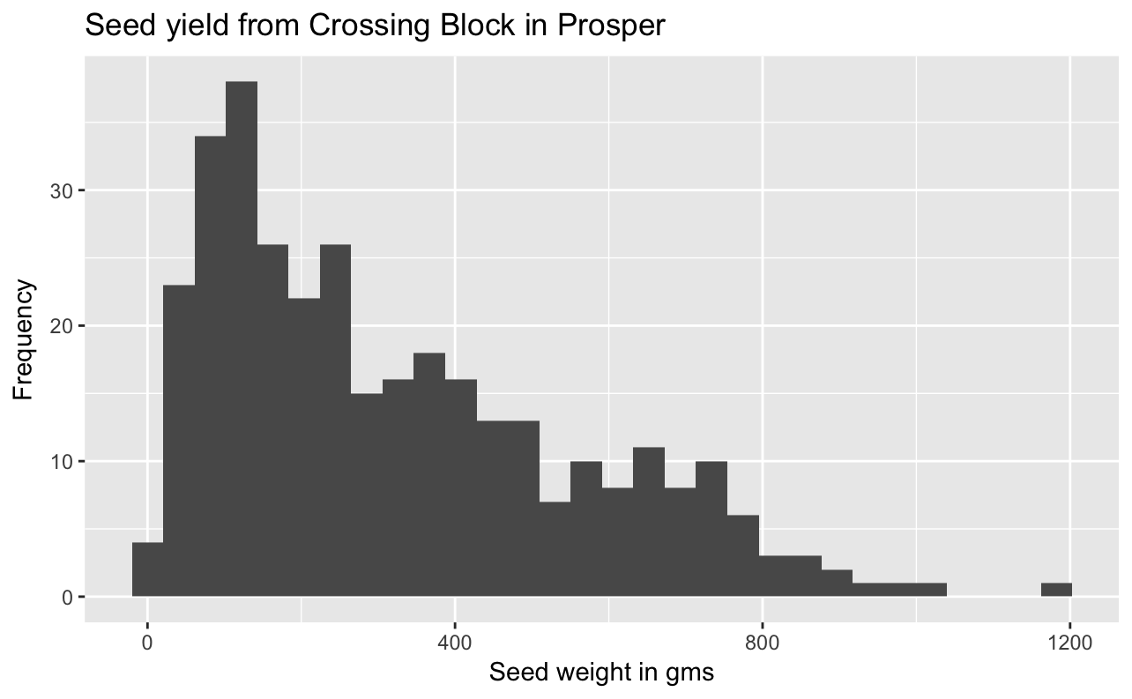
Seed yield from 2017 crossing blocks

Slide 22
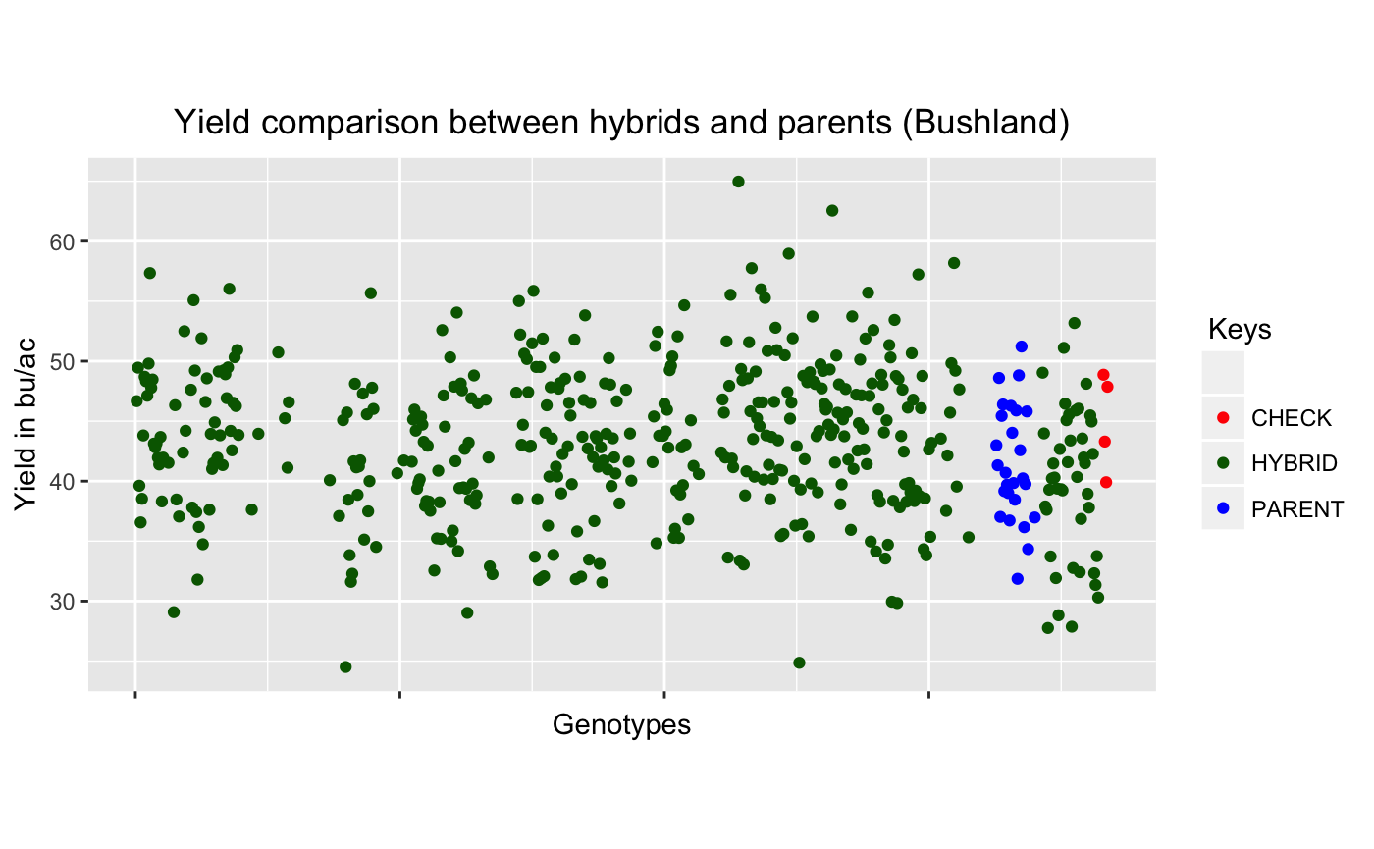
Hybrid F1 performance in Bushland, TX - 2017
79 lines performed better than the best check “RUTH”
105 lines performed better than 2nd best check ”TAM111”
40 lines performed better than the best parent

Slide 23
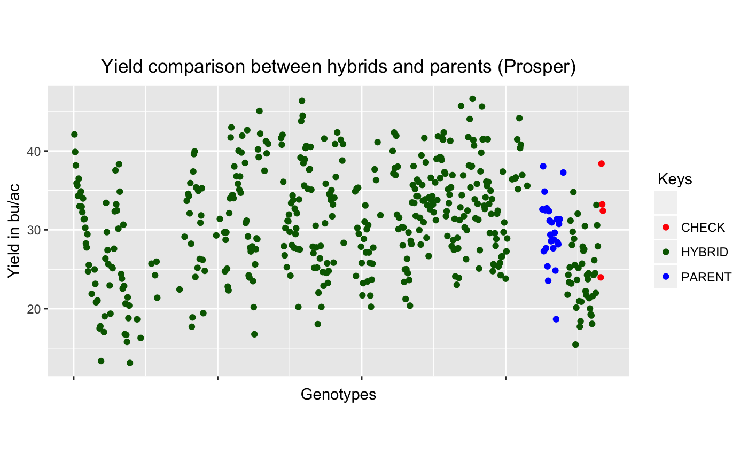
Hybrid F1 performance in Prosper, TX - 2017
67 lines performed better than the best check “Freeman”
198 lines performed better than 3rd best check “TAM111”
72 lines performed better than the best parent

Slide 24
Wheat heterosis in Texas - 2017
Description |  | Bushland |  |  | Prosper
 | Heterotic lines | Highest (%) | Mean (%) | Heterotic lines | Highest (%) | Mean (%)
Mid-parent Heterosis | 277 | 57.0 | 14.5 | 266 | 118 | 22.6
High-parent Heterosis | 208 | 52.5 | 11.2 | 212 | 103 | 19.6
Commercial Heterosis vs “Freeman” | 236 | 50.2 | 11.2 | 67 | 21.4 | 7.6
Commercial Heterosis vs “TAM111” | 109 | 35.7 | 6.8 | 198 | 43.8 | 14.9
Commercial Heterosis vs “Ruth” | 78 | 32.9 | 6.9 | 400 | 95 | 36.5
Commercial Heterosis vs “Wesley” | 331 | 62.8 | 15.9 | 181 | 43.2 | 13.4
Best check in Greenville: Freeman (38.4 bu/ac), TAM 111 3rd place (32.8 bu/ac)
Best check in Bushland: Ruth (48.9 bu/ac), TAM 111 2nd place (47.9 bu/ac)

Slide 25
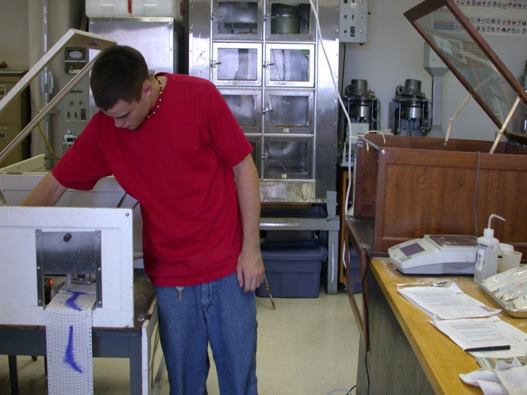
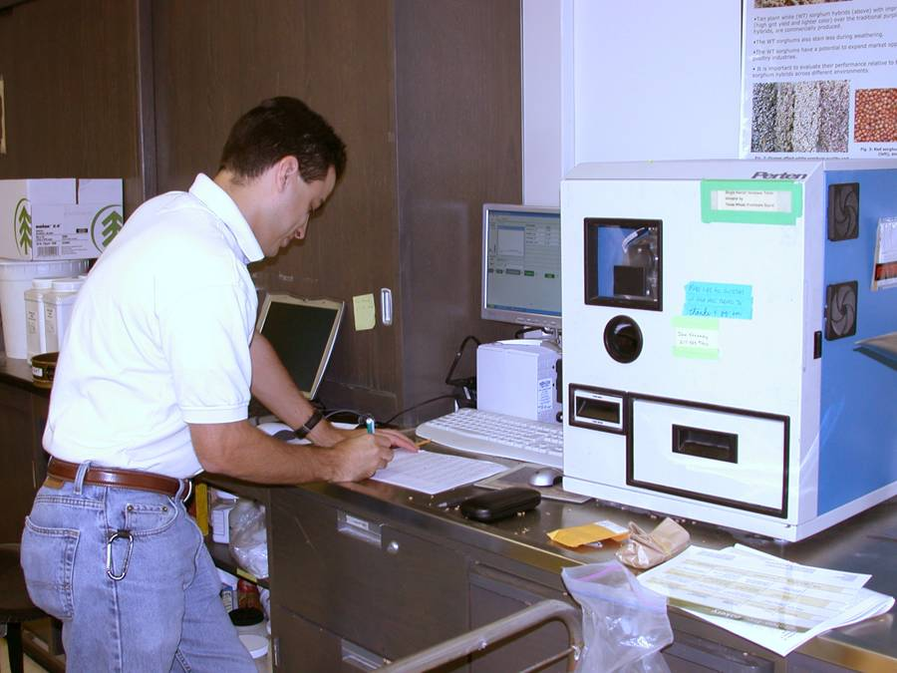
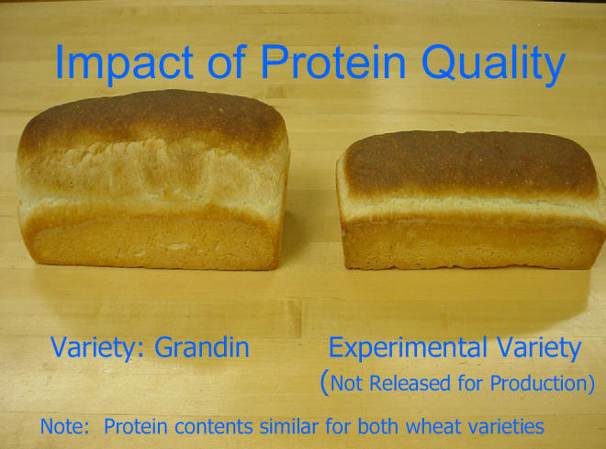
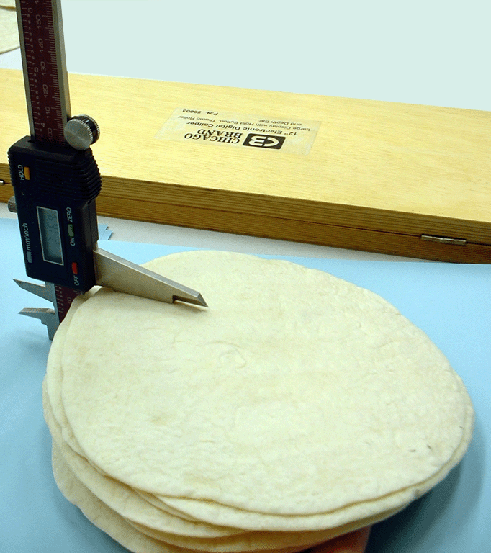
Milling and Baking Quality
Milling (TW, hardness, weight, size, ash, flour yield)
Mixing properties (time to peak, tolerance, absorption, Farinograph development time, mixing stability, mixing tolerance index, stability, extensibility)
Baking (bake mix time, crumb grain, crumb texture, crumb color, loaf volume)
Tortilla (diameter, opacity, rollability)
Other traits (viscosity, PPO, falling number)
Mixing properties
SKCS
Tortilla

Slide 26
Wheat quality highlights
Tortilla and other flatbread research
  Small scale tortilla quality testing system
  Clean ingredient tortilla quality
  Predictive models for tortilla and flat bread quality
Genotype-by-environment stability for milling and baking quality
Computerized and digitized milling and dough quality parameters
End-use quality screening is an integral component of the wheat breeding program
Use of markers in end-use quality evaluation

Slide 27
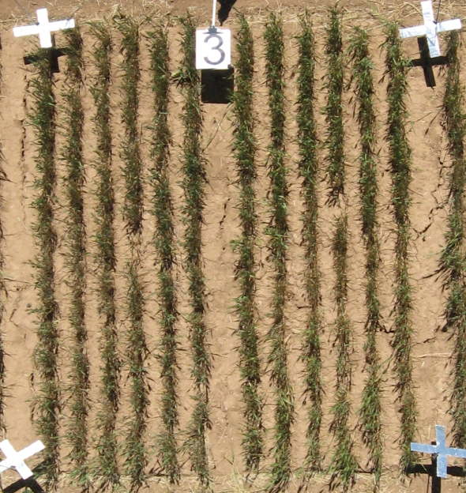
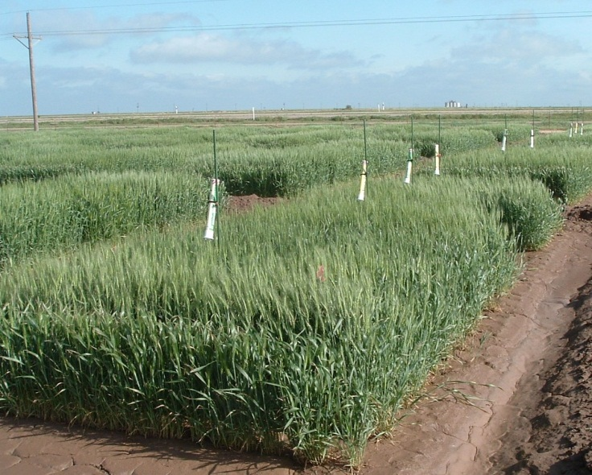
Evolution of our phenotyping: Thermal sensing
Advantages
  Easy
  Inexpensive
Disadvantages
  Measure a small spot
  Soil interference
  High maintenance
  Cannot do many lines
IRT
IRTs
Notes:
How to screen drought tolerance in the field?
One technique we have been evaluating is to quantify wheat canopy temperature depression, the difference between air temperature and canopy temperature.
We currently use 2 types of sensors:
Infrared thermometers (IRTs), particularly the sensors can measure temperature continuously.
Thermal imaging
The advantages of these sensors: they are quick, non-contact, automated and non-destructive approach for determining the canopy temperature. They also can measure the temperature of the targeted area.
Continuous monitoring of canopy temperature is possible using IRT sensors as they provide temperature data in every 5 minutes.
27

Slide 28
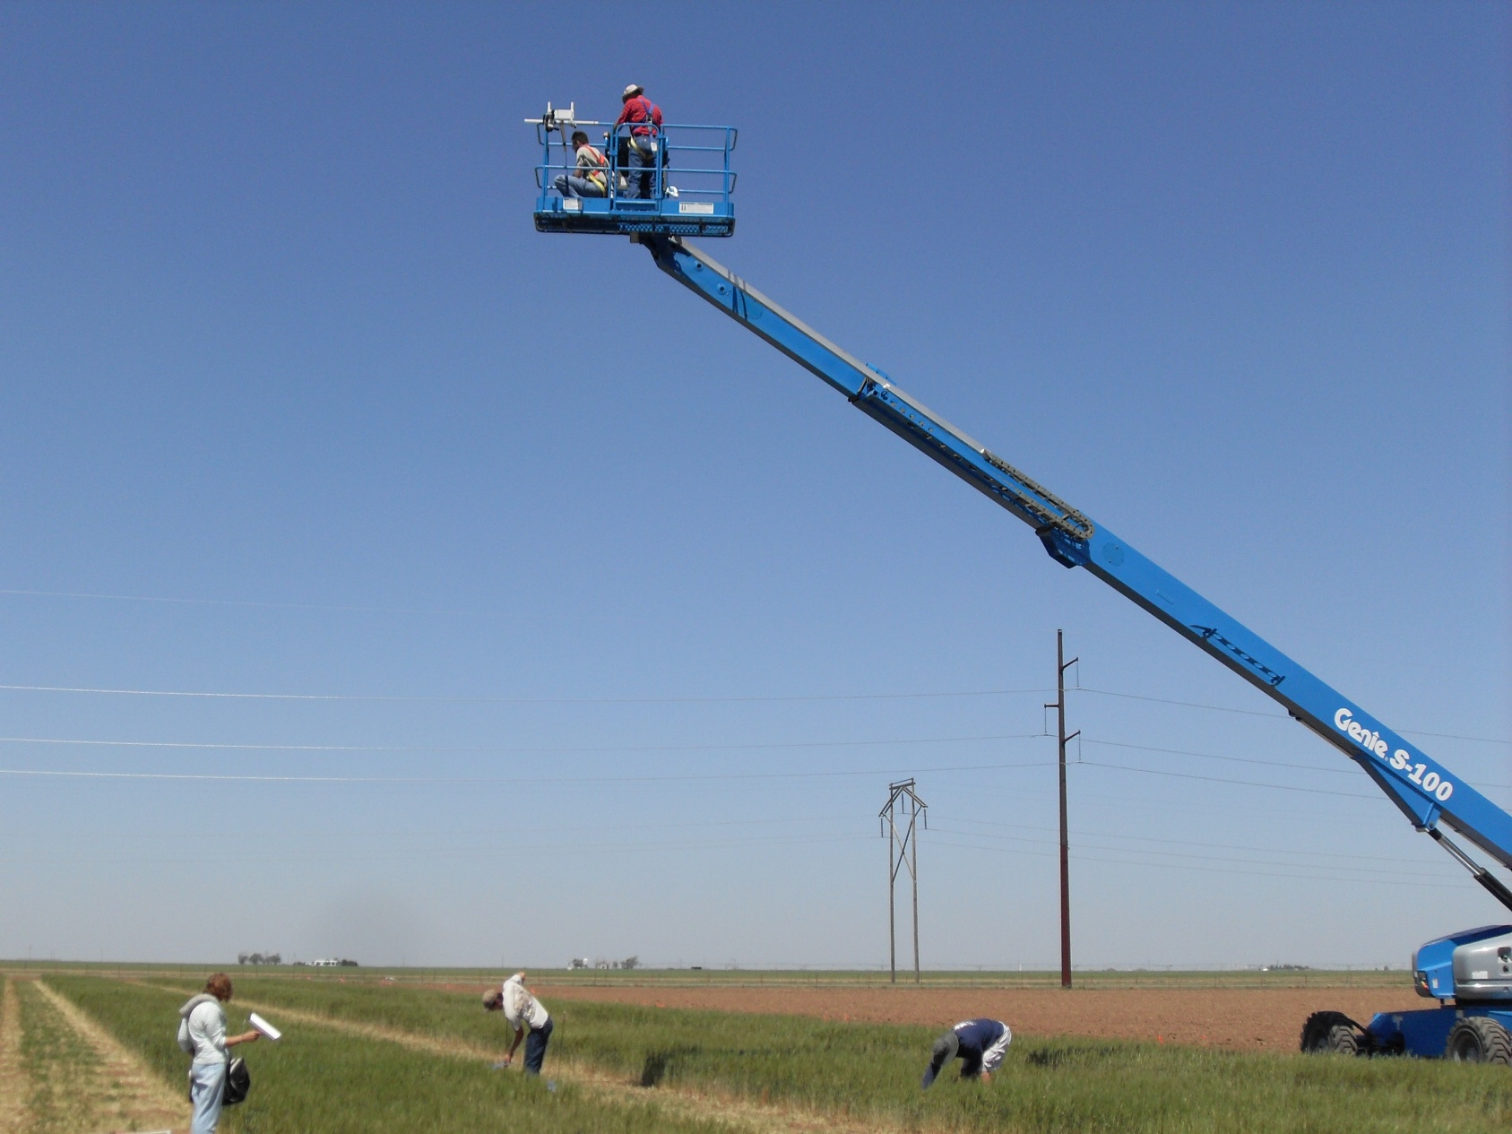
Evolution of our phenotyping
Special thanks to Steve Evett and his crew at USDA-ARS
Notes:
However, we have to take thermal images using special equipment like this lifter.
Ideally, the thermal images may be taken by an airplane or a balloon.
One of the key aspect in thermal imaging is to reduce the time duration in taking thermal images at least within the replication to minimize the error caused by changing sunlight direction and temperature. Therefore, the aerial approach of obtaining images will be the better than using boom lifts

Slide 29
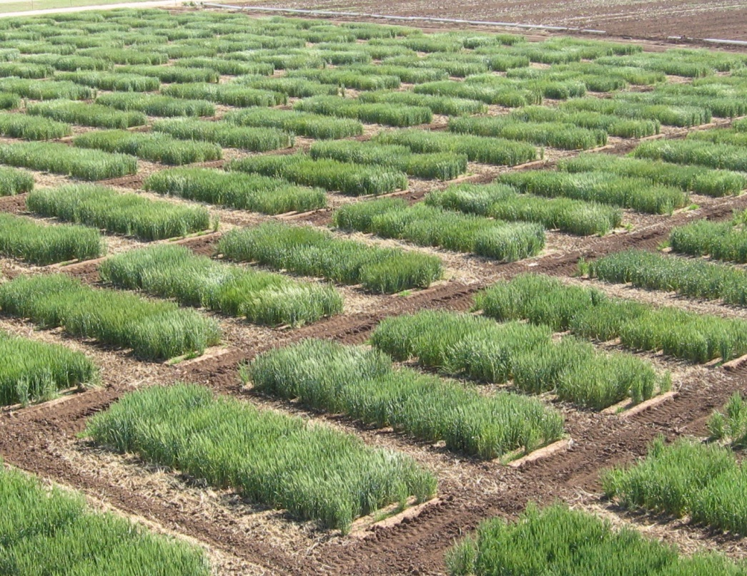
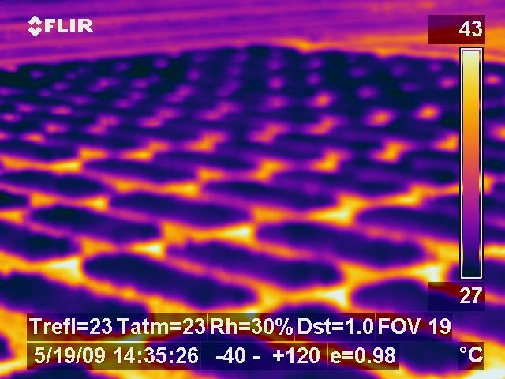
Evolution of our phenotyping: Thermal imaging
Notes:
Since, IRT sensors could potentially capture the radiations from the soil when the field is not completely covered by the canopy, infrared thermography is gaining popularity these days.
Some of the advantages are
It can cover larger area within a short period of time
Thermal images provide an opportunity to filter out the background soil and estimate the canopy temperature leading to higher precision
Can take into account over thousand simultaneous temperature measurements

Slide 30



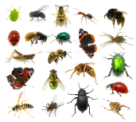
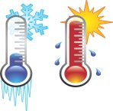
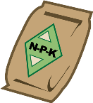

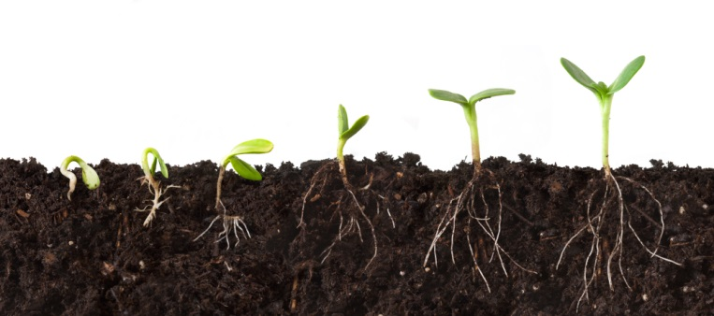








Genotype
Environment
Cultivar Selection
Growth Habit
Stress Tolerance
Insect Tolerance
Disease Resistance
Earliness
Health Status
Phenotype
Notes:
The major objective is to find the linkage between high-throughput genotyping and phenotyping to improve efficiency and accuracy in breeding program. High-throughput phenotyping is expected to play a major role in reducing the human error while collecting data from numerous field plots

Slide 31





Field Data Collection
Data Visualization & Analysis
Platforms & Sensors
Data Interpretation & Applications

Slide 32
ENVIRONMENT
Agronomic Team
Area of Interest
Plot
Field
Cropping System
Ecosystem
Plant
Traits:
Developmental
Morphological
Biochemical
Physiological
Observe, Measure, and respond to inter- and intra-field variability
Organ
Precision Management
Phenotyping
Cell
Physical and Biochemical changes in response to genetics and environment
G x E Hierarchy
GENETICS
Phenomics
Gene
Sequencing and Analysis of an organism’s DNA
Genomics
Notes:
Where we are today (plot/field scale) as well as the need for phenotyping tools. I usually like to mention here that molecular tools available for breeders/geneticists are way ahead of field-level phenotyping tools, and that UAS technology may help bridge that gap.

Slide 33


Sensors & Platforms
DJI Phantom 4
  RGB sensor
  12 Mega Pixel
3DR X8+, eBee
  Tetracam ADC Snap (Multispectral sensor)
  FLIR Vue Pro R (Thermal imaging)

Slide 34


Evaluating and monitoring of growth and maturity of wheat
Notes:
From the imagery one can get data that shows the plant height values through the volumetric profile analysis and vegetation indices development

Slide 35


Estimating wheat canopy height
Notes:
The platforms carries high resolution RGB and multispectral sensors. The multispectral sensor records green, red, and near-infrared (NIR) wavebands of the electromagnetic spectrum. The raw UAS data (Level 1 products) are calibrated and geo-referenced across different dates utilizing ground control points and reflectance tarps, and processed using the structure from motion algorithm to generate Level 2 georeferenced data (including orthomosaic image, 3D point cloud, and digital surface model). Phenotypic feature extraction (Level 3 data products) will include stand density, canopy cover, canopy height canopy volume, normalized difference vegetation index, and excess green vegetation index, which is obtained either from Level 2 products or directly from Level 1 products and integrated into Level 2 as orthomosaic feature images. The Level 3 data products are used to estimate wheat yield and monitor disease response.

Slide 36

Estimating wheat biomass using UAS
Notes:
Preliminary results from an ongoing study by members of this team demonstrated the application of UAS remote sensing for estimating wheat growth and development. A fixed wing UAS was used for acquiring high resolution multispectral imagery of a winter wheat variety test at the Texas A&M University Brazos Bottom Farm (30°32'26.02"N and 96°25'33.34"W) using a Sentek GEMS multispectral camera. Each plot was 3.5 m long and 1.5 m wide. Red and NIR images were collected at an altitude of 40 m above ground on 26 February 2016. For radiometric calibration, calibration tarps were laid out in the field. Results also indicate a highly significant relationship between NDVI estimated from high-resolution UAS-based data and leaf area index (LAI) and ground cover, both important characteristics for estimating biomass production.

Slide 37


Estimating reaction to wheat fungal diseases using UAS
Several genotypes were grown at Castroville, Texas (highly favorable environment for natural inoculation for wheat leaf rust)
RGB (red, green, and blue) image was taken on March 31 and April 14, 2017 using a UAS platform: DJI Phantom rotary wing
Green seeker was used to collect NDVI data
Disease type and severity notes were taken
Coefficient of Infection (COI) calculated from
visually obtained data (severity and disease type)

Slide 38


Incidence of leaf rust
Resistant
Susceptible
Tolerant

Slide 39



UAS - Image processing
RGB image of the entire research area
Boundary selection of each plot for ROIs
Image classification (UVT )
Bright red: Less infected
Notes:
Obtaining the Reflectance values from individual plots: Image processing:
A plot boundary with an area of 3.25 m² (2.6m length and 1.25m width) was created in each plots as an Region of Interest (ROIs)
Statistics of individual ROIs was calculated in ENVI (image processing software) to obtain the reflectance values of each bands (RGB)
Image classification was carried out by developing several different vegetation indices based on visual trial method
Reflectance values on Red band divided by reflectance values on Green band (R/G) was found to be useful approach for classifying diseased and healthy plots

Slide 40


Estimating reaction to wheat fungal diseases
Notes:
The platforms carries high resolution RGB and multispectral sensors. The multispectral sensor records green, red, and near-infrared (NIR) wavebands of the electromagnetic spectrum. The raw UAS data (Level 1 products) are calibrated and geo-referenced across different dates utilizing ground control points and reflectance tarps, and processed using the structure from motion algorithm to generate Level 2 georeferenced data (including orthomosaic image, 3D point cloud, and digital surface model). Phenotypic feature extraction (Level 3 data products) will include stand density, canopy cover, canopy height canopy volume, normalized difference vegetation index, and excess green vegetation index, which is obtained either from Level 2 products or directly from Level 1 products and integrated into Level 2 as orthomosaic feature images. The Level 3 data products are used to estimate wheat yield and monitor disease response.

Slide 41

Estimating reaction to wheat fungal diseases using UAS
Notes:
Leaf rust infection leads to reduction in chlorophyll resulting in higher reflection of red light and helps to distinguish between diseased and healthy canopy
Reflection in NIR region is lower in diseased plants reducing NDVI compared to healthy plants

Slide 42

Estimating wheat yield from images
Notes:
The goal of this study was to measure the width, length and projected area of wheat heads, and relate these parameters to grain yield. Wheat plants growing in pots from greenhouse trials were selected based on expected differences in yield. Four images of each plant were collected from several wheat plants of two varieties with a SENZ3D (RGB plus depth) camera (Creative Technology Ltd., Milpitas, CA). An image-analysis algorithm was developed to measure the width, length and projected area of the wheat spikes. Image segmentation was performed with K-means clustering followed by feature detection to identify the wheat spikes. Subsequent analysis calculated the area, minor axis and major axis of each wheat spike, based on the assumption of an elliptical shape. Furthermore, distance from the plant to the camera was determined from the depth layer of the images. The minor and major axes of individual spikes were converted from pixels to mm with a conversion factor dependent on plant-to-camera distance. Results indicate good estimates of wheat yield per spike can be obtained from RGB images (Figure 3) with promising correlations (r = 0.83, P < 0.05; R² = 0.70)

Slide 43

Tiller count in wheat will be done similar to panicle count in sorghum & maize
35 panicles
Notes:
The raw UAS data calibrated and geo-referenced processed using the structure from motion algorithm to generate orthomosaic image, 3D point cloud, and digital surface model. Using this similar techniques, there are possibilities of counting the number of heads in wheat which can be an effective approach to predict final grain yield in wheat.

Slide 44
Highlights of physiology/phenotyping
Biomass at anthesis is important for maintaining high yield under drought in the Southern High Plains
Newer TAM cultivars use soil water more efficiently. All cultivars are drought-tolerant but have different mechanisms to respond to drought
Cooler canopy, conferred by varying mechanisms and traits, contribute to higher yield in new drought-tolerant cultivars

Slide 45
Highlights of physiology/phenotyping
UAS/Ground vehicle phenotyping
  High Throughput Phenotyping for grain and forage
  UAS data is highly associated with ground-based data
  Spectral vegetation indices associated with biotic and abiotic stress tolerance can be phenotyped quickly and efficiently
Ground penetrating radar
Terrestrial laser scanning
Spectral reflectance/screening of epicuticular wax
Canopy temperature

Slide 46


Genotyping By Sequencing
Genomics & Bioinformatics Unit
RFLP
Genome Size and complexity
Lack of reference
Key factors
Reproducible
Sensitivity, specificity
Cost effective
AFLP

Slide 47

AgriGenomics Laboratory

Slide 48








Genotyping and marker assisted breeding
SNP genotyping (LGC Genomics, KASP)
1
High-throughput SNP genotyping service
4
7
Labconco FreeZone (freeze-drier)
TALBOYS homogenizer
Fastprep 24 homogenizer
Eppendorf Centrifuge
QIAxtractor
BMG PHERAstar ^{Plus}
Hydrocycler (KBiosciences)
Eppendorf Thermocycler
2
5
8
3
6

Slide 49

KASP Workflow

Slide 50

Cluster analysis and reporting
KlusterCallerTM software (KBiosciences)
  Scatterplots- FAM and HEX data plotted on x-axes and y-axes
  ROX data- normalization
Allele 2
Heterozygotes
NTC
Allele 1
DNA sample plate

Slide 51



SNP’s fully utilized at AGL
30 SNP markers were screened on 48 parents and 159 populations: 16 out of 30 SNPs can be used for genotyping

Slide 52
SNP markers available at the AGL
SNP |  | Primer |  | Trait
Fhb1_SNP319-KASP |  | Fhb1_SNP319-AL1-FAM-WT |  | Fusarium head blight resistance
Fhb1B_umc_3837-KASP |  | Fhb1B_3837_AL1 |  | Fusarium head blight resistance
FHB3BS-SNP8-KASP |  | snp3BS-8_AL1 |  | Fusarium head blight resistance
Glu-D1-DX-KASP |  | Glu-D1d_SNP_AL1 |  | Gluten strength
Lr34Inron4_A-KASP |  | Lr34-int4_A_AL1 |  | Leaf rust resistance
Lr34JagExon22-KASP |  | Lr34jagger_AL1 |  | Leaf rust resistance
LR42-113325-01-KASP |  | LR42-113325_01_AL1 |  | Leaf rust resistance
LR46-Yr29-JF2-2-KASP |  | Lr46_JF2-2A_AL1 |  | Leaf rust resistance
Lr9a-KASP |  | Lr9a_AL1 |  | Leaf rust resistance
Lr42-TC425250_08-KASP |  | Lr42-TC425250_08_AL1 |  | Leaf rust resistance
PHS1-SL-SNP1-KASP |  | PHS1-MFT_1587_AL1 |  | Pre-harvest sprouting
RhtB1_cim-KASP |  | RhtB1_AL1 |  | Height
RhtD1-KASP |  | RhtD1_AL1 |  | Height
Sr36-Pm6_8085-KASP |  | Sr36_8085_AL1 |  | Stem rust resistance
Sr40-Seg2-SNP2-KASP |  | Sr40-Seg2-SNP2-_AL1 |  | Stem rust resistance
1A1R_8035-KASP |  | 1A1R_8035_AL1 |  | Stem rust, PMD

Slide 53

Genotyping genes/QTL Highlights
Name | SNPGb3 | GB testing
PI268210 | A | R
Largo | A | R
TAM110 | A | R
TAM112 | A | R
TAM204 | A | R
TX09V7352 | A | R
TX10A001099 | A | R
TX10A001537 | A | R
TX11A001295 | A | R
TX11A001440 | A | R
TX11A001549 | A | R
TX11A001643 | A | R
TX97V5300 | A | R
TXGBE273A | A | R
TAM111 | B | S
TAM113 | B | S
TAM400 | B | S
TAM401 | B | S
TX01M5008 | B | S
TX01M5009 | B | S
TX01M5009-28 | B | S
TX10D2063 | B | S
TX11A001112 | B | S
TX11A001137 | B | S
TX11A001173 | B | S
TX11A001445 | B | S
TXGBE281C | B | S
Kompetitive allele specific PCR (KASP) SNP markers have been developed for wheat streak mosaic virus resistance, Wsm2, greenbug resistance, Gb3, and wheat curl mite resistance, CMC_{TAM112}.
Apply marker-assisted breeding to develop germplasm lines with tolerance to multiple stresses

Slide 54





Genotyping genes/QTL highlights
Map genes/quantitative trait loci associated with higher yield under dryland, resistances to diseases, arthropods, and their transmitted viral diseases
Validate and develop high throughput single nucleotide polymorphic markers
Provided a saturated map for Wsm2 based on 90K SNP markers
Tightly linked markers linked to Wsm2 have a potential to improve genetic gain in wheat
Putative QTL for yield and yield components are localized on chromosomes 2B,1A and 3B
Markers linked to drought tolerance QTL are being converted to KASP and tested
Stripe rust
Drought
Greenbug
Curl mite
WSMV
Notes:
First, I would like to give you some brief introductions about wheat research teams and goals.

Slide 55
Genotyping genes/QTL highlights
Wild relative exploitation
  Triticum turgidum for heat tolerance
  Aegilops tauschii for insect and disease resistance
  Synthetic hexaploids for biomass and grain yield
QTL Mapping results published
  Tiller production in wheat
  Epicuticular wax in wheat
  Stripe rust in wheat
  Greenbug in wheat
  Wheat curl mite in wheat
  Wheat streak mosaic virus in wheat

Slide 56
“CRISPR Everywhere”
The rise of gene editing

Slide 57
CRISPR/Cas9 bacterial immune system
Clustered Regularly Interspaced
Short Palindromic Repeats (CRISPR)
CRISPR-associated protein 9 (Cas9)
Irrigated Rice South Asia
Doudna and Charpentier 2014

Slide 58
CRISPR/Cas 9 technology
Irrigated Rice South Asia
Doudna and Charpentier 2014

Slide 59
CRISPR-Cas9 genome editing
Introduce Cas9 and guide RNA matching target sequence
Double strand break (DSB) is created in the gene of interest
Targeted mutations
(loss of function or gain of function)
Irrigated Rice South Asia
Ding et al. 2016 Frontiers Plant Sci

Slide 60
CRISPR/Cas9 creates a double strand break at a specific target site in the genome
Irrigated Rice South Asia
Kim and Kim 2014

Slide 61
Genome editing to rapidly combine targeted alleles for breeding
Explore the use of genome editing for rapid pyramiding of beneficial alleles at breeding relevant genetic loci:
  Validate genes where knock-outs provide the desired phenotypes (such sd1, BadH2)
  Validate functional nucleotide polymorphisms by allele replacement → rapid testing of known alleles at each locus in the same background
  Use as a replacement for marker-assisted backcrossing (MABC) to combine targeted alleles through multiplexed gene editing
M. Thomson, TAMU

Slide 62
Texas A&M AgriLife Research
Crop Genome Editing Lab
New 3,500 ft² facility on the Texas A&M campus in College Station undergoing renovations for completion by January 2018
Will provide research, service, and training functions to optimize protocols, set up a high throughput gene editing pipeline, and enable CRISPR/Cas9 research projects for target crops
Starting with rice, cotton, wheat, and peanut but will rapidly expand into other crops in the future
M. Thomson, TAMU

Slide 63

The Missing link: The root
Sean Thompson at CIMMYT in the Chihuahuan Desert, Mexico
Texas A&M/CIMMYT collaborative project

Slide 64
International Collaboration
CGIAR Centers
  International Maize and Wheat Improvement Center (CIMMYT)
  International Center for Agricultural Research in the Dry Areas (ICARDA)
  International Center for Tropical Agriculture (CIAT)
Countries
  Poland
  Ukraine
  Georgia
  Turkey
  Tunisia
Several private sector entities

Slide 65

It takes a team!!
Synergism: 1 + 1 = 3; Antagonism: 1 + 1 = -2

