Slide 1

New Advances in Digital Cardiograph for Screening and Detecting Heart Diseases in Children
CAPIS
Amir A. SEPEHRI, PhD
CAPIS Biomedical Research Center
Mons, Belgium
Sepehri@capis.be

Slide 2
Objectives
Statistical analysis show that around 1% of children are born with congenital heart diseases. While, as many as 50–70% of asymptomatic children referred for specialist evaluation or echocardiography because of a murmur have no heart diseases. Pathological symptoms are sometimes neglected during conventional auscultation due to the incapability exists in human auditory system. For instance, ASD is a congenital heart disease which is often missed until adulthood. Besides, children living in deprived and underprivileged rural areas encounter a more serious situation for having opportunities to visit even a family physician.

Slide 3
Objectives
As the results of many years of joint multidisciplinary researches, an Automated Auscultation Diagnosis Device for cardiac murmurs in children (AADD), we name it Pooya-Heart, has been developed. This monograph presents the accuracy of the device for pediatric heart diseases screening based on medical examination and screening of 613 cases. The screening composed of normal hearts, innocent murmurs and defected hearts. Echocardiography diagnosis confirmed by four skilled pediatric cardiologists was presumed as the gold standard for judgment about correctness of diagnosis. The results show that the screening specificity, efficiency and sensitivity of the device are around 97%, 93% and 90% respectively which is a substantial breakthrough in pediatric heart diseases screening. It provides an efficient facility for children in deprived and underprivileged rural areas.

Slide 4
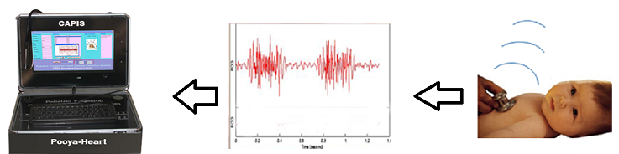
Pooya-Heart
The intelligent system for screening and detecting congenital heart diseases

Slide 5
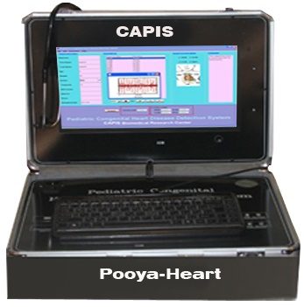
Pooya-Heart
The device technology is based on the Arash-Band which is a method for characterizing heart murmurs based on the heart parts initiating them and it is internationally patented. The spectral energies of the discriminative bands are employed to constitute the feature vectors for classification. Congenital heart diseases screening is performed by classifying the feature vectors using a multi-layer perceptron (MLP) neural network.
The diagnosis method of the AADD relies on classification of congenital heart diseases based on the heart sections that cause the pathological murmurs.

Slide 6
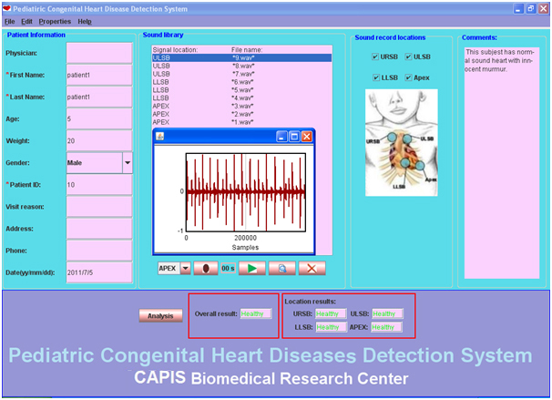

Slide 7
Heart sounds signals are recorded using a wireless or normal electronic stethoscope. The system shows the diagnosing results, segmentations and other characteristics of the signals are shown in related boxes. The AADD is also an advanced digital phonocardiogram. Moreover, it enables the physician to delete, view or listen to recorded sound signals. One of the advantages of this system is that it provides the possibility of recording sound signals from different locations. The comments can be added online.

Slide 8
The Pooya-Heart records for 10 seconds automatically from each location. However, it enables the physicians to set their preferred recording time but, our studies indicate that 10 seconds is the best for analyzing the signals.
The analysis of each record is reported separately. Besides automatic diagnosis the system is an advanced digital phonocardiogram. There are also different options on the system such as, listening and playback of recorded sounds with adjustable intensity levels, various selectable times scales for viewing the whole or part of a sound cycle and extra. In addition, the system uses an intelligent and unique method for automatic segmentation.

Slide 9
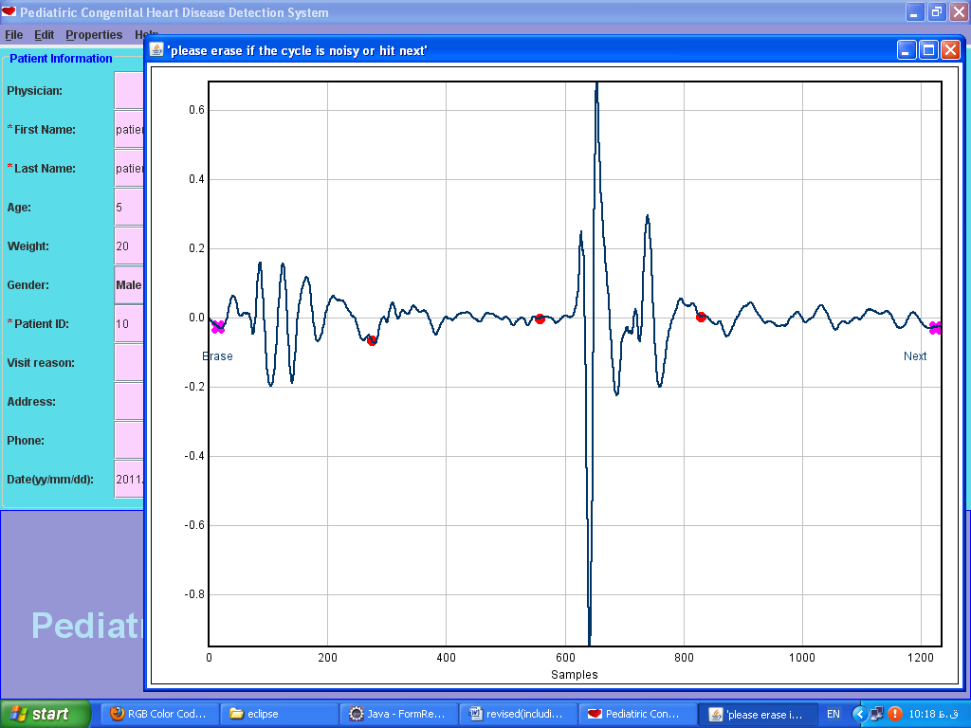
The Pooya-Heart automatically analysis the heart sound signals but, it gives physician many options and possibilities of using the system as a computer-aided auscultation device. For instance, viewing presence of additional murmur in systolic and diastolic intervals can be observed by setting the relative soft bottom. The figure shows a depicted sound signal related to a child with VSD disease. The additional murmur in systolic interval is highlighted.
Figure 2: one cycle of the recorded sound signal of a normal subject in which the first sound (S1) and the second sound (S2) are separated automatically by the system..

Slide 10
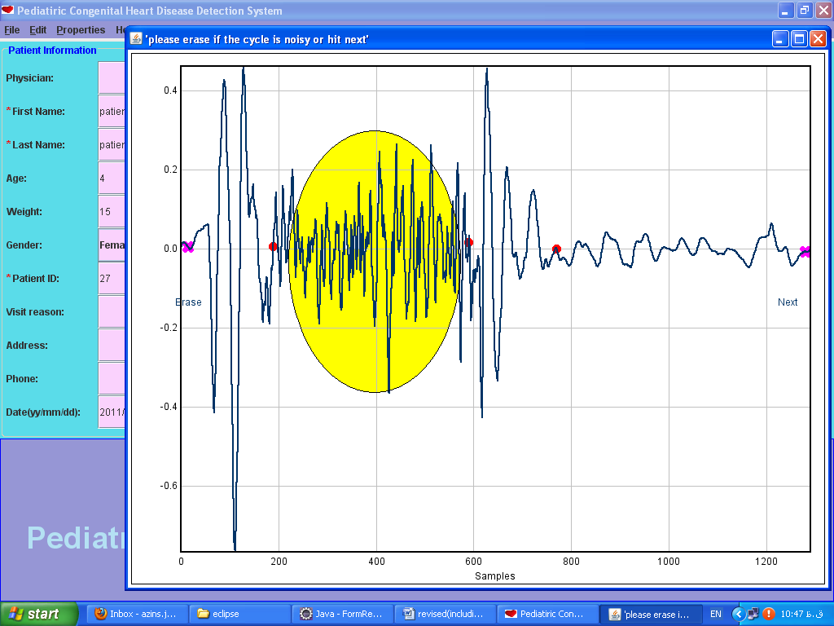
Figure 3: one cycle of the recorded sound signal of a VSD subject. An additional murmur in systolic interval is shown in yellow color.

Slide 11



A sample test results:
We have designed a cross-sectional study in two phases. Ethical approval was obtained from the Hospital Ethical Committee. In the initial phase, we have made a recorded audio data bank of cardiac auscultation of 563 children aged 2 to 12 years with respective precise echocardiography diagnosis as shown in following Table 1. Using this novel artificial intelligence-based medical device, we analyzed the recorded sounds. The Pooya-Heart’s diagnoses were compared with echocardiography diagnoses confirmed by four skilled pediatric cardiologists. Then, specificity, sensitivity and efficiency of results obtained by the medical software device were calculated using following formulas:
Specificity=
Sensitivity=
Efficiency=

Slide 12
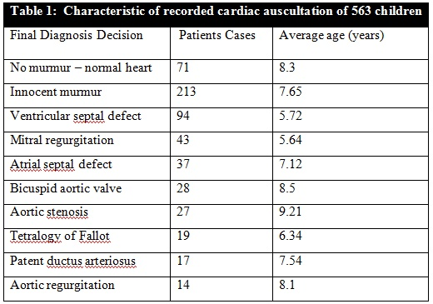

Slide 13
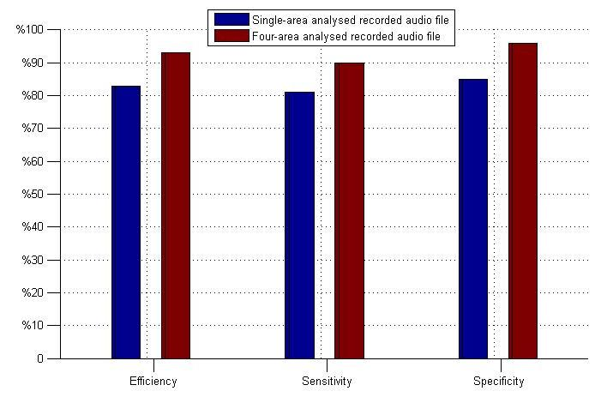
Diagnosed results obtained under two circumstances, single-area and four-area recorded audio file, referenced by echocardiography diagnoses.
Figure 4: Correctness of diagnoses by the Pooya-Heart under two circumstances. Single –area was only recorded at mitral area and four –area were recorded in all four areas.

Slide 14
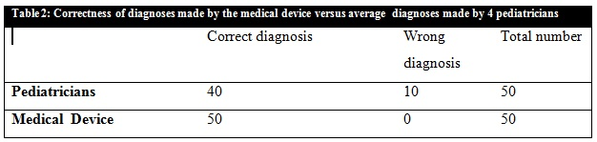
A sample test results for innocent murmurs verification:
50 normal volunteers’ children of elementary schools were entered into the study. 15 of them had no cardiac murmur and 35 of them had innocent murmur. After obtaining informed consent of their parents and obtaining the children’s permission, all of the 50 children underwent comprehensive echocardiography examination by pediatric cardiologist.
The diagnoses accuracy of the Pooya-Heart has been compared with the diagnoses of pediatricians. In both phases of the study, echocardiographic diagnosis was presumed as the gold standard for judgment about correctness of diagnosis. The diagnosis accuracy of the medical device compared to 4 pediatricians diagnosis results is presented in Table 2.

Slide 15
Results:
As it is indicated in figure 4, specificity, sensitivity and efficiency of the Automated Auscultation Diagnosis Device are 97%, 90% and 93% respectively. As it is shown in table 2, specificity of the Pooya-Heart has been 100% versus 80% of the pediatrician’s specificity. According to Johns Hopkins University School of Medicine Studies, average specificity of board-certified primary care physician is 80% in USA. Besides automated diagnosis, the AADD provides many heart sounds processing options including graphical interpretation of the recorded auscultation signals as indicated in figures 2 and 3. Such a device opens a new vision in importance of auscultation in children hearts abnormalities detections. By completing the AADD data bank, it is possible to increase the system accuracies and reach the specificity, the efficiency and the sensitivity of almost 100%, as the gold standard.

Slide 16
Conclusion:
We have indicated efficiency, sensitivity and specificity of this novel medical device for cardiac murmurs detection, screening and automatic diagnosis of children heart diseases. It is a promising tool in increasing the number of appropriate and timely referrals by family physicians to pediatric cardiologists. Also, this new Automated Auscultation Diagnosis Device for cardiac murmurs in children with such a high performance indicated by efficiency, sensitivity and specificity is certainly an ancillary mechanism to provide reliable diagnostic facilities for children living in deprived and underprivileged rural areas. The new medical device with automated diagnosis and different options and possibilities for children hearts sounds analysis, along with graphical interpretations, have wide applications; as a clinical tool for clinicians, family physicians, pediatricians and pediatric cardiologists to identify children congenital heart diseases and the heart abnormalities.

Slide 17
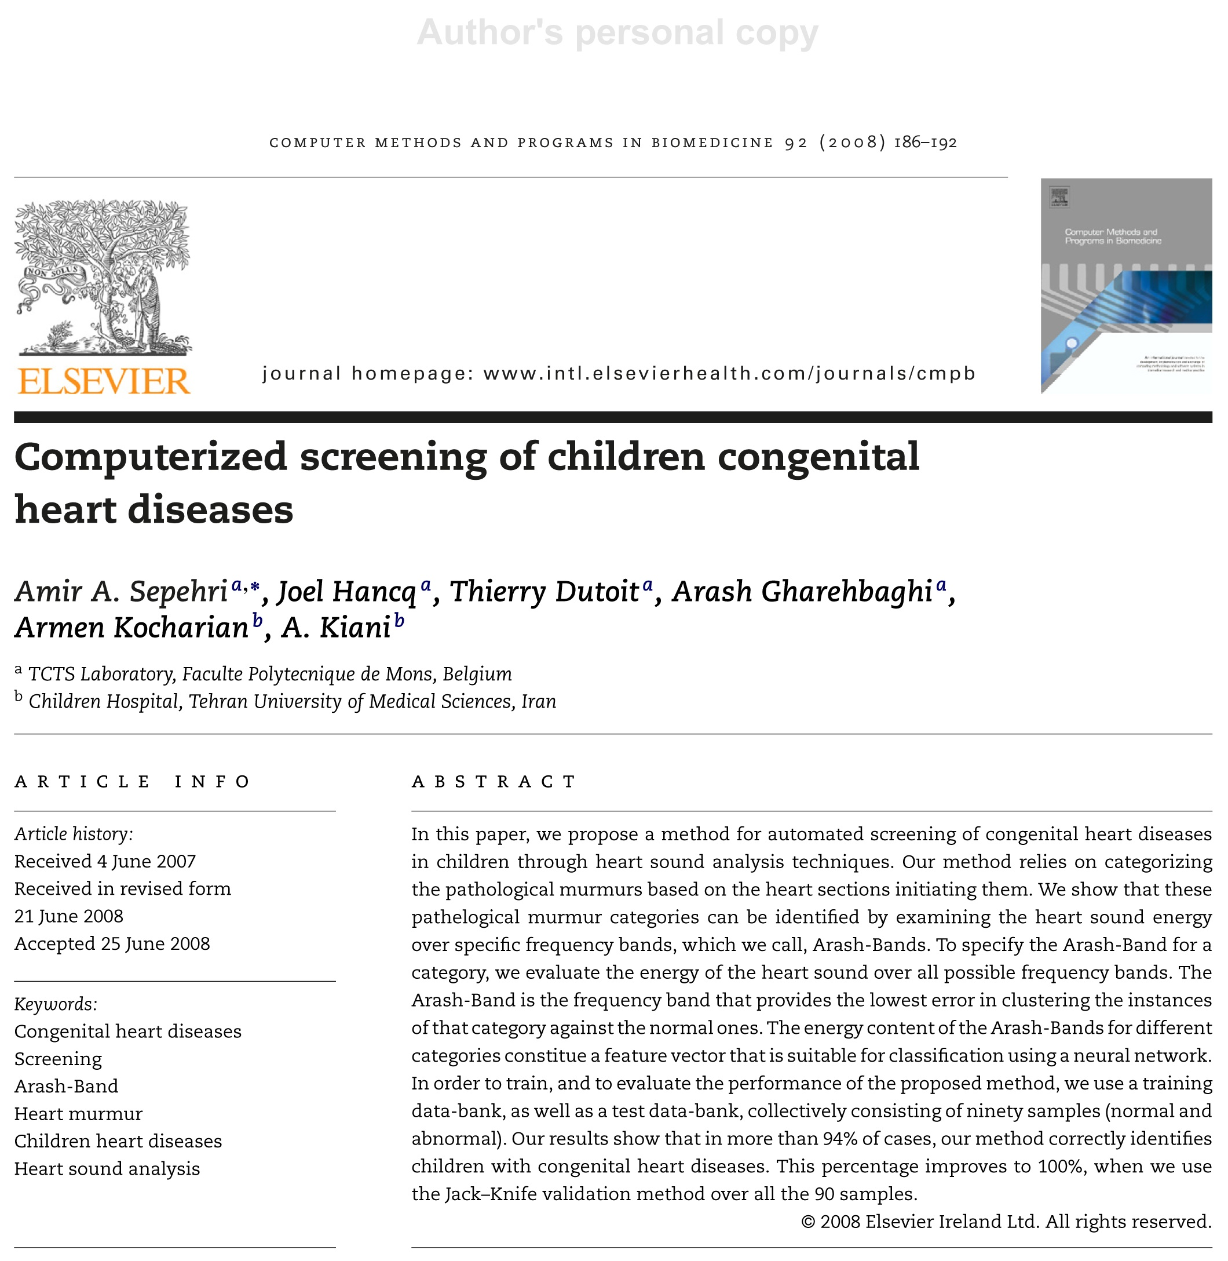

Slide 18
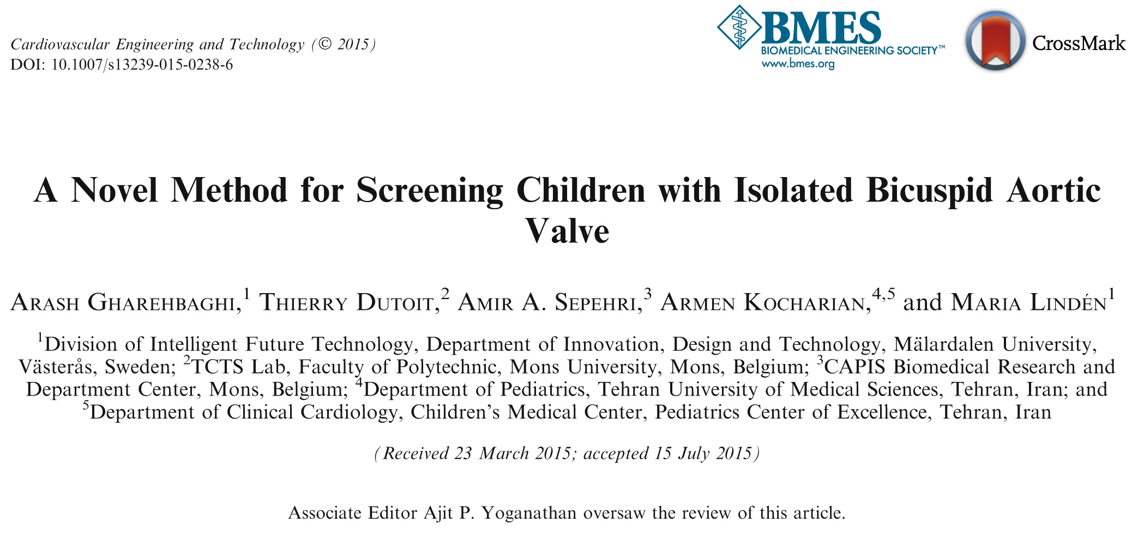

Slide 19
Thank you for your attention

