Slide 1

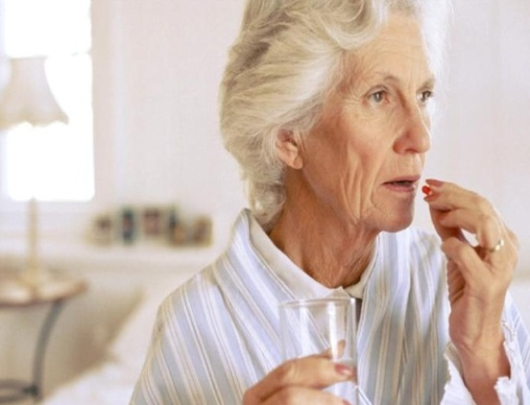


Trends of prescribing for elderly outpatients of a tertiary hospital in Dubai
Amina Mahdy
BPharm, MSc, PhD, Dip.ClinPharm
Associate Professor, Pharmacology & Therapeutics
Dubai Pharmacy College, UAE
DPC

Slide 2
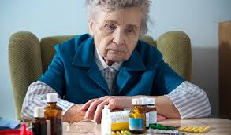
Outlines
Principles of drug prescribing for older patients: Factors to consider
Beer’s criteria and its significance in clinical decision making (STOPP & START)
Our research in a tertiary hospital in Dubai
Design
Sample and data collection
Findings

Slide 3

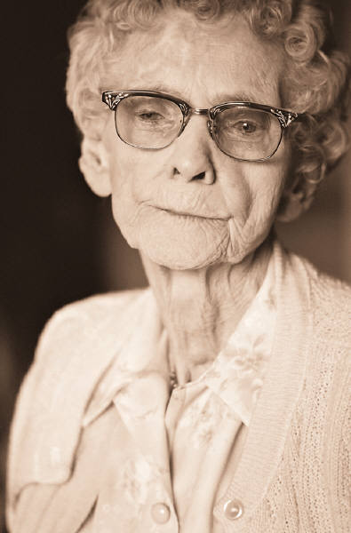

Aging by numbers
Globally, the number of persons aged 60 years or over is expected almost to triple, increasing from 672 million in 2005 to nearly 1.9 billion by 2050 @
In developed countries, 20% of the population is aged 60 years or over and is projected to be 32% by 2050@
(@: United Nations, Economics and Social Affairs. World Population Prospects. The 2004 Revision. February 25, 2005)
The Elderly (>60 years) account for nearly 5% of total UAE population (Government of Dubai, Community Development Authority. Elderly services, 2013)
DPC

Slide 4
Prescription for Elderly
Adverse events such as falls and cognitive impairment increasing morbidity and health resource utilization
Multiple co-morbid states
Poly-pharmacy
Effects of aging on physiology of drug therapy and compliance to medication
New drugs available each year with increasing off-label usage
Lack of evidence-based safety for newly introduced drugs
Medication cost

Slide 5
Optimal Pharmacotherapy
Balance between overprescribing and under-prescribing
  Correct drug
  Correct dose regimen
  Targets appropriate condition
  Is appropriate for the patient
  Avoid “a pill for every ill”
  Always consider non-pharmacologic therapy
DPC

Slide 6
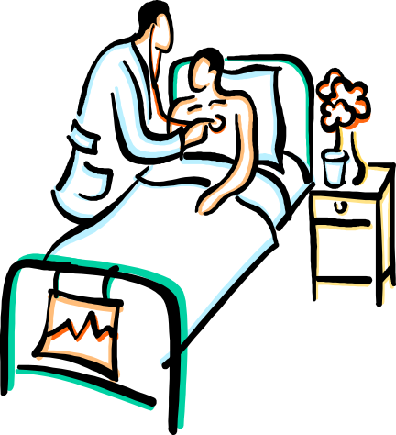
Adverse Drug Reactions (ADRs)
Responsible for 5-28% of acute geriatric hospital admissions
Greater than 95% of ADRs in the elderly are considered predictable and approximately 50% are considered preventable
Medication intake involves serial steps:
Prescription
Communication
Dispensing
Administration
Clinical follow-up
DPC
Page et al. 2010, Clin Interv Aging. 5:75-87
Davies et al. 2010, Br J Clin Pharmacol, 70:749–755

Slide 7
STOPP and START
Strategies have recently been developed to identify older patients at risk from adverse effects and to reduce the risk of initiating drugs likely to cause adverse events
Screening Tool of Older Person's Prescriptions (STOPP)
Screening Tool to Alert doctors to Right Treatment (START)
DPC

Slide 8
STOPP | START
It comprises 65 clinically significant criteria for potentially inappropriate prescribing in older people
Each criterion is accompanied by a concise explanation as to why the prescribing practice is potentially inappropriate
It consists of 22 evidence-based prescribing indicators for commonly encountered diseases in older people
Potentially inappropriate prescribing is defined as the use of medicines whose potential harms to older adults may outweigh the benefits.
Gallagher P, Ryan C, Byrne S, Kennedy J, O'Mahony D. STOPP (Screening Tool of Older Person's Prescriptions) and START (Screening Tool to Alert doctors to Right Treatment). Consensus validation. Int J Clin Pharmacol Ther. 2008 Feb;46(2):72-83.

Slide 9
Medication Appropriateness Index
Is it needed? Is the medication effective for the condition? pros, cons and evidence base
Limit the range of drugs used in older patients: small formulary for elderly
Dosage regimen: Start low, go slow
Are the directions correct and practical? Keep it as simple as possible & Make it clear
Review regularly :
- Is there unnecessary duplication?
- Are there possible drug/drug OR drug/condition interactions?
Is this drug the least expensive member among alternatives?
Use team & Support
DPC

Slide 10
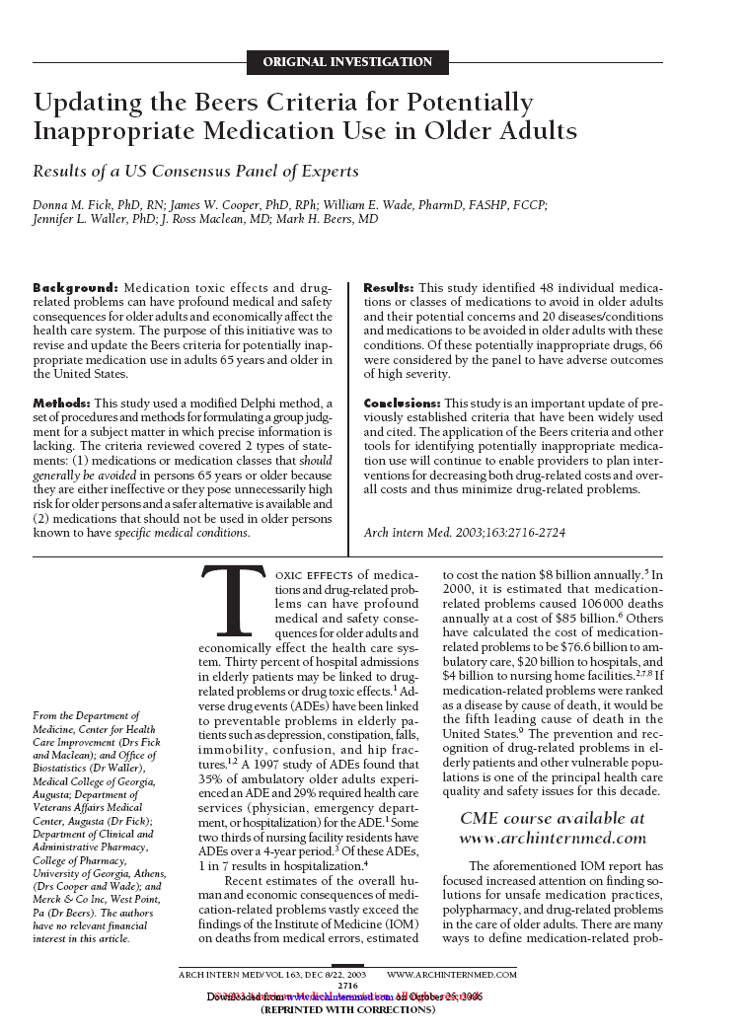
What is Beers Criteria?
An explicit USA consensus list consisting the most widely used indicator to define potentially inappropriate prescribing
DPC

Slide 11
Beers Criteria (cont.)
Originally conceived in 1991 by Mark Beers, MD (geriatrician)
1991 → 1997 → 2003 → 2012 → 2015
  Guide for identifying medications for which risks > benefits
  Not meant to be punitive
  Not meant to supersede clinical judgment or an individual patient’s values & needs
  Underscores the importance of using a team approach & use of non-pharmacological approaches
  Other criteria such as STOPP/START criteria & Medication Appropriateness Index should be used in a complementary manner
DPC
http://www.americangeriatrics.org/files/documents/beers/2012BeersCriteria_JAGS.pdf

Slide 12

Beers Criteria (Categories)
1st Category | 2nd Category | 3rd Category
PIMs for older people: Pose high risks of adverse effects OR Appear to have limited effectiveness AND There are alternatives to these medications | PIMs for older people: Who have certain diseases/disorders These drugs may worsen the current health problems | Use with caution in older adults May be associated with more risks than benefits in general However, may be the best choice for a particular individual if administered with caution
53 medications or medication classes that should be avoided in older adults |  | 14 that should be used with caution

Slide 13


Caution vs Potentially Inappropriate
Caution
Slow down
Monitor closely for effectiveness & adverse events
Stop & Ask – Is this drug appropriate?
Why is the patient on this drug?
Does the patient still require treatment?
Does the risk of this medication outweigh the benefit?
Is this the best drug for the patient? Is there a safer or more effective alternative?

Slide 14
Beers Criteria (Evidence)
Quality of Evidence
  High
  Moderate
  Low
Strength of Recommendation
  Strong
  Weak
  Insufficient
Validated literature evaluation tool to support recommendations
American College of Physicians guidelines grading system which is based on the GRADE scheme developed by Guyatt et al

Slide 15
Present Study
Steps Followed in the study:
1. Examining the pattern of prescription medication (therapeutic groups) issued to elderly patients
2. Evaluating the prescribing practice using the WHO prescribing indicator
3. Identifying the extent of potentially inappropriate prescribing for elderly patients using Beers explicit criteria (2012)
DPC

Slide 16
Present Study
Steps Followed in the study:
1. Examining the pattern of prescription medication (therapeutic groups) issued to elderly patients
2. Evaluating the prescribing practice using the WHO prescribing indicator
3. Identifying the extent of potentially inappropriate prescribing for elderly patients using Beers explicit criteria (2012)
DPC

Slide 17
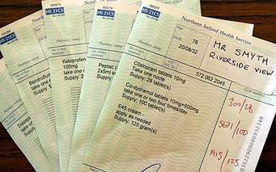
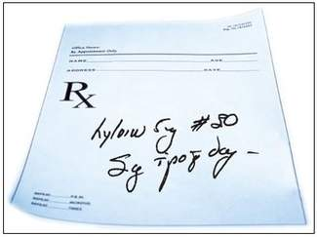
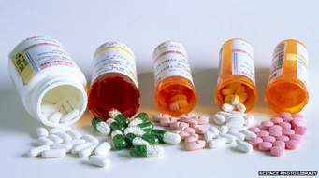
Study Design
A retrospective study was carried out using prescriptions issued to the geriatric patients, 60 years and above, attending the various outpatient clinics of a tertiary hospital in Dubai. The prescriptions were collected during the period from 1st of January to 26th of February 2013

Slide 18
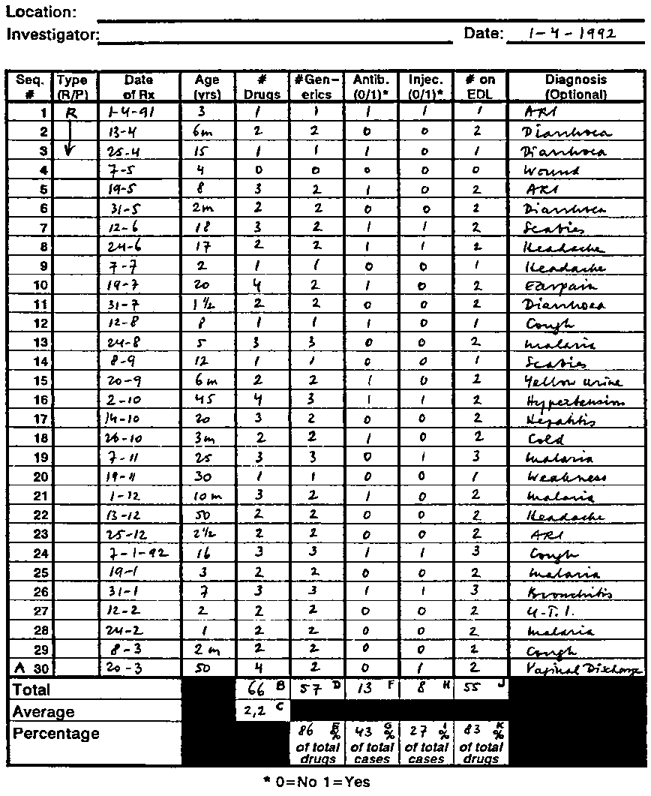
Sample & Data Collection
A total of 518 prescriptions for elderly outpatients were reviewed
WHO prescriber indicator form was used for data collection
DPC

Slide 19
Prescribing Indicators
Data on age, gender, and possibly diagnosis
Average number of drugs per prescription
% of drugs prescribed by generic name
% of encounters with an antibiotic
% of encounters with an injection
% of drugs prescribed from the essential drugs list
PIMs
The extent of PIMs prescribed for these elderly patients was identified using the Beer’s criteria (2012)

Slide 20
Research Results
Demographic Data
Characteristics | Frequency(%)
Age (years)
60-64 | 72(13.9)
65-69 | 121(23.4)
70-74 | 126 (24.3)
75-79 | 102 (19.7)
80-84 | 59 (11.4)
85-89 | 30 (5.8)
> 90 | 8 (1.5)
Gender
Male | 301(58.1)
Female | 217 (41.9)
DPC

Slide 21
Average number of drugs
Our study revealed poly-pharmacy in geriatric patients with
an average number of drugs per prescription being 3.7
deviating from the WHO
standard of 1.6 – 1.8
Number of drugs/encounter | Frequency | Percent
1-2 | 201 | 35.30
3-4 | 119 | 20.27
5-6 | 82 | 14.29
7-8 | 74 | 14.48
9-10 | 32 | 8.49
11-12 | 6 | 3.09
13-14 | 1 | 1.93
15-16 | 1 | 1.35
17-20 | 2 | 0.77
Total | 518 | 100.0

Slide 22
Therapeutic Classes
DPC

Slide 23
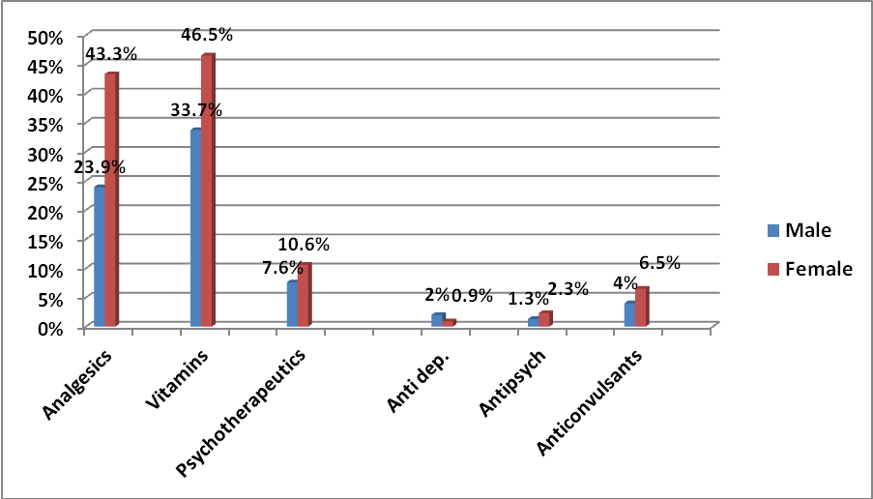
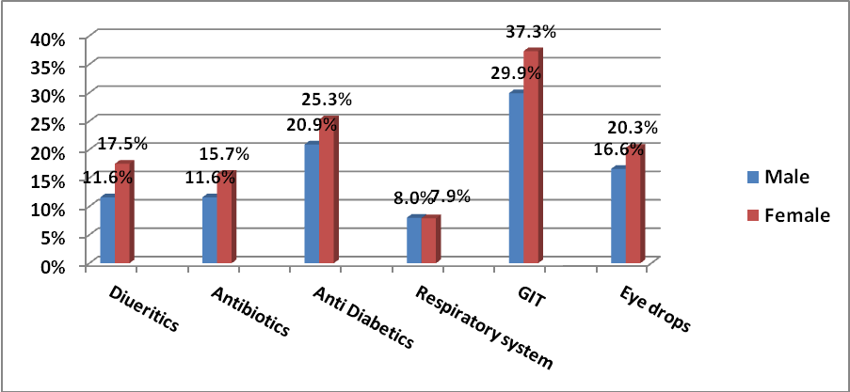
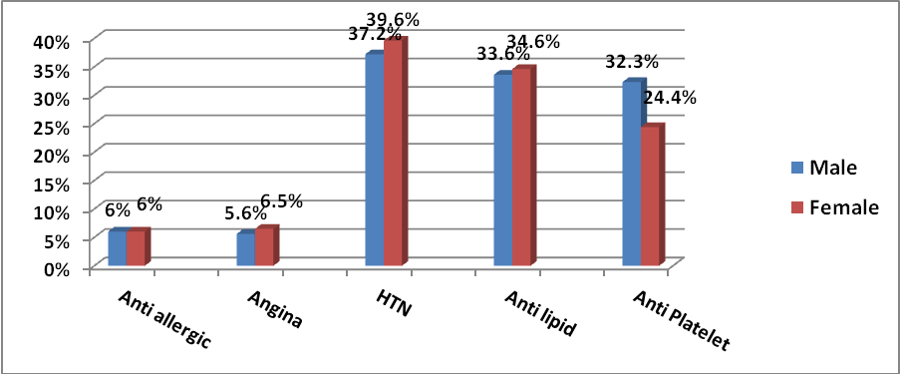
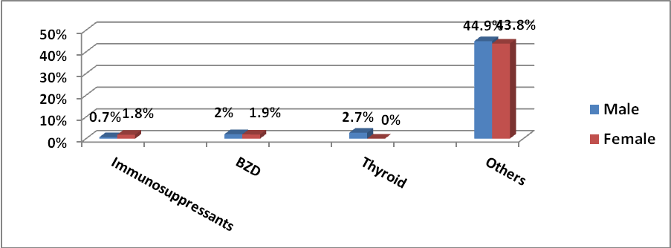
Men vs Women
*
*

Slide 24
Generics & Drug list
Percentage of medicines prescribed by generic name
A total of 90.4% of drugs were prescribed in their generic names. Only 9.6% appeared in brand names
Percentage of medicines prescribed from the essential drugs list
All Drugs were prescribed from the UAE essential drug list
DPC

Slide 25
Antibiotics & Injections
Percentage of encounters with an injection prescribed
Percentage of encounters with an antibiotic prescribed
DPC

Slide 26
Potentially Inappropriate Medicines
DPC

Slide 27
Potentially Inappropriate Medicines
DPC

Slide 28
Potentially Inappropriate Medicines
DPC

Slide 29
Drugs | No. of Rx | % of Rx | Recommendation | Strength of Recommendation
Anticholinergics (Excludes TCAs)
First generation antihistamines
Diphenhydramine | 4 | 10.2 | Avoid | strong
Chlorpheniramine | 2 | 5.1
Hydroxyzine | 4 | 10.2
Antispasmodic
Hyoscyamine | 5 | 12.8 | Avoid except in short-term palliative care to decrease oral secretions | Strong
Clidinuim-chlordiazepoxide | 2 | 5.1
Anti-infective
Nitrofurantoin | 2 | 5.1 | Avoid for long-term suppression | strong
Antithrombotic
Dipyridamole | 2 | 5.1 | Avoid | Strong
Pain Medications
Non-COX selective NSAIDS
Naproxen | 1 | 2.5 | Avoid chronic use unless other alternatives are not effective and patient can take gastroprotective agent | Strong
Diclofenac | 3 | 7.6
Meloxicam | 5 | 12.8
Ibuprofen | 1 | 2.5
Central Nervous system
TCAs
Amitriptylline | 1 | 2.5 | Avoid | strong
Benzodiazepines
Diazepam | 1 | 2.5 | Avoid benzodiazepines for treatment of insomnia, agitation, or delirium | Strong
Lorazepam | 2 | 5.1
Gastrointestinal
Metoclopromide | 4 | 10.2 | Avoid unless for gastroparesis | Strong

Slide 30
Drugs | No. of Rx | % of Rx | Recommendation | Strength of Recommendation
Aspirin for primary prevention of cardiac events | 17 | 45.9 | Use with caution in adults ≥80 years old | Weak
SNRIs (Duloxetine) | 3 | 8.1 | Use with caution | Strong
SSRIs (Escitalopram) | 5 | 13.5
Antiphsycotics (Respiredone) | 1 | 2.7
Antiphsycotics, (Prochlorperazine) | 1 | 2.7
Antiphsycotics, (Quetipine) | 5 | 13.5
Dabigatran | 5 | 13.5 | Use with caution in adults ≥75 years old or if CrCl <30ml/min | Weak
DPC

Slide 31

Potentially Inappropriate Medicines
To be avoided
NSAIDs Meloxicam Diclofenac Naproxen Ibuprofen | They increase risk of GI bleeding and PUD. Use of PPI or misoprostol reduces but does not eliminate the risk.
Anticholinergics | Clearance reduced with advanced age, greater risk of confusion, dry mouth, constipation
Tricyclic antidepressants | Highly anticholinergic, sedating and cause orthostatic hypotension
Benzodiazepines | Decreased metabolism of long acting agents ⇒ Increased risk of cognitive impairment, delirium, falls & fractures
DPC

Slide 32
Potentially Inappropriate Medicines
To be avoided
Antispasmodics | Highly anticholinergic with no certainty of effectiveness
Nitrofurantoin | Potential for pulmonary toxicity, there are safer alternatives
Dipyridamole | Frequently a cause of orthostatic hypotension in the elderly
Metoclopramide | Can cause extrapyramidal side effects including tardive dyskinesia, risk may be further increased in frail older adults
DPC

Slide 33
Potentially Inappropriate Medicines
To be used with caution
Aspirin | Increased risk of bleeding and risks outweigh benefits
Antipsychotics Quetipine Prochlorperazine Respiredone
SSRIs Duloxetine Escitalopram
Dabigatran | May increase risk of bleeding compared with warfarin in adults > 75 years old (80% more bleeding compared with their age-matched counterparts on warfarin)
May exacerbate or cause SIADH or hyponatremia, need to monitor sodium level closely when starting or changing dosage in older adults due to increased risk

Slide 34
Key Messages
Number of medications per prescription should be minimized to the least possible . . . “Avoid pill for every ill”
Anticholinergics are the most common inappropriately-prescribed medications for elderly (⬆ ADRs)
Use of Non-COX selective NSAIDs has to be limited and gastroprotection is a must
The clinical practice of recommending aspirin for the 1° prevention of cardiac events in elderly ≥80 years old is not proper and should be better avoided
Warfarin is safer than dabigatran in elderly > 75 years old
DPC

Slide 35
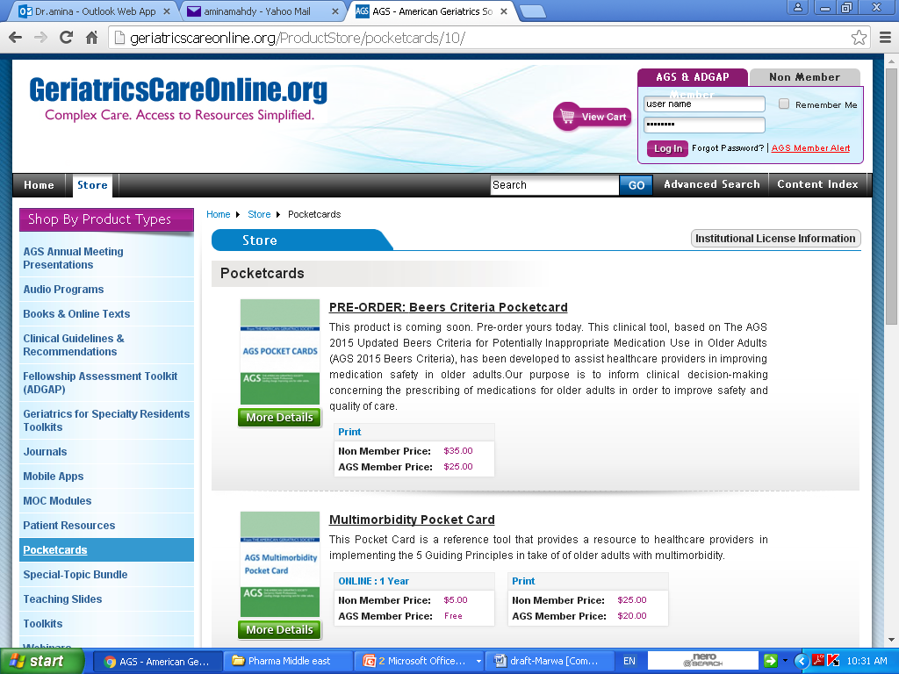
Pocket Cards
http://www.americangeriatrics.org/files/documents/beers/PrintableBeersPocketCard.pdf
DPC

Slide 36
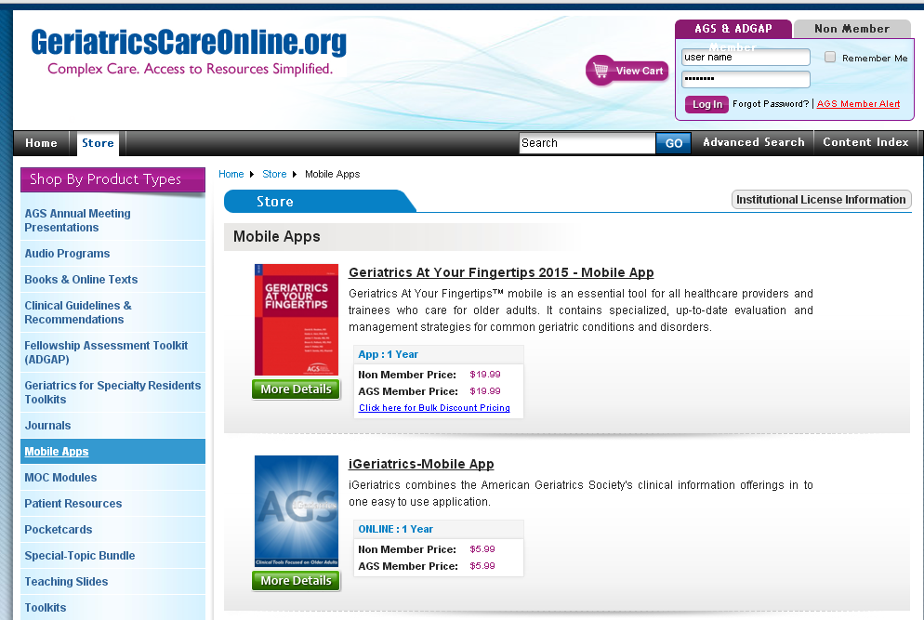
Mobile Apps
DPC

Slide 37
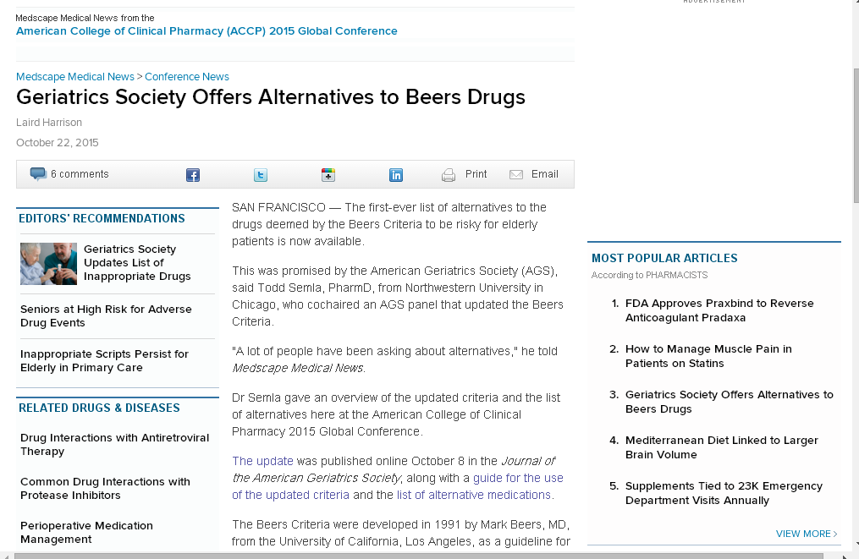
Latest News
DPC

Slide 38
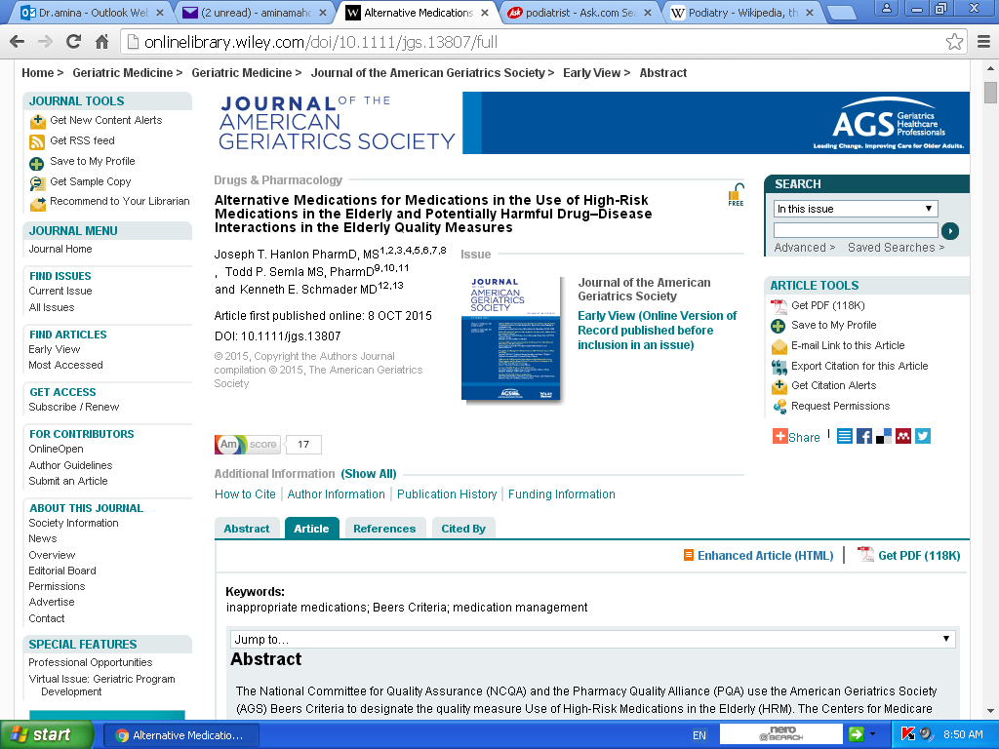
Latest News
DPC

Slide 39
THANK YOU

