Slide 1
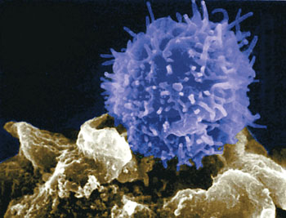
TRANSFORMING GROWTH FACTOR-β PROGRAMS CENTRAL-MEMORY DIFFERENTIATION IN EX-VIVO STIMULATED HUMAN T CELLS BY MODULATING ID3 EXPRESSION
Amina Dahmani
Dr Jean-Sébastien Delisle lab’s
Université de Montréal
Hôpital Maisonneuve-Rosemont Research Center
5th European Immunology & Innate Immunity
July 21st, 2016. Berlin, Germany

Slide 2


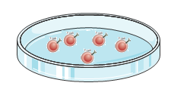
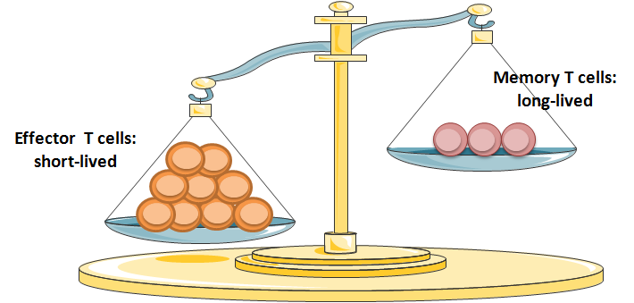
Hypothesis
Effectors T cells
T cell growth factors (such as IL-2)
Ex vivo specific activation and differentiation
Patient
With advanced cancer/chronic infection
T cells isolation
Diminished antitumor/viral activity

Slide 3
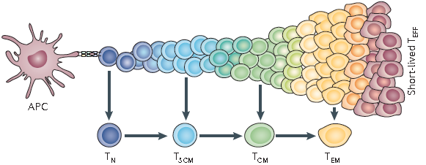
The adoptive transfer of T cells with early memory features may improve the therapeutic potential of AI
Transforming Growth Factor β (TGF-β)
TGF-β is a quiescence factor that promotes hematopoietic stem cell maintenance (Blank and Karlsson, Blood. 2015).
A recent study showed that continuous transforming growth factor-β signaling is required to maintain the identity of memory T cells in mice (Ma et Zhang, PNAS. 2015).
Strength of APC signal
Self renewal
ability
Proliferative capacity
Long-term persistence
Therapeutic efficacy
Modified from Gattinoni, Klebanoff and Restifo . Nature. 2012.

Slide 4
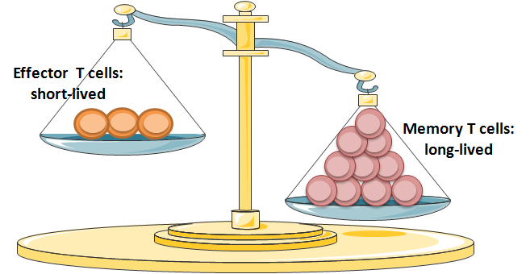
Hypothesis
Effectors T cells
Memory T cells
Exogenous TGF-β
T cell growth factors (such as IL-2)
+
Ex vivo specific activation and differentiation
ex vivo specific activation and differentiation
Patient
With advanced cancer/chronic infection
Patient
T cells isolation
T cells isolation
Diminished antitumor/viral activity
Enhanced antitumor/viral activity

Slide 5
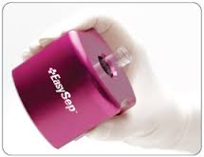
Methodology
Ficoll
Polyclonal stimulation
PBMC
T cells
aCD3 coating/CD28
Blood samples from healthy donors
T-cell enrichment
ø
TGF-β
(5ng/ml)
GW788388
(2.5µM)
Monitoring:
  Proliferation
  Survival
  Phenotype: differentiation, activation, exhaustion
  Functionality
  Transcriptional signature
Flow cytometry
qPCR
Day 7
Day 14

Slide 6
How does TGF-β modulation affect T-cell differentiation
?

Slide 7
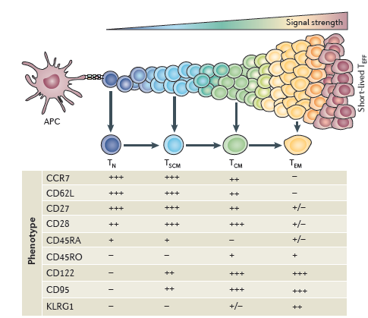
Effect of TGF-β modulation on T-cell differentiation
Activation, expansion and ex-vivo culture
Modified from Gattinoni, Klebanoff and Restifo . Nature. 2012.

Slide 8

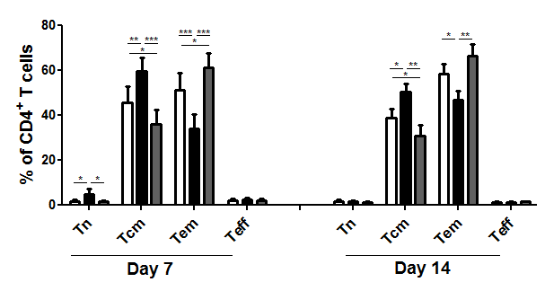
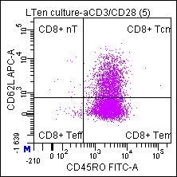
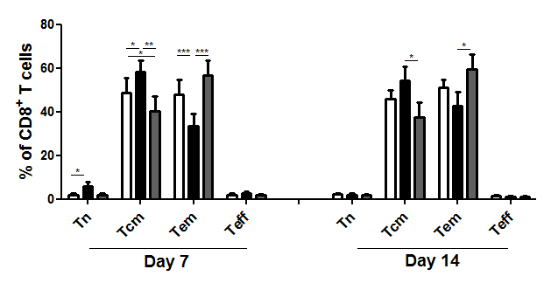
Effect of TGF-β modulation on T cell differentiation
CD4⁺ T cells
Tn
Tcm
Teff
Tem
CD62L
CD45RO
nT: naive T cells.
Tcm: central memory T cells
Tem: effector memory T cells
Teff: effector T cells
CD8⁺ T cells
N=10; *P˂0.05; **P˂0.01; ***P˂0.001 by one tailed paired T test.
TGF-β promotes the accumulation of central memory T cells
Notes:
So we analysed the effect of TGF on T cells differentiation based on the expression of CD62L and CD45RO. Interestingly, we observed that TGF-treated T cells dominantly displayed a central memory phenotype (shown here in black bar). While for control conditions, or for TGF signaling inhibitor condition, the majority of T cells expressed effector memory phenotype (open bar). An this was true for both CD4 and CD8 T cells.
So These data show that TGF promotes central memory differentiation of ex vivo stimulated T cells.
I will not show you this today, but we also found that TGF did not COMPROMISED T cells functionality and proliferation

Slide 9
At transcriptional level:
Does TGF-β modulate the expression of memory/effector transcription factors
?

Slide 10

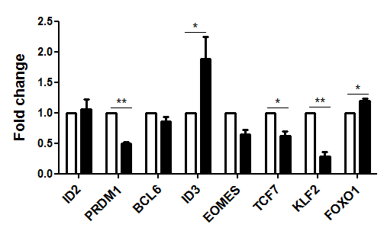
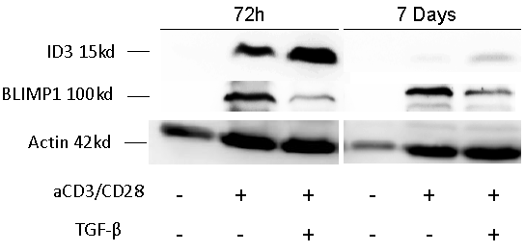
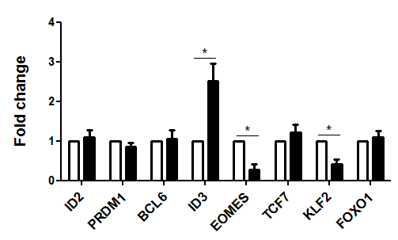
What is the transcriptional signature of TGF-β-induced memory cells
A
-
CD4⁺
B
CD8⁺
N=4
N=4 for ID3, N=3 for BLIMP1
Effector
associatedgenes
Memory associated
genes
TGF-β exposure is associated with ID3 up regulation
PRDM1: encode for BLIMP1

Slide 11
Does the effect of TGF-β on memory differentiation depend on ID3 expression
?

Slide 12
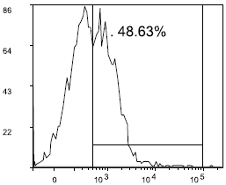
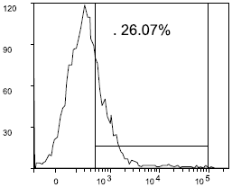
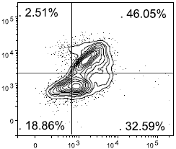
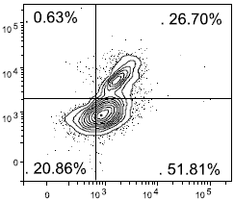
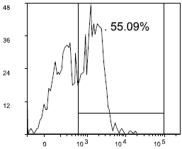
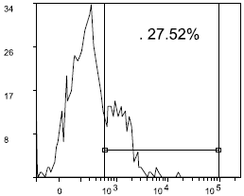
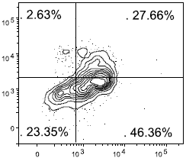
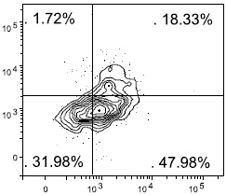
IS the effect of TGF-β on memory differentiation ID3-dependent?
Effect of TGF-β on T-cell differentiation in ID3 Knock Down
ID3 Knock Down
aCD3/CD28 + TGF-β
aCD3/CD28 + TGF-β
siRNA-CTRL
siRNA-ID3
siRNA-CTRL
siRNA-ID3
Tcm
Tcm
CD4⁺
Tem
Tem
Tcm
Tcm
CD8⁺
Tem
Tem
CD62L
ID3
CD45RO
TGF-β favors central memory differentiation through the induction of ID3

Slide 13
In vivo model:
Are TGF-β-treated T cells capable of enhanced proliferation, persistence and reactivity in vivo
?

Slide 14
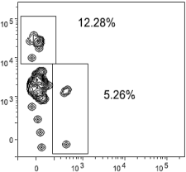
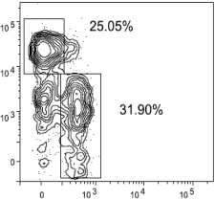

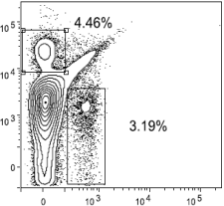
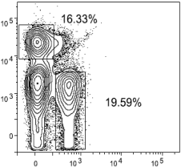
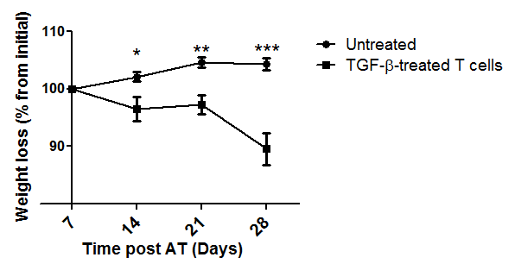
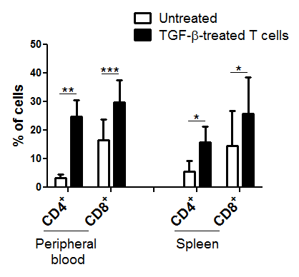
TGF-β treated-T cells show enhanced
expansion, persistence and alloreactivity in vivo
Untreated
TGF-β-treated
2.25 Gy
Peripheral blood
CTRL or TGF-β-T cells
Analysis
Day
-1
0
7
14
21
28
NSG
N=8
Spleen
hCD8
TGF-β treated-T cells induce GVHD
hCD4

Slide 15
Clinical pertinence:
CAN adoptive immunotherapy benefit from tgf-β MODULATION in a “clinical-like” protocol
?

Slide 16
“Clinical-like” protocol for the generation of EBNA1-specific T-cell line (Epstein-Barr virus antigen)
PBMC
EBNA1-specific T cell line
Blood samples from healthy donors
21-28 days
Irradiation
IL-7 + IL-15
IL-7 + IL-15
+ TGF-β
+
EBNA1 peptide library
EBNA1- pulsed Dendrtitic cells
Monitoring:
  CM differentiation (FACS).
  Functionality (IFN-γ ELISPOT asssay)
  Expansion

Slide 17
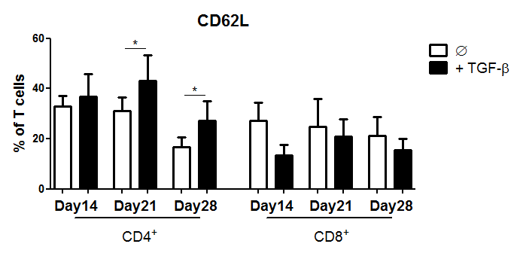
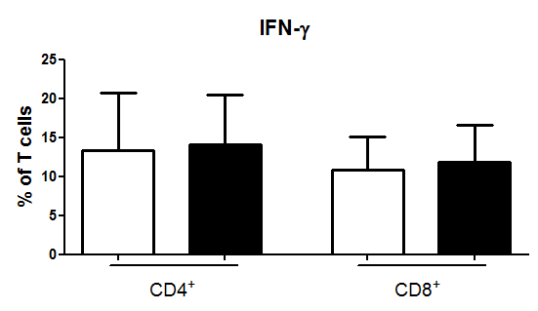
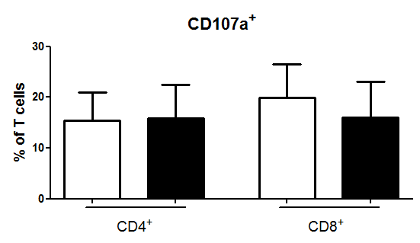
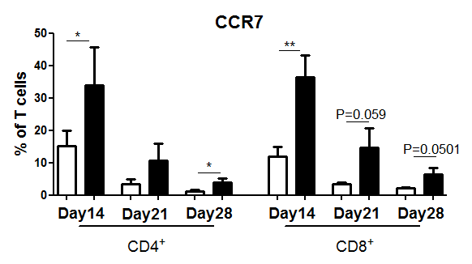
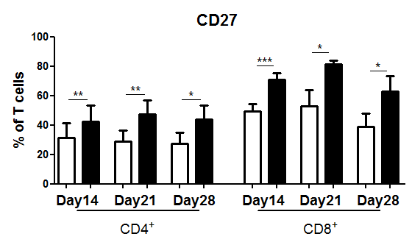
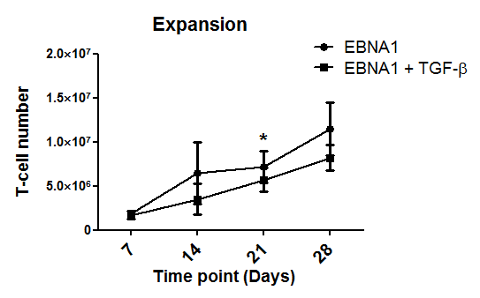
Effect of TGF-β on EBNA1 T-cell line differentiation, function and expansion (EBV antigen)
A
B
C
IFN-γ ELISPOT assay
No
peptide
EBNA1
library
ø
TGF-β
D
N=5; *P˂0.05; **P˂0.01; ***P˂0.001 by one tailed paired T test.
TGF-β favors memory differentiation of CD4⁺ EBNA1-T-cell line without affecting their expansion or capacity to release IFN-γ upon antigen recognition.

Slide 18




TCR-CD3
TGF-β
Clinical pertinence:
Memory differentiation of CD4+ EBNA1-T-cell line
?
P
LCK
P
CD62L
P
?
CCR7
X
BLIMP1
ID3
+
In vivo:
Persistence
Proliferation
Reactivity
IFN-γ
Memory T cell
TNF-α
IL-2
Polyfunctionality

Slide 19
Take home message
In this study:
  We have identified a new role of TGF-β in human T cell biology: memory differentiation
  We provide a rationale for clinical use of TGF-β for the preparation of improved T cells for adoptive immunotherapy

Slide 20
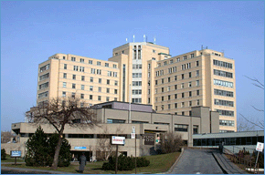



Acknowledgement
Supervisor: Dr Jean-Sébastien Delisle
Lab members:
Cédric Carli
Manon Richaud
Valérie Janelle
Julie Orio
Eustache Ouassa
Caroline Lamarche
Sheena Blaise
Cecile Grange
Shirin Lak
Thomas Pincez
Victoria Georgest
Guillaume Brodeur
Mathieu Goupil
Myriam Khalili
Collaborators:
Dr Denis-Claude Roy lab’s
Dr Claude Perault
Dr Heather Melichar
Dr Nathalie Labreque
Cell sorting – Martine Dupuis
Animal care staff
Healthy donor volunteers
Thank you for your attention

Slide 21
Supplementary data

Slide 22

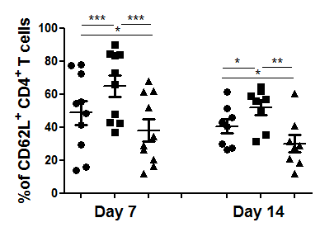
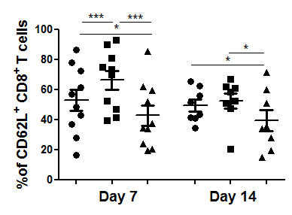
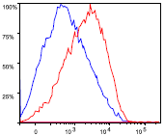
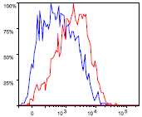
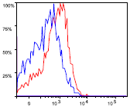
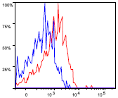
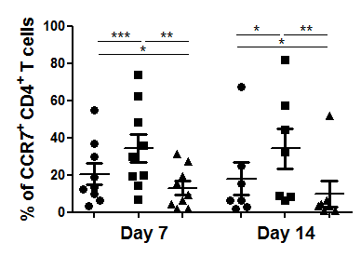
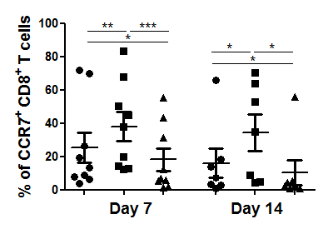
Effect of TGF-β modulation on T-cell phenotype
ø
A
TGF-β
B
CD4⁺
CD8⁺
CD62L
CCR7
N=10 for CD62L; N=9 for CCR7; *P˂0.05; **P˂0.01; ***P˂0.001 by one tailed paired T test.
TGF-β promotes the expression of CD62L and CCR7 in ex vivo stimulated hT cells

Slide 23
Does TGF-β modulation affect T-cell functionality (cytokine secretion)
?

Slide 24

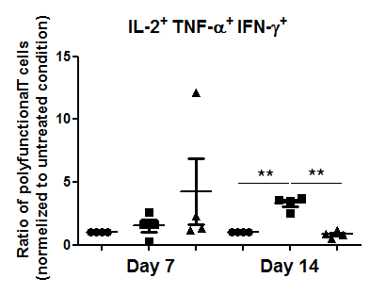
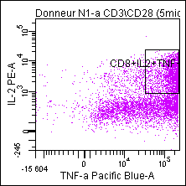
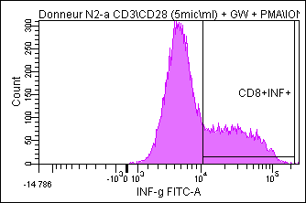
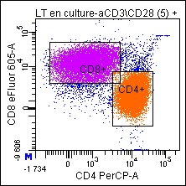
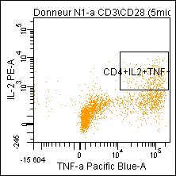
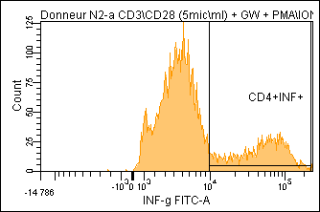
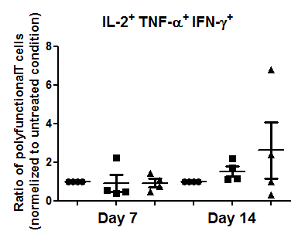
Effect of TGF-β signalling modulation on polyfunctionality
CD8⁺
CD4⁺
CD8
CD4
IL-2
TNF-α
IFN-γ
N=4 ; **P˂0.01
TGF-β does not impede the acquisition of polyfunctionality of T cells

Slide 25
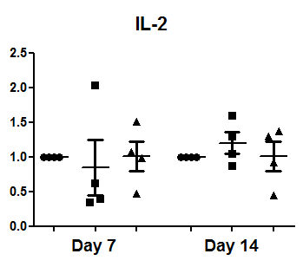





CD4⁺
CD8⁺
Ratio of cytokine secreting T cells (normalized to untreated condition)

Slide 26
























A
B
CD8⁺
CD4⁺
ø
TGF-β
GW
ø
TGF-β
GW
Day 3
C
Day 7
Day 14
CTV
C

Slide 27








A
CD3⁺CD45RA⁺ CCR7⁺T cells
CD45RA
CCR7
CD3⁺CD45RO⁺ T cells
CD3
CD45RO
B
CD4⁺ T cells
CD8⁺ T cells
CD3⁺CD45RA⁺ CCR7⁺T cells
CD3⁺CD45RO⁺
T cells

Slide 28











TGF-β does not induce Treg or Th17
A
CD4⁺
B
D
CD8⁺
C
Unstimulated
aCD3/CD28
ø
+ TGF-β
TReg
T cells/Treg To responder ratio
1:8
CTV dilution

Slide 29


Slide 30




ID3 expression(d14)
CD4⁺ T cells
aCD3/CD28 + TGF-β
aCD3/CD28
siRNA-CTRL
siRNA-ID3

Slide 31




Does ID3 down regulation affect differentiation of TGF-β-treated T cells?
CD4⁺ T cells
aCD3/CD28
aCD3/CD28 + TGF-β
siRNA-CTRL
siRNA-ID3
CD62L
CD45RO

Slide 32




ID3 expression(d14)
CD8⁺ T cells
aCD3/CD28 + TGF-β
aCD3/CD28
siRNA-CTRL
siRNA-ID3

Slide 33




Does ID3 down regulation affect differentiation of TGF-β-treated T cells?
CD8⁺ T cells
aCD3/CD28
aCD3/CD28 + TGF-β
siRNA-CTRL
siRNA-ID3
CD62L
CD45RO

Slide 34








Day 7
Day 14
Day 21
Day 28
ø
TGF-β
hCD8
hCD4

Slide 35

Effect of TGF-β modulation on T-cell proliferation
aCD3/CD28
aCD3/CD28 + TGF-β
aCD3/CD28 + GW
CD8⁺
CD4⁺
CD8⁺
CD4⁺
CD8⁺
CD4⁺
Day 3
Day 7
Day 14
CTV
Results are representative of one of 3 independent experiments.
N=6 donor; Error bars represent SEM variation.

Slide 36


Effect of TGF-β modulation on CD4⁺ and CD8⁺ T-cell proportion
Day 7
Day 14
N=6 donor; Error bars represent SEM variation.
TGF-β modulation does not affect CD4⁺ and CD8⁺ T-cell proportion.

Slide 37
Does TGF-β modulation affect T-cell viability
?

Slide 38



Effect of TGF-β modulation on T-cell viability
PI
Annexin V
CD8⁺ T cells
CD4⁺ T cells
*
*
N=3; Error bars represent SEM variation. *P˂0.05.
TGF-β signaling inhibition affects slightly T-cell viability on day 7.

Slide 39


Effect of TGF-β modulation on T cells viability
N=6 donor; Error bars represent SEM variation.
TGF-β modulation does not affect T cells’ viability

Slide 40
Clinical relevance:
Cross-talk between TGF-β and other cytokine signalling pathways,
USED IN ”clinical-like” T-CELL CULTURE.

Slide 41

T cells enrichment
Day 7
FACS
Day 14
PBMC
T cells
aCD3 coating/CD28
Cytokines
IL-7
+
IL-15
+
TGF-β
IL-7
+
IL-15
+
GW
IL-7
+
TGF-β
IL-7
+
GW
IL-15
+
TGF-β
IL-15
+
GW
ø
TGF-β
GW
IL-7
IL-15

Slide 42


CD4⁺ T cells
*
*
*
*
CD8⁺ T cells
*
*
N=3; Error bars represent SEM variation.

Slide 43







Effect of TGF-β on WT1-T-cell line differentiation, function and expansion (Tumor associated antigen)
A
B
C

Slide 44
Déterminer la concentration optimale in vitro de GW chez l’humain

Slide 45



Effet du GW788388 au jour 7
Conclusion:
La concentration optimale de GW semble être 2.5µM (comme chez la souris).

Slide 46



Effet du GW788388 au jour 14
Conclusion:
Au jour 14, l’effet dose dépendent du GW n’est plus appréciable.

Slide 47



Strategies that might be used to preserve or to confer stemness to T cells
Gattinoni, Klebanoff et Restifo. Nat Rev Cancer, 2012

Slide 48
TCR-CD3
LCK
P
P
P
X
IL-7Rα
BLIMP1
X
CCR7
X
BCL2
X
ID3
X
X
CD-122
X
CXCR5
E2A
X
KLF2
X
SOCS3
X
ID3
+
Cell cycle arrest
+
Differentiation

Slide 49
TCR-CD3
TGF-β
LCK
P
P
P
miR-23a?
+
IL-7Rα
X
BLIMP1
+
CCR7
ID3
+
+
BCL2
+
MC2,3,10
Topa2
+
CD-122
E2A
+
KIF2c, KIF4a,…
+
CXCR5
ID3
+
Cdac5, cdac8
STK39
+
KLF2
+
FOXM1
NeK2
X
+
SOCS3
X
INK4A
+
ID3
X
Differentiation
+
X
Cell cycle arrest
+
X
Differentiation

Slide 50
TCR-CD3
TGF-β
LCK
P
P
P
miR-23a?
X
BLIMP1
ID3
+
+
Maintenance of self-renewal
E2A
+
Survival
ID3
+
Multipotency
X
+
Homeostasis
Maintenance of genome integrity
+
X
Cell cycle arrest
X
Replicative senescence
X
Differentiation
X
Differentiation

Slide 51
TCR-CD3
TGF-β
P
LCK
P
CD62L
P
CCR7
X
BLIMP1
ID3
+
Persistence
Proliferation
Reactivity
E2A
Transcriptional activity
X
X
IFN-γ
Memory T cell
TNF-α
IL-2
Polyfunctionality

