Slide 1


Efficient Separation of Dilute Oil Contaminations from Wastewater by Functionalized Magnetic Nanoparticles
Dr. Nima Rezaei, Dr. Abdulwahab S. Al-Musallam
Prof. Ameer Al-Haddad*
Chemical Engineering Department
KUWAIT UNIVERSITY

Slide 2
Research motive
The oil spill incident are common all around the world.
Efficient and selective separation of oil from water has not been addressed successfully.
The recovery rate after the spill is usually low, causing significant environmental effects in addition to oil loss.

Slide 3
Research motive
Researchers are developing advance methods instead of the conventional oil-water separation.
Various methods under study to only allow the oil to be collected.
Superhydrophobic and superoleophlic surfaces with hierarchical micro/nano roughness found tremendous attention for oil-water separation.
These methods have applications such as wastewater treatment and managing oil or chemical spills.

Slide 4
Industries producing waste water
Industries producing oily waste water are:
  Oil and gas
    It produces the highest oil (and grease) concentration in the wastewater effluent
  Metal processing
  Food industry
  Textile industry
  Pulp and paper industries
  Can producing industry

Slide 5
Oil water mixture
The oil contaminant can be in the form of:
  Free-oil (a layer of oil on water, such as in oil spills)
  Dispersed oil
  Emulsified oil
  The separation of emulsified oil is the most difficult separation, especially if the:
    Emulsion is stable (or tight emulsion)
    Concentration of oil contaminant is low

Slide 6
Seperation techniques
The oil-water separation is achieved by different physical and chemical methods:
  Sedimentation and floatation for dispersed (with or without coagulant) or free oil
  Centrifugation used to accelerate the settling and floatation velocities
  Dissolved air floatation
  Skimmers
  Biological degradation
  Membrane technology

Slide 7
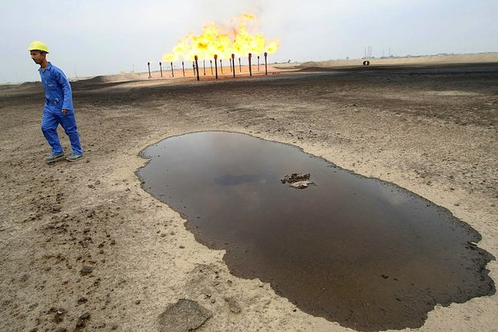
Main Challenges in oil water Separation
Current technologies to separate the oil contaminants are:
  Compositional dependent
  Energy and material demanding
  Expensive technology
  Require large buffering tanks because of low selectivity
  Frequent process maintenance in the case of membrane-based separation technologies

Slide 8
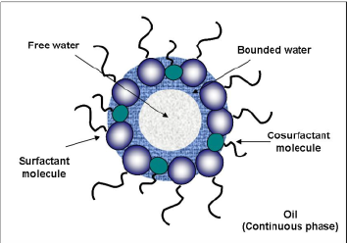
Challenges with large wastewater throughput
These challenges are intensified for conditions where the oil is in the form of tight micro-emulsions
  As it has high viscosity
  Has comparable density to the water phase (e.g., heavy oil-water mixture)
  Presence of surfactants and solid contaminations add complexity to the challenge

Slide 9
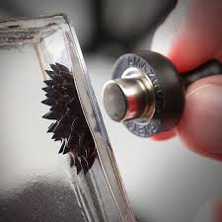
magnetic force for the separation
Important properties of Magnetic NanoParticles (MNP) are:
  Good magnetic properties
  Low cytotoxicity
  Biocompatibility

Slide 10
MNP surface chemistry
The surface chemistry of this magnetic core should be modified to:
  Attain proper interfacial activity
  The surface modifier (a surfactant or a polymer) should enhance the interfacial activity in a way for MNPs to exhibit their magnetic property at oil-water interface and/or in the dispersed phase
  Provide good dispersibility in the continuous phase

Slide 11
Benefits of using magnetic nanoparticles
Benefits of magnetic nanoparticles (MNP) for encapsulation and separation of oil droplets are:
  Easy dispersibility of nanoparticles in the aqueous phase and allow them to accumulate the interface of oil droplets with water
  MNP increases the stability of the emulsion.
  The magnetic force between MNPs and magnet accelerates the oil separation
  Decreases the energy requirements for such separation process

Slide 12
Experimental Investigation
Experimental runs are conducted to investigate:
  Emulsion size distribution
  Effect of oil concentration
  Effect of MNP concentration
  Effect of MNP coating
  Magnetic field strength on the efficiency of oil separation.

Slide 13
Experimental procedure
Preparation of oil-water-surfactant mixture
The oil water microemulsions are prepared using a high-shear mixer
The size distribution of oil droplets are analyzed by light-scattering technique
Analysis predict the MNPs size, morphology and roughness

Slide 14
benefits
The study significantly benefits:
  Recycling oily wastewater to minimize the footprint; this is critical importance to Kuwait, which is among the countries with lowest available water per capita.
  It will also help the companies with water availability for an increase in the oil production capacity of waterflooding (for conventional oil) and steam-assisted gravity drainage—SAGD (for heavy oil formations).

Slide 15
first phase
Emulsion preparation and characterization
  Preparation of 1% oil in aqueous phase solution using dodecane as the oil phase, de-ionized water and sodium dodecyl sulfate (SDS) as surfactant.
  The emulsion was prepared by a combination of high shear mixer and sonicator.
  The stability of the emulsions was quantified using droplet size distribution measurement along with visual inspection of any creaming.

Slide 16
Emulsion preparation
Emulsions was prepared by:
  Mixing oil, surfactant and water at concentrations 1%, 0.3% and 98.4% water (by volume).
  Initially the samples are prepared by weight and the values are converted to volume by density.
  The oil concentration was fixed at 1% and the concentration of SDS was obtained by changing the concentration of SDS
  The concentration of SDS was changed from 0 - 1% by volume.
    It is beneficial to use minimal amount of surfactant to avoid its interference with the light scattering measurements (size distribution and concentration) and with the separation process in general, and to have enough stability during the experiments

Slide 17
dissolved air removal
The de-ionize water phase (W) was first de-aerated under vacuum.
The air dissolved in fresh water can exsolve from solution under shear conditions and can attach at the oil-water interface in the o/w emulsion.
This condition adds complexity to the separation process because the air bubbles can make the oil droplets buoyant and can separate them through creaming.

Slide 18
Mixing procedure
The de-aerated water was mixed with proper amount of SDS surfactant.
They were mixed in a high shear mixer (Silverson L5M-A) at 500 rpm until completely dissolved.
Desired amount of oil (1% in solution) is added to resemble a dilute oil contamination.
The oil was emulsified in high shear mixer for a period of 15 minutes in successive increase in rpm from 500 to 3000 rpm.
750 ml of the solution was prepared for each run.
A 20 ml sample was taken from the high shear mixer, and a sonication probe (MISONIX) was placed in the solution and sonicated for a period of 10 minutes at a power of about 10W.

Slide 19
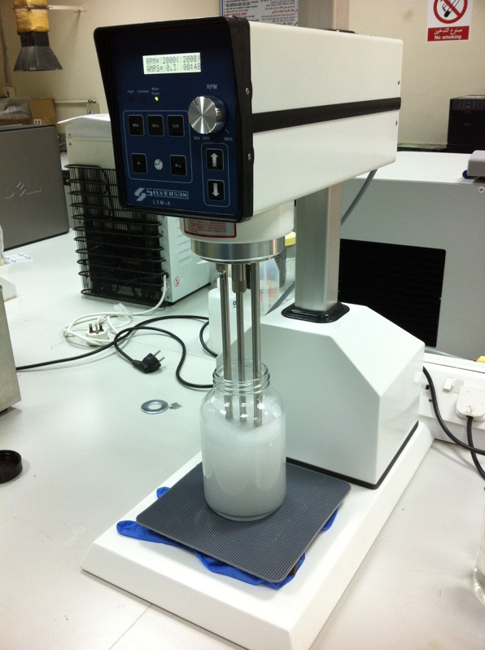
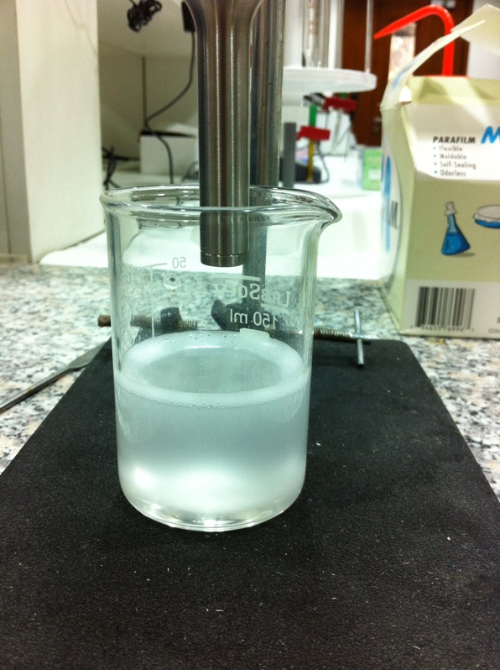
two-step emulsification process
Homogenization by high shear mixer
Ultrasonication to create stable emulsions

Slide 20
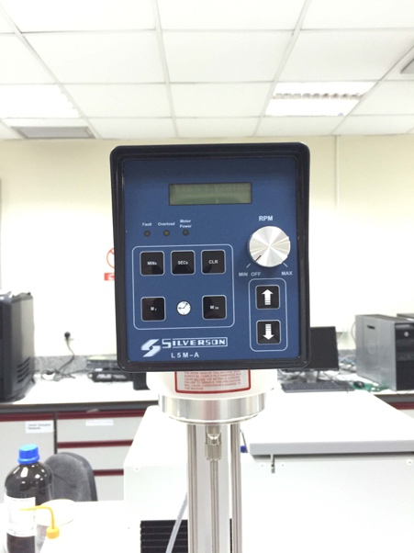
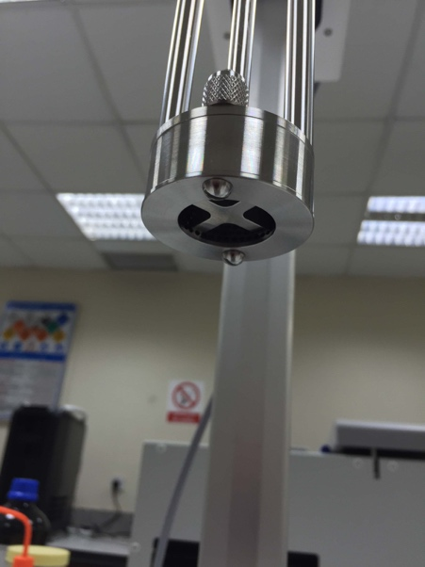
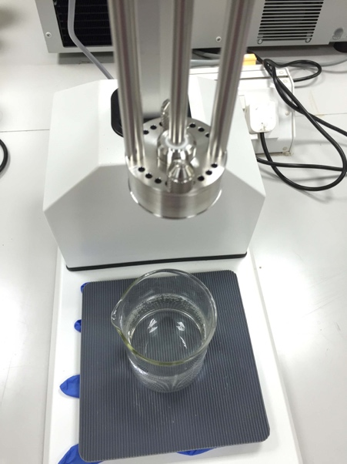
high shear mixer
Head and controller
Bottom mixer blades
Shaft and top mixer holes

Slide 21
high shear mixer operation
The mixing, and emulsion droplet rupture was obtained in two stages
A high shear blade creates the condition for suction, and the liquids entered the mixer casing to be forced radially through perforations, and then upwards through the holes .
The mixing system lowers the extent of aeration.
Perforated plates of different window openings can be used for different emulsion size.

Slide 22
sonication
Sonication is used to further decrease the size of emulsions (to achieve emulsion stability within the time-frame of oil-water separation experiments).
Cooling water bath is used to avoid the overheating imposed during the sonication process.
The temperature of cooling water bath was adjusted at room temperature of 25 ºC.

Slide 23
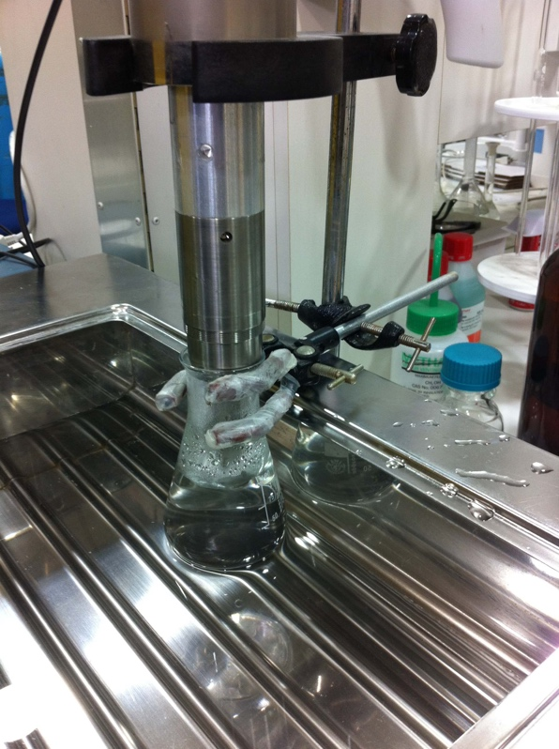
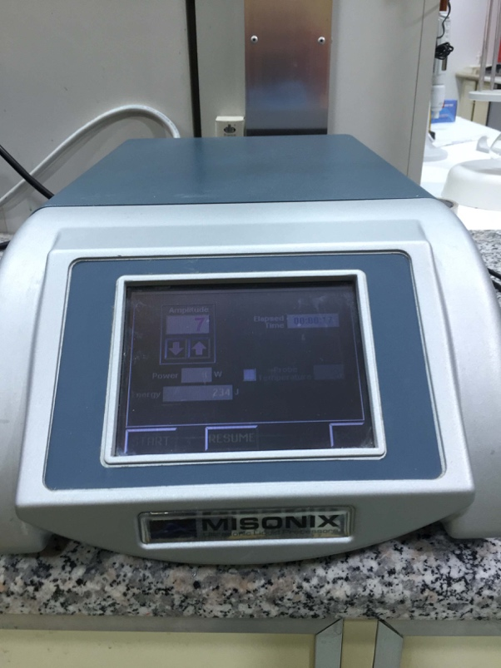
Sonication equipment
Sonication horn and water bath
Sonication controller

Slide 24
size distribution measurements
  Calibration the oil concentration measurement using static light scattering measurement for dilute oil-water mixtures.
Measurements were conducted by dynamic light scattering for a time period of
  2 hrs
  6 hrs
  1 day
  2 days
  7 days

Slide 25
Emulsion stability analysis
The stability of emulsion was quantified using dynamic light scattering (MALVERN)
This was also combined with visual observation of possible creaming
A sample is taken from the emulsion and is studied for a period up to 48 hours with frequent size distribution measurements
The growth of emulsion size is investigated by this method

Slide 26
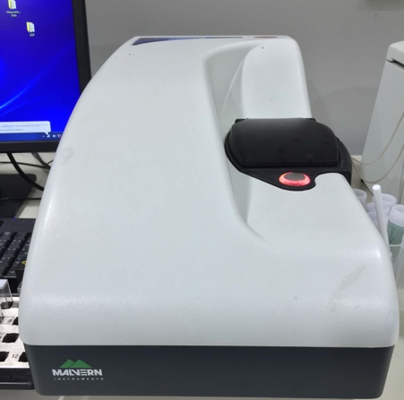
Dynamic light scattering by MALVERN
Emulsion size distribution measurement apparatus

Slide 27
Effect of surfactant concentration on size distribution and emulsion stability
The size distribution of emulsion droplets was measured through dynamic light scattering
First replicability experiments are conducted to quantify measurement variability.
This test is conducted for 1% oil, and 0.3% SDS in water solution.
The emulsification was conducted using an ultrasonic probe at a power of 10 W for a period of 30 minutes, while the vessel containing the emulsion was immersed in a cooling bath at a temperature 25 ºC.

Slide 28
Effect of surfactant concentration on size distribution and emulsion stability
The solution was characterized initially, and after one week the stability of o/w emulsions was measured.
The replication results showed a very good replicability in the mean size distribution.
A 95% confidence interval is shown which demonstrates replicable measurements.
These five samples were prepared and measured independently and show replicated runs and not repeated measurements.

Slide 29
Effect of surfactant concentration on size distribution and emulsion stability
Replication results for 1% oil, 0.3% SDS and 98.7% water (by volume)
Run | Mean droplet diameter (nm)
 | After preparation | After one week
1 | 155.2 | 212.8
2 | 156.5 | 214.1
3 | 154.9 | 210.2
4 | 155.5 | 217.0
5 | 154.5 | 216.0

Slide 30
Effect of SDS concentration on mean oil droplet diameter in dilute o/w emulsions (at 1% vol. oil concentration)

Slide 31
Effect of surfactant concentration on size distribution and emulsion stability
It is clear from this figure that with an increase in SDS concentration, the size of oil droplets decreases.
The reason for the decrease in size is due to reduction in interfacial tension between the oil and water phases which makes it easier for the interface to be ruptured under shear.
The critical micelle concentration (CMC) for SDS is around 0.2 wt%, depending on temperature.

Slide 32
Effect of surfactant concentration on size distribution and emulsion stability
After critical micelle concentration is formed, the addition of surfactant concentration does not appreciably change the interfacial tension which will result in size to be unaffected by the addition of surfactant thereafter.
The average size of oil droplets in the mixture of oil, water, surfactant under shearing condition of sonication (for 30 minutes) is about 156 nm, which grows to 214 nm after a period of 1 week.

Slide 33
Emulsion stability dynamics
The dynamics of emulsion stability was quantified through size measurement by dynamic light scattering over a prolonged period of time.
The results for droplet mean diameter for the case of emulsion mixture at composition 1% dodecane (oil), and 0.3% SDS in de-ionized water is shown in the following figure

Slide 34
Dynamic measurement of droplet mean diameter
Measurement for 1% dodecane, 0.3% SDS (vol%) using dynamic light scattering at 25 °C

Slide 35
Emulsion stability dynamics
This figure shows that initially there is a stronger dynamic effect on the mean diameter of oil-in-water emulsion droplets.
After about 10 hours, the change in droplet size by time is more gradual.
Thus it is better not to use fresh o/w emulsion samples for the use in oil-water separation using MNPs.
Based on this result, the samples, should be allowed to rest overnight, and then to conduct the separation tests in the morning.
The reason is that the size distribution of o/w emulsion droplets will affect the separation efficiency by MNPs, and also the size distribution measurements by dynamic light scattering.

Slide 36
Overlay of size distribution
Size distribution for o/w emulsions at 1% oil, 0.3% SDS in de-ionized water.
Mixture prepared by high shear mixer (15 minutes at 2000 rpm) and 10 minutes sonication

Slide 37
Emulsion size distribution
This figure shows that the emulsion size distribution obtained by the two step emulsification by high shear mixer and ultrasonification follows a unimodal size distribution.
there is a shift in droplet mean size towards larger sizes after the sample is prepared.
The growth in size is similar for both the smaller and larger droplets which is interesting as the symmetry in size distribution is still seen over time.
This emulsion droplet growth is ceased after about 10 hours.
Especially, after 15 hours there is not a significant change in size distribution of o/w emulsion droplets.

Slide 38
dynamic results for mean size of emulsion droplet
Droplet mean size for o/w emulsion at 1% oil, and 0.6% SDS in water
The mixture is homogenized with high shear mixer and emulsified using ultrasonic horn

Slide 39
dynamic results for mean size of emulsion droplet
Long-term droplet mean size for o/w emulsion at 1% oil, and 0.6% SDS in water
The mixture is homogenized with high shear mixer and emulsified with ultrasonic horn

Slide 40
dynamic results for mean size of emulsion droplet
This figure shows that the emulsion is still not stable up to 48 hours; however, the rate of change in the size of o/w emulsions decreases significantly after the sharp increase in size which occurs initially.
Similar to our previous results, we should avoid the use of fresh emulsions for oil-water separation tests with the use of MNPs. Similarly, after about 15 hours, the rate of growth in size is practically small.
We find that a quadratic function can be roughly used to model the growth dynamics in the size of emulsion droplets in the range of experimental levels. This mathematical function can be used to predict the size of emulsion as a function of time up to 48 hrs.

Slide 41
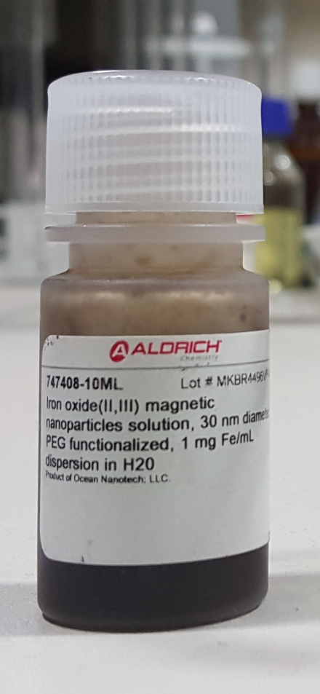
Magnetic nano particles
The details of MNPs used for the experimental runs are:
  Iron Oxide (II, III) magnetic nanoparticle solution
  30 nm diameter
  PolyEthylene Glycol functionalized
  1 mg Fe/ml
  Dispersion in H₂O

Slide 42
oil-water separation test by the use of MNPs
Test with MNPs were conducted to separate the (semi) stable oil emulsions with a size of about 200 nm.
For this test, the emulsion mixture of 1% dodecane, and 0.3% SDS in de-aerated de-ionized water was used.
After the emulsion was stable, MNPs was added and dispersed them in the mixture using ultrasonic horn at a power 10 W for about 10 minutes.
The nanoparticles which were used in this preliminary run were 30 nm Fe₃O₄, functionalized with PolyEthylene Glycol (PEG) and dispersed in water at concentration 1 mg/ml Fe₃O₄ (Sigma Aldrich).

Slide 43
oil-water separation test by the use of MNPs
Initially MNP solution was added to the emulsion and was sonicated and then allowed it to rest over a piece of magnet.
The magnetic nanoparticles are accumulated at the bottom of test tube after magnetic field is applied.
However, we do not see the oil droplets being dragged to the bottom of the vessels along with the nanoparticles.
The mixture was allowed to sit for about 2 days.
The PEG-coated Fe₃O₄ nanoparticles with a mean size of 30 nm can not effectively separate the oil droplets from oil-water-surfactant mixture, using qualitative measurements.

Slide 44
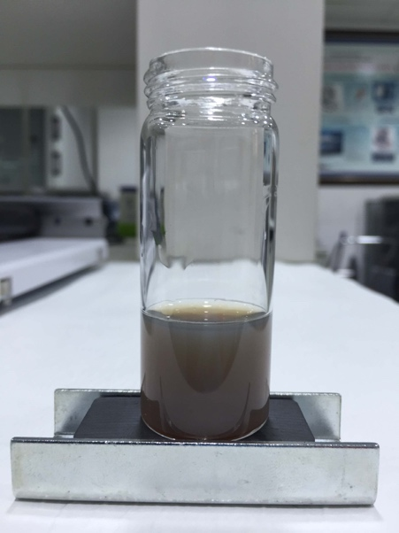
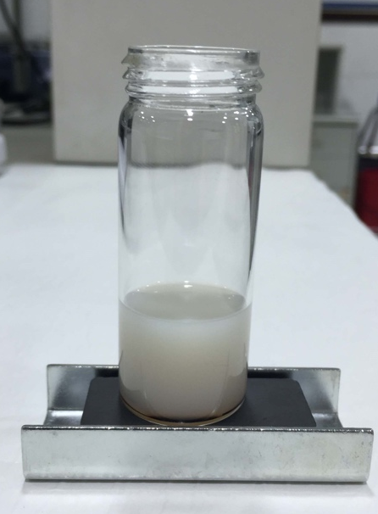
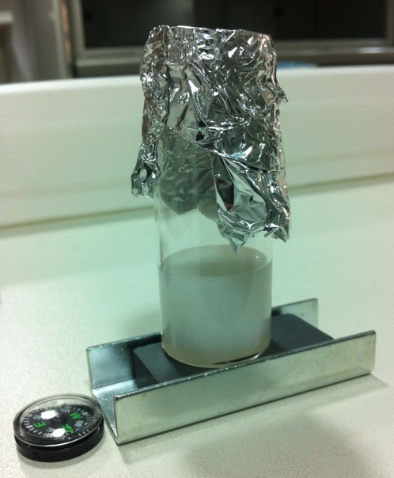
oil-water separation test by the use of MNPs
At the time of preparation
After magnetic field is applied
after 2 days
Pictures of dispersed 30 nm PEG functionalized iron oxide nanoparticles in water, dispersed in 1% dodecane, 0.3% SDS, in water

Slide 45
Conclusions
The critical micelle concentration was found for SDS-water system at room temperature to be between 0.2 to 0.3% by volume.
To attain the critical micelle concentration level, the mean size of emulsions was measured by dynamic light scattering for a mixture with SDS concentration varying between 0.05 to 0.4% by volume and oil concentration of 1%.
For a system of 1% dodecane, 0.3% SDS in de-ionized water, oil-in-water emulsion was created by sonicating the mixture for 30 minutes with a controlled temperature bath.
Using dynamic light scattering, the size distribution has a mean diameter at 156 nm which grows to about 214 nm after 1 week.
The grow in size of droplets occurs for both small and large oil droplets and the dynamic study of emulsion droplet size distribution shows a single peak.

Slide 46
Conclusions
The 24-hour dynamic study of o/w size distribution for the system of 1% dodecane, 0.3% SDS in aqueous solution shows that there is a more rapid growth of emulsion droplets, initially.
This study suggests using stable emulsion. After about 15 hours, the growth of oil droplets is slower.
The 48-hour study of o/w size distribution for the system of 1% oil and 0.6% SDS in the aqueous solution shows the same trend. After about 15 hours, the size is about 12% smaller than the size after 2 days; after 1 day, the size is about 8% smaller.
Similarly, the size distribution shows a shift in size for both small and large droplets.

Slide 47
Conclusions
Preliminary oil-water separation test was conducted using PEG-coated Fe₃O₄ nanoparticles with a mean diameter of 30 nm dispersed in water at concentration 1 mg/ml.
The preliminary run revealed no significant change in turbidity of emulsion mixture after the addition of MNPs, and after applying the magnetic forces using a magnet.
In this preliminary run, we had sonicated the solution.
For future studies, the concentration of MNPs and the type of mixing should be studied for a better performance.

Slide 48
Acknowledgment
This project was fully funded by Kuwait Foundation for Advancement of Science (KFAS)
Project #P315-25C-01

