Slide 1


Prevalence and reasons for consumption of energy drinks among adolescents and young adults in Jeddah, Saudi Arabia
Dr. Amani A. Alrasheedi
Associated professor Nutrition and food science
Food and Nutrition- Home Economics
King Abdul Aziz University – Jeddah Saudi Arabia
Notes:
It’s a great honor to be standing here to present my study pertaining the

Slide 2
Energy drinks
The number of energy drink consumers increased since 1997 (Kenndy &Scholey 2004; Boyle & Castillo, 2006).
It is marketed in more than 140 countries and is the largest growing beverage industry. In the US in 2011 topped $9 billion. (Nitzke et al., 2011; Malinauska et al., 2007; Press office, 2011).
There are large advertising markets promoting their products to new consumers, and their main focus are children, adolescents, and youth (Babu et al., 2008).
Notes:
Energy drinks are beverages that mainly contain caffeine and sugar. And its popular worldwide due to its alerting effect and as an energy provider.
The number of energy drink consumers increased dramatically since 1997.

Slide 3
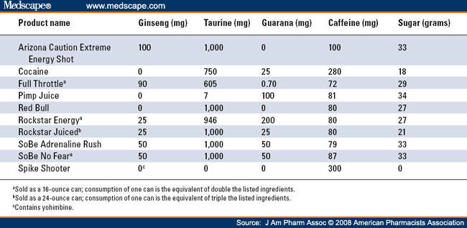
Active components
Notes:
Caffeine is the main active ingreadiant in energy drinks and it ranges from 80 – 300mg per can about 125 to 250ml.
The maximum limit of caffeine intake for healthy adults is 400 milligrams (mg). And for children not more than (2.5 mg/kg bodyweight per day) were not linked with such effects and indeed may benefit cognitive function and sports performance based on the results of adult studies.

Slide 4
Caffeine
Evidence about the effect of energy drinks on improving physical and mental performance were limited (Kennedy & Scholey 2004).
most of the literature reviews reported adverse effects on health, that include seizures, diabetes, cardiac abnormalities, mood and behavioral disorders (Seifert et al., 2011, Gallimberti et al., 2013).
Notes:
Energy drinks are marketed as an energy provider, but evidence about its role on improving physical and mental performance were limited
Whereas most of the literature reviews reported adverse effects on health, that include seizures, diabetes, cardiac abnormalities, mood and behavioral disorders

Slide 5
Caffeine
Teens often do not realize how much caffeine they drink, and many teenagers do not know how easy it is to become dependent on caffeine.
Some people are more sensitive to stimulants than others.
Notes:
Most teenaged consumers are unaware of the caffeine they consume as well as how easy it is to become dependent on it.

Slide 6
Active components
herbal extracts (guarana, ginseng and ginko biloba) Vitamins (B), amino acids (taurine), amino acids derivatives (carnitine) and sugar derivatives (glucuronalactone, ribose) (Boyle & Castillo, 2006).
There are potential interaction, such as taurine and other amino acids and between caffeine and some herbal extracts (Ballistrr & Corradi-Webster 2008).
Notes:
There are potential interactions between the components, such as taurine and other amino acids and between caffeine and some of the herbal extracts.

Slide 7
Energy drinks in Saudi Arabia
In Saudi Arabia, studies about the consumption of energy drinks by students in different education levels is limited.
(Musager & Zagzoug 2005) adolescent students(n= 834) (13-18 years) 80% drank energy drinks at least 1 can /week, males more than females.
(Al-Hazzaa et al., 2011) adolescent students (14-19years) 16.3% male drank energy drinks more than three times / week.
Notes:
Studies in Saudi arabia about energy drink consumption in general is limited.
A study taken in 2005 indicated that 80% of adolescent students drank at least 1 can per week. It also showed that males were the predominant consumers.
Another study conducted recently in 2011 showed that male adolescents drank more than three cans per week.

Slide 8
Aim of the study
to investigate the frequency of energy drink consumption among male and female intermediate, high school and university students in Jeddah city and to evaluate the reasons for drinking, knowledge and attitude regarding energy drinks.
Notes:
With the concern of the majority of the Saudi Arabian population form young adults and adolescents.
The aim of the study was to investigate the frequency of energy drink consumption among both males and females in three educational levels. It was conducted in Jeddah city to evaluate the reasons for drinking, knowledge and attitude regarding energy drinks.

Slide 9
Methods
The study was conducted from March 2014 to the end of December 2014. Approval for the study was obtained from the Ethical Committee of King Abdul Aziz University.
Study sample: A multistage, stratified, cluster random sampling technique was conducted to recruit the study sample.
4355 students: the total participants.
Study tools: A self-administrated questionnaire was used to collect the data.
Data analysis: Data were analyzed using SPSS program version 22. means ± standard deviations (SD), T-test and one way ANOVA, chi-squared test, P> 0.05
Notes:
The study was conducted in 2014. its approval was obtained from the ethical committee of KAU university.
The study sample technique used was a multistage, stratified, cluster random sample. The study sample included 4355 students.
A self-administrated questionnaire was used and the data were analyzed using an SPSS program.

Slide 10
Results
Demographic characteristics of study participants
Variable | Groups | N (%)
Gender | Male female | (50) (50)
Age | 12-14 15-17 18-20 21-23 24-26 | (21.9) (38.8) (22.0) (12.9) (4.5)
Education level | Intermediate High university | (33.2) (33.6) (33.1)
Notes:
The main results of the study showed here.
The study population was equal between both genders. And the ages ranged between 12 to 26 years. With almost equal percentages between the 3 educational levels.

Slide 11
Consumption of energy drinks n= 4355
Do you drink energy drinks?
Yes
50%
No
40%
Sometimes
(1 can / month)
4.5%
Rarely
(1 can/ 3 months)
5.5%
30 % male
20% female
15 % male
25 % female
2.5 % male
2 % female
3 % male
2.5 % female
Education level
Intermediate school
(28.5% M – 23.8% F)
High School
(28% M – 22.5% F)
University
(33.2% M – 14.6% F)
P < 0.05
Notes:
When students were asked if they drink energy drinks , 50% of them said yes, 40% said no , and a nearly close percentage chose either sometimes or rarely.
Male students predominated the females in energy drink consumption.
The study also showed that the education level was directly proportional to energy drinks consumption.

Slide 12
Consumption of energy drinks n= 4355 reasons to drink or not??
Yes
50%
No
40%
Sometimes
(1 can / month)
4.5%
Rarely
(1 can/ 3 months)
5.5%
30 % male
20% female
15 % male
25 % female
2.5 % male
2 % female
3 % male
2.5 % female
Why do you drink?
Tasty flavor 40%
Provide energy loss 15%
Reduces fatigue 10%
Friends influence 3.5%
Commercial effects 2 %
* More than one choice.
Why don’t you drink?
Health effects 28%
Never tried it before 8.5%
Friends influence 3.5%
Not tasty 6%
Other healthy choices were available 5 %
Friends influence 3.5%
Parents restrictions 2.5%
Notes:
When the students were asked for the reason of drinking the energy drink, 40% response was for the tasty flavor and 15% seek for energy or to reduce the feeling of fatigue.
While students who were not drinking appeared to be concerned about their health.

Slide 13
Consumption of energy drinks n= 4355
No of cans /week
Type of energy drinks
(more than one choice)
1 can 20.5 %
(14.2 % M - 6.5% F)
2-4 cans 38%
(22.8% M – 15.2% F)
5-7 cans 0.7%
(0.3% M – 0.3% F)
8 < cans 0.6%
(0.3% M – 0.3% F)
Red bull 20.5%
Code Red 31.6%
Bison 15%
Power horse 8.6%
Bugzi 2.3%
Monster 1.6%
Bom Bom 1.5%
Rockstar 0.3%
Burn 0.6%
P < 0.05
Notes:
A high proportion (37.9%) of respondents reported that they drank from 2 to 4 cans of energy drinks per week and (20.6%) drank one can per week.
Red bull ranked as the highest international energy drink consumed by the students at 20.5%, whereas code red had the highest consumption percentage at 31.6% as a nationally manufactured drink.

Slide 14
Consumption of energy drinks n= 4355
Consumption time
Early morning 5.6%
During the day 15.4%
Afternoon 39%
Evening 6.5%
Reasons for drinking:
Keep me awake 17%
Let me drive the car for long period of time 4%
For studying or doing a major project 2.5%
Need energy (in general) 35.5 %
Notes:
Most of the consumers drank the energy drinks in the afternoon period for the most popular reason of seeking energy at 35.5% and the second popular reason was to be kept awake.

Slide 15
Student's knowledge and attitude among energy drinks
Knowledge and Attitudes | Male (n=2176) % | Female (n= 2179) % | P-value
Do you read the food label of energy drink? Yes No | 14.3 85.7 | 35.0 65.0 | < 0.05
Do you think that energy drinks contain caffeine? Do not know Yes No | 7.5 34.8 57.7 | 17.6 31.3 51.1 | <0.05
Do you think that energy drinks contain sugar? Do not know Yes No | 5.8 91.5 2.6 | 4.5 86.0 9.5 | <0.23
Do you think that energy drinks contain herbs? Do not know Yes No | 16.2 13.2 70.6 | 13.3 15.7 71.0 | <0.36
Notes:
The students knowledge and attitudes showed that both males and females don’t read the food label of energy drinks and that might be the reason why they don’t know it contains both caffeine and herbs. On the other hand both males and females were aware of the sugar content in the drinks.

Slide 16
Student's knowledge and attitude among energy drinks
Knowledge and Attitudes | Male (n=2176) % | Female (n= 2179) % | P-value
Do you consider energy drinks to be the same as sport drinks? Do not know Yes No | 5.8 70.7 23.5 | 29.2 37.7 33.1 | <0.001
Are energy drinks proper for children? Do not know Yes No | 9.8 38.7 51.4 | 11.6 34.1 54.3 | <0.32
Are energy drinks safe during pregnancy or lactation period? Do not know Yes No | 16.7 7.3 76.1 | 8.1 0.8 91.1 | < 0.05
Are there any side effects from energy drinks on health? Do not know Yes No | 7.3 42.2 50.5 | 1.8 87.0 11.2 | < 0.001
Notes:
Most of male students thought that energy drinks are the same as sports drinks. 50% of both genders thought its not proper for children to consume the drinks. a high percentage of females thought its not safe during pregnancy and lactation period.

Slide 17
Conclusion
half of the participants consumed energy drinks at least once a week. They are motivated by both the taste and energy provided in general.
Students knowledge level regarding energy drinks were acceptable whereas their practices need improvement.
Further research should be conducted to identify if students recognize the amounts of caffeine they consume during the day from all other products that they consume aside from energy drinks.
Notes:
In conclusion half of the study sample consumed energy drinks at least once a week for both the taste and the energy provided.
The students knowledge level pertaining energy drinks was acceptable but their practices are in need of improvement.
Further research should be conducted to identify if students are aware of their daily amount of caffeine intake on a daily bases from all other products they consume aside from energy drinks alone.

Slide 18
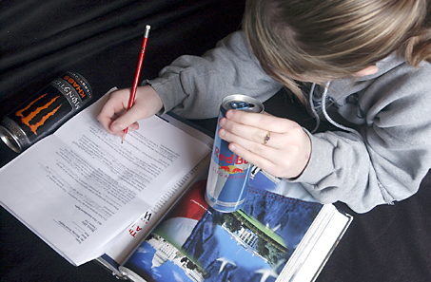
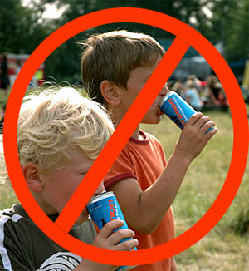
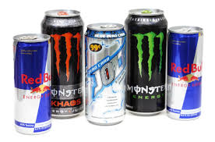

Thank you ..
Questions ?

