Slide 1
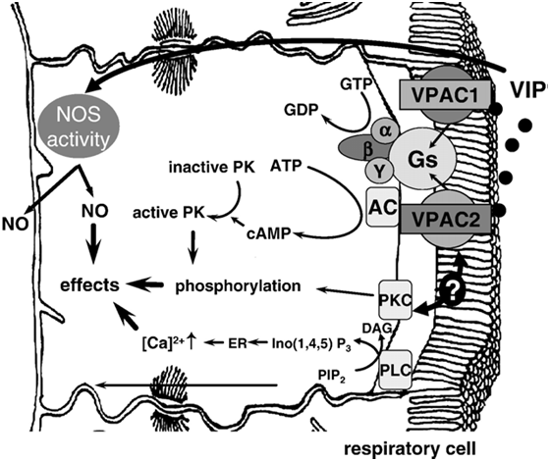
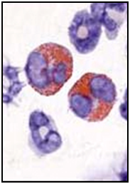
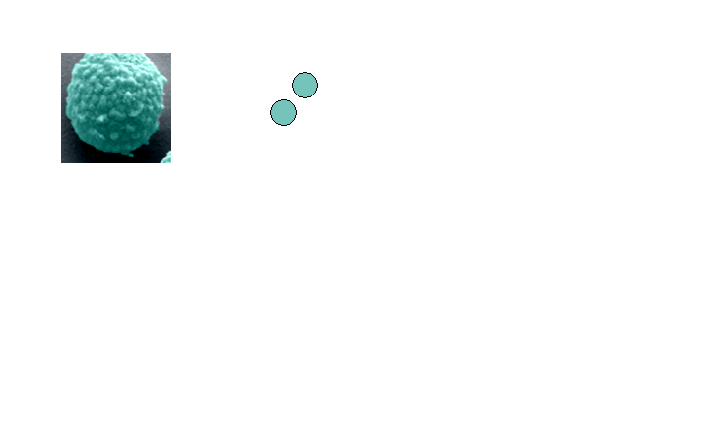

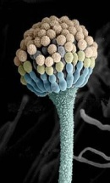
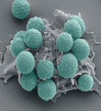

VIP/VPAC axis plays an immunomodulatory role in a murine model of Aspergillus fumigatus-induced allergic asthma
Amali Samarasinghe
20th October 2014

Slide 2
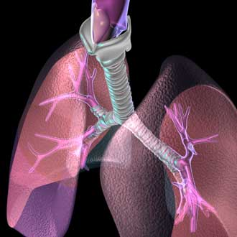
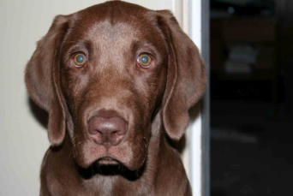

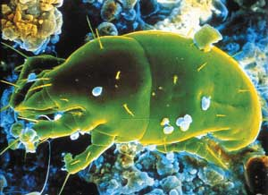




Asthma research is important
Types of asthma
  Intrinsic
  Extrinsic

Slide 3
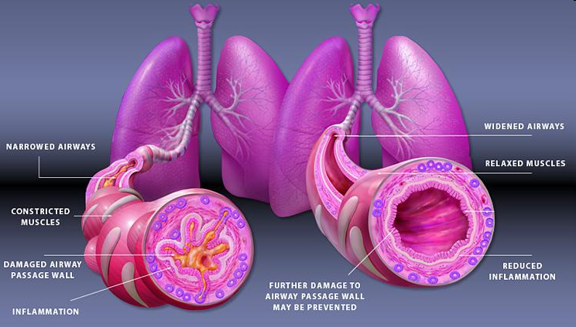
Asthma attack
Characteristics of allergic asthma:
  Airway hyperresponsiveness
  Elevated serum IgE
  Eosinophilic inflammation
  Goblet cell metaplasia with mucus hypersecretion
  Airway wall remodeling
    Subepithelial fibrosis
    Smooth muscle cell hyperplasia/hypertrophy

Slide 4
Animal models of human asthma are important
Common mouse models
  Ovalbumin
  House dust mite
  Cockroach
  Fungi
Aspergillus fumigatus
  Ubiquitous
  Small
www.medgadget.com

Slide 5
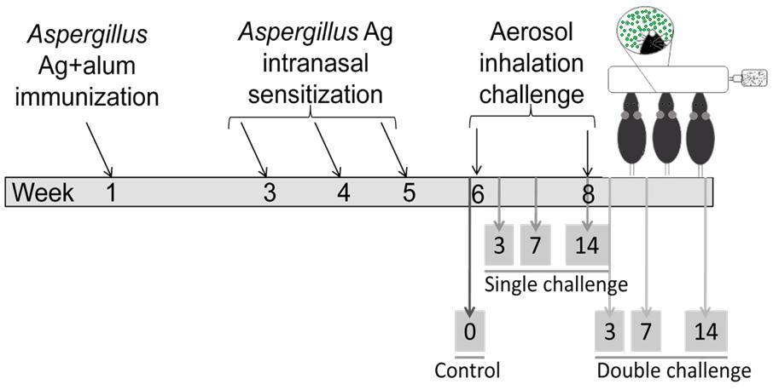
Mimicking allergic asthma in mice
Output
  AHR
  Airway inflammation
  Goblet cell metaplasia
  Airway wall remodeling
  Antibody production
  Cytokine profile

Slide 6
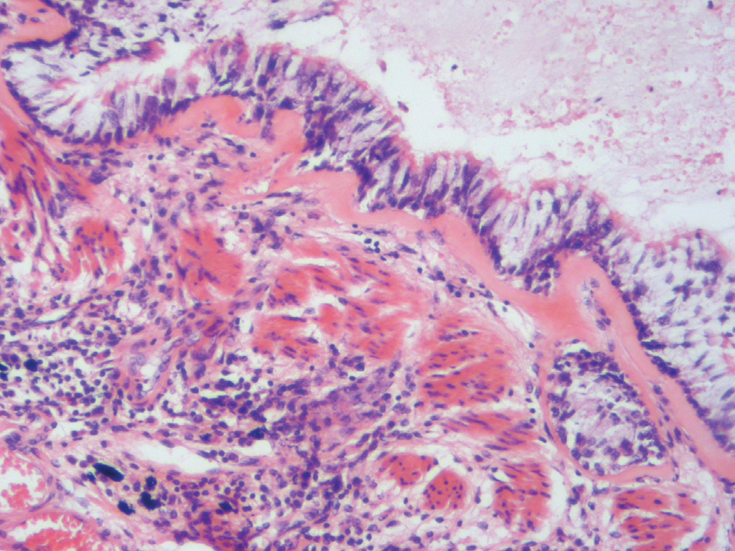
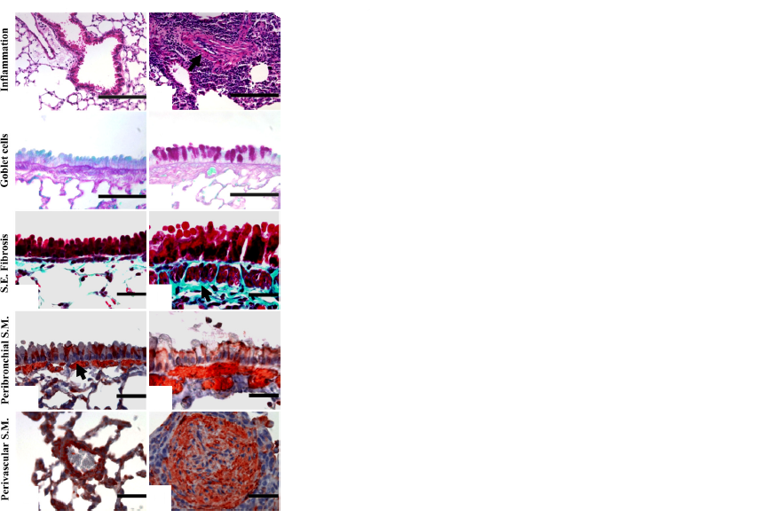
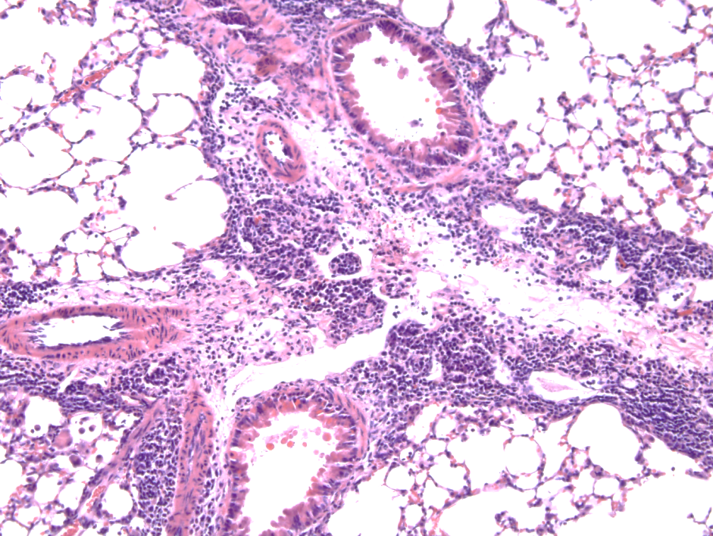
Eosinophilic airway inflammation
Human
Mouse Model
Samarasinghe et al, Fungal Biology, 2011
Homer and Elias. Physiology, 2005

Slide 7
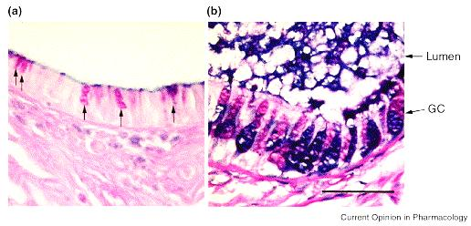
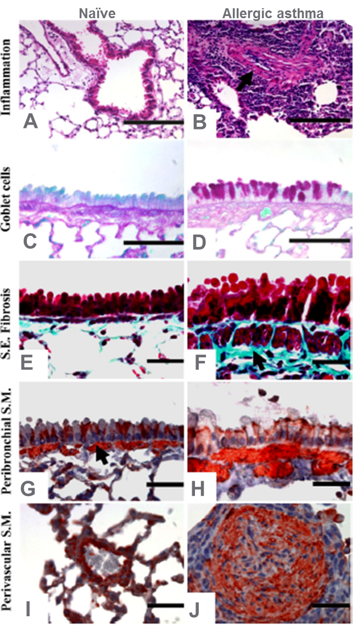
Increased mucus production
Human
Mouse Model
Healthy
Samarasinghe et al, Fungal Biology, 2011
Asthmatic
Nadel et al. Current Opinion in Pharmacology, 2001

Slide 8
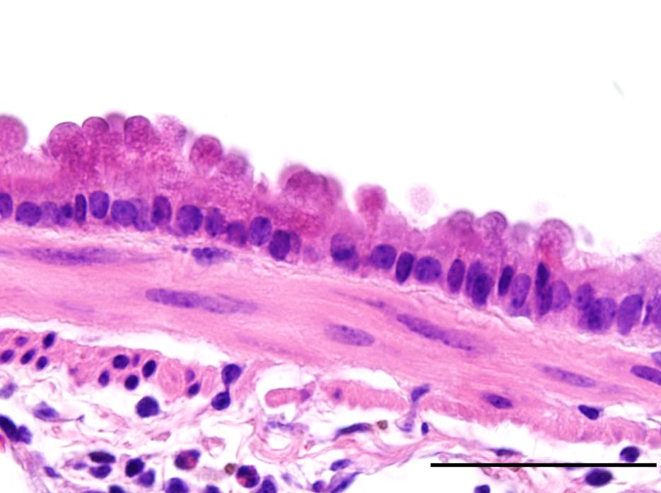
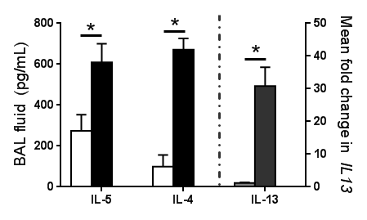

Airway wall remodeling:
SM cell hyperplasia/hypertrophy
Subepithelial fibrosis
Human
Mouse Model
Homer and Elias. Physiology, 2005
Samarasinghe et al, Fungal Biology, 2011

Slide 9
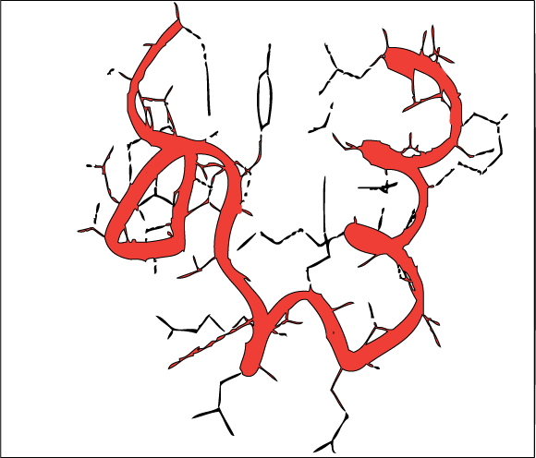
Vasoactive Intestinal Peptide (VIP)
Identified in 1970 by Drs. Said and Mutt
Immune regulatory
  Abundant in the lung
  “Anti-asthma” factor
Regulation in lung
  Neutral endopeptidase (NEP)
Caraglia et al., Amino Acids, 2007
Receptors in lung
  VPAC₁
  VPAC₂

Slide 10
VIP production is altered in allergic lungs

Slide 11
VIP
Columnar epithelium
Arteriolar smooth muscle
Distal blood vessel
Naïve
Day 14
D
E
F
50μm
Samarasinghe et al, Regulatory Peptides 2010

Slide 12
Naïve Bronchial Epithelial Layer
VIP

Slide 13
Allergic Bronchial Epithelial Layer
VIP

Slide 14
VIP functions through two receptors
VIP
VPAC-1
VPAC-2
Eosinophil migration
Alters chemokine production by DCs
Induced upon activation
T_{H}1 and T_{H}2
“pro-allergy”

Slide 15
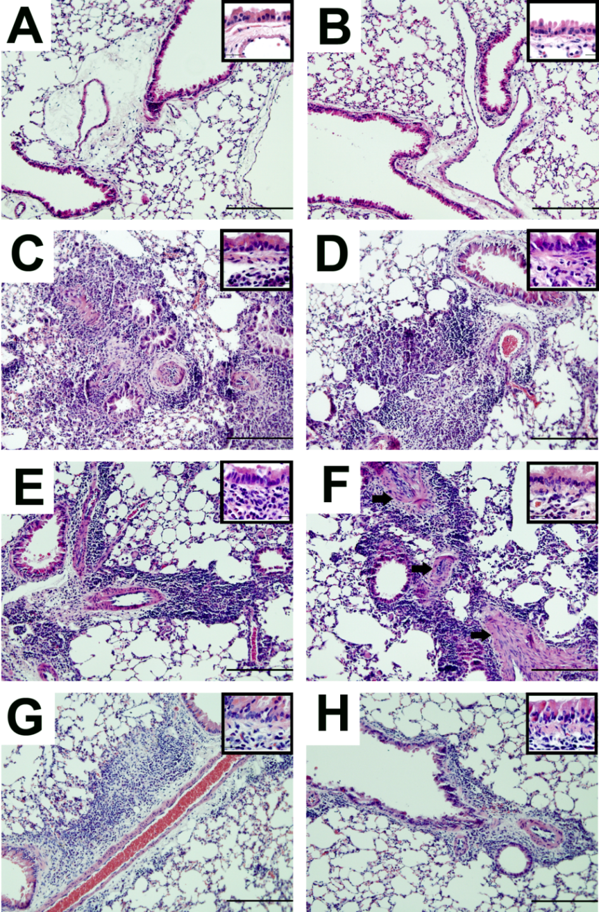
Absence of VPAC-2 did not affect tissue inflammation
WT
KO
Naïve
Day 3
Vascular smooth muscle increase was more apparent in KO
Day 7
Day 14
200μm
Samarasinghe et al, Peptides, 2010

Slide 16
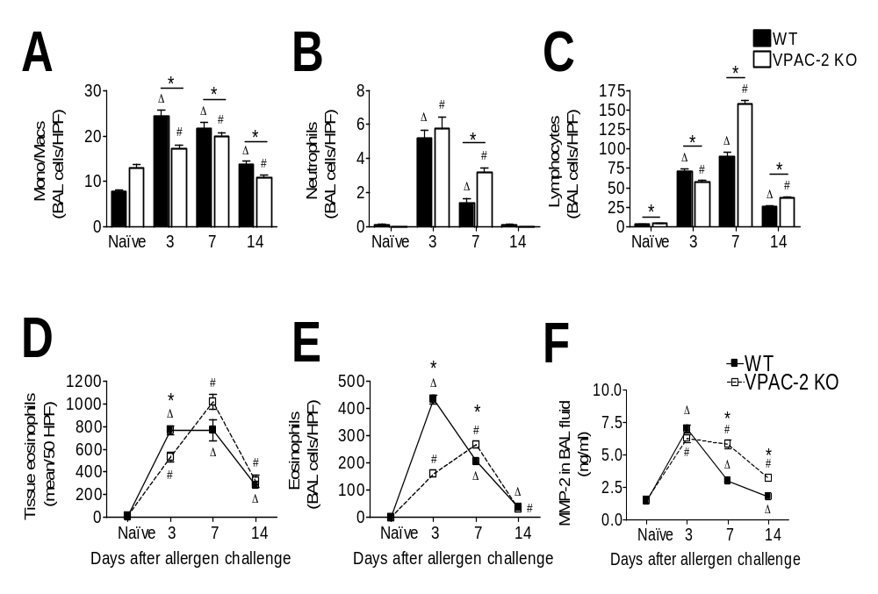
Mice lacking VPAC-2 develop airway inflammation
VPAC-2 KO mice had a delay and reduction in eosinophil egression into airway lumen
Samarasinghe et al, Peptides, 2010

Slide 17
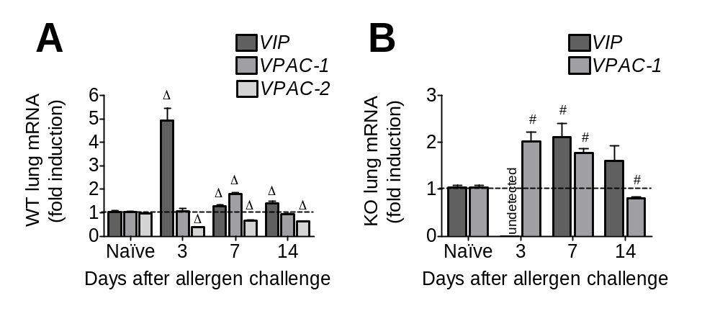
VPAC-2 was down-regulated in allergic lungs
Peak in VIP in the WT corresponded to eosinophil peak
VPAC-2 was downregulated in the WT
Samarasinghe et al, Peptides, 2010

Slide 18
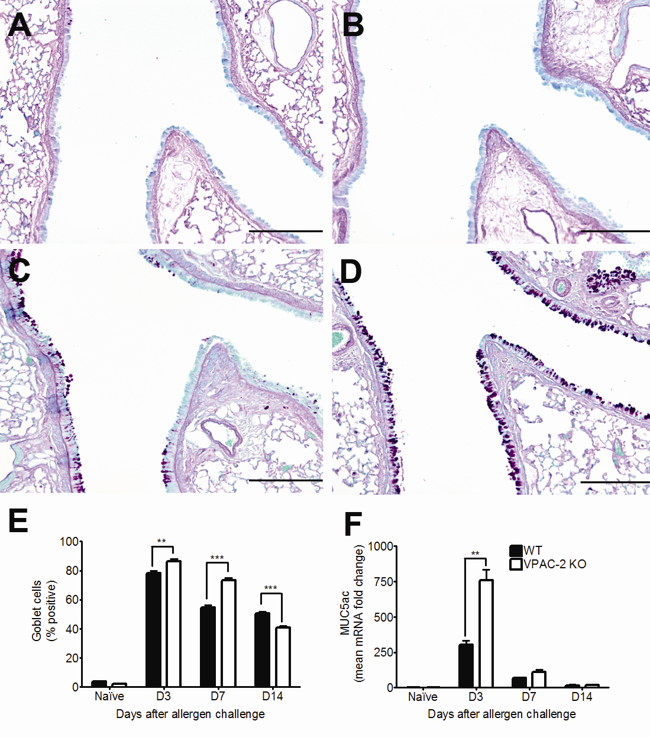
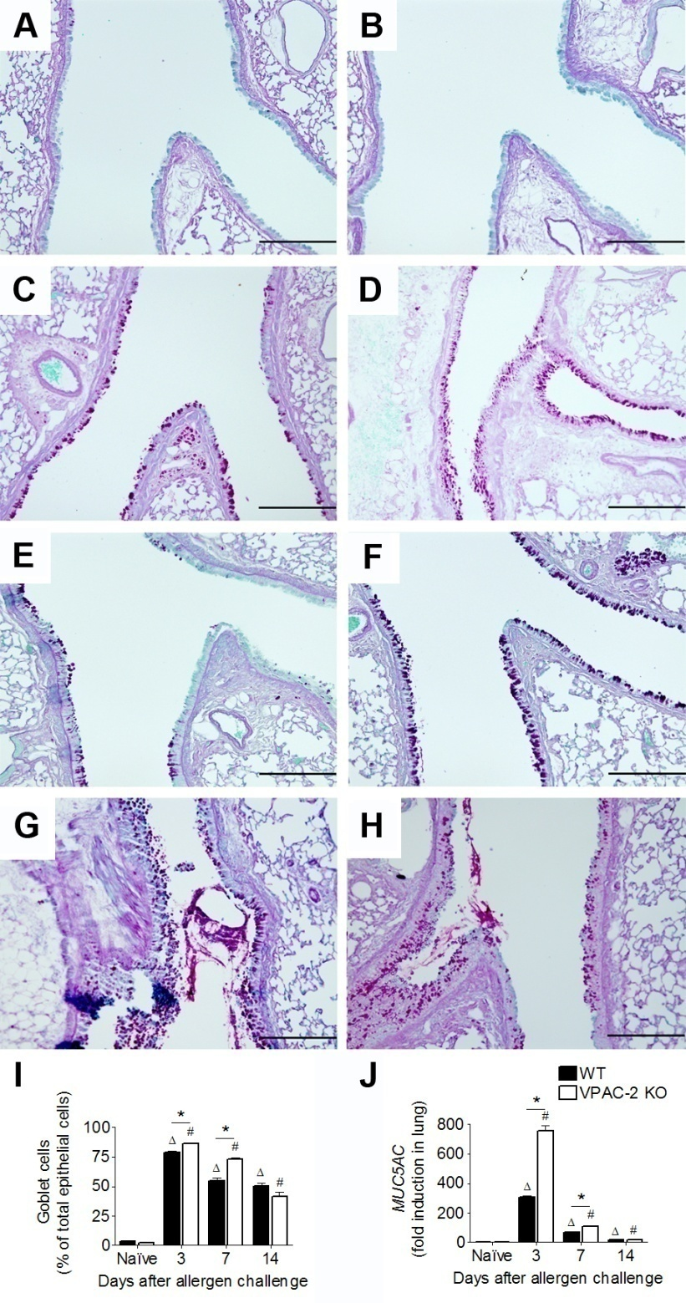
More goblet cell metaplasia in the absence of VPAC-2
Naïve
WT
Naïve
KO
Day 7
Day 7
200μm
Samarasinghe et al, Peptides, 2010

Slide 19
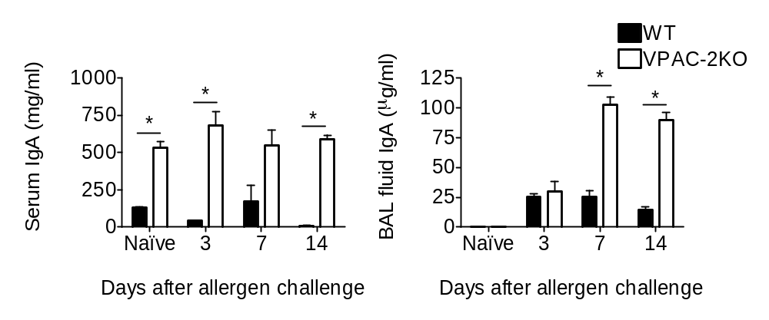
IgA increased in the VPAC-2 KO
Naïve IgA was elevated in KO
IgA was further induced in the BAL fluid of KO
Samarasinghe et al, Peptides, 2011,

Slide 20
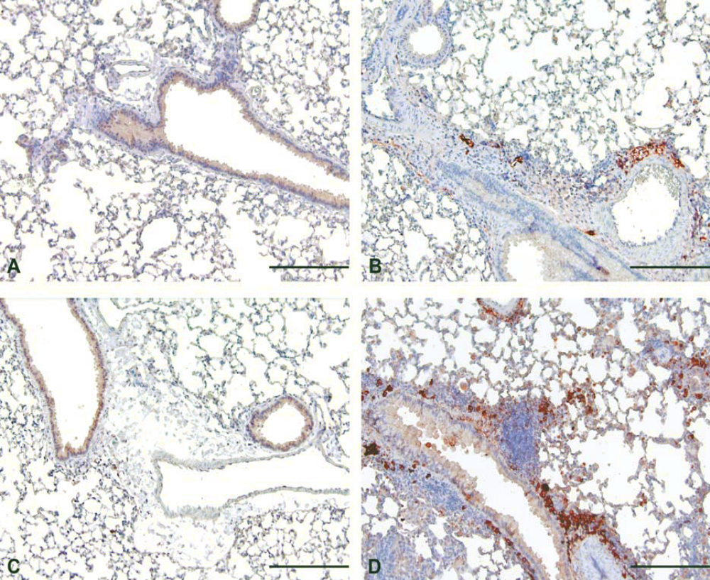
More IgA producing cells were found in KO allergic lungs
Naïve WT
Day 7 WT
Naïve KO
Day 7 KO
200μm
Samarasinghe et al., Peptides, 2011,

Slide 21
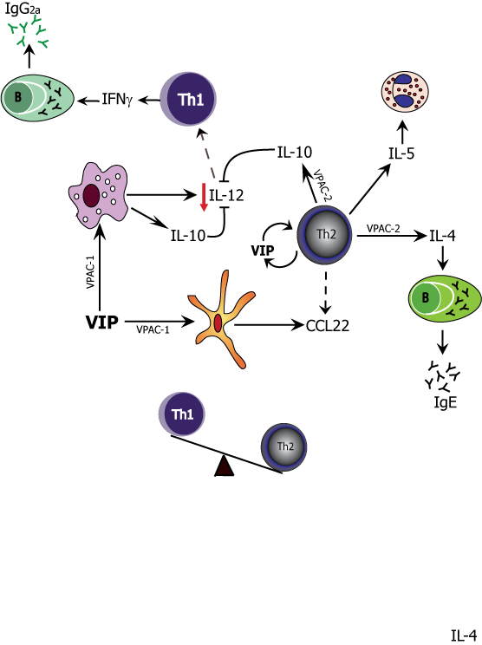
Wild-type
Samarasinghe et al., Peptides, 2011

Slide 22
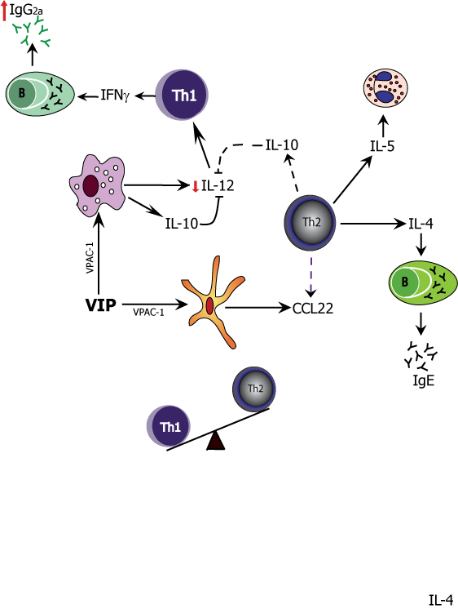
Knock-out
Samarasinghe et al., Peptides, 2011

Slide 23
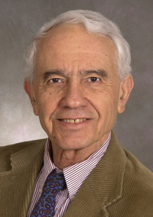




Acknowledgements
Mentors
  Dr. Sami Said
  Dr. Jane Schuh
  Dr. Jon McCullers
Funding
  Presidential Fellowship, NDSU college of graduate studies
  COBRE (Jane Schuh)
  Le Bonheur Junior Faculty Award
  Bea Gerber Award

