Slide 1

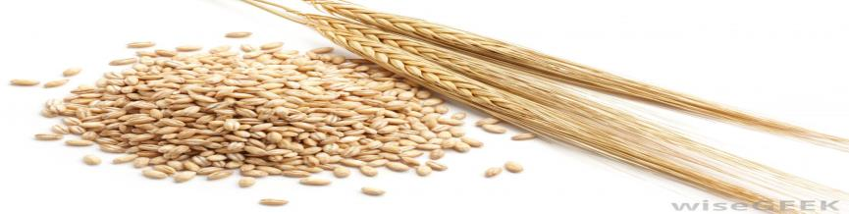
Hypocholesterolemic Effect Of Whole Barley Bread Compared To Whole Wheat Bread In Diabetes Induced Hyperlipidemic Rats
5th European Nutrition and Dietetics Conference June 16-18, 2016, Italy
Alzahraa M. Motawei, PhD
Mansoura University, Egypt

Slide 2
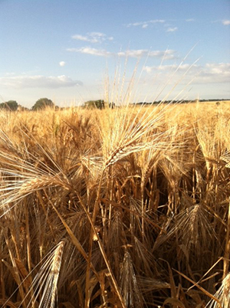
content
History
Problem
Why Barley?
Hypothesis
Study design
Results
Perspectives

Slide 3
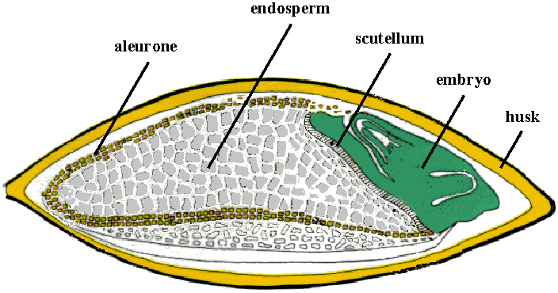
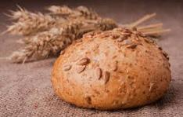
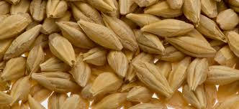
Barley ????
Barley (Hordeum vulgare L.) is a good source of dietary fiber especially (1→3),(1→4)-β-D-Glucan (4-12%).
Evidently, whole barley grain products reduce the risk of coronary heart diseases (FDA, 2006). Regular consumption of β-glucan contributes to maintenance of normal blood cholesterol concentrations” (EFSA, 2009).
Nutrition Congress 6-18 June, Italy Zahra Motawei

Slide 4
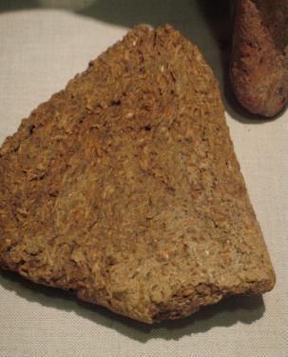
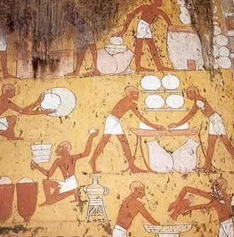
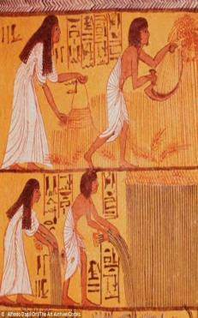
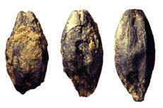
Barley Bread is Not New….
Ten thousand years ago, ancient egyptians were the first to creat beer and leavened bread from barley. We mostly know the process of baking from wall paintings of bread-making scenes in several tombs.

Slide 5

Problem
Wheat shortage
Metabolic Diseases (Obesity, T2D, CVD, MS)

Slide 6
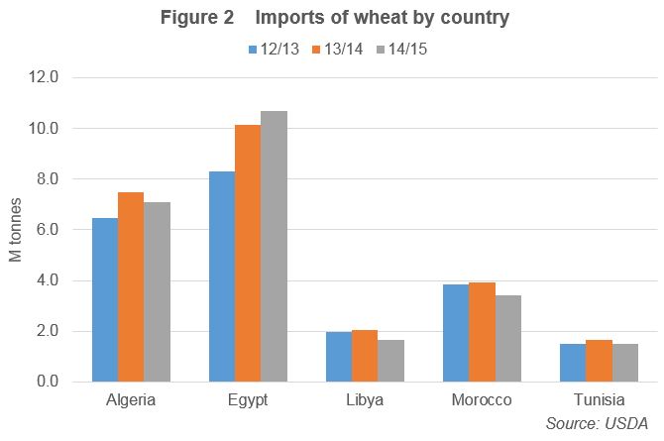

Slide 7
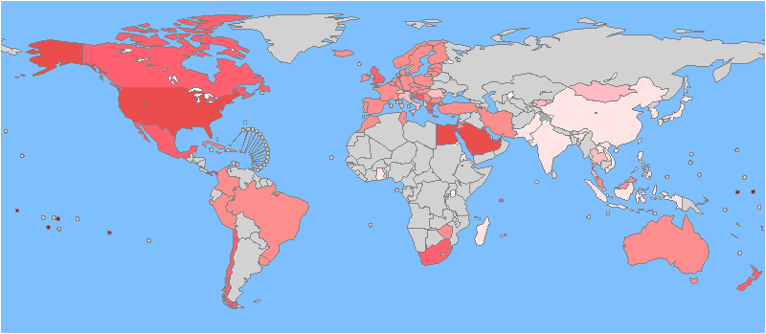
Obesity Prevalence In The Globe
Map Legend: The darkest red areas on the map (Pacific islands) represent obesity rates of 40% or more. The next darkest areas (US, Egypt, Saudi Arabia, Panama, and United Arab Emirates) represent obesity rates of 30-40%. Progressively lighter colors represent 20-30% obesity rates, 10-20% obesity rates, 5-10% obesity rates, and 0-5% obesity rates. The grey areas are not represented on the scale.
World Health Organization (WHO), Global Database on Body Mass Index: Maps," apps.who.int/bmi/index.jsp( July 22, 2011)

Slide 8
What is NEW?
Barley can be a good alternative to other common grains in our diet –how can it be a staple food?
Bread…

Slide 9
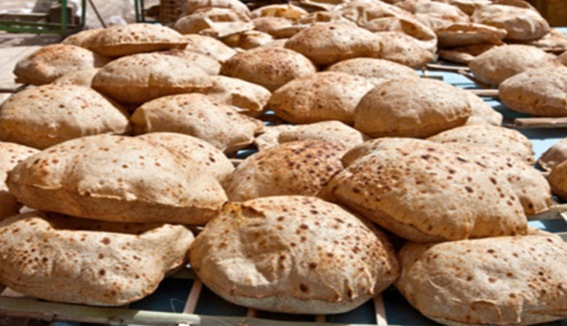
WHOLE BARLEY BREAD

Slide 10
WHY BARLEY ?
High nutritional value (Protein, minerals, vitamines)
High dietary fiber content especially Beta-glucan (soluble & insoluble)
Barley Reduces Blood glucose levels
Barley improves Serum Lipids
Barley Bread Lowers Cholesterol
Greater Satiety, Fewer Calories Eaten With Barley

Slide 11
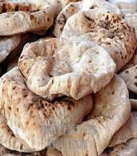
Hypothesis
Whole barley bread improves lipid profile compared to Wheat based-diet.
Improvement in lipid profile is linked to betaglucan content in barley.
Substitution of wheat flour with whole barley flour could be a smart solution for wheat shortage and critical need for bread flour material in Egypt and could be pioneer intiation for countries facing hunger.

Slide 12

Study Design
0
4 wk
8 wk
35 rats
+ Control
100% WWB
50%WWB
100% WBB
- Control
Total Cholesterol (TC),
Triglycerides (TG),
HDL,
LDL
Atherogenic index A.I.%

Slide 13
Soluble And Insoluble Β-glucan Content In Whole Barley Flour And Whole Wheat Flour

Slide 14
Changes In Serum Lipid Profile Of Diabetic Hypercholesterolemic Rats Groups After 4 And 8 Weeks
Parameter | Time (week) | %CHANGE
TC |  | G1 | G2 | G3 | G4 | G5
 | 4 | - 11.61 | +10.46 | +4.59 | -5.13 | -6.06
 | 8 | -2.5 | +9.59 | -3.59 | -5.44 | -7.01
TG | 4 | -15.03 | +7.39 | -8.01 | -6.43 | -16.14
 | 8 | 0 | +15.18 | +3.43 | -8.03 | -16.14
LDL-c | 4 | -15.68 | +10.67 | +15.76 | -12.28 | -10.13
 | 8 | -3.18 | +11.26 | +14.84 | -1.84 | -6.44
vLDL-c | 4 | -14.78 | +7.41 | -5.54 | -8.66 | -13.68
 | 8 | -0.87 | +3.37 | +6.16 | -8.15 | -13.68
HDL-c | 4 | 0 | -8.31 | -3.83 | +6.52 | +23.53
 | 8 | -3.25 | -5.00 | -7.39 | +23.11 | +41.18
% A.I | 4 | -5.18 | +16.15 | +18.53 | -23.59 | -22.47
 | 8 | 0 | +33.03 | -4.21 | -36.03 | -36.49

Slide 15
Mean Of Changes In Serum Lipid Profile Levels In Rats Groups At The End Of The Study
Parameter | Group
 | G1 | G2 | G3 | G4 | G5
TC | 76.44 ^{d} | 119.00 ª | 96.00 ^{c} | 107.11 ^{b} | 99.22 ^{bc}
TG | 54.56 ^{d} | 119.56 ª | 114.89 ^{ab} | 98.33 ^{b} | 89.44 ^{c}
HDL-c | 20.11ª | 16.17 ^{b} | 16.97 ^{b} | 17.78 ^{b} | 20.68 ª
LDL-c | 45.42 | 78.44 ª | 56.24 | 71.37 | 59.23
vLDL-c | 10.91 ^{c} | 23.91ª | 22.78 ª | 17.89 ^{b} | 19.29 ^{b}
A.I | 2.83 ^{d} | 6.34ª | 4.67^{b} | 5.13 ^{b} | 3.89 ^{c}

Slide 16
Levels Of TC, TG, HDL-c, and LDL-c In Diabetic-mild Hypercholesterolemia Rats Groups

Slide 17


G1= Normal control
G2= Positive Control

Slide 18


G4= 50%WBb
G3= 100%WWb

Slide 19

G5= 100%WBb

Slide 20
Outcomes
improvement of lipid profile increases HDL-cholesterol, improves the total lipid profile, in diabetic animal model .
Reducing risk of CVD and T2D
Development of a Healthy New Basic Diet. and may replace wheat bread.
New trend in solving wheat shortage problem could be applied world wide, using
Healthy, Available, Commercial resource.
Whole Barley Flour

Slide 21
Perspectives
Metabolic Disorders
Rheological Quality
Further investigations on whole barley products effects on metabolic syndrome in unhealthy or at-risk human subjects
Further investigation on whole barley bread rheological quality improvement.

Slide 22

Thank You

