Slide 1
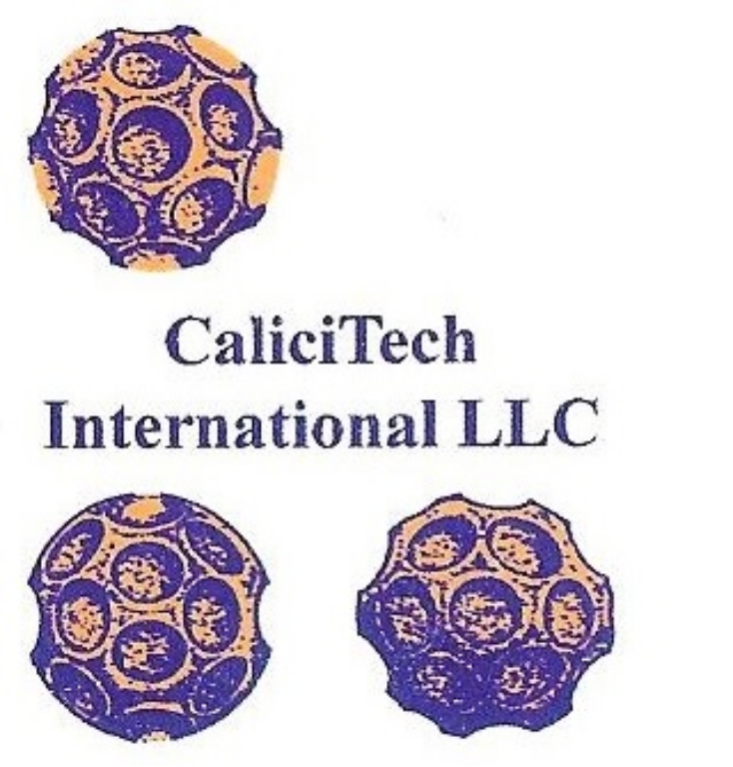
The Original Calicivirus:
An Emergent Human Pathogen Implicated on Three Continents in the Occurrence of Severe Disease Including Hepatitis
A review and update
Presented by
Alvin W. Smith
4th World Congress
On virology
San Antonio, Texas
October 6 – 8, 2014
Laboratory for Calicivirus Studies
Notes:
Greetings.
Thank you to The Organizers and guests.
If you have read the abstract, you already know what I want to tell you.
So this will be an adventure story – Relax – Enjoy and the serious ending will be held to the very last.

Slide 2
OVERVIEW
What is a Vesivirus ?
Historical Prospective and Distribution
Vesivirus Associated Disease Conditions
Hepatitis, Blood Transfusions and Disease
Conclusions
Acknowledgments
Laboratory for Calicivirus Studies
Notes:
The Vesivirus is a bit of a phantom agent – they appear – disappear and re-appear.
Historically – US researchers try to trap them in a box but this is one virus that lives – outside the box.
The viral – versatility here is bewildering and always unexpected.
The diseases that can occur slide under the radar – so remember if we don’t know about pathogenic Vesiviruses and if we have no way of diagnosing them – then vesiviral disease does not exist.

Slide 3
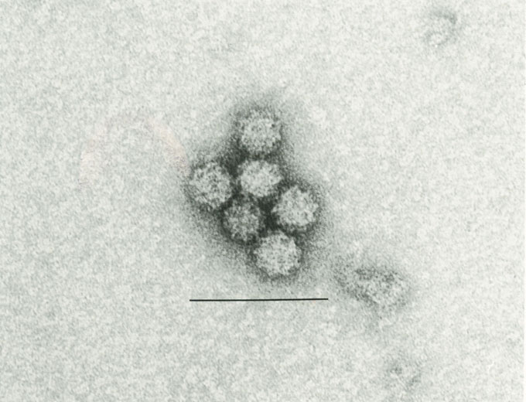
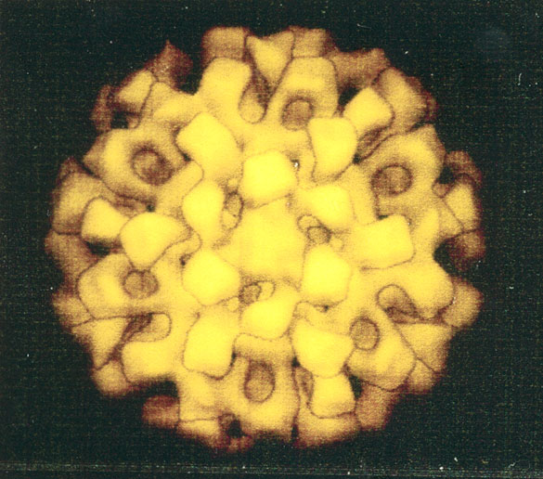
Electron Photomicrograph of Cetacean Calicivirus Showing Typical Morphology
Negative stain. Bar equals 100nm. Photo by Douglas E. Skilling.
Cryomycoscopy by BV Prasad
Laboratory for Calicivirus Studies
Notes:
A cetacean is a toothed whale – sperm whales, killer whales and dolphins.
The bar is 100 nanometers.
The genome is about 8kb.
The capsid 180 molecules of a single protein species.
Symmetry is icosahedral with 2, 3 and 5-fold axes.
Mutation rates about 1-10 per replicate.
Projected number of viable Vesivirus variant possible is 4⁴⁰⁰⁰ .
Take home lessons – it is an accident if any two Vesivirus replicates are identical.
All of this gives the Vesivirus great plasticity in nature – please keep this fact in mind as we continue.

Slide 4
Genera (five) within the family Caliciviridae
Norovirus
Nebovirus
Lagovirus
Sapovirus
Vesivirus
  Feline calicivirus (species)
  Vesicular Exanthema of Swine (species)*
    Swine isolates 1932-1956 (13 Serotypes)
    San Miguel Sea-lion virus 1972-present (17 serotypes)
    Cetacean, bovine, reptile, primate, rabbit, walrus, human, skunk etc. 1978-present (>10)
    * Colloquially grouped as Marine Caliciviruses/Vesiviruses
Laboratory for Calicivirus Studies
Notes:
Each genus except Vesivirus tend toward host restrictions.
Vesivirus versatility is the hallmark of this genus, especially species VESV – grouped as the marine Vesiviruses.
There are over 40 serotypes where infection by one serotype does not confer resistance to any other serotype.
Vaccine development will be difficult.

Slide 5
Historical Prospective
1932-1952 (Foot & Mouth-like-Disease seen in California only)
1952-1972 (Spread & Eradication)
1972-1992 (Ocean origins and human infection)
1992-2014 (Re-emergence in food animals, vesiviral viremia and blood transfusion-transmission)
Laboratory for Calicivirus Studies
Notes:
Vesivirus mimicked FMD, which was the most feared disease of cattle and swine.

Slide 6
USA – Disease Spread
Alaska
Hawaii
Laboratory for Calicivirus Studies
Notes:
A train called “City of San Francisco” bound for Chicago – served pork in the diner – discarded the raw pork scraps into the garbage, which was fed to swine in the stock yards in Cheyenne, Wyoming, 14 month later the disease had spread to most of the United States.
The disease had been confined to California for the previous 20 years.

Slide 7
Historical Prospective
1932-1952 (Foot & Mouth-like-Disease seen in California only)
1952-1972 (Spread & Eradication)
1972-1992 (Ocean origins and human infection)
1992-2014 (Re-emergence in food animals, vesiviral viremia and blood transfusion-transmission)
Laboratory for Calicivirus Studies
Notes:
Federal regulations required that the law, which required the cooking of garbage for swine feeding had to be enforced. Feeding raw garbage to swine was illegal.
The last outbreak of VESV in swine was reported in 1956.
In 1959, VESV was declared eradicated and a Foreign Animal Disease Agent although it was not reported in any other country.
In 1972, this mysterious virus was found hiding out in the ocean infecting migrating marine mammals – eradication had failed and was impossible.

Slide 8
Evidence of Diseases Seen in Association with Caliciviruses (Genus Vesivirus) in
Phylogenetically Diverse Animal Species
Disease Condition | Swine | Seal | Cat | Cattle | Human | Primate | Dog | Snake | Whale | Horse | Rabbit
Blisters
Hepatitis
Diarrhea
Abortion
Encephalitis
Pneumonia
Hemorrhage
Myocarditis
Pancreatitis
Thymus Involution
Myositis
Laboratory for Calicivirus Studies
Notes:
Since 1972 we have found the vesicular exanthema of swine virus to be very different than originally seen where swine were the only natural host.
Today, the virus seems to be misnamed because vesicular disease is rare and other conditions associated with this agent are not.
The number of blue squares filled in under each species is probably much more a reflection of how much research has been done on that species rather than the actual extent of disease present.
A single serotype SMSV-5 (remember there are >40 serotypes) has been isolated usually in association with disease in swine, seals, cattle, humans and rabbits and has been grown in cell lines derived from numerous species including primates and humans.

Slide 9
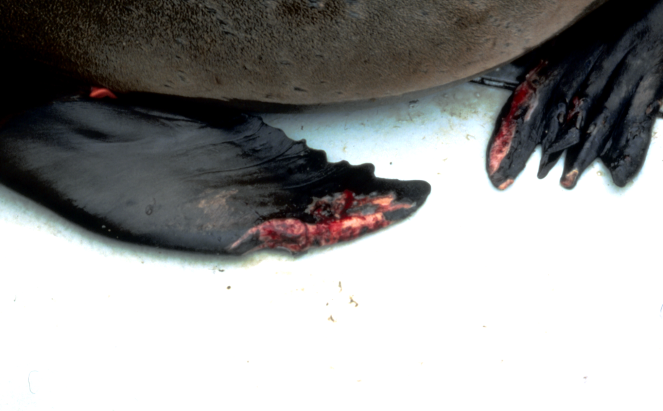
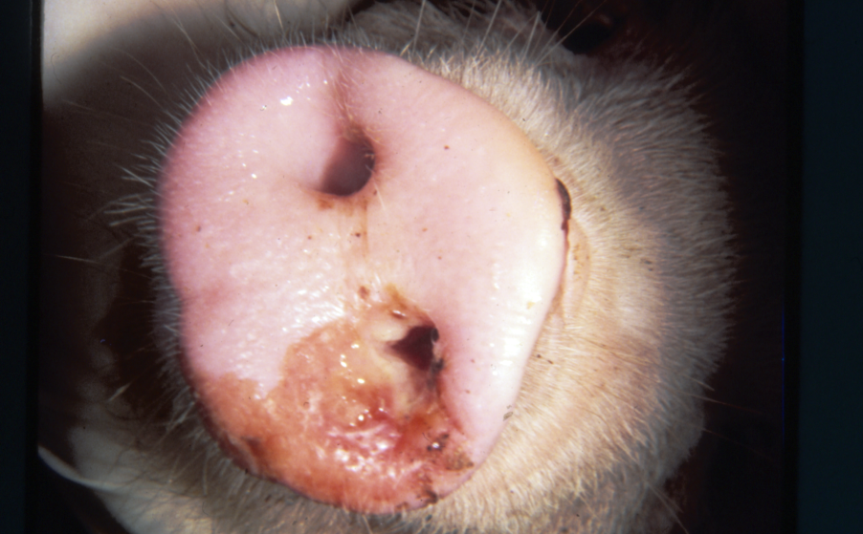
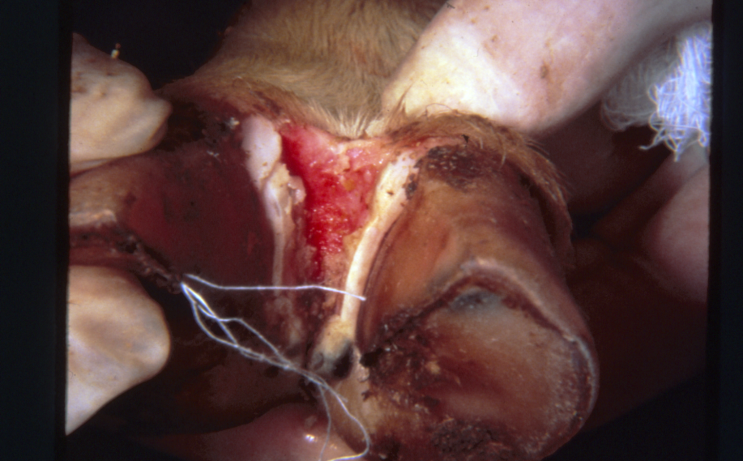
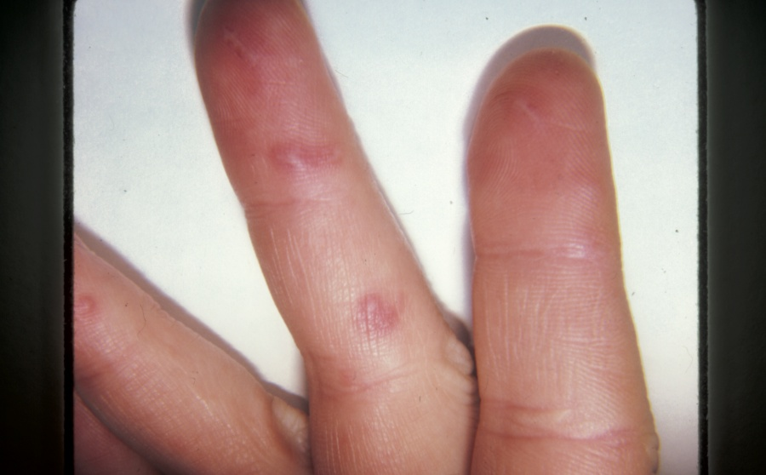
Seal, Pig, Calf, Man
Laboratory for Calicivirus Studies
Notes:
The agent infecting seal, pig and calf is named San Miguel sea lion virus – 13 (SMSV-13) and is the most vesiculagenic of any serotype.
The human hand is infected with SMSV-5, a much more common serotype but less vesiculagenic.

Slide 10
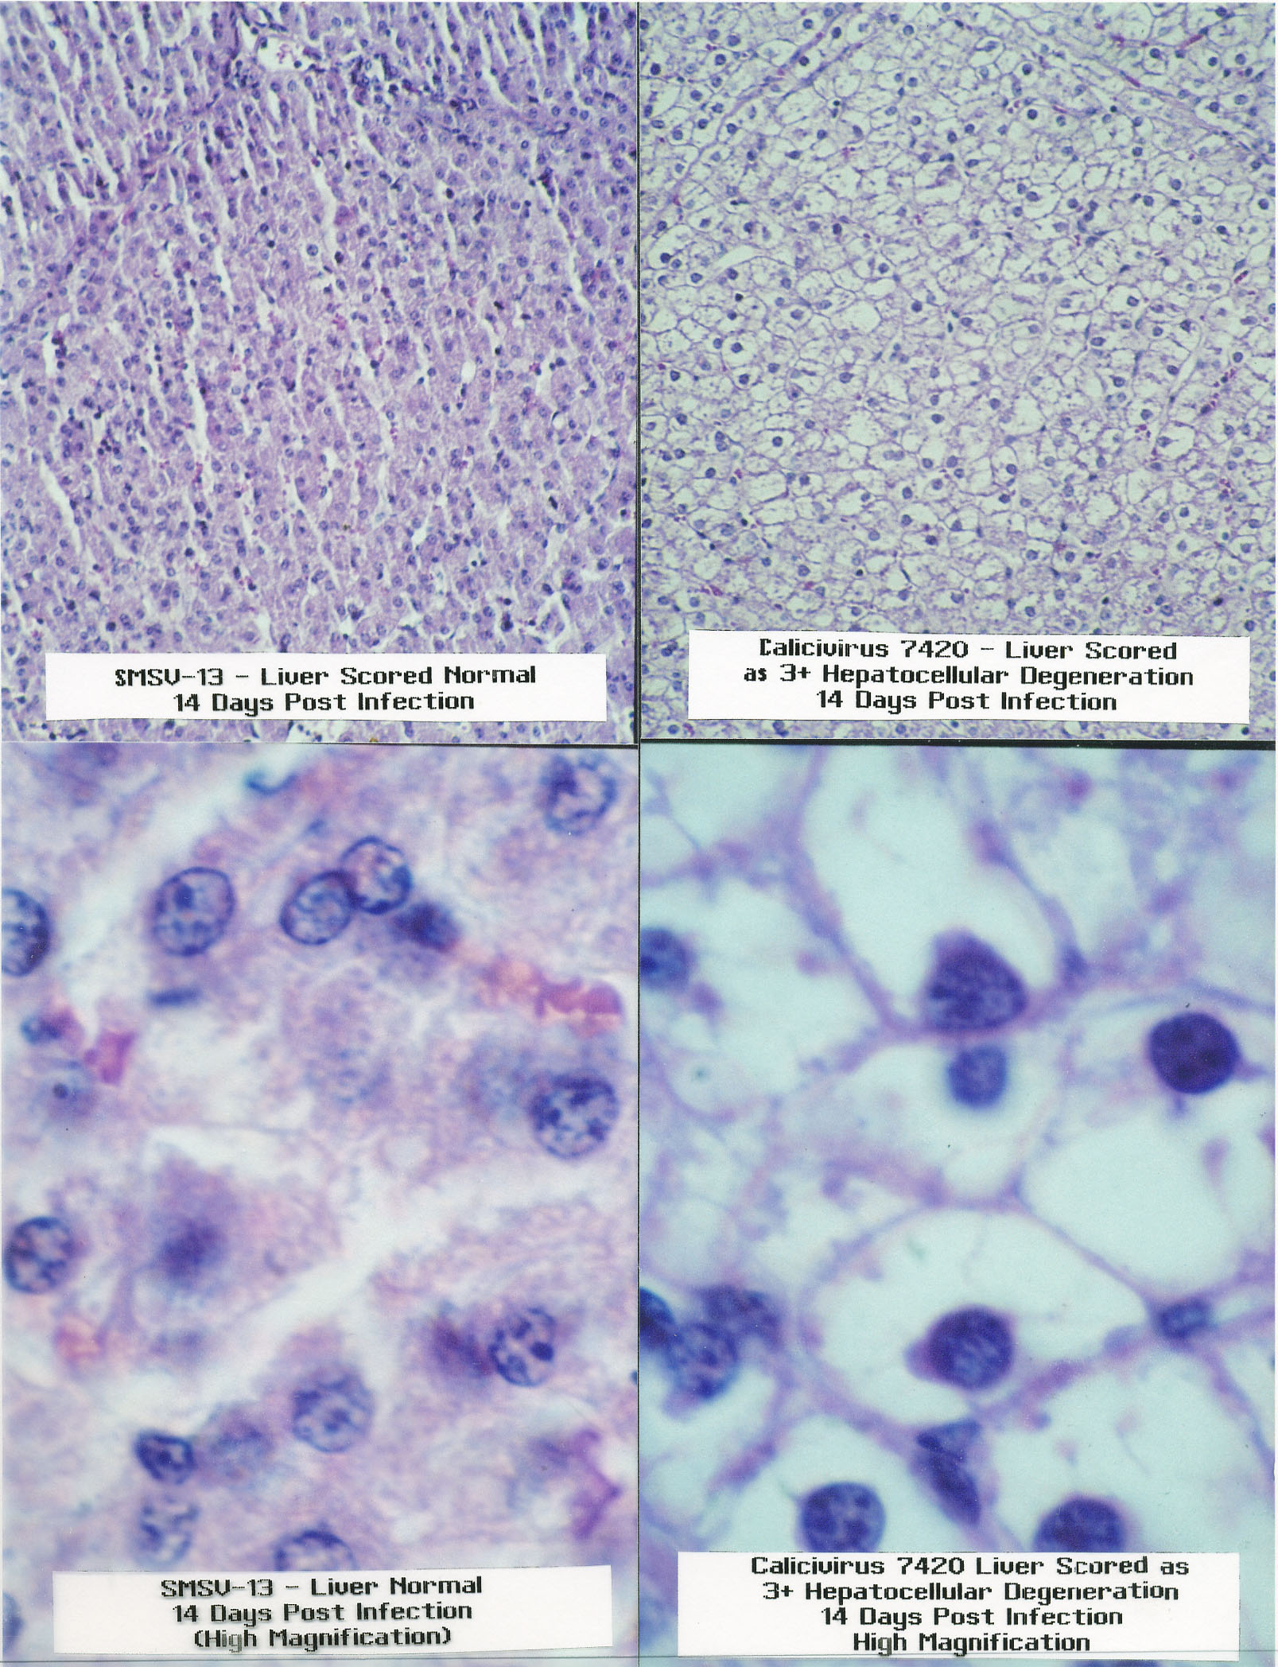
Laboratory for Calicivirus Studies
Notes:
In contrast to the previous slides, walrus Vesivirus caused no vesicular disease in infected pigs, but did cause more hepatocyte degeneration than the other serotypes. Histologic Diagnosis: Marked (3 plus) hepato cellular degeneration.

Slide 11
California and Southern Sea Lions
Laboratory for Calicivirus Studies
Notes:
The ecology of the Vesivirus agent marked a paradigm shift in viral disease where marine ecosystems can and do generate and release massive Vesivirus loads into the – near shore – ocean waters.
The California sea lion (most often seen as the performing seals in carnivals) is the most involved of any species studied.
The southern Sea lion range is given to see the potential for spread from Pacific to Atlantic waters and land masses.

Slide 12
Northern Fur Seal Annual Migration
Laboratory for Calicivirus Studies
Notes:
The northern fur seal migrates from San Diego in the south into the Bering Sea and there is mixing with Russian population on the Commendorsci Island.

Slide 13
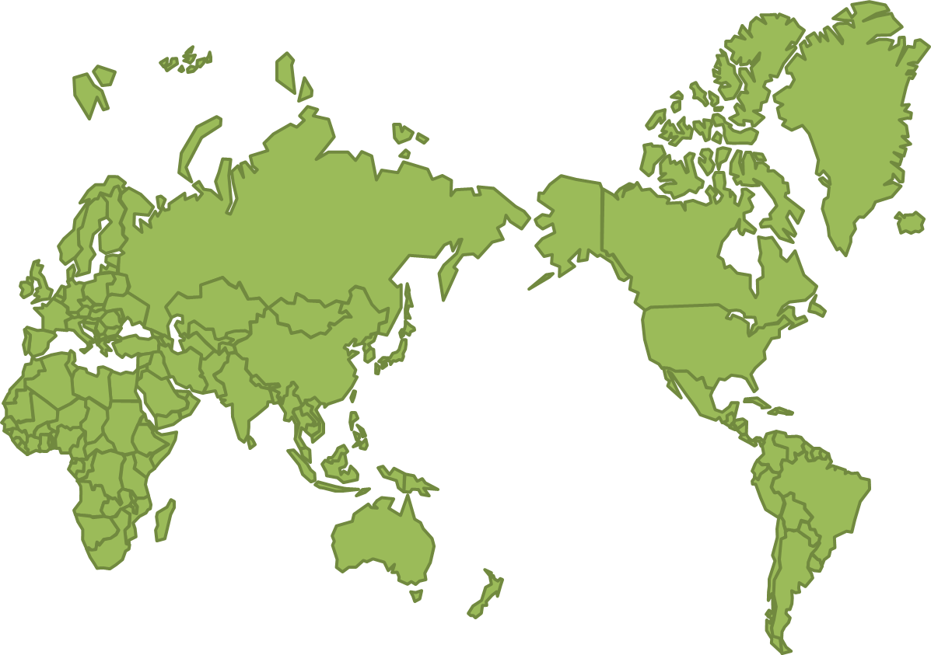
Stellar (Northern) Sea Lion
Laboratory for Calicivirus Studies
Notes:
This species has local migrations but stay within the various regions.

Slide 14

California Gray Whale Arctic Ocean
Beaufort Sea
Chukchi Sea
Laboratory for Calicivirus Studies
Notes:
The first virus isolate from any marine mammal was a California Gray Whale and the virus was classified as an enterovirus for 20 years but was ultimately found to be a Calicivirus (VESV-A48). The prototype virus for the family Caliciviridae.
This species migrates from out of the arctic ocean to the Sea of Cortez and back each year.
The migration is through the Bering Straits, a choke-point separating Pacific and Atlantic waters.
There is mixing between the Asian and North American populations.

Slide 15

Walrus
Laboratory for Calicivirus Studies
Notes:
The walrus also inhabits both sides of the choke-points formed by the Bering Straits.
Migration mainly follow the edge of the ice sheets.

Slide 16

Bowhead Whale
Current
Historic
Laboratory for Calicivirus Studies
Notes:
A few Bowhead Whales are harvested each year for subsistence by the Alaskan people.
This species lives on the edge of the ice and moves seasonally as the ice grows and reseeds.
Historically populations extended into Atlantic waters.
Strangely, the last VESV serotype isolated from swine in 1956 in Secaucus New Jersey had also infected Bowhead Wales resulting in their having type-specific antibodies.

Slide 17

Sperm Whales World Wide
Males
55°North and South
Females
45°North and South
Laboratory for Calicivirus Studies
Notes:
Sperm Whales have on array of serotype specific antibodies for Vesiviruses, thus the rest of the worlds oceans become open for vesiviral seeding by a marine mammal species.

Slide 18
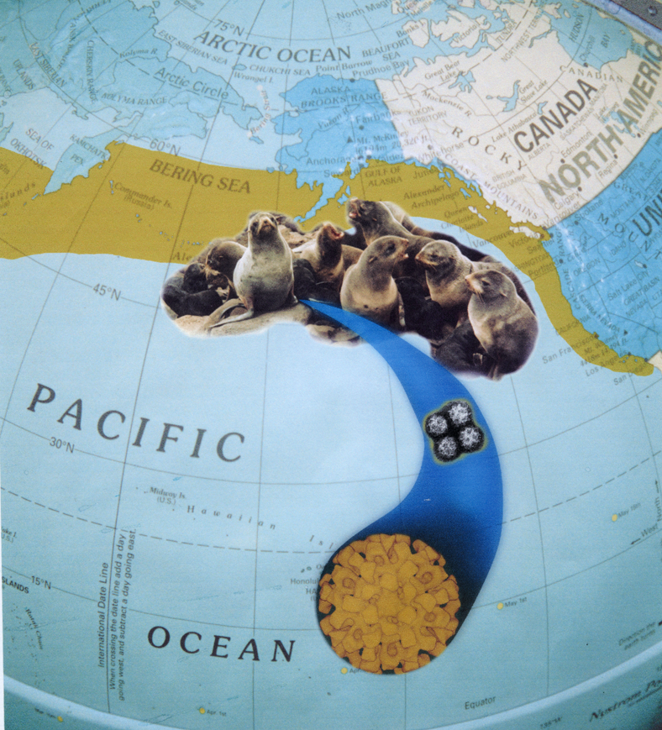
Fur Seal and Virus
Laboratory for Calicivirus Studies
Notes:
The first Vesivirus isolated from fur seals was SMSV-5, which is the same serotype that was isolated from hand blisters on a human.
Our serodiagnostic screening antigen “D3A” is derived from this serotype.

Slide 19
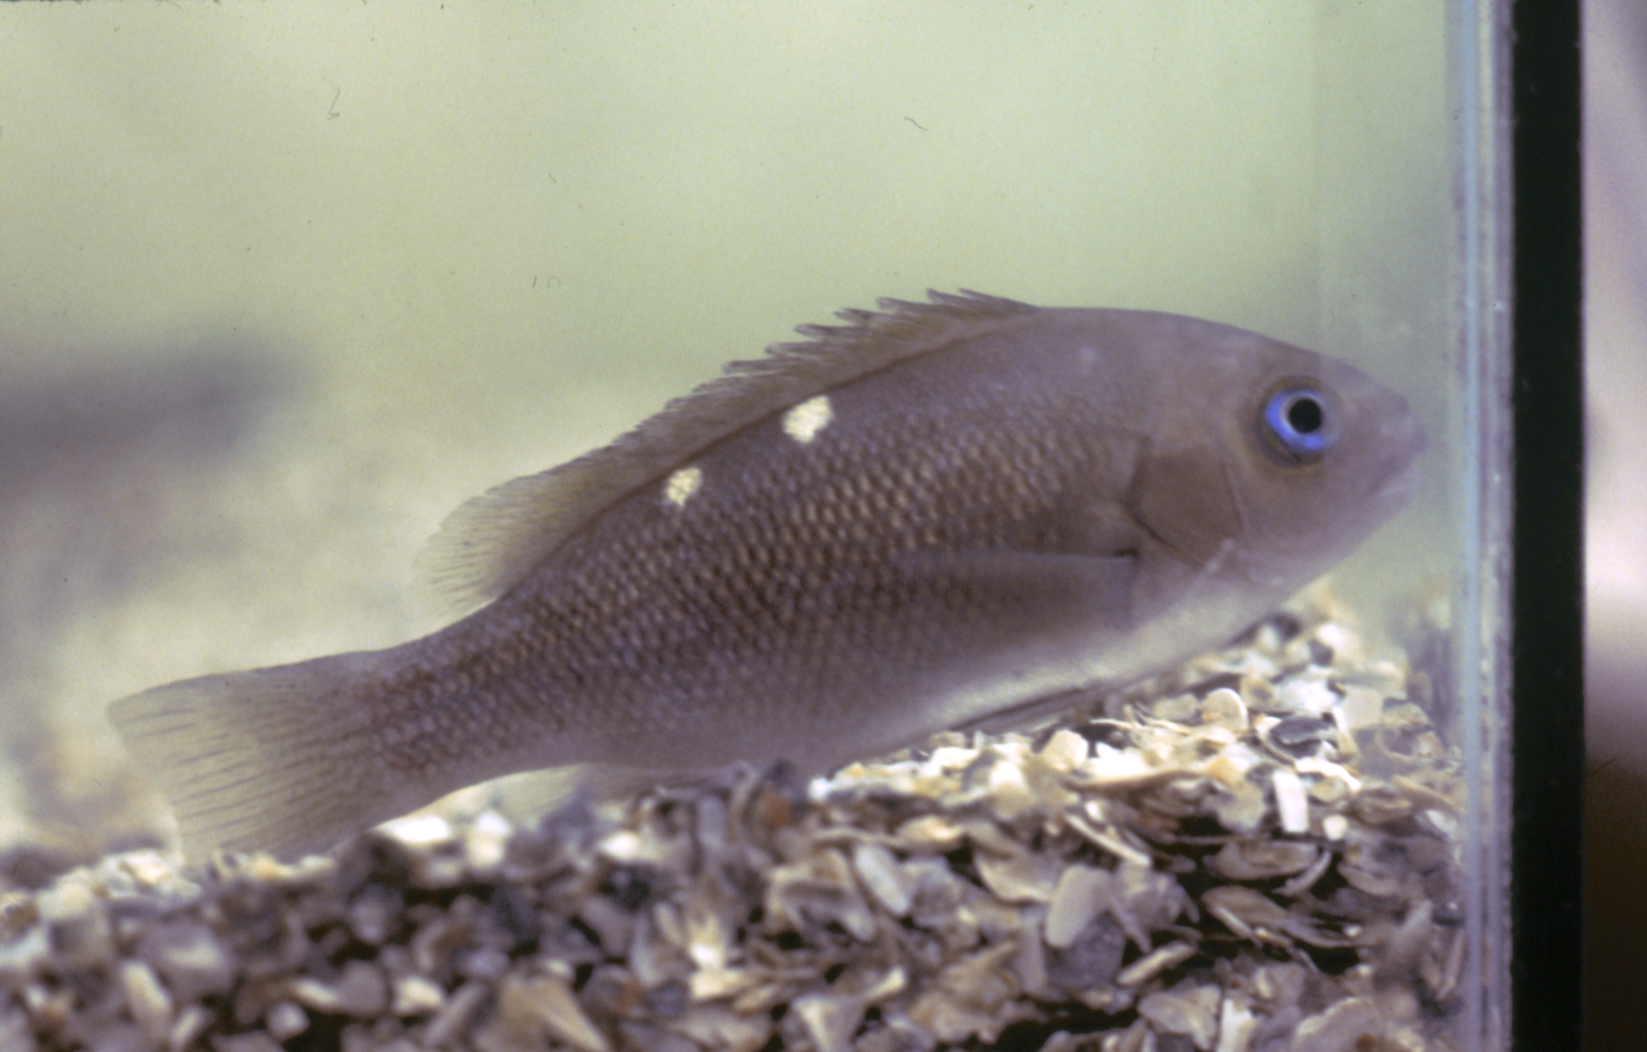
Opel eye Perch
Laboratory for Calicivirus Studies
Notes:
We need to be reminded that Girella nigricans the Opel eye perch is a reservoir for Vesivirus as a prey species for sealions and also as both a game and commercial perch species could infect humans.

Slide 20
Oysters, Clams and Mussels Cattle in New York and each Kansas County
Washington
New York
Oregon
Kansas
Maine
Maryland
California
North Carolina
Florida
Texas
Laboratory for Calicivirus Studies
Notes:
Filter feeders – clams, mussels oysters concentrate virus from the water and all three of these food source shell fish from the Atlantic, Gulf on Pacific shell fish beds both open and closed have tested positive for Vesiviruses using both a monoclonal antibody and hybridization probes.
Kansas cattle were antivesivirus antibody positive in every county of the state.
25% of cryptogenic abortions among dairy cows in New York (125 head) also had antibody profiles suggesting active Vesivirus infections.

Slide 21
Europe – Germany, Spain, Italy, Sweden
Asia – South Korea, Japan
North America – USA
Laboratory for Calicivirus Studies
Notes:
In every country where we have had the opportunity to test for VESV in human populations, the results have been positive (about 10%) in the general population.

Slide 22
Evidence of Diseases Seen in Association with Caliciviruses (Genus Vesivirus) in
Phylogenetically Diverse Animal Species
Disease Condition | Swine | Seal | Cat | Cattle | Human | Primate | Dog | Snake | Whale | Horse | Rabbit
Blisters
Hepatitis
Diarrhea
Abortion
Encephalitis
Pneumonia
Hemorrhage
Myocarditis
Pancreatitis
Thymus Involution
Myositis
Laboratory for Calicivirus Studies
Notes:
Please keep in mind that the same Vesivirus variant causing disease in one species of animal very often causes the same or a different disease manifestations in other species.
By extrapolation, most of the diseases shown above could be of Vesivirus etiology in humans but because there is a refusal to expand the test screening to include Vesivirus, the presence of this virus can be ignored.

Slide 23
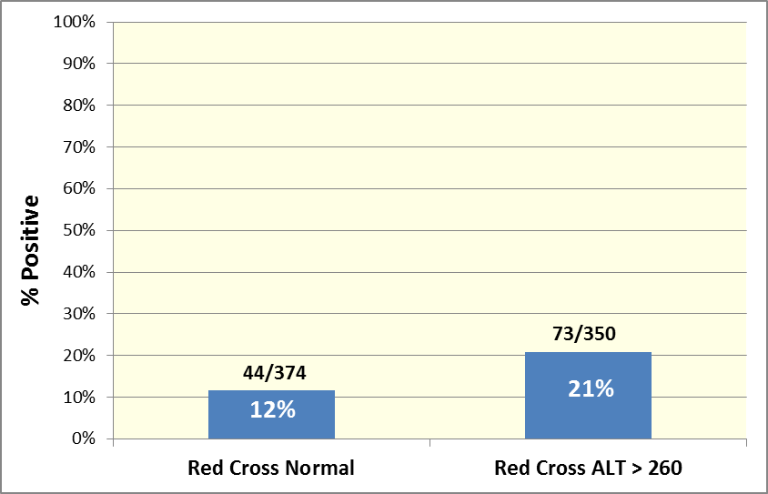

Calicivirus Antibody in Red Cross Blood Donors - Portland Regional Laboratory
Laboratory for Calicivirus Studies
Notes:
Our initiative to examine human sera began because we had observed one validated case of human vesiviral disease and knew that some people (mostly our own laboratory personnel) had type specific antibodies to more than one Vesivirus serotype. – Also, our most effective cell culture system for isolation was a primate cell line and several human cell lines were also effective, primates could be experimentally infected, and natural infections had occurred in both chimpanzees and gorillas, and 3 additional primate genera.
As seen in this graph, 374 sera from a Regional Red Cross Testing Laboratory were 12% positive. We discovered that blood units testing normal and approved for transfusions except for ALT’s>120 IU were discarded. These (N=350) tested 21% positive and we knew we were onto something important.

Slide 24
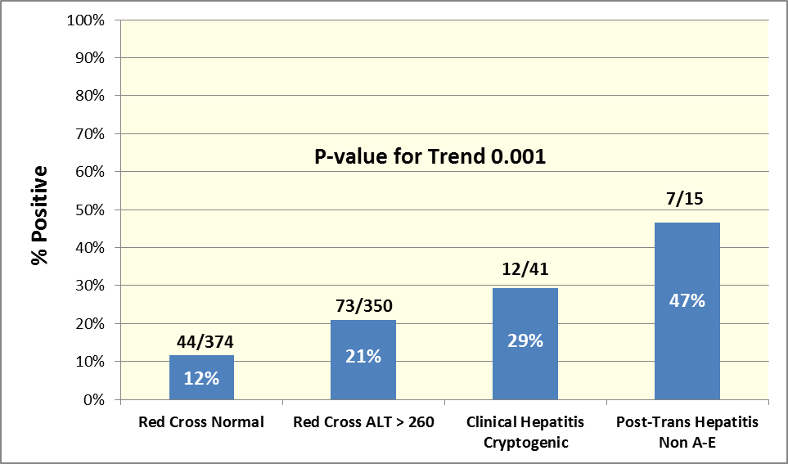
Calicivirus Antibody in Red Cross Blood Donors and Clinical Samples
Laboratory for Calicivirus Studies
Notes:
When clinical cases of cryptogenic non A-E Hepatitis was added the positively increased to 29% and if post-transfusion cases of non A-E were added, the risk of blood-borne post-transfusion non A-E Hepatitis become obvious, which brings, the safety of our blood supply into question.
Note: Some of these cases of non A-E cryptogenic Hepatitis and post-transfusion Hepatitis were from Italy and Spain.

Slide 25
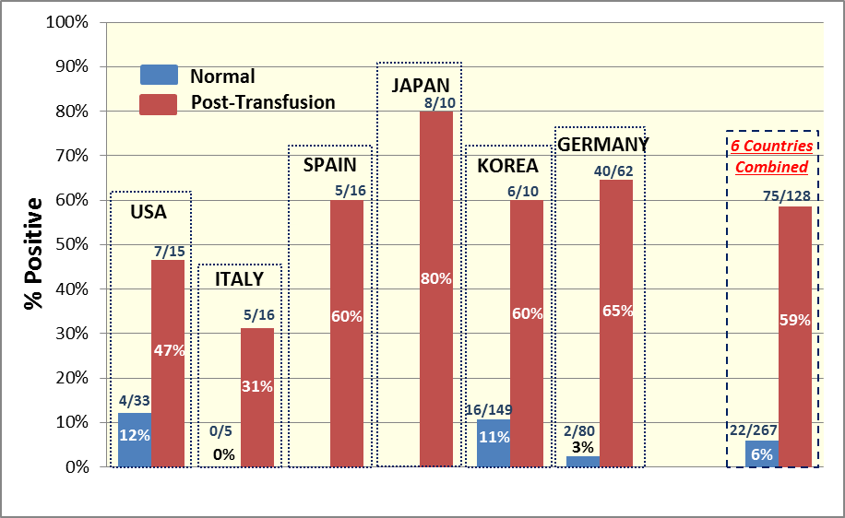
Six Countries Comparison of Post-Transfusion Hepatitis and/or Elevated Transaminase
Control Not Available
Control Not Available
Sources of Serum Samples Assayed
Laboratory for Calicivirus Studies
Notes:
These are remarkable numbers and in our attempt to compensate for the rather small numbers in some data-sets, we combined all the numbers as seen in the graphic at the far right.
The trends are all in the same direction irrespective of which country or continent of origin was being screened for anti-vesiviral antibody.

Slide 26
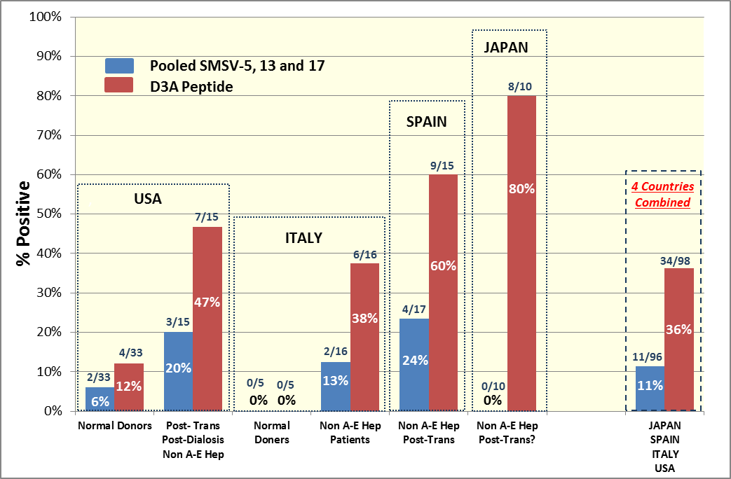
Pooled Whole Virus (Serotypes SMSV-5, 13 and 17) Antigen Compared To D3A Antigen
Laboratory for Calicivirus Studies
Notes:
There is a great deal of antigenic variability as shown by serotyping for neutralizing Antibodies. – However, there are many shared or group antibodies between serotypes.
A screening antigen needs to have a wide antigenic reach to not only detect known serotypes but to also detect serotypes yet to be isolated and characterized.
D3A antigen is shown to have more activity (sensitivity/specificity) than the pooled virus antigen, which also includes SMSV-5 Hom-1 (Human isolate), the virus strain that D3A was derived from.

Slide 27
CONCLUSIONS:
Begin Vesiviral Testing of All Blood and Organ Donors, Foods and Seafood, which are at Risk and for Cryptogenic Illnesses of Probable Viral Etiology
Normal blood donors are about 10% Vesivirus antibody positive
There is highly significant association between hepatitis non-A-E, transfusions, elevated Transaminases and anti-Vesivirus antibody
Vesivirus viremia has occured in Donor Blood cleared for transfusions
Vesivirus hepatitis, miscarriage pneumonia, pupura and many other severe diseases can likely be blood transmitted
Contaminated blood, foods (fish, shellfish, beef and pork) water and direct contact may all play a part in vesiviral transmission disease
Genus specific Vesivirus diagnostic screening reagents (D3A antigen, Mab, RT-PCR primers, hybridization probes) have been developed
An antiviral specific for and effective in controlling a highly lethal Vesivirus in cats suggests effective antiviral treatment of human infections
Laboratory for Calicivirus Studies

Slide 28
Acknowledgments
This work was supported by Oregon State University, the Oregon Agricultural Experiment Station, OSU Foundation President’s Club Account for the Laboratory for Calicivirus Studies, The Robert Koch Institute, The Center for Pediatric Research, Seoul National University and Avi BioPharma
Laboratory for Calicivirus Studies

Slide 29
General References
Heetae Lee, You-Hee Cho, Jeong Su Park, Eui-Chong Kim, Alvin W. Smith, GwangPyo Ko. Elevated Post-Transfusion Serum Transaminase Values Associated With a Highly Significant Trend for Increasing Prevalence of Anti-Vesivirus Antibody in Korean Patients. Journal of Medical Virology 84:1943-1952 (2012)
Alvin W. Smith, Patrick L. Iversen, Peter D. O’Hanley, Douglas E. Skilling, Janet R. Christensen, Sherry S. Weaver, Kimberli Longley, Michael A. Stone, Steve E. Poet , David O. Matson. Virus-Specific Antiviral Treatment for Controlling Severe and Fatal Outbreaks of Feline Calicivirus Infection. American Journal of Veterinary Research, Vol. 69, No.1 (2008)
Alvin W. Smith, Patrick L. Iversen, Douglas E. Skilling, David A. Stein, Karin Bok, David O. Matson. Vesivirus Viremia and Seroprevalence in Humans. Journal of Medical Virology 78:693-701 (2006)
Smith AW, Skilling DE, Castello JD, et al. Ice as a reservoir for pathogenic human viruses: specifically, caliciviruses, influenza viruses, and enteroviruses. Med Hypotheses 63:560-566 (2004)
Smith AW. Virus cycles in aquatic mammals, poikilotherms, and invertebrates. In: Hurst C, editor. Viral ecology. San Diego: Academic Press 447-491 (2000)
Smith AW, Skilling DE, Cherry N, Mead JH, Matson DO. Calicivirus emergence from ocean reservoirs: Zoonotic and interspecies movements. Emerging Infectious Diseases 4:13-20 (1998)
Smith AW, Berry ES, Skilling DE, Barlough JE, Poet SE, Berke T, Mead J, Matson DO. In vitro isolation and characterization of a calicivirus causing a vesicular disease of the hands and feet. Clin infect Dis 26:434-439 (1998)
Smith AW, Boyt PM. Caliciviruses of ocean origin: A review. The Journal of Zoo Wildlife Medicine 21:3-23 (1990)
Smith AW, Skilling DE, Barlough JE, Berry ES. Distribution in the North Pacific Ocean, Bering Sea, and Arctic Ocean of animal populations known to carry pathogenic caliciviruses. Disease of Aquatic Organisms 2:73-80 (1986)
Laboratory for Calicivirus Studies

Slide 30
CaliciTech
International LLC
Laboratory for Calicivirus Studies

