Slide 1






2015
Exploring the Research Challenges and Advancements in Pharmaceutical Sciences

Slide 2
About OMICS Group
OMICS Group is an amalgamation of Open Access Publications and worldwide international science conferences and events. Established in the year 2007 with the sole aim of making the information on Sciences and technology ‘Open Access’, OMICS Group publishes 500 online open access scholarly journals in all aspects of Science, Engineering, Management and Technology journals. OMICS Group has been instrumental in taking the knowledge on Science & technology to the doorsteps of ordinary men and women. Research Scholars, Students, Libraries, Educational Institutions, Research centers and the industry are main stakeholders that benefitted greatly from this knowledge dissemination. OMICS Group also organizes 500 International conferences annually across the globe, where knowledge transfer takes place through debates, round table discussions, poster presentations, workshops, symposia and exhibitions.

Slide 3
OMICS International Conferences
OMICS International is a pioneer and leading science event organizer, which publishes around 500 open access journals and conducts over 500 Medical, Clinical, Engineering, Life Sciences, Pharma scientific conferences all over the globe annually with the support of more than 1000 scientific associations and 30,000 editorial board members and 3.5 million followers to its credit.
OMICS Group has organized 500 conferences, workshops and national symposiums across the major cities including San Francisco, Las Vegas, San Antonio, Omaha, Orlando, Raleigh, Santa Clara, Chicago, Philadelphia, Baltimore, United Kingdom, Valencia, Dubai, Beijing, Hyderabad, Bengaluru and Mumbai.

Slide 4
Below the water line
Research Challenges and Advancements
Pharmaceutical Sciences
Scientists

Slide 5
The root
The Challenge of Cultivating the Next Generations of Pharmaceutical Researchers

Slide 6

The questions
I. What are the Challenges?
II. How to Remedy them?

Slide 7



CHALLENGES
Career options
Pathway to Scientists
The “big new innovations¹”
The Reward
Time & cost to gainful readiness
Competing choices

Slide 8

CHALLENGES
Career options
  Discovery
  Developing
  Manufacturing

Slide 9
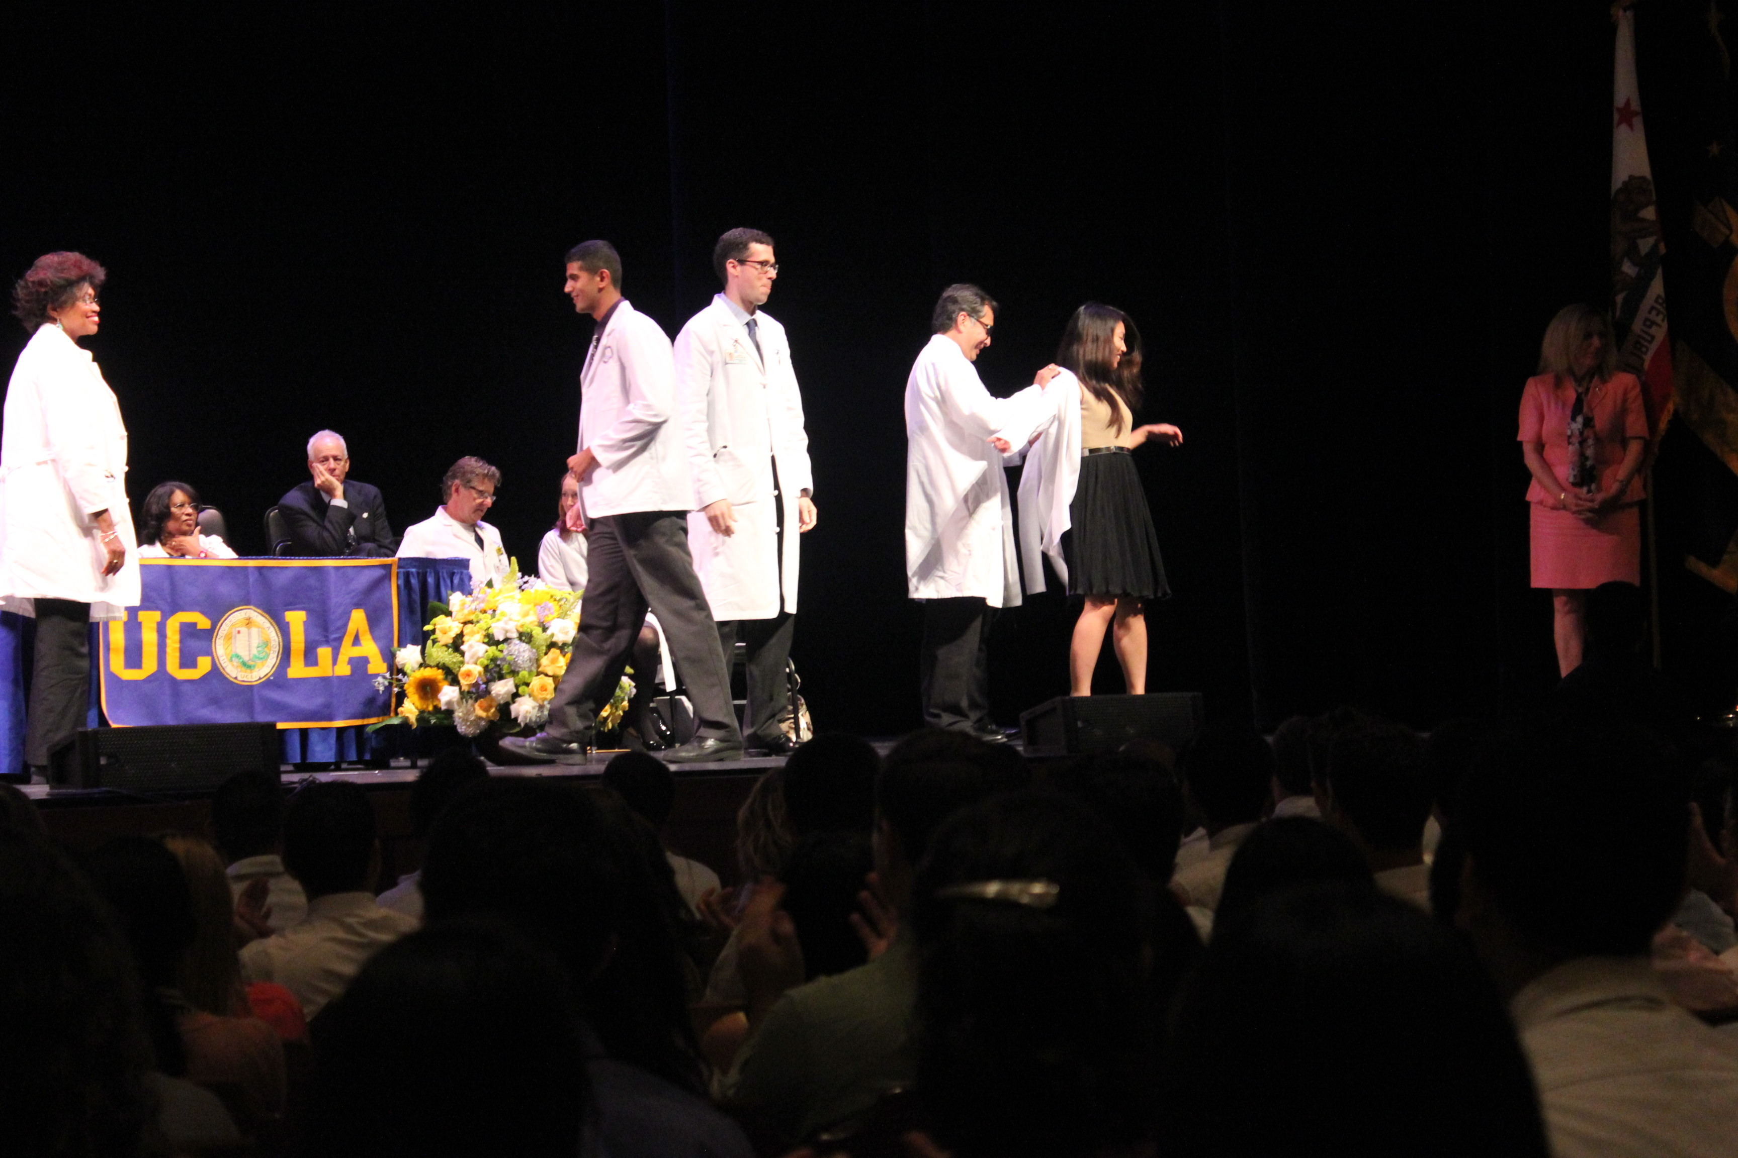
CHALLENGES
2. Pathways
    Academic
    Pharma
    CRO
    Government
    Non-profit foundations
    Self-employ

Slide 10
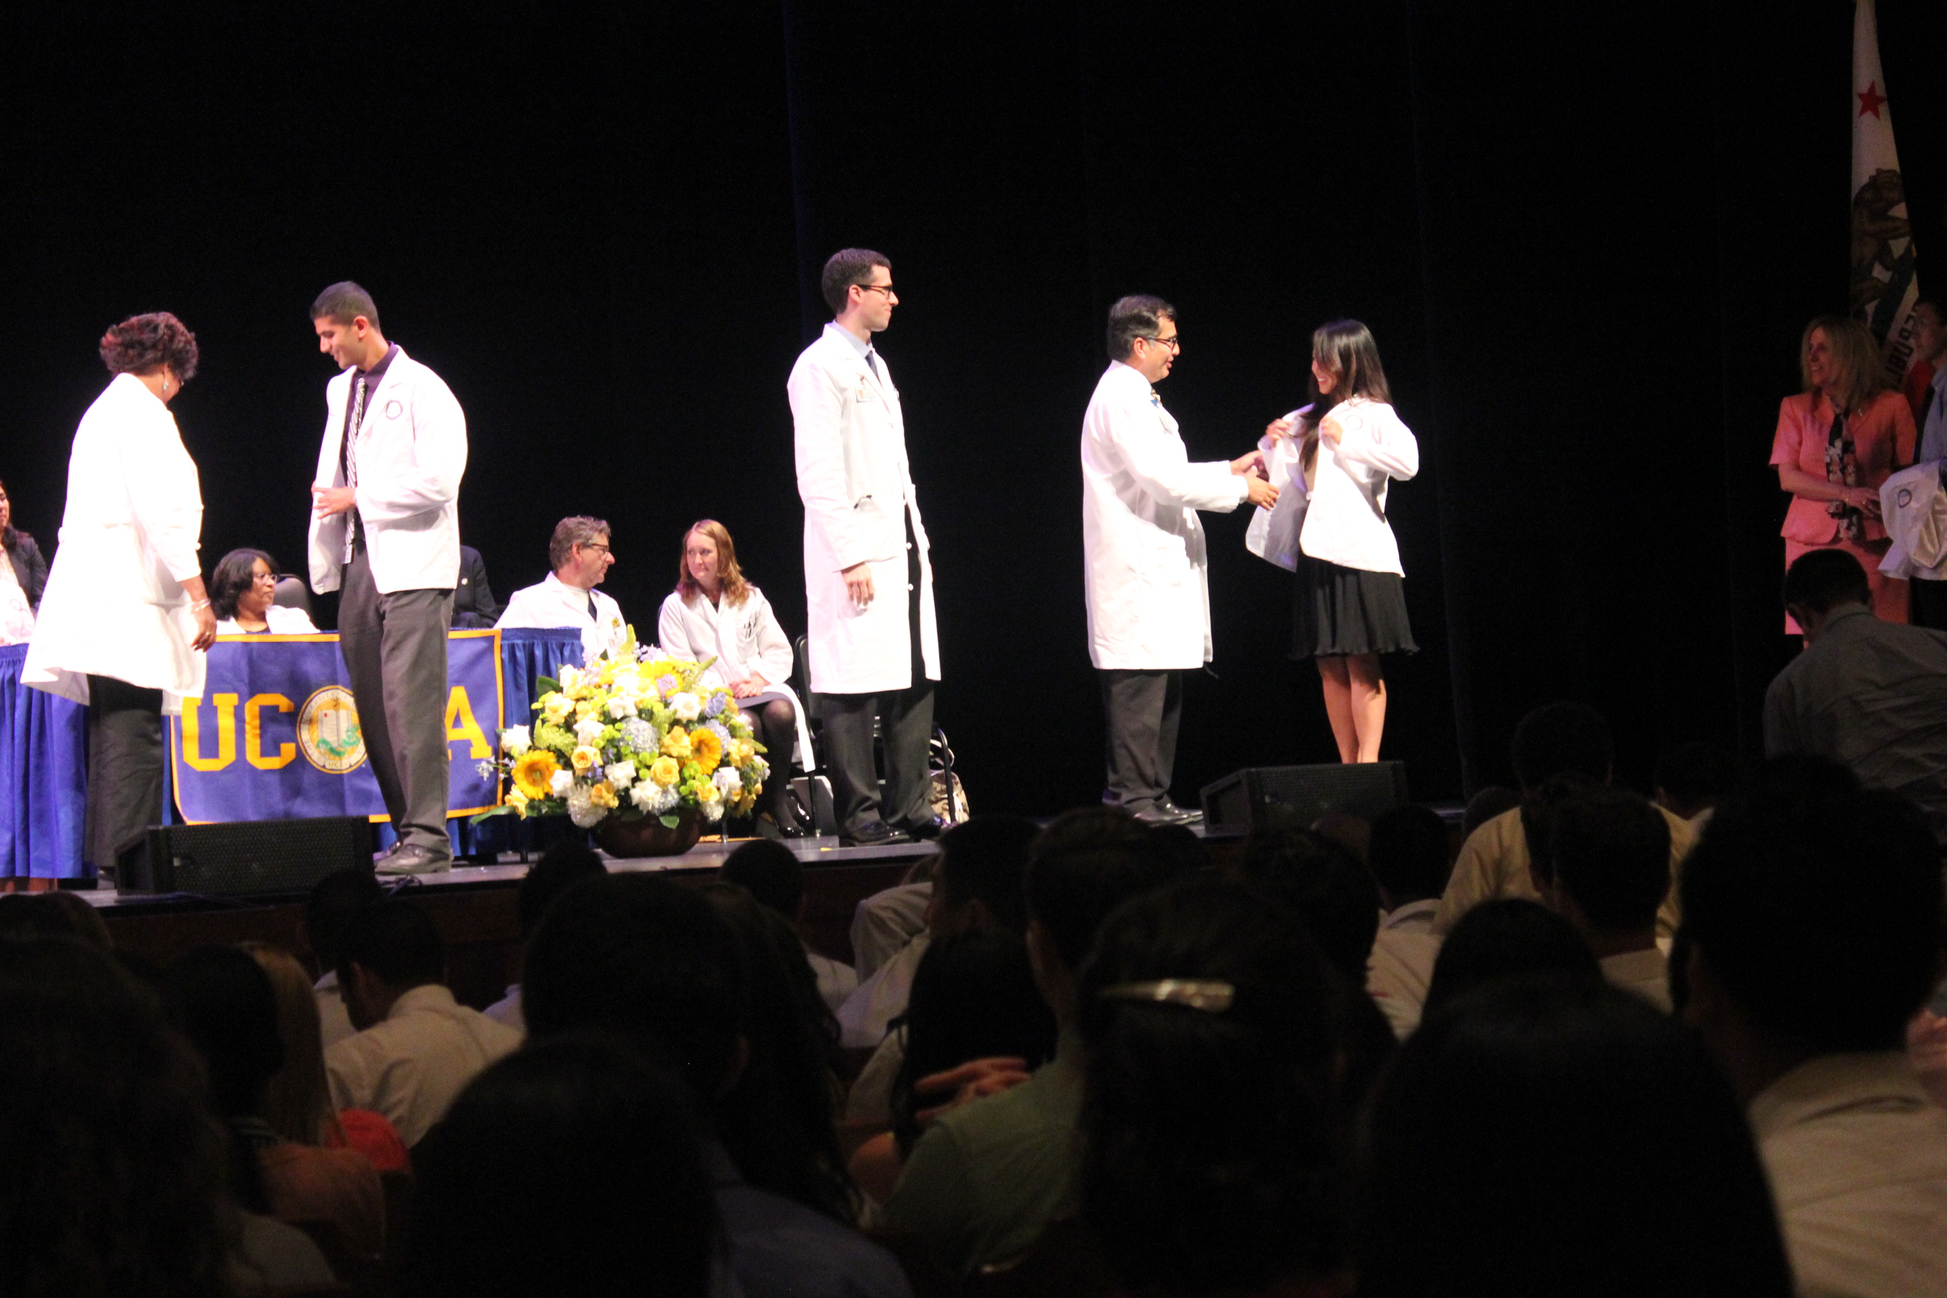
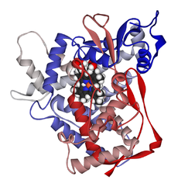
CHALLENGES
3. The Big New Innovations
    PCR vs “Shot Gun Sequencing”
    Hepatitis C Anti-viral drugs
    3-D drug printing

Slide 11

CHALLENGES
4. The Reward
    PI
    Chief Scientist
    Bonuses
    Next project
    Fortune 5
    Nobel prize

Slide 12

CHALLENGES
5. Time & Cost To Gainful Readiness
    5 - 6 years to PhD
    2 - 3 years more of post-doc .
    Elite labs are highly competitive
    Low pay and indebtedness
    A long uncertain road for a bright mind

Slide 13

CHALLENGES
6. Competing Choices
    Medicine
    Pharma Sales Executive
    FDA inspector
    Congressman
    Running for president

Slide 14
rEMEDIES
Career options
Pathway to Scientists
The “big new innovations¹”
The Reward
Time & cost to gainful readiness
Competing choices

Slide 15
EVEN More selective
Personality
    Patient
    Persistency
    Delayed gratification
Research Universities: ↑ selectivity of PhD candidates

Slide 16
REMEDIES
EDUCATION AND TRAINING
CAREER
Undergraduate Education
Predoctoral Training/Clinical Doctorate
Postdoctoral Training/Clinical Residency
Early Research Development
Mid-Career Research Development and Mentoring
Senior Career Research Development and Mentoring

Slide 17
REMEDIES
EDUCATION AND TRAINING
CAREER
Undergraduate Education
Strong K-12 STEM
Undergrad Research Opportunity Programs (UROP) at
  Universities
  Industries (Pharma)
  Gov. (NIH) – T02
  Non-profits

Slide 18
REMEDIES
EDUCATION AND TRAINING
CAREER
Undergraduate Education
Predoctoral Training/Clinical Doctorate
Better paid work-studies (e.g. Gates Millennium Scholars program)
Graduates Research at:
  Universities
  Industries (Pharma)
  Gov. (NIH)- T01, T90
  Non-profits
Research is integral graduate study: inquiry based- learning

Slide 19
REMEDIES
EDUCATION AND TRAINING
CAREER
Undergraduate Education
Predoctoral Training/Clinical Doctorate
Postdoctoral Training/Clinical Residency
Combined Degree-Programs: B.S./MD, PhD/MD, PharmD/PhD
Better paid Research/Study Programs at
  Universities
  Industries (Pharma)
  Gov. (NIH)
  Non-profits

Slide 20
REMEDIES
EDUCATION AND TRAINING
CAREER
Undergraduate Education
Predoctoral Training/Clinical Doctorate
Postdoctoral Training/Clinical Residency
Early Research Development
Solving indebtedness: Income based repayment (10% of income)
B.S./MD, PhD/MD, PharmD/PhD: Increase Availability
Better paid Research/Study Programs at
  Universities
  Industries (Pharma)
  Gov. (NIH)
  Non-profits
Early selection / determination

Slide 21
REMEDIES
EDUCATION AND TRAINING
CAREER
Undergraduate Education
Predoctoral Training/Clinical Doctorate
Postdoctoral Training/Clinical Residency
Early Research Development
Mid-Career Research Development and Mentoring
Senior Career Research Development and Mentoring
Solving indebtedness or compensation issues
Advanced Employment Opportunity
  Universities
  Industries (Pharma)
  Gov. (NIH)
  Non-profits
Grant opportunity
Tenure is not a solution
Getting prepared & counseling
  Quality of life (long hours)
  High risk and unstable earning, pay is not guaranteed

Slide 22
remedies
EDUCATION AND TRAINING
CAREER
Undergraduate Education
Predoctoral Training/Clinical Doctorate
Postdoctoral Training/Clinical Residency
Early Research Development
Mid-Career Research Development and Mentoring
Senior Career Research Development and Mentoring
Mentoring:
  Adjust the mindset
  Big picture initiative
  Be content with being a small part of a big machine
  Lay-off potential
  Risk of R&D stages
  Be willing to move along from firm to firm
Collaboration
Greater technology transfer opportunity

Slide 23
A Few Examples – Amgen’s
Amgen’s UROP
One of the Best:
  >5,000 applied – 354 accepted (75)
  213 participants in the US, 101 participants in Europe, and 40 in Japan
  Most common areas: Biology, biochemistry, and biomedical engineering
So much effort, yet still not enough…
 | # accepted | # of Universities | # of States/ Countries
US | 213 | 128 | 39
Europe | 101 | 63 | 20
Japan | 40 | 33 | 10

Slide 24
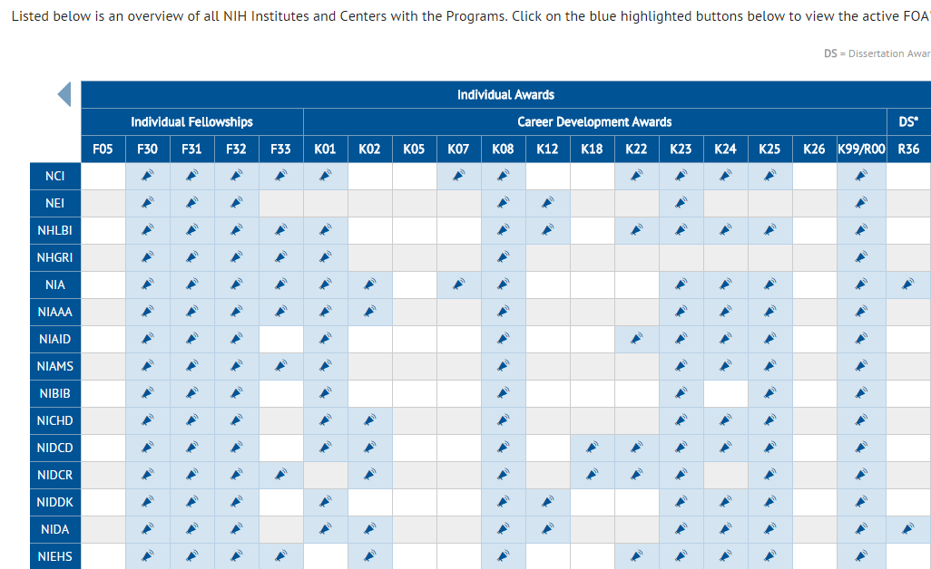
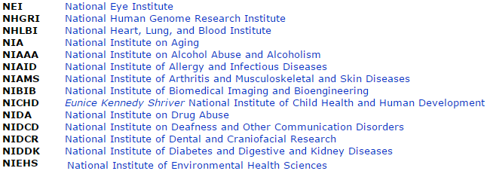
NIH
http://grants.nih.gov/grants/acronym_list.htm

Slide 25
Student Financial Aid
Reconciliation Act of 2010 H.R. 4872 was signed into law on March 30, 2010.
http://explorehealthcareers.org/en/issues/news/Article/233/Reconciliation_Act_of_2010_Includes_Significant_Student_Aid_Provisions

Slide 26
Qustions?

Slide 27
Let us meet again..
We welcome you all to our future conferences of OMICS International
7th Annual Global Pharma Summit
On
June 20-22, 2016 at New Orleans, USA
http://american.pharmaceuticalconferences.com/

