Slide 1


Skin Care and Advanced Skin Changes in Lower Limb Lymphedema
Alper TUĞRAL, PT, MSc,Res. Assist,
Yeşim BAKAR, PT, PhD, Prof.
Abant Izzet Baysal University
School of Physical Therapy and Rehabilitation-BOLU/TURKEY
tugral.alper@gmail.com

Slide 2
Presentation Plan
Normal Skin Structure
Skin changes and problems specific to Lymphedema
Skin care in Lymphedema

Slide 3
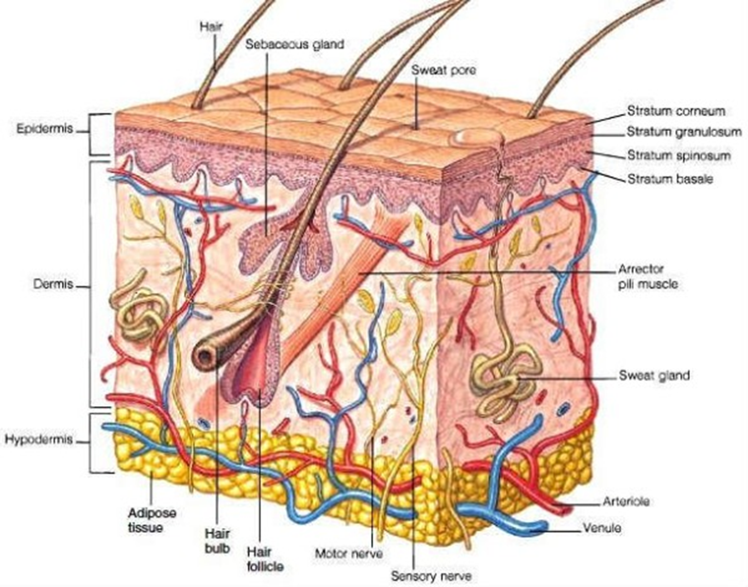
Normal Skin
Protective barrier function
Primary determiner of maintaining natural moisture balance.

Slide 4
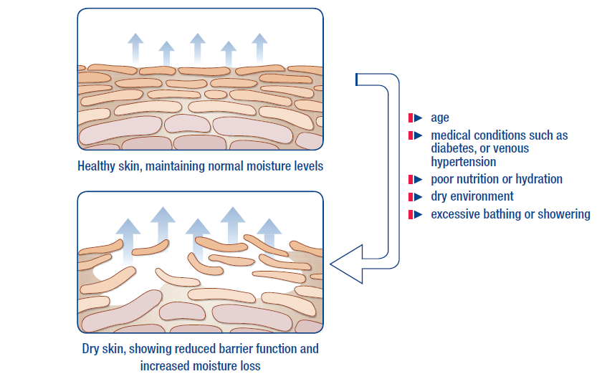
Importance of skin moisture

Slide 5
Skin changes in Lymphedema
Structural fibroproliferative tissue changes
-Activation of Fibrin and WBC
Fibroproliferation→ Epidermal, dermal and soft Tissue thickening.
Structural degeneration in capillary→ Ineffectivity
Researchers also pointed out anormal expression of inflamatory cytokines, adhesion molecules and growth factors.

Slide 6
Background Physiology
Prolonged and increased interstitial pressure→Skin changes.
Changes in perfusion and nutrition.
Underlying reason, changes in adipose and fibrous tissue in basic. (Olzewski, 2003)
Diminished elasticity, natural moisture balance is lost.
Advanced skin changes→ Hyperkeratosis, Papillamatosis etc.

Slide 7
Impacts
Advanced skin changes cause patients to be more vulnerable to infection in addition to corruption of barrier function of skin.
Moffatt (2003): Incidence of cellulitis infection in patients with chronic edema is 29%.
25% of them or above, hospitalization is required!
Moffatt, C. J., Franks, P. J., Doherty, D. C., Williams, A. F., Badger, C., Jeffs, E., ... & Mortimer, P. S. (2003).Lymphoedema: an underestimated health problem. Qjm, 96(10), 731-738. ISO 690

Slide 8
Diagnosing and intervention to skin problems in early stage prevent the cycle to get worse and improve patients’ quality of life.
Besides, improvement in progression of disease and reducing health care costs could be achieved by early intervention.
Hofman, D. (2010). Managing ulceration caused by oedema. Wounds Essentials, 5, 80-6.

Slide 9
Skin changes and problems specific to Lymphedema
Cellulitis (Erysipelas)
Hiperkeratosis
Papillamatosis
Lymphorrhoea (Lymph Fistula)
Fungal infections
Folliculitis
Ulcerations
Skin folds

Slide 10
Cellulitis (Erysipelas)
Inflamatory reaction which includes tissues in skin and sub-skin
Typical inflamation signs (+).
β-hemolitic streptococcus.
Group A streptococcus according to some researchers
Microbiologists: Staphylococcus Aureus in some patients.
Mortimer, P. (2000). 9 Acute inflammatory episodes. Lymphoedema, 130.
Al-Niaimi, F., & Cox, N. (2009). Cellulitis and lymphoedema: a vicious cycle. Journal of Lymphoedema, 4(2), 3-42.
Chira, S., & Miller, L. G. (2010). Staphylococcus aureus is the most common identified cause of cellulitis: a systematic review. Epidemiology and infection, 138(03), 313-317.

Slide 11

Cellulitis (Erysipelas)
Strong correlation with LE together with reduced immune system function.
Lower extremity is the most affected area
96 M £ each year according to the NHS
7.1 days hospitalization in average!
Dupuy, A., Benchikhi, H., Roujeau, J. C., Bernard, P., Vaillant, L., Chosidow, O., ... & Bastuji-Garin, S. (1999). Risk factors for erysipelas of the leg (cellulitis): case-control study. Bmj, 318(7198), 1591-1594.
Cox, N. H., Colver, G. B., & Paterson, W. D. (1998). Management and morbidity of cellulitis of the leg. Journal of the Royal Society of Medicine, 91(12), 634-637.
Halpern, J., Holder, R., & Langford, N. J. (2008). Ethnicity and other risk factors for acute lower limb cellulitis: a UK‐based prospective case–control study. British Journal of Dermatology, 158(6), 1288-1292.
UK Dermatology Clinical Trials Network's PATCH Trial Team. (2012). Prophylactic antibiotics for the prevention of cellulitis (erysipelas) of the leg: results of the UK Dermatology Clinical Trials Network’s PATCH II trial. The British journal of dermatology, 166(1), 169.

Slide 12
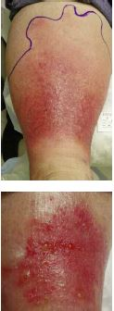
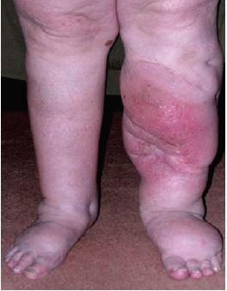
Integration to treatment
In case of acute erysipelas→ Broad spectrum antibiotics (14-21 days).
Topical antibiotics.
MLD ve CDT contraindicates.

Slide 13

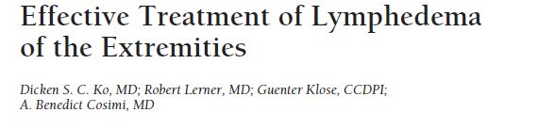
Ko et al: CDT reduces frequency of infection attacks
Ko, D. S., Lerner, R., Klose, G., & Cosimi, A. B. (1998). Effective treatment of lymphedema of the extremities. Archives of Surgery, 133(4), 452-458.
CDT carries a primary importance regarding the prevention of recurrence and lymphatic improvement after stabilization is maintained

Slide 14
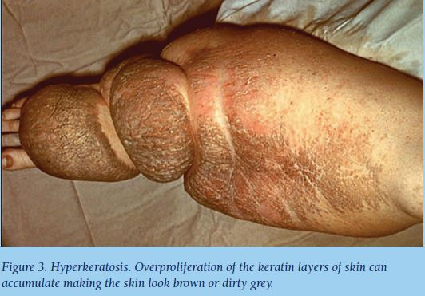
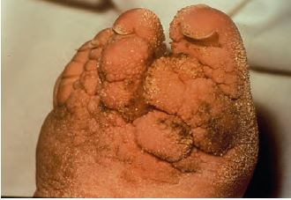
Hyperkeratosis
Excessice thickening of external layer of skin (SC) (ILF,2012).
Epidermal hyperplasia due to lymph stasis
Physiology: Hyperproliferative keratinocytes.
Characterized by Brown-gray color, fissures and fractures (Day and Hayes, 2008).
Fissures cause bacterial and fungal colonization→ Infection!

Slide 15
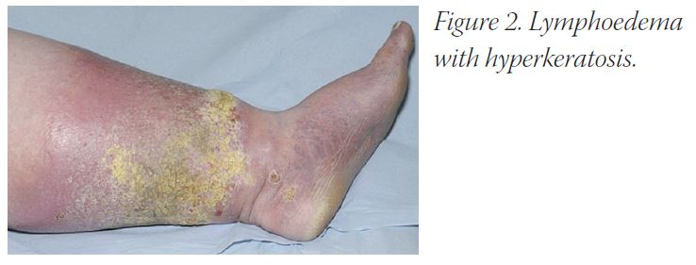
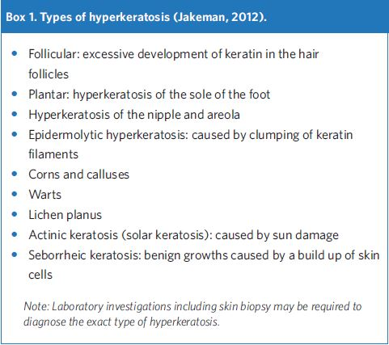

Slide 16
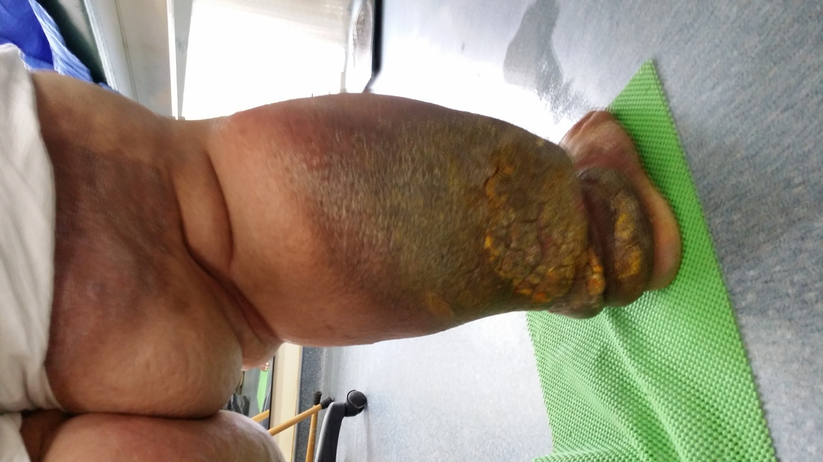
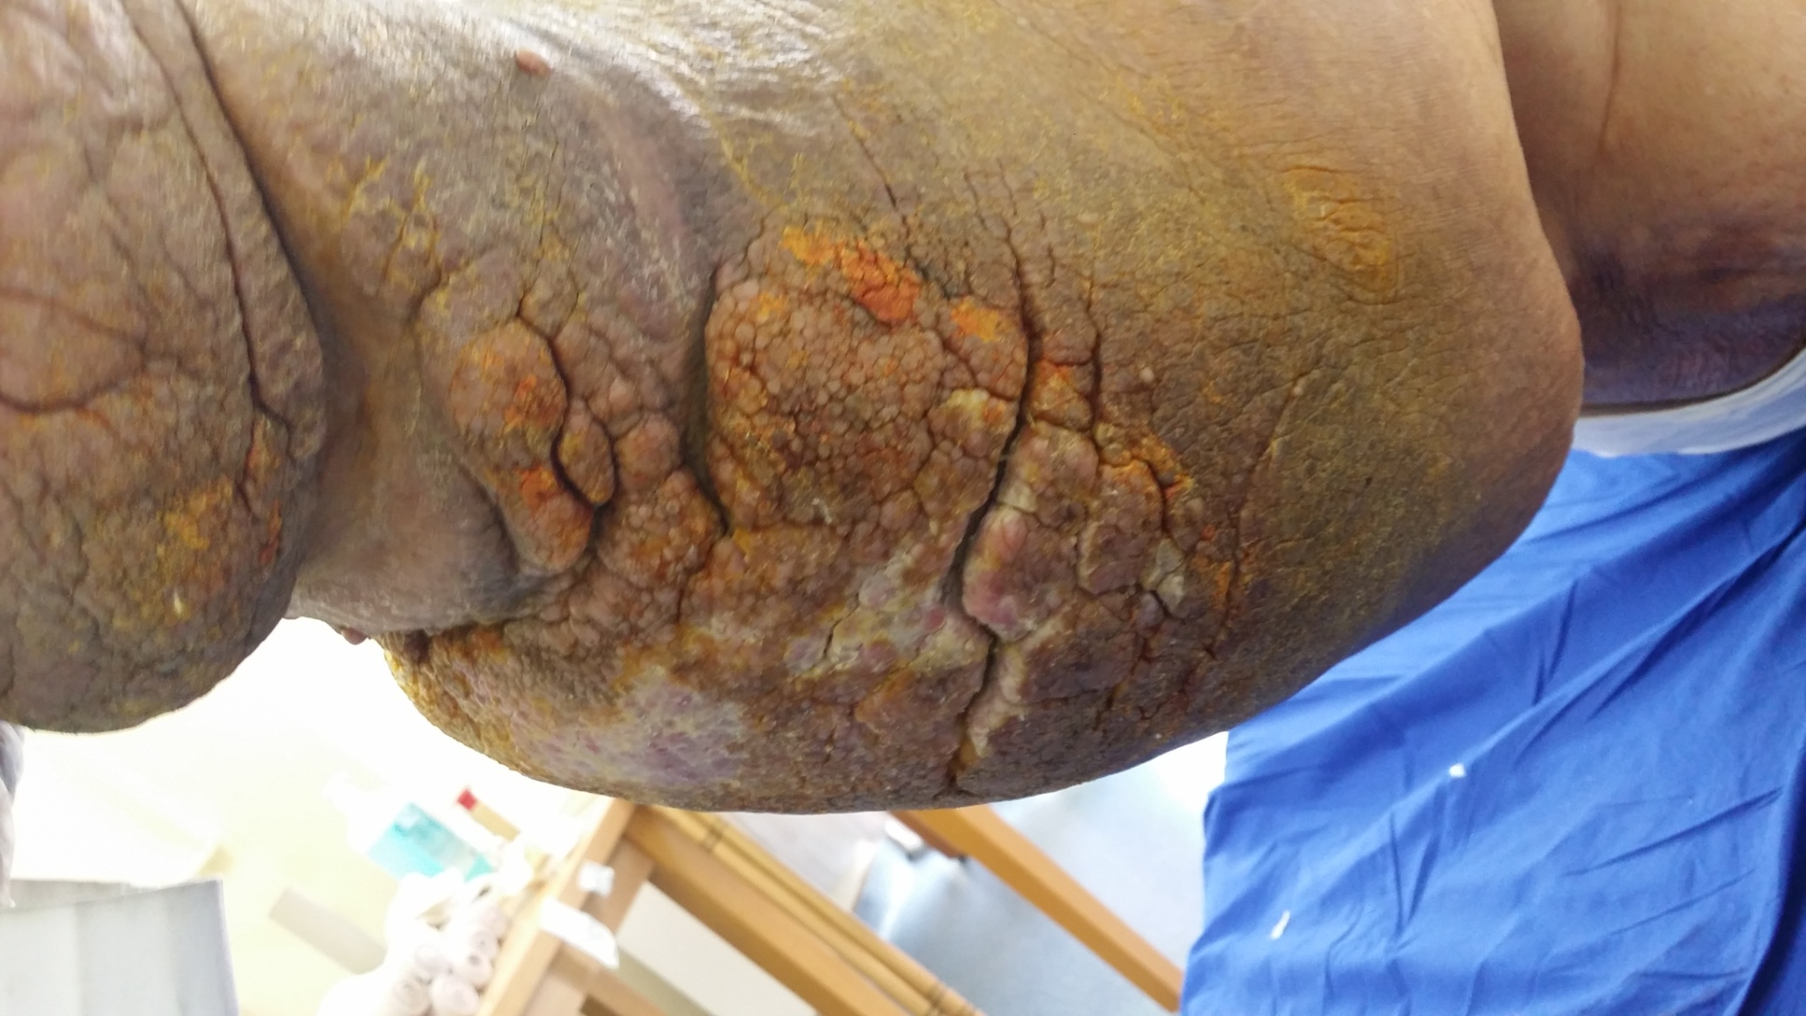

Slide 17


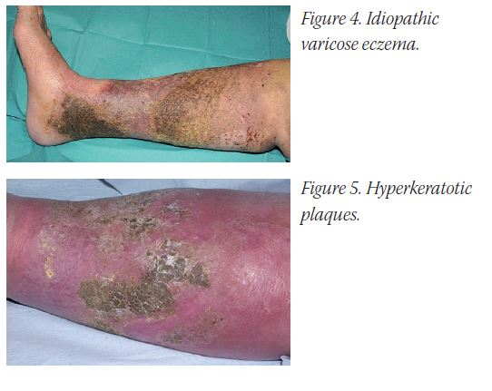
There is no exact standardized approach. (Young, 2010).
Bacterial colonization+ fungal infections can be exist, therefore those all resulted recurrent infections and corruption of skin integrity by creating a cyclic cycle (Day and Hayes, 2008).
Maintaning daily hygiene and integration of self-care are primarily important in the treatment (Whitaker 2012, Pidock and Jones,2013).
Young T (2011) EWMA poster. A national survey of the nursing
practice of the treatment of hyperkeratosis associated with venous
hypertension. EWMA Conference. Bruges. Belgium
Day, J., & Hayes, W. (2008). Body image and leg ulceration. Leg Ulcers and Problems of the Lower Limb: An Holistic Approach.
Whitaker, J. (2012). Self-management in combating chronic skin disorders. Journal of Lymphoedema, 7(1), 46-50.
PIDCOCK, L., & JONES, H. (2013). Use of a monofilament fibre debridement pad to treat chronic oedema-related hyperkeratosis. Wounds UK, 9(3).

Slide 18

What can be done?
Integration to Treatment
Elimination of hyperkeratotic plaques Whitaker, J. (2012). Self-management in combating chronic skin disorders. Journal of Lymphoedema, 7(1), 46-50
Using monofilament debridement pads (MDP). NICE Medical Technologies Guidance {MTG17] (2014) The Debrisoft monofilament debridement pad for use in acute or chronic wounds. Available from www.nice.org.uk/guidance/ MTG17
MDP is effective in clinical usage. Using this in LE patients is also effective. Gray, D., Cooper, P., Russell, F., & Stringfellow, S. (2011). Assessing the clinical performance of a new selective mechanical wound debridement product. Wounds UK, 7(3), 42-6. Bahr, S., Mustafi, N., Hättig, P., Piatkowski, A., Mosti, G., Reimann, K., ... & Abb42-8. McGrath, A. (2013). The management of a patient with chronic oedema: a case study. British journal of community nursing.ritti, F. (2011). Clinical efficacy of a new monofilament fibre-containing wound debridemen.t product. J Wound Care, 20(5), 2. PIDCOCK, L., & JONES, H. (2013). Use of a monofilament fibre debridement pad to treat chronic oedema-related hyperkeratosis. Wounds UK, 9(3).

Slide 19
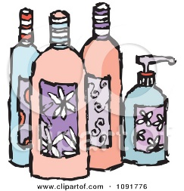
Proper Moisturizer
Water based moisturizers are not effective regarding moisturizing in the treatment of hyperkeratosis.Moncrieff, G., Cork, M., Lawton, S., Kokiet, S., Daly, C., & Clark, C. (2013). Use of emollients in dry‐skin conditions: consensus statement. Clinical and experimental dermatology, 38(3), 231-238.
250-600 gr/week is convenient in adultsErsser, S., Maguire, S., Nicol, N., Penzer, R., & Peters, J. (2007). Best practice in emollient therapy: a statement for healthcare professionals. Dermatology Nursing, 6(4).
Patient compliance is the most important parameter regarding moisturizing and skin care protocolCork, M. J., & Danby, S. (2009). Skin barrier breakdown: a renaissance in emollient therapy. British Journal of Nursing, 18(14).

Slide 20
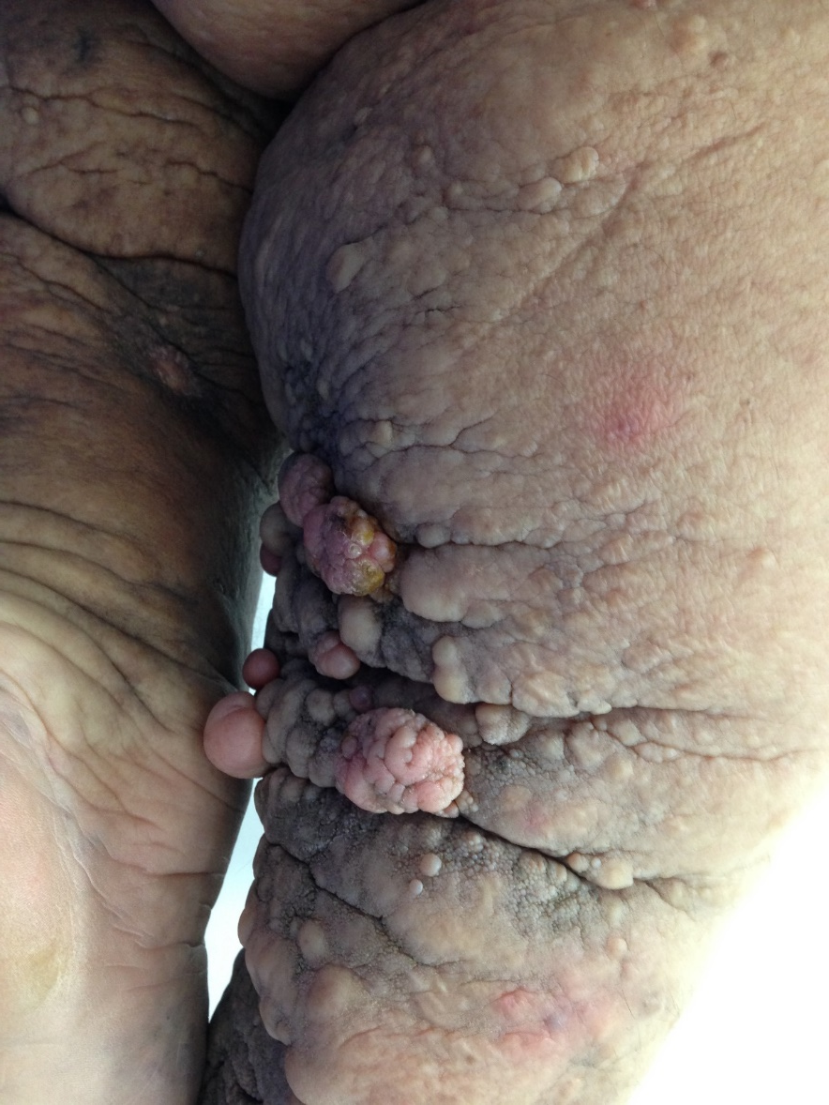
Papillamatosis
Benign skin growths characterized by epithelial neoplasms.
Villous/fibrous vascular structures.
Tends to hyperkeratosis.
Vulnerable to mechanical traumas and can be easily bleed due to vascular background.

Slide 21
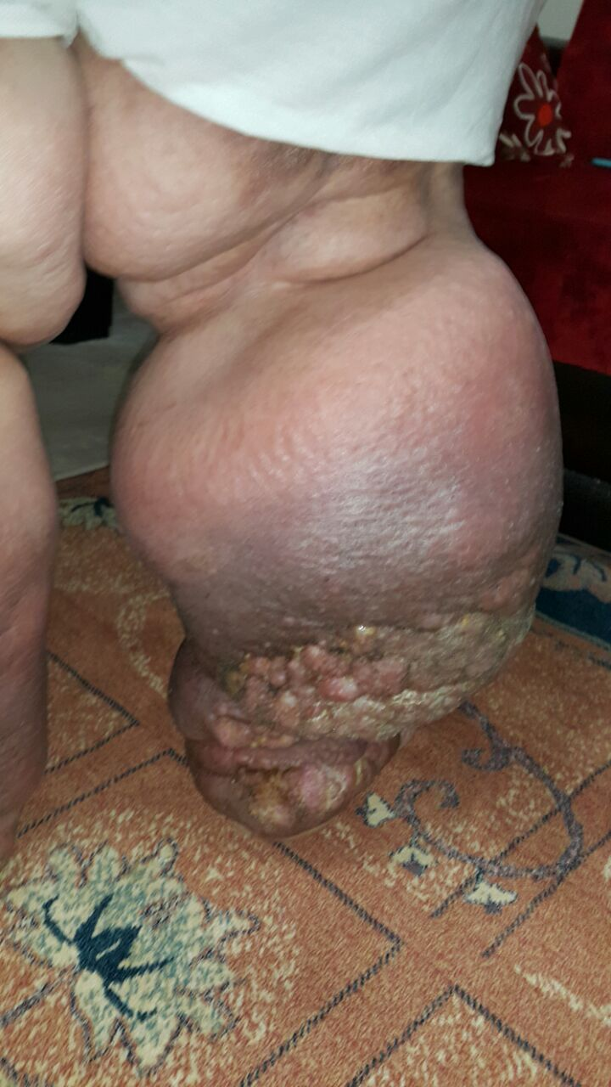

Slide 22
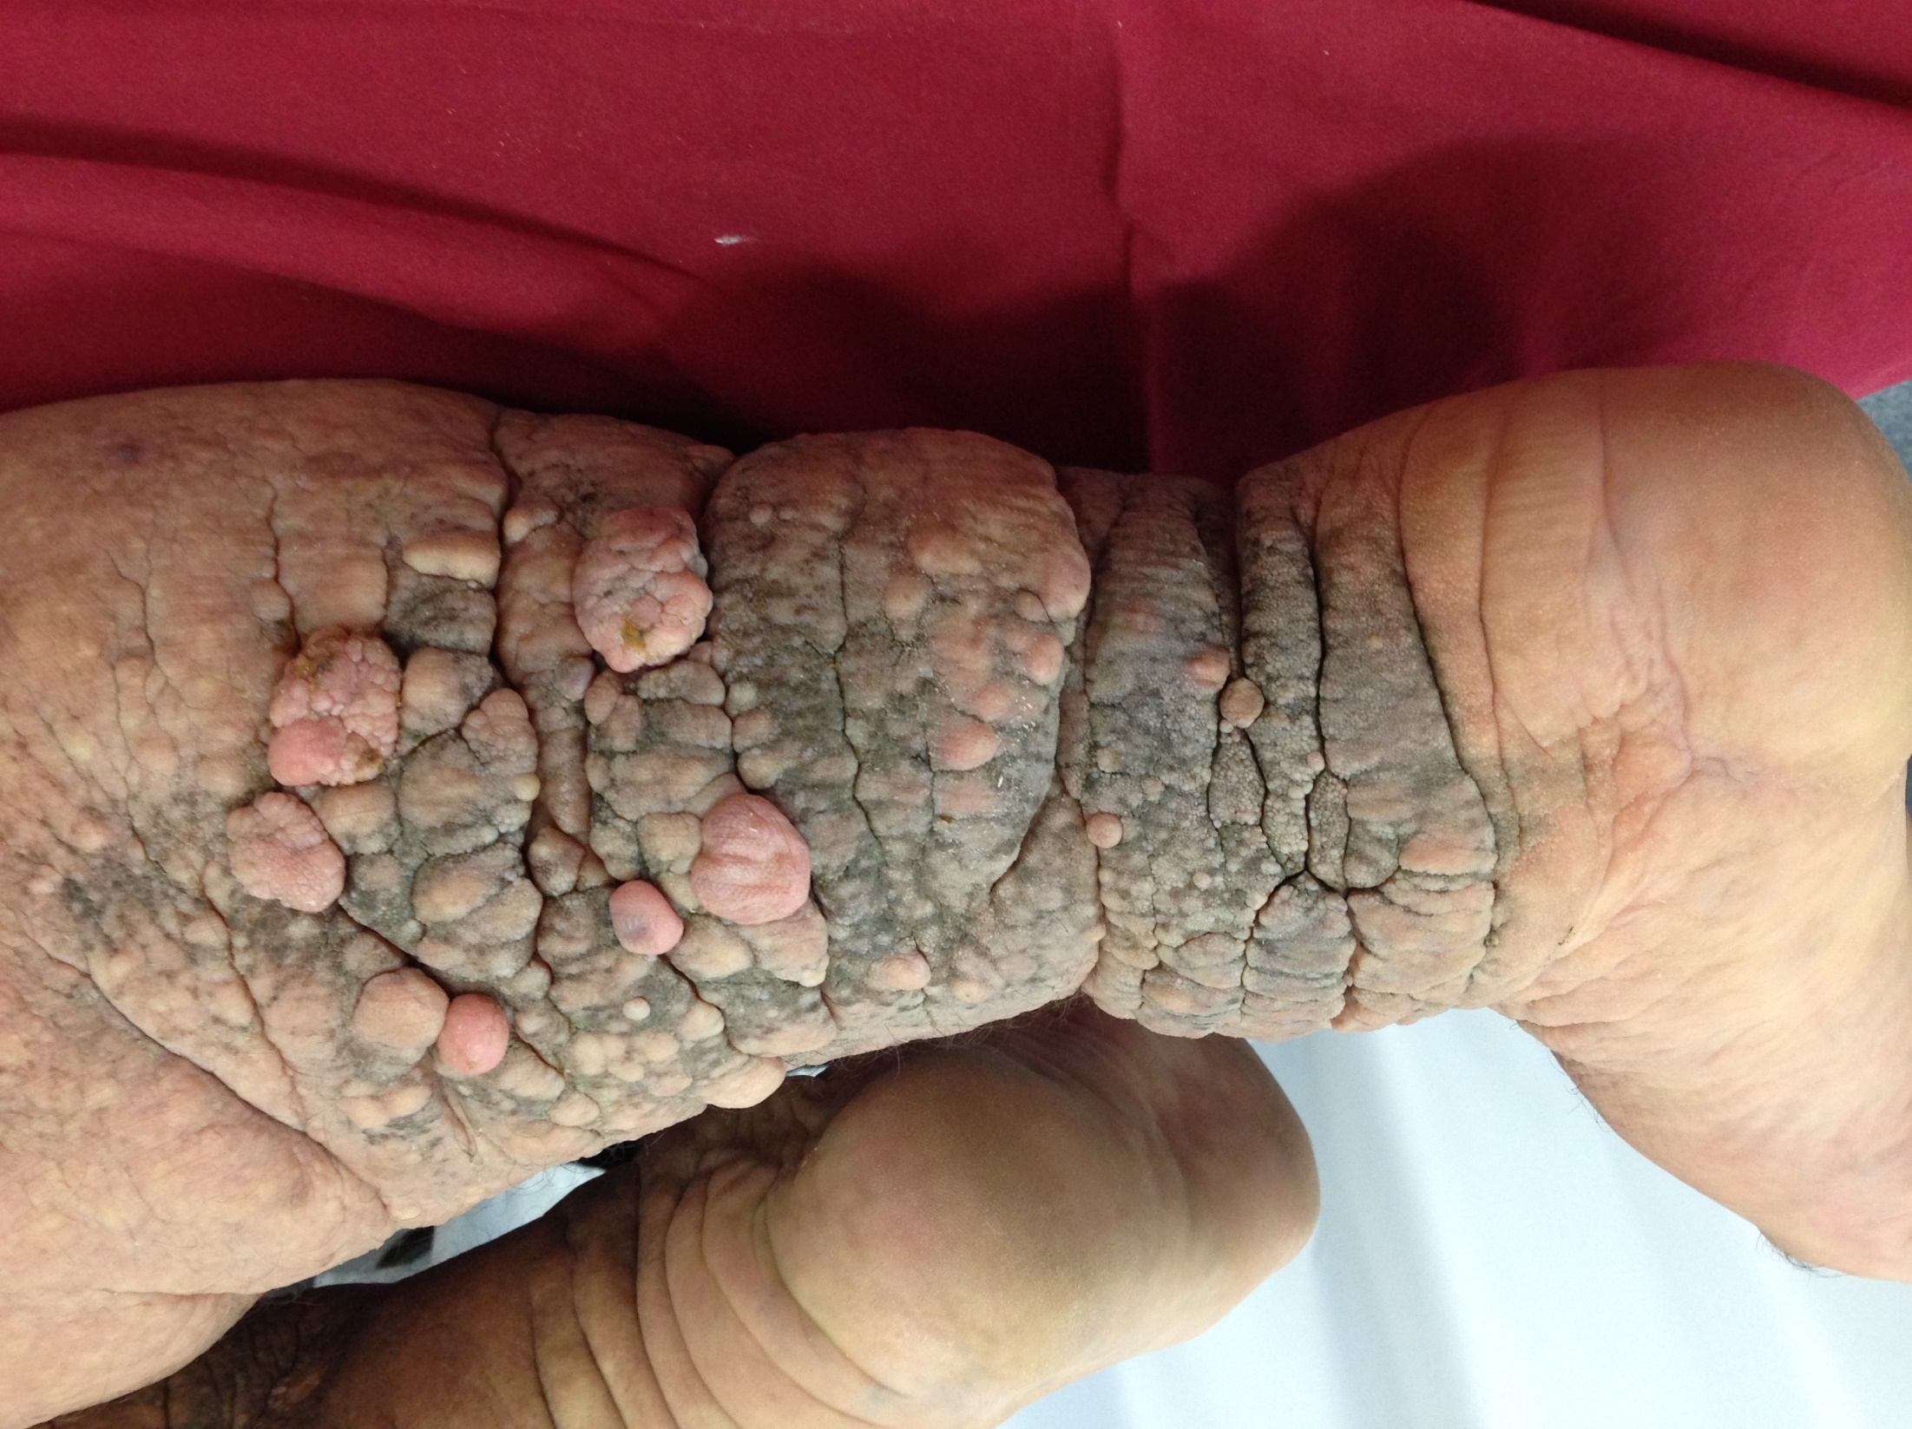

Slide 23
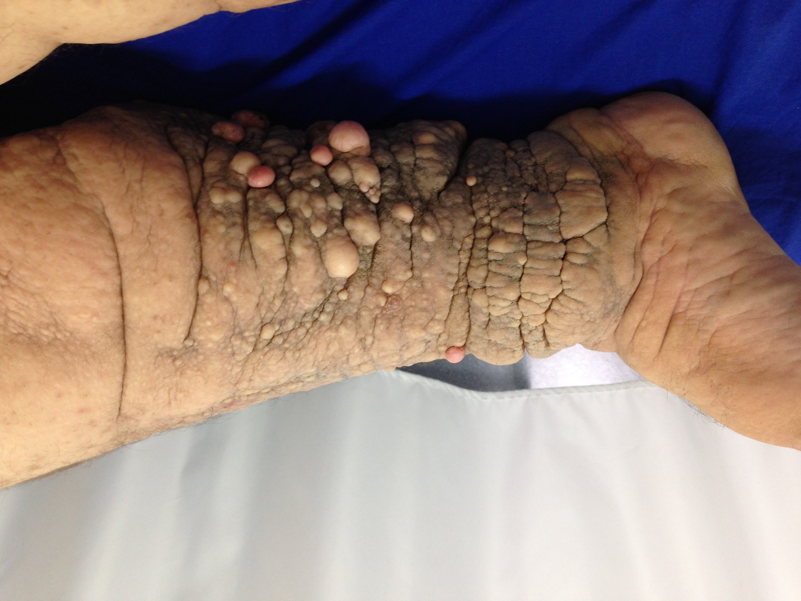

Slide 24
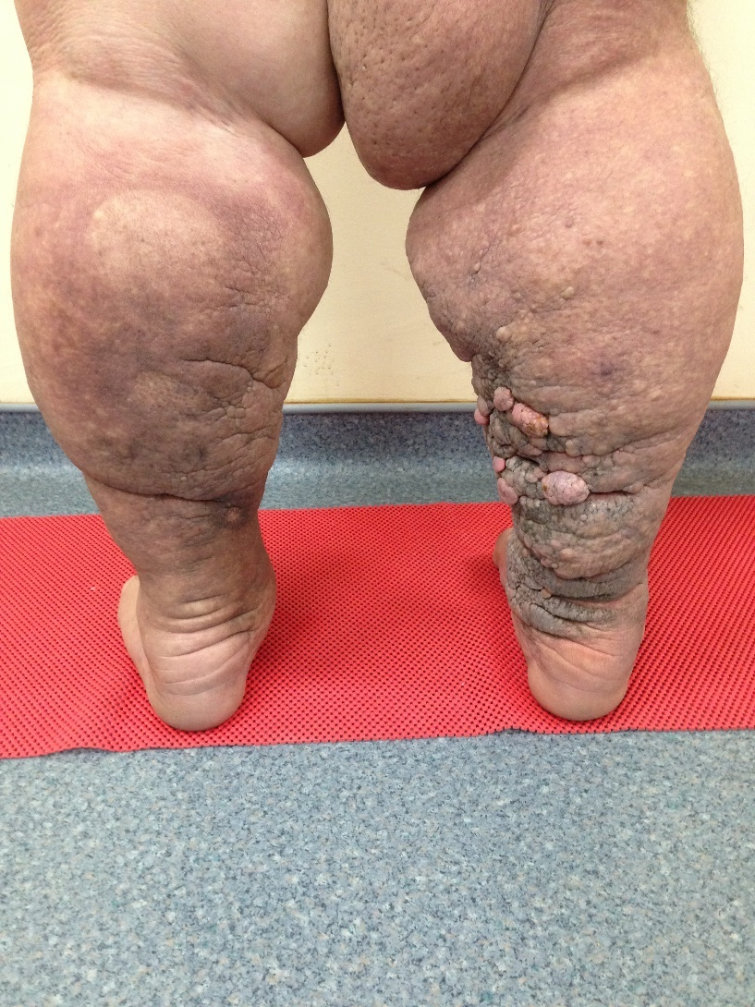
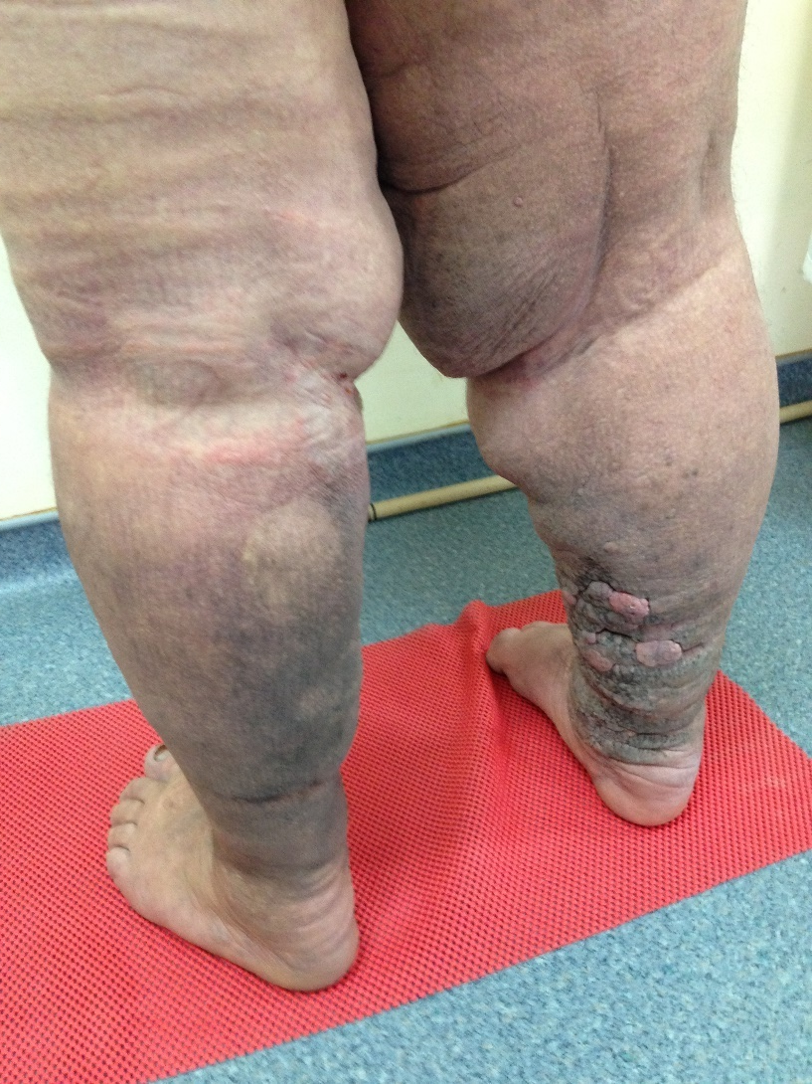

Slide 25
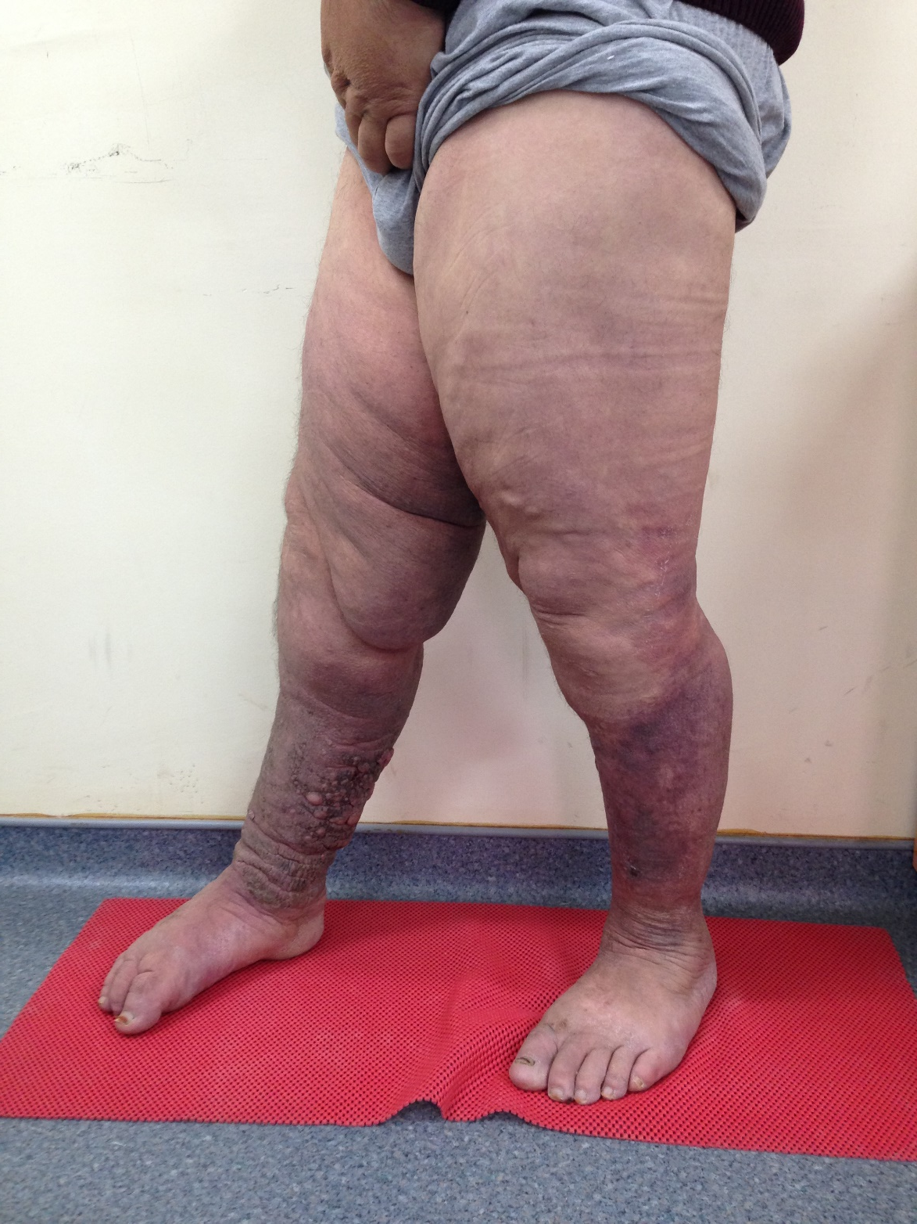

Slide 26
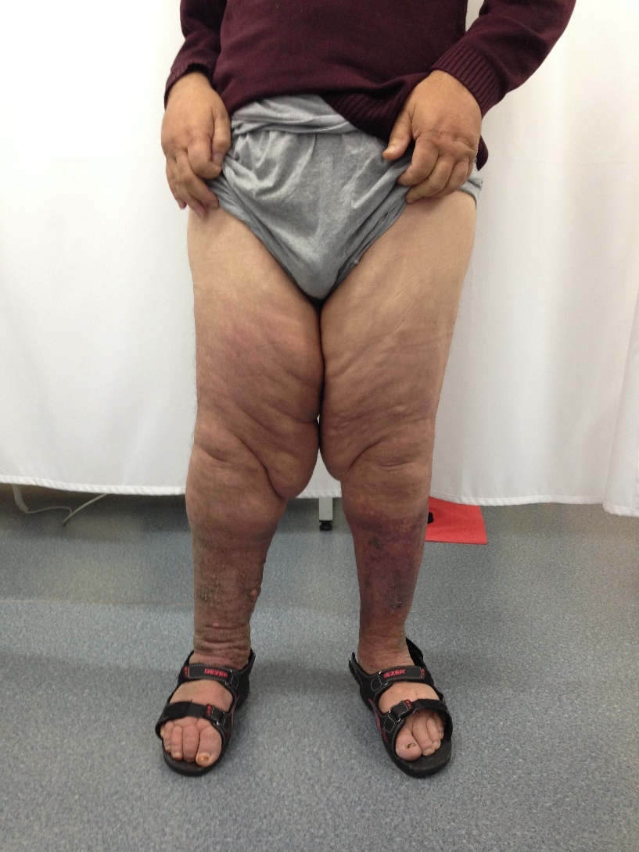
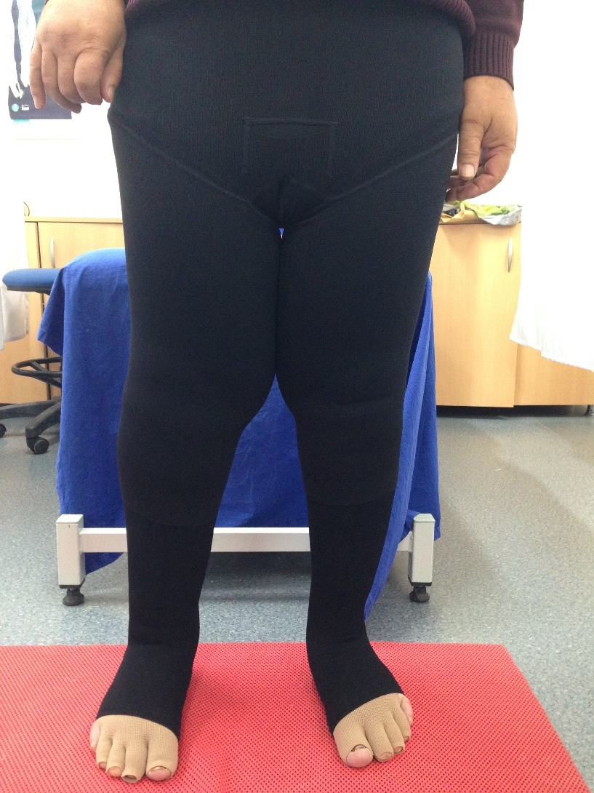

Slide 27
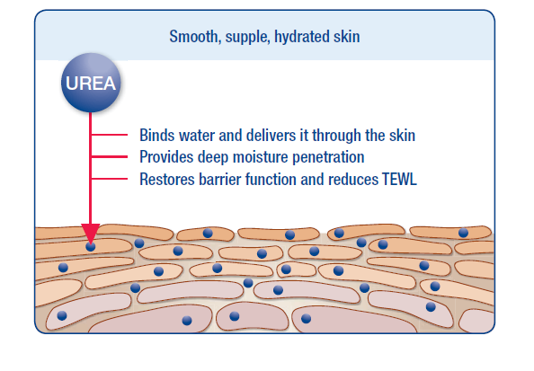
Integration to Treament
Skin care and protection of natural moisture balance of skin with urea based creams
They should be supported during the application of compression bandage
Should be protected againts mechanical traumas: Infection risk!
Surgical debridement?→ Immune inefficacy must be taken into account

Slide 28
Lymphorrhea (Lymph Fistula)
Frequent in sides where interstitial pressure increased and reduced lymphatic transport
Lymph cyst→ Trauma→ Lymph Fistula
Leakage of serum fluid
It might be spontaneous in primary lymphedema (Cardone-Gaines and Khachemoune, 2013).
Infection risk increased due to contact between acidic fluid and intact skin (+++).

Slide 29

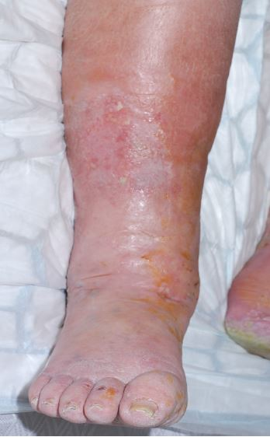
Wet Legs
-Odour
-Tend to be infected

Slide 30
Integration to Treatment
Fluid absorbent wound pads
Compression bandage with fluid absorbent wound pads.
Cook (2011): Attention to sub-bandage pressure. (Due to the capacity of absorbent pads)
Potassium permanganate: Effective in exudative inflamatory degenerations.
High protein concentration: Inflamation!
Cook, L. (2011). Effect of super-absorbent dressings on compression sub-bandage pressure. British Journal of Community Nursing, 16(3), 38.

Slide 31
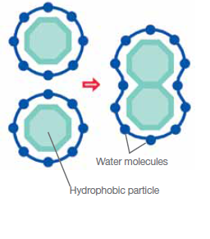
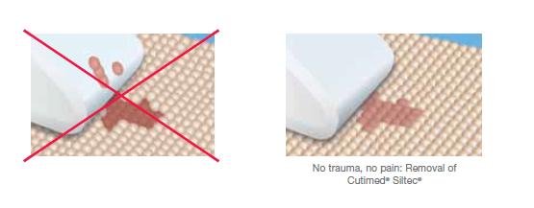
Absorbent Pads
Hydrophobicity; provides adhering bacteries and other infectious agents to wound pads, remove them from wound by preventing bacterial colonization in an infected wound.

Slide 32
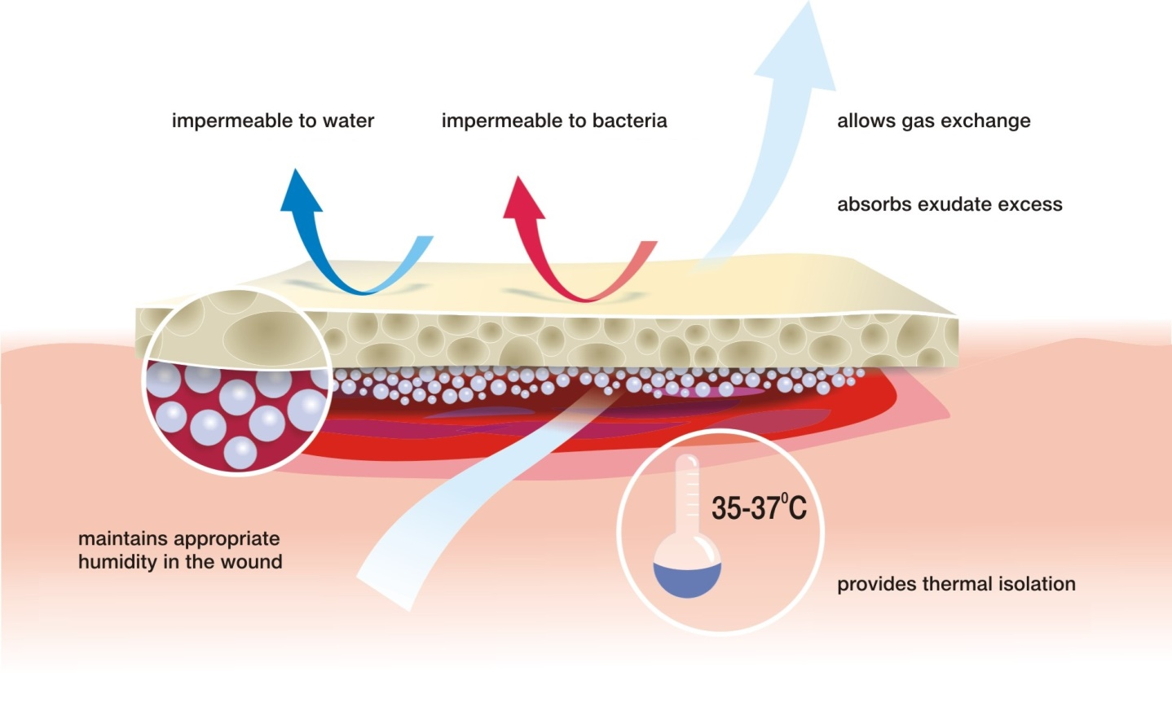
Key Features of Wound Pads

Slide 33
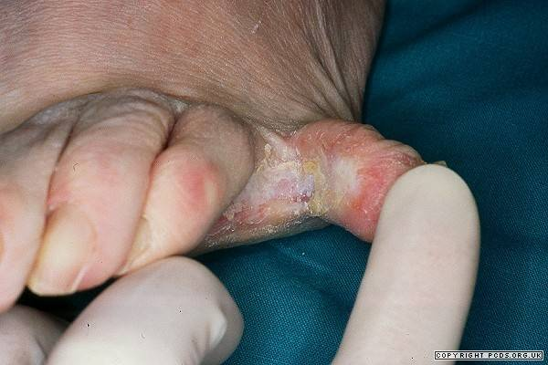
Fungal Infections
Fungal growth in dead keratin (+++)
Accumulation of keratin is frequent in LE
Protein: Fasilitator of the growth of fungal infections
Hygiene problems between skin folds, increased temperature, friction between skin folds: Frequent infection!
Recurrent infections: Affect the treatment negatively.
Especially in interdigital areas!

Slide 34
Integration to Treatment
Antifungal topical applications
Supporting the gaps between skin folds (Reducing friction stress)
Maintaining hygiene
Compression bandage with topical antifungal applications.
Contact exposure!

Slide 35
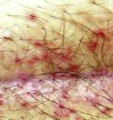
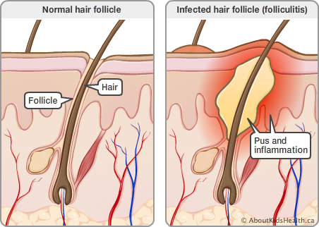
Folliculitis
Inflamation of hair follicle
Can include fungal/ bacterial component
Frequent in LE: Folliculitis due to mechanical irritation

Slide 36
Integration to Treatment
Maintaining hygiene
Determination of factors which cause irritation
Especially in males, moisturizer should be applied to downward direction due to the hair growth.
Infected area should be supported with anti-microbial agents.

Slide 37
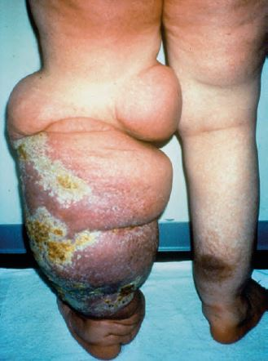
Ulceration
Dysfunctional immune system
Prolonged tissue hypoxia
Concomitants(Infection, Trauma)
In lower limb LE:Ulcerations due to vascular insufficiency.
Increased interstitial fluid→ Increased diffusion distance(O₂→ Dermal capillaries)

Slide 38
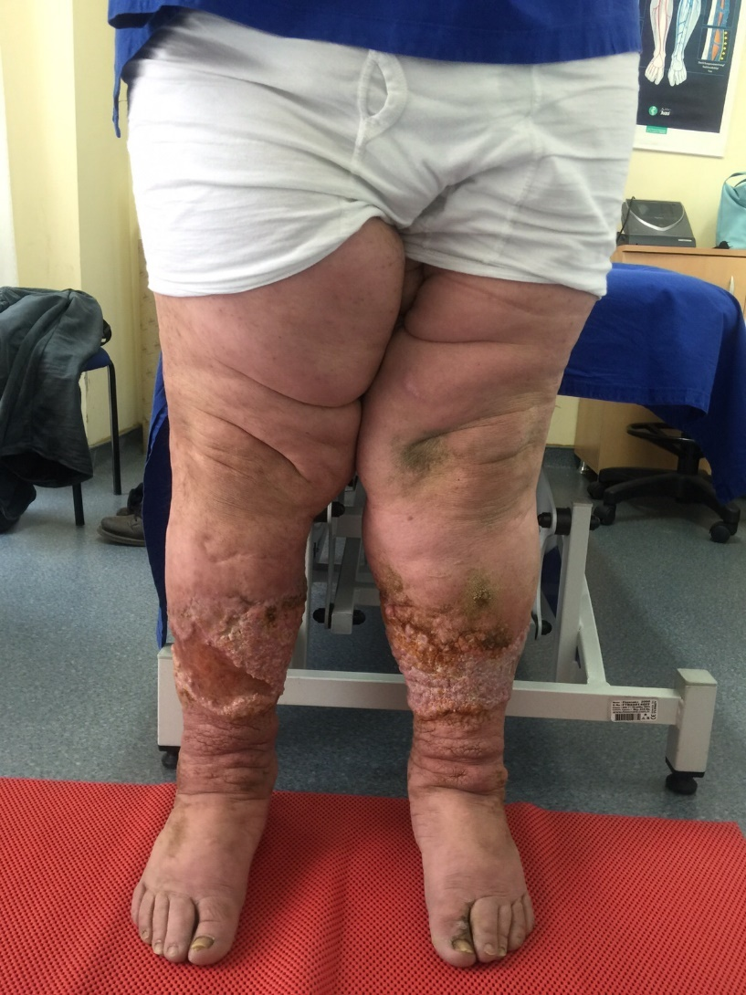
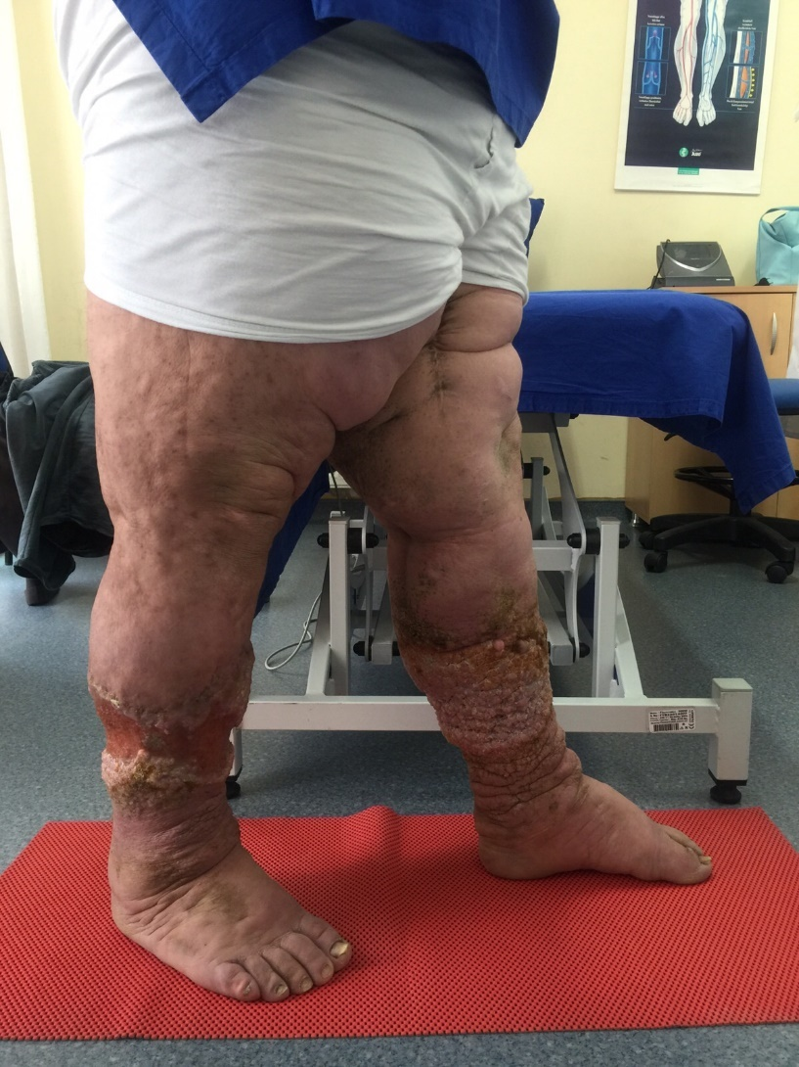

Slide 39
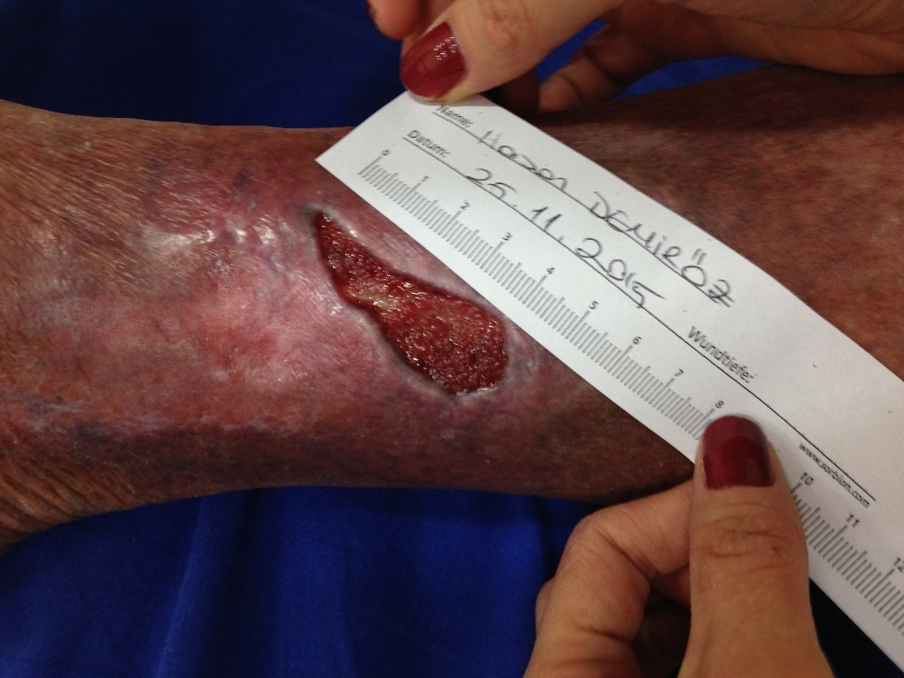
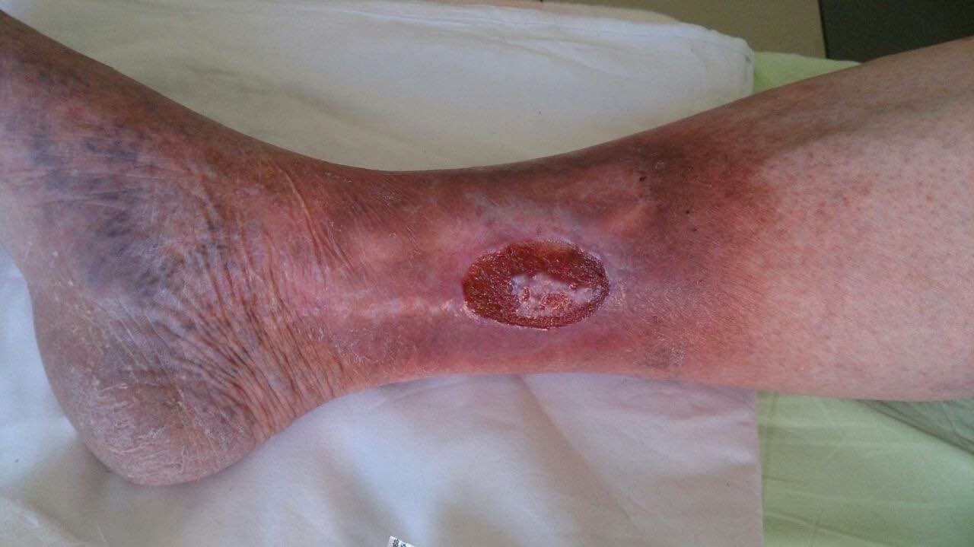
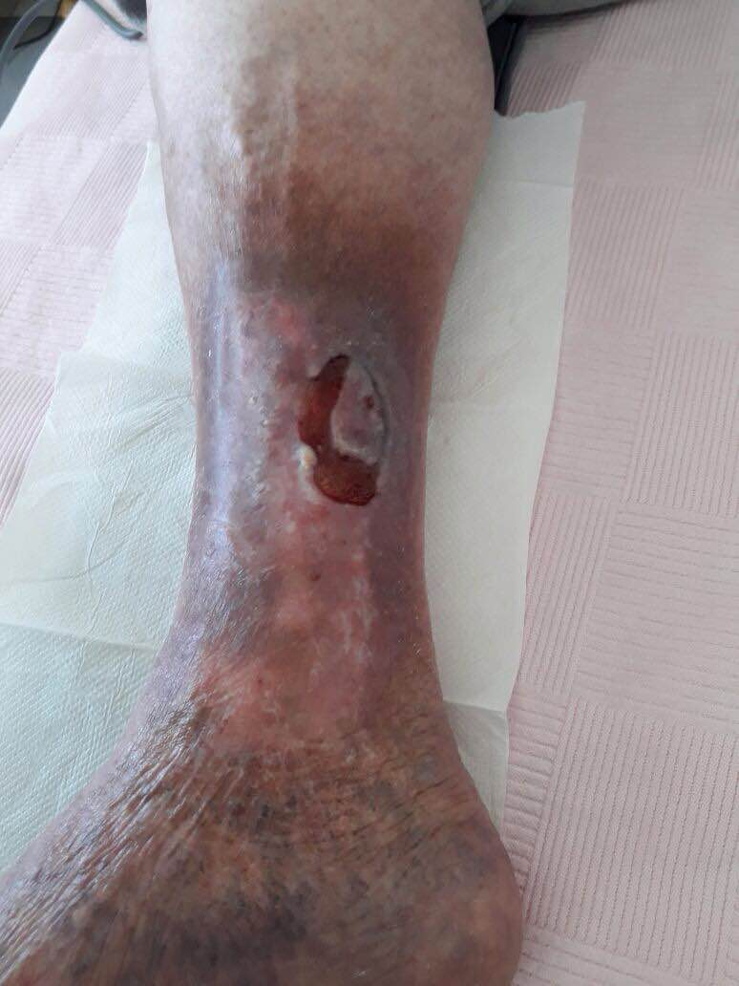
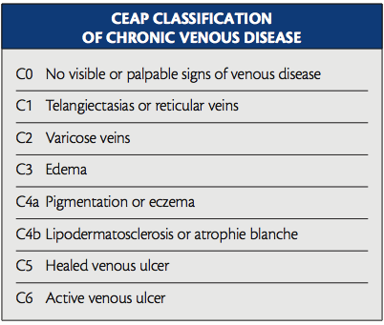
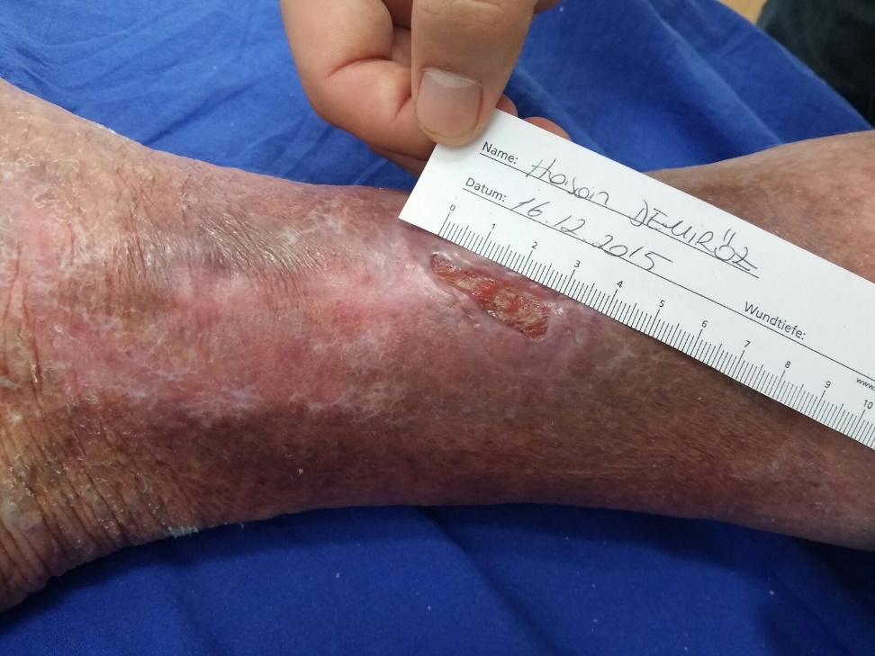
Important!→ Determination of Etiology
Phlebolymphedema→ Ulceration with venous background

Slide 40
Compression Effects
Healed ulcerations only with compression treatment→ 70%
Improves peripheric pump activation
Increases venous blood flow rate
Reduces venous reflux.
Reduces venous blood volume.
Increases lymphatic drainage, reduces edema
Important: Compression treatment should be combined with active movement. Efficacy can be increased more by this way.

Slide 41
Venous Stats
1.5-2 M patients with leg ulcer.
200.000 new cases per annum
70% of them originating from CVI
Ulcer manifested 1 year ago at least 50% of patients
Recurrence rate after healing 60-90%
(Joachim Dissemond 2007: Ulcus-cruris doğuşu,tanılama,tedavi. UNI-MED araştırma)

Slide 42
Venous Stats
5% of patients aged over 80 years or above
Total treatment costs: 1-1.5 billion €
Healing rates after 3 months: %66-90
In Ulcus Cruris Venosum:
-30% of patients heal totaly
-Recurrence rate: 70%. Why?

Slide 43
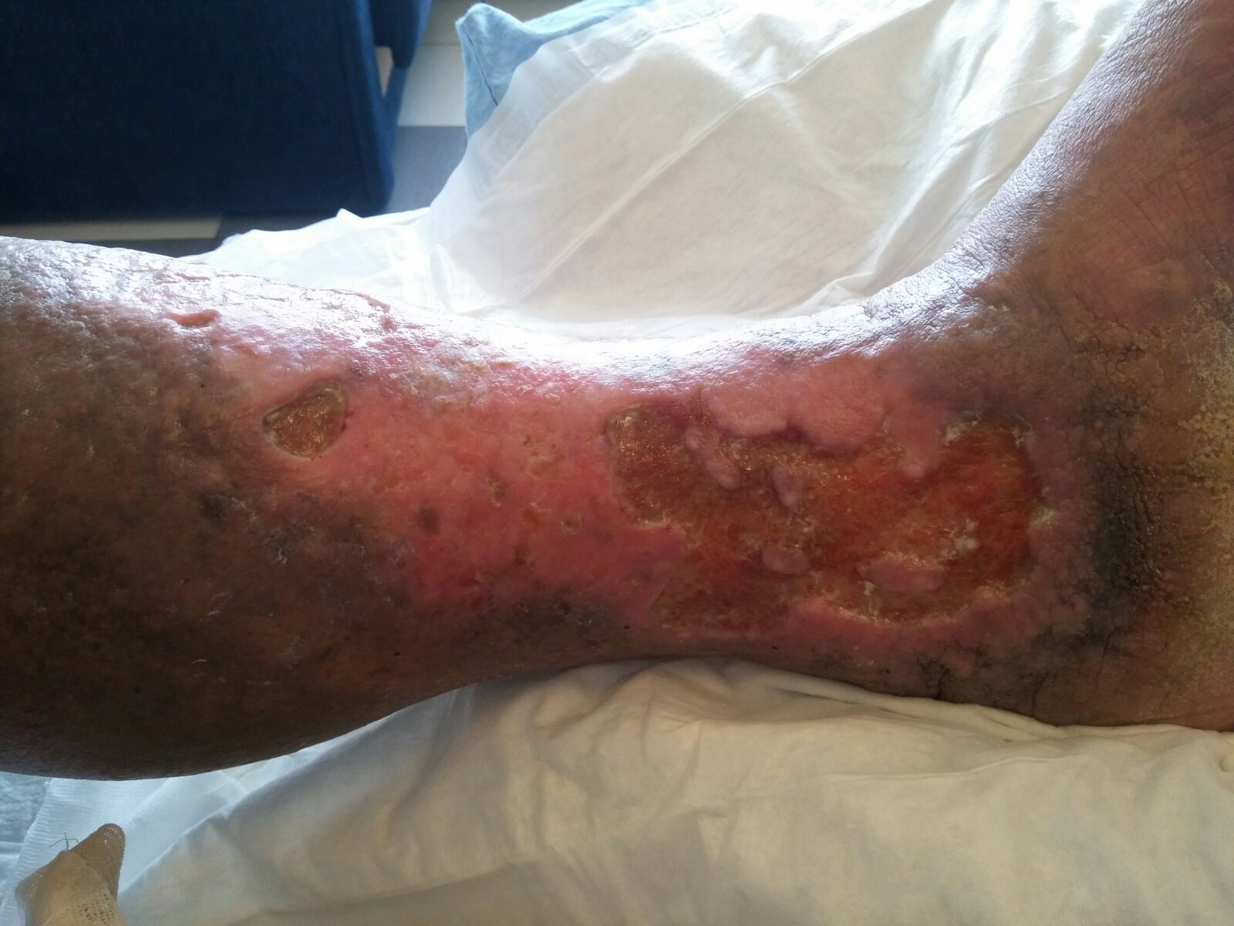

Slide 44
Integration to Treatment
Cause of ulceration?!→ Infection?, Trauma? → Should be determined.
Absorbent wound pads+ compression.
Maintaining tissue sterilization with anti-inflamatory agents (Topical antimicrobial applications)
Infection control!

Slide 45
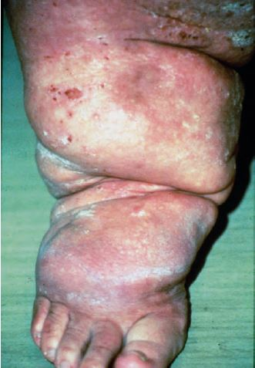
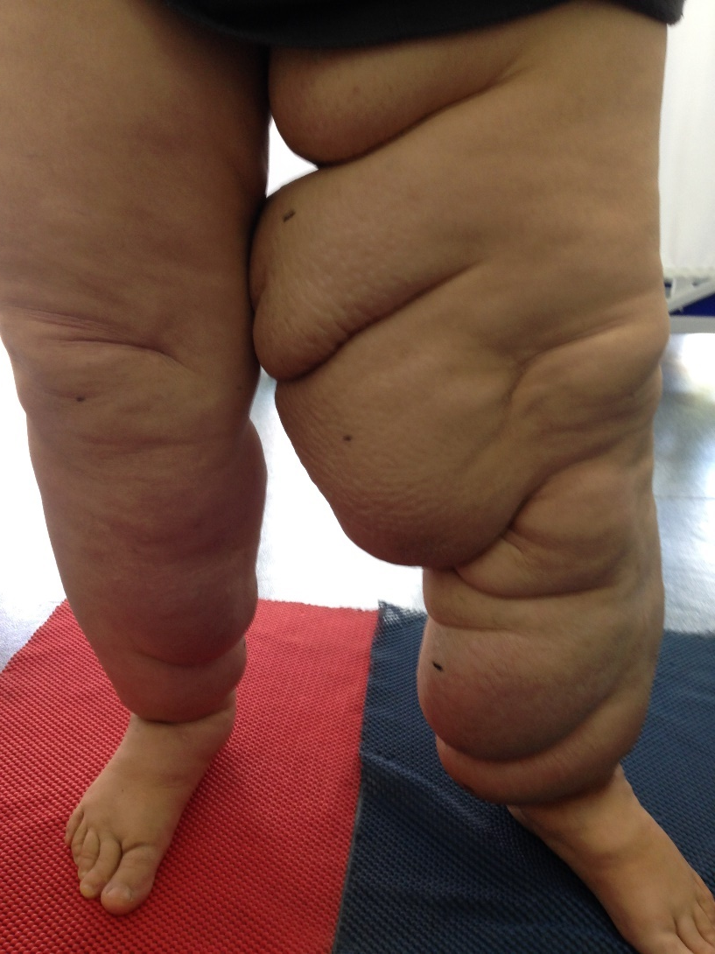
Skin Folds
Increased edema
Gravity effect
Skin elasticity
Between folds: Infection risk
Maceration
Infection→ Edema!

Slide 46
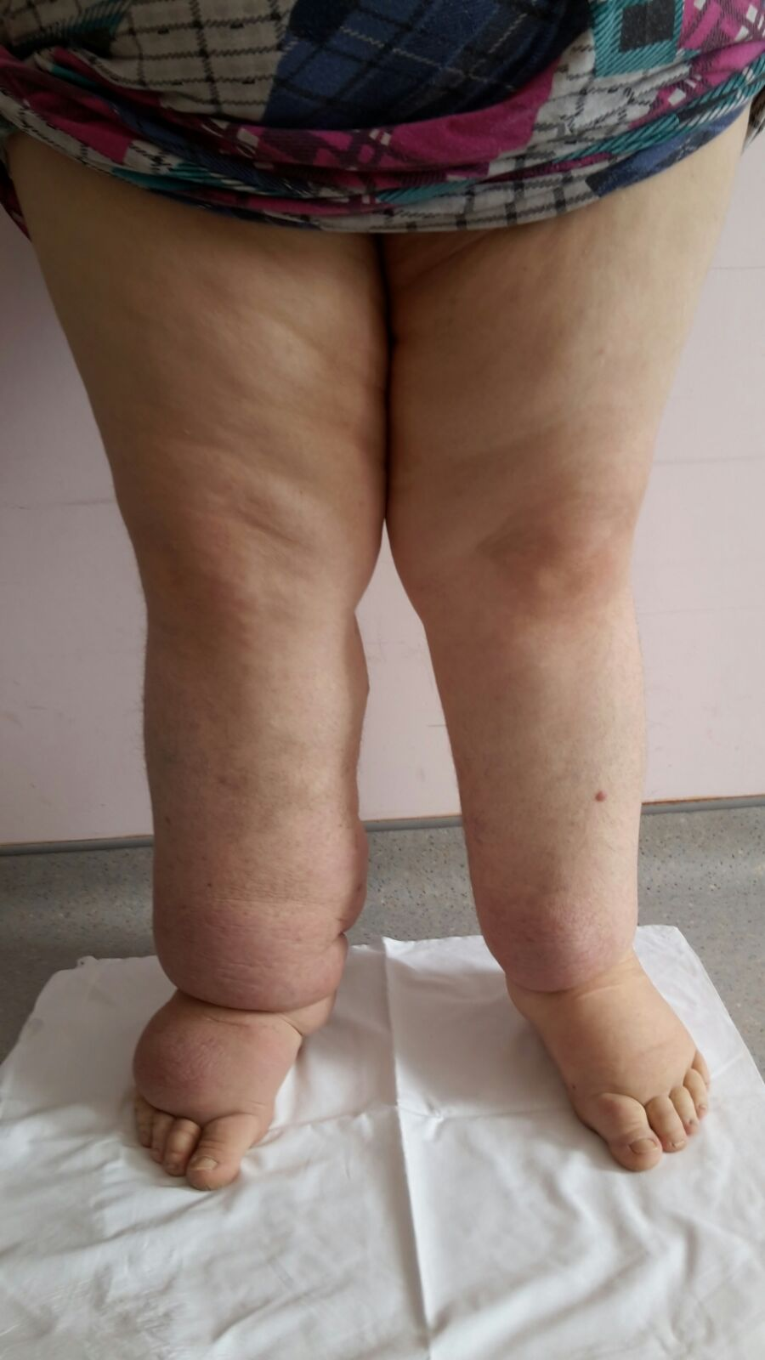
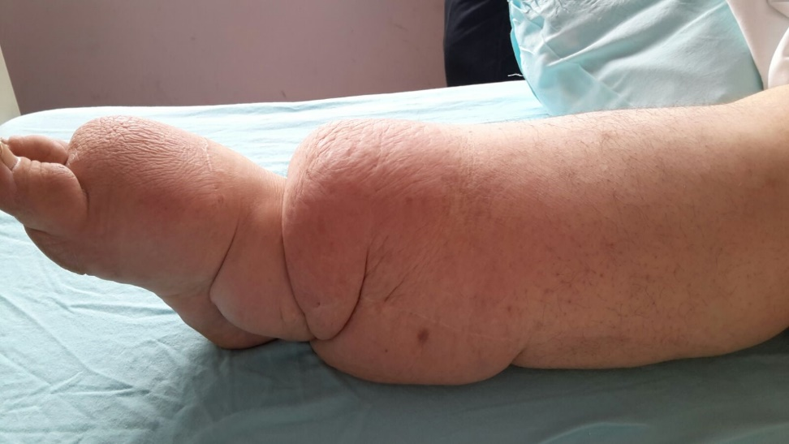

Slide 47
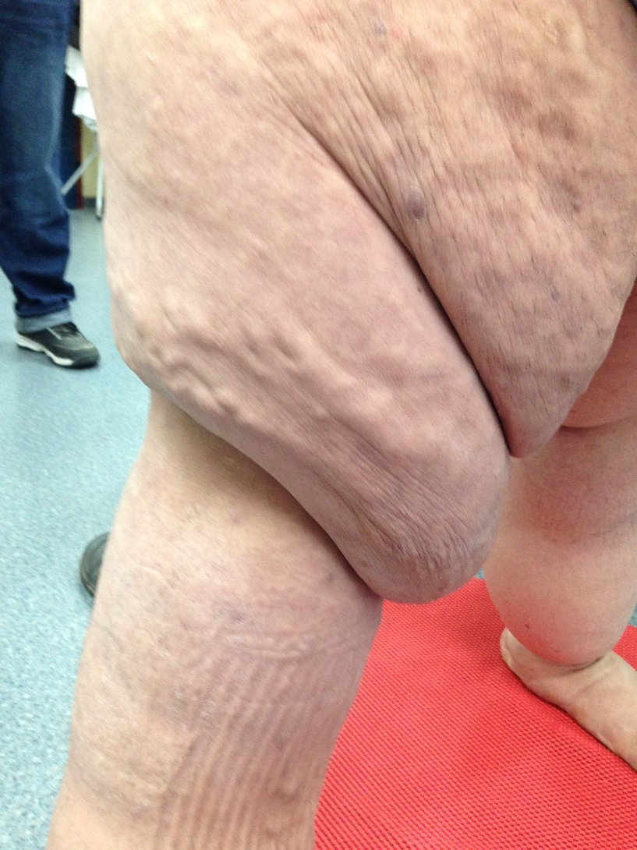
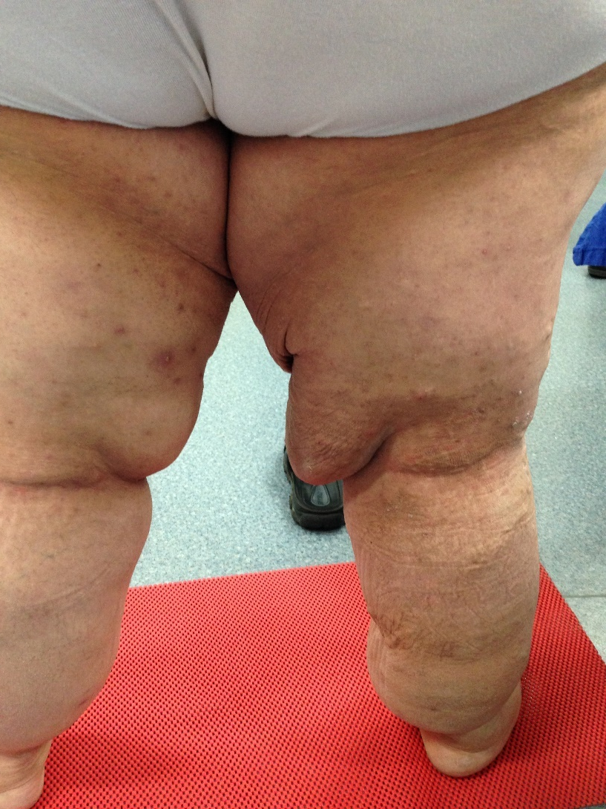

Slide 48
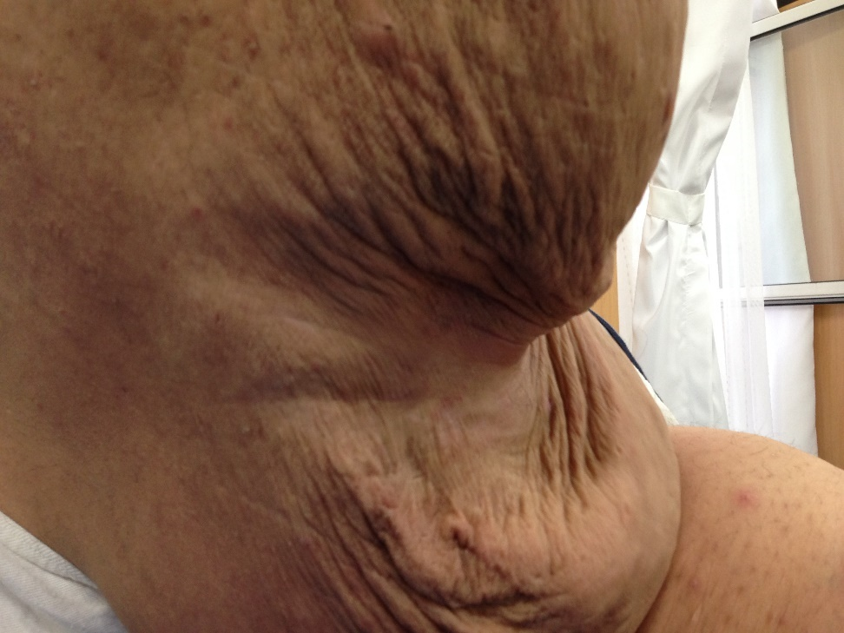
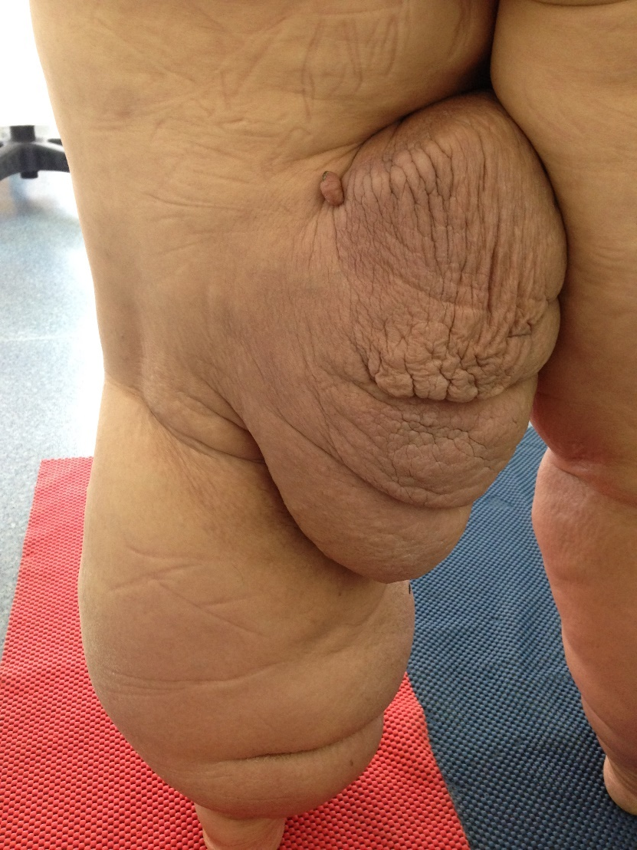

Slide 49
Integration to Treatment
Maintaining the optimal hygiene betwen skin folds:
-Anti-bacterial, anti-fungal topical agents
Integration to CDT should be done by supporting folds with proper filling materials→ (equal pressure distribution)
Maintaining moisture balance (Skin tend to be more fragile in skin folds).

Slide 50
Skin Care in Lymphedema
Regardless of etiology, in all chronic edema skin care is crucial!
Providing optimal moisture balance:
→Primary protection mechanism to infections and skin integrity
Timmons, J., & Bianchi, J. (2008). Disease progression in venous and lymphovenous disease: the need for early identification and management. Wounds UK, 4(3), 59-71.

Slide 51
Why is Skin Care important?
Providing the lipid layer on skin and hidration
Moffatt (2006): Protecting the skin from bacteria and other infectious agents, adherence to achievements of treatment: Skin Care!
Skin care: Improvement of barrier function!
Stephen-Haynes, J. (2007). Skin care in chronic oedema. Wounds UK, 3(2 Suppl), 1-40.
Moffatt, C. J. (2006). Skin care management for patients with lymphoedema. Wound Essentials, 1, 172-4.

Slide 52

Skin care and maintaining optimal moisture balance are more advantageous than medications regarding the prevention of infections (Badger, 2004).
Badger, C., Preston, N., Seers, K., & Mortimer, P. (2004). Antibiotics/anti‐inflammatories for reducing acute inflammatory episodes in lymphoedema of the limbs. The Cochrane Library.

Slide 53
Moisturizers
Each moisturizer is not the same
Working principle:
Moisturizing/ epidermal→ dermal penetration and moisture (urea,glycerin content).
Epidermal moisture: Could be exfoliative/ anti inflamatory. BDNG (2012)
British Dermatological Nursing Group (BDNG) (2012) Best Practice in Emollient Therapy. A statement for healthcare professionals. Dermatol Nurs 11(4)

Slide 54
Moisturizer
Proper choice→ Without any perfume or smell.
Oil based moisturizer? → Lymphedema?
Dry skin→ paraffin based (50/50) Moffatt, C. J. (2006). Skin care management for patients with lymphoedema. Wound Essentials, 1, 172-4.
Skin condition and hidration
Personal choice
Cosmetic acceptability→ proper pH interval.

Slide 55

Important
Patient education!
Self monitorization of skin
Recognizing infection signs
Importance of skin care
Downward application to hair growth
Choice of proper products

Slide 56
