Slide 1
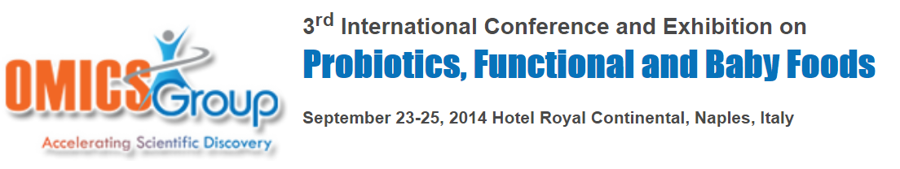
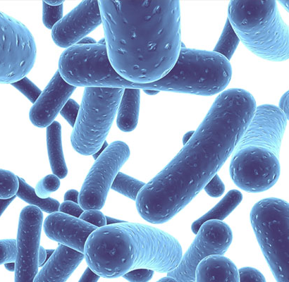
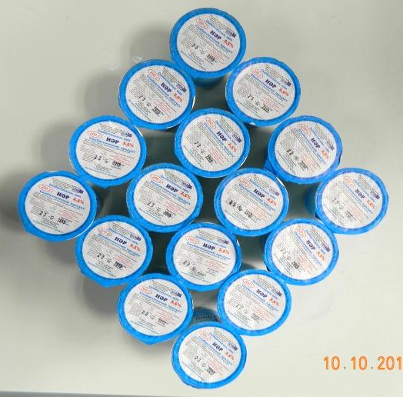

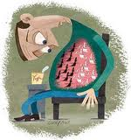
Research and development new symbiotic product and its clinical effect
Almagul Kushugulova, DMSc, akushugulova@nu.edu.kz
Center for Life Sciences, Nazarbayev University, Astana, Kazakhstan

Slide 2
First stage: To study the gut microbiome
To determine gut microbiome types and to compare microbial composition of the gut microbiome in different aged Kazakhstani

Slide 3

I group - to 44 years
II group – 50 – 70 years
III group - 90 years and above
Patients signed informed consent on the procedure, screening and collection of samples
Subjects were divided into 3 groups:

Slide 4
Questionnaire
General information (date and place of birth, weight, growth, gender, smoking habits, diet, nationality)
Information about diseases of gastro-intestinal tract (IBD, H. pylori, dyspepsia, etc.)
General clinical information (blood group, antibiotics (last 2 months), birth, nutrition in infancy, stool frequency, regularity of the cycle, etc.)
Information about the diet (alcohol, probiotics, vegetables, dairy products)

Slide 5
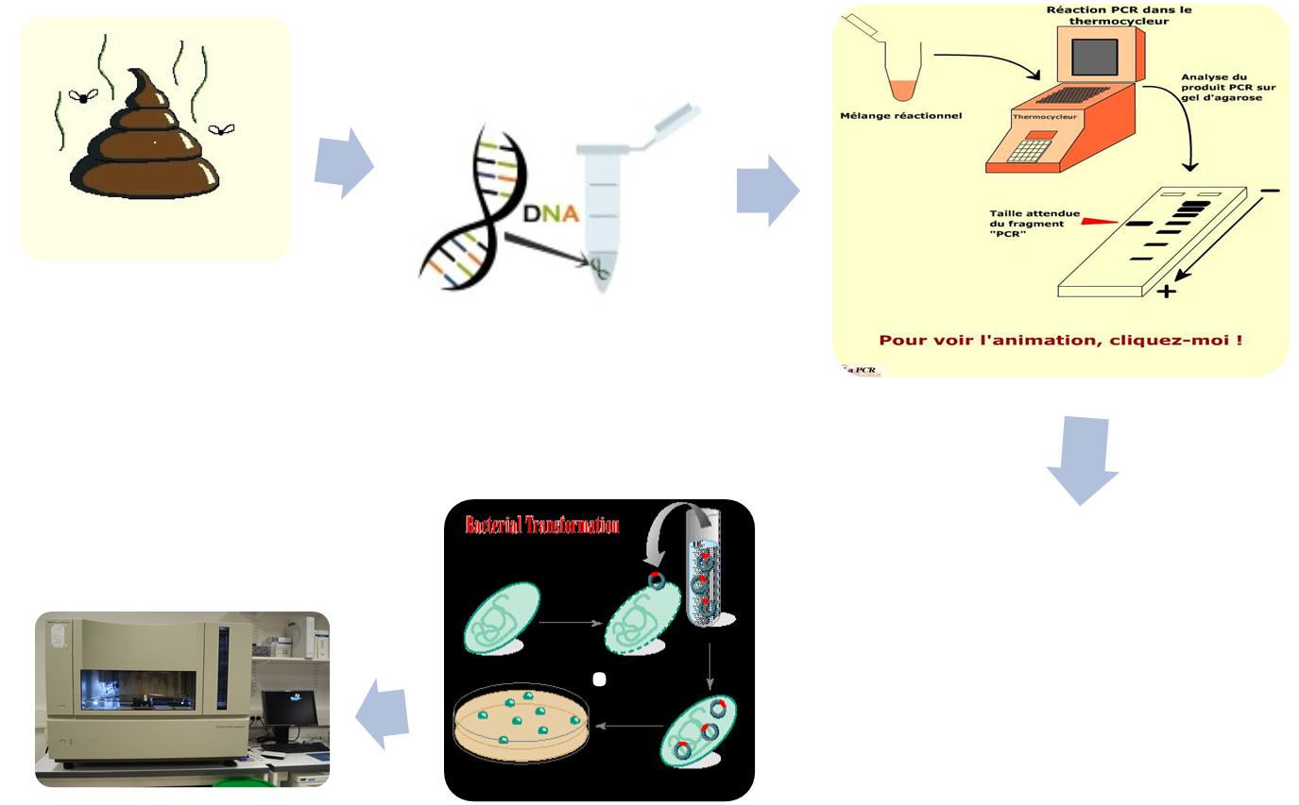
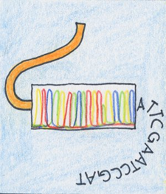

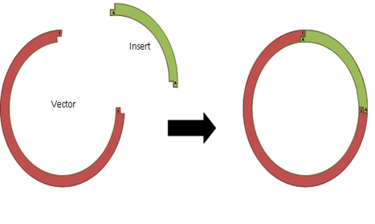
16S rRNA approach

Slide 6
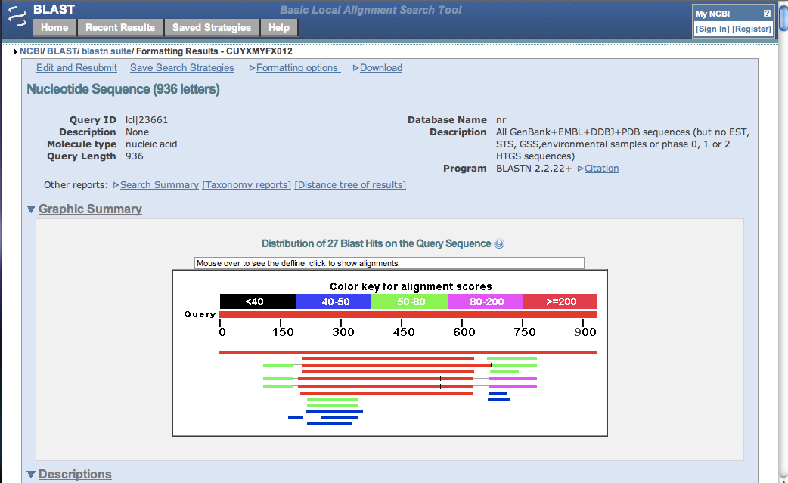

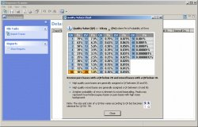
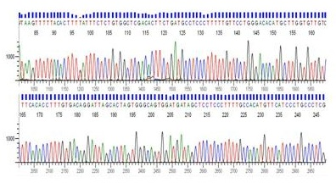
Data processing
Sequence Scanner v 1.0

Slide 7
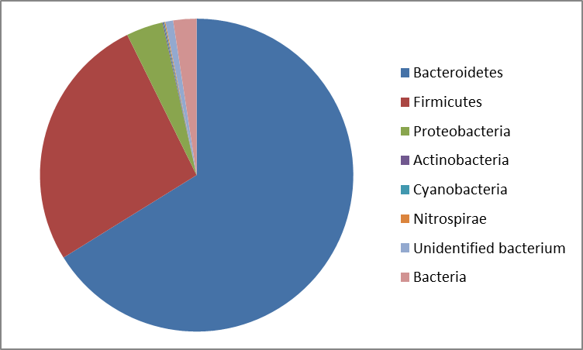
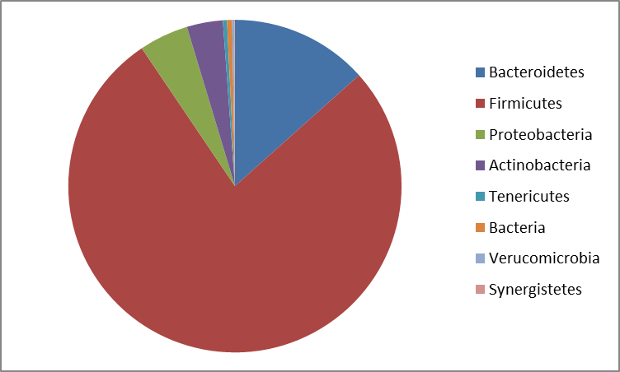
Results
It was observed that in all groups independently on age prevail two enterotypes
Bacteroides enterotype Firmicutes enterotype

Slide 8
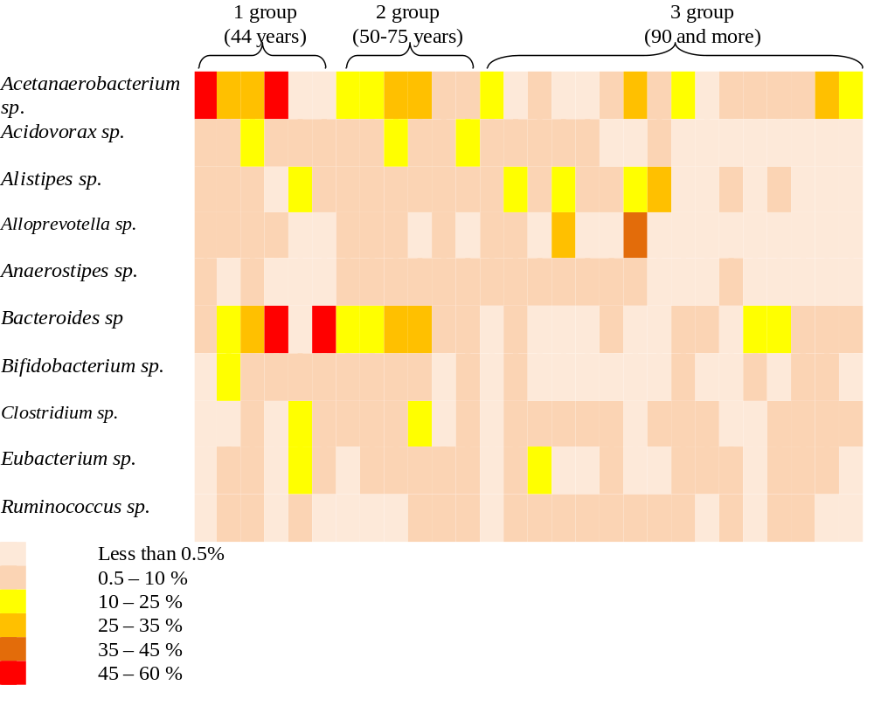
Most numerous members of the gut microbiome

Slide 9
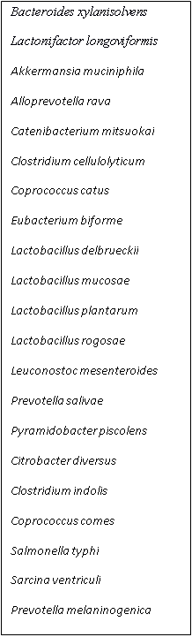

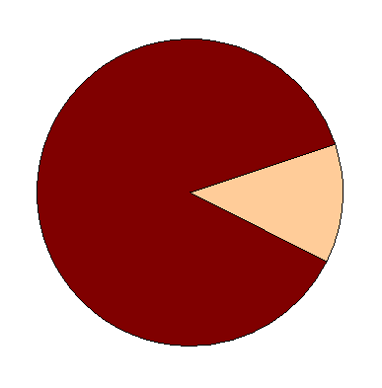

Species’ variety in subjects of 30-70 years

Slide 10


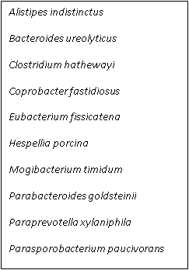

Species’ variety in subjects of 90 years and above

Slide 11
Functional characteristics of species
Functional characteristics | 30-70 years | 90 years and above
Plant substrates degrading bacteria (cellulose) | + | +
Mucin-degrading bacteria | + | -
Butyrate-producing bacteria | + | -
Carbohydrates converting bacteria (production of organic acids, acetate, ethanol,carbon dioxide, hydrogen) | + | +
Protein and starch degrading bacteria | + | -
Mucus-binding bacteria | + | -
Infections causing pathogens | + | +

Slide 12
1. Two enterotypes of the gut microbiome: Bacteroidetes and Firmicutes independently on age of subjects
2. Significant differences in bacterial species between all 3 groups according to age
3. The richest diversity occured in younger individuals and decreased in the elderly. It can be explained by the age factor
4. The percentage of bifidobacteria and lactobacilli is low in all research groups
5. More research is needed for better understanding of compositional structure of the gut microbiome of Kazakhstani population

Slide 13
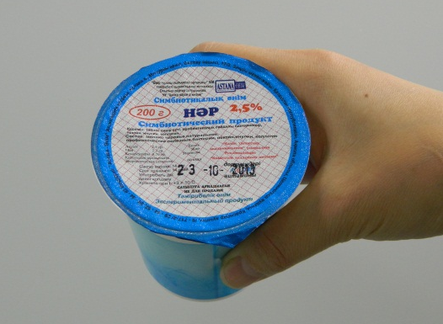
Synbiotic “НӘР” NAR
A formula and a production technology were developed and a pilot batch of a symbiotic bio-product “НӘР” was produced (Dairy plant Astana – onim)
Probiotic component
Prebiotic - inulin
Plant fiber – pectin
Fish collagen
Milk
Consortium content:
Lactobacillus plantarum;
Lactobacillus fermentum;
Lactobacillus acidophilus;
Bifidobacterium longum;
Bifidobacterium bifidum
NAR has been tested in JSC “Kazakh Academy of Nutrition”
The probiotic component is deposited in the National Depository of industrial microorganisms.

Slide 14
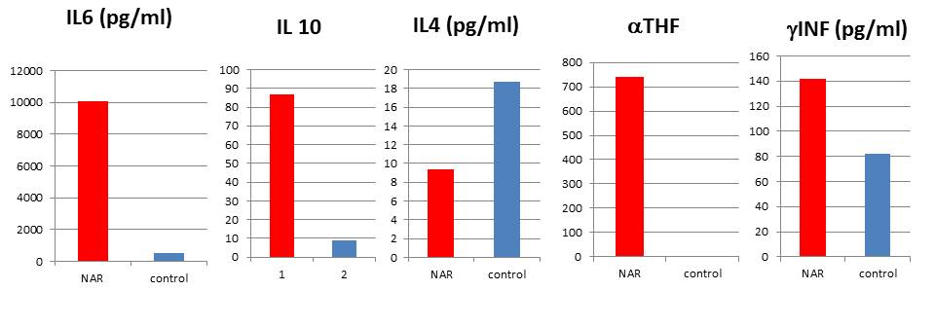
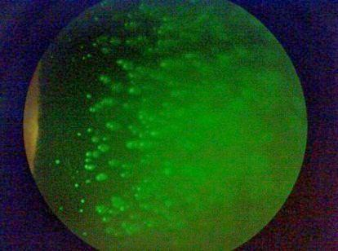
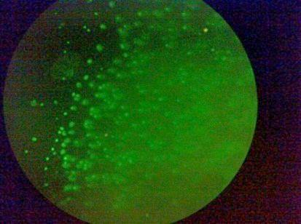
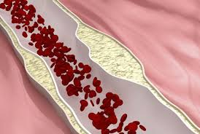
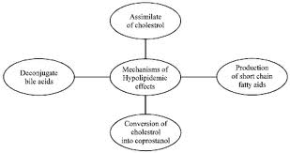
Synbiotic “НӘР” NAR: properties
Synbiotic activates primary immune response.
First of all, synbiotic coming into an organism interacts with colon epithelium cells. Reaction of macrophages and dendritic cells of lamina propria is induced, and as a result induction of IL-6 (10080,0±238,0 pg/ml)
IL-6 promotes clonal expansion of IgA-lymphocytes, increase in quantity of IgA-producing cells and passing them through plasmatic cells in lamina propria of intestinal mucous (64,7±0,7).
In the analysis of induced cytokines, we observed significant increase in TNF-α and IFN-γ and regulatory cytokine IL-10
Induction of γ IFN along with increase in production of IL-12 (228,9±17,8) inhibits producing IL4 due to activation of signal pathway of NF-Kb and STAT
The listed changes bring Th1/Th2 balance towards Th1
А
В
Antioxidant activity
Total antioxidant activity of the synbiotic product 67.4 mmol/ml
SOD is 1.42 U/mg
Glutathione reductase 0.06 U/ml
Damage index–0.60
1
2
Cholesterol lowering properties
in MRS broth medium 22 %
in the presence of 0.2 % bovine bile 50 %.

Slide 15
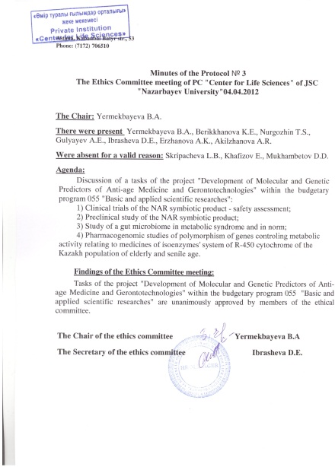
Preclinical and clinical study
Group | Sample collection |  |  | total
 | Isolation period (5 days) | + 14 days od experiment | 14 days after feeding post effect
Control 1 (standart feeding) | 5 | 5 | 5 | 15
Control 2 (standart+prebiotic) | 5 | 5 | 5 | 15
Exp 1 1 dose NAR | 5 | 5 | 5 | 15
Exp 2 probiotic component 1 dose | 5 | 5 | 5 | 15
Exp 3 2 dose NAR | 5 | 5 | 5 | 15
Exp 4 probiotic component 2 dose | 5 | 5 | 5 | 15
Total | 30 | 30 | 30 | 90
1 stage of clinical trials -70 patients: 35m and 35 f
Recruiting and Clinical - laboratory investigation were performed in two different Medical Center
Notes:
С целью стандартизации результатов вводится карантин на 14 дней
+ 14 дней эксперимента: взятие материала проводим после 14 дней
+14 дней постэффект: проводим взятие материала через 14 дней прекращения введения препарата.
Препарат вводится 1 раз в день внутрижелудочно через зонд.
Стандартное питание предусматривает стандартный рацион в комплексе с молоком ферментированным химическим способом (закисление с помощью слабой кислоты). Последнее вводится для исключения повышенной белковой нагрузки по крысам, получающим кисломолочную смесь.
Таким образом, 90 исследований по оценке количественного и качественного состава фекалий крыс и 90 иммунологических исследований включающих Il10, Il 12, TNF, IFγ.
В результате исследований определены дозы применения симбиотического продукта. Предварительные результаты оценки эффективности демонстрируют потенциал иммуномодулирующего эффекта симбиотического продукта.
Симбиотический продукт «НӘР» относится в биологическим активным веществам и не является лекарственным препаратом. Поэтому для проведения клинических испытаний не требуется специального разрешения Фармкотитета и Приказ Министра здравоохранения Республики Казахстан от 19 ноября 2009 года № 744 «Об утверждении Правил проведения клинических исследований и (или) испытаний фармакологических и лекарственных средств, изделий медицинского назначения и медицинской техники» не распространяется на разработанный симбиотический продукт. Тем не менее, для оценки эффективности, спектра активности, возможных побочных эффектов, клинические исследования симбиотического продукта решено проводить в соответствии со стандартной схемой.
На проведение клинических исследований получено одобрение Этического комитета ЧУ «Центр наук о жизни». Первая фаза клинических исследований проводится с целью предварительной оценки безопасности испытуемого образца.
В исследовании приняли участие 70 лиц пожилого возраста: 35 мужчин и 35 женщин. Каждый участник ознакомился с информационным листком, где подробно приведен состав симбиотического продукта и общее описание исследования (ПРИЛОЖЕНИЕ В).
В результате проведенных клинических исследований, пациенты в течение двух недель употребляли симбиотический продукт по 200 грамм дважды в сутки. Из 70 пациентов 20 пациентов находились на стандартном рационе, в качестве контроля исследования.
В рамках исследования, все пациенты прошли клинико-лабораторное обследование до начала и после применения симбиотического продукта: общий анализ крови, общий анализ мочи, иммунофенотипирование, анализ крови на общий холестерин, анализ на глюкозу, анализ кала на дисбактериоз и копрограмму.
Для проведения обследования пациентов был заключен контракт с Республиканским диагностическим центром.
Результаты исследований, на основе объективных параметров (клинико-лабораторные данные), ежедневного общего осмотра пациентов, подтвердили безопасность симбиотического продукта.

Slide 16
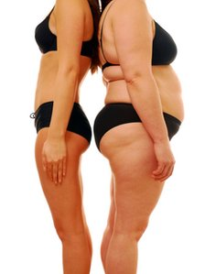
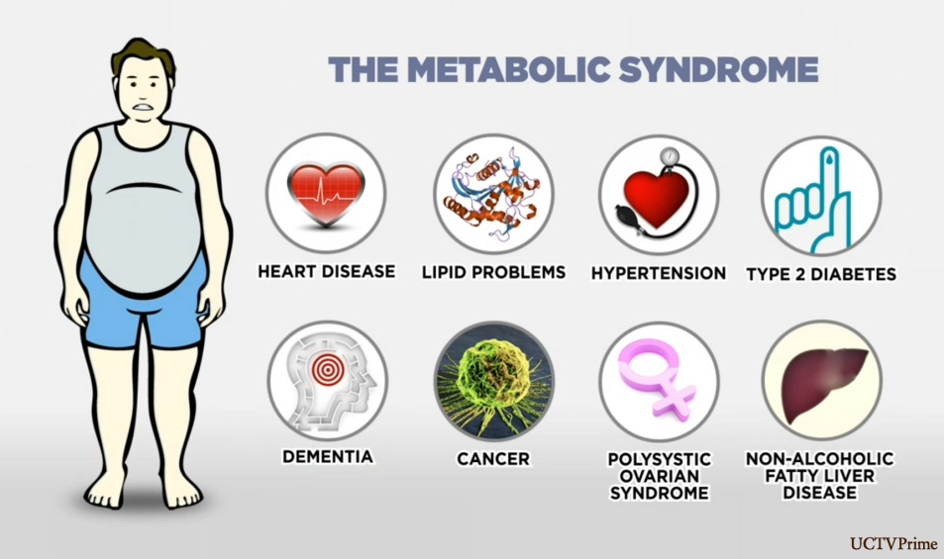
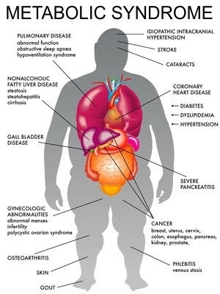
Introduction
The aim of this study is to investigate the efficacy of a synbiotic in treatment of adult with metabolic syndrome
Metabolic syndrome is an umbrella name for a collection of health risk factors — high blood pressure, high blood sugar, high triglycerides, low HDL cholesterol, high LDL cholesterol, and excess belly fat.

Slide 17

Study design
recruiting volunteers
initial clinical and laboratory examination
sampling: blood and stool
survey
Dairy plant Astana - onim
Duration of synbiotic/placebo taking is 3 months
Placebo group
Synbiotic group
repeated clinical and laboratory examination
repeated collection of stool samples
Data analysis
Metagenome analysis of gut microbiome
in normal and with metabolic syndrome, before and after receiving the symbiotic product NAR
SNP analysis on markers associated with metabolic syndrome

Slide 18
Randomisation and blinding
Random selection of patients from the database of Medical Center of President's Affairs Administration of Republic of Kazakhstan
The physician-researchers responsible for enrolling patients
Study leader is responsible for the distribution of participants by placebo-symbiotic groups
Placebo and synbiotic provided in identical packages
The physician-researchers collecting the reporting forms and performing the patients investigations were blind to the patient's treatment assignment

Slide 19
Participants and subject eligibility
Assessed for eligibility (n=180)
Declined to participate (n=13)
Enrollment (n=167)
Placebo group
Synbiotic group
Allocated to intervention (n=83)
Received allocated intervention (n=83)
Allocated to intervention (n=84)
Received allocated intervention (n=83)
Did not receive allocated intervention (n=1)
Discontinued intervention (n=3)
Lost to follow-up (n=2)
Subjects completed (n=80)
Subject completed (n=81)

Slide 20
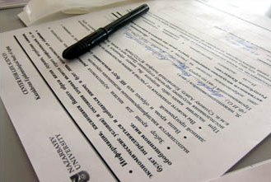
Participants and subject eligibility
We enrolled 161 adult
92 patients with metabolic syndrome
69 patients with no symptoms
of metabolic syndrome
key criteria for inclusion:
No history of the use of probiotics or antibiotic for 3 months
Blood pressure: = 130/90 mmHg
Raised fasting plasma glucose (FPG): >100 mg/dL (5.6 mmol/L), or previously diagnosed type 2 diabetes
DyslipidemiaTG: = 1.695 mmol/L; HDL-C = 0.9 mmol/L (male), = 1.0 mmol/L (female)
Central obesity: waist:hip ratio > 0.90 (male); > 0.85 (female), or body mass index > 30 kg/m2
key criteria for inclusion:
No history of the use of probiotics or antibiotic for 3 months
healthy on items 2-5 above for the first group
Notes:
Category of participant: officials
Why:
1. social status
2. economical status
3. stress, which provocate metabolic syndrome
4. food habits
5. they linked to central medical office, which allow to do longitud study
No history of the use of probiotics or antibiotic for 3 months
Blood pressure: = 130/90 mmHg
Raised fasting plasma glucose (FPG): >100 mg/dL (5.6 mmol/L), or previously diagnosed type 2 diabetes
Dyslipidemia: triglycerides (TG): = 1.695 mmol/L and high-density lipoprotein cholesterol (HDL-C) = 0.9 mmol/L (male), = 1.0 mmol/L (female)
Central obesity: waist:hip ratio > 0.90 (male); > 0.85 (female), or body mass index > 30 kg/m2

Slide 21
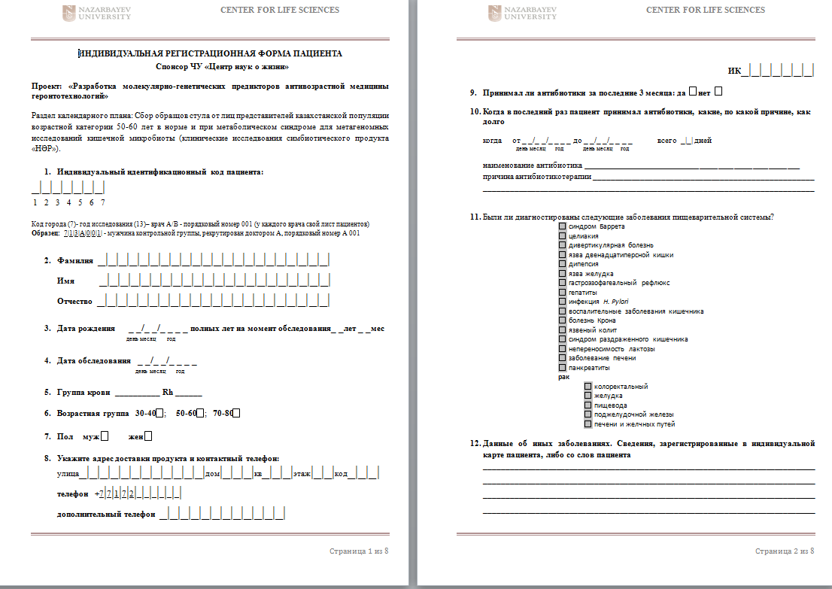
Participants and subject eligibility
Age categories
30-39; 40-49; 50-59; 60-69; 70-79
Before the start of the study, all patients were examined comprehensively, including the following list of clinical and laboratory examination
family history
information on the use of antibiotics
anthropometry
characterization of the cardiovascular system
characterization of the stool and its frequency
characterization of immune status
data for the blood glucose, ApoE, C-reactive protein, total cholesterol, HDL, LDL
Total about 200 questions
my microbe
Food Frequency Questionnaires (FFQ)
SF Health Surveys
Other questions about health
Notes:
The two groups were similar for demographic and clinical characteristics. All patients signed a consent letter. All patients underwent clinical and laboratory evaluation, including complete blood tests, glucose test, glycosylated hemoglobin, total cholesterol + triglycerides, cholesterol, LDL, HDL plasma, immunogram, coprogram. All patients were interviewed, the questionnaire included 200 questions related to diet, lifestyle and health.

Slide 22
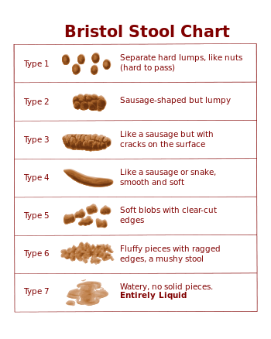
Effect of synbiotic on function of Digestive tract
average stool frequency | Synbiotic |  | Placebo
 | before | after | before | after
>twice daily | 14.9% | 21.9% | 15.3% | 7.1%
once daily | 14.2% | 65.6% | 3.8% | 10.7%
once every 2 days | 70% | 12.5% | 76.9% | 82%
<once every 2 days | 0.9% | 0 | 4% | 0.2

Slide 23
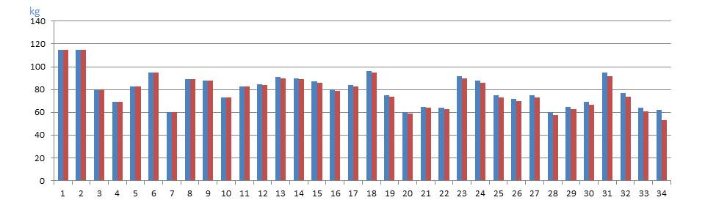
Clinical outcome
BMI Categories:
Underweight = <18.5
Normal weight = 18.5–24.9
Overweight = 25–29.9
Obesity = BMI of 30 or greater
34.3% no change in BMI
66.7% BMI decreased by 0.3 - 3.8
713В053 | 158 | 62.5 | 53 | 25.03605 | 21.23057
713А038 | 173 | 77 | 73.5 | 25.72756 | 24.55812
713В065 | 164 | 88 | 86 | 32.71862 | 31.97501
Waistline
placebo
14,2% - a decrease by 0,5-1 cm
63% - no changes
22,8% - an increase by 0,5 – 4 cm
synbiotic
42.86% - a decrease by 1-3 cm
40% - no changes
17.14% - an increase by 1 - 2 cm

Slide 24
Effect of synbiotics on Lipid Profile
mmol/L
Data | Synbiotic |  | Placebo
 | before | after | before | after
Total Blood Cholesterol | 4.92±0.25 | 4.58±0.23 | 5.02±0.06 | 4.97±0.07
LDL-Cholesterol | 3.37±0.28 | 2.98±0.27 | 2.94±0.08 | 3.08±0.1
HDL-Cholesterol | 1.09±0.08 | 1.20±0.07 | 1.13±0.08 | 1.27±0.12
TG | 1.59±0.07 | 1.50±0.06 | 1.61±0.06 | 1.73±0.09

Slide 25
Effect of synbiotic on Inflammatory Markers
C-reactive protein (CRP)
Low Risk: less than 1.0 mg/L
Average risk: 1.0 to 3.0 mg/L
High risk: above 3.0 mg/L
Before 3,162±0,122 mg/L
After 1,987±0,124 mg/L
The erythrocyte sedimentation rate (ESR)
Before 11,19±1,00 mm/hour
After 9,88±0,85 mm/hour
Leukocytes (White Blood Cells)
Before 6,75±0,46 10⁹/L
After 6,16±0,39 10⁹/L

Slide 26
Effect of synbiotic on HB
Data | before | after
average | 134±3 | 138±3
min | 82 | 104
max | 165 | 177
Bifidobacterium contributes to increasing permeability through the intestinal wall of the ions of calcium, iron, vitamin D.
Bioeng Bugs. May 1, 2012; 3(3): 157–167.

Slide 27
Conclusion
Synbiotic NAR
Improves motor function of the intestine
Improves metabolism of macroorganism
Lowers Blood Cholesterol
Possesses anti - Inflammatory effects
synbiotic is proposed as an addition to the basic treatment,
not an alternative to main therapy
In the study group the percentage of colds were significantly lower than in placebo group
the majority of patients reported an improvement in abdominal discomfort
Eat Probiotics foods, live healthy life

Slide 28
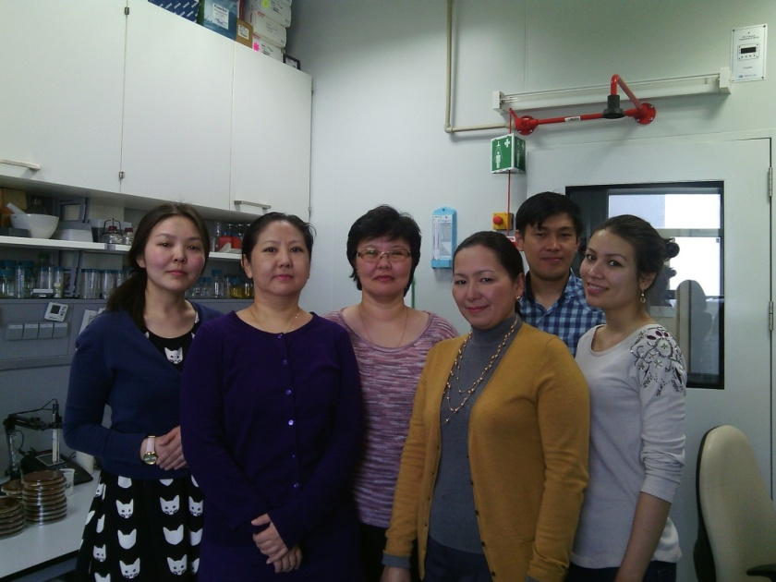

Acknowledgment
Prof. Francesco Marotta
Regenera Research Group
Center for life sciences
Kozhakhmetov Samat
PhD, senior researcher
Saduakhasova Saule
PhD, senior researcher
Shakhabayeva Gulnara
PhD, senior researcher
Tynybayeva Indira
Baiskhanova Dinara
Medical Center of President's Affairs Administration of Republic of Kazakhstan
Dairy plant Astana - onim
Usenov KZh - collaborator of dairy plant
Baimenova BA - collaborator of dairy plant
Kozhentaeva ZT - dairy technologist
Zhabagenova A - microbiologist at the milk plant
USM NU

Slide 29
Thank you for your attention!
So…..
Eat the “good bugs” every day……….
Invite them in………..
You will find they make very friendly houseguests.

