Slide 1


Ischemic stroke detection through
image processing techniques
Allan Felipe Fattori Alves
1

Slide 2
Introduction
Stroke is considered a non-transmissible chronic disease;
It is estimated that in 2016 there will be 18 million new cases
worldwide;
In Brazil, stroke causes the death of approximately 100,000 people
each year.
National Institute of Aging, Publication no. 07 (2007)
Garritano et al. (22012)

Slide 3
Introduction
Stroke Classification
Ischemic (87%): obstruction of vessels that supply blood to the brain;
Hemorrhagic (13%): disruption of a blood vessel and spread to brain tissues.
Even when not cause deaths, stroke can cause damage that compromise life quality;
Roger et al. (2012)

Slide 4
Introduction
Detection
Primarily diagnosed clinically and confirmed and followed through imaging tests.
Cerebral Angiography
CT scan: w/ or w/o contrast
MRI: w/ or w/o contrast
T1 or T2 weighted (T1WI, T2WI)
FLAIR
Diffusion weighted image (DWI)
Amar (2011)

Slide 5
Introduction
MRI advantages:
o excellent detection of ischemic tissues;
o does not use ionizing radiation;
o more imaging sequences;
CT advantages:
o more accessible examination;
o faster than MRI;
o preferably used for emergency decisions.
Amar (2011)

Slide 6
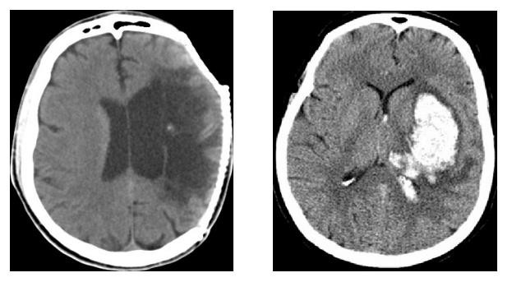
Introduction
Stroke Diagnosed with CT
Distinguish between ischemic and hemorrhagic stroke.
ischemic stroke with hemorrhagic transformation >> the wrong choice of treatment can lead to patient death;
Hyperdense area of
hemorrhage
Chawla et al. (2009)

Slide 7
Introduction
Treatment
Tissue Plasminogen Activator (rt-PA) is a protein involved in the breakdown of blood clots and is used to treat embolic or thrombotic stroke.
There is an effective treatment window of 3 hours.
Stroke Guideline (2013)

Slide 8
Introduction
ASPECTS - Alberta Stroke program early CT score
Standard ischemic stroke diagnosis with a reproducible scoring system;
The score divides the middle cerebral artery (MCA) territory into 10 regions of interest.
A single point is subtracted for an area of early ischemic change, such as focal swelling or
parenchymal hypoattenuation, for each of the defined regions.

Slide 9
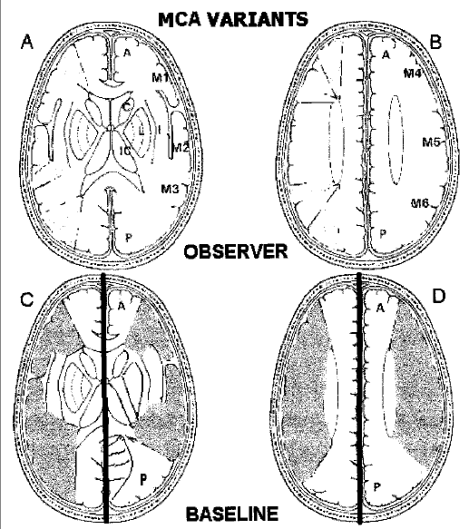
Introduction
ASPECTS
This analysis estimative of
is thus the
a subjective
affected area by
ischemic stroke.
Pexman et al. (2001)
9

Slide 10
Objectives
Quantify and enhance brain areas of interest (normal brain, ischemic stroke) through automatized computational algorithms;
Comparison
the detection of ischemic stroke
between the
computational algorithm and neuroradiologists.

Slide 11
Methods
Construction of a database with retrospective examination of patients
diagnosed with stroke;
Inclusion criteria
patient diagnosed with stroke by specialist (neuroradiologist);
CT scans acquired with at least 16 slices scanner;
Exclusion criteria
history of intracranial hemorrhage;
Malformations, tumors and aneurysms.

Slide 12
Methods
Computational algorithm was developed in Matlab software
Image
segmentation
Multiscale enhancement (wavelets)
Fuzzy C-means
clustering
Initial Image
Final Image
Area Quantification
Active Contour

Slide 13
Methods
Stage 1
Subjective
analyzes were performed by neuroradiologists to
quantified ischemic areas in the middle cerebral artery region.
They performed an manual segmentation process within the ischemic stroke region.

Slide 14
Methods
Stage 2
Application of the computational algorithm on the same CT
scan slices.
Comparison of both results.

Slide 15
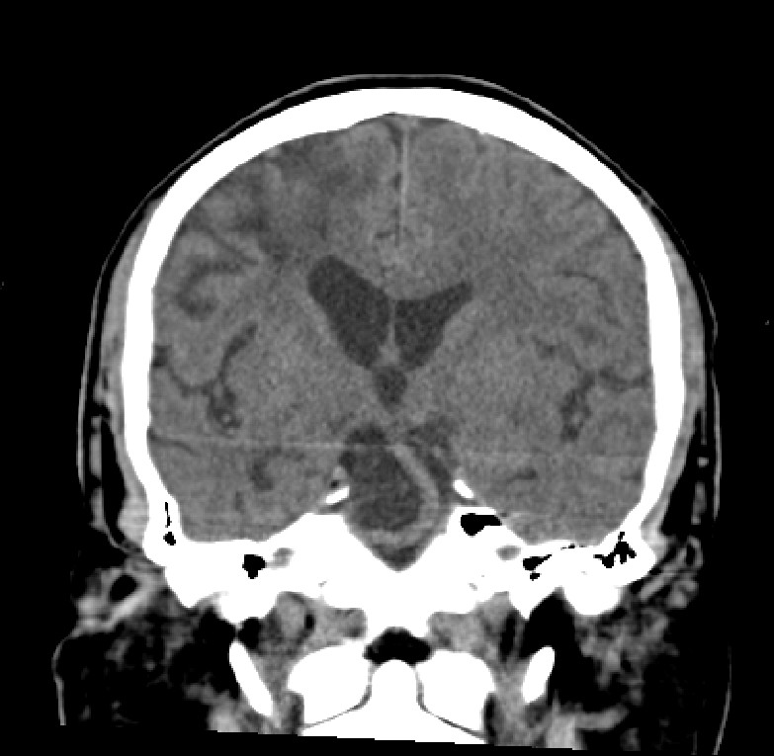
Methods
Examples of images evaluated

Slide 16
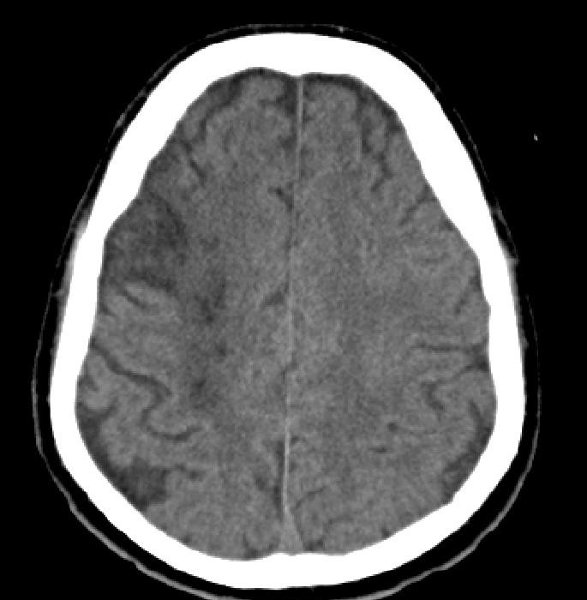
Methods
Examples of images evaluated

Slide 17
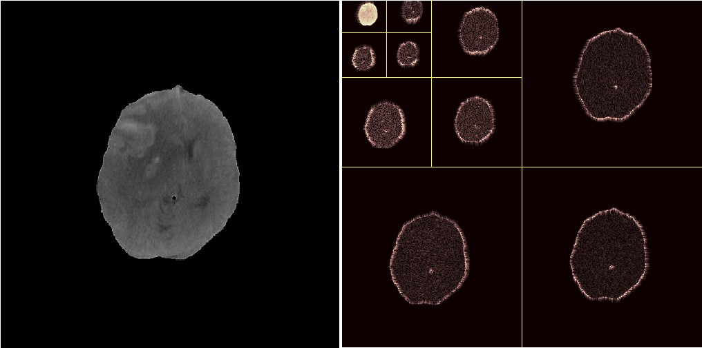
Results
Multiresolution analysis via Wavelets: enables the segmentation of an image
by highlighting morphological characteristics and frequencies.

Slide 18
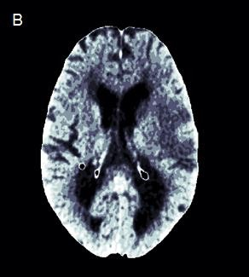
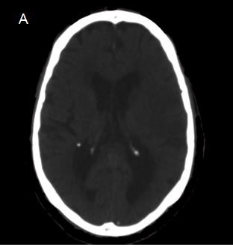
Results
Fuzzy c-means clustering (FCM): identified natural groups in a wide range of data.
A) Original image
B) Image after applying the FCM.

Slide 19
Results
15 patients were analyzed;
Neuroradiologists found that the morphological filters actually
improved the ischemic areas;
The comparison in area between the neuroradiologist and the computational algorithm showed no deviations greater than 16% in any exams. (underestimate the regions)

Slide 20
Results
Further Analysis
Sensibility
Especificity
Jaccard index
Dice coefficient
20

Slide 21
Contributions of this work
Applying a set of image processing tools for CT scans;
The algorithm could assist the performance of neuroradiologist for assessment of stroke;
Development of a computer aided diagnosis software.

Slide 22
Contributions of this work
In clinical practice:
Aid for the inexperienced or non-specialist radiologists;
Greater efficiency in the diagnosis;
Early diagnosis (within 3 hours of treatment window);

Slide 23
References
Why population aging matters: a global perspective. Bethesda (MD): National Institute on Aging, National Institutes of Health, US Department of Health and Human Services, US Department of State; 2007.p.1-32.
GARRITANO, C. R., LUZ, P. M., PIRES, M. L. E., BARBOSA, M. T. S., BATISTA, K. M. Análise da Tendência da Mortalidade por Acidente Vascular Cerebral no Brasil no Século XXI. Arquivo brasileiro de Cardiologia, Rio de Janeiro, v. 98 n. 6, p. 519- 527, 2012.
ROGER V.L., GO A.S., LLOYD – JONES D.M. Heart Disease and Stroke Statistics – 2012, A report from the American Heart Association, v. 125, p. e2 – e220, 2012.
AMAR A.P. Brain and Vascular Imaging of Acute Stroke. World Neurosurg, v. 76, p. S3-S8, 2011.
J. H. WARWICK PEXMAN, PHILIP A. BARBER, MICHAEL D. HILL, ROBERT J. SEVICK, ANDREW M. DEMCHUK, MARK E. HUDON, WILLIAM Y. HU, AND ALASTAIR M. BUCHAN. Use of the Alberta Stroke Program Early CT Score (ASPECTS) for Assessing CT Scans in Patients with Acute Stroke. Am J Neuroradiol v. 22, p. 1534–1542, 2001.
H. S. BHADAURIA, M. L. DEWAL. Intracranial hemorrhage detection using spatial fuzzy c-mean and region-based active
contour on brain CT imaging. V. 8, p. 357–364, 2012.

Slide 24





Thank You!

