Slide 1
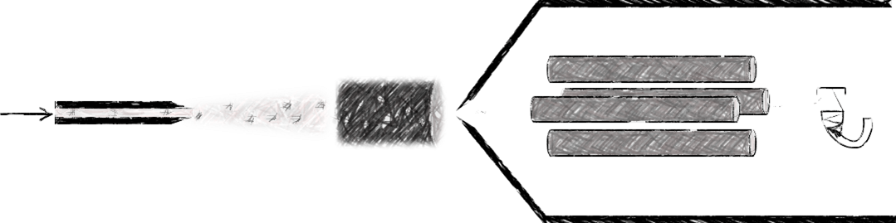
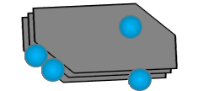

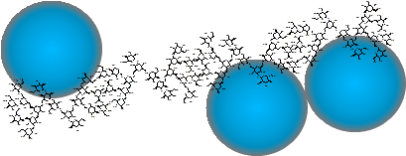
Hydrodynamic Chromatography Coupled to ICP-MS for Studying Nanoparticles in Complex Media
International Conference and Exhibition on HPLC and Chromatography Techniques
Allan Philippe
University of Koblenz-Landau, Germany
London, 14.03.2016

Slide 2
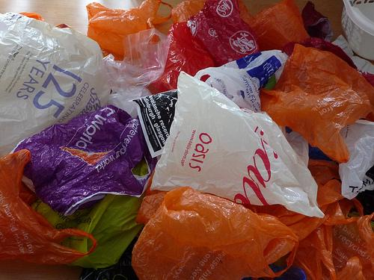

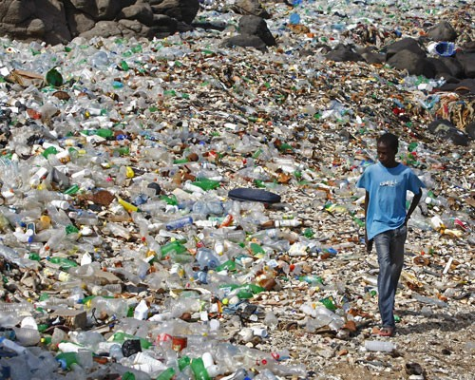

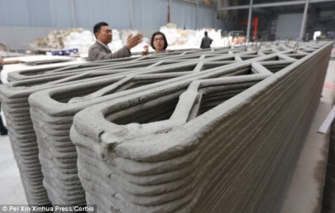
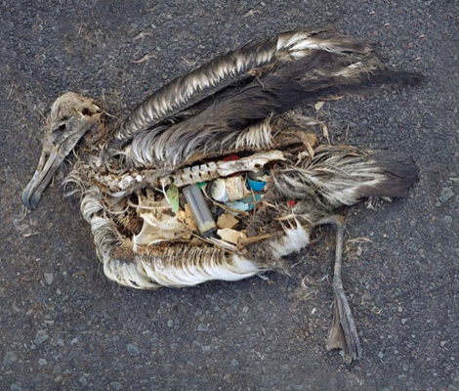
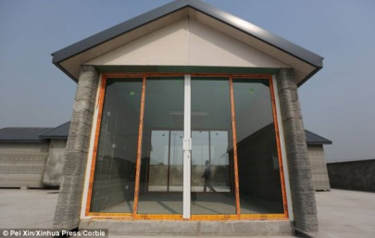
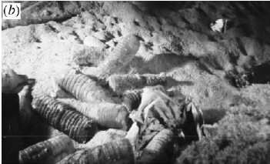
Introduction
The dark side of a revolution…
Barnes D. K. A. et al. (2009), Philos. T. Roy. Soc. B.

Slide 3
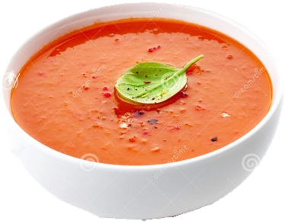
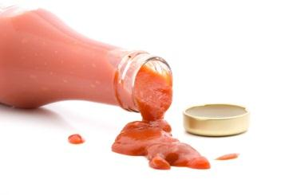
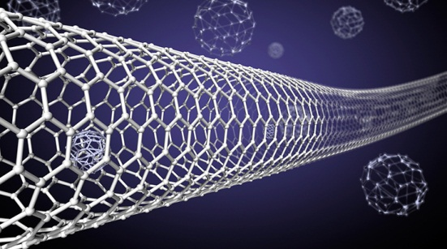
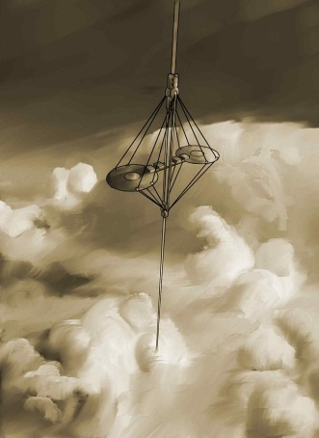
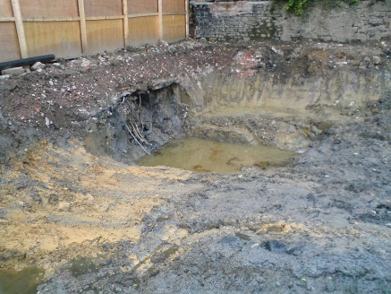
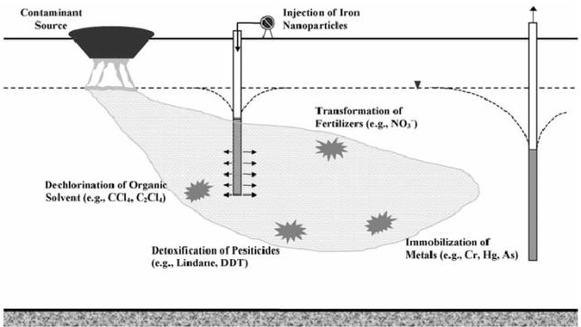


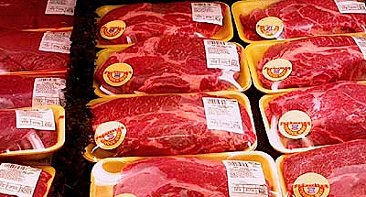
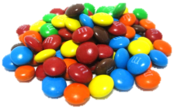
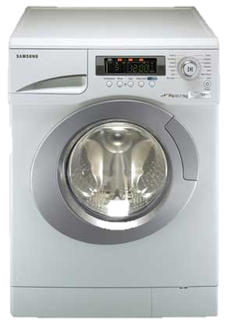

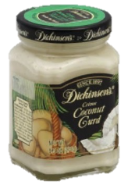
Introduction
The dark side of a revolution?
SiO₂
C⁽⁰⁾
Fe⁽⁰⁾
Environmental fate?
Zhang, W. (2003). J. Nanopart. Res.
Ag⁽⁰⁾
http://www.aboneobio.com/blog/images/JUILLET
_2010/filtres-solaires-chimiques-ou-naturels.jpg
ZnO
http://www.maisonbrico.com/mb_images/divers/IMP400/
PeinturesEnduitsDeco400/DIY02G02C018P05-400.jpg
TiO₂

Slide 4
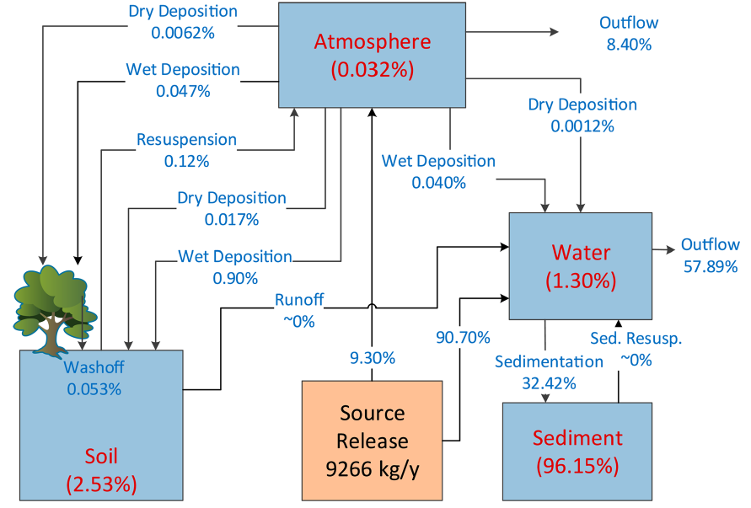
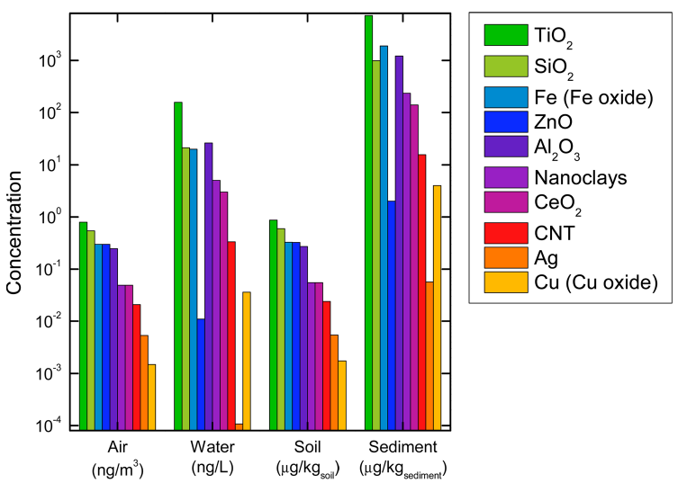
Introduction
Fate of nanoparticles in the environment
Accumulation in the sediments?
Most relevant processes occur in the water phase.
Liu, H. H. and Cohen, Y. (2014), Environ. Sci. Technol.
Final concentrations in water
< 1 µg.L⁻¹
Liu, H. H. and Cohen, Y. (2014), Environ. Sci. Technol.

Slide 5
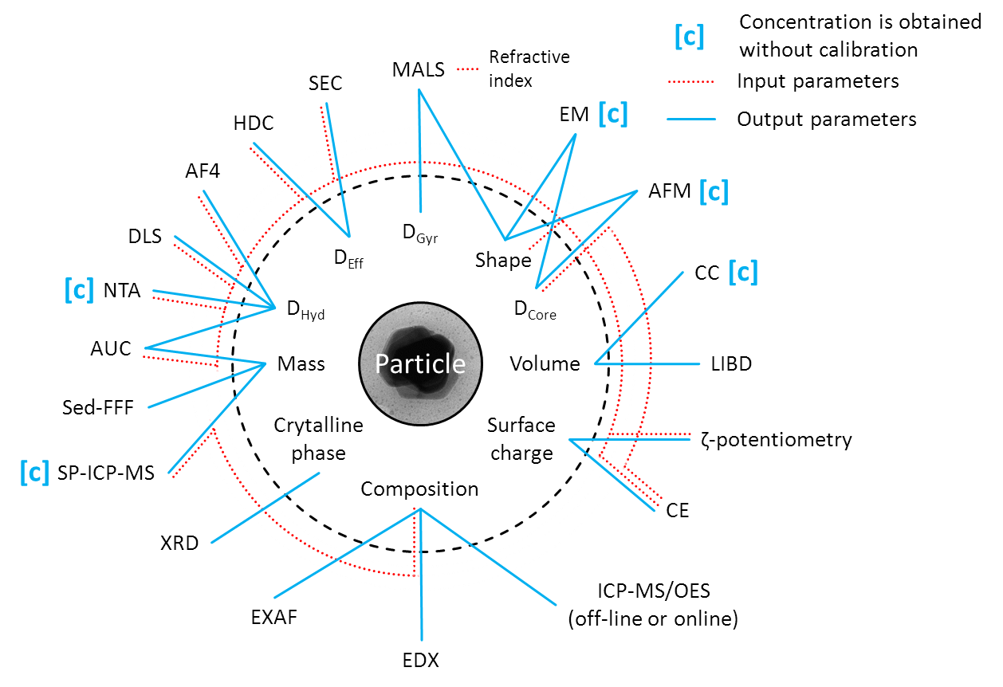

Introduction
The analytical toolbox

Slide 6
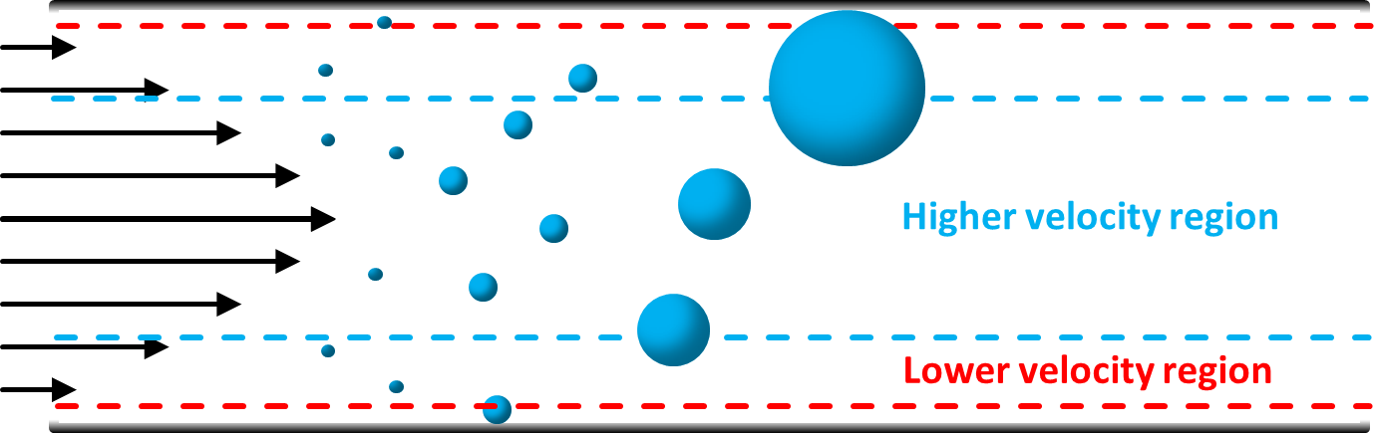
Introduction
Separation techniques
Hydrodynamic chromatography
Size exclusion
Field flow fractionation
Field: hydrodynamic,
centrifugal, electric…

Slide 7
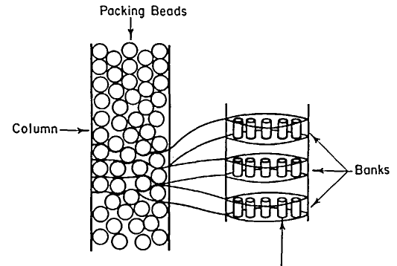

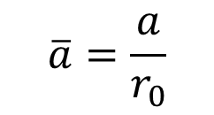
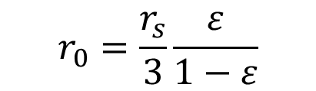
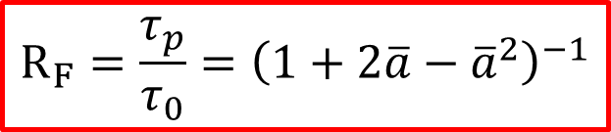
What is HDC-ICP-MS?
Principle of hydrodynamic chromatography
Higher flow velocity
Lower flow velocity
$$R_{F}=\frac{τ_{p}}{τ_{0}}={\left(1+2\overline{a}−{\overline{a}}^{2}\right)}^{−1}$$
$$\overline{a}=\frac{a}{r_{0}}$$
$$r_{0}=\frac{r_{s}}{3}\frac{ε}{1−ε}$$
Mc Hugh A. and Brenner H. (1984), Crit. Rev. Anal. Chem.

Slide 8
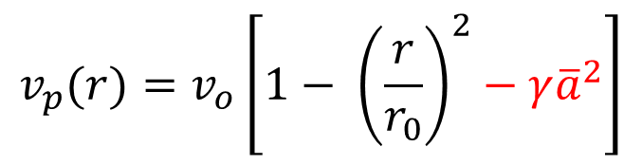
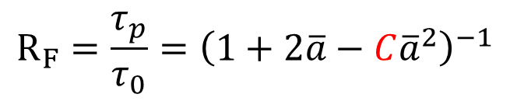
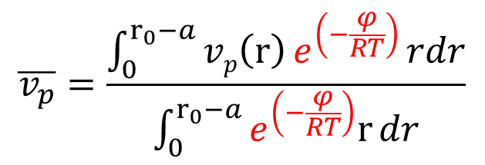
What is HDC-ICP-MS?
Principle of hydrodynamic chromatography
$$R_{F}=\frac{τ_{p}}{τ_{0}}={\left(1+2\overline{a}−C{\overline{a}}^{2}\right)}^{−1}$$
$$v_{p}(r)=v_{o}\left[1− {\left(\frac{r}{r_{0}}\right)}^{2}−γ{\overline{a}}^{2}\right]$$
$$\overline{v_{p}}=\frac{\int_{0}^{r_{0}−a}{vp\left(r\right)}e^{\left(−\frac{φ}{RT}\right)}rdr}{\int_{0}^{r_{0}−a}{e^{\left(−\frac{φ}{RT}\right)}r}dr}$$
R. Tijssen et al. (1986), Anal. Chem.
Mc Hugh A. and Brenner H. (1984), Crit. Rev. Anal. Chem.

Slide 9
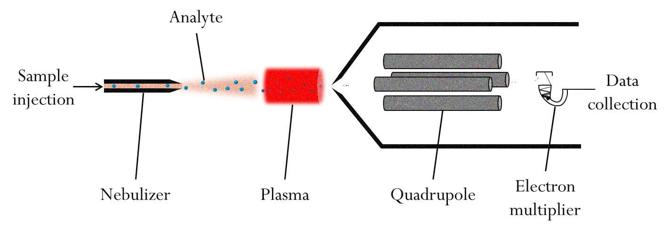
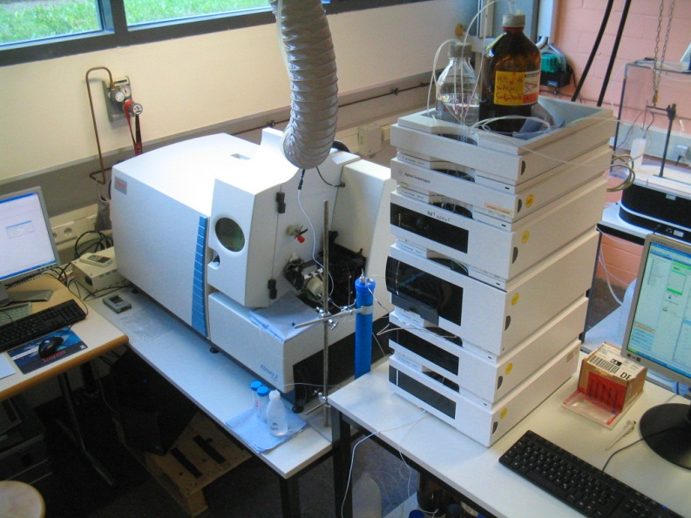
What is HDC-ICP-MS?
Principle of ICP-MS
Low detection limit for most metals
Low matrix sensitivity
Minimal sample perturbation
High sample throughput

Slide 10
Evaluation of HDC-ICP-MS
Method development
Optimisation of eluent composition and flow rate (retention time and recovery)
Development of a new time marking method
Characterisation of size calibrants (Au, Ag, SiO₂) by electron microscopy, DLS and NTA
Development of a quantification method
Philippe, A. and Schaumann, G. E. (2014) PLoS ONE

Slide 11
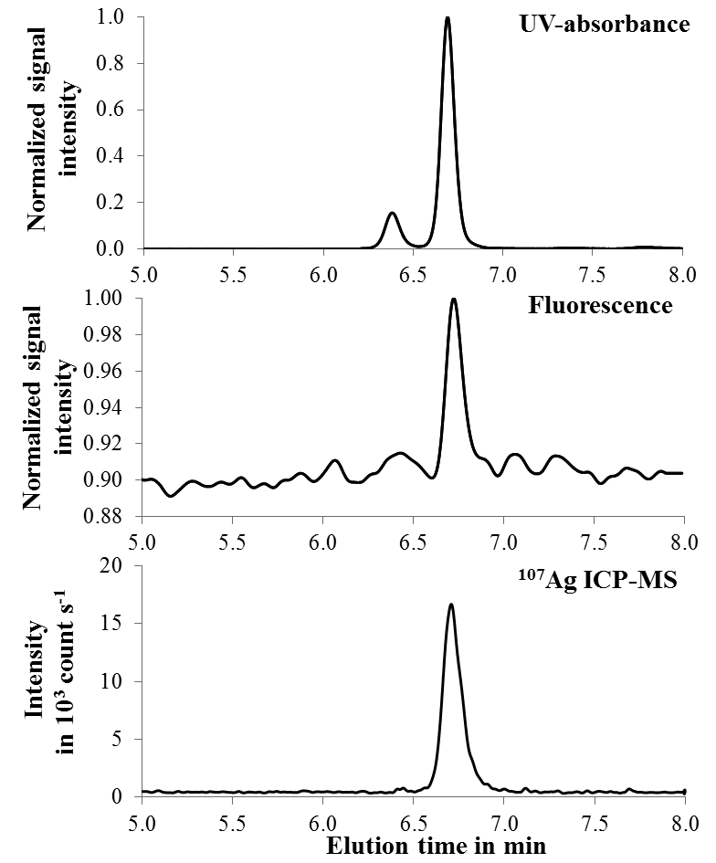


Evaluation of HDC-ICP-MS
Example: multi-detector approach
Humic acids
Moderately soft water containing:
humic acids - 5 mg L⁻¹
SiO₂ particles - 200 nm, 10 mg L⁻¹
Ag⁽⁰⁾ particles - 20 nm, 5 µg L⁻¹
SiO₂ particles
Humic acids
Ag⁽⁰⁾ particles
10 particles of SiO₂ for 1 Ag⁽⁰⁾

Slide 12
Evaluation of HDC-ICP-MS
Method development
Effect of temperature on the retention factor
Effect of the density and the coating of the particles on the retention factor
Elution behaviour of non-spherical particles
Philippe, A. et al. (2014) Anal. Meth.

Slide 13
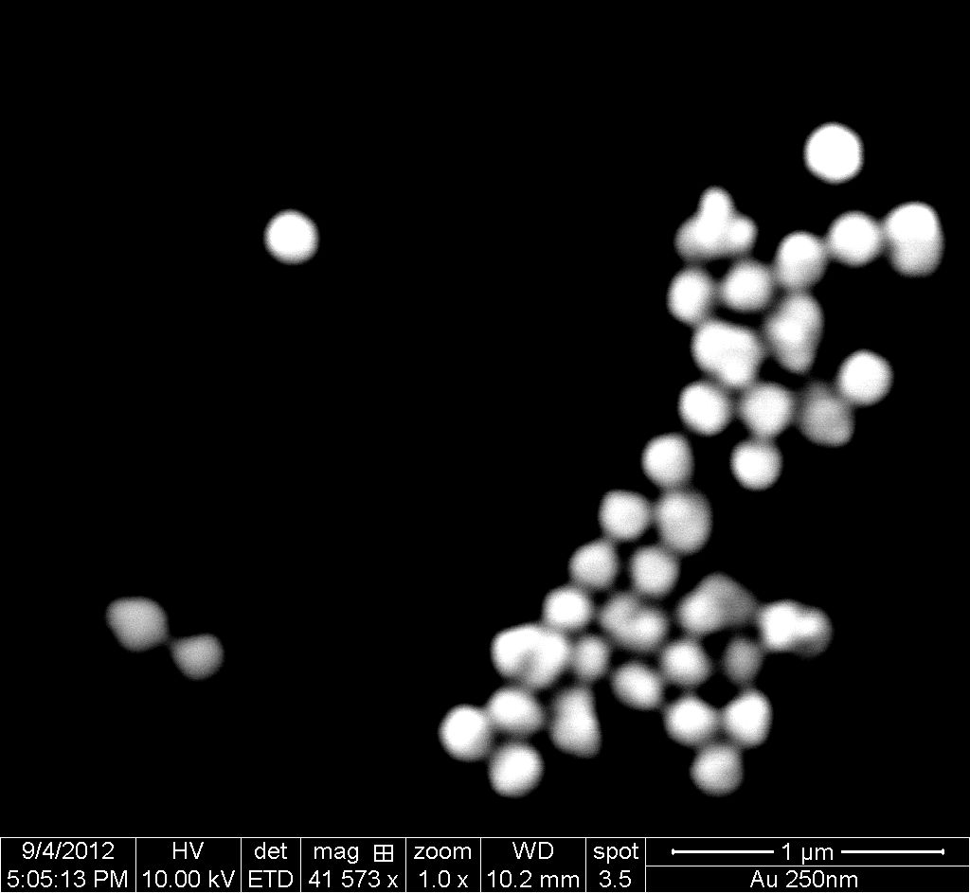
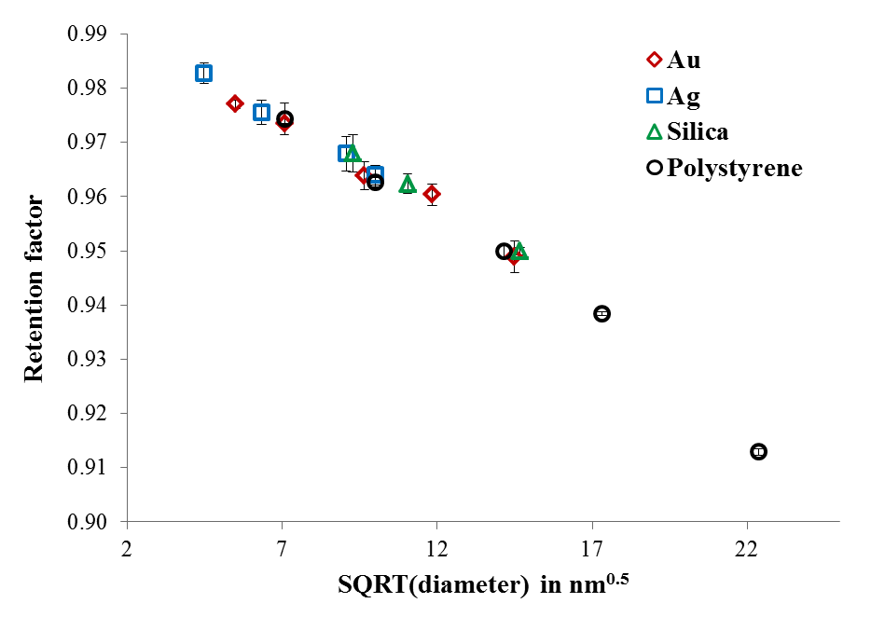
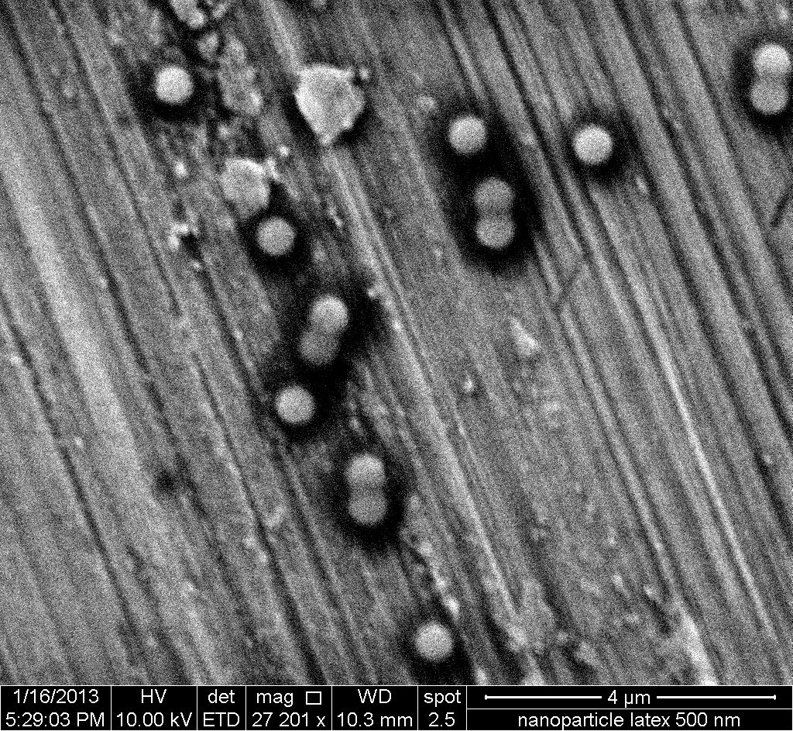
Evaluation of HDC-ICP-MS
Example: universal calibration
Au⁽⁰⁾
Ag⁽⁰⁾
SiO₂
Poly.
Philippe, A. et al. (2014) Anal. Meth.

Slide 14
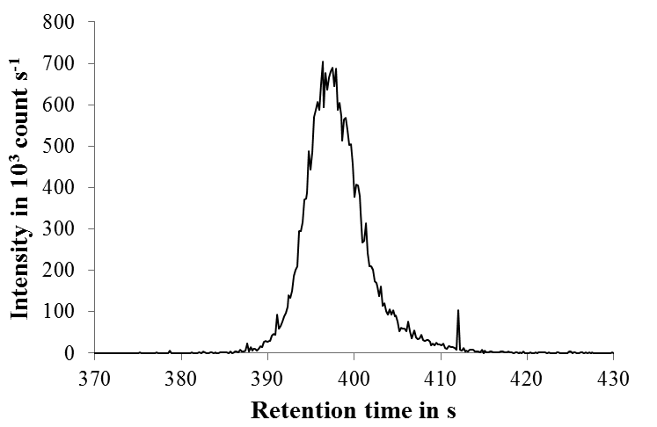
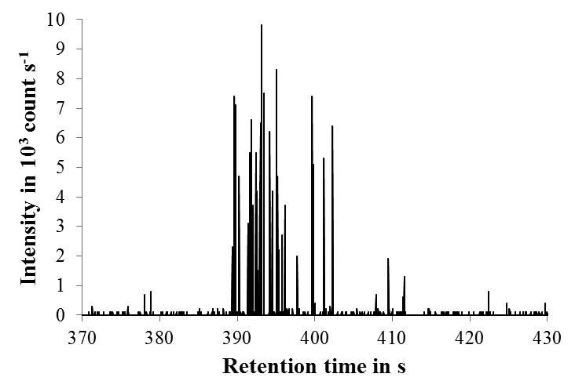
HDC-SP-ICP-MS
Principle of single particle analysis
Number of peaks
∝ concentration
Peak height
∝ mass
Retention time
related to the
effective diameter

Slide 15
HDC-SP-ICP-MS
Principle of single particle analysis
Peak height
from sp-ICP-MS
=
=
„Core“ diameter = D_{C} ∝ mass
Retention time
from HDC
=
=
Effective diameter = D_{E}

Slide 16
HDC-SP-ICP-MS
Application: structure of homo-agglomerates
Also available from the data:
Particle elemental density
Agglomerate fractal dimension
Rakcheev, D., Philippe A. et al. (2014), Anal. Chem.

Slide 17
Conclusions and outlook
Potential of HDC-SP-ICP-MS
Size
Elemental composition
Mass concentration
Concentration
calibrants
Size calibrants
HDC - SP - ICP - MS
Concentration
calibrants
Mass
calibrants
Size
Number
concentration
Elemental
mass distribution
Density
(geometry)

Slide 18
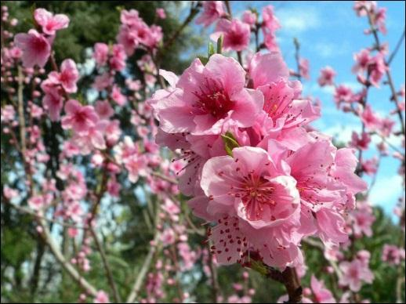
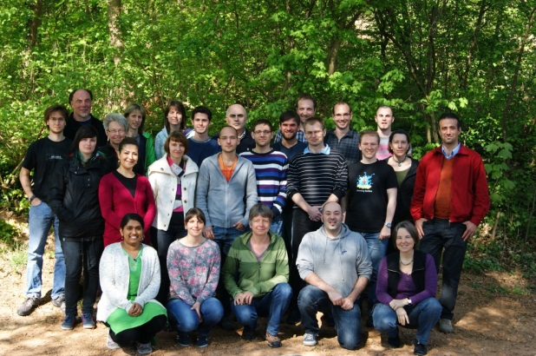




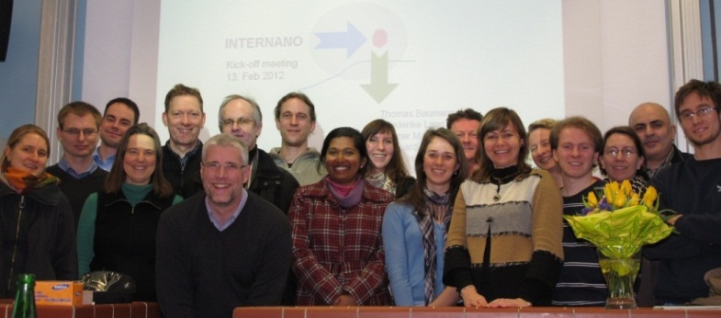
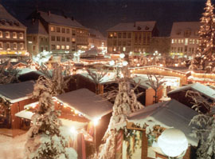
Acknowledgements
For helping…
Marie Gangloff
Miriam Schäfer
The group…
Soil and environmental chemistry
For financing…
For co-authoring/collaborating…
Denis Rakcheev
Wolfgang Fey
Cooperation partners…

Slide 19
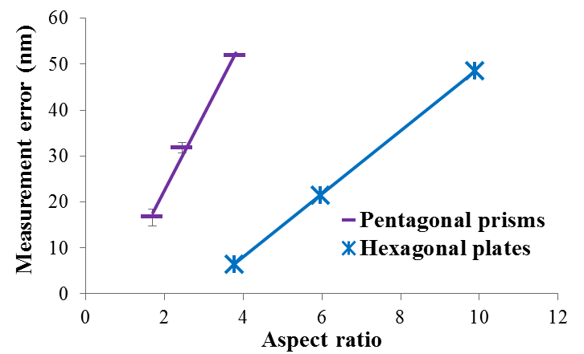
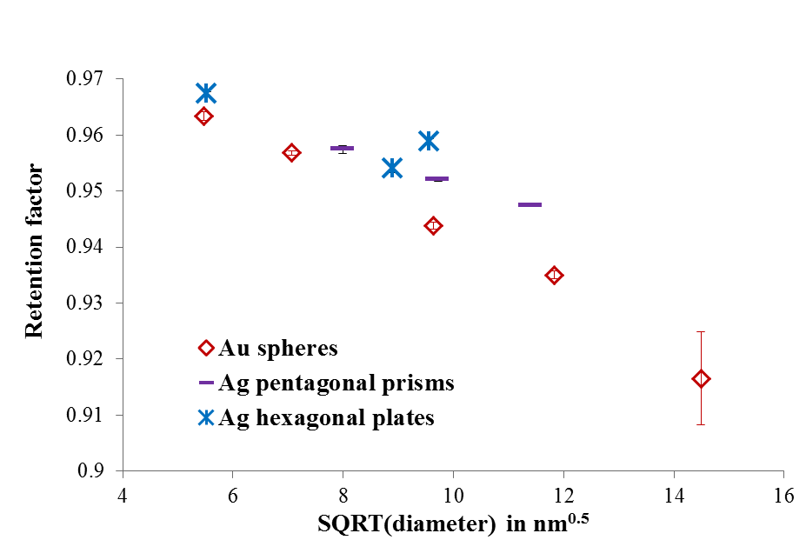
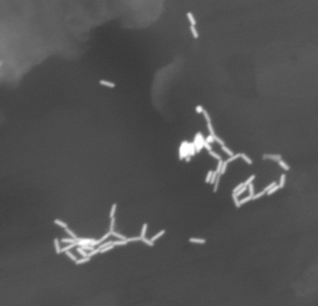

II: Evaluation of HDC-ICP-MS
Example: effect of particle shape
Intrinsic effect of the shape
R_{F} correlated with the aspect ratio
Affinity effects excluded
Philippe A. et al. (2014), Anal. Meth.

Slide 20
Ag⁽⁰⁾ pentagonal prisms
Philippe A. et al. (2014), Anal. Meth.

Slide 21
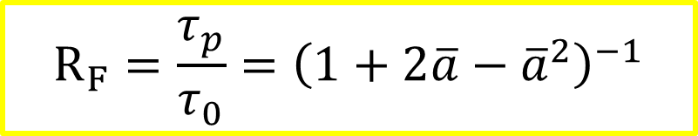
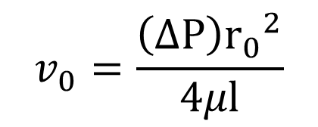
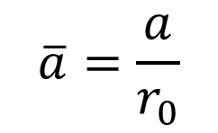
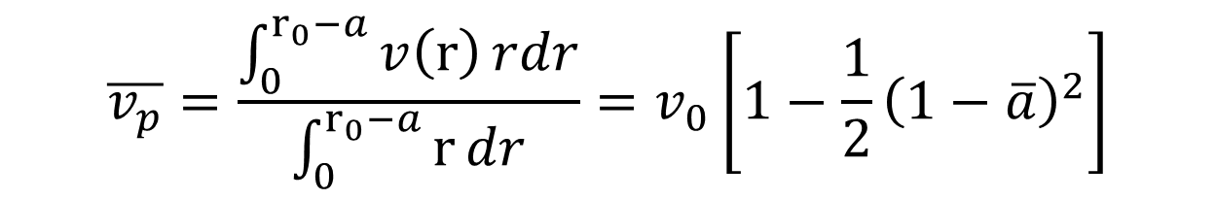
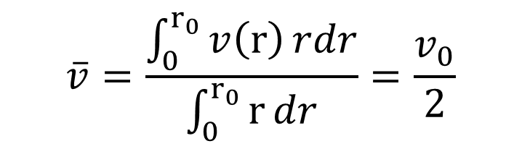


Model
$$v(r)=v_{0}\left[1− {\left(\frac{r}{r_{0}}\right)}^{2}\right]$$
$$v_{0}=\frac{\left(∆P\right){r_{0}}^{2}}{4μl}$$
$$\overline{v}=\frac{\int_{0}^{r_{0}}{v\left(r\right)}rdr}{\int_{0}^{r_{0}}{r}dr}=\frac{v_{0}}{2}$$
$$\overline{v_{p}}=\frac{\int_{0}^{r_{0}−a}{v\left(r\right)}rdr}{\int_{0}^{r_{0}−a}{r}dr}=v_{0}\left[1−\frac{1}{2}{\left(1−\overline{a}\right)}^{2}\right]$$
$$\overline{a}=\frac{a}{r_{0}}$$
$$R_{F}=\frac{τ_{p}}{τ_{0}}={\left(1+2\overline{a}−{\overline{a}}^{2}\right)}^{−1}$$
$$r_{0}=\frac{r_{s}}{3}\frac{ε}{1−ε}$$
Tijssen R. et al., Anal. Chem., 1986.

Slide 22



Eluent
Water based
Phosphate buffer: pH = 7-8 (adjustable)
Stabilisator: formaldehyde
Surfactants: SDS, Triton® X-100, Brij® L23
50 ppt of CsCl
G. R. McGowan et al., J. Colloid Interf. Sci., 1982.

Slide 23

Quantification (ICP-MS)
Quantification possible…
…and independent on size.
Philippe and Schaumann, in prep.
Notes:
Example with gold in HA and ions

Slide 24



Analysis of ions
Composition (from XRD and ICP-OES measurements):
Na_{1.6}Ca_{1.1}(UO₂)₂(PO₄)_{2.}7∙nH₂O
Lattice geometry: cubic or prismatic

