Slide 1


Prune the inputs, increase data volume, or
select
strategy
a different classification method – a
to improve accuracy of classification.
Center for Big Data Analysis
Bergen, Norway
Dr. Alla Sapronova
alla.sapronova@uni.no

Slide 2
Problem
of missing
values
●
Data analysis: fitting data to mathematical
model (e.g. probability distribution)
Data with inaccurate, corrupted or missed entries (especially for high-dimensional data) often impossible to fit
Simple deletion of incomplete data leads to information loss
●
●

Slide 3
Case study:
●
Build
a
predictive
model
for
fish
school
presence at the given location and time.
●
12
fish
types
to
predict and
data
from
750
historical catches recorded in 2010-2017
●
Classification
shall
be
used
for
predictive
modeling
(learn
the
relation
between
desired
feature-vector and labeled classes)

Slide 4
Addressing
missing
values
●
singe complete case analysis
replacing missing values with means replacing the missing values with sensible
estimates of these values (imputation)
complete case analysis followed by nearest- neighbor assignment (assign observations to the closest cluster based on the available data)
partial data analysis based on the common data
●
●
●
●

Slide 5
Adding
information
●
Build time-series
Use variability of parameter (over averaged data)
Add new, correlated data from different source
Find low-dimensional subspace in which the data reside
●
●
●
●
use
procedures
that
adapt
the
standard
PCA
algorithm by considering the missing values in the
computation of PCA outputs
–
Good summary can be found at Plant Ecol (2015) 216:657–667
"Principal component analysis with missing values: a comparative survey of methods" by Ste´phane Dray and Julie Josse

Slide 6
Case
study
approach
during
data
pre-processing
Variables: position, date, fishes type, additional and environmental parameters
Added values:
●
fishing
●
●
environmental data from position (at lower
frequency)
timeseries from date (e.g. seasurface temperature)
●
●
First approach: imputation - construct missed
environmental parameters from lower frequency data
Second approach: replace missed environmental parameters by lower frequency data
●

Slide 7
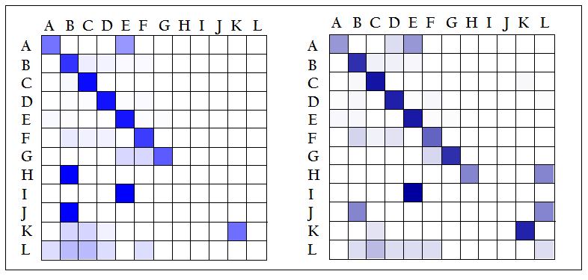
Data
re-constructioin
replacemet
vs
data

Slide 8
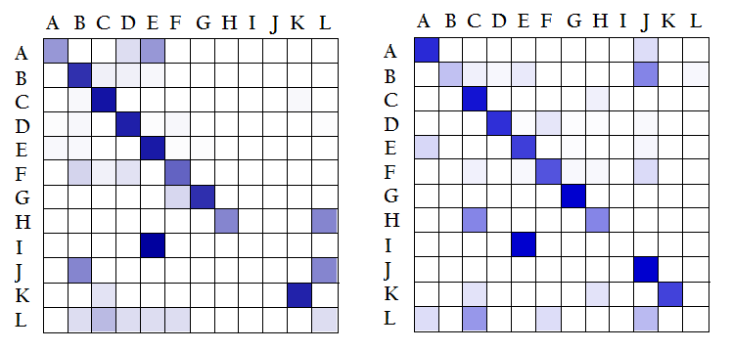
Timeseries
vs
single
point
data

Slide 9
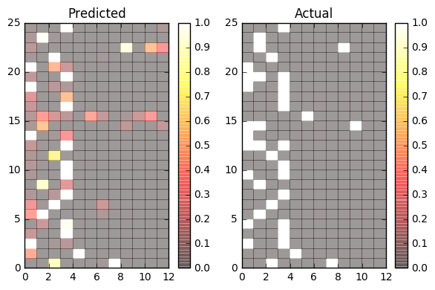
Predicting
model
build
on
new
data

Slide 10
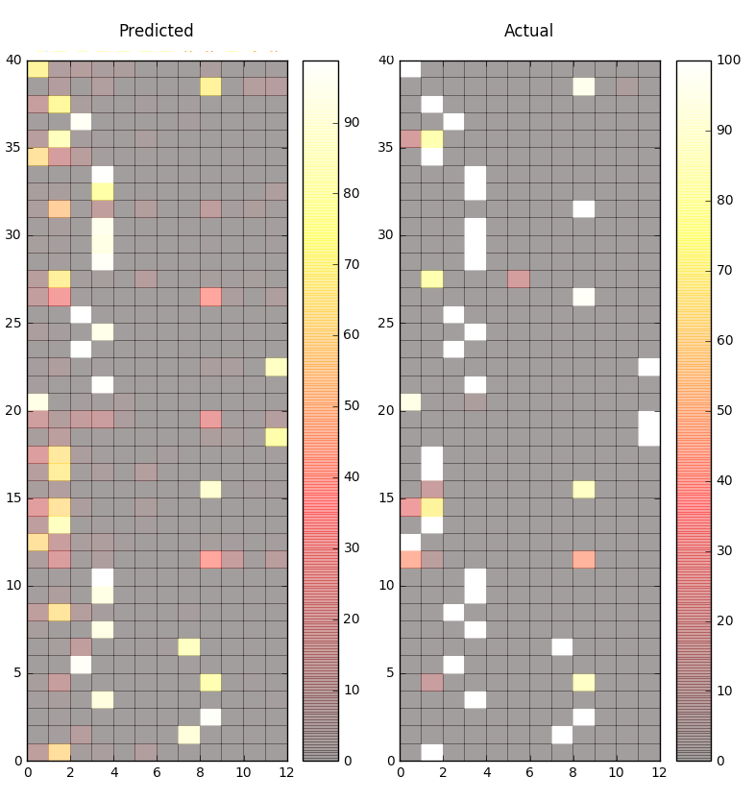
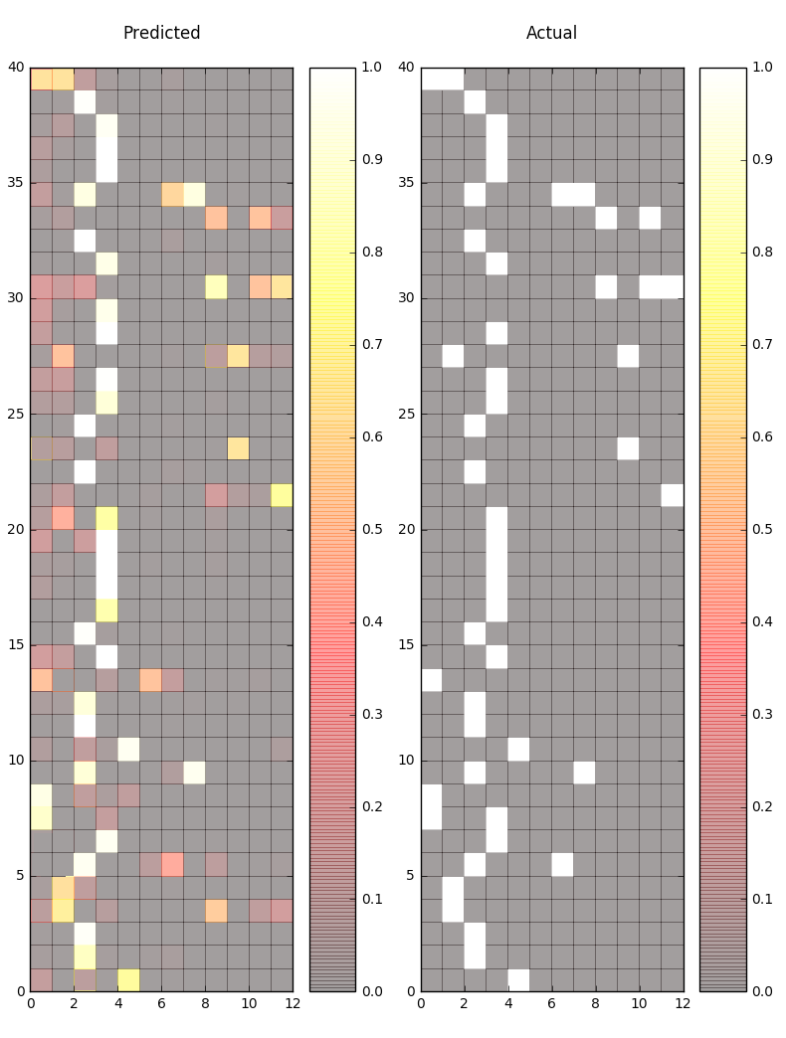
Automatic search for best model
regression vs decision tree

Slide 11
Summary
●
All cases model:
True positive rate (sensitivity) 0.58,
●
Accuracy
0.65
●
Increased data volume (25% more data):
●
TPR 0.67,
Accuracy 0.7
●
Added data from different sources:
●
TRP 0.67,
Accuracy 0.75
●
Reconstructed missed values:
●
TRP 0.72,
Accuracy 0.74
●
Re-placed data:
●
TRP 0.72,
Accuracy 0.82
●
Timeseres used:
●
TRP 0.72,
Accuracy 0.82

Slide 12
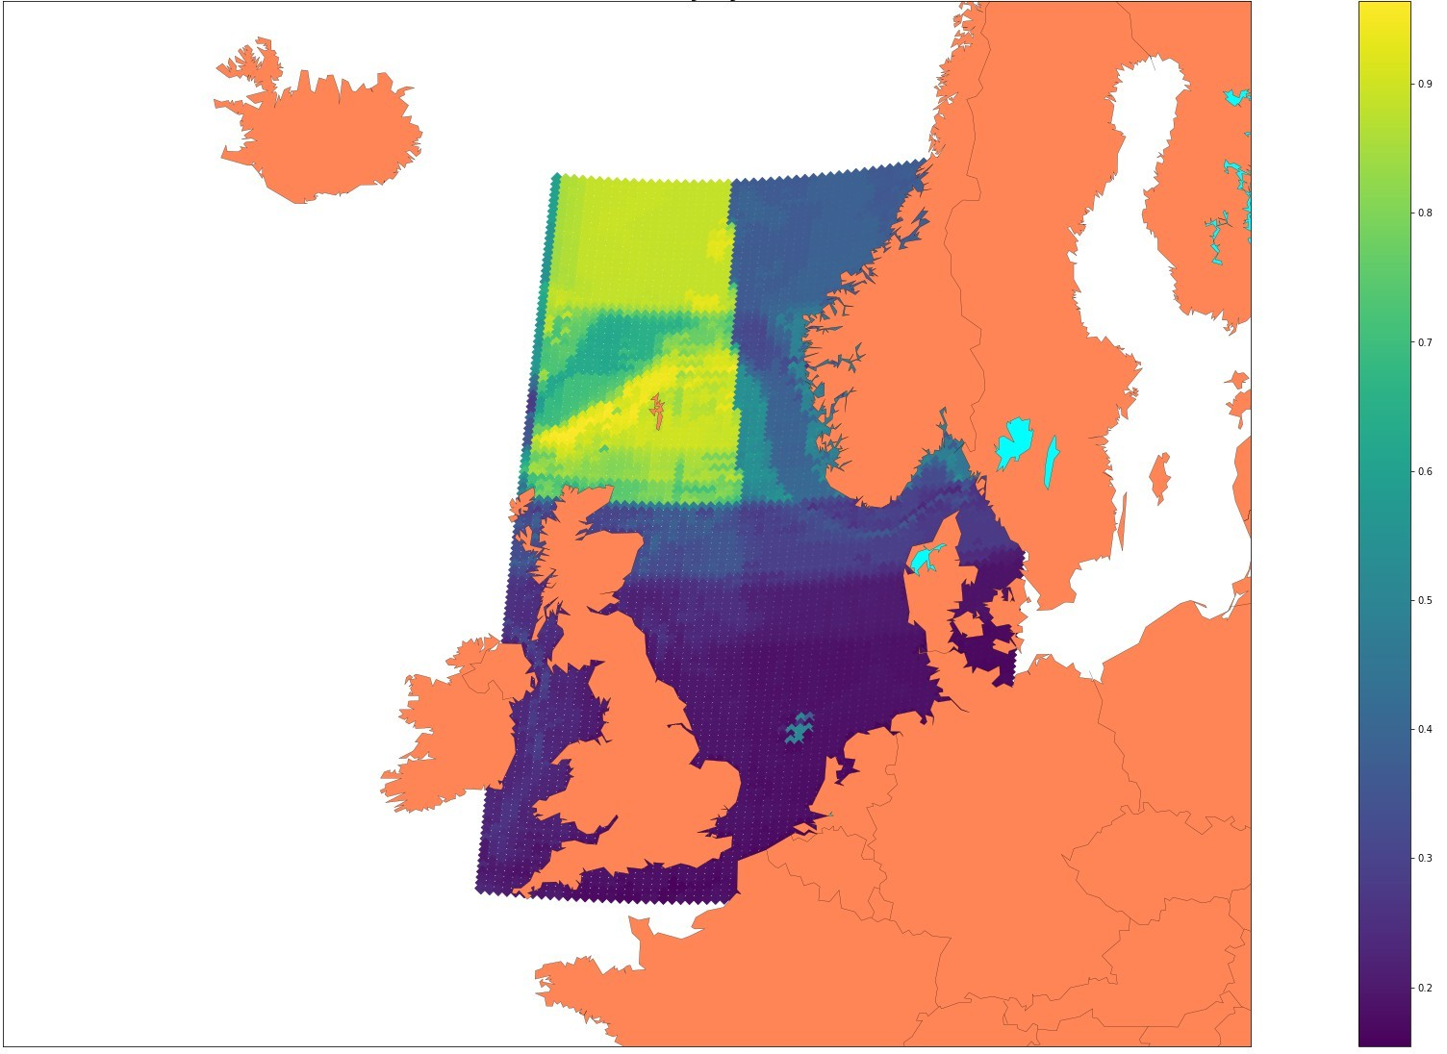
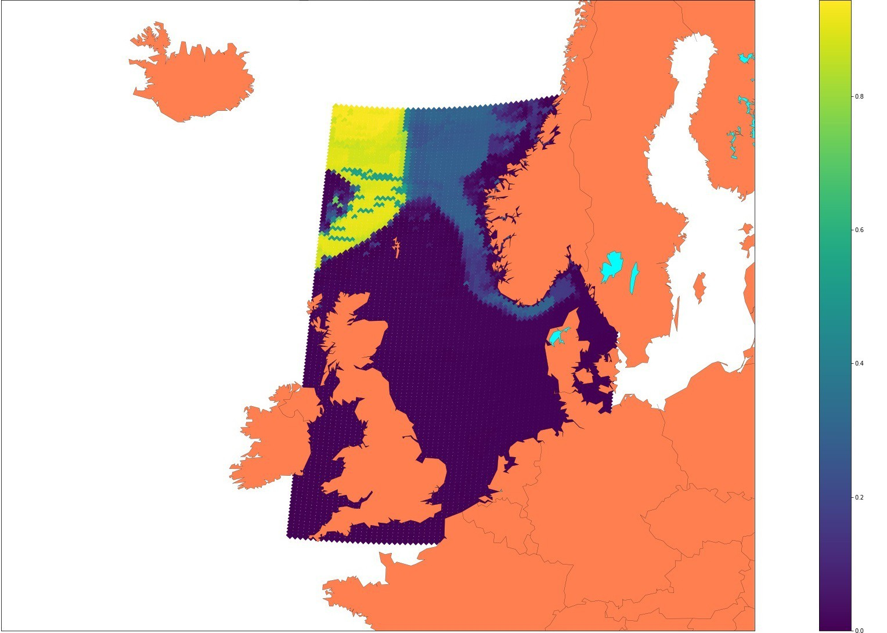
Results:
probability
vs
location

