Slide 1


Differential Regional Fatty Acid Distribution in
Normotensive and Preeclampsia Placenta
6TH CONGRESS OF BIOTECHNOLOGY
Alka Rani, Preeti Chavan-Gautam, Savita Mehendale,
Girija Wagh & Sadhana Joshi
Dept. of Nutritional Medicine, IRSHA &
Dept. of Ob&Gy, Bharati Hospital, Bharati Vidyapeeth Deemed
University, Pune, India
5.10.2015
Notes:
Good evening everyone, I am Alka Rani here to present my research work entitled differential regional fatty acid distribution in normotensive and preeclampsia placenta.

Slide 2

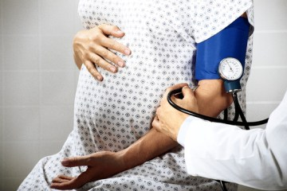
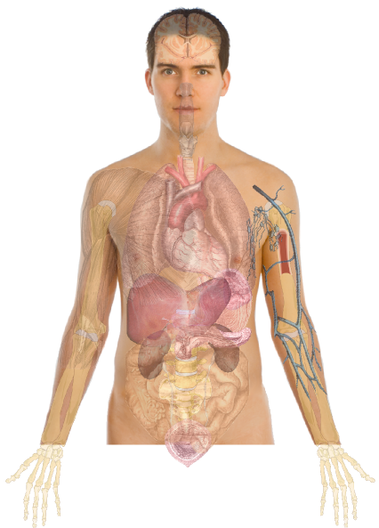
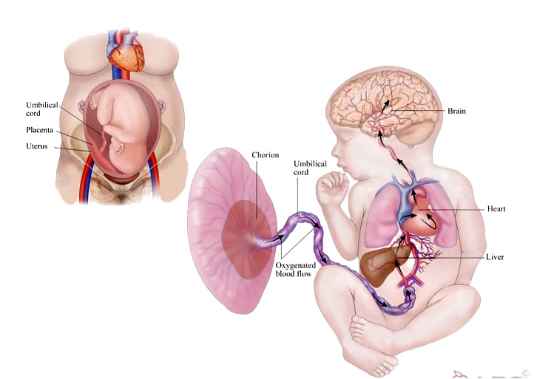
Origin
PREECLAMPSIA (PE)
  Characteristics:
  Hypertension: Systolic BP≥140 and Diastolic BP≥90
  Proteinuria: >1+ or 300mg after 20 weeks of gestation
  Prevalence:
  Worldwide 2% to 8% of all pregnancies, majorly developing countries (Jeyabalan, 2013)
  Leading cause of worldwide pregnancy-related maternal and neonatal mortality
  and morbidity (Park et al., 2015)
Development Origin of Health & Diseases Hypothesis
(Fall, 2013)
Mother
Adulthood
Fetus
Pregnancy Disorders
Placental Malfunctioning
High Risk of NCDs
Adverse Fetal Programming
Altered Maternal Nutrition
Notes:
Inside the womb the placenta is the connecting organ between the mother and the fetus were exchange of gases and transfer of nutrients takes places. Development origin of health and diseases hypothesis which started late in 1970s says that nutritional deficit to a growing fetus does adverse placental and fetal programming and increases the risk of non-communicable diseases in later life. Such scenario has been observed in pregnancy disorders like preeclampsia which is characterized by hypertension and proteinuria in the women after 20 weeks of gestation.

Slide 3


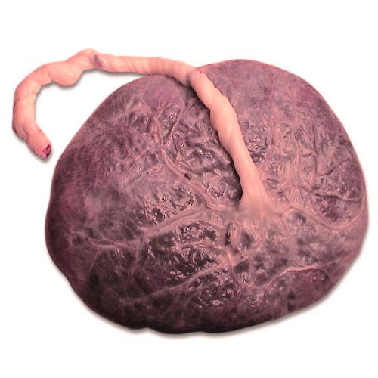


Maternal Nutrition - Long Chain Polyunsaturated Fatty Acids
Maternal
Diet
LCPUFA
Sources
LCPUFA Transfer Cycle
Placental
Development
Fetal
Development
Retina
Brain
(Uauy et al., 2001)
Notes:
When we talk about nutritional requirements of the mother during pregnancy fatty acids especially long chain polyunsaturated fatty acids are essential during this period. LCPUFA are essential fatty acid because they cannot synthesized in the body and should be taken through diet. Dietary as well as stored LCPUFA in the mother are required for early placental development which later efficiently mobilizes the its transport for fetal brain and retinal development.

Slide 4

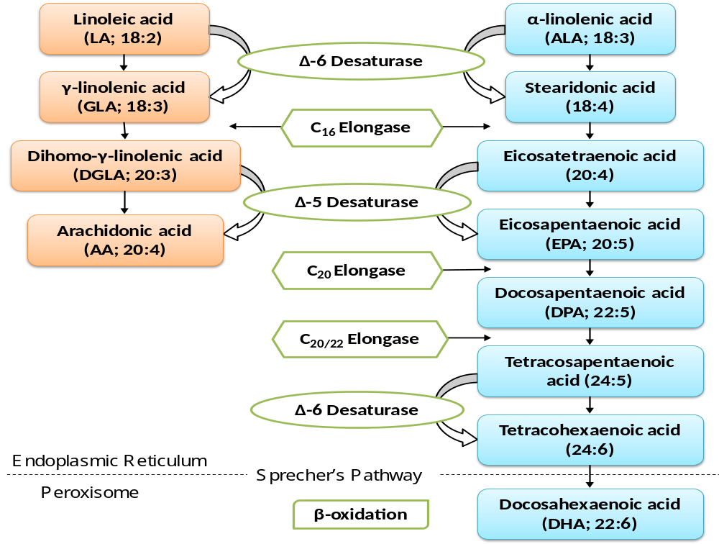
LCPUFA – Biosynthesis
OMEGA 6 SERIES
ENZYMES
OMEGA 3 SERIES
Rani et al., 2015 (Book Chapter, CRC Press|Taylor and Francis)
Notes:
The omega 6 series linoleic acid and the omega 3 series alpha linolenic acid gets converted to functionally important arachidonic acid and docosahexaenoic acid respectively through various elongation and desaturation pathways.

Slide 5
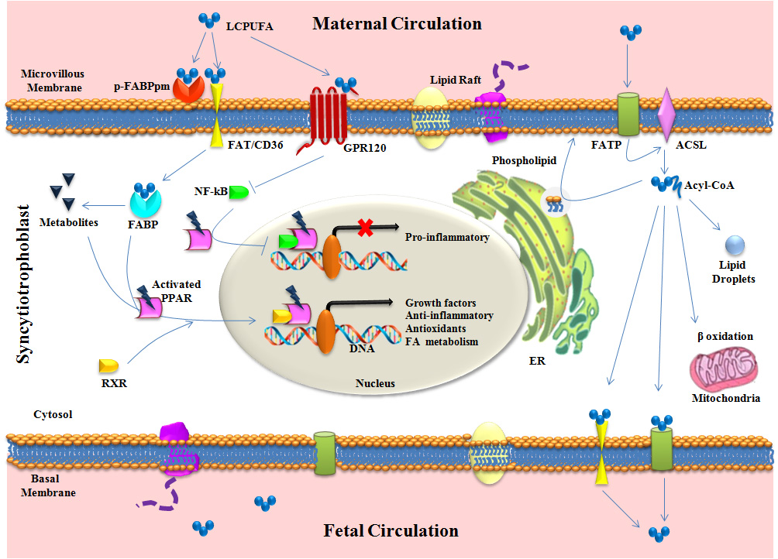
LCPUFA – Transport & Metabolism
Rani et al., 2015 (Book Chapter, CRC Press|Taylor and Francis)
Notes:
Transport of these LCPUFA from maternal to fetal circulation requires various fatty cid binding and transport proteins present in the syntiotrophoblastic layer of the placenta. However placenta also requires these fatty acids for its own metabolism like phospholipid formation, regulation of gene expression, production of eicosanoids, beta oxidation and lipid storage.

Slide 6
Preeclampsia - Our Earlier Studies
Altered LCPUFA levels in PE placenta (Kulkarni et al, 2011a; Wadhwani et al., 2014)
Presence of desaturases enzymes in normal placenta and its reduced expression in PE placenta (Wadhwani et al., 2014)
Reduced expression of FATP 1 and FATP 4 in PE placenta (Wadhwani et al., 2014)
Altered maternal and cord blood LCPUFA levels in PE (Mehendale et al., 2008; Wadhwani et al., 2014)
Negative association of placental DHA with oxidative stress marker homocysteine in PE (Kulkarni et al., 2011b)
All these placental studies were done on tissues taken from maternal side of the placenta
Notes:
In preeclampsia or PE we have previously shown altered LCPUFA levels in the maternal blood, cord blood and the placenta. Reduced expression of fatty acid binding protein and synthesizing enzymes have also been reported in the PE placenta. However these studies were on placental tissues taken randomly from the maternal side of the placenta.

Slide 7
Placenta - Regions
Maternal blood flow is initiated in periphery and expands progressively (Jauniaux et al., 1999)
Concentration gradient of nutrient from maternal to fetal side (Sala et al., 1984)
In the pathological pregnancy blood flow more in the center than the periphery (Jauniaux et al., 2000)
Notes:
Recently the focus has been drawn to heterogeneous structure of the placenta where studies have shown differences in blood flow, oxygen concentration, trophoblast maturity, nutrients gradient within the placental disc which is further altered in case of preeclampsia.

Slide 8
Hypothesis
Notes:
Hence, we hypothesize that Fatty acid are distributed in different regions of the placenta is altered in preeclampsia which is associated with a poor birth outcome.

Slide 9
Objectives
To examine the regional placental fatty acids distribution in normotensive control and preeclampsia placenta.
To study the association of these parameters with birth outcome and maternal blood pressure.
Notes:
Our objectives were to…

Slide 10
Study Design
The sample size was calculated based on our earlier study with power of 80% and type I error of 0.05 (Kulkarni et al., 2011)
Recruitment at Dept. of OBGY, Bharati Hospital, Pune
Ethical approval from institute ethical committee
Written informed consent taken
INCLUSION & EXCLUSION CRITERIA:
Preeclampsia women
Blood Pressure ≥140/90
Proteinuria >1+ or 300mg
Normotensive women
Inclusion criteria:
  Age: 18-35 yrs
Exclusion criteria:
History of non-communicable diseases like diabetes mellitus, renal diseases, hypertension, cardiovascular diseases, seizure disorder, renal or liver disease etc. Pregnant women with alcohol or drug abuse. Multiple gestations (twins etc.). Bleeding disorders, HIV (Human Immunodeficiency virus) and HBsAG (Hepatitis B) positive
69
Normotensive Control (NC)
20
Term preeclampsia (TPE)
24
Preterm preeclampsia (PTPE)
Notes:
Sample size of this study was calculated with 80% power and alpha of 0.05. Recruitment of patients were done at Bharati Hospital Pune after taking the ethical approval. Following were the exclusion and inclusion criteria.

Slide 11
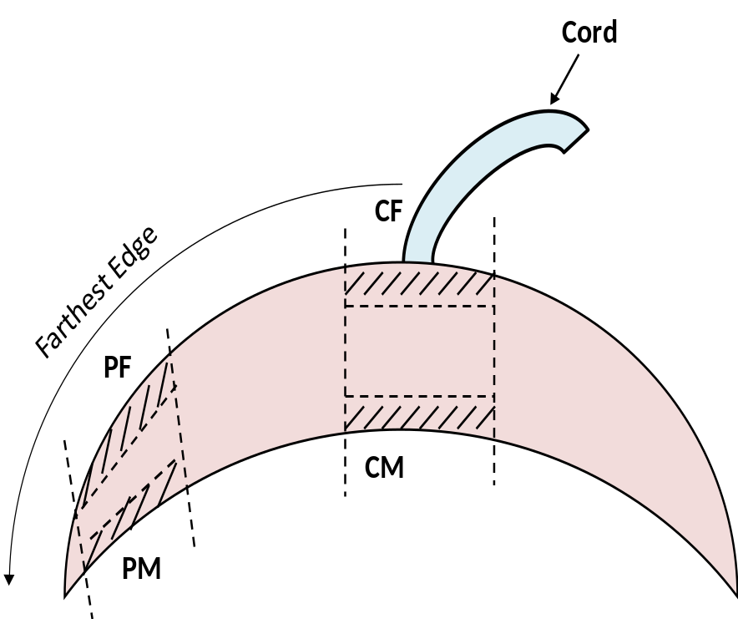
Placenta Sampling
Placental tissues were collected immediately after delivery
Tissues were washed in 1X PBS (phosphate buffer saline) and kept at -80ºC until analyzed
Towards Fetus
1
Central Maternal (CM)
2
Central Fetal (CF)
3
Peripheral Maternal (PM)
4
Peripheral Fetal (PF)
Attached to Uterus
Notes:
Fresh placental tissues were collected from these four regions. Based on the cord insertion center was identified from which tissues were obtained from maternal and fetal sides. Similarly from the periphery which was farthest edge from the cord insertion.

Slide 12
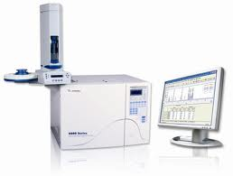
Methodology
Fatty Acid Estimation:
  Transesterification of cell membrane fraction using methanolic–HCl
  Gas Chromatography, GC-MS Perkin Elmer (SD 2330, 30m capillary column, Supelco)
Statistical Analysis:
  SPSS/PC+ package (ver. 20.0, Chicago IL)
  Skewed variables log₁₀ transformation
  One way ANOVA with LSD
  Pearson's partial correlation after adjusting for confounder i.e. gestational age, maternal age and BMI
Sample Size Calculation:
  PS power and sample size calculator (ver. 3.0.43)

Slide 13
Results & Discussion

Slide 14
Maternal & Neonatal Characteristics
Groups (Mean±S.D) | NC (n=69) | TPE (n=20) | PTPE (n=24)
Maternal age (Yr) | 24.38 ± 3.47 | 25.24 ± 3.62 | 27.26 ± 4.87**&&
Income (Rs) | 11303.03 ± 7749.88 | 15700 ± 12260.76** | 10673.91 ± 7612.20&&
BMI (kg/m²) | 24.91 ± 4.07 | 29.35 ± 4.68** | 27.18 ± 5.35*
Sys BP (mmHg) | 119.19 ± 8.27 | 151.90 ± 18.06** | 155.74 ± 19.67**&&
Dias BP (mmHg) | 77.04 ± 5.19 | 94.86 ± 10.31** | 100.87 ± 11.31**&&
Gestation (weeks) | 38.86 ± 1.14 | 38.49 ± 1.43 | 34.07 ± 2.13**&&
MOD (n) Vaginal C-Section | 56 13 | 9 11 | 4 20
Birth weight (kg) | 2.90 ± 0.31 | 2.62 ± 0.57** | 1.70 ± 0.44**&&
Baby length (cm) | 49.30 ± 3.14 | 47.48 ± 2.87** | 42.21 ± 3.68**&&
NC - normotensive control, TPE - term preeclampsia; PTPE - preterm preeclampsia; BMI - body mass index; Sys BP - systolic blood pressure; Dias BP - diastolic blood pressure; MOD - mode of delivery; C-section - cesarean delivery; n - number; p<0.05; **p<0.01 as compared with NC, &&p<0.01, &p<0.05 as compared with TPE
One Way ANOVA

Slide 15
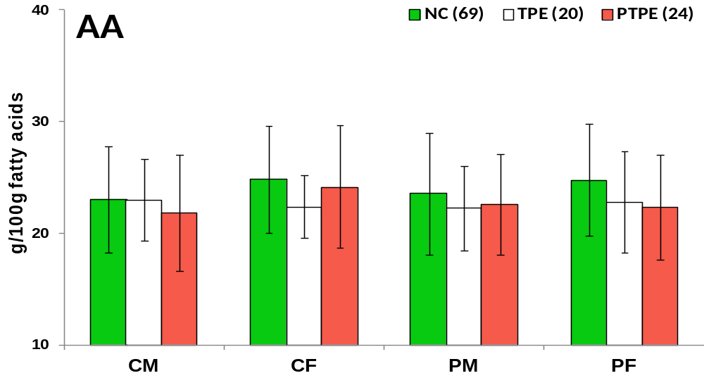
Regionwise Arachidonic Acid Levels
@
@
*
*
CM- central maternal region, CF- central fetal region, PM- peripheral maternal region, PF- peripheral fetal region;*p<0.05 than
NC, @p<0.05 than CM
Lower in TPE in CF and in PTPE in PF regions than control
Within control, higher in fetal regions (CF&PF) than CM
One Way ANOVA

Slide 16
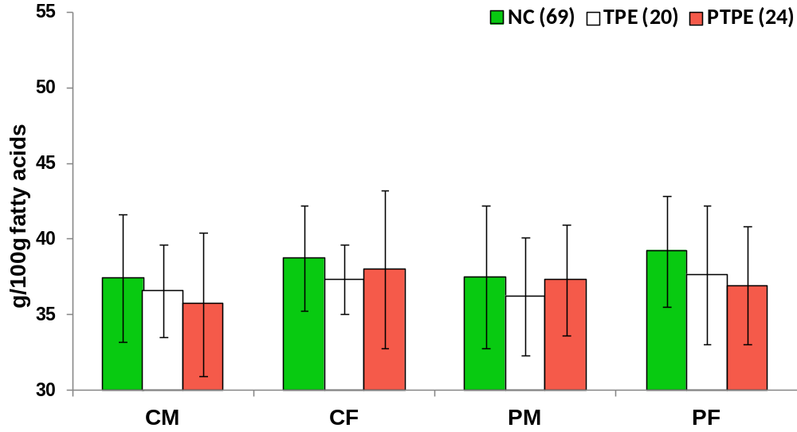
Regionwise Omega 6 Fatty Acid Levels
@ @
%
*
CM- central maternal region, CF- central fetal region, PM- peripheral maternal region, PF- peripheral fetal region;*p<0.05 than
NC, @@p<0.05 than CM, %p<0.05 than PM
Lower in PTPE in PF regions than control
Within control, higher in PF than CM and PM
One Way ANOVA

Slide 17
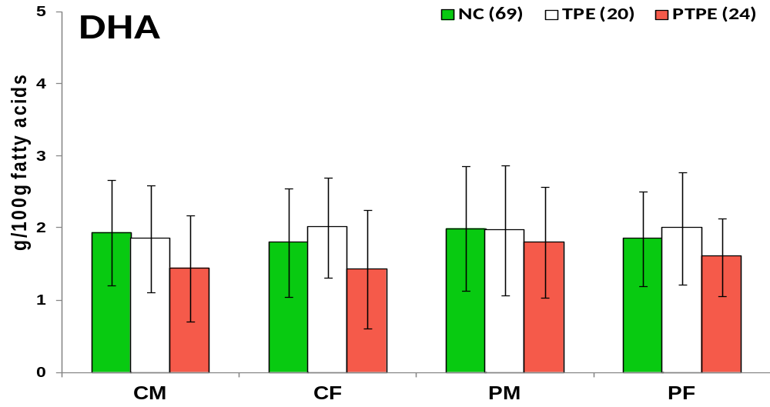
Regionwise Docosahexaenoic Acid Levels
#
**
*
&
&
&
CM- central maternal region, CF- central fetal region, PM- peripheral maternal region, PF- peripheral fetal region; **p<0.01, *p<0.05 than NC, &p<0.05 than TPE, #p<0.05 than CF
Lower in PTPE in CM, CF and PF regions than control
Within PTPE placenta, lower in CF region than PM region
One Way ANOVA

Slide 18
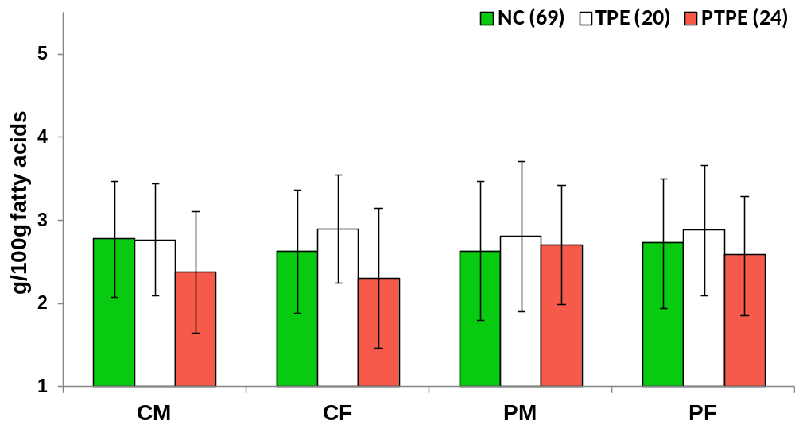
Regionwise Omega 3 Fatty Acid Levels
#
*
*
&
&&
CM- central maternal region, CF- central fetal region, PM- peripheral maternal region, PF- peripheral fetal region; **p<0.01, *p<0.05 than NC, &p<0.05, &&p<0.05 than TPE, #p<0.05 than CF
Lower in PTPE in central regions (CM&CF) than control
Within PTPE placenta, lower in CF region than PM region
One Way ANOVA

Slide 19
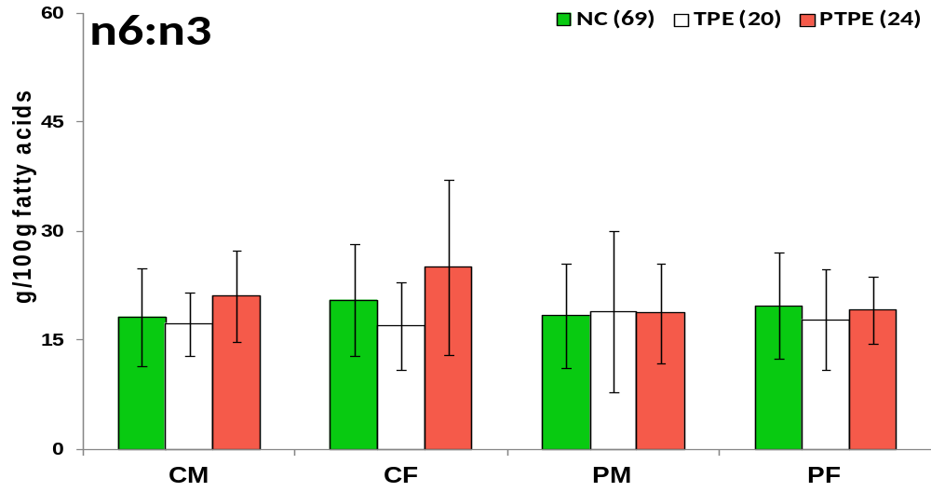
Regionwise Omega 6:3 Ratio
#
*
##
*
&&
&
CM- central maternal region, CF- central fetal region, PM- peripheral maternal region, PF- peripheral fetal region; *p<0.05 as compared with NC, &p<0.05 , &&p<0.01 TPE, #p<0.05 ##p<0.01 than CF
Higher in PTPE than TPE and control in both the central regions (CM&CF)
Within PTPE placenta, lower in both the peripheral regions (PM&PF) than CF
One Way ANOVA with LSD
Notes:
We analyzed the ration of n6 to n3 because it is an indicator of inflammation as n6 fatty acids produces pro and n3 fatty acid produces anti inflammatory metabolites.

Slide 20
Regionwise Fatty Acid Levels
Fatty acids (g/100g FA) | Gps | Central Maternal | Central Fetal | Peripheral Maternal | Peripheral Fetal
LA | NC | 10.22±2.11 | 9.79± 2.47 | 9.90± 2.23 | 10.16± 2.59
 | TPE | 9.39±2.73 | 10.34± 2.18 | 9.69± 2.16 | 10.27± 2.64
 | PTPE | 9.92±2.21 | 9.86± 2.15 | 10.40± 1.98 | 10.40± 1.86
ALA | NC | 0.17±0.15 | 0.15± 0.10 | 0.15± 0.12 | 0.18± 0.35
 | TPE | 0.23±0.23 | 0.18± 0.10 | 0.20± 0.16 | 0.17± 0.14
 | PTPE | 0.24±0.16 | 0.21± 0.13* | 0.19± 0.12 | 0.22± 0.13*
SFA | NC | 41.97±4.29 | 42.17± 4.04 | 42.09± 4.55 | 41.22± 3.14
 | TPE | 43.84±3.44 | 43.84± 3.43 | 44.53± 4.12* | 43.91± 4.77**
 | PTPE | 44.84±4.36** | 43.66± 3.77 | 42.50± 2.41@ | 43.47± 3.51**
MUFA | NC | 7.60±2.29 | 6.72± 1.54@@ | 7.29± 2.33 | 6.82± 1.63@
 | TPE | 7.05±1.33 | 6.79± 1.66 | 6.83± 1.49 | 6.78± 1.49
 | PTPE | 7.46±1.82 | 6.73± 1.83 | 7.85± 1.53# | 7.26± 1.35
**p<0.01, *p<0.05 as compared with NC, @@p<0.01, @p<0.05 as compared with CM, #p<0.05 as compared with CF
One Way ANOVA with LSD

Slide 21
Sidewise Fatty Acid Levels
Fatty acids | Mean± SD | Maternal | Fetal | Central | Peripheral
AA | NC | 23.28± 3.79 | 24.78± 4.01^{ω} | 23.92± 3.70 | 24.14± 4.25
 | TPE | 22.59± 2.42 | 22.60± 2.85* | 22.67± 2.64 | 22.52± 3.36
 | PTPE | 22.19± 3.37 | 23.25± 3.82 | 22.97± 3.48 | 22.46± 3.89
Omega 6 | NC | 37.45± 3.16 | 38.97± 2.94^{ωω} | 38.07± 2.97 | 38.35± 3.18
 | TPE | 36.38± 2.62 | 37.48± 2.91 | 36.94± 2.13 | 36.92± 3.80
 | PTPE | 36.48± 2.78 | 37.46± 3.48* | 36.84± 3.53 | 37.10± 3.32
DHA | NC | 1.97± 0.65 | 1.82± 0.60 | 1.87± 0.60 | 1.92± 0.63
 | TPE | 1.91± 0.75 | 2.00± 0.62 | 1.93± 0.63 | 1.98± 0.71
 | PTPE | 1.62± 0.59* | 1.51± 0.56*&& | 1.43± 0.54**&& | 1.70± 0.55
Omega 3 | NC | 2.30± 0.61 | 2.18± 0.62 | 2.20± 0.59 | 2.27± 0.66
 | TPE | 2.29± 0.72 | 2.39± 0.61 | 2.33± 0.58 | 2.34± 0.71
 | PTPE | 2.04± 0.56 | 1.94± 0.68& | 1.84± 0.56*&& | 2.14± 0.62^{Ψ}
Omega 6 :Omega3 | NC | 18.31± 5.56 | 20.15± 6.09 | 19.37± 6.14 | 19.08± 5.84
 | TPE | 18.11± 6.45 | 17.38± 5.13 | 17.09± 4.21 | 18.40± 7.16
 | PTPE | 19.88± 5.31 | 22.05± 6.79& | 23.02± 6.79*&& | 18.90± 4.54^{Ψ}
**p<0.01, *p<0.05 as compared with NC, &&p<0.01, &p<0.05 as compared with TPE in the corresponding region; ^{ωω}p<0.01, ^{ω}p<0.05 as compared with M, ^{ΨΨ}p<0.01, ^{Ψ}p<0.05 as compared with C
One Way ANOVA with LSD

Slide 22
Association with Birth Weight & BP
DHA was positively associated with birth weight in PF region
Omega 6 fatty acid was positively associated with maternal systolic BP of PF region
n
39
94
r
0.35
0.2
p
0.035
0.053
Group
PE
Whole
n
39
r
0.36
p
0.032
Group
PE
Whole
94
0.22
0.042
Pearson’ correlation after adjusting for maternal age, BMI and gestational age confounders
Pearson’s Correlation

Slide 23
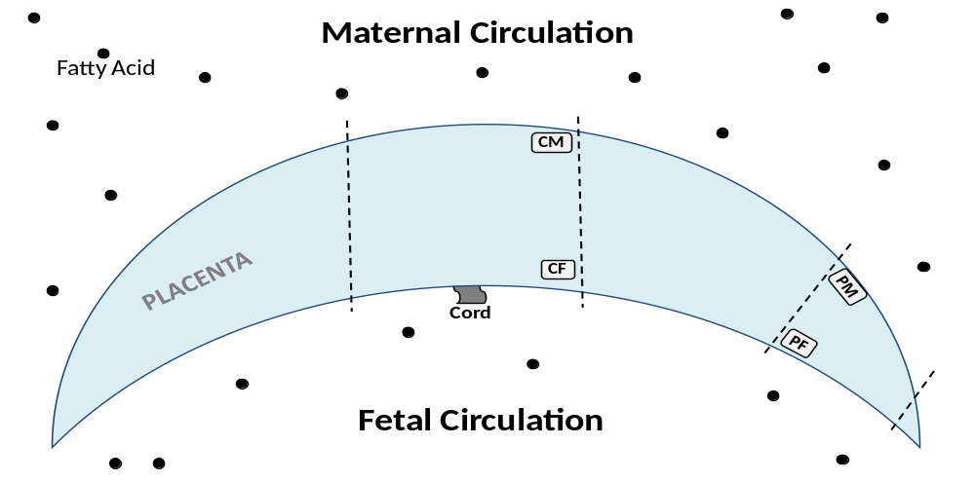
Regionwise Fatty Acid Variation
Regional Fatty Acid Distribution within Placenta
Maternal Circulation
DHA
Omega-3
Omega6:3
AA
Preterm PE
PLACENTA
Preterm PE
PLACENTA
CONTROL
PLACENTA
Fetal Circulation
Preferential Transfer of AA in NC Placenta
(Haggarty, 2000)
Better DHA uptake/synthesis in periphery than center in PTPE placenta
(Jauniax et al, 2003)
Highest omega6:3 ratio shows highest inflammation in CF region of PTPE placenta
(Wang et al, 2005)

Slide 24
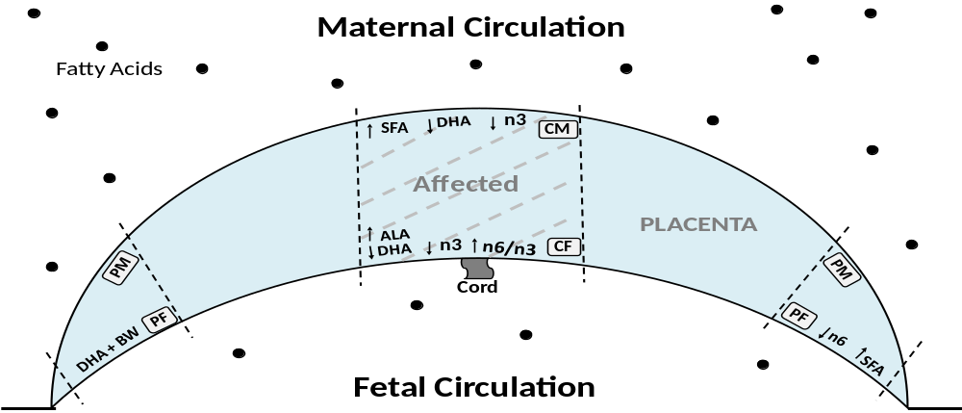
PTPE - Placental Pathology
Regional Fatty Acid Alterations in PTPE Placenta
Maternal Circulation
Fetal Circulation
Lower produce DHA and higher precursor ALA may be due to limited biosynthesis
Lower DHA may affect fetal brain and retinal development (Uauy et al., 2001)
Higher SFA may increase oxidative stress (Liang et al., 2009)
Nutritional Deficit to Fetus
Fetal Programming of Adult Diseases

Slide 25
Conclusion
Differential regional fatty acid distribution in normal placenta
Regional fatty acid distribution altered in PE placenta
Fatty acids in preterm PE placenta is more affected as compared to term PE placenta
In PE, LCPUFA in peripheral fetal region is associated with birth weight and maternal BP

Slide 26
Implication
This study will help us to plan future studies to understand the
role of different regions of the placenta in fatty acid metabolism & transport
affecting fetal growth in preeclampsia

Slide 27




Acknowledgment
Department of Science and Technology (DST)
Participants and Nurses of the Bharati Hospital

Slide 28
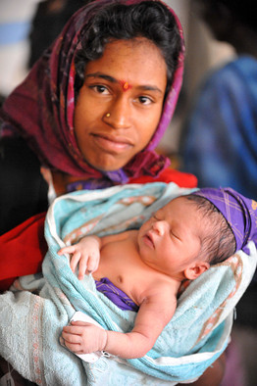


Thank You !

