Slide 1
About OMICS Group
OMICS Group is an amalgamation of Open Access Publications and worldwide international science conferences and events. Established in the year 2007 with the sole aim of making the information on Sciences and technology ‘Open Access’, OMICS Group publishes 500 online open access scholarly journals in all aspects of Science, Engineering, Management and Technology journals. OMICS Group has been instrumental in taking the knowledge on Science & technology to the doorsteps of ordinary men and women. Research Scholars, Students, Libraries, Educational Institutions, Research centers and the industry are main stakeholders that benefitted greatly from this knowledge dissemination. OMICS Group also organizes 500 International conferences annually across the globe, where knowledge transfer takes place through debates, round table discussions, poster presentations, workshops, symposia and exhibitions.

Slide 2
OMICS International Conferences
OMICS International is a pioneer and leading science event organizer, which publishes around 500 open access journals and conducts over 500 Medical, Clinical, Engineering, Life Sciences, Pharma scientific conferences all over the globe annually with the support of more than 1000 scientific associations and 30,000 editorial board members and 3.5 million followers to its credit.
OMICS Group has organized 500 conferences, workshops and national symposiums across the major cities including San Francisco, Las Vegas, San Antonio, Omaha, Orlando, Raleigh, Santa Clara, Chicago, Philadelphia, Baltimore, United Kingdom, Valencia, Dubai, Beijing, Hyderabad, Bengaluru and Mumbai.

Slide 3



EUROPEAN PHARMACOVIGILANCE UNDER EUDRAVIGILANCE
Practising Safety
Coimbatore, India
London, United Kingdom

Slide 4
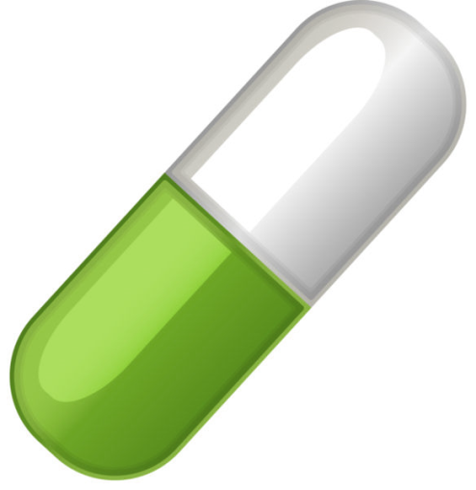

EUROPEAN PHARMACOVIGILANCE UNDER EUDRAVIGILANCE
Introduction
Where it fits within the entire European framework
Understanding the EudraVigilance system
How it is implemented in the post-
marketing approval of medicinal
Drugs
Challenges
Questions

Slide 5
EUROPEAN PHARMACOVIGILANCE UNDER EUDRAVIGILANCE
Introduction
EudraVigilance is a data processing network and management system for reporting and evaluating suspected adverse reactions during the development and following the marketing authorisation of medicinal products in the European Economic Area (EEA).

Slide 6

EUROPEAN PHARMACOVIGILANCE UNDER EUDRAVIGILANCE
Where it fits within the entire European framework
EudraVigilance (EV) – mandatory in EEA for post-marketing European-wide PV system for rapid dissemination of data of a safety nature for evaluation.

Slide 7

EUROPEAN PHARMACOVIGILANCE UNDER EUDRAVIGILANCE
Understanding the EudraVigilance system
EV is consistent with Electronic Data Interchange (EDI) principles and meets Electronic Standards for the Transfer of Regulatory Information (ICH E2B [E2B defines the data elements for transmission of individual case safety reports]).

Slide 8
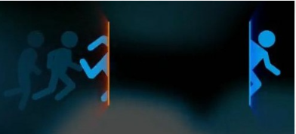
EUROPEAN PHARMACOVIGILANCE UNDER EUDRAVIGILANCE
Understanding the EudraVigilance system
EV is a database for the EMA & NCAs – benefit/risk analysis (fully searchable), but only a portal for sponsors or MAHs (ie MAHs have access to their own data only).

Slide 9

EUROPEAN PHARMACOVIGILANCE UNDER EUDRAVIGILANCE
Understanding the EudraVigilance system
  3 methods for updating EV
    E2B transfer
    EVWEB
    EVPOST

Slide 10
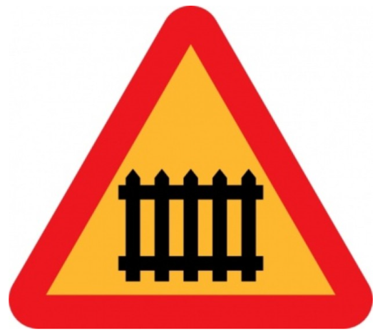
EUROPEAN PHARMACOVIGILANCE UNDER EUDRAVIGILANCE
Understanding the EudraVigilance system
E2B transfer – automated transfer of xml data via a Gateway (database to database - it’s called the ‘Gateway ’ method)

Slide 11

EUROPEAN PHARMACOVIGILANCE UNDER EUDRAVIGILANCE
Understanding the EudraVigilance system
EVWEB is a method of manually populating EV (it’s called a ‘Web trader’ method)

Slide 12
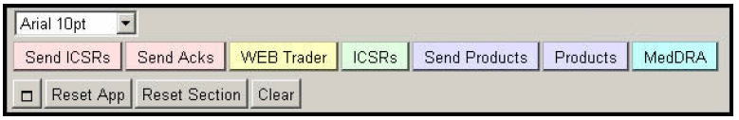
EUROPEAN PHARMACOVIGILANCE UNDER EUDRAVIGILANCE
Understanding the EudraVigilance system
EVWEB

Slide 13
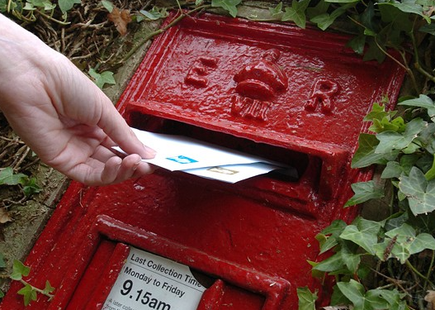
EUROPEAN PHARMACOVIGILANCE UNDER EUDRAVIGILANCE
Understanding the EudraVigilance system
EVPOST – which cannot transfer the data automatically via a Gateway (enter onto your database, then create the computer E2B xml, then the xml is given to EV)

Slide 14
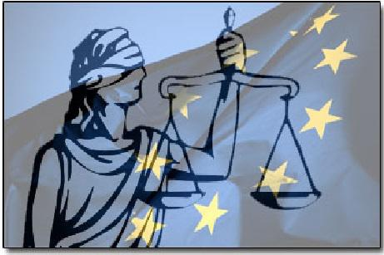
EUROPEAN PHARMACOVIGILANCE UNDER EUDRAVIGILANCE
How it is implemented in post-marketing situations
    i. Regulation (EU) No 1235/2010
    (EC 726/2004 as amended)
    ii. Directive 2010/84/EU
    (2001/83/EC as amended)
    iii. Good Pharmacovigilance
    Practice guidelines
    (GVP module VI)

Slide 15
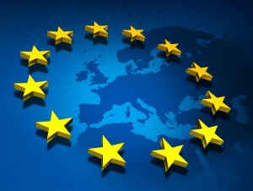
EUROPEAN PHARMACOVIGILANCE UNDER EUDRAVIGILANCE
How it is implemented in post-marketing situations
QPPV – specifically for MAHs & legislated (role is defined in GVP) because it covers PV

Slide 16

EUROPEAN PHARMACOVIGILANCE UNDER EUDRAVIGILANCE
How it is implemented in post-marketing situations
The order [access rights]:
QPPV (super user)
‘Trusted’ deputy
Standard users (DE only)

Slide 17

EUROPEAN PHARMACOVIGILANCE UNDER EUDRAVIGILANCE
How it is implemented in post-marketing situations
Reason for rigorous registration procedure:
EMA want to be sure you’ve a valid reason for access
Security of proprietary data
Patient protection (individual anonymity)
Wider information protection
(protecting against ‘bandwagon’
effect/media exaggeration)

Slide 18

EUROPEAN PHARMACOVIGILANCE UNDER EUDRAVIGILANCE
How it is implemented in post-marketing situations
Safety case complance timelines from: date case 1st received by MAH to date that acknowledgment message is returned.
Associated to EV, is XEVMPD ie the medical
products dictionary for EV – Created
Using SmPC

Slide 19

EUROPEAN PHARMACOVIGILANCE UNDER EUDRAVIGILANCE
Challenges
Official User Training
Registration
Population of XEVMPD
Resources (departmental
organisation)
Language (your safety DB v EV)
Compliance Timelines (ICSRs)

Slide 20

EUROPEAN PHARMACOVIGILANCE UNDER EUDRAVIGILANCE
Thank You for your attention.
Questions?

Slide 21

EUROPEAN PHARMACOVIGILANCE UNDER EUDRAVIGILANCE
References
http://ec.europa.eu/health/documents/eudralex/index_en.htm#
https://eudravigilance.ema.europa.eu/human/docs/guid¯P¯Technical%20Documentation¯EMEA-H-20665-04-en-Final.pdf

Slide 22





Contact Me
INDIA
Oviya MedSafe Pvt Ltd
2nd Floor, KTVR Gardens
220a-3, Marudha Konar Road
Velandipalayam
Coimbatore - 641 025
Tamil Nadu, India
Tel: +91-422-2444442
UNITED KINGDOM
Oviya MedSafe UK Ltd
Suite LP25393
20-22, Wenlock Road
London
N1 7GU
United Kingdom
Tel: +44-8452-733839
E-Mail: alistair.c@oviyamedsafe.com
Web: www.oviyamedsafe.com
Stay connected:
www.linkedin.com/company/oviya-medsafe
www.twitter.com/OviyaMedSafe
www.facebook.com/OviyaMedSafe

Slide 23
Let us meet again..
We welcome you all to our future conferences of OMICS International
5th International Conference & Exhibition on Pharmacovigilance & Clinical Trials
On
September 19 - 21, 2016 at Vienna, Austria http://pharmacovigilance.pharmaceuticalconferences.com/

