Slide 1

Compare the ability to generate power from Azolla biogas by CHP units
Alireza Mehrdadfar, Prof. Majid Amidpour, Najmeh Bashiri
¹Departement of Chemical Engineering, College of Engineering, Tehran North branch, Islamic Azad University,Tehran, Iran
²Department of Mechanical Engineering, K.N. Toosi University of Technology,,Tehran, Iran
³ Departement of Chemical Engineering, Tarbiat Modares University,Tehran, Iran
Word Bioenergy and Expo (bioenergy-2016)

Slide 2
Contents
1 Introduction
Azolla Fern
Small Scale CHP units
2 Methodology
Process modeling
Process evaluation
3 Result and Discussion
Conclusion

Slide 3
1 Introduction

Slide 4

Azolla Fern
Introduction
Azolla filiculoides is a small floating aquatic pterido-phyte with bilobed leaves
Azo
(Dry
Ollyo
(kill)
Azolla
1
2
3
Notes:
Azolla filiculoides is a small floating aquatic pterido-phyte with bilobed leaves (dorsal and ventral lobes).
The dorsal lobe is contact with air and think and inclined towards the horizon and only one edge in contact with water and ventral lobe is thin and sometimes the relatively larger size. Dorsal lip, except at the margins identified, is green and includes Anabaena colony in a hole which contact with atmosphere by a peephole.
This unique association is important as rice culture biofertiliser, animal feed or wastewater purifier.
The nitrogen-fixing capability of Azolla has led to Azolla being widely used as a biofertiliser, especially in parts of southeast Asia.
Under optimized conditions Azolla can double their biomass in less than two days with dinitrogen as the only N source and accumulate 5-6.5% N based on a dry weight.
Azolla from two words, azo (ie drying) and ollyo (ie kill) was taken. The name of Azolla indicates dependence on the water for life.

Slide 5


Introduction
Azolla Fern
1
2
3
Notes:
From temperate to tropical areas are found. (1) The plant originally native to Asia, Africa and America relaxed in rivers, can be published.
The history of the emergence of Azolla on earth to the Cenozoic era and dates back more than two million years ago. It is estimated species of this genus, only 7 species is now available. (Some scientists believe there are 6 or 8 species)

Slide 6
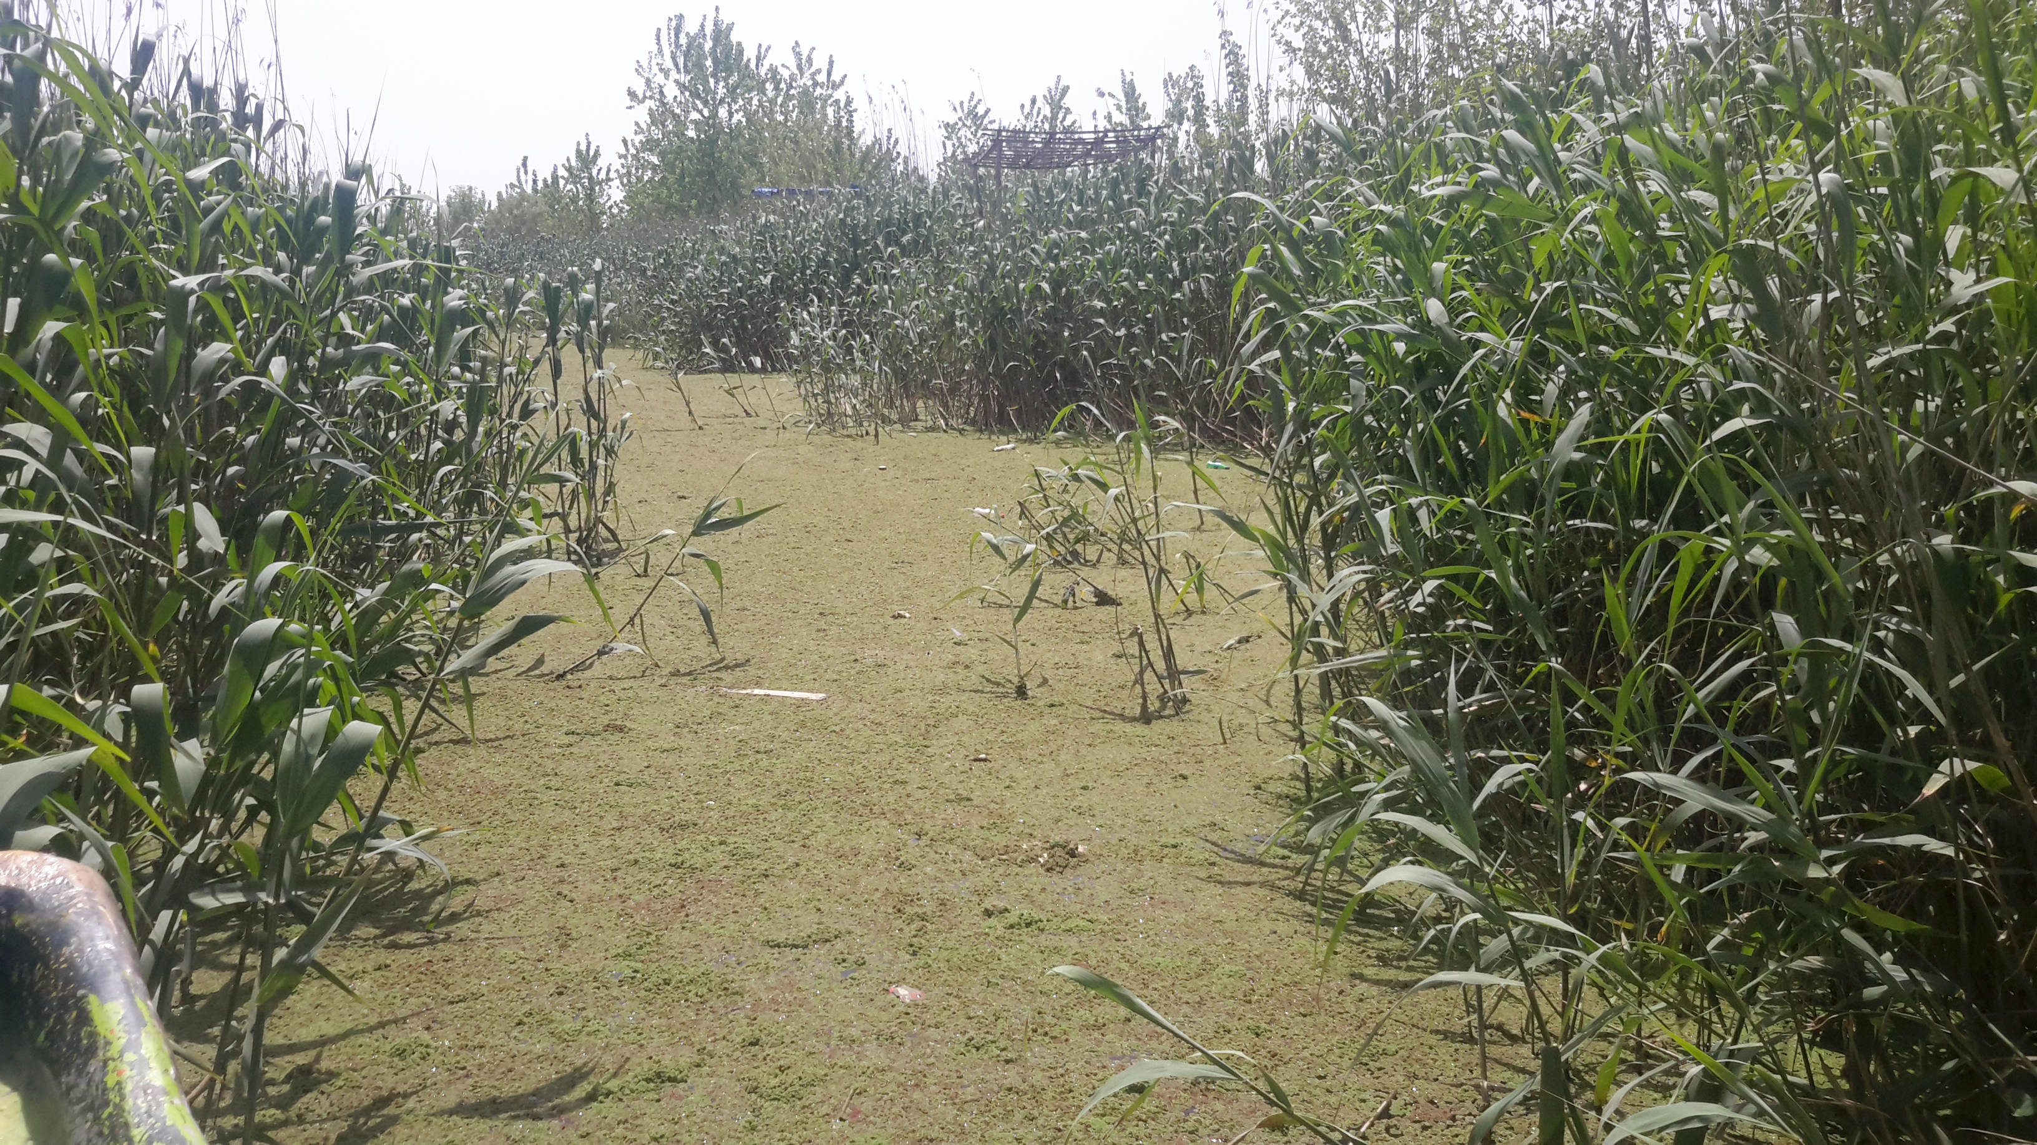
Azolla Fern
Introduction
1
2
3
Notes:
The roots of this plant is thin like a carpet spread on the water surface.
Leaves are delicate and sensitive, and depending on what point in time of the growth has different colors. For example, when the plant is growing the color is Lime green and slowly darken in color and sometimes red and silver too.

Slide 7
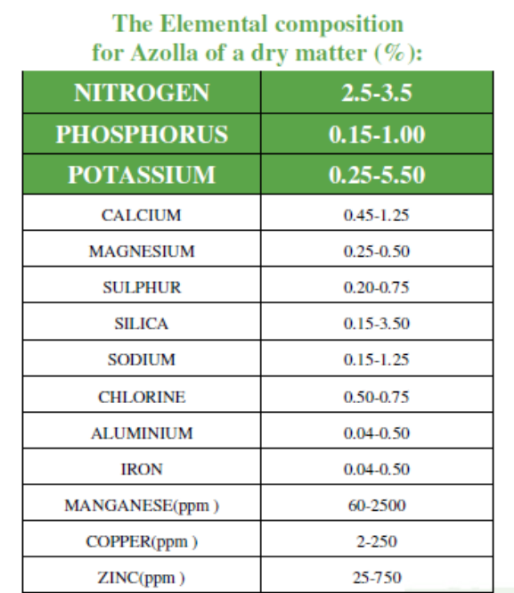
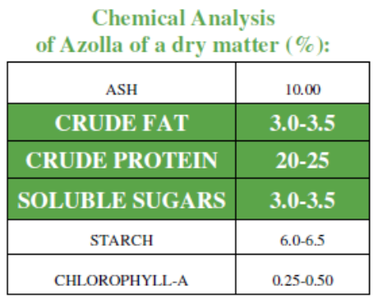
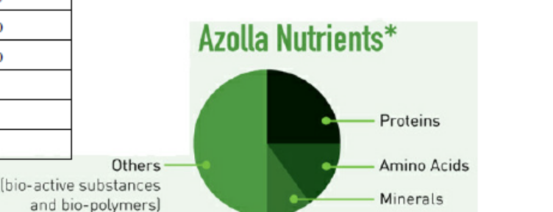
Azolla Fern
Introduction
1
2
3
Notes:
Azolla chemical analysis shows that this plant is very rich minerals of the order. Although the amount of protein in Azolla is desirable, but in terms of some amino acids such as lysine and methionine has a limitations.
The amount of beta-carotene is more than carrots, but it ascorbic acid is negligible. The minerals contain a variety of elements (micronutrients and macronutrients). However, oxalic acid in this plant is at a high level.

Slide 8
Small Scale CHP
Introduction
CHP power Plant
Internal Engine
Micro Turbine
Gas Turbine
Steam Turbine
1
2
3
Notes:
In the energy supply, there are several ways to optimize energy. The one of them is the simultaneous production of power and heat. Combined Heat and Power or short (CHP) is the simultaneous production of two or more of the combined thermodynamic energy from the simple original source. This method is one way to save energy in which electricity and heat are produced simultaneously.
In today's power generators, usually from burning fossil fuels and biogas from biomass and heat use to produce power-driven data and then convert it to electricity.
Greater use of the heat released during the fuel burning process, increase energy efficiency and reduce fuel consumption and thus reduce the costs of primary energy supply. The waste heat recovered from these systems can be used for domestic heating, cooling and used in many industrial processes. Combined heat and power, can also increase the efficiency and reduce fuel consumption, reduce lead emissions.
We selected 4 different kinds of the chp systems with the name …. As you seen in this study

Slide 9
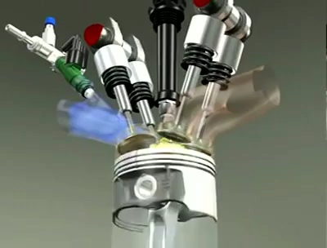
Internal Combustion
Introduction
Internal Combustion
Plant Capacity
1kWel – 10MWel
work produce by piston movement in turn drives the rotating shaft for power generation
Operating cycle
Otto cycle
1- Spark ignition
2- Compression ignition
1
2
3
Notes:
Internal combustion (IC) engines is said to be the workhorse in land, air and sea transportation From history, IC engine was initially developed for automobile sector but with continuous research over times, IC engine technology has been applied in power generation. Plant capacity at which this technology is used ranges from 1kWel – 10MWel. In developing countries, IC engine technology is used for generating electricity for small industries, residential buildings and etc.
Internal combustion engines are heat engines used in generation of mechanical work using products from the combustion as working fluid. The mechanical work (shaft work) produce by piston movement in turn drives the rotating shaft for power generation (Fernando, 1998).
. There are mainly two types:
• Spark ignition (SI) or Otto engines
• Compression ignition engines
The operating cycle of the SI engine is called Otto cycle.
In its operation, air is compressed only and fuel is injected at high pressure which produces air-fuel mixture in the cylinder.

Slide 10
Internal Combustion
Introduction
Internal Combustion
Electrical Efficiency
30% for 100 KWel size
35-45% for more than 1 MWel
natural gas, biogas, gaseous fuel from gasification, diesel fuel, biodiesel, bioethanol
high flexibility, long lifecycle, reliability, low cost
1
2
3
Notes:
In general, different fuel types can be use in IC engines. These include: natural gas, biogas, gaseous fuel from gasification, diesel fuel, biodiesel, bioethanol, etc. Most CHP application adopts natural gas as fuel due to its low cost and constant availability but methane which has good anti-knock behaviour is seen suitable for SI engines.
The electrical efficiency of IC engines in power generation is high when compared to other small scale power generation technologies. The efficiency is seen to be averagely 30% for 100 kWel size, 35-45% for more than 1 MWel. Other merits of IC engines include: high flexibility, long lifecycle, reliability, low cost, etc

Slide 11
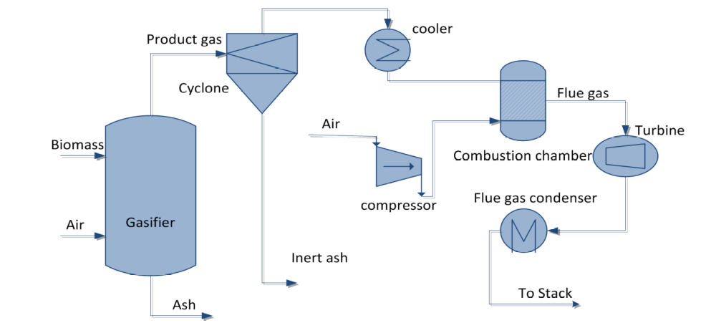
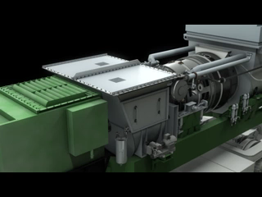
Gas Turbine
Introduction
1
2
3
Notes:
Gas turbine can be termed as an internal combustion engine which uses air as the working fluid. It was originally developed for propulsion purposes (aeronautical applications).
A typical gas turbine power plant mainly consist of air compressor (rotary type) coupled to a gas turbine, combustion chamber which is in between the compressor and turbine, power generator driven by turbine, and other auxiliaries (lubrication system, duct system, etc).
The working principle involves the intake of the working fluid (air) to the compressor where it is compressed and injected into the combustion chamber where fuel is added for combustion. The hot gases produced from combustion, expands through the turbine (mechanical energy is produce in form of shaft power) and the exhaust gas is discharged (Brandin et al., 2011, Spittle, 2003, Soares, 2011).

Slide 12
Gas Turbine
Introduction
Gas Turbine
Joule-Brayton cycle
1- Open cycle
2- Closed cycle
electrical efficiency is a function of size
1-Good electrical efficiency
2-Compact assembly
3-Ideal for cogeneration plant due to high temperature of exhaust gas
1
2
3
Notes:
Thermodynamically, the gas turbine operates on a cycle called the Joule-Brayton cycle.
There are two type of gas turbine power plant
a) Open cycle gas turbine power plant where exhaust gas is discharge to the atmosphere
b) Closed cycle gas turbine power plant where the mass flow of air is constant and the exhaust gas is circulated over again.
The electrical efficiency of a gas turbine is a function of size (output power capacity) i.e. the larger the size (500 kWel – 350 MWel) of gas turbine the higher the electrical efficiency and vice visa. The thermal efficiency of gas turbine power plant depends on compression ratio, efficiency of compressor, turbine inlet temperature and compressor inlet temperature. The configuration of gas turbine also plays an important part in the size. Gas turbines are usually in multistage (Axial) configurations but for sizes ranging for 500 kWel – 1 MWel with low mass flow adopts radial configuration. Compared to other small scale power plant technology, the advantages of gas turbines power plant are (Brandin et al., 2011);
• Good electrical efficiency
• Compact assembly
• Ideal for co generation plant due to high temperature of exhaust gas

Slide 13
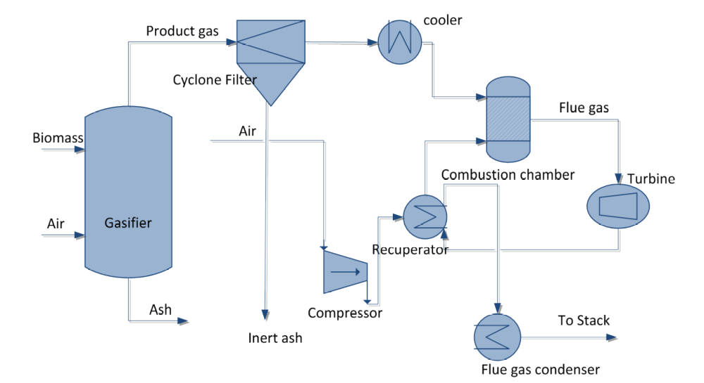
Micro gas Turbine
Introduction
1
2
3
Notes:
The micro gas turbine is a gas turbine as earlier mention but the power output and volume defines the name “micro”, it also can be called “nano”.
The working principle of micro gas turbines is the same as the conventional gas turbine i.e. the brayton cycle. In this operation, incoming air is compressed to 3-5 bars by a single stage centrifugal compressor which passes through the recuperator after compression (gain energy from exhaust gases) and thereafter preheated air enters the combustor where the fuel is combusted (temperature reaching 900 - 1000ºC). Hot flue gases expand through the turbine where mechanical work is produce and exhaust gases leaves the turbine. The exhaust gases (a high heat content) then passes through the recuperator where it further drops it temperature.

Slide 14
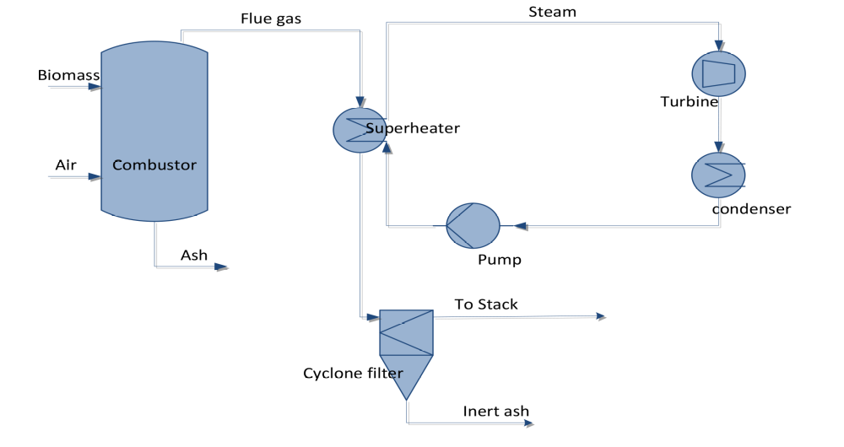
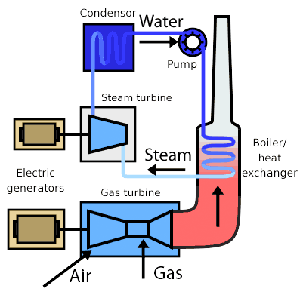
Steam Turbine
Introduction
1
2
3
Notes:
The most applied technology use in power generation is the steam turbine. This involves using steam as working fluid for production of electricity. Irrespective of other power production alternative technologies, steam power is seen to meet the energy demand for many years (Kirjavainen et al., 2004). This technology has been applied locally to treat waste (thermally) for energy extraction and utilization of renewable energy resource.
Working Cycle involves production of steam in a boiler, where combustion reaction of air and fuel (e.g. natural gas, biogas, biomass, etc) takes place. In the boiler, heat produced from hot flue gases are transferred through tubes to feed water which produces steam. The produced steam is directed to the steam engine where it expands and thereby producing mechanical energy transmitted by a rotating shaft to a generator for power generation. The rejected energy steam flows to the condenser where it is cooled and recycled by a feed pump to the boiler. Energy released from condenser can be use for district heating network. This working cycle is called steam rankine cycle. The cycle involves heating, expansion, condensation and pump.

Slide 15
2 Methodology
Notes:
I want to say how those technologies and hydrothermal technology can help us to generate power from Azolla

Slide 16
Biogas
Methodology
Hydrothermal Carbonization (HTC)
Hydrothermal liquefaction (HTL)
Aqueous phase reforming (APR)
Supercritical water Gasification (SCWG)
1
2
3
Notes:
One way of the thermochemical potential of biomass for energy and chemicals is hydrothermal processes. Hydrothermal processes primarily due to the final product, are classified.
Are the most famous hydrothermal process
We use SCWG in order to produce biogas from Azolla.

Slide 17
Supercritical Gasification
Methodology
Excellent transmission based on the high diffusion coefficient
Control mechanisms related to the dissolution properties
Creation of appropriate conditions for different reactions
Complete mixing with oxygen in any proportion
Negligible surface tension
Low viscosity
Supercritical fluid refers to a fluid which temperatures and pressures is above of the critical point.
1
2
3
Notes:
Supercritical fluid refers to a fluid which temperatures and pressures is above of the critical point.
In this conditions, water shows different properties than ordinary water. In geochemistry supercritical water, called as hydrothermal fluids, where supercritical water plays the role of solvent for hydrothermal reactions.

Slide 18
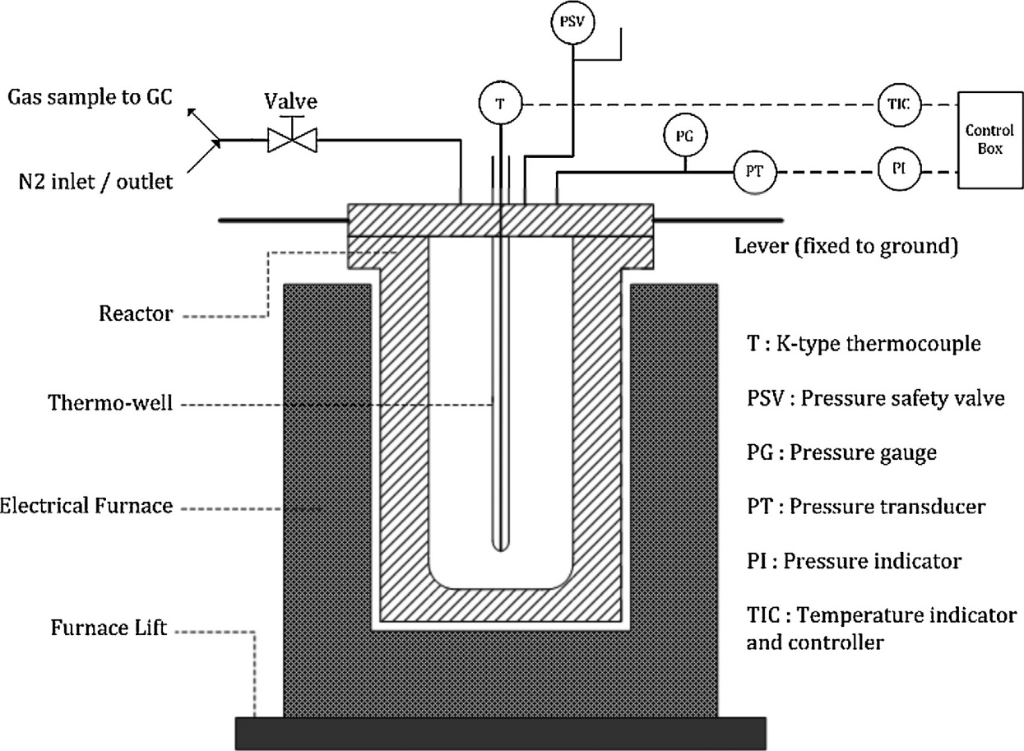
1
2
3
Notes:
So at this stage of we used batch supercritical water gasification reactor. Gasification reactor that used for this research, Subcritical water gasification were carried out in a stainless steel 316 L batch autoclave and the thickness was 15mm. The reactor assembly included a K-type thermocouple inserted in a thermo-well and the reaction temperature was maintained with a PID controller. Pressure was monitored directly by means of a pressure gauge and a pressure transducer fitted to the top of the reactor.
In a typical run, the reactor was loaded with prepared solution of dried Azolla and wastewater.
Spiral-wound gaskets were used to fully seal the autoclave flange. Then it was heated by an electrical furnace (1000W) to the desired reaction temperature. After a given reaction time, the furnace was removed and the reactor was exposed to ambient air to cool down to 200 ◦C by natural convection and subsequently to 30 ◦C by fan. Forced convection was not applied from the beginning of cooling period to prevent reducing the reactor life time. This procedure was kept identical for all runs. Gaseous product was collected in a gas bag for further analysis with GC method and Finally the reactor was opened for volumetric measurement of the remaining liquid phase.

Slide 19
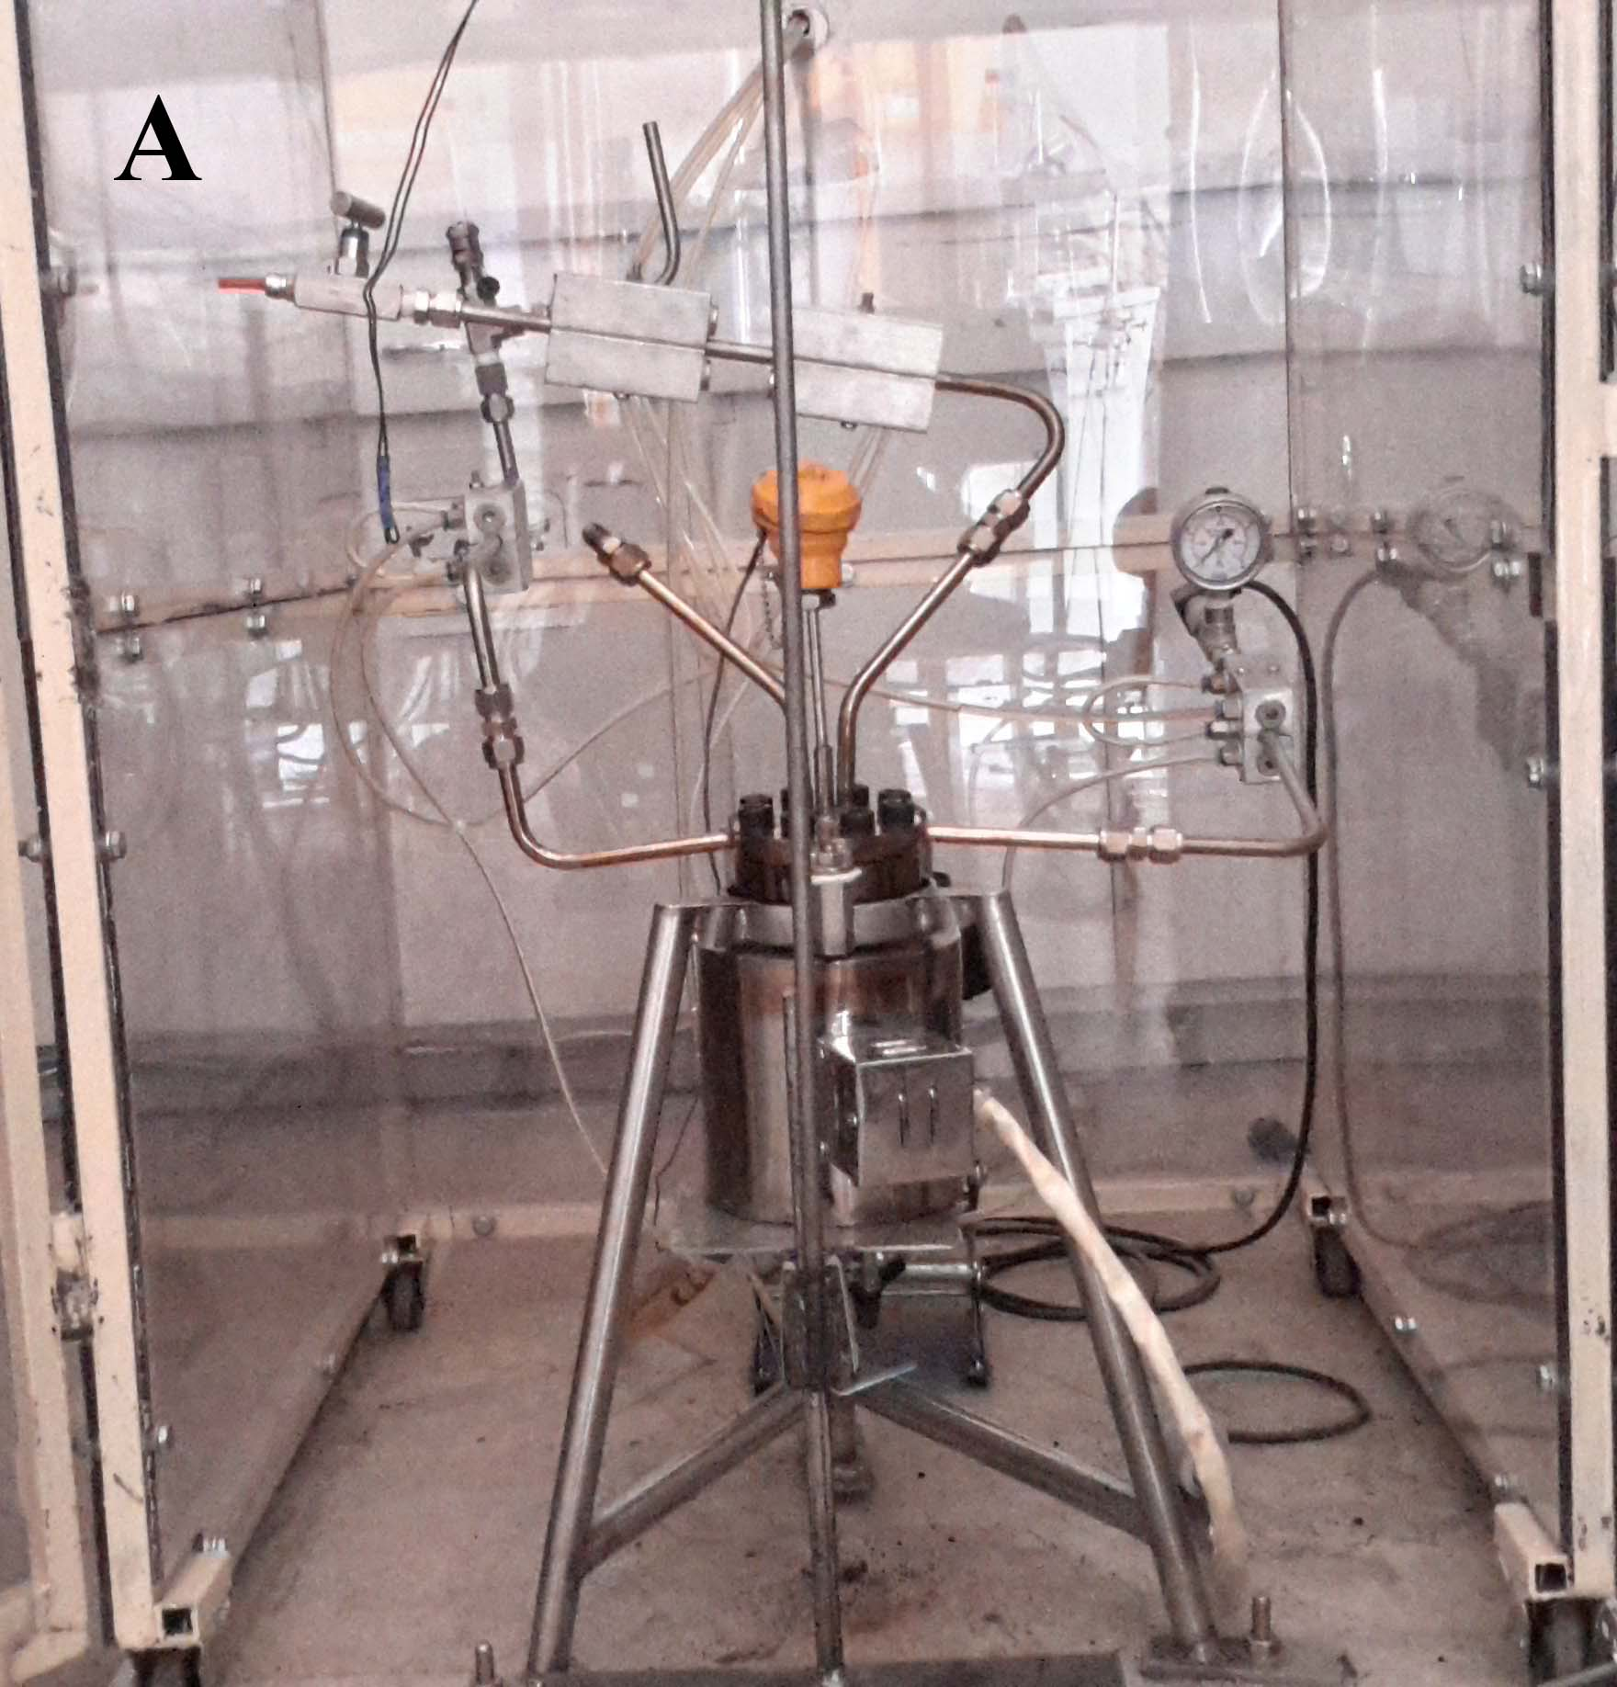
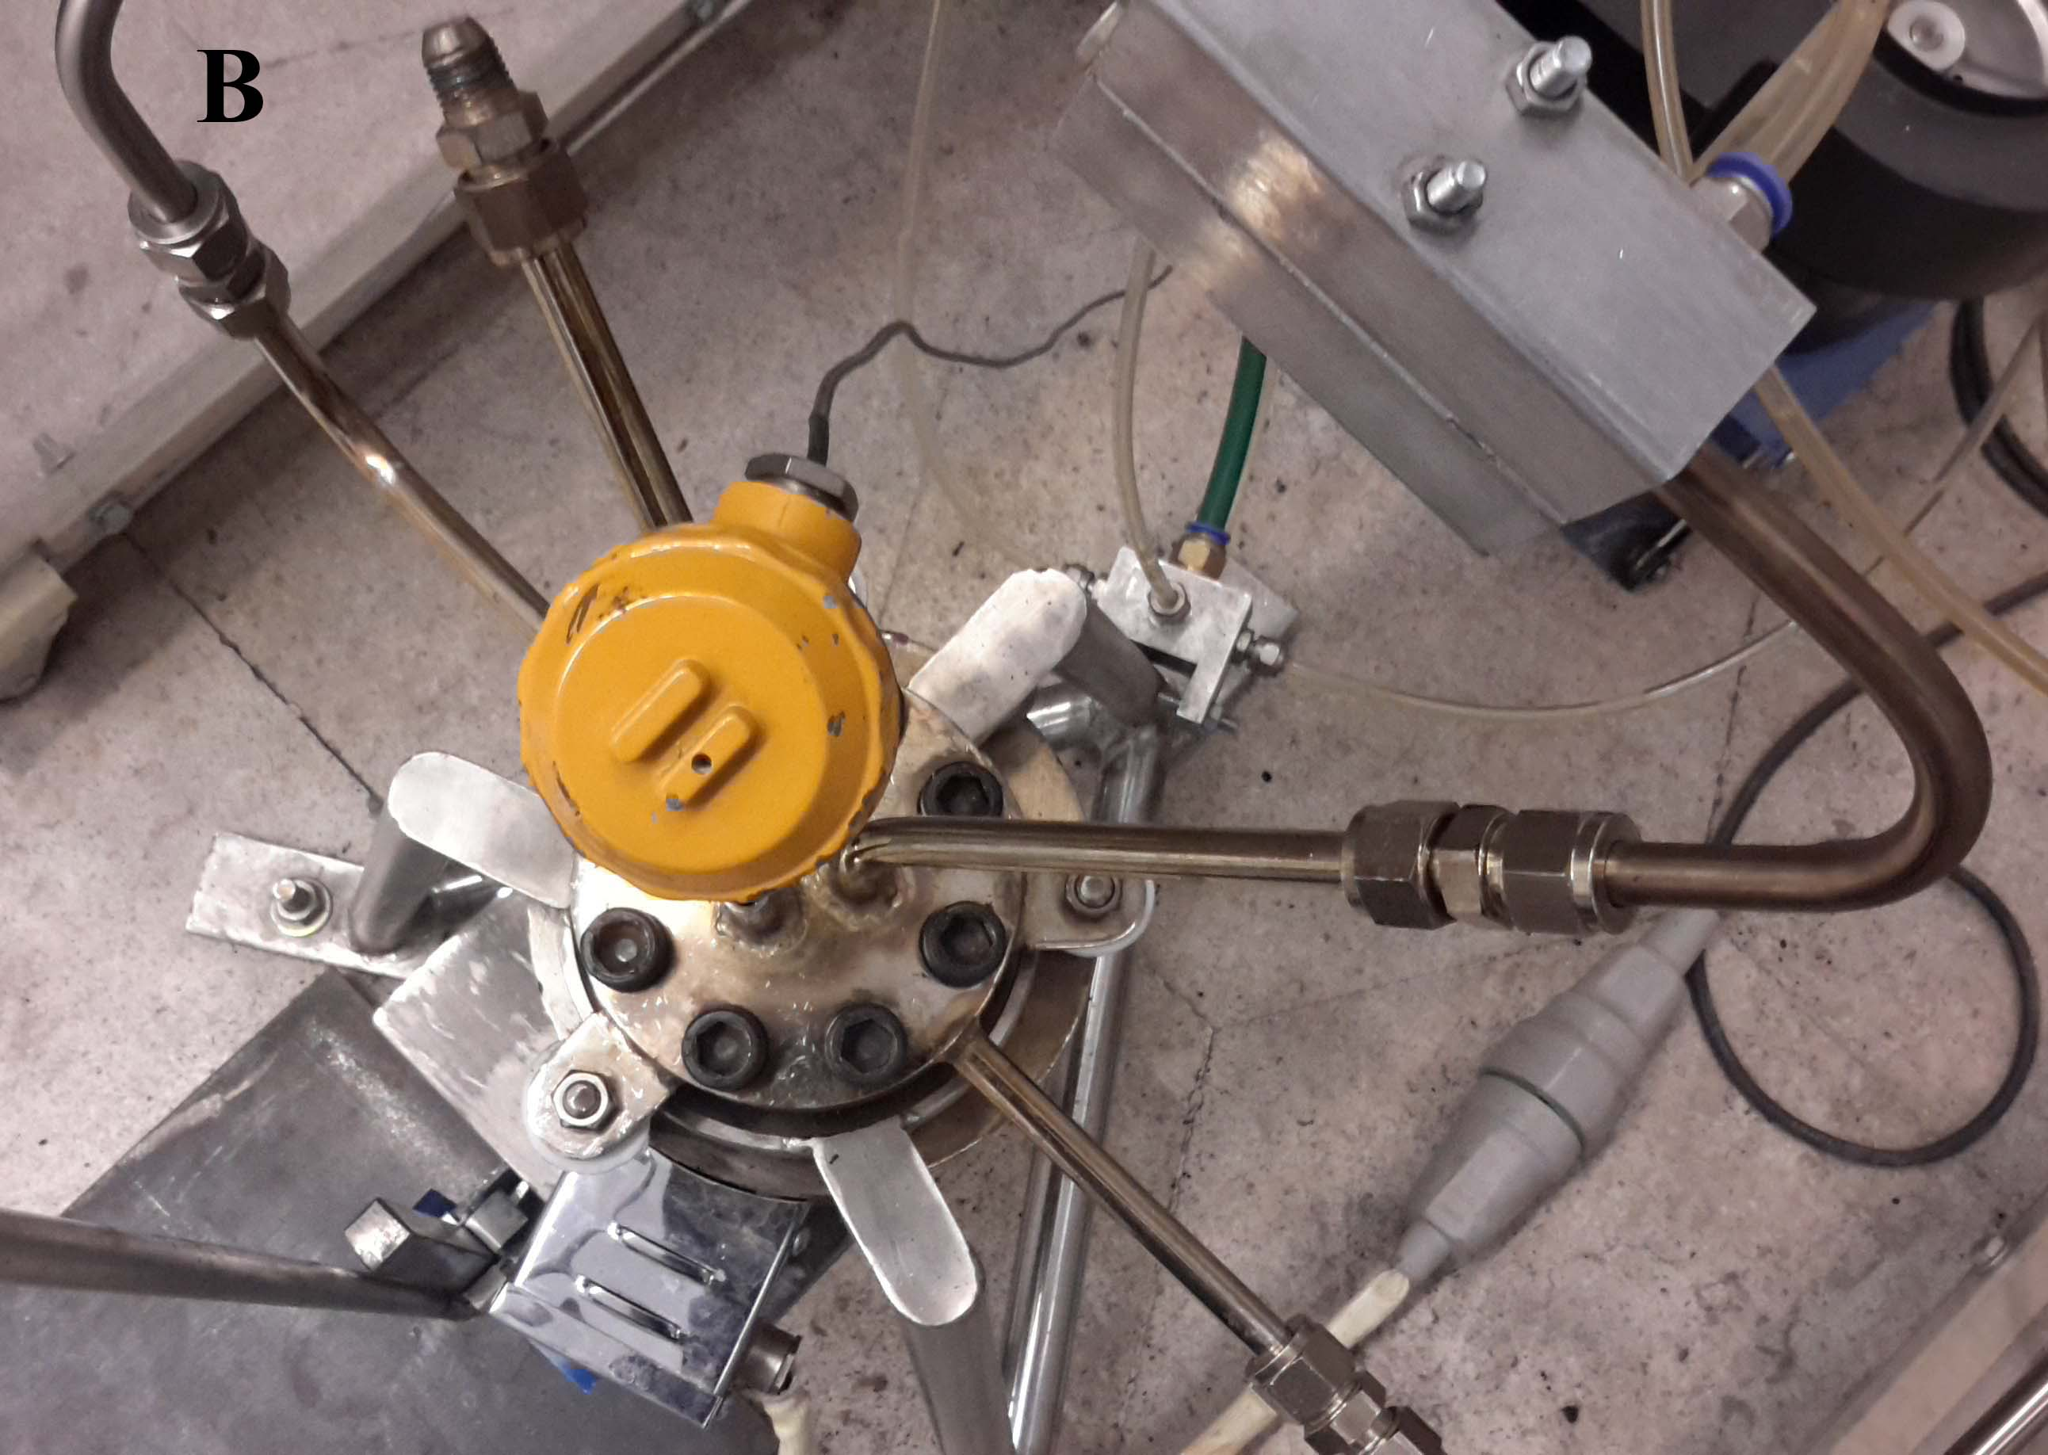
Supercritical Gasification
Methodology
1
2
3

Slide 20
Simulation
CHP
Methodology
Biomass Power Technologies | Reference plants (Operating Condition)
Micro Gas Turbine | Lora and Nogueira, 2000, Gimelli and Luongo, 2012
Internal Combustion Engine | Goldstein et al., 2003
Gas Turbine | Goldstein et al., 2003, Aichering et al., 2004
Steam Turbine | Obernberger and Thek, 2004
Aspen Plus V8.6
Peng – Robinson equation
and Boston – Mathias
1
2
3
Notes:
Since some of the process considered in this research work are yet to be commercialized and with little information availability from reference plants (operating conditions or parameters), the use of modelling tools makes it possible in estimating these conditions.
The Aspen Plus version use for this thesis is V8.4.
For the purpose of this work, the base method employed under the power method filter for thermodynamic model is the Peng – Robinson equation of state with Boston – Mathias modification to represent the physical properties of the components. This is because of its standard. The process modelling result were validated with a reference plants for each technology.

Slide 21
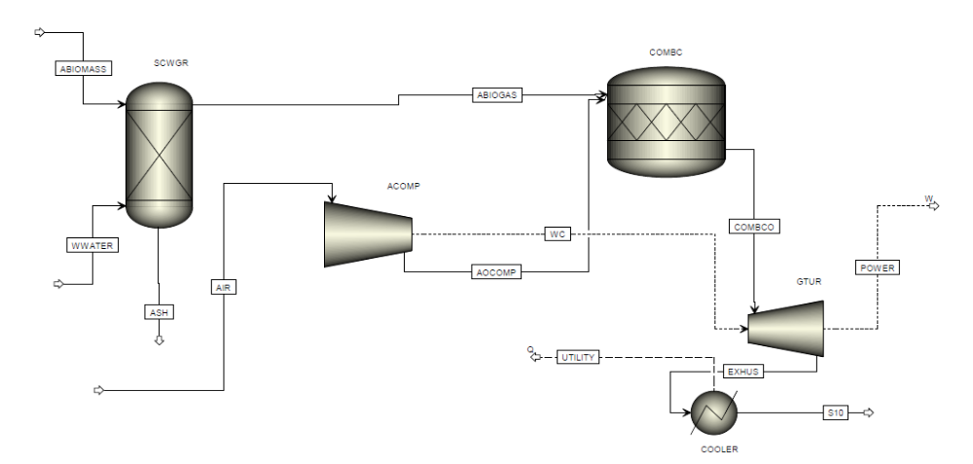
Simulation
Gas Turbine
Methodology
1
2
3
Notes:
The cooled gas is compressed and combust in the reactor (Rstoic) with the compressed air, before the produced gas from the reaction expand through the turbine.

Slide 22
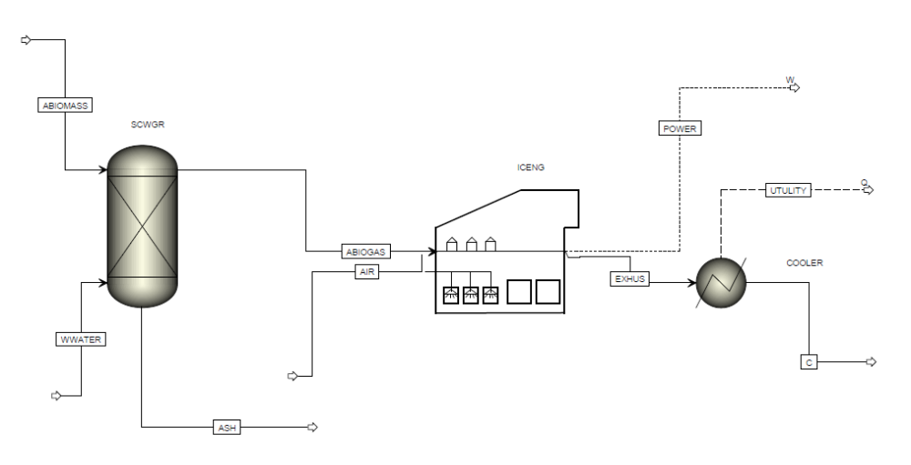
Simulation
IC Engine
Methodology
1
2
3
Notes:
The design of this process is a little similar to that of the gas turbine power process design flow sheet but just the introduction air and fuel gas are mixed before compression.

Slide 23
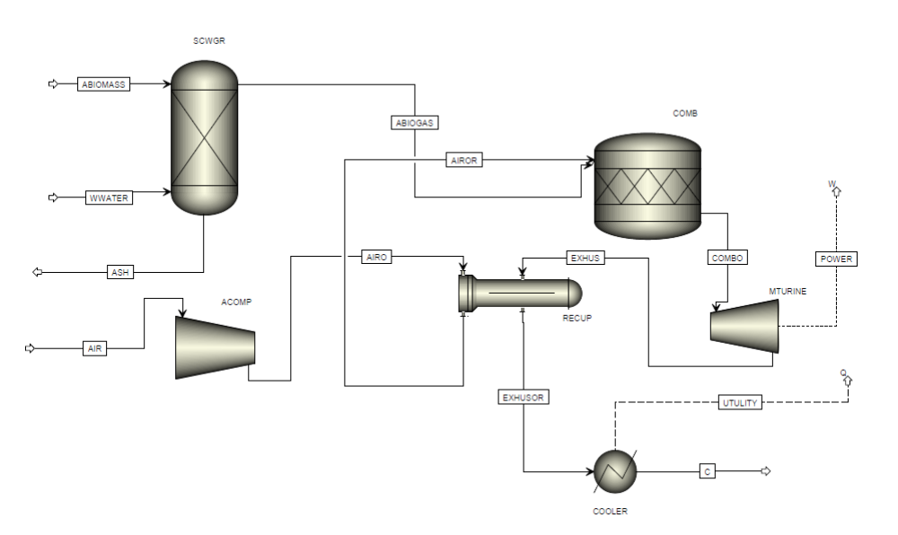
Simulation
Micro Gas Turbine
Methodology
1
2
3
Notes:
The process is the same with the gas turbine process but the only different is the recuperator which exchange heat between the exhaust gas from the turbine and the compressed air.

Slide 24
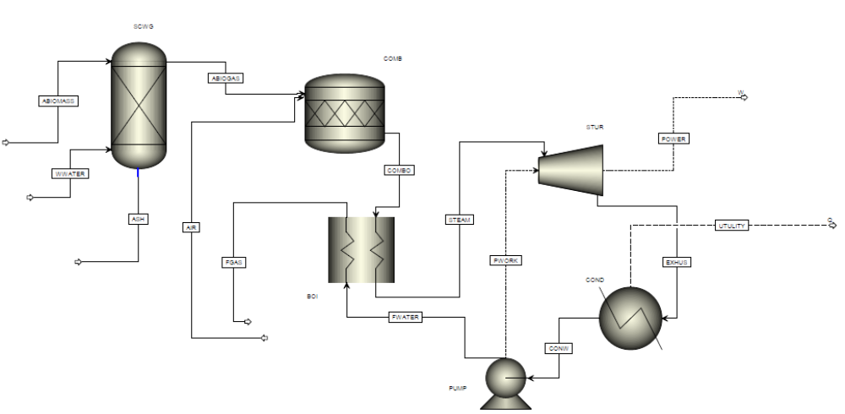
Simulation
Steam Turbine
Methodology
1
2
3
Notes:
This configuration is made up of biomass combustion unit and steam power cycle (steam turbine, condenser, pump and heater).

Slide 25

Process Evaluation
Methodology
Electric Efficiency :
$η_{el}= \frac{P_{gen}}{M_{f}×{LHV}_{fuel}}$
1
2
3
Notes:
This evaluation includes thermodynamic analysis. The thermodynamic part, aims at maximizing electricity generation using Azolla biomass information. Also, environmental analysis is done based on nitric oxide emission.
Electric Efficiency ηel – this is the ratio of net power output or generated to the thermal input of feedstock
Where – Net electricity generated, – mass flow of fuel and – lower heating value of fuel

Slide 26
3 Result and Discussion

Slide 27
Supercritical
Gasification
Result and Discussion
Test# | Temp. (℃) | Azolla (gr) | Main gas composition (mol %) |  |  |  |  |  |  |  |  | GP (mmol) | GPR | HS
 |  |  | CH₄ | C₂H₆ | C₂H₄ | C₃H₆ | C₃H₆* | n-C₄H₁₀ | CO₂ | CO | H₂
1 | 300 | 10 | 6.7 | 1.5 | 0.53 | 0.54 | 0.5 | 0.13 | 69.4 | 7.4 | 13.3 | 10.59 | 1.05 | 15.34
2 | 350 | 10 | 7.65 | 1.65 | 0.78 | 0.7 | 0.72 | 0.2 | 62.9 | 7 | 18.4 | 13.68 | 1.36 | 22.54
3 | 400 | 10 | 9.3 | 2 | 1 | 0.8 | 0.9 | 0.2 | 50.9 | 5 | 29.9 | 17.14 | 1.71 | 42.65
1
2
3
Notes:
In this study, subcritical water gasification is studied in a batch reactor with residence times 15 min and temperatures and pressures ranging from 300 to 400 ℃ and from 83 to 150 bar, respectively. Moreover, biomass loading in reaction mixture was explored with 10 gr solutions. The summary of experimental conditions and results of this work is presented in Table 9.

Slide 28
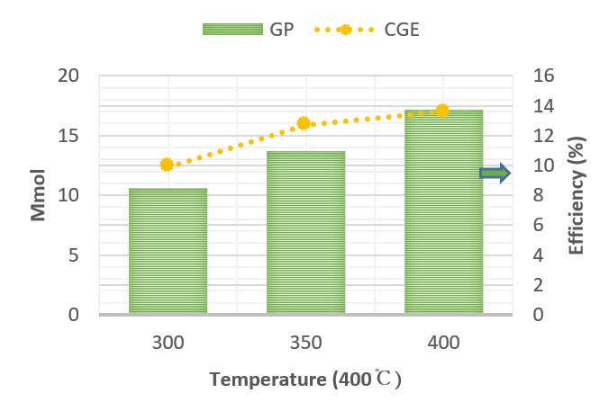
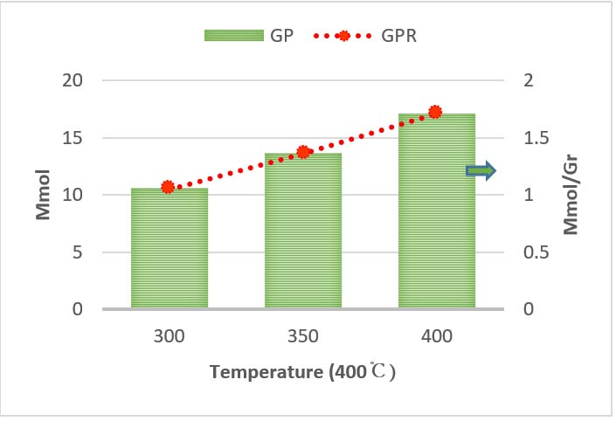
Supercritical
Gasification
Result and Discussion
1
2
3
Notes:
Series of experiments were carried out to determine the effect of temperature on the gaseous product obtained from subcritical water gasification. The gaseous product mainly contained H₂, CO₂, CH₄, CO and C₂H₆ with less amounts of n-Butane, Propane, and Propylene. Gas product and CGE obtained at various temperatures are depicted in Figure. The significance of temperature on gasification is evident. As it can be seen, gas product ratio has a general tendency to increase by temperature increment at a given reaction time. Moreover, gas formation was facilitated at higher temperature, as the gas product enhanced from 1.78 to 17.14 mmol, by temperature increment from 300 to 400 ℃.
This behavior was widely noted by previous reports and could be attributed to several facts. First, higher temperature is generally favorable to higher reaction rate and also free-radical reactions, as the dominating pathway for gas production near critical point of water [38]. Moreover, water undergoes considerable changes in properties near and above its critical point, making it a unique reaction media as well as both reactant and solvent for gases and organic matters. H3O+ and OH− ions are formed due to the self-dissociation of water, behaving as catalytic precursors for acidic or basic reactions and reacting with smaller intermediate products [19, 39]. Higher temperature is also in favor of progressing the reforming of biomass as an endothermic reaction (Eq. (1)). Increasing heat capacity, diffusivity and transport properties of water as the results of temperature increment could be other reasons for delectability of hydrothermal water as reaction media.

Slide 29
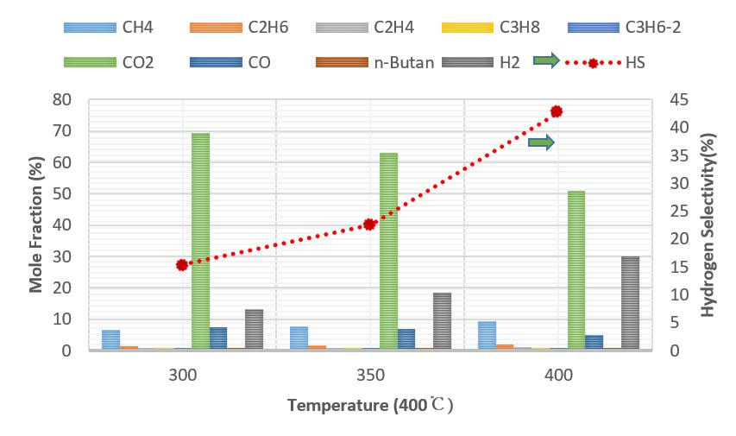
Supercritical
Gasification
Result and Discussion
1
2
3
Notes:
Fig. shows the composition of gaseous product and hydrogen selectivity over temperature, carried out with 10 gr Azolla. Increasing the temperature from 300 to 400 ℃ had considerable enhancement of H2 mole fraction from 13.3 to 29.9%.
This trend was accompanied by continuous reduction of CO2 and slight increase in CO mole fraction. Carbon monoxide can be consumed through both WGS and methanation reactions. There is a suggestion that extremely low CO fraction could be attributed to significant enhancement of WGS reaction
Moreover, considering the increase in CH4 content implies that methanation reactions had also contribution in CO consumption. also methanation reaction becomes dominant beyond the critical point.
Fig. also shows that temperature increase from 350 to 400 ℃ resulted in sharp rise of hydrogen selectivity by more than five folds. During thermal decomposition, large molecules of wastewater are dissolved and hydrolyzed into smaller intermediates and gasified into final products, mainly due to the cleavage of C-O bonds and reacting with OH− and H+ ions. This mechanism favors the formation of H2 through reforming and WGS reactions which are accelerated at higher temperatures. These findings are in good accordance with previous reports [2,19,42].

Slide 30
Power
Generate
Result and Discussion
 | Azolla biomass (kg) | Azolla biogas (cum/hr)
Case 1 | 0.01 | 0.00013584
Case 2 | 5 | 0.07
Case 3 | 7500 | 100
Case 4 | 10000 | 135.9
1
2
3
Notes:
In this section, results from the investigation of electric performance along with some modification of power process considered in this work were presented and discussed
Azolla biogas were used as feed streams (case 1 = 1.3584*10⁻⁴ cum/hr. (10gr), case 2 = 0.07 cum/hr. (5kg), case 3 = 100 cum/hr. (7.5 ton), case 4 = 135.84 cum/hr. (10 ton)) to each power process simulation.

Slide 31
Power
Generate
Result and Discussion
1
2
3

Slide 32
Power
Generate
Result and Discussion
Units | Case 1 | Case 2 | Case 3 | Case 4
Gas Turbine | 34.2 | 30.1 | 62.1 | 62.3
Micro gas Turbine | 33.7 | 29.7 | 61.2 | 61.4
IC Engine | 33 | 32.3 | 52.6 | 53.3
Steam Turbine | 26.4 | 23.2 | 47.77 | 48.1
1
2
3

Slide 33
Power
Generate
Result and Discussion
NO produced (kg/kWh) | Biomass Power Systems
0.0053 | Gas Turbine
0.0077 | Micro Turbine
0.016 | ICE
0.0037 | Steam Engine
1
2
3

Slide 34
Result and Discussion
Conclusion
Considerable Biogas production from SCWG
Electric performance of more than 30%
Produce 1 to 2.2 MWh from Azolla biomass
Gas turbine > micro gas turbine > steam turbine > IC Engine
1
2
3
Notes:
From this study, which aims at estimating biogas production, electric potential of Azolla biomass environmental evaluation via different biomass power technologies simulations, the following can be concluded, that:
درنتیجه گازی سازی آب فوق بحرانی، مقدار قابل توجه و کافی از بیوگاز برای استفاده در سیستم تولید همزمان گرما و برق، حتی در مقیاس کوچک، تهیه می‌کند
تولید هیدروژن بصورت قابل توجهی در اثر افزایش و رسیدن دما به نقطه بحرانی، افزایش می‌یابد
• gasification o biomass This not only helps to reduce utility and operational cost compared when pure oxygen or steam is used but holds a large possibility for rural electrification via gas biomass power plant.
• From the different biomass power technologies i.e. gas turbine, micro gas turbine, internal combustion engine, and the steam turbine, the Power generation based engines from biomass gave a better electric performance of more than 30%. But this would have not been possible without the integration of biomass gasification technology in production of fuel gas.
In generally, Gas turbine, micro gas turbine, steam turbine and IC Eninge show high performance in generate net electricity respectively in large amount of biomass.

Slide 35
نتیجه گیری
Result and Discussion
Conclusion
Internal Combustion has high NOx emission
While Gas Turbine has moderate emission rate
Produce 1 to 2.2 MWh from Azolla biomass
Azolla(all biomass) Power plant possible path to world’s economic, social and environmental sustainability
1
2
3
Notes:
• Despite the good electric performance of internal combustion engine, there are threats over its environmental compatibility. From the study, result shows that the technology emits more of NO compared to other technologies. This mean that additional cost is in cured in treatment of flue gas and generally increases the operational and maintenance cost in the application of this technology.
Power generation via the utilization of biomass prove to be a possible path to world’s economic, social and environmental sustainability but the extent to which this can achieved is strongly dependent institutional framework, investment, incentives and information policies.

Slide 36
Thank you for your attention and interest

