Slide 1


Creating the best clinical and economic evidence to assist decision-making in urological cancers
Alice Dragomir, MSc, PhD
Assistant Professor,
Urology/Surgery, McGill University
Scientist – Health Economics and Outcomes Research
Research Institute of the McGill University Health Center
Associate Professor,
Faculté de pharmacie, Université de Montréal
Chercheur boursier FRQS – Junior 1
Notes:
Please comment on your research project and its relevance to prostate cancer.
Identify potential implications for health care and policy making and any ethical considerations associated with the research.
What prompted your interest in your particular area of research?
What are your short and long-term goals, and your commitment to prostate cancer research career particularly in Canada?

Slide 2
MISSION
Improve health care delivered to patients with urological cancer, while optimizing health services and cost allocation

Slide 3
CLINICAL and ECONOMIC BURDEN
34% of all cancers in men; 4.5% in women.
 | Bladder | Kidney | Prostate
Incidence | 8300 | 6200 | 24 000
Early phase (cost/patient) 12 months | $21,000 | $22,000 | $12,000
metastatic phase (drugs cost/patient) | $36,500 (12 months) | $68,274 to $101,330 (20 to 32 months) | $ 48,428 to $100,000 (27 to 37 months)
Life-time cost | $31B (US) | $357M | $1B
de Oliveira C, et al. Understanding the costs of cancer care before and after diagnosis for the 21 most common cancers in Ontario: a population-based descriptive study. CMAJ Open. 2013
Jan 16;1(1)
Abugaber A.Cost of illness of renal cell carcinoma. ASCO 2007. Abstract
Significant clinical & economic burden
Notes:
Prostate cancer (PCa) is the most common cancer; Incidence of 122 per 100,000 persons-years (twice the lung and colorectal cancer incidence rate) - 25,000 new cases;
3rd leading cause of cancer mortality in Canadian men (4,000 PCa related deaths per year);
The five-year survival rate is estimated at 96%;
The lifetime direct medical costs of the 1998 Canadian cohort of newly diagnosed - $9.8 billion (Grover, 2000);
In 1998, the hospitalization and drug costs - $100 million (Health Canada);
Since then several clinical advances, new technologies and new medications, have increased the economic burden of Pca.

Slide 4
NEW TECHNOLOGIES
Current situation:
New diagnostic tests (Prolaris – after + biopsy, confirmMDx – after - biopsy)
New techniques of biopsy (MRI-guided biopsy)
New medications for advanced cancer (abiraterone, enzalutamide, radium 223, pazopanib, axitinib);
New technologies for initial treatment (robotic surgery, IMRT)
Future situation (short/long term):
Other new discoveries : tests/techniques/medications/markers
New technologies require advanced evaluation & optimization

Slide 5
IMPACT TO PATIENTS
Are all these new advances in cancer care available to patients or integrated in clinical practice?
Yes / No / Yes with restrictions
Limited routinely usage in clinical practice in Canada
  High cost
  Uncertainty related to effectiveness and/or toxicity
  Regional/ provincial differences
  Limits of clinical trials
  Lack of cost-effectiveness evidence
  Budget and/or health services resources constraints
  Comparative data for new medications
New recommendations against PSA screening → Increased confusion surrounding screening for prostate cancer
Limited access to new technologies
Notes:
What prompted your interest in your particular area of research?

Slide 6
ROLE / IMPACT OF HEALTH ECONOMICS/ OUTCOMES RESEARCH
Improving access to new technologies
Create evidence for cost-effectiveness interventions
Evaluate healthcare services utilisation and economic impact
Help achieve individualised medicine
Patient empowerment
Improved clinical decisions
Healthcare system optimization
Influence health policy decisions
Best evidence for decisions on urological cancer
Notes:
(identifying group of patients beneficiating from particular tx/technologies);
Influence health policy

Slide 7
HEALTH ECONOMICS/ OUTCOMES RESEARCH
Simulation studies – models developed using data from the literature/ observations studies/experts opinion, etc…;
Observational studies – administrative databases (RAMQ) / data collected from patients files (MUHC database);
Combination of observational studies / simulation studies
Notes:
Data on health outcomes and costs

Slide 8


COST-EFFECTIVENESS OF MRI TARGETED BIOPSY
OF THE PROSTATE IN A CANADIAN SETTING
Alice Dragomir, Yannick Cerantola, Simon Tanguay, Armen Aprikian,
Franck Bladou, Wassim Kassouf
McGill University, Montreal, Canada

Slide 9
Standard diagnostic procedure for PCa
Clinical suspicion
PSA
DRE
Bx
12-core
TRUSGB
Dx
Overdiagnosis of insignificant PCa
Sampling errors
Background

Slide 10
Alternative diagnostic procedure
Clinical suspicion
PSA
DRE
Bx
1-4 core MRTB
Dx
Significant PCa
Better risk stratification
Background
MRI
Significant PCa

Slide 11
Background
Pros: Proven benefits of MRI and MRTB
  Detection of mostly significant PCa; reduce the detection of insignificant PCa
    Reduces the risk of overdiagnosis and overtreatment of insignificant PCa
  Accurate grading→ Better risk-stratification and treatment allocation at the time of diagnosis
  Use of fewer (1-4) cores→ potential reduction of infections?
Cons:
  MRTB alone misses 2-6% of significant Pca
  Costs
Moore, Eur Urol, 2013
Pokorny, Eur Urol, 2014

Slide 12
Objective
Cost-effectiveness/cost-utility analysis
To determine the health-economic impact of incorporating MRTB in the process of diagnosing PCa
Moore, Eur Urol, 2013
Pokorny, Eur Urol, 2014

Slide 13
Methods
Cost-effectiveness of standard TRUSGB vs alternative MRTB
Markov model with Monte Carlo microsimulations for 5-, 10-, 15- and 20- year horizon
Model based on evidence + assumptions
Direct costs (Canadian setting):
medical costs (physician fees, equipment and processing) ;
hospital costs (procedure and admission fees and cost of tests and procedures done during surveillance);
medications costs during CRPC.
Effectiveness measure (outcome) : the quality adjusted life-years gained, i.e. overall survival weighted with the specific health state utilities.

Slide 14
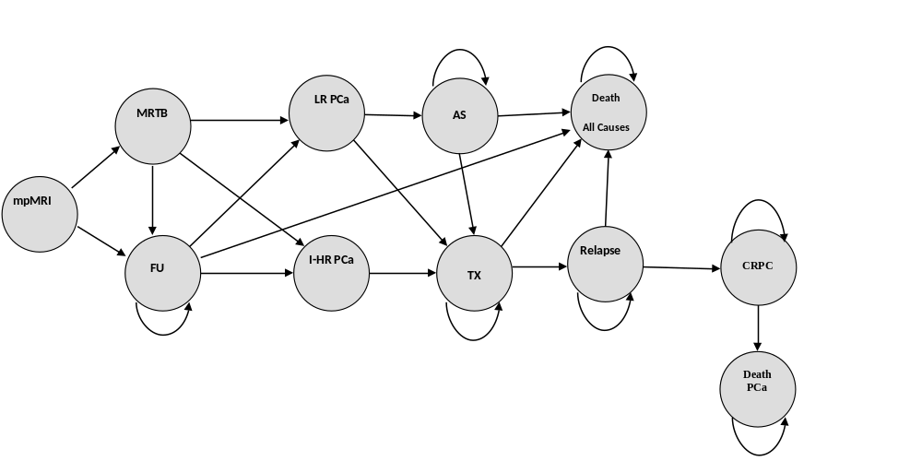
Methods
MRTB strategy

Slide 15
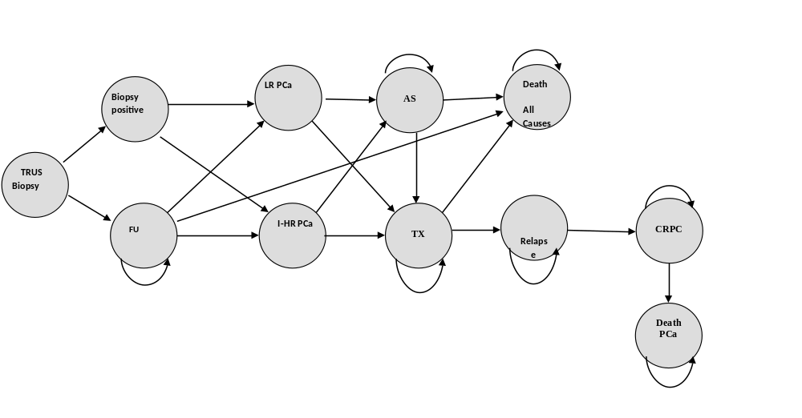
Methods
Standard TRUSGB strategy

Slide 16
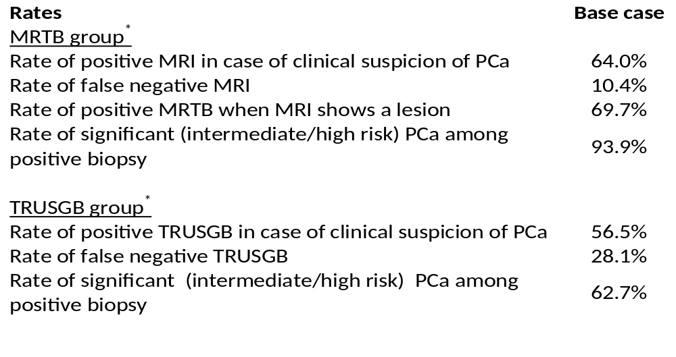
Methods
Model assumptions

Slide 17
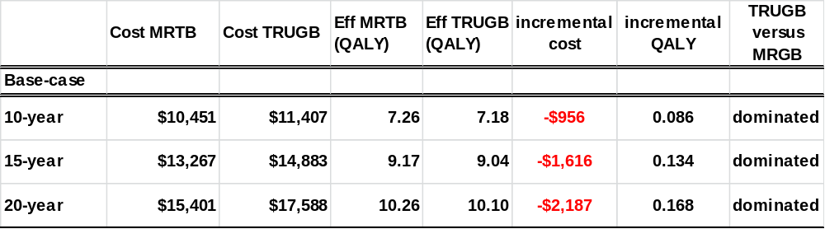
Results

Slide 18
Results
Conservative model since some anticipated benefits of MRTB were not taken into account
  Decreased overtreatment of insignificant PCa
  Better risk stratification:
    More patients allocated to the optimal treatment→ less salvage/adjuvant treatments?
  Decreased number of cores→ decreased costs and complications
  Cost of CRPC based on systematic treatment offered to patients before 2014 (abiraterone after docetaxel based chemotherapy)

Slide 19
Conclusions
Incorporating MRTB in PCa diagnosis and treatment is cost-effective at 5-, 10-, 15- and 20-year horizon (dominate strategy)
Given radiologist/urologist experienced
MRTB might become standard

Slide 20
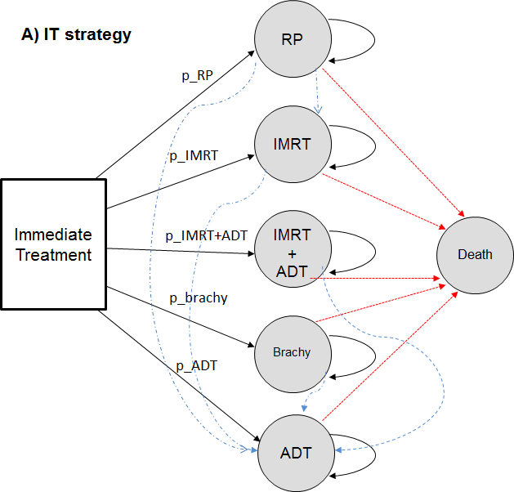
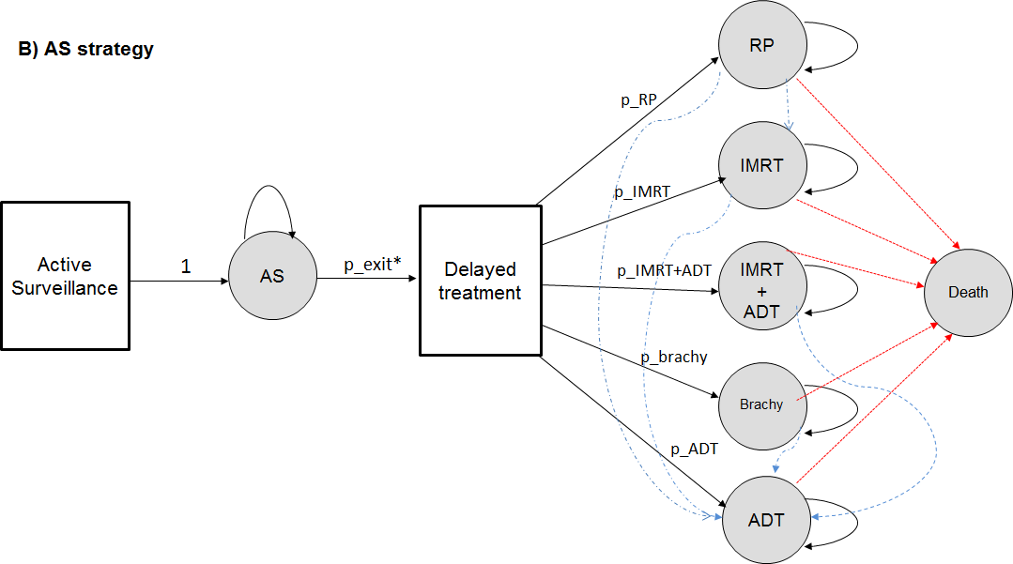
ACTIVE SURVEILLANCE VS IMMEDIATE TX
Markov model with Monte-Carlo microsimulations
Model’s assumptions: Canadian active surveillance cohort (Klotz et al., J Clin Oncol., 2010)

Slide 21
ACTIVE SURVEILLANCE VS IMMEDIATE TX
Simulated PCa management and death:
6-year period:
    2,767 (21%) have received delayed treatment,
    374 (2.9%) have received delayed treatment and died;
    2,306 (18.1%) died on AS;
    7,303 (57.3%) still on AS.
11-year period:
    2,833 (22.2%) have received delayed treatment;
    924 (7.2%) have received delayed treatment and died;
    3,527 (27.7%) died on AS;
    5,366 (42.9 %) still on AS.

Slide 22
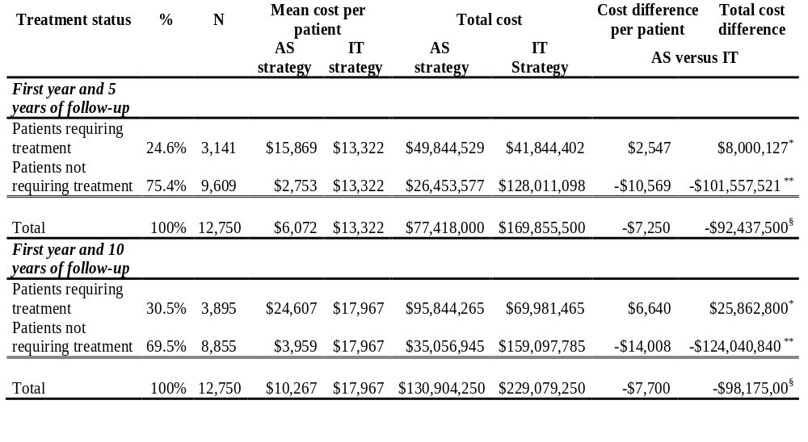
ACTIVE SURVEILLANCE VS IMMEDIATE TX
Total cost and possible cost savings corresponding to an annual cohort of 12,750 patients with prostate cancer (CMAJ Open, 2014):
* Additional cost attributable to delayed treatment; ** Cost savings attributable to AS strategy;
§ Total cost savings obtained with the AS strategy.

Slide 23
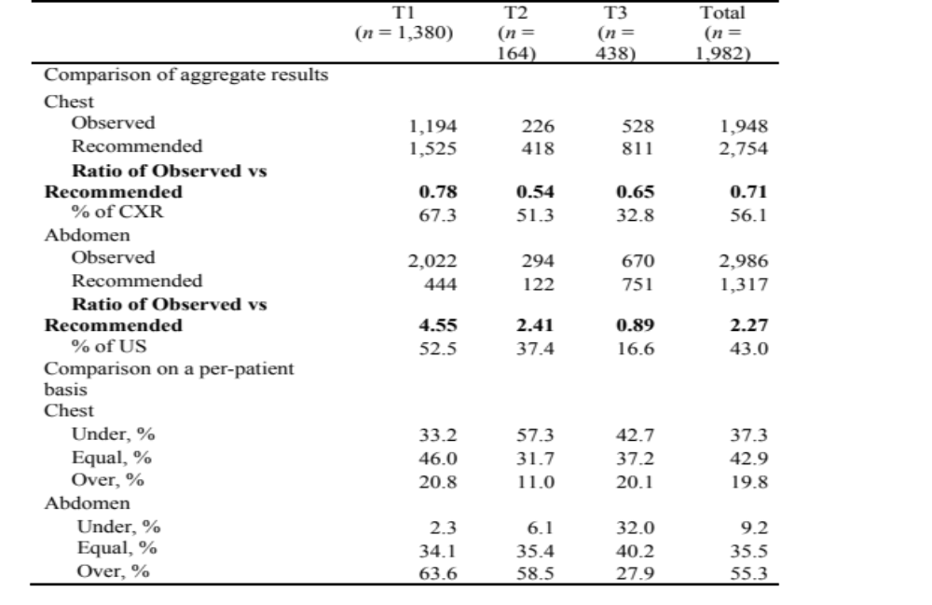
OUR WORK on KIDNEY CANCER
Follow-up imaging after nephrectomy in Canada: urologists’ compliance
with guidelines and cost of surveillance
Notes:
Transrectal ultrasound-guided biopsy (TRUSGB)

Slide 24
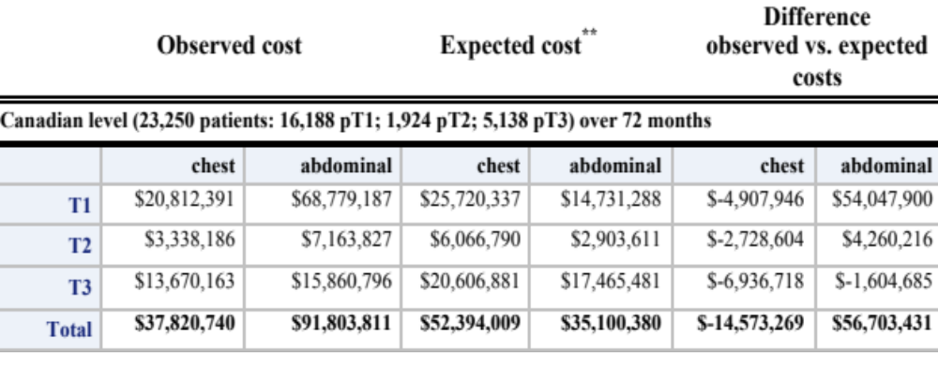
OUR WORK on KIDNEY CANCER
Follow-up imaging after nephrectomy in Canada: urologists’ compliance
with guidelines and cost of surveillance
Notes:
Transrectal ultrasound-guided biopsy (TRUSGB)

Slide 25
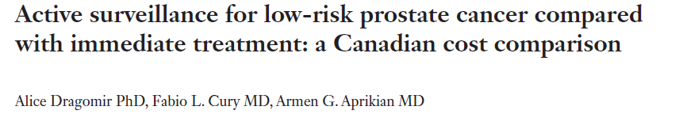




IMPACT OF OUR RESEARCH
TV interview for Radio-Canada/RDI presented on April 26th 2014 on the evening news
Live radio interview on Radio-Canada’s 15-18 program on April 28th 2014
Interviews for The Gazette and Perspective Infirmière
Other specialised websites : Medscape, American Sentinel, World News, American Journal of Managed Care
Notes:
Other specialised websites have also commented on and referred to our study, example:

Slide 26



OUR WORK on PROSTATE CANCER
100 M
Active surveillance vs Immediate treatment
$1,000 - $2,000
MRI guided biopsy dominates TRUBG
$40,000 - $100,000
Drug costs of mCRPC
Lifetime direct medical costs of the 2015 Canadian cohort
$1B
$114,000/LY
CE of abiraterone for mCRPC
Significant clinical & economic burden of PCa
Notes:
Transrectal ultrasound-guided biopsy (TRUSGB)

Slide 27





THANK YOU
Dr. Armen Aprikian
Dr. Fabio Cury
Dr. Marie Vanhuyse
Dr. Wassim Kassouf
Dr. Simon Tanguay
Mrs. Noémie Prévost
Mr. Jason Hu
Dr. Joice Rocha
Mrs. Halima Lahcene
Mrs. Sara Nazha
Dr. Yannick Cerentola
Côté Sharp Family Foundation
Notes:
Canadian Center for applied Research in Cancer Control

