Slide 1
Therapeutic modality employing bee venom acupuncture for controlling of chronic low back pain
Aliaa El Gendy, PhD
Researcher at the National research Center
Cairo - Egypt

Slide 2
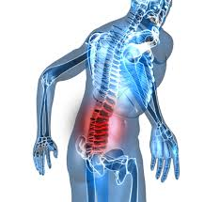
Low back pain or lumbago (/lʌmˈbeɪɡoʊ/) is a common disorder involving the muscles and bones of the back. It affects about 40% of people at some point in their lives. Low back pain (often abbreviated as LBP) may be classified by duration as acute (pain lasting less than 6 weeks), sub-chronic (6 to 12 weeks), or chronic (more than 12 weeks).

Slide 3
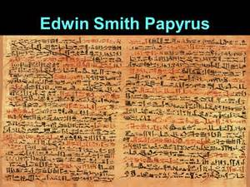
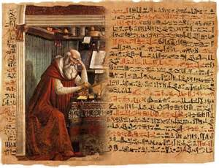
History
Low back pain has been with humans since at least the Bronze Age. Edwin Smith Papyrus, dating to about 1500 BCE – describes a diagnostic test and treatment for a vertebral sprain.

Slide 4
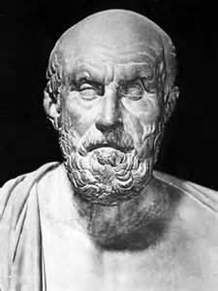
History
Hippocrates (c. 460 BCE – c. 370 BCE) was the first to use a term for sciatic pain and low back pain . Physicians through the end of the first millennium did not attempt back surgery and recommended watchful waiting.

Slide 5
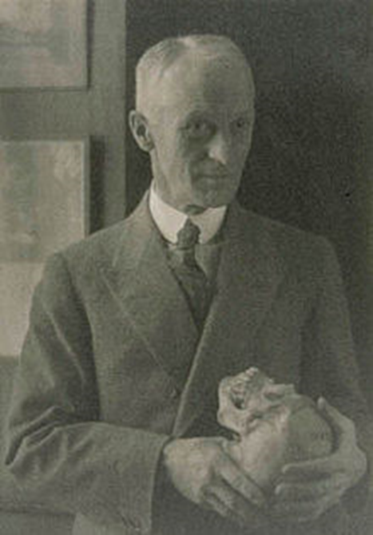
Harvey Williams Cushing
In the early 20th century, American neurosurgeon Harvey Williams Cushing increased the acceptance of surgical treatments for low back pain.

Slide 6
Incidence Rate

Slide 7
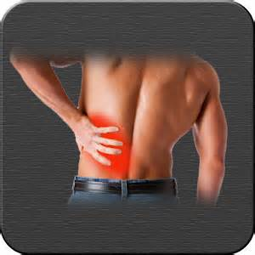
It is not clear whether men or women have higher rates of low back pain. A 2012 review reported a rate of 9.6% among males and 8.7% among females.

Slide 8
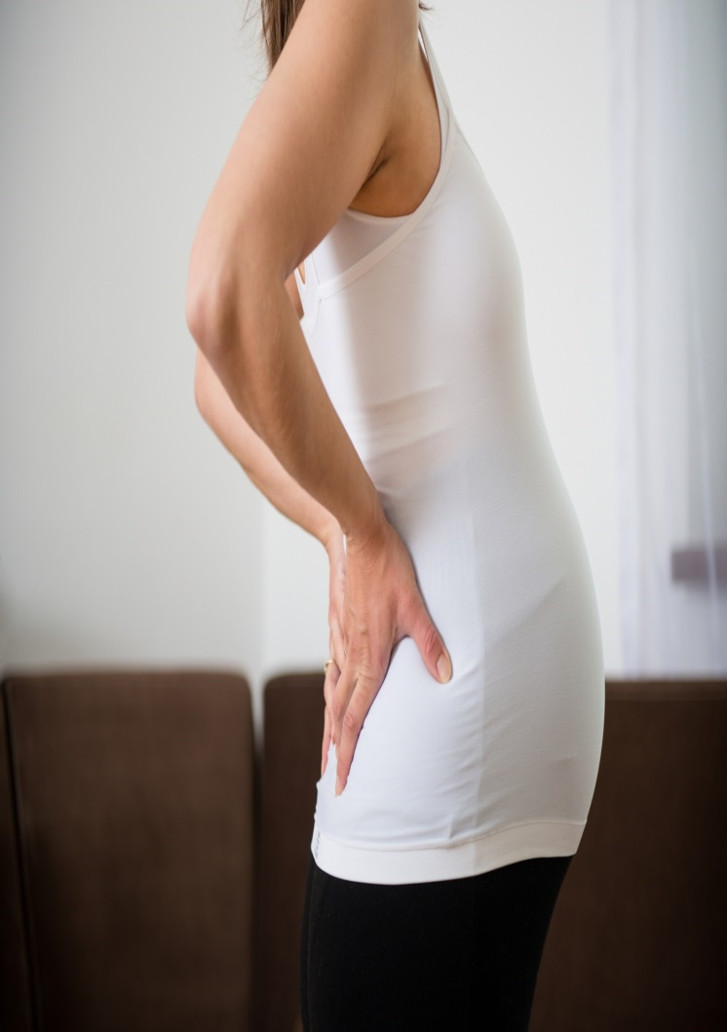
However, another 2012 review found a higher rate in females which the reviewers felt was possibly due to osteoporosis, menstruation, and pregnancy among women, or possibly because women were more willing to report pain than men.

Slide 9
What is the magnitude of the problem?

Slide 10
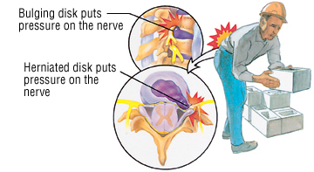

Low back pain results in large economic costs. In the United States, it is the most common type of pain in adults, responsible for a large number of missed work days. It was estimated to be responsible for $90 billion in annual health care costs .

Slide 11
Causes of LBP

Slide 12
Causes of LBP
Musculoskeletal - mechanical (including muscle strain, muscle spasm, or osteoarthritis); herniated nucleus pulposus, herniated disk; spinal stenosis; or compression fracture
Inflammatory - HLA-B27 associated arthritis including ankylosing spondylitis, reactive arthritis, psoriatic arthritis, and inflammatory bowel disease
Malignancy - bone metastasis from lung, breast, prostate, thyroid, among others
Infectious - osteomyelitis; abscess

Slide 13
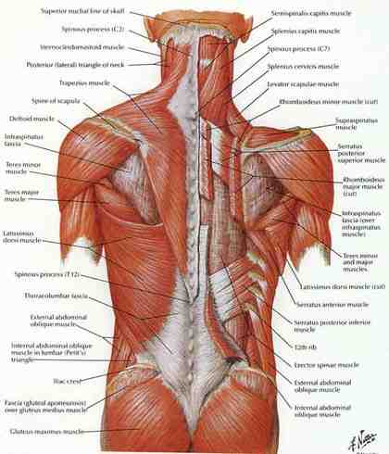
Sprains and strains account for most acute back pain. Sprains are caused by overstretching or tearing ligaments, and strains are tears in tendon or muscle.

Slide 14
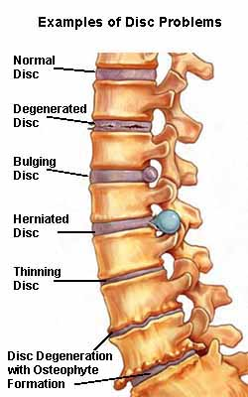
Intervertebral disc degeneration is one of the most common mechanical causes of low back pain, and it occurs when the usually rubbery discs lose integrity as a normal process of aging.

Slide 15
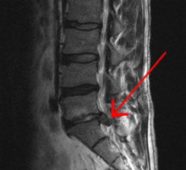
Herniated Discs
Herniated or ruptured discs can occur when the intervertebral discs become compressed and bulge outward (herniation) or rupture .

Slide 16
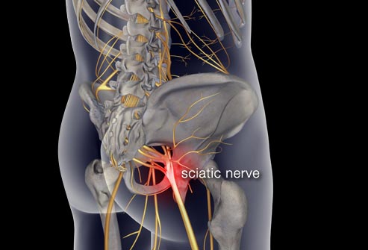
Sciatica is a form of radiculopathy caused by compression of the sciatic nerve .

Slide 17
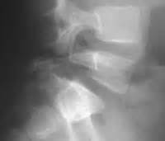
Spondylolisthesis is a condition in which a vertebra of the lower spine slips out of place, pinching the nerves exiting the spinal column.

Slide 18
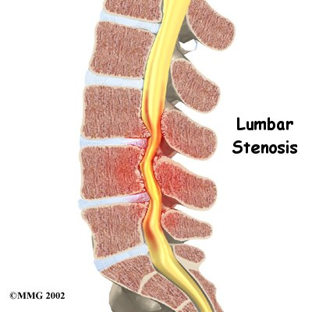
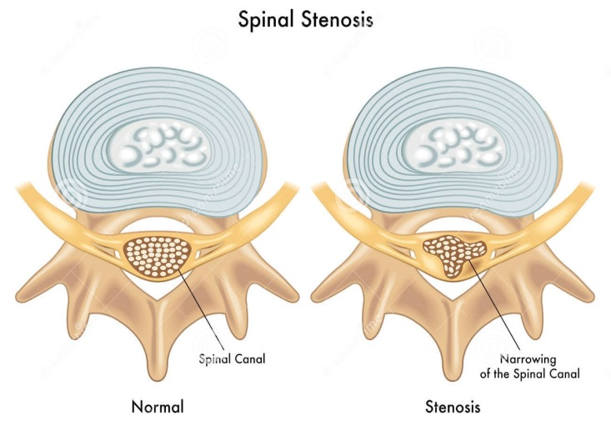
Spinal stenosis is a narrowing of the spinal column that puts pressure on the spinal cord and nerves .

Slide 19
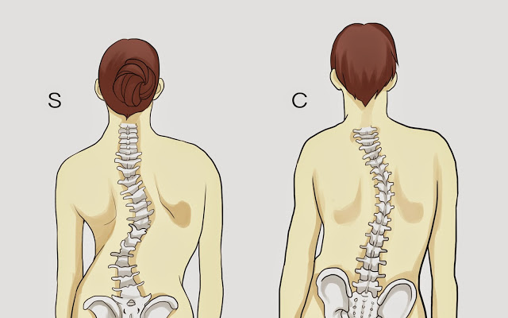
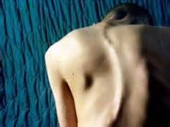
Skeletal irregularities include scoliosis, a curvature of the spine that does not usually cause pain until middle age .

Slide 20
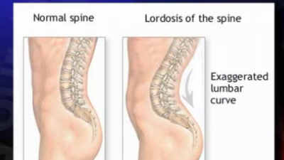
Lordosis,
an abnormally accentuated arch in the lower back of the spine.

Slide 21
Other underlying conditions that predispose people to low back pain include:
Inflammatory diseases of the joints such as arthritis, including osteoarthritis and rheumatoid arthritis as well as spondylitis, an inflammation of the vertebrae, can also cause low back pain. Spondylitis is also called spondyloarthritis or spondyloarthropathy.
Osteoporosis is a metabolic bone disease marked by a progressive decrease in bone density and strength, which can lead to painful fractures of the vertebrae.
Endometriosis is the buildup of uterine tissue in places outside the uterus.
Fibromyalgia, a chronic pain syndrome involving widespread muscle pain and fatigue.

Slide 22
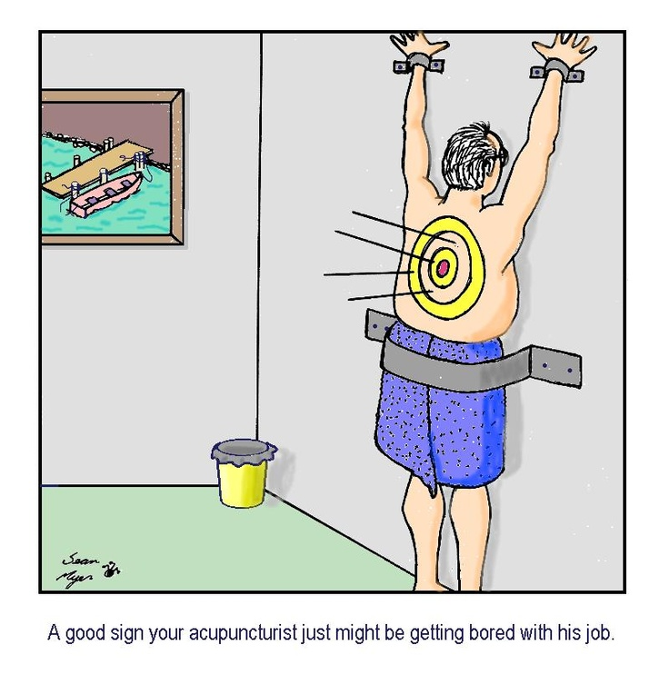
Prevention

Slide 23
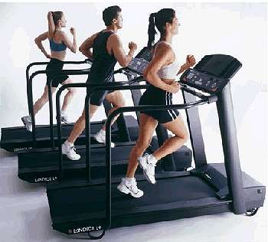

Effective methods to prevent low back pain have not been well developed. Exercise is probably effective in preventing recurrences in those with pain that has lasted more than six weeks.

Slide 24
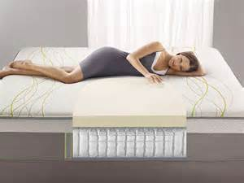
Medium-firm mattresses are more beneficial for chronic pain than firm mattresses.

Slide 25
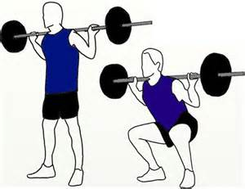
education about proper lifting techniques..

Slide 26
Treatment

Slide 27
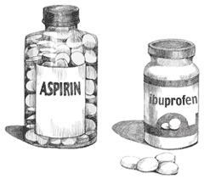
The medication typically recommended first is acetaminophen (paracetamol) or NSAIDs (though not aspirin), and these are enough for most people. Standard doses of acetaminophen are very safe; however, high doses may cause liver problems, and very high doses can be fatal. A 2015 review, however, did not find benefits with acetaminophen. Muscle relaxants may be beneficial.

Slide 28
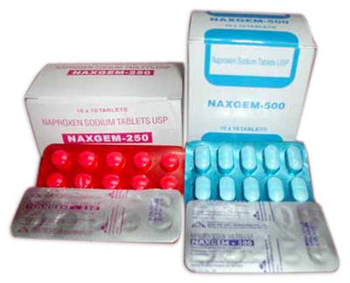
NSAIDs are more effective for acute episodes than acetaminophen; however, they carry a greater risk of side effects including: kidney failure, stomach ulcers and possibly heart problems.

Slide 29
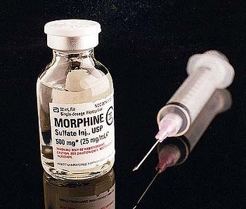
If the pain is still not managed adequately, short term use of opioids such as morphine may be useful. These medications carry a risk of addiction, may have negative interactions with other drugs, and have a greater risk of side effects, including dizziness, nausea, and constipation.

Slide 30
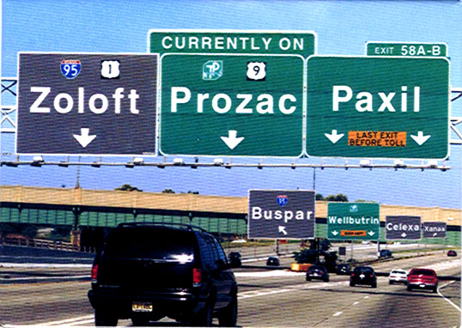
Antidepressants may be effective for treating chronic pain associated with symptoms of depression, but they have a risk of side effects.

Slide 31
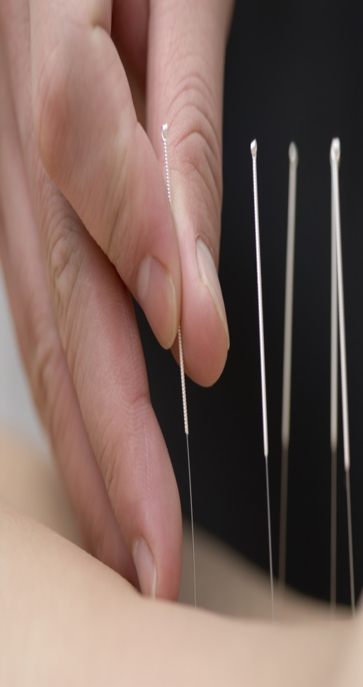


Alternative medicine

Slide 32
CAM is a term used to describe a diverse group of healing systems that are not presently considered to be part of mainstream medicine. There has been a rise in the use of CAM as a health care option in recent years globally. According to the World Health Organization (WHO), more than three-quarters of the world'population rely upon CAM

Slide 33
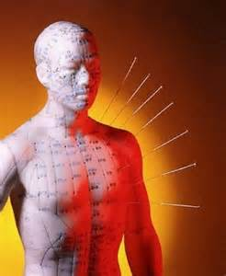
Acupuncture is moderately effective for chronic low back pain. It involves the insertion of thin needles into precise points throughout the body. Some practitioners believe this process helps clear away blockages in the body’s life force known as Qi .

Slide 34

When the needles are inserted and then stimulated (by twisting or passing a low-voltage electrical current through them) naturally occurring painkilling chemicals such as endorphins, serotonin, and acetylcholine are released.

Slide 35
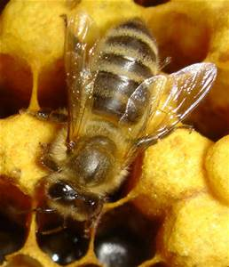
Bee Venom Therapy (BVT) is an ancient therapy that works well in a variety of medical conditions. With this therapy, bee venom in bee-sized doses is put into acupuncture sites or other critical spots in the skin. The resulting sting works wonders with arthritis, multiple sclerosis, fractures, sciatica, and many other conditions.

Slide 36
Now why would a naturopathic doctor use this odd therapy?

Slide 37

Because it is safe, effective, and less expensive than other therapies for these problems. One obstacle is fear of the pain from a sting, but when people realize the benefits gained in pain relief, the sting becomes unimportant.

Slide 38
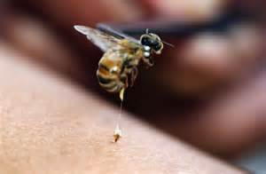
Bee venom acupuncture (BVA), as a kind of herbal acupuncture, exerts not only pharmacological actions from the bioactive compounds isolated from bee venom but also a mechanical function from acupuncture stimulation.

Slide 39
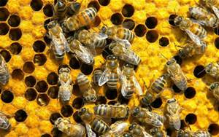
Several studies suggested that the effects of bee venom were intensified by acupuncture stimulations, which may help in reaching therapeutic goals. The anti-nociceptive property of BVA may be explained by the process of counter irritation

Slide 40
Intelukien 1
Also known as IL-1; IL1F2; IL1-BETA .The protein encoded by this gene is a member of the interleukin 1 cytokine family. This cytokine is produced by activated macrophages as a proprotein . This cytokine is an important mediator of the inflammatory response, and is involved in a variety of cellular activities, including cell proliferation, differentiation, and apoptosis.

Slide 41
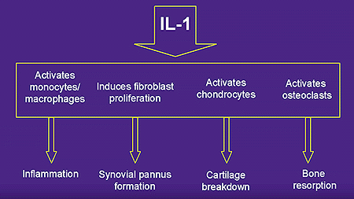

Slide 42
Nuclear factor kappa-B
NF-κB (nuclear factor kappa-light-chain-enhancer of activated B cells) is a protein complex that controls transcription of DNA, cytokine production and cell survival. NF-κB is found in almost all animal cell types and is involved in cellular responses to stimuli such as stress, cytokines, free radicals, ultraviolet irradiation, oxidized LDL, and bacterial or viral antigens

Slide 43
Cont.
NF-κB plays a key role in regulating the immune response to infection (κ light chains are critical components of immunoglobulins). Incorrect regulation of NF-κB has been linked to cancer, inflammatory, and autoimmune diseases, septic shock, viral infection, and improper immune development.

Slide 44
Aim of the work

Slide 45
The aim of this work is to:
1) Compare the efficiency of bee venom acupuncture versus convention therapy as complementary modalities in the treatment of chronic back pain.
2) Correlation with serum level of nuclear factor kappa B(NFKB) and Interleukin 1(IL1) factor pre- and post treatment.

Slide 46

Patients and Methods

Slide 47
Patients and Methods (Cont.)
Forty female patients with chronic back pain were recruited from the attendants at the complementary clinic of the medical service unit of NRC in Egypt in a randomized parallel pattern (March 2015-Aug 2015) with written consents after approval of the Medical Ethical Committee.

Slide 48
Patients and Methods (Cont.)
Inclusion criteria were:
Age 30-65 years
Painful restriction of lumbar spine mobility >6 months
On no treatment for 2 weeks prior the study
Verified by lumbar X-ray to diagnose and detect the degenerative changes,

Slide 49
Patients and Methods (Cont.)
Exclusion criteria:
Diabetes mellitus
Neurological deficits
rheumatoid arthritis, ankylosing spondylitis
organ failure, Cancer, Epilepsy, Pregnancy,
clotting disorders or anticoagulant therapy.
Previous history of surgery in the back or dislocation or fracture

Slide 50
Patients and Methods (Cont.)
They were allocated to 2 equal groups;
A. Bee venoum acupuncture group
B. Convention drug group
On a one to one sequential basis by order of applying for the study.

Slide 51
Patients and Methods (Cont.)
Group A was subjected to bees sting at standard acupoints according to Traditional Chinese. where each patient received 2 sessions weekly for 6 weeks.

Slide 52
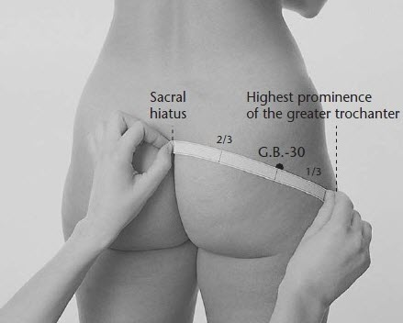
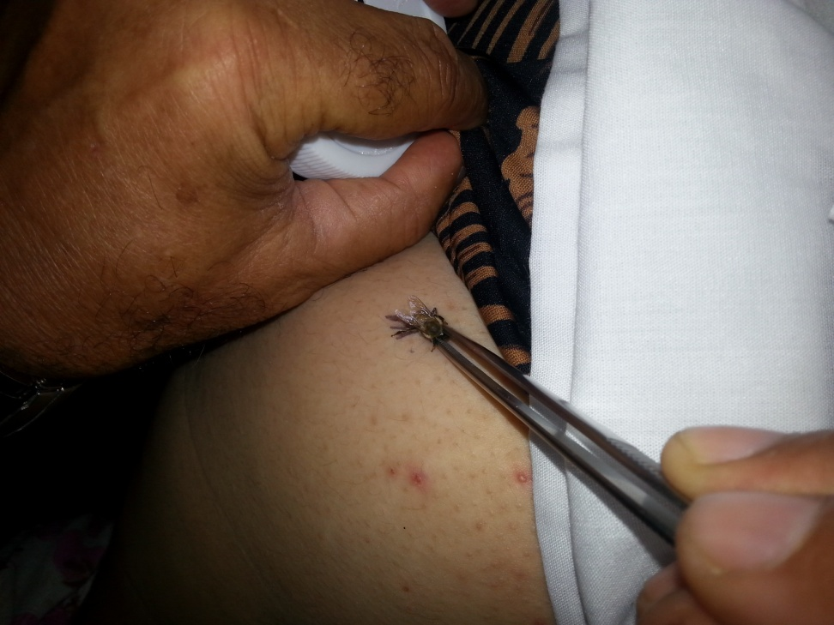
GB30

Slide 53
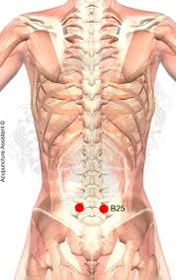
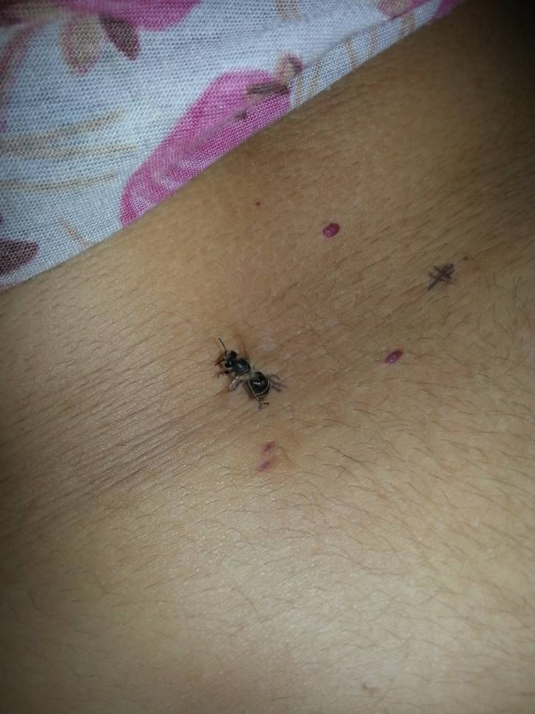
B25

Slide 54
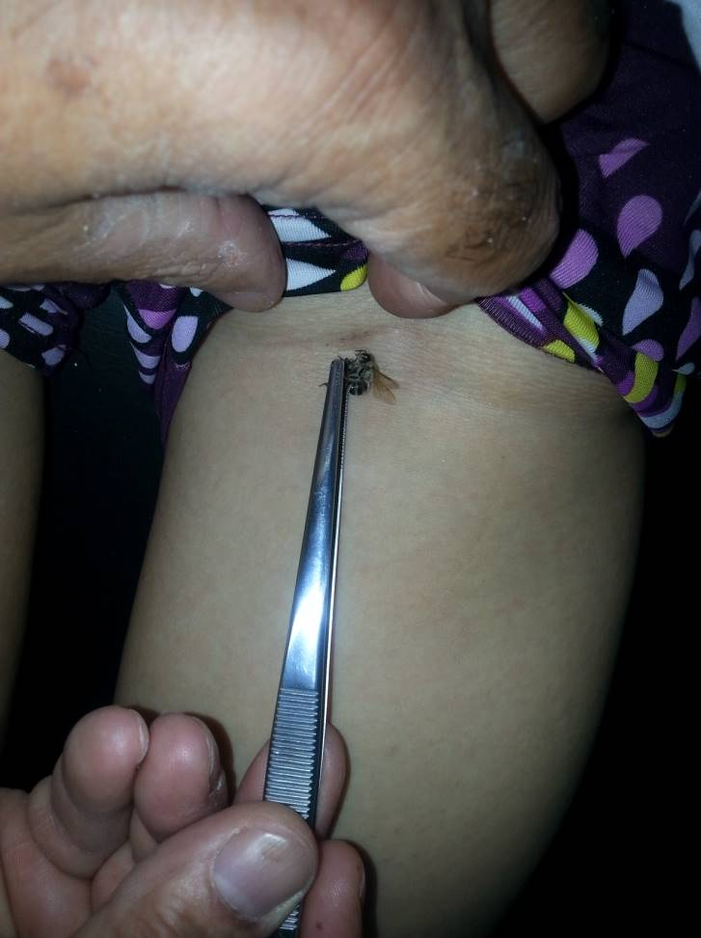
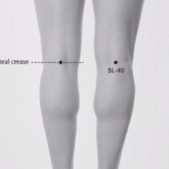
BL40

Slide 55
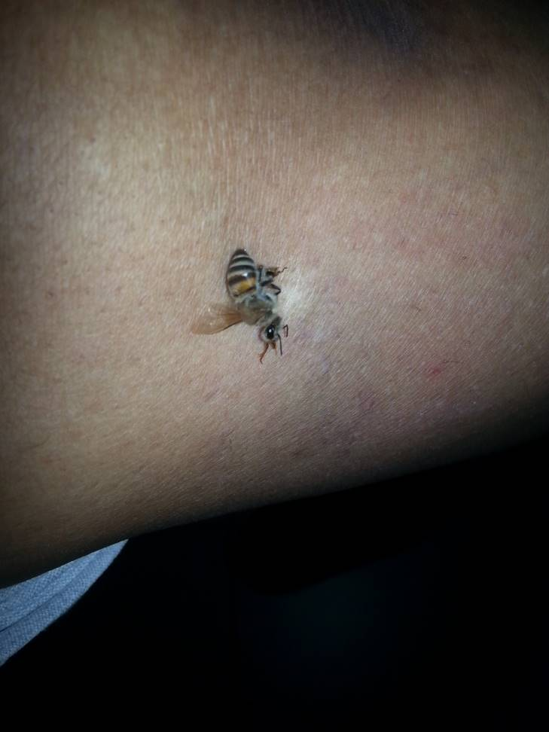
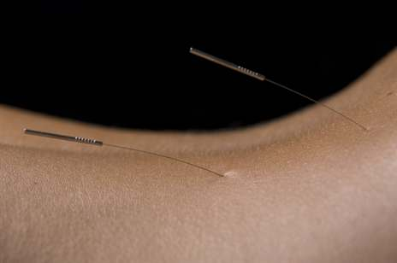
B37

Slide 56
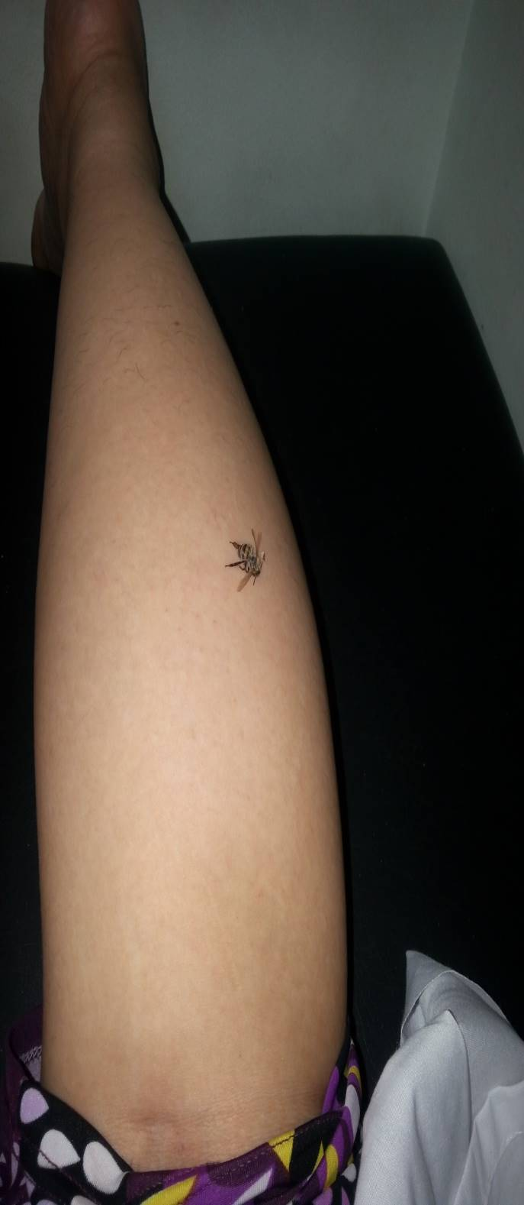
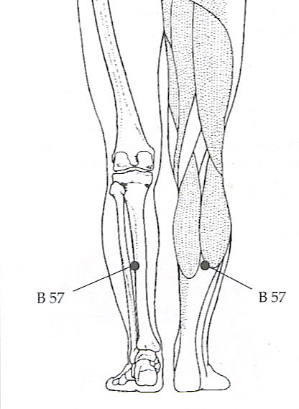
B57

Slide 57
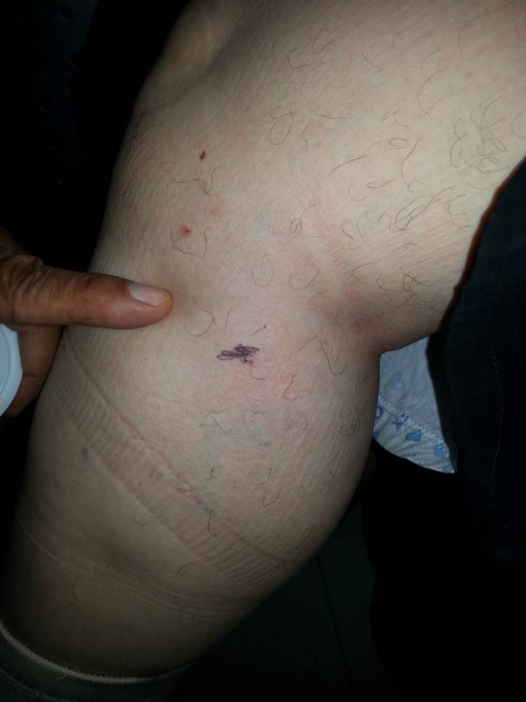
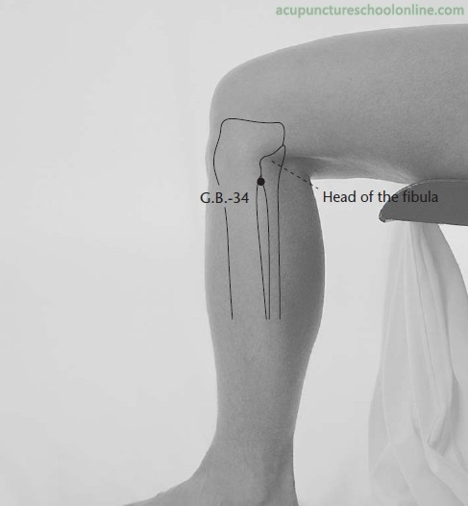
GB34

Slide 58
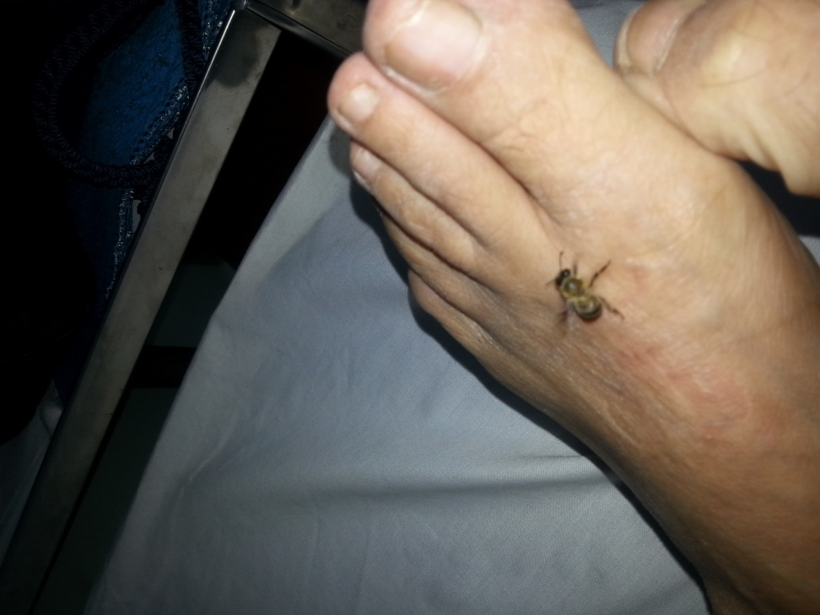
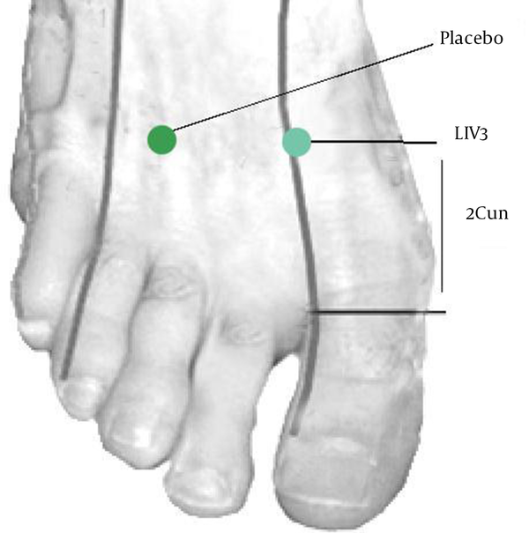
LIV3

Slide 59
    VAS ,Oswestry Disability Index , serum NFKB and IL1 were assessed at baseline and after 6 weeks of the end of the study .

Slide 60
The Oswestry Disability Index
(also known as the Oswestry Low Back Pain Disability Questionnaire) is an extremely important tool that researchers and disability evaluators use to measure a patient's permanent functional disability. The test is considered the ‘gold standard’ of low back functional outcome tool

Slide 61
Results

Slide 62
Age and duration

Slide 63
Weight, height and body mass index

Slide 64
Visual analogue scale

Slide 65
ESR

Slide 66
Pain intensity

Slide 67
Personal care

Slide 68
Lifiting

Slide 69
Walking

Slide 70
Standing

Slide 71
Sleeping

Slide 72
Social

Slide 73
Traveling

Slide 74
NFkβ concentration

Slide 75
IL1 β concentration

Slide 76
IL1 β concentration

Slide 77
Conclusion

Slide 78
Both modes of treatment for LBP show improvement as regard pain intensity, disability and quality of life being more evident in the bee venom group with no side effects .

Slide 79
Recommendations

Slide 80
Recommendations
Encouraging patients with chronic LBP to use complementary modalities to overcome the serious side effects of analgesic (NSAI) and steroid treatment.
.

Slide 81
Recommendations (Cont.)
Encouraging medical personnel to gain more knowledge about complementary modalities, and to have good practice before aiming to use it.

Slide 82

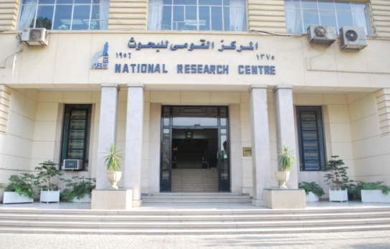
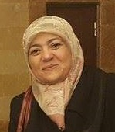


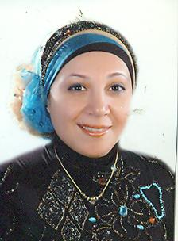

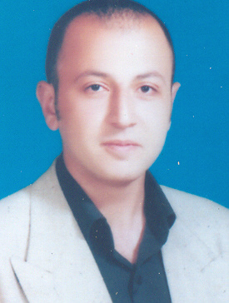


Slide 83





Slide 84



Thank You

