Slide 1

About OMICS Group
OMICS Group International is an amalgamation of Open Access publications and worldwide international science conferences and events. Established in the year 2007 with the sole aim of making the information on Sciences and technology ‘Open Access’, OMICS Group publishes 400 online open access scholarly journals in all aspects of Science, Engineering, Management and Technology journals. OMICS Group has been instrumental in taking the knowledge on Science & technology to the doorsteps of ordinary men and women. Research Scholars, Students, Libraries, Educational Institutions, Research centers and the industry are main stakeholders that benefitted greatly from this knowledge dissemination. OMICS Group also organizes 300 International conferences annually across the globe, where knowledge transfer takes place through debates, round table discussions, poster presentations, workshops, symposia and exhibitions.

Slide 2
About OMICS Group Conferences
OMICS Group International is a pioneer and leading science event organizer, which publishes around 400 open access journals and conducts over 300 Medical, Clinical, Engineering, Life Sciences, Pharma scientific conferences all over the globe annually with the support of more than 1000 scientific associations and 30,000 editorial board members and 3.5 million followers to its credit.
OMICS Group has organized 500 conferences, workshops and national symposiums across the major cities including San Francisco, Las Vegas, San Antonio, Omaha, Orlando, Raleigh, Santa Clara, Chicago, Philadelphia, Baltimore, United Kingdom, Valencia, Dubai, Beijing, Hyderabad, Bengaluru and Mumbai.

Slide 3

Optimization for ccr
NHT = 33000 BPSD
CCR=20000 BPSD

Slide 4
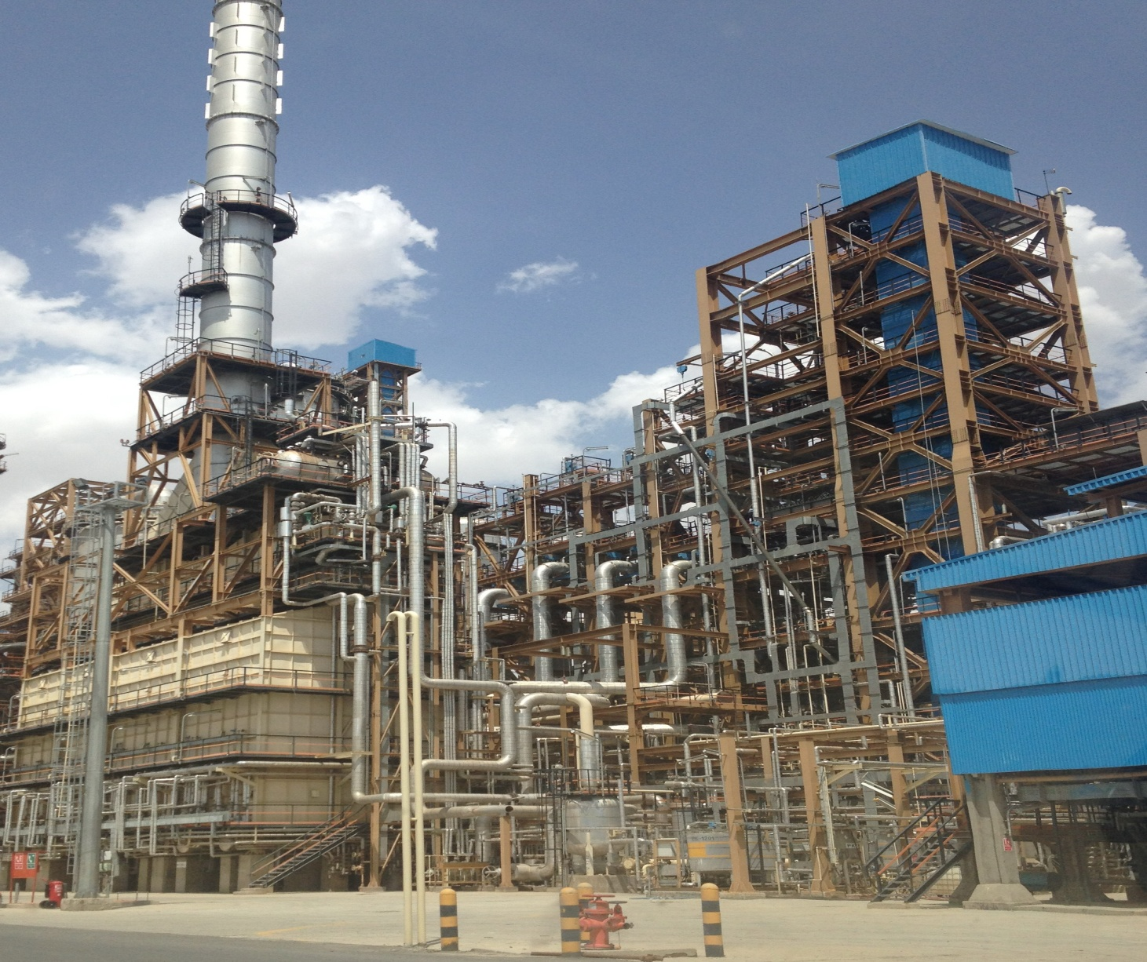

Slide 5
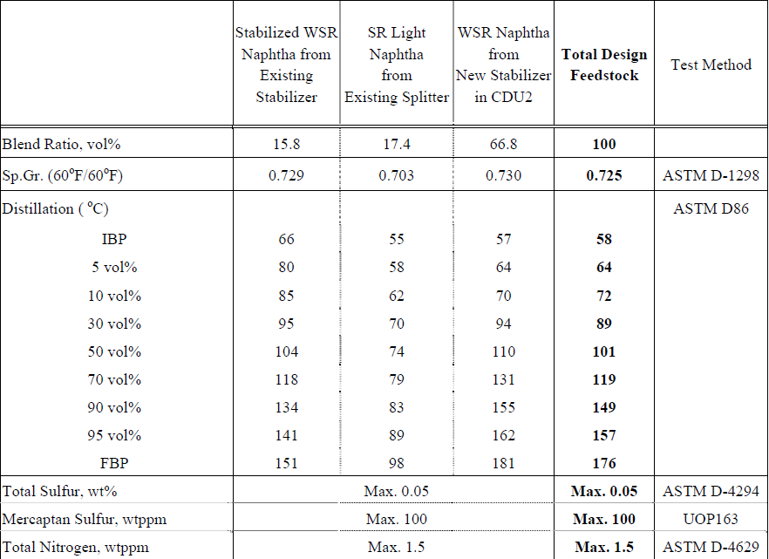
NHT Feed

Slide 6
Naphta Splitter l.n =30-95 C₅-c₆ h.n = 100-175 c₆-c₁₂

Slide 7
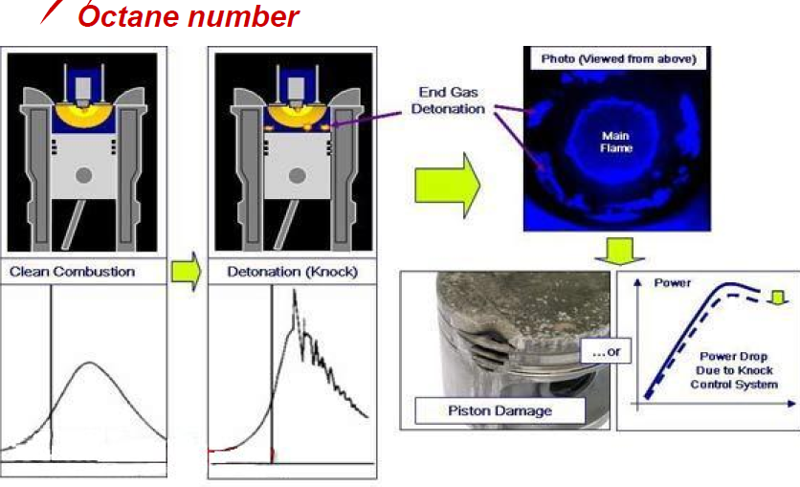
Effect of RON

Slide 8
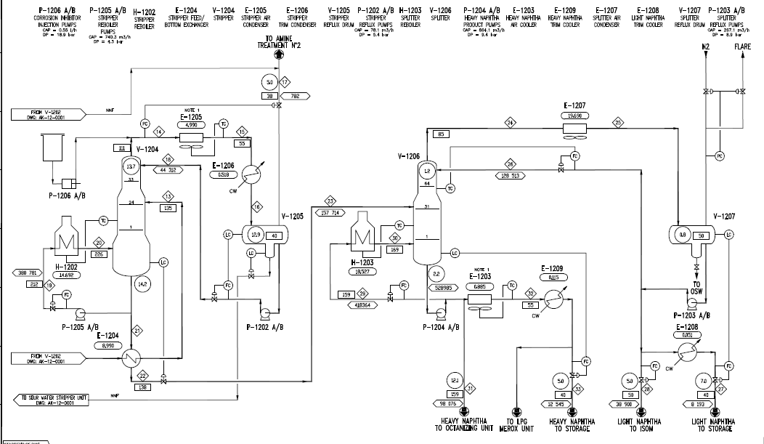
PFD

Slide 9
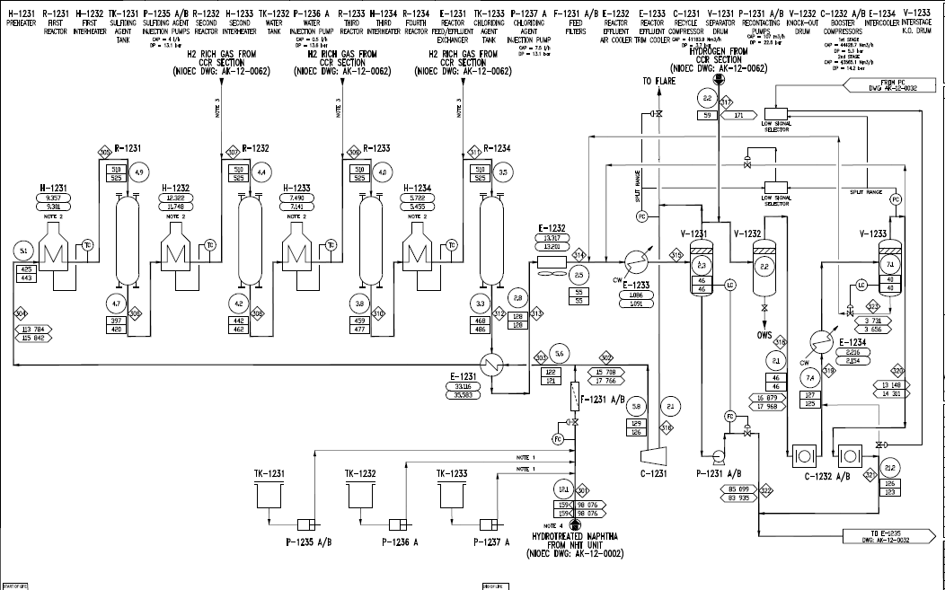

Slide 10
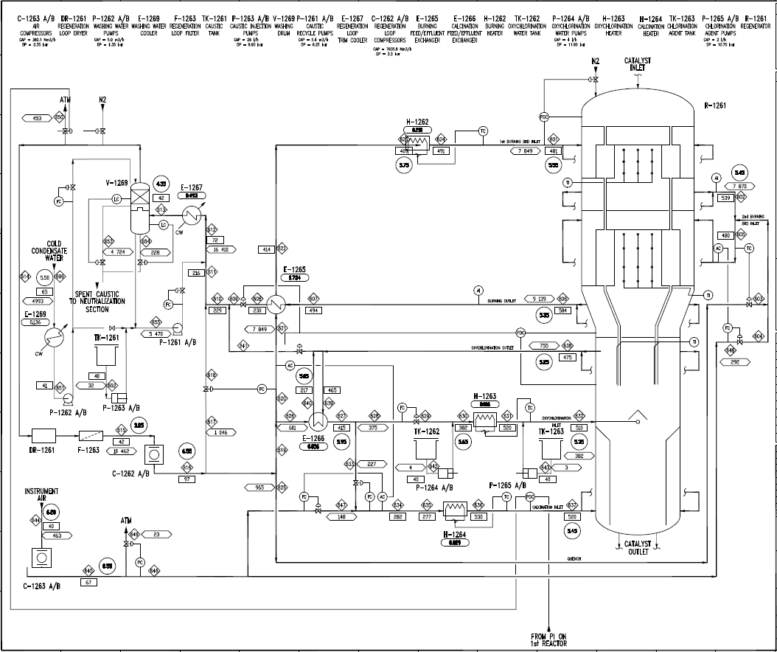

Slide 11
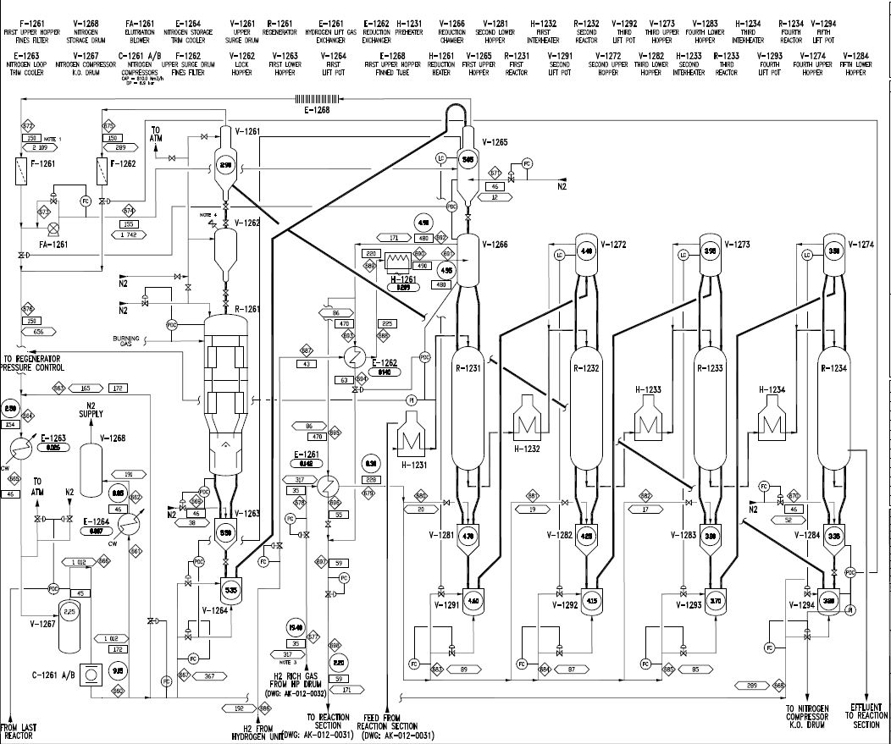

Slide 12
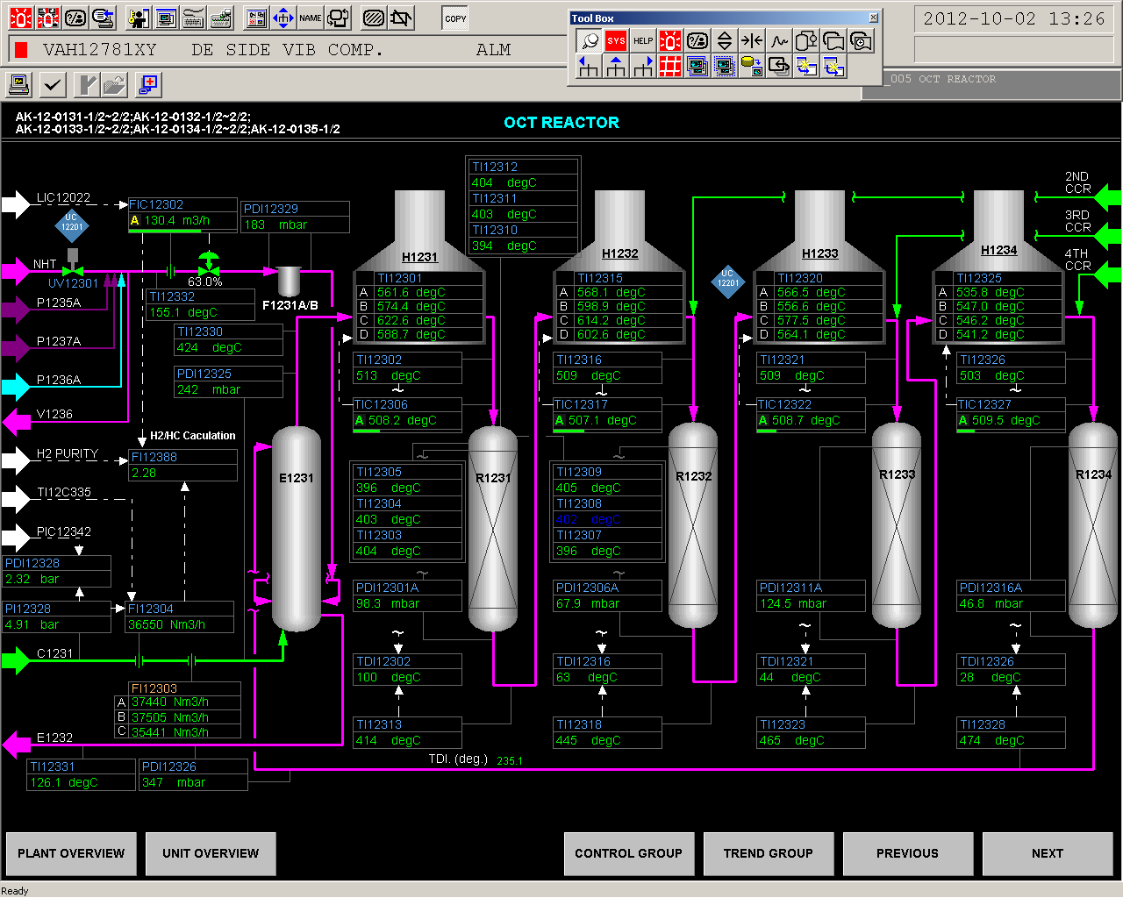

Slide 13
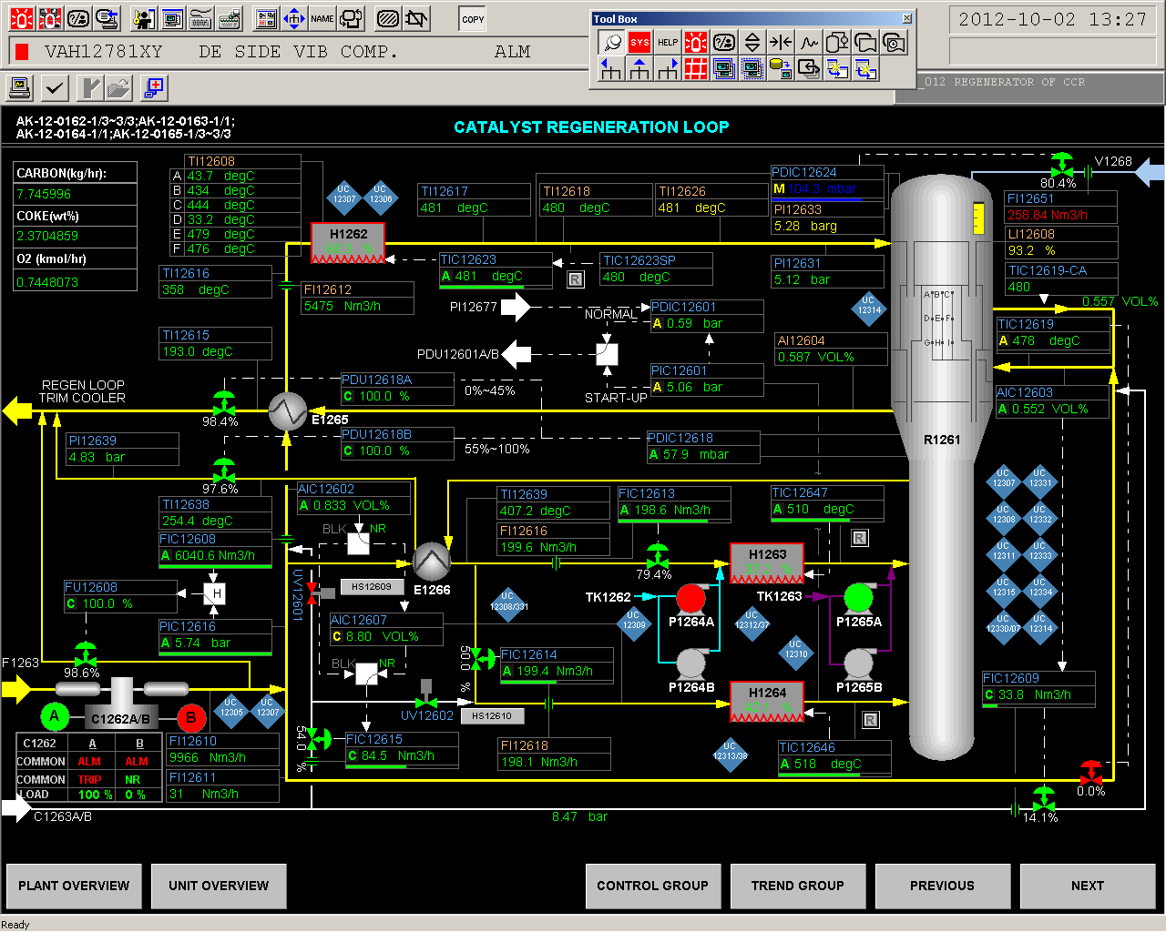

Slide 14
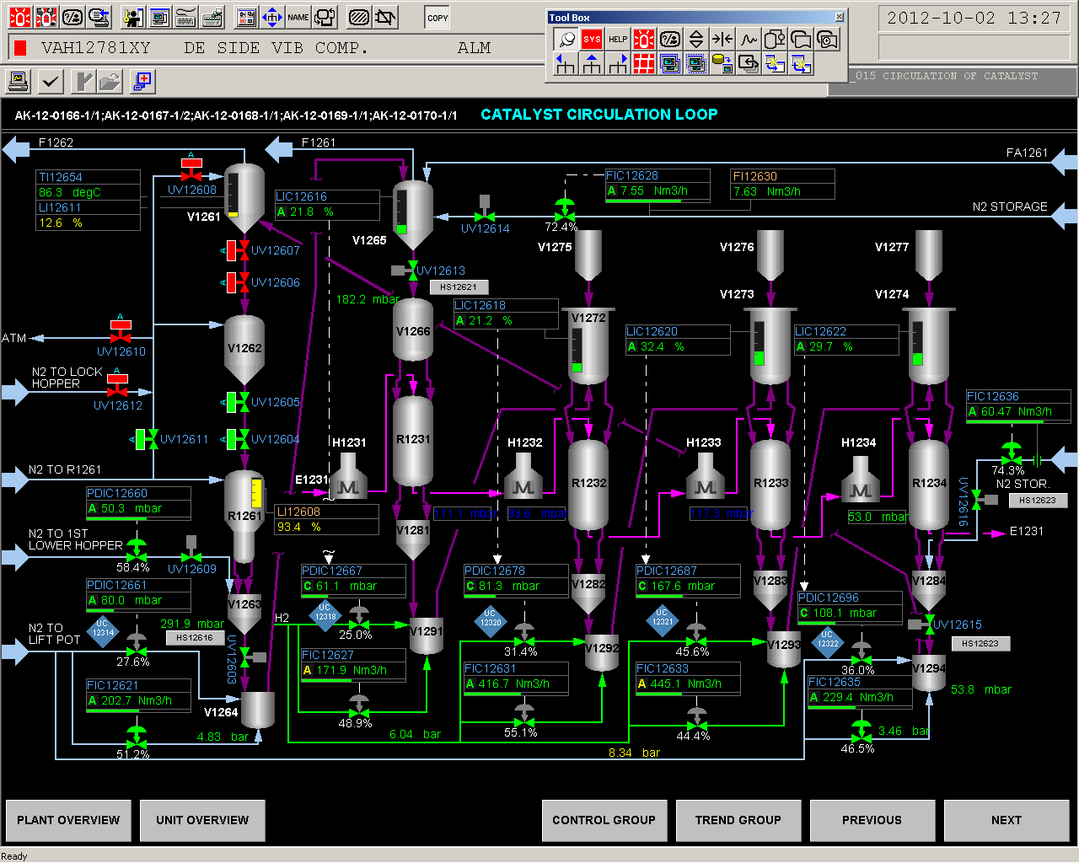

Slide 15
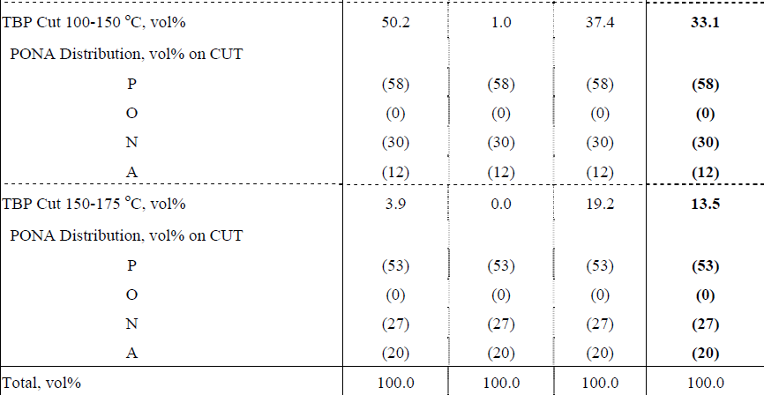
FEED PONA

Slide 16
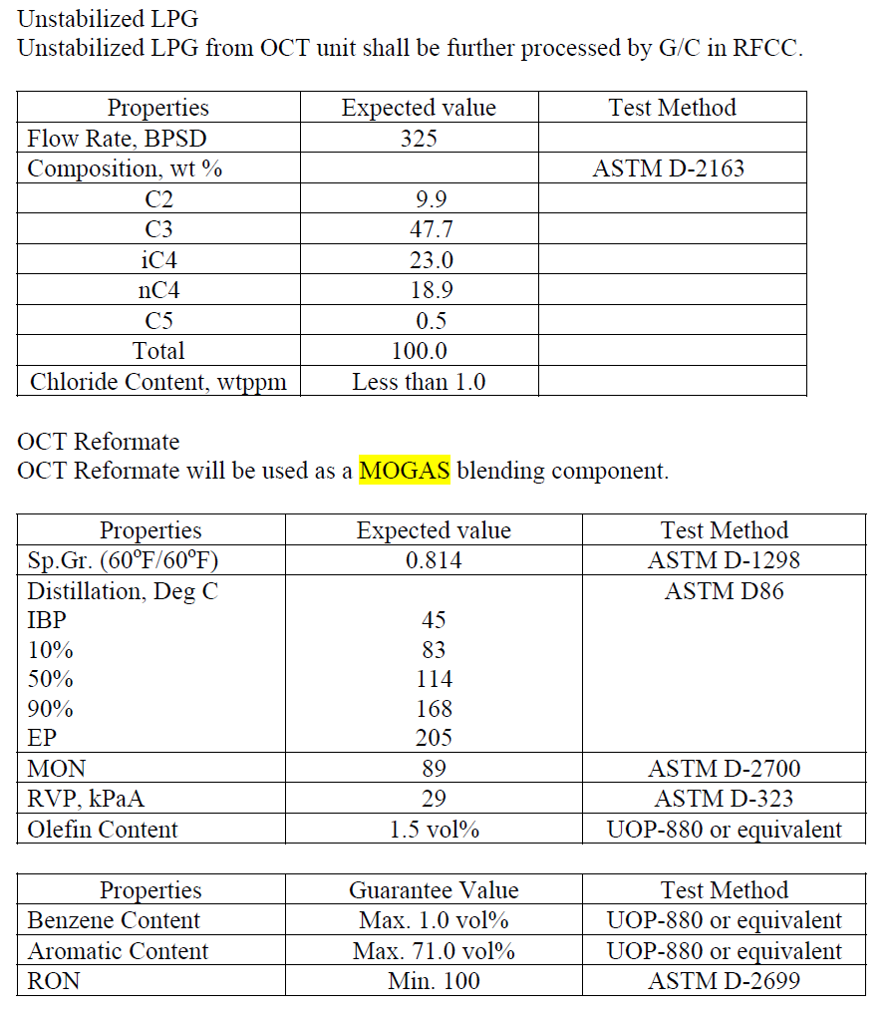
Product Spec

Slide 17
CCR FEED SPECIFICATION
Sulfured < 0.5 PPMW
Nitrogen< 0.1 PPMW
METAL < 5 PPB

Slide 18
:MAIN SECTION
1-Reaction Section
2-Compression & Re contacting Section
3-LPG Recovery & Stabilization Section

Slide 19
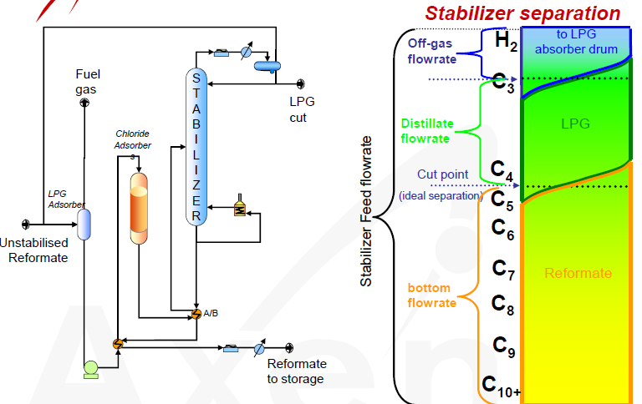

Slide 20
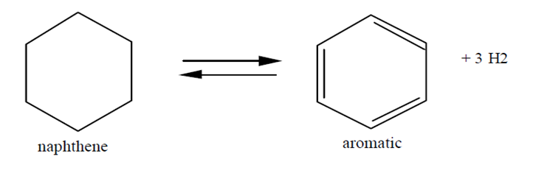
MAIN REACTIONS:

Slide 21
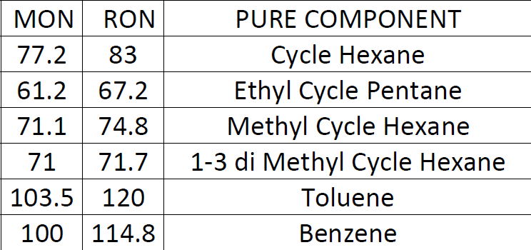
EFFECT OF DEHYDROGENATION
NAPHTENE ON RON

Slide 22
LINEAR PARAFFINE ISOMERIZATION REACTION
ACIDITY EFFECT
EXOTERMIC REACTION

Slide 23
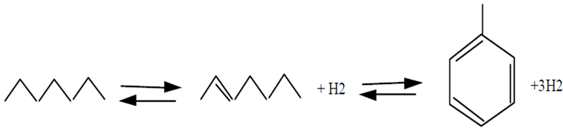
WE NEED :
MORE HEAT
ACIDITY ELEMENT + METAL ELEMENT ON CATALYST

Slide 24
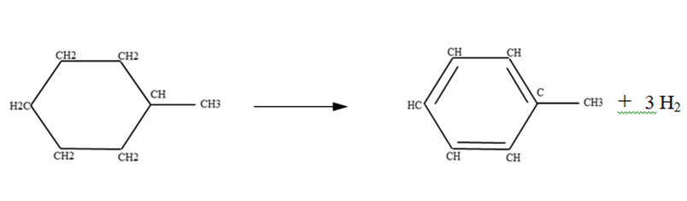
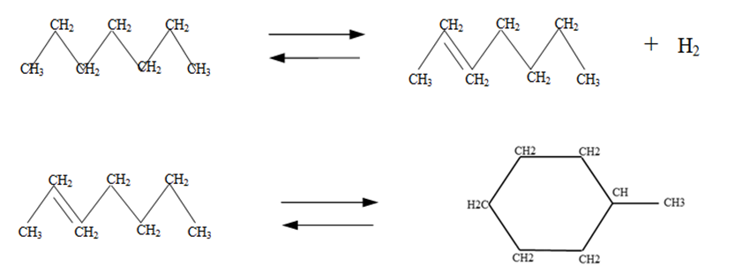

Slide 25
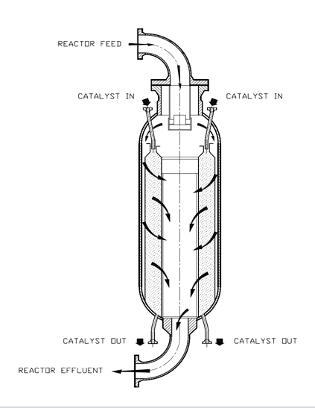
REACTOR

Slide 26
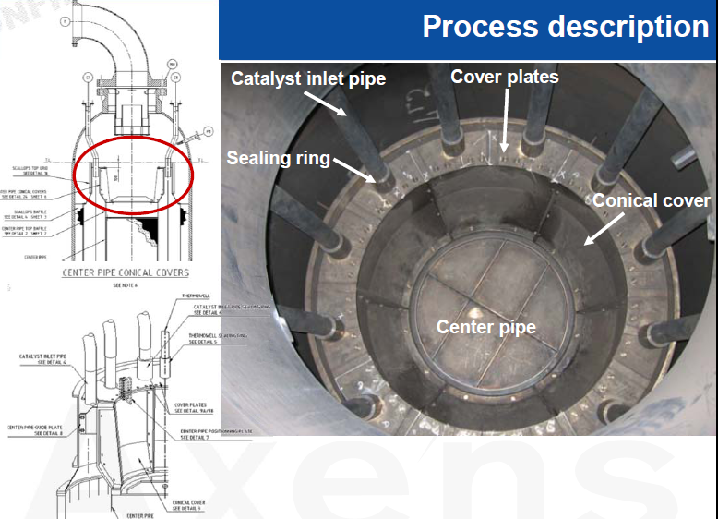

Slide 27
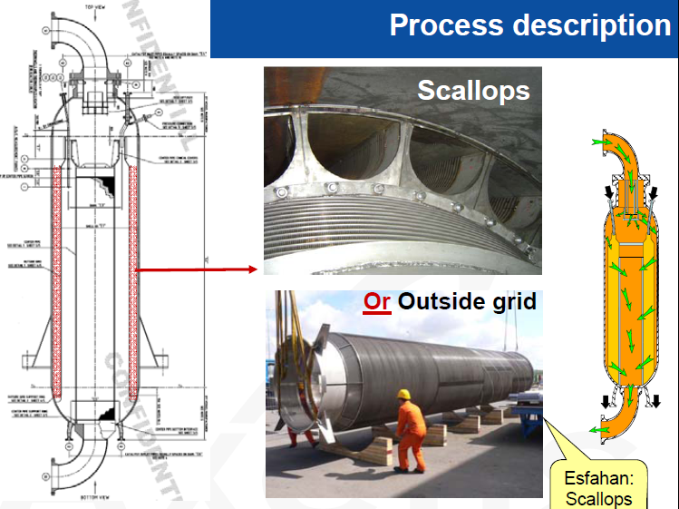

Slide 28
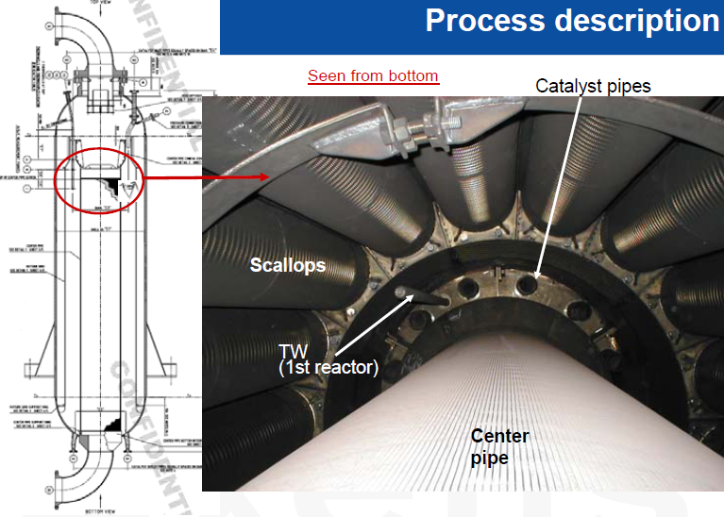

Slide 29
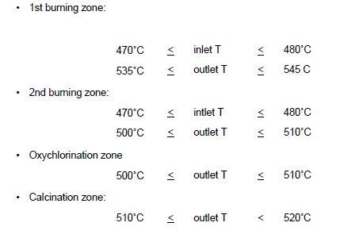
Regeneration Reactor

Slide 30
CATALYST DISTRIBUTION
FIRST 15%
SECOND and THIRD 20-25%
FORTH 40%

Slide 31
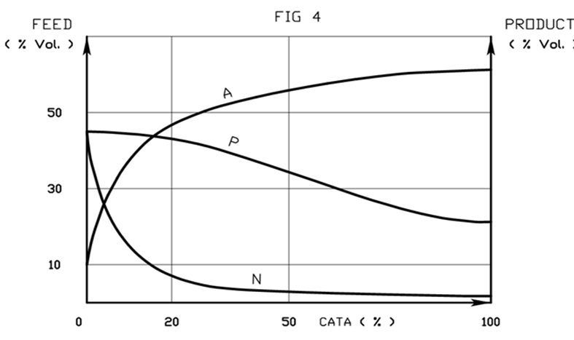

Slide 32
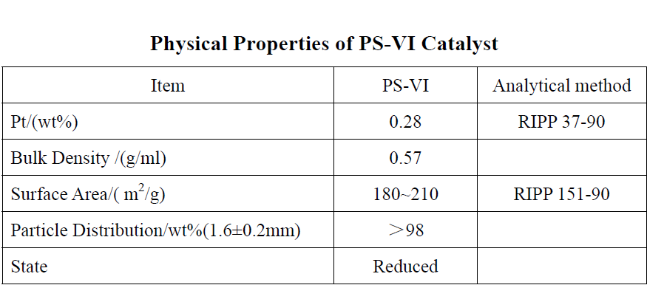
CCR CATALYST

Slide 33
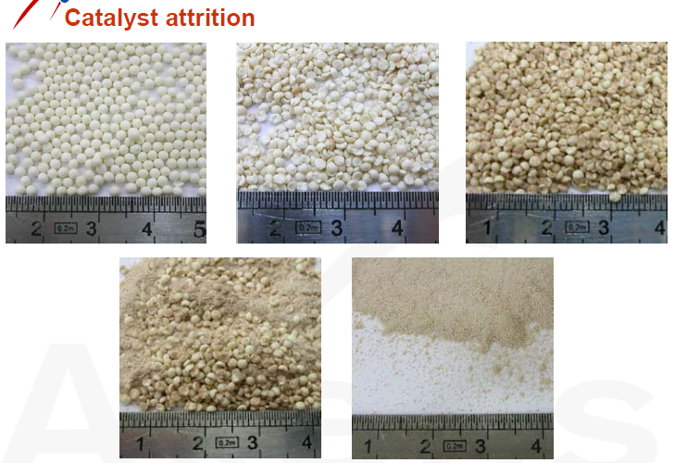
CRASHED CATALYST

Slide 34
SIMULATION DONE WITH FOLLOWING ASSUMPTION:
1-CONSTANT CATALYST ACTIVITY
2-IGNORE EFFECTED OF WATER AND
3-SULPHURE OVER CAT.
4-S.S MODE
5-Pt Dispersion Constant

Slide 35
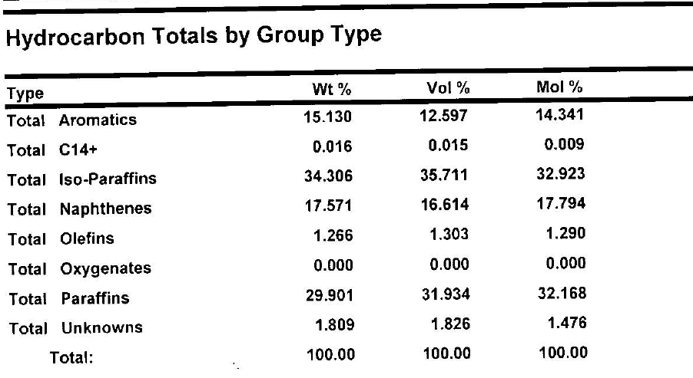
Feed PIONA

Slide 36
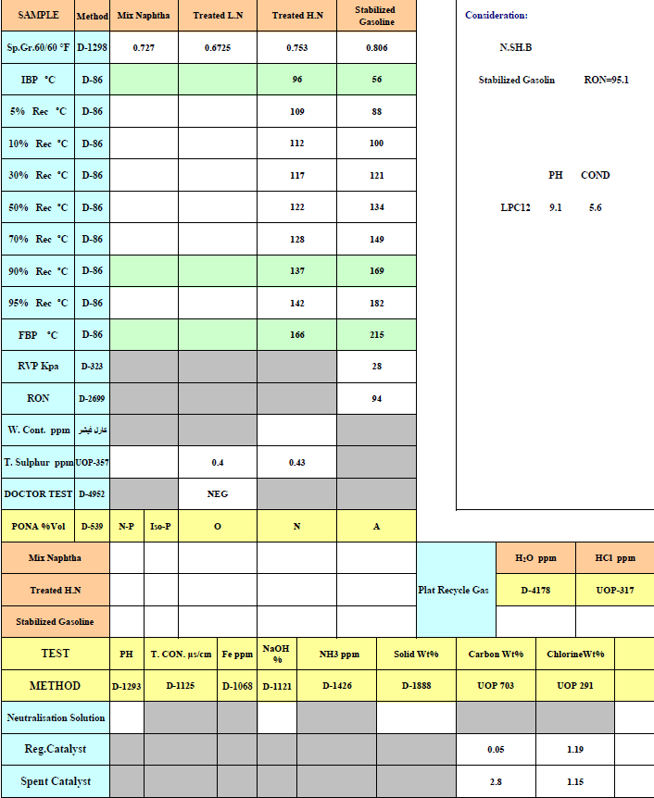
Feed and Product (Lab Test)

Slide 37
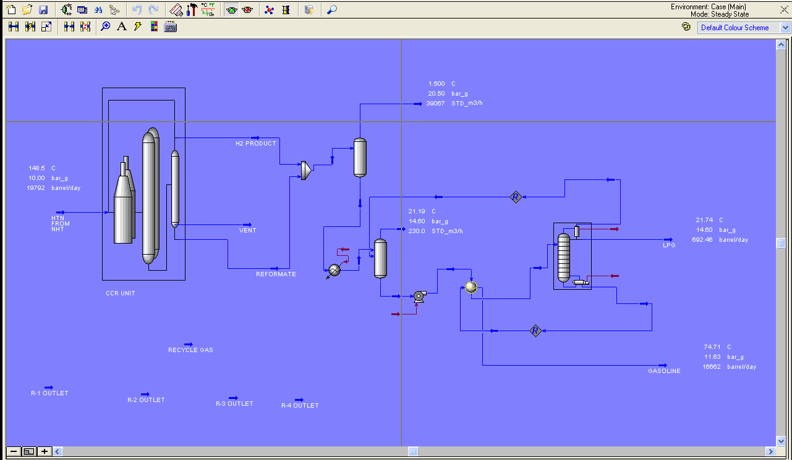
SIMULATION BY PETROSIM

Slide 38
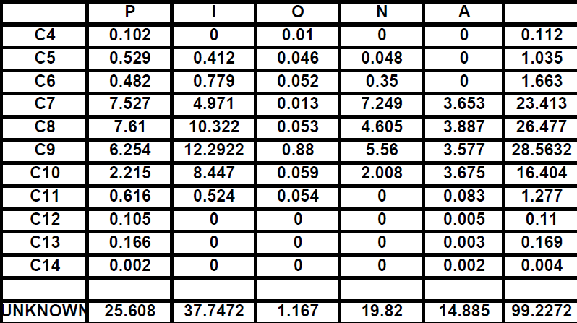
Feed Detail- PIONA

Slide 39
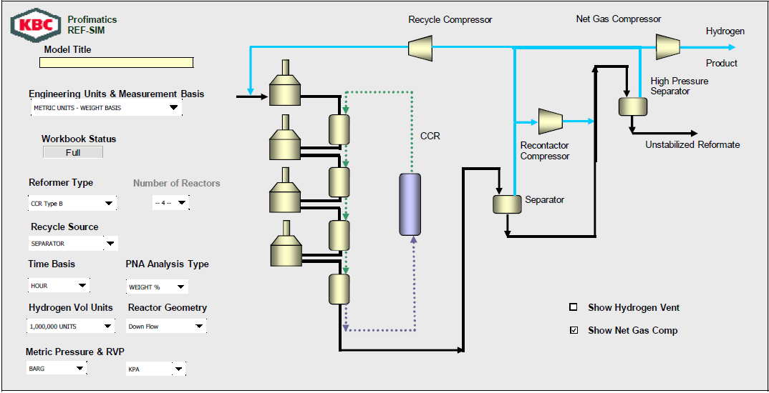

Slide 40
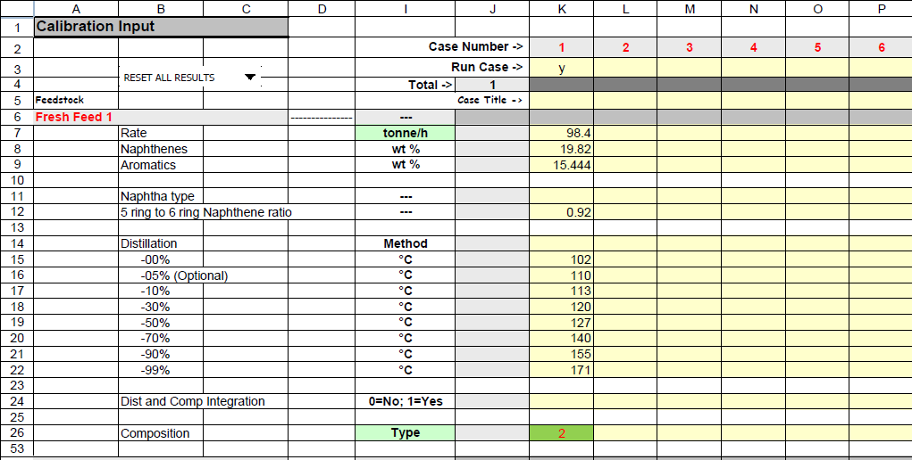
Input DCS and Lab result

Slide 41
REASON OF DIFFERENT
1-INSTRUMENTATION DEFECT
2-LAB ERROE
3-SOFT WARE ERROE
4-NOT COMPLETE RESULT LAB
5- LACK OF C₁₀ ⁺ INFORMATION IN FEED

Slide 42
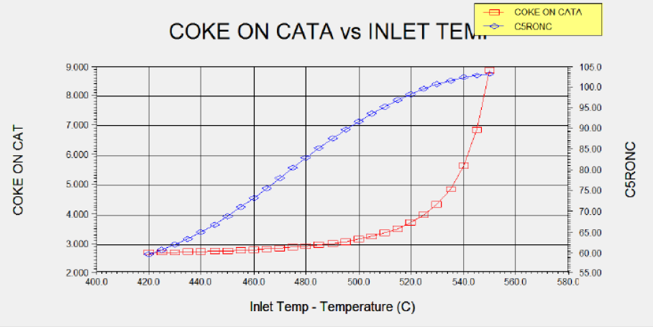

Slide 43
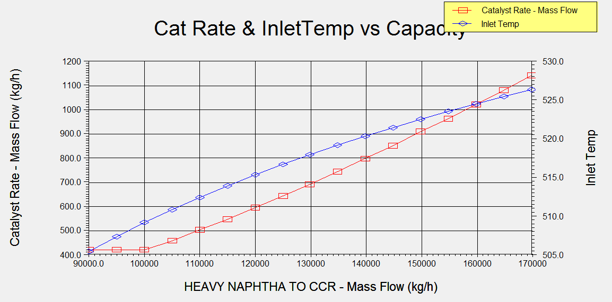
RON=99 and Coke = 3.5%

Slide 44
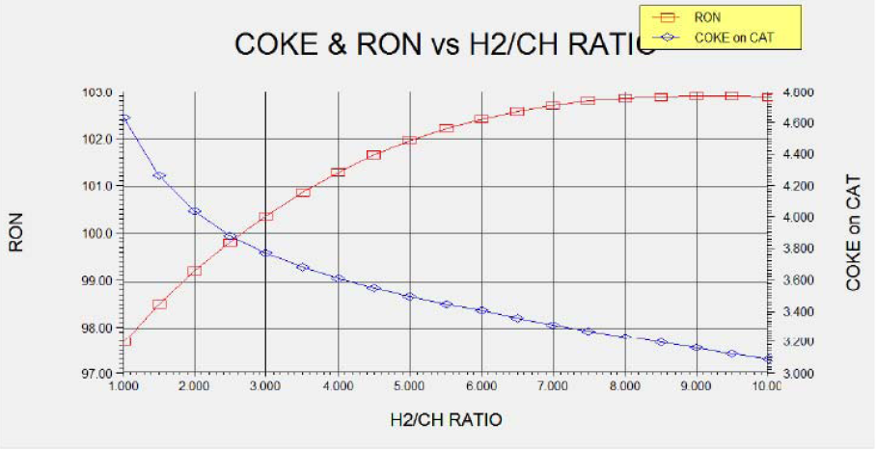

Slide 45
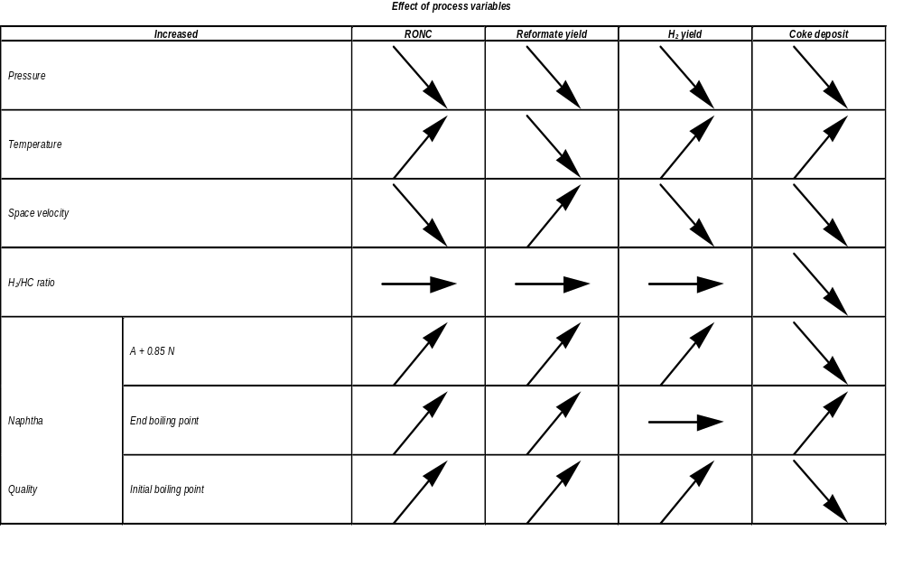
Axens believe in this H₂/HC has no any effect on RON ?

Slide 46
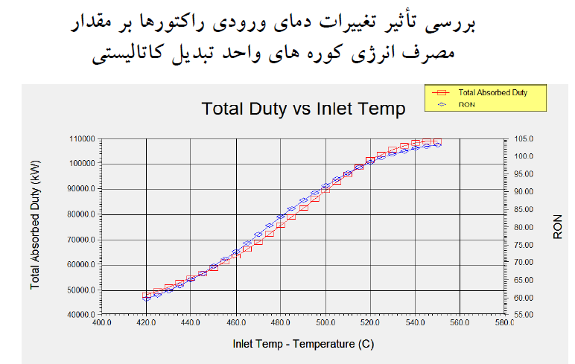

Slide 47
INCREASE 1 RON
NEEDED
930 KW ENERGY

Slide 48
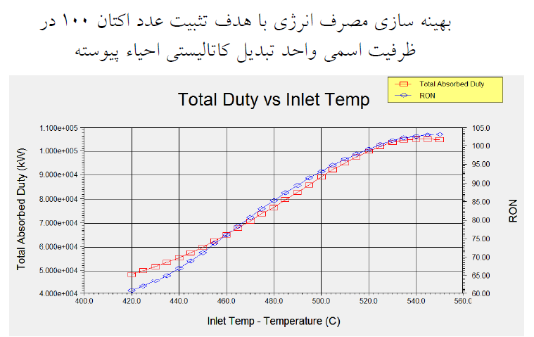

Slide 49
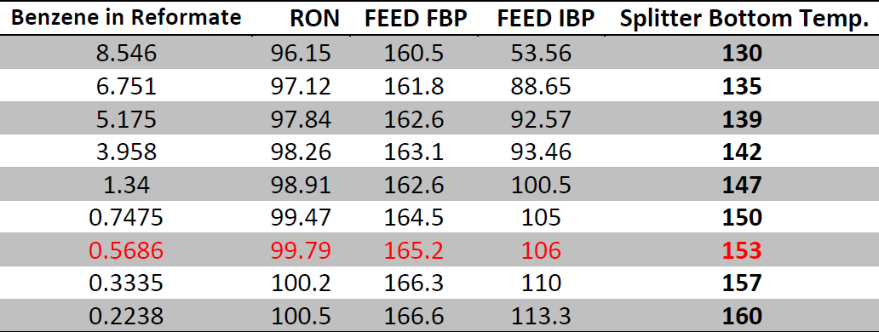
Effect of splitter temperature bottom and IBP on RON and Yield

Slide 50
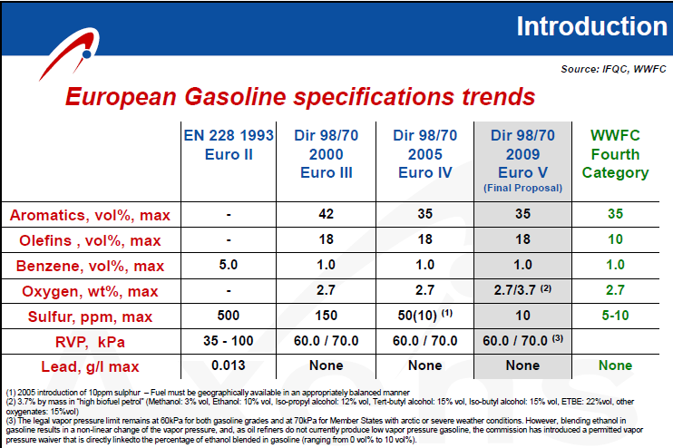

Slide 51
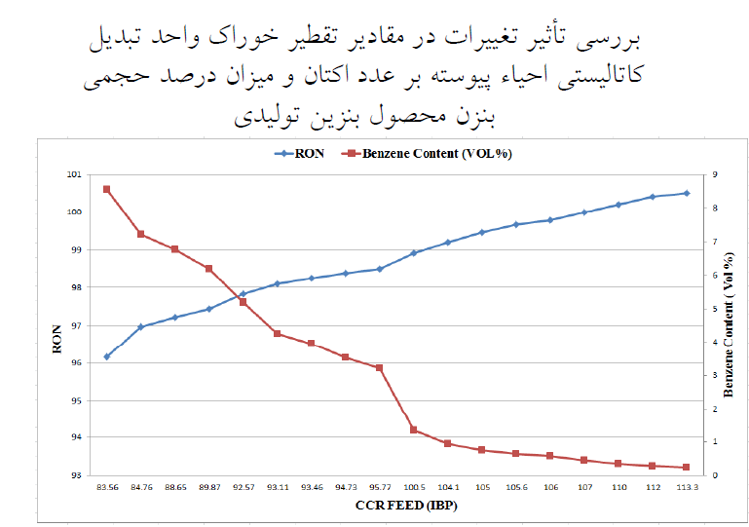

Slide 52
Optimization Results for 20000 BPSD
Inlet Temperature= 512°C
Mol H₂/mol feed= 2.5
CL on the catalyst = 1.05 wt
Catalyst Circulation rate=550Kg/hr
Splitter Bottom Temperature= 152 °C
Coke on Catalyst= 3.5Wt%

Slide 53
Advice
1- Despite of Axens advise , we believe in this H₂/HC effects on RON
increasing this ratio acts as heat source and increase the average bed temperature.
So RON increase too
In simulation and actual test, we have proved this effect

Slide 54
Advice
2- if the coke on the catalyst is less than 4wt% , control system decrease Injected Air to the Calcinations section and the oxygen content in oxychlorination zone decrease below 4vol% then re-dispersion of the Pt on the catalyst decrease subsequently.

