Slide 1

About OMICS Group
OMICS Group International is an amalgamation of Open Access publications and worldwide international science conferences and events. Established in the year 2007 with the sole aim of making the information on Sciences and technology ‘Open Access’, OMICS Group publishes 400 online open access scholarly journals in all aspects of Science, Engineering, Management and Technology journals. OMICS Group has been instrumental in taking the knowledge on Science & technology to the doorsteps of ordinary men and women. Research Scholars, Students, Libraries, Educational Institutions, Research centers and the industry are main stakeholders that benefitted greatly from this knowledge dissemination. OMICS Group also organizes 300 International conferences annually across the globe, where knowledge transfer takes place through debates, round table discussions, poster presentations, workshops, symposia and exhibitions.

Slide 2
About OMICS Group Conferences
OMICS Group International is a pioneer and leading science event organizer, which publishes around 400 open access journals and conducts over 300 Medical, Clinical, Engineering, Life Sciences, Pharma scientific conferences all over the globe annually with the support of more than 1000 scientific associations and 30,000 editorial board members and 3.5 million followers to its credit.
OMICS Group has organized 500 conferences, workshops and national symposiums across the major cities including San Francisco, Las Vegas, San Antonio, Omaha, Orlando, Raleigh, Santa Clara, Chicago, Philadelphia, Baltimore, United Kingdom, Valencia, Dubai, Beijing, Hyderabad, Bengaluru and Mumbai.

Slide 3

Evaluation of the causes of increasing the pressure drop of fixed bed reactor RCD unit

Slide 4
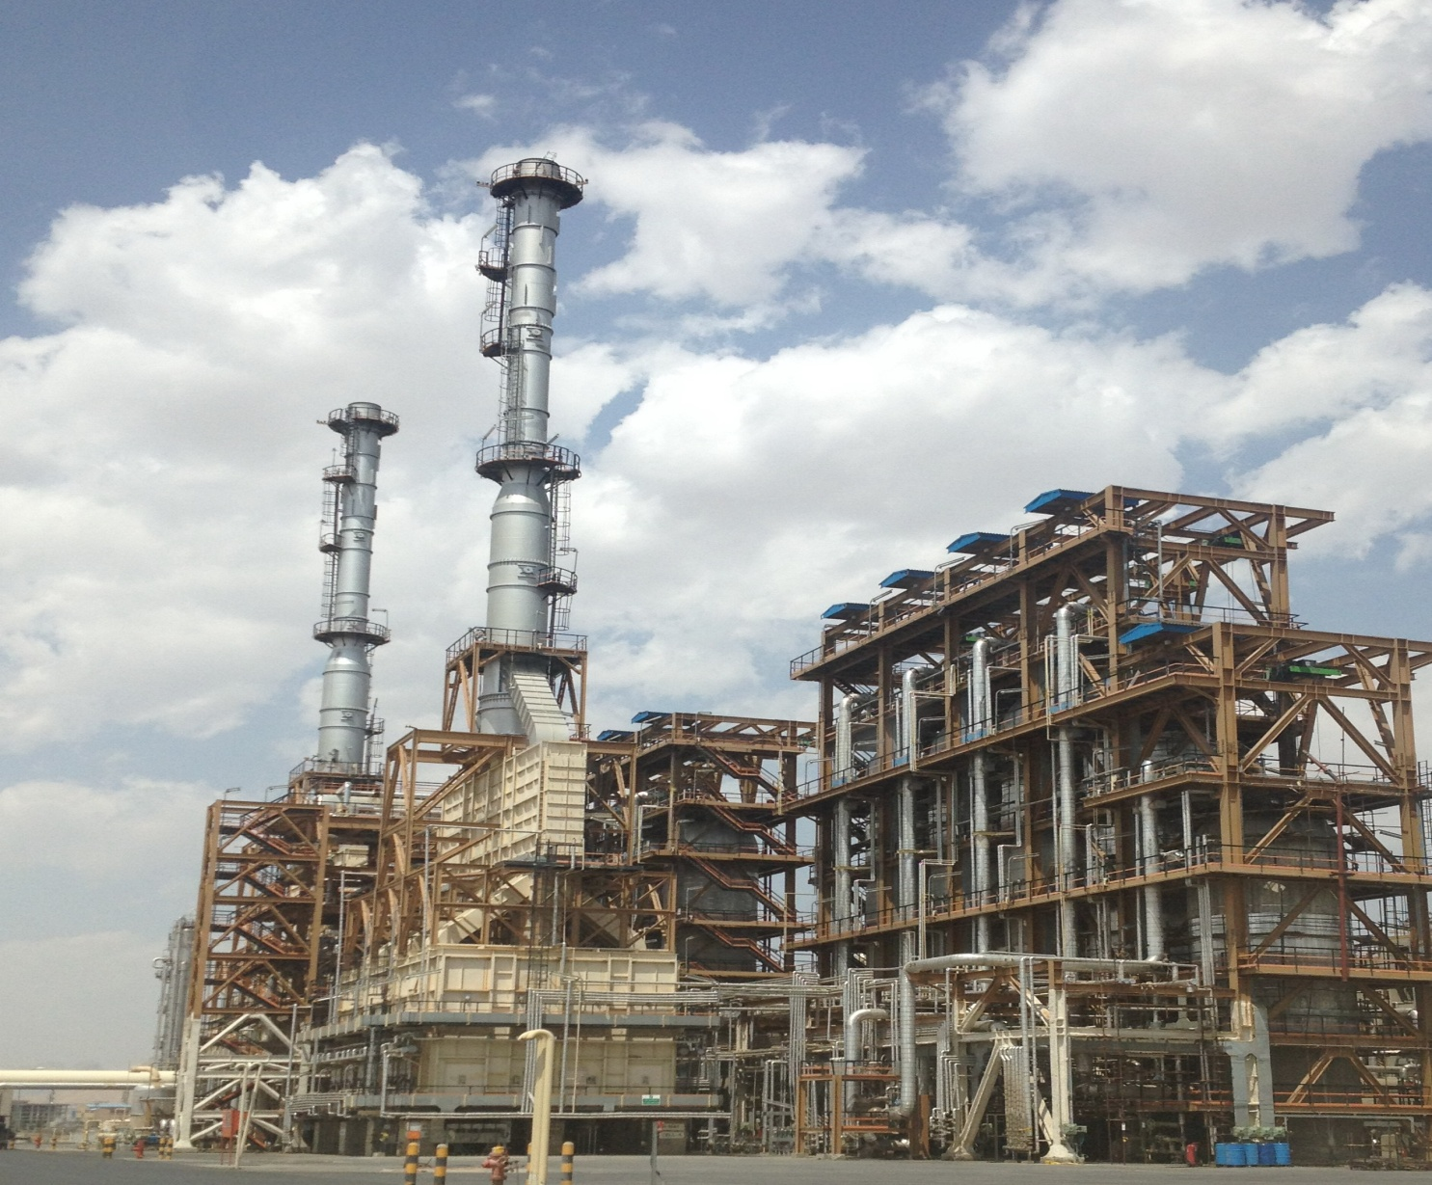

Slide 5
What is RCD?
(Reduced CRUDE DESULFURIZATION)

Slide 6
Feed : 69000 BPSD
Divided in two train
Turn Down : 50%

Slide 7
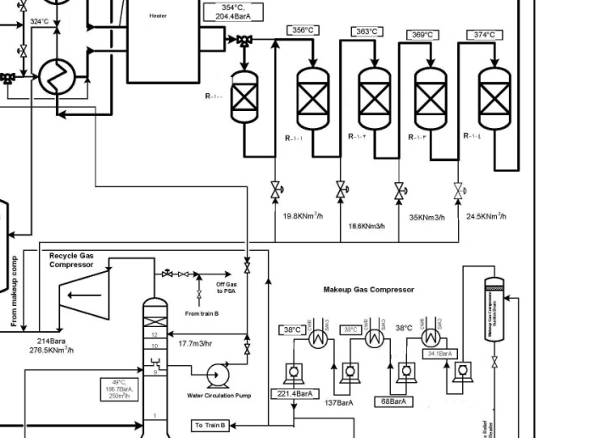
Why H2 injected to the each reactor?

Slide 8
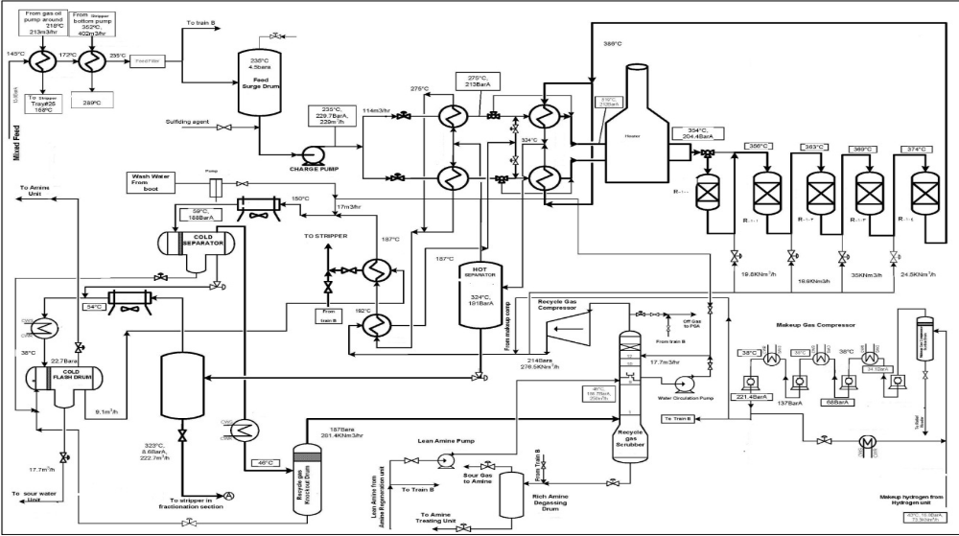

Slide 9
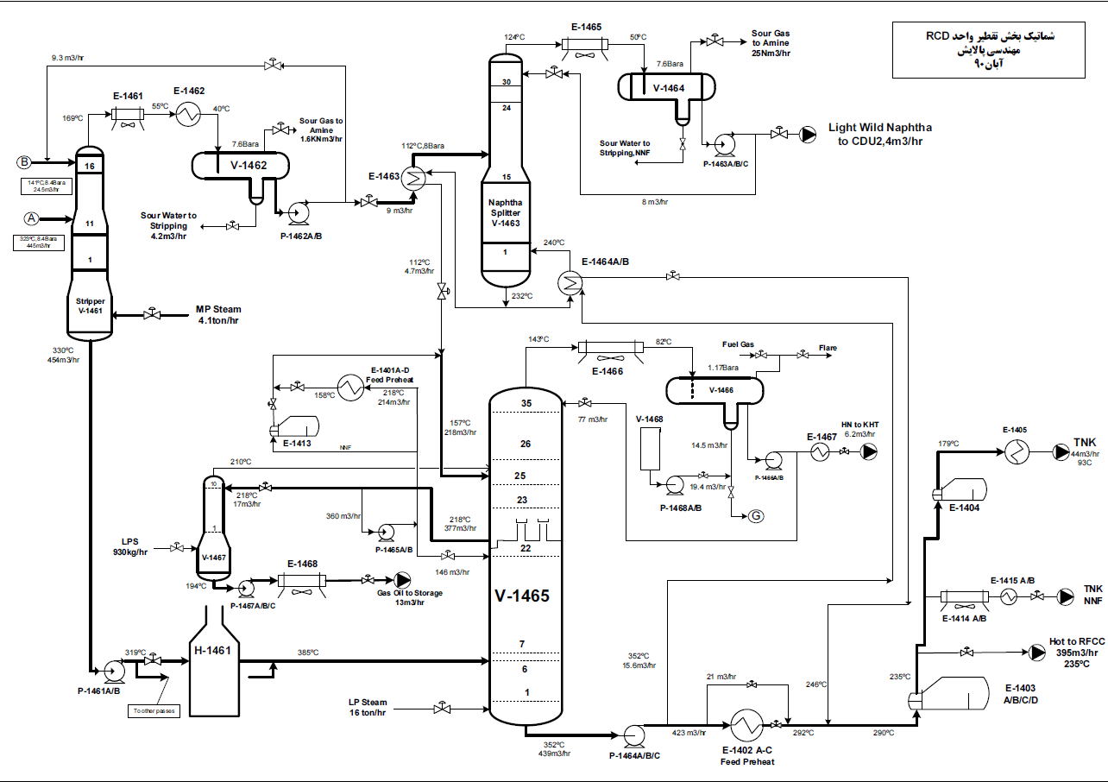

Slide 10
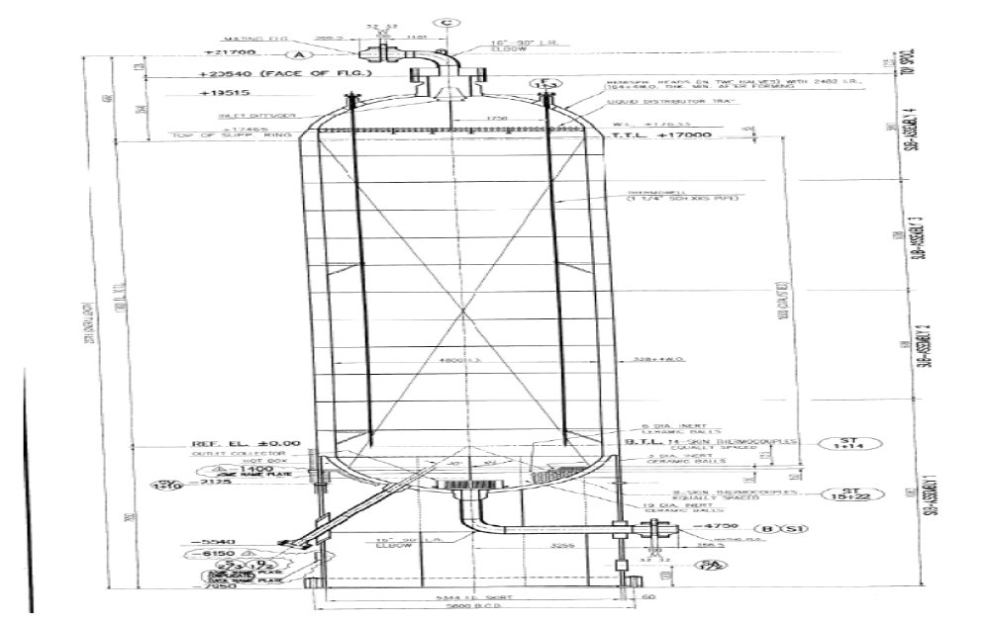
Fixed bed reactor
This distributor to avoid channeling

Slide 11
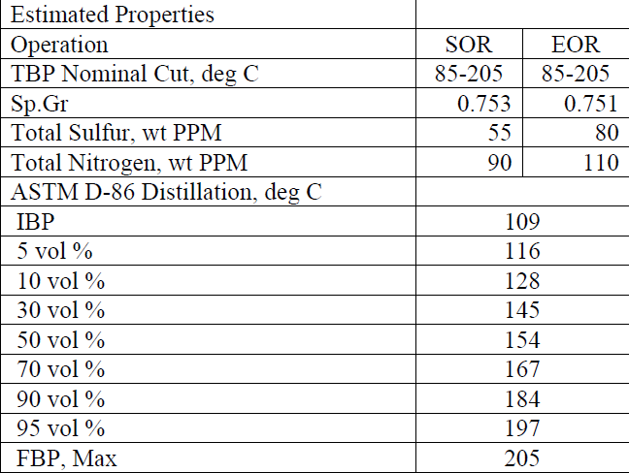
PRODUCTION
HEAVY WILD NAPHTA:

Slide 12
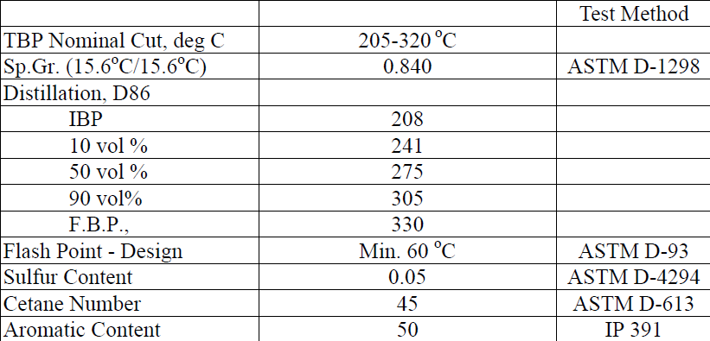
GAS OIL

Slide 13
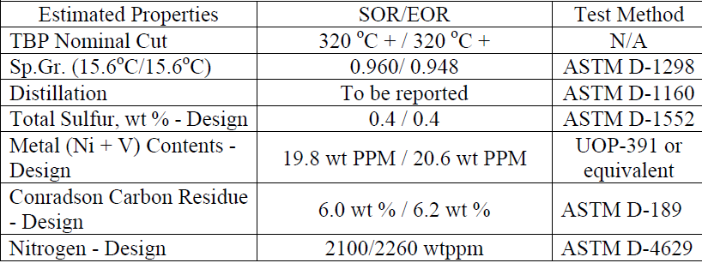
TREATED RESIDUE

Slide 14
The unit of RCD was applied for:
decreasing of Sulfur and CCR
metals of heavy feeds AR and VB
prepared the feed of RFCC unit
(With 5000ppmw Sulphur)

Slide 15
The unit includes the following parts:
Feed Pretreating (Filter) Section
Reactor Section
Fractionator Section
Make-up Hydrogen Compression Section

Slide 16
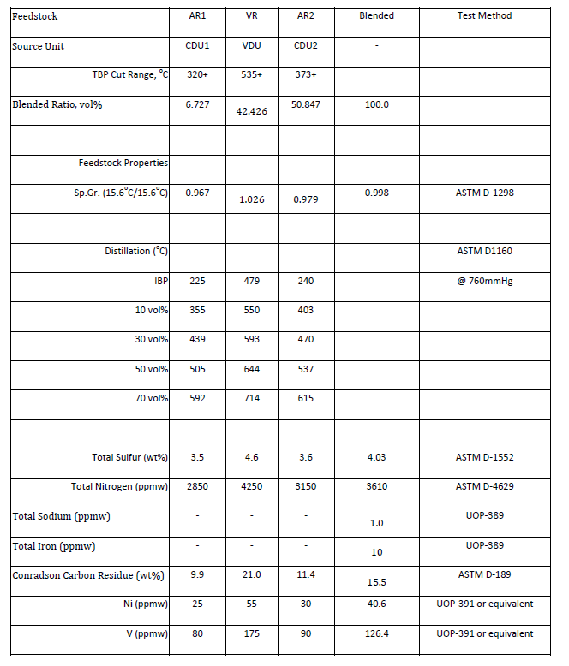
FEED

Slide 17
The unit was acted at high temperature and high pressure
(454°C, 210Kg/Cm²).
The unit was included four series reactors and Guard Sulfure, moreover the impurities of feed can be removed in presence of hydrogen.
Following reactions were carried out in the reactors and all of them were exothermic:
1-Sulfure removal
2-Nitrogen removal
3-Oxygen removal
4-Olefin saturation
5-Aromatic saturation
6-Metal removal
7-Halides removal
8-Hydro cracking
9-Thermal cracking

Slide 18
CATALYST
The catalyst is composed of several spherical PROMOTER METALS IMPREGNATD based on Alumina. Due to control of pressure drop, suitable distribution of feed, adequate selectivity, and using different compounds were preferred.

Slide 19
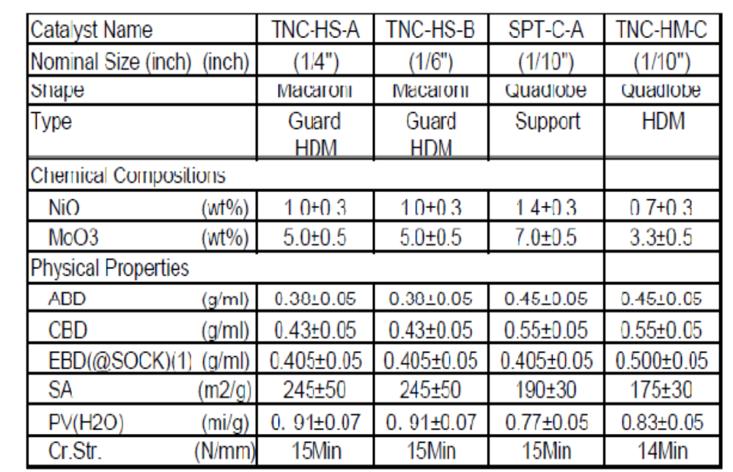

Slide 20
hYDROGEN
MAKE UP H₂ FROM HPU (99.9) :
3 Reciprocating compressor (4stage)
Final Pressure Discharge: 221.4 barg
74Knm³/hr
H₂ Recycle supplied by : Centrifugal Compressor Min purity : 70%

Slide 21
What is our problem in the RCD Unit ?

Slide 22
We started up the unit then,
seen huge DP in the first reactor

Slide 23
All data is actual and extract from
DCS reports

Slide 24
H₂ Recycle Duties
Force the heavy liquid to fluidity
Reactor phase is three
(solid , Gas and Liquid)
If H₂ recycle is cut , all liquids hold up in the catalyst bed, goes in the bottom of the reactors

Slide 25
Because of heavy nature of feed , total Dp (reactors , exchanger , furnace)
is about 25 bar

Slide 26
Investigate DP in the reactor
In the three phase reactors , DP depends on liquid and gas flow rate and temperature

Slide 27
WHAT WAS HAPPENING?

Slide 28
Power failure happened
The recycle compressor stopped
All liquid hold up in the bed of the reactor goes to the bottom of the reactors
Total Hold up : 600m³

Slide 29
Feed pump drivers are Turbine , so the feed was not cut and flow to the train consciously.
The compressors run again and the speed increase rapidly
Huge amount of liquid from bottom of Guard reactor transfer to the 1st reactor
Bed of reactor is not designed with this huge amount of liquid and liquid could not pass through the reactor

Slide 30
It causes huge liquid present in the top of reactor and plugged route of H2 recycle gas.
SO DP Happened in the reactor

Slide 31
Reactor diameter : 4.8 m
1bar pressure increasing = 183 tone force to the reactor bed.

Slide 32
Catalyst is very Porosit and this is very fragile and brittle
Then increasing of the pressure drop causes :
crash the catalyst Completely then
DP increasing more and more

Slide 33
Dp of the 1st reactor was increasing gradually , finally :
We had to Shut Down the Unit

Slide 34
We opened the 1st reactor
What we seen?

Slide 35
1.5 METER OUTAGE

Slide 36
SOLOUTION
1- When the recycle gas compressor stopped for any reason, the feed shall be cut
2- Run the recycle compressor as Full Spillback and the speed increasing slowly,
3- Spill back shall be closed slowly till the hold up exit from the reactor.
If We had done that , we would never had shut down and lost the money

Slide 37
SOLOUTION
TIT of the reactor inlet temperature does not work good, Control by hand
So fluctuation was so high
And effect on H₂ flow rate

Slide 38

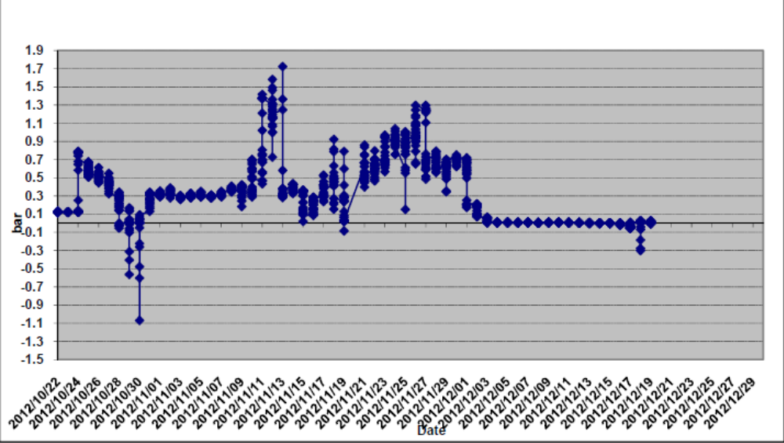

Slide 39

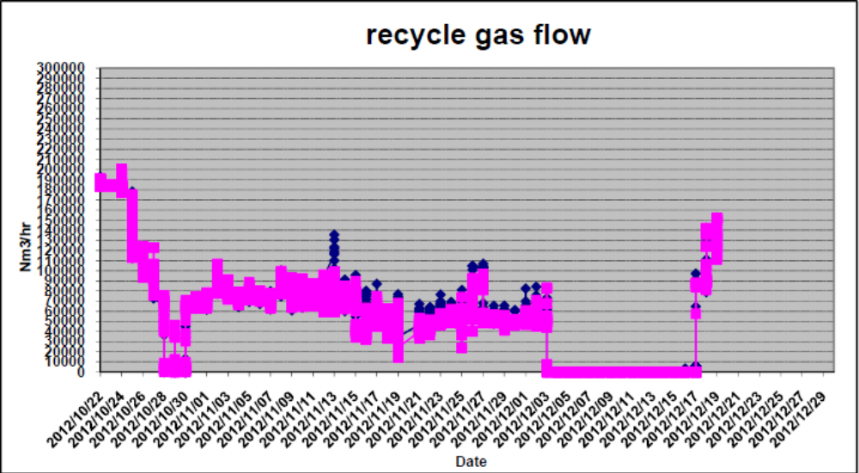

Slide 40

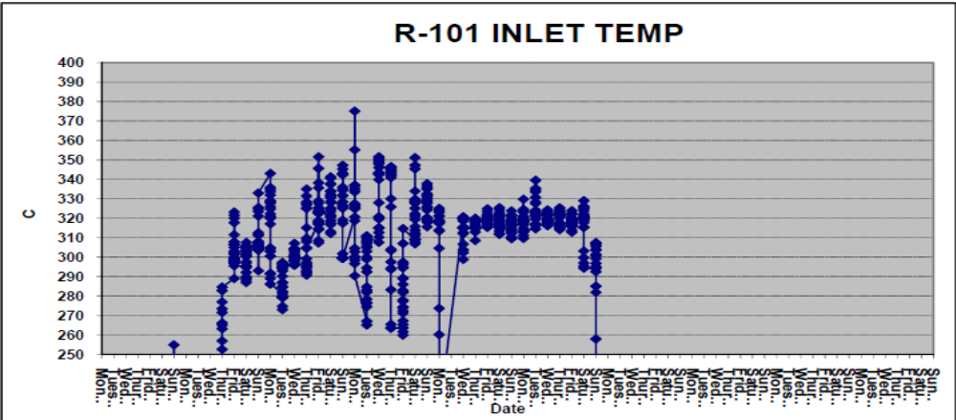
Because of hand control of TIT:
you could see so many fluctuation
VB was not injected when this story happen, so they
should not increase the temperature up to 370C

Slide 41

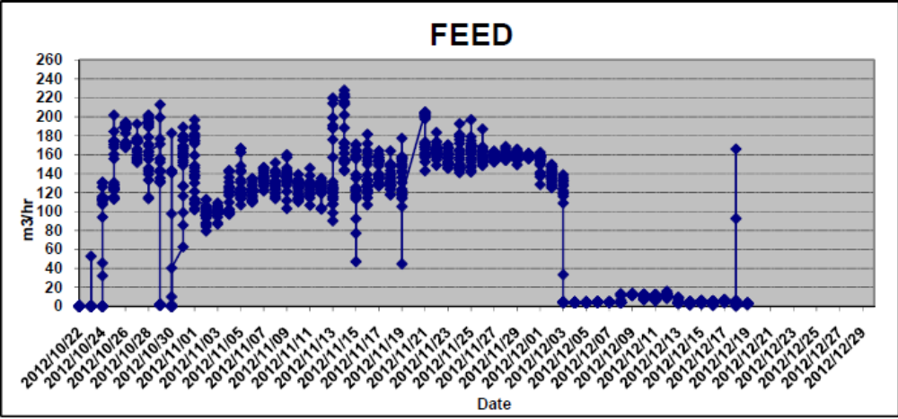
You could see large range for feed ( 100 to 240m3/hr) , so it cause damage of catalyst .
Change of feed shall be adjust with reactor temperature , but in one day , the flow rate changed many times.

Slide 42
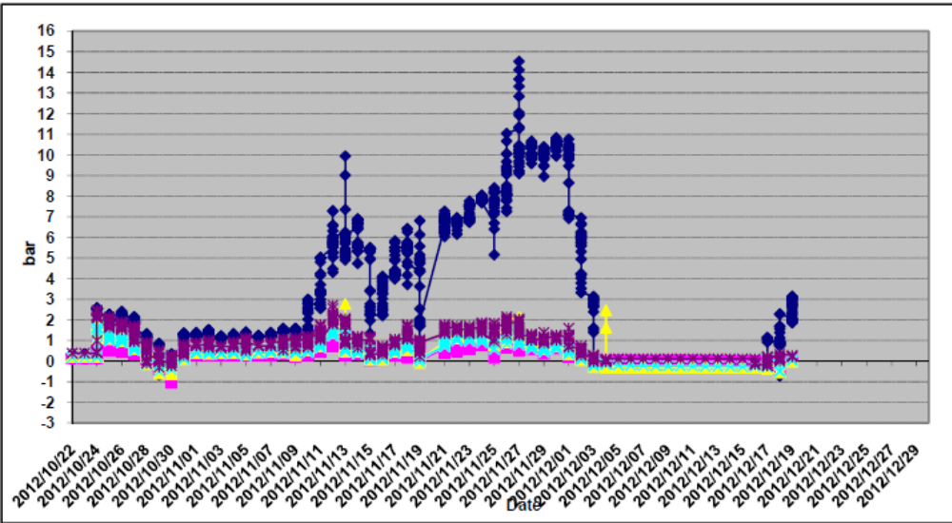
Shown strongly DP in the 1st reactor with comparison the other reactors because of feed flow rate and reactor temperature changed many times.

Slide 43
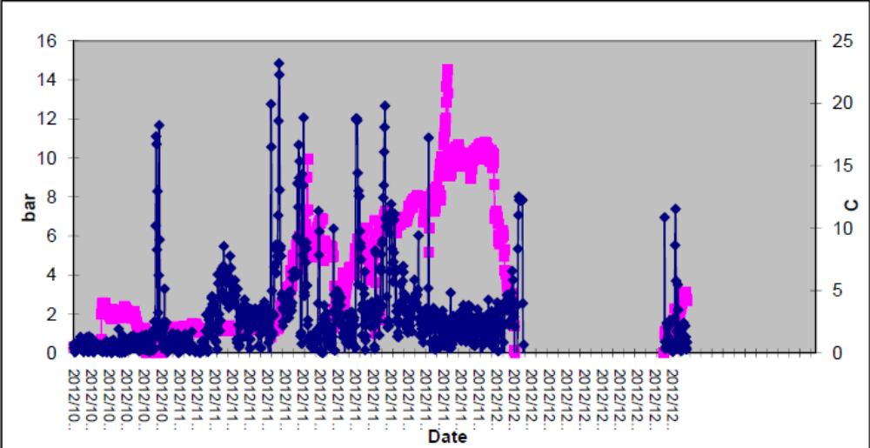

Slide 44
In conclusion
1- In case of recycle gas compressor stopped as emergency , the unit shall be Feed cut and compressor back to work as Full Spillback
Regarding to DP , speed shall be increased very slowly till spillback closed
Feed injected shall not been done till hold up liquid goes out.
Feed could be increased gradually.

Slide 45
If the unit feed cut normally , recycle compressor shall be in service till all hold up liquid goes out from reactors.
Temperature shall be establish over reactor inlet

Slide 46
THANK YOU FOR YOUR KIND ATTENTION

