Slide 1

The use of satellites in the border security
Ali Emre DESTEGÜL
First Lieutenant
Turkish Air War College
Satelite Conf. 17-19 Agust 2015 Houston,USA

Slide 2
Overview
Introduction
What is the land border?
Why border security must be ensured?
The Efficiency of Satellites in Border Security
SWOT Analysis of the System Created to Ensure the Security of a designated Area
Conclusion
Satelite Conf. 17-19 Agust 2015 Houston,USA

Slide 3
Introduction
Speaker’s Biography
Department of Electronic Engineering of Turkish Air Force Academy in 2007
2010 - Became a F-16 pilot
2014 - Master degree study on “Image Fusion” from Turkish Aeronautics and Space Technologies Institute
Recently - Attending in Turkish Air War College(TAWC) as a staff officer candidate
Satelite Conf. 17-19 Agust 2015 Houston,USA

Slide 4
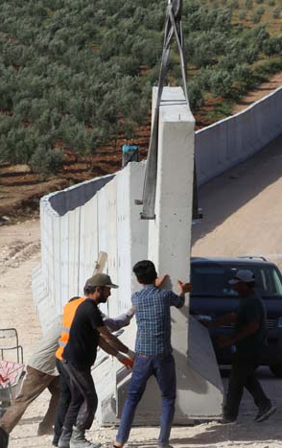
What is the land border?
Borders make the designated country easy to protect itself, and also make a significant contribution to people live there safely. (Gümüşçü, 2010)
Security factors are also referred to the security of the borders.
Satelite Conf. 17-19 Agust 2015 Houston,USA

Slide 5
Why border security must be ensured?
Land borders, can divide the lands of the country to ensure the controllability.
Borders are like the walls and doors of a house, they provide not only the effectiveness of controllability but also easiness of legal trade. (Marenin, 2010)
Due to the similar reason of ethnic differences, difficult geographical conditions, economic difficulties and the human factor land border control is never fully done. (Barth, 1969)
Satelite Conf. 17-19 Agust 2015 Houston,USA

Slide 6
Why border security must be ensured?
“How can we provide effective border security”
Software programming capability, the ability to produce own sensors and the satellite technology after that, they eager to put the UAV project into practice to surveillance and recognize of a land area.
To get the ability to obtain instant aerial images from satellites to be able to lower the cost of unexpected ISR workout.
Satelite Conf. 17-19 Agust 2015 Houston,USA

Slide 7
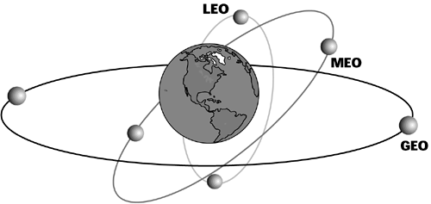
The Efficiency of Satellites in Border Security
Examine the constraints about earth satellite orbits and the difficulties that likely to be encountered.
Satelite Conf. 17-19 Agust 2015 Houston,USA

Slide 8
The Efficiency of Satellites in Border Security
Five different Lagrange points.
LEO satellites are scientific satellites and the ones used for getting regional weather forecast information. (Riebeek, 2009)
MEO is suitable for observing the areas far from the equator.
Satellite systems are used as supplementation for proposed border security system.
Satelite Conf. 17-19 Agust 2015 Houston,USA

Slide 9
SWOT Analysis of the System should Created to Ensure the Security of a designated Area
* Strengths
Real time view of greatly huge land
Redundancy capability
Peacetime High ISR ability performance
Ideal system
Mimimized human workload
Satelite Conf. 17-19 Agust 2015 Houston,USA

Slide 10
SWOT Analysis of the System should Created to Ensure the Security of a designated Area
* Weakness
Form of several satelite group(not only a single satellite)
Sensor and orbit measure combination problem
Long intervals can be process if system break down
Cost of the system to be built will not be suitable for a country.
IMINT satellites are short-lived.
Negative effects of adverse weather.
Satelite Conf. 17-19 Agust 2015 Houston,USA

Slide 11
SWOT Analysis of the System should Created to Ensure the Security of a designated Area
* Opportunities
Image fusion algorithms can automatically realize the changes.
Can be used in many other ISR activities.
It can be easily to find the person who harbour an outlaw.
* Threats
Detailed calculations and advanced technology
Satelite Conf. 17-19 Agust 2015 Houston,USA

Slide 12
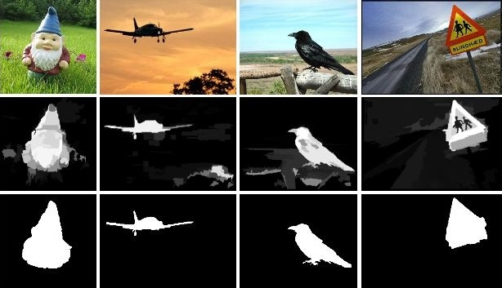
Conclusion
The BorderSense System(Zhi SUN, 2010) and Image tracking in UAV’s
Satelite Conf. 17-19 Agust 2015 Houston,USA

Slide 13
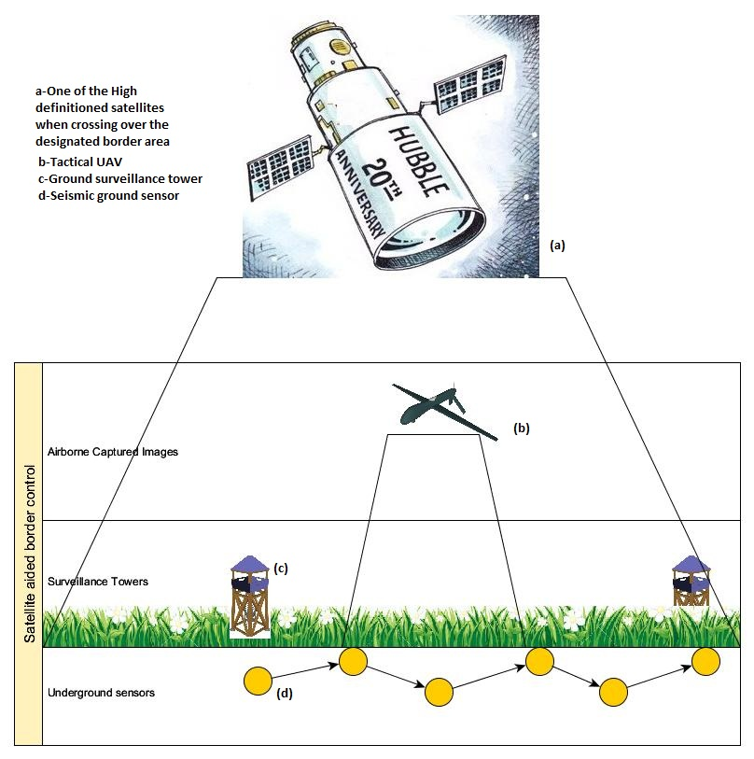
Modern Sınır Güvenliği Sağlama Sistemleri Örnek Mimarisi
Satelite Conf. 17-19 Agust 2015 Houston,USA

Slide 14
THANKS
Satelite Conf. 17-19 Agust 2015 Houston,USA

