Slide 1

About OMICS Group
OMICS Group International is an amalgamation of Open Access publications and worldwide international science conferences and events. Established in the year 2007 with the sole aim of making the information on Sciences and technology ‘Open Access’, OMICS Group publishes 400 online open access scholarly journals in all aspects of Science, Engineering, Management and Technology journals. OMICS Group has been instrumental in taking the knowledge on Science & technology to the doorsteps of ordinary men and women. Research Scholars, Students, Libraries, Educational Institutions, Research centers and the industry are main stakeholders that benefitted greatly from this knowledge dissemination. OMICS Group also organizes 300 International conferences annually across the globe, where knowledge transfer takes place through debates, round table discussions, poster presentations, workshops, symposia and exhibitions.

Slide 2
About OMICS Group Conferences
OMICS Group International is a pioneer and leading science event organizer, which publishes around 400 open access journals and conducts over 300 Medical, Clinical, Engineering, Life Sciences, Pharma scientific conferences all over the globe annually with the support of more than 1000 scientific associations and 30,000 editorial board members and 3.5 million followers to its credit.
OMICS Group has organized 500 conferences, workshops and national symposiums across the major cities including San Francisco, Las Vegas, San Antonio, Omaha, Orlando, Raleigh, Santa Clara, Chicago, Philadelphia, Baltimore, United Kingdom, Valencia, Dubai, Beijing, Hyderabad, Bengaluru and Mumbai.

Slide 3


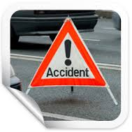
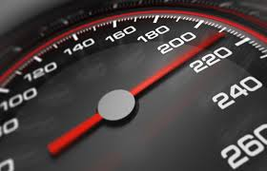
GRNN and MFFNN Models for Energy Equivalent Speed Prediction and Fault Rate Determination of Involvements in Traffic Accidents: A case study in Turkey
by
Ali Can YILMAZ

Slide 4
*Highway Fatality Trend in Turkey
*Turkish Statistical Institute, 2015

Slide 5
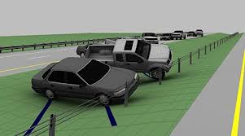
Vehicular Accident Reconstruction
The scientific process of investigating, analyzing and drawing conclusions about the causes and events during a vehicle collision.

Slide 6
Importance and Benefits of Accident Reconstruction
Identifying the collision causation and contributing factors in different types of collisions including the role of the driver(s), vehicle(s), roadway and the environment and determining precautions to minimize accidents,
Calculating useful quantities by using softwares based on the laws of physics and engineering principles such as the conservation of linear momentum, work-energy methods, and kinematics,
Providing analysis of fault rates of involvements in a systematic way in terms of neutral decisions especially on events like matter for the courts or forensic investigations.

Slide 7
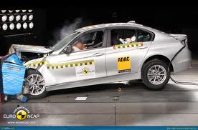
Energy Equivalent Speed (EES)
The equivalent speed at which a particular vehicle would need to contact any fixed rigid object in order to dissipate the deformation energy corresponding to the observed vehicle residual crush.

Slide 8
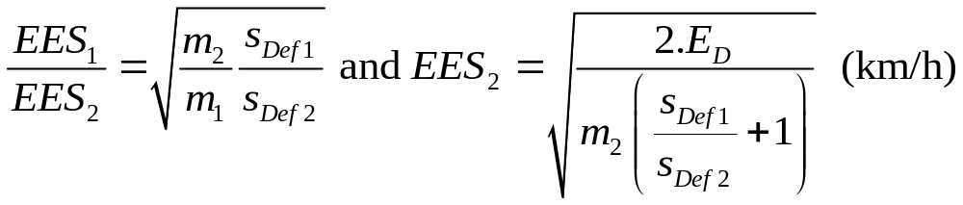
Energy Equivalent Speed (EES)
The plastic deformation energy of the damaged car is expressed as a kinetic energy of the car with the virtual velocity value EES.
where;
m₁, m₂: mass of each vehicle , kg
s_{Def1}, s_{Def2}: crush depth of each vehicle, outer surface to impact point in line with impact force, m
E_{D}: energy lost by both vehicles in the collision due to damage, J.

Slide 9
Reconstruction & Analysis of a Sample Traffic Accident
Parameters related to EES calculation are:
Pre-impact (ν₁) & post impact (ν₂) velocity, km/h
Deformation (ε), m
Pre-omega (ω₁) & post omega (ω₂), rad/s
Impulse (Imp), N.s
Time (t), seconds
X, y, z coordinates, m
Change in velocity (Δv), km/h
Deformation energy (E), J

Slide 10

Current Status in Turkey
There are some deficiencies in defining fault rates (FR) in "No.2918 Turkish Highway Traffic Act (THTA)". Currently, in Turkey, fault rates are determined according to initiative of accident experts (sometimes no speed analyses of vehicles, just procession of accident) and there are no specific quantitative instructions on fault rates related to procession of accident in act. Mostly, only consistence situation of accident does not yield adequate data in determining fault rate.
?
Fault Rate

Slide 11
Current Status in Turkey
Controversial Cases: The most challenging issue in analyzing an accident and determining fault rates rises in debated situations which are defined as neither at-fault nor not at-faults according to the THTA.

Slide 12
Current Status in Turkey
AT-FAULTS
Breaching red light and/or stop sign of authorized officer,
Encroaching "No vehicle" sign on roadway or lane, ramp or connection road occupied by opposite traffic stream,
On two or more-lane highways, encroaching lane or section where opposite traffic stream flows on,
Rear crash,
Disobeying "No Passing" sign,
Incorrect weaving maneuvers,
Encroaching lane,
Violation of passing priority rules on intersections,
Intrusion of "maneuver rules",
Parking or stopping on rural highways except of compulsory situations and not to take necessary precautions,
Crashing into vehicles on parking lots or appropriate parked cars outside of vehicle roadway.

Slide 13
Current Status in Turkey
NOT AT-FAULTS
Disobeying "STOP" sign,
Drop-off/loading passengers and goods incorrectly on faulty places,
Carrying goods or passengers incorrectly on faulty places,
Driving vehicle inappropriate for safe traffic stream,
Driving sleepless, fatigued, ill, pensive,
Not blinking in case of encountering or on urban roads, not using short lights,
Absence of reflectors on vehicle,
Absence of haul rope, mounting, tire chains,
Existence of alcohol while driving,
Driving on excessive speed.

Slide 14
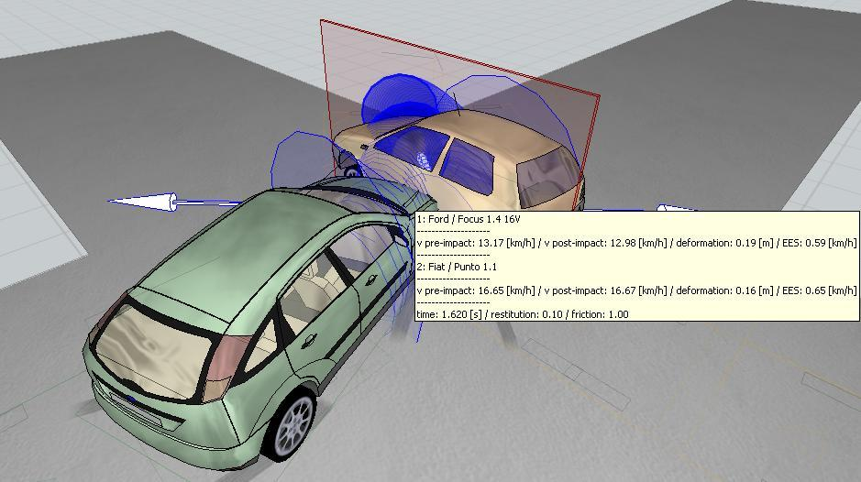
A Case Study
Sample Controversial Case: Fault rate analysis of an accident at an equal-arm intersection (no traffic lights, “STOP”, “YIELD”, etc. warning signs)

Slide 15
A Case Study
What were the speeds of vehicles just before the contact to each other?
Are there any skid marks on the road surface in order to compute the collision velocities of the vehicles?
If the right side vehicle enters the intersection above legal speed limits, can he/she be deemed not at-faulty?
Is there any systematic method to determine the fault rates?
?
?
?

Slide 16
Data Set Constitution for EES
 | Statistics Name
Data | Mean | Maximum | Minimum | Std. Deviation
t | 1,662 | 5,623 | 0,06 | 1,174
x | 8,525 | 111,657 | -78,109 | 30,132
y | -1,436 | 8,756 | -80,962 | 16,494
z | 0,431 | 0,642 | 0,005 | 0,114
phi | 86,912 | 169,632 | 0,066 | 45,521
Δv₁ | 8,771 | 75,095 | 0,237 | 14,759
Imp | 10232,695 | 100421,035 | 532,244 | 19552,068
E | 74885,498 | 1112047,522 | 781,718 | 203235,981
ε | 0,200 | 0,705 | 0,025 | 0,142
ν₁ | 28,290 | 90,471 | 0 | 25,613
ω₁ | 0,053 | 1,724 | -0,487 | 0,270
ν₂ | 25,234 | 69,384 | 0,055 | 19,391
ω₂ | 0,245 | 8,085 | -3,708 | 1,597
Δv₂ | 14,814 | 48,092 | 0 | 12,620
GEV | 0,988 | 1,614 | 0 | 0,388
EES | 14,521 | 44,215 | 0,002 | 10,938

Slide 17

Artificial Neural Network Methods
Artificial Neural Network (ANN)
Multi-Layer Feed Forward Neural Network (MFFNN)
Generalized Regression Neural Networks (GRNN)

Slide 18
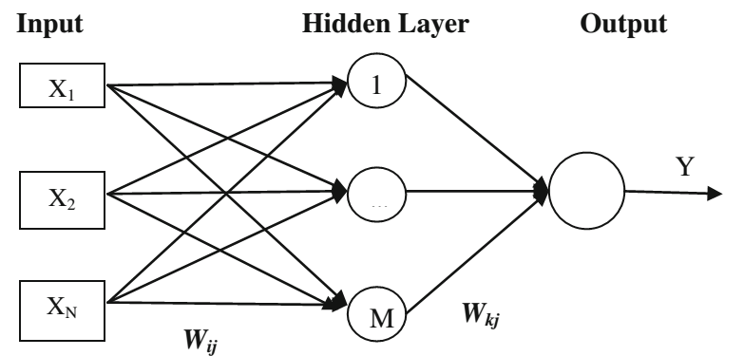
MFFNN
An MFFNN consists of at least three layers: input, output and hidden layer. Each neuron in a layer receives weighted inputs from a previous layer and transmits its output to neurons in the next layer. The summations of weighted input signals are calculated and this summation is transferred by a nonlinear activation function. The results of the network are compared with the actual observation results and the network error is trained until the error reaches an acceptable value [1].
[1] E. Alpaydın, Introduction to Machine Learning, 2nd ed. MIT press, London, 2010.

Slide 19
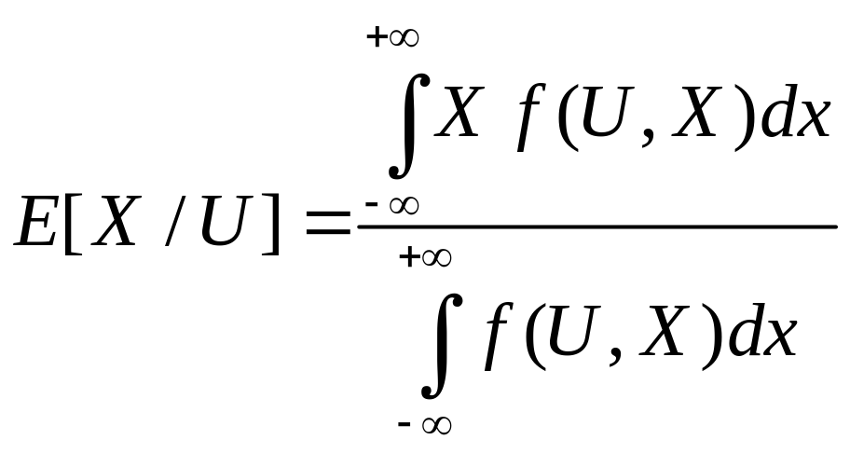
GRNN
The main function of a GRNN is to estimate a linear or nonlinear regression surface on independent variables (input vectors) U, given the dependent variables (desired output vectors) X. That is, the network computes the most probable value of an output, O_{x}, given only training vectors U. Specifically, the network computes the joint probability density function of U and X [2].
[2] M. Khashei, A. Z. Hamadani and B. Bijari, “A novel hybrid classification model of artificial neural networks and multiple linear regression models,” Expert Syst App.,vol. 39, pp. 2606–20, 2010.

Slide 20
MFFNN & GRNN Comparison for EES Prediction
Two different training algorithms (trainlm,trainlp) within MFFNN and GRNN were used in order to compare the multiple corelation coefficient (R) and standard error of estimates (SEE) values.
 | MFFNN-based model |  | GRNN-based model
Folds | R | SEE | R | SEE
Fold 1 | 0,86 | 3,32 | 0,93 | 3,69
Fold 2 | 0,87 | 3,63 | 0,88 | 4,55
Fold 3 | 0,90 | 3,51 | 0,87 | 3,71
Fold 4 | 0,83 | 4,43 | 0,89 | 4,41
Fold 5 | 0,93 | 2,19 | 0,91 | 4,75
Average | 0,88 | 3,42 | 0,90 | 4,22
R and SEE values of the MFFNN and GRNN models by means of 5-fold cross-validation (EES prediction)

Slide 21
Assumptions for Fault Rate Prediction
Referring to the case study, one of the most important parameter is speed (EES) of the involvements. In case of absence of skid marks, the biggest clue about the speeds of vehicles is the damage formed on the vehicles. More damage on the vehicle(s), more energy transformed into deformation energy which is defined as crush depth (S_{def}) in terms of meters.
Similar vehicles with ones in real world accident were crashed into each other in the way they were exposed to various average crush depths on the collision region of each (1000 trials).
The larger the crush depth the bigger the EES value
Thanks to simulation software, since every EES value corresponding to an average deformation amount and every deformation amount corresponding to an average EES value were known, at the accident scene average crush depths were used as main parameter to predict EES values of involvements.
Every average 5 km/h increment in EES of an involvement corresponds to 3 increment in fault rates of the related vehicle.
Every crush depth amounts versus every EES values and every fault rates were obtained which are to be training data for MFFNN and GRNN.

Slide 22
Descriptive Statistics for the Scenario
 | ε₁ (m) | ε₂ (m) | EES₁ (km/h) | EES₂ (km/h) | FR₁ % | FR₂ %
Minimum | 0,072 | 0,065 | 15 | 20 | 0 | 18
Maximum | 1,637 | 1,598 | 170 | 175 | 82 | 100
Mean | 0,849 | 0,774 | 68,818 | 74,108 | 28,028 | 72
Std. Dev. | 0,421 | 0,408 | 37,198 | 36,672 | 26,786 | 26,797

Slide 23
Results of the scenario by means of 5-fold cross-validation (Fault rate prediction)
 | MSE |  | R
Fold number | MFFNN | GRNN | MFFNN | GRNN
1 | 1,011110 | 2,512337 | 0,999492 | 0,997346
2 | 1,016606 | 3,517386 | 0,999598 | 0,994529
3 | 2,100327 | 3,800502 | 0,999190 | 0,993723
4 | 4,081504 | 4,292495 | 0,998548 | 0,991565
5 | 0,705644 | 2,934098 | 0,999708 | 0,995829
Average | 1,783038 | 3,411364 | 0,999307 | 0,994598

Slide 24
Results and Discussion
The followings can be concluded from 5-fold cross validation results for both EES and FR predictions:
In average, MFFNN model performed better results (i.e., higher R and lower MSE) than GRNN prediction model in terms of fault rate prediction.
For EES prediction, MFFNN gave lower MSE and R values whereas GRNN gave higher for both.
Since there is no training phase in GRNN, the GRNN model produced results much faster than MFFNN.
The R values for prediction of fault rates were close to 1 for all folds.

Slide 25
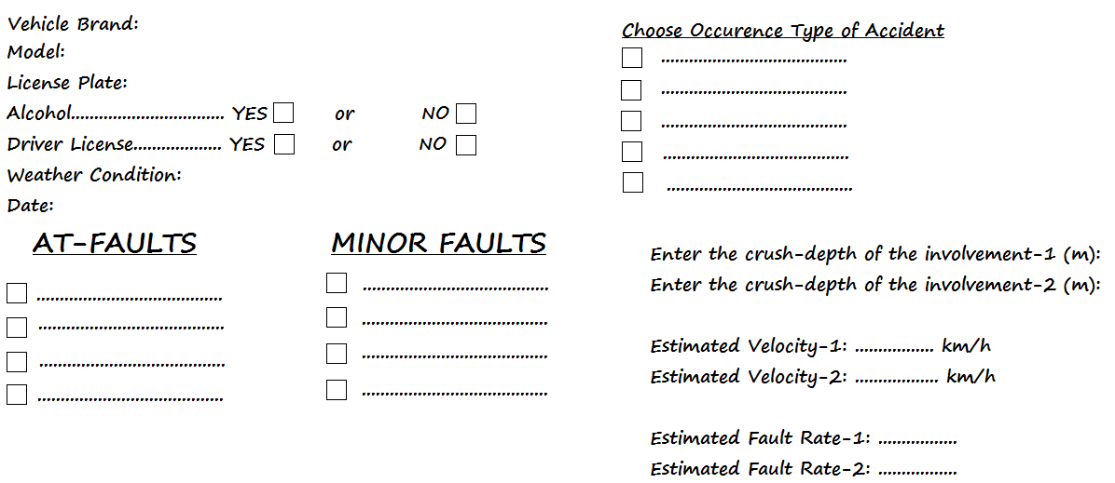
Sample Fault Rate Application Interface on a Portable Device

Slide 26
Conclusions
A scientific, systematic and initiative-independent approach was tried to be achieved by simulating one of the most frequent type of accidents and predicting fault rates of involvements.
Precise fault rate prediction of involvements in terms of neutral decisions is especially beneficial on events like matter for the courts or forensic investigations.
Deficiencies in THTA, especially in terms of fault rates, can be eliminated with this approach.
Probable useful approach for insurance companies which just consider 100%, 50% and 0% fault rate situations in case of an accident at present.
Appropriate for implementable and developable interface on portable devices for traffic police and/or experts
Impartial and systematic approach for controversial cases.
Suitable application to commercialize.

Slide 27
THANK YOU
FOR
LISTENING

